Slide 1
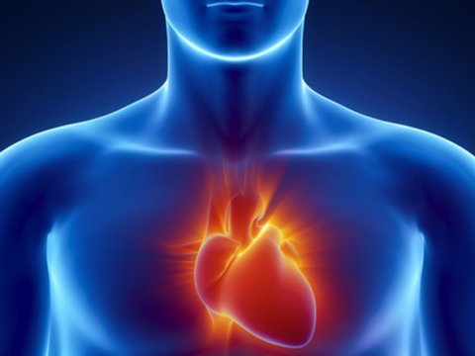
CARDIOVASCULAR SYSTEM
HEART CHAMBERS & CARDIAC VALVES
Dr. Aiman Qais Afar
Surgical Anatomist
College of Medicine / University of Mutah
2023-2024

Slide 2
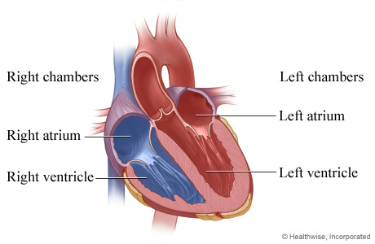
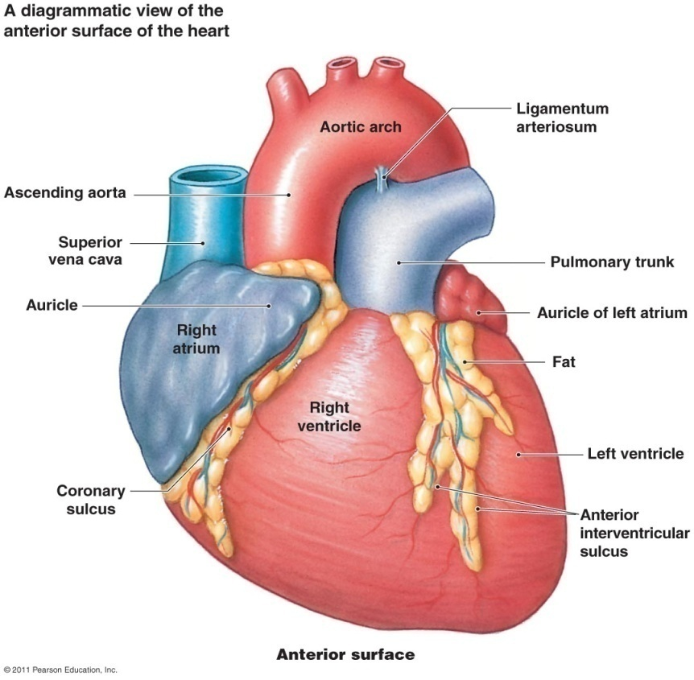
Chambers of the Heart
The heart is divided by vertical septa into four chambers:
The right and left atria and the right and left ventricles.
The right atrium lies anterior to the left atrium
The right ventricle lies anterior to the left ventricle.

Slide 3
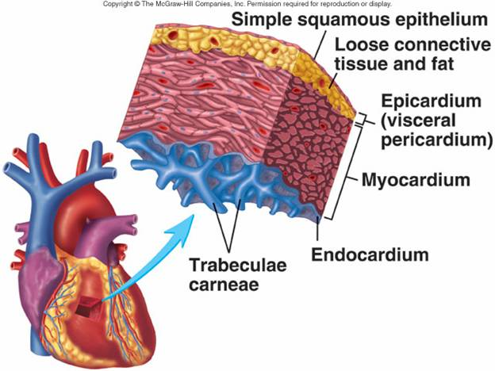
Chambers of the Heart
The walls of the heart are composed of cardiac muscle The myocardium;
covered externally with
serous pericardium The epicardium
And lined internally with a layer of endothelium called The endocardium

Slide 4
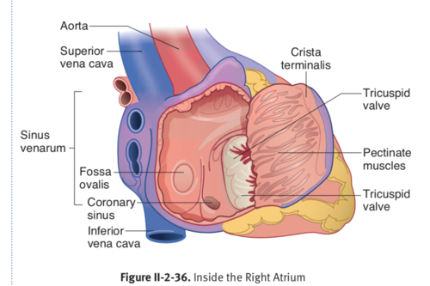
Chambers of the Heart
Right Atrium
The right atrium forms the right border of the heart and receives venous blood from the SVC, IVC, and coronary sinus
The ear-like right auricle is a conical muscular pouch that projects from this chamber like an add-on room, increasing the capacity of the atrium as it overlaps the ascending aorta.

Slide 5
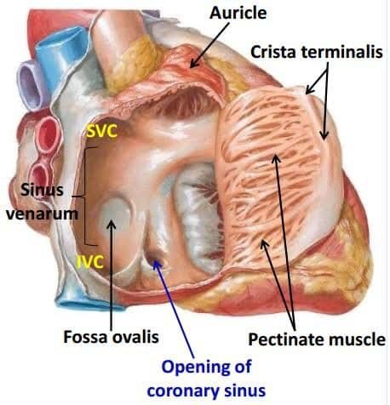
Right Atrium
The interior of the right atrium has a:
Smooth, thin-posterior wall, on which the venae cavae (SVC and IVC) and coronary sinus open, bringing poorly oxygenated blood into the heart.

Slide 6
Right Atrium
Rough, muscular anterior wall composed of pectinate muscles
Right AV orifice through which the right atrium discharges the poorly oxygenated blood, it has received into the right ventricle.

Slide 7
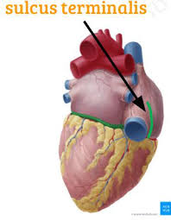
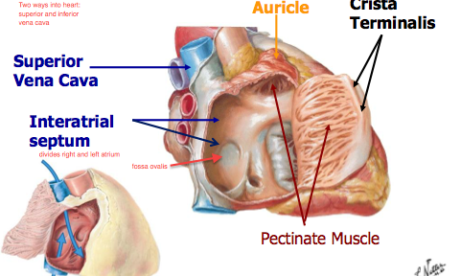
Right Atrium
The smooth and rough parts of the atrial wall are separated externally by a shallow vertical groove, the sulcus terminalis or (terminal groove)
and internally by a vertical ridge, the crista terminalis or (terminal crest).

Slide 8
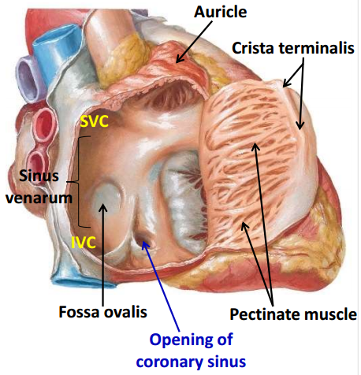
Right Atrium
The SVC opens into the superior part of the right atrium at the level of the right 3rd costal cartilage.
The IVC opens into the inferior part of the right atrium almost in line with the SVC at approximately the level of the 5th costal cartilage

Slide 9
Right Atrium
The opening of the coronary sinus, receiving most of the cardiac veins, is between the right AV orifice and the IVC orifice
The interatrial septum separating the atria has an oval, thumbprint-size depression, the oval fossa (L. fossa ovalis), which is a remnant of the oval foramen (L. foramen ovale) and its valve in the fetus.

Slide 10
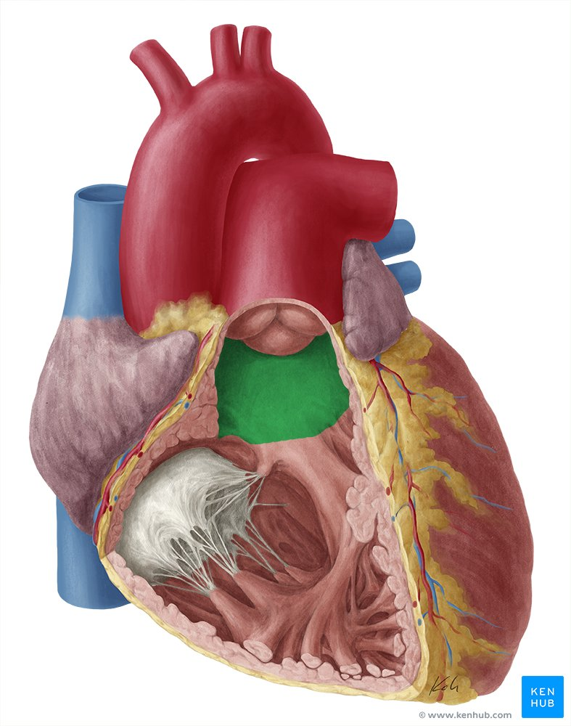
Chambers of the Heart
Right Ventricle
Forms the largest part of the anterior surface of the heart
a small part of the diaphragmatic surface
and almost the entire inferior border of the heart
Superiorly it tapers into an arterial cone, the conus arteriosus (infundibulum) which leads into the pulmonary trunk.
The interior of the right ventricle has irregular muscular elevations (trabeculae carneae).
Conus arteriosus

Slide 11
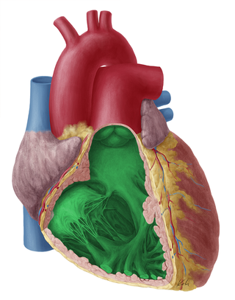
Right Ventricle
A thick muscular ridge, the supraventricular crest, separates the ridged muscular wall of the inflow part of the chamber from the smooth wall of the conus arteriosus, or outflow part.
Supraventricular crest
The inflow part of the ventricle receives blood from the right atrium through the right AV (tricuspid) orifice located posterior to the body of the sternum at the level of the 4th and 5th intercostal spaces.

Slide 12
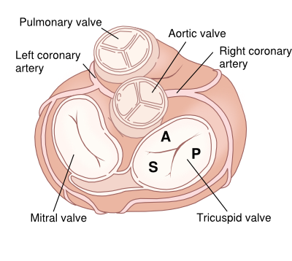
Right Ventricle
The tricuspid valve guards the right AV orifice.
The bases of the valve cusps are attached to the fibrous ring around the orifice.
Because the fibrous ring maintains the caliber of the orifice, the attached valve cusps contact each other in the same way with each heartbeat.

Slide 13
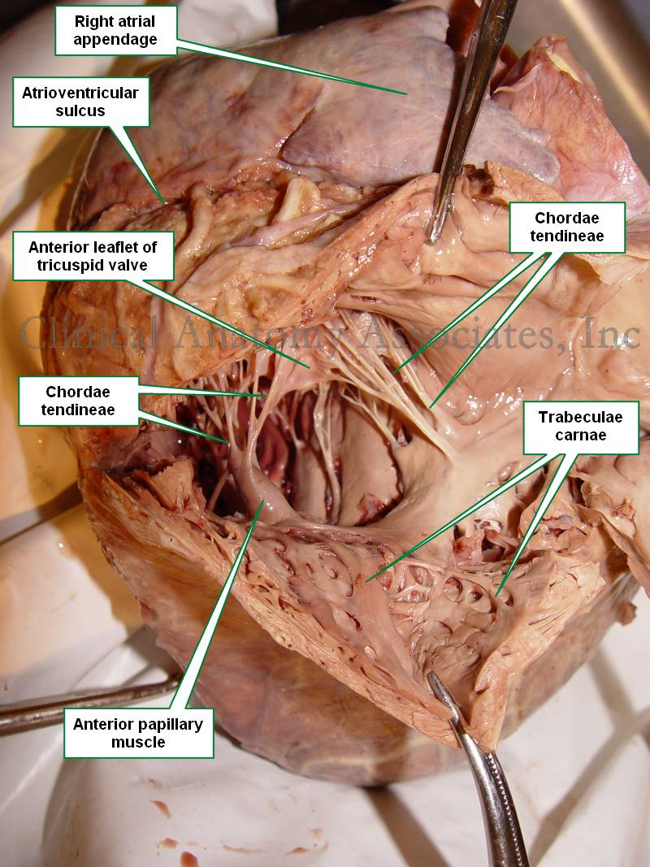
Right Ventricle
Tendinous cords (L. chordae tendineae) attach to the free edges and ventricular surfaces of the anterior, posterior, and septal cusps, much like the cords attaching to a parachute.
The tendinous cords arise from the apices of papillary muscles, which are conical muscular projections with bases attached to the ventricular wall.

Slide 14
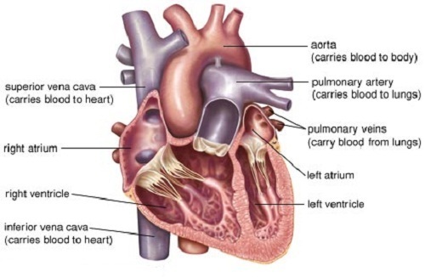
Right Ventricle
Three papillary muscles in the right ventricle correspond to the cusps of the tricuspid valve:
The anterior papillary muscle, the largest one, arises from the anterior wall of the right ventricle
The posterior papillary muscle, smaller than the anterior muscle, may consist of several parts; it arises from the inferior wall of the right ventricle

Slide 15
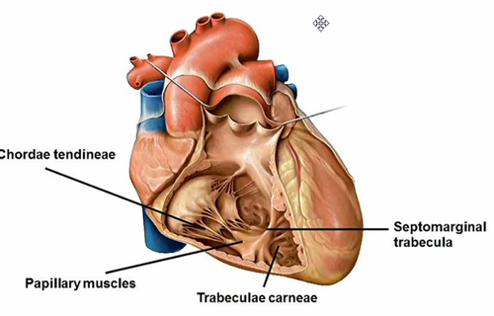
Right Ventricle
The septal papillary muscle arises from the interventricular septum, and its tendinous cords attach to the anterior and septal cusps of the tricuspid valve.
septal papillary muscle

Slide 16
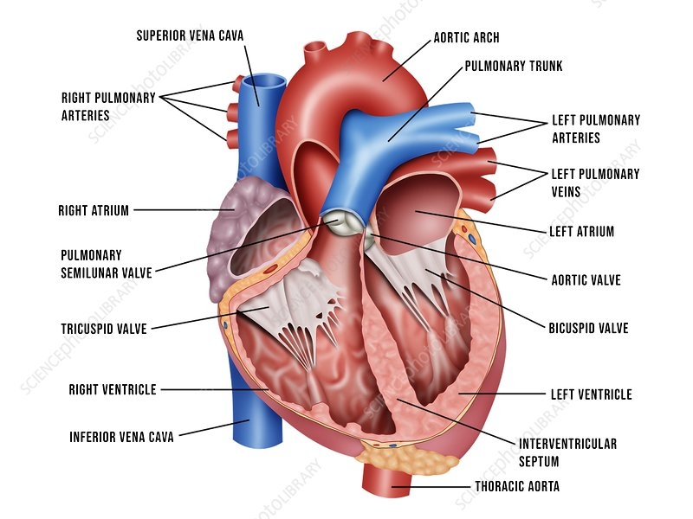
Right Ventricle
The interventricular septum (IVS), composed of muscular and membranous parts, is a strong, obliquely placed partition between the right and left ventricles.
Superiorly and posteriorly, a thin membrane, part of the fibrous skeleton of the heart , forms the much smaller membranous part of the IVS

Slide 17
Right Ventricle
Because of the much higher blood pressure in the left ventricle, the muscular part of the IVS, which forms the majority of the septum, has the thickness of the remainder of the wall of the right ventricle (two to three times as thick as the wall of the right ventricle)

Slide 18
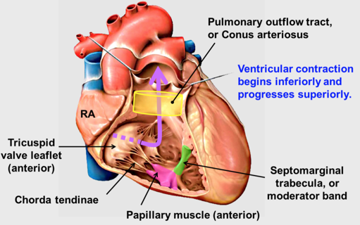
Right Ventricle
The septomarginal trabecula (moderator band) is a curved muscular bundle that traverses the right ventricular chamber from the inferior part of the IVS to the base of the anterior papillary muscle.
This trabecula is important because it carries part of the right branch of the AV bundle, a part of the conducting system of the heart to the anterior papillary muscle

Slide 19
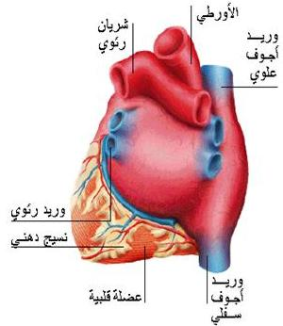
LEFT ATRIUM
Similar to the right atrium, the left atrium consists of a main cavity and a left auricle. The left atrium is situated behind the right atrium and forms the greater part of the base or the posterior surface of the heart
Behind it lies the oblique sinus of the serous pericardium, and the fibrous pericardium separates it from the esophagus

Slide 20
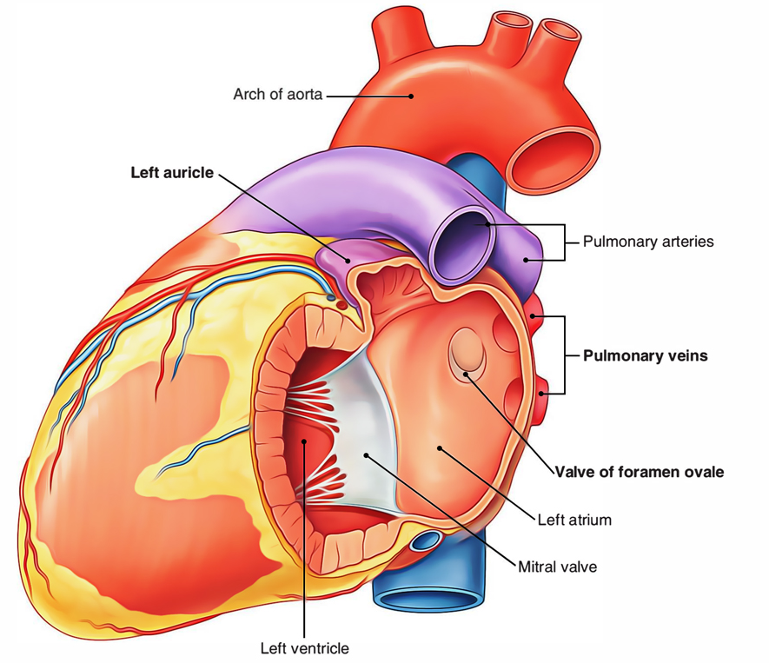
LEFT ATRIUM
The interior of the left atrium is smooth, but the left auricle possesses muscular ridges as in the right auricle.
Openings into the Left Atrium
The four pulmonary veins, two from each lung, open through the posterior wall and have no valves. The left atrioventricular orifice is guarded by the mitral valve

Slide 21
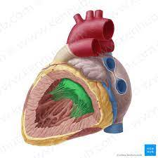
LEFT VENTRICLE
Forms the apex of the heart, and most of the diaphragmatic surface.
The interior of the left ventricle has:
Walls that are two to three times as thick as those of the right ventricle.
Walls that are mostly covered with a mesh of trabeculae carneae that are finer and more numerous than those of the right ventricle
A conical cavity that is longer than that of the right ventricle.

Slide 22
LEFT VENTRICLE
Anterior and posterior papillary muscles that are larger than those in the right ventricle.
A smooth-walled, non-muscular, superoanterior outflow part, the aortic vestibule, leading to the aortic orifice and aortic valve.
A double-leaflet mitral valve that guards the left AV orifice
An aortic orifice that lies in its right posterosuperior part . The ascending aorta begins at the aortic orifice.

Slide 23
LEFT VENTRICLE
The mitral valve
guards the atrioventricular orifice. It consists of two cusps, one anterior and one posterior.
The anterior cusp is the larger and intervenes between the atrioventricular and aortic orifices.
The mitral valve is located posterior to the sternum at the level of the 4th costal cartilage.

Slide 24
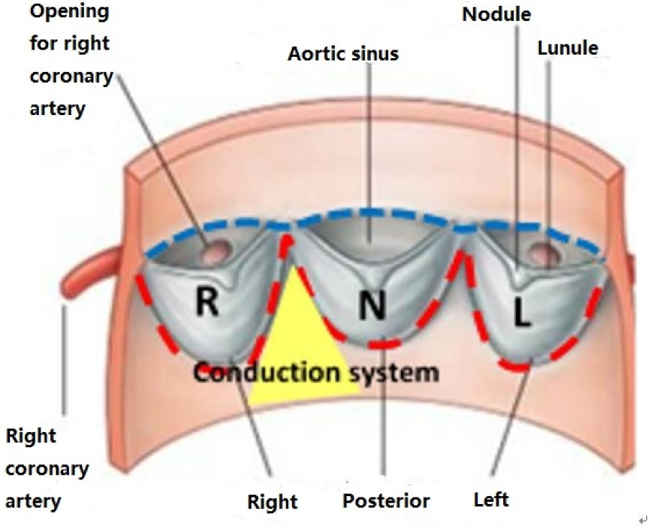
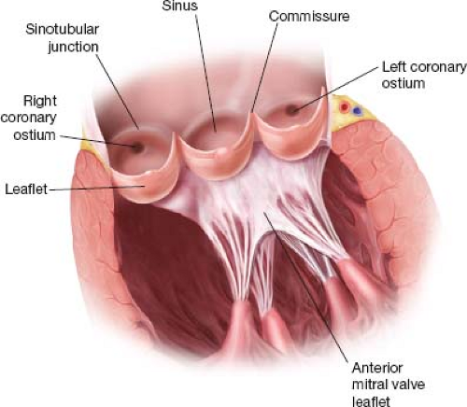
LEFT VENTRICLE
The aortic valve
guards the aortic orifice
One cusp is situated on the anterior wall (right cusp) and two are located on the posterior wall (left and posterior cusps).
Behind each cusp, the aortic wall bulges to form an aortic sinus.

Slide 25
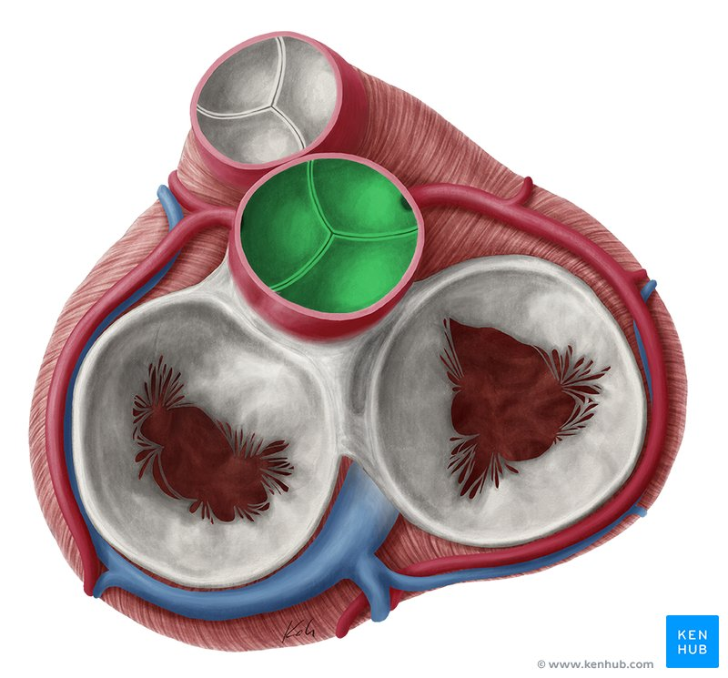
The aortic valve
The anterior aortic sinus gives origin to the right coronary artery, and
The left posterior sinus gives origin to the left coronary artery
Rt. Coronary A.
Lt. Coronary A
It is located posterior to the left side of the sternum at the level of the 3rd intercostal space.

Slide 26
ATRIAL SEPTAL DEFECTS
A congenital anomaly of the interatrial septum, usually incomplete closure of the oval foramen, is an atrial septal defect (ASD).
The small openings, by themselves, cause no hemodynamic abnormalities and are, therefore, of no clinical significance and should not be considered forms of ASDs.

Slide 27
VENTRICULAR SEPTAL DEFECTS
Membranous part is the common site of ventricular septal defects (VSDs), although defects also occur in the muscular part
VSDs rank first on all lists of cardiac defects. Isolated VSDs account for approximately 25% of all forms of congenital heart disease.
A VSD causes a left to right shunt of blood through the defect. A large shunt increases pulmonary blood flow, which causes severe pulmonary disease (hypertension, or increased blood pressure) and may cause cardiac failure.

Slide 28
8 November 2023

