Slide 1
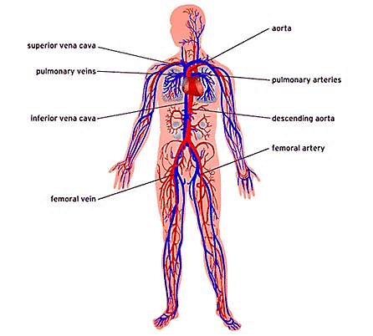
The vascular system Professor Dr. Hala El-mazar 2020 (Lecture 2)

Slide 2
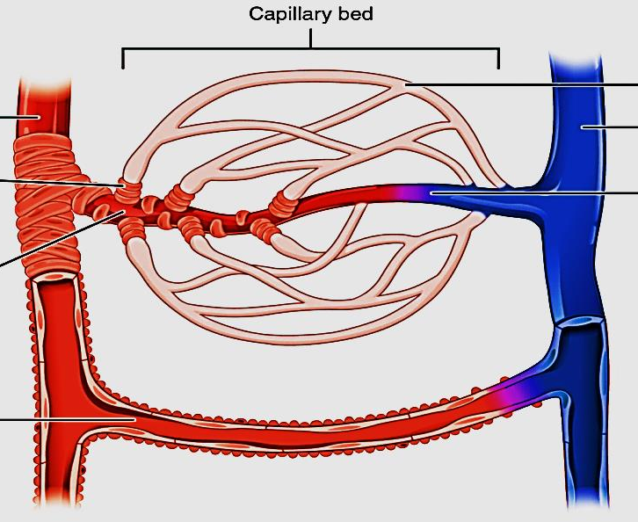
microcirculation
Composed of :
Terminal arterioles→ metarteriols → capillaries →
post-capillary venules
Capillaries are where exchange between blood & tissue fluids occur
Capillaries:
* Continuous
* Fenestrated
* Sinusoidal
Arterio-venous anastomosis

Slide 3
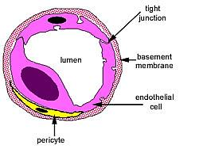
Most of microcirculation are lined by one or two endothelial cells and many of them
are surrounded by pericytes
The endothelium provides smooth surface for the flow of blood & easy exchange of water and nutrients between blood & interstitial fluid
The endothelium also produces molecules that prevents the blood from clotting.
Pericytes cells can contract to decrease the size capillaries →regulate blood flow and blood pressure.

Slide 4
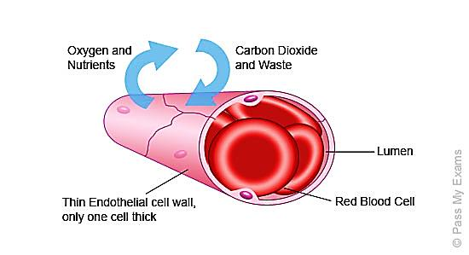
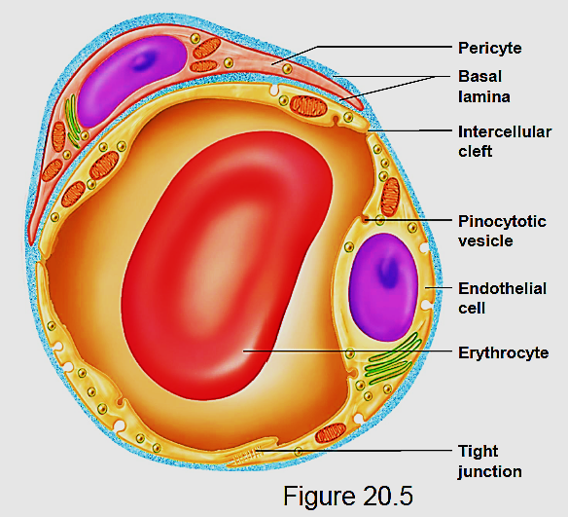
Capillaries
the smallest blood vessels 5- 8 µm
90% of all blood vessels of body
cells get nourished & maintained through exchange between them & blood in capillaries
Formed by a single layer of endothelial cells + Pericytes + basal lamina , NO smooth ms cells
Pericytes: branched cells, contractile
Can differentiate into endothelial cells
(& smooth ms cells ) in injury

Slide 5
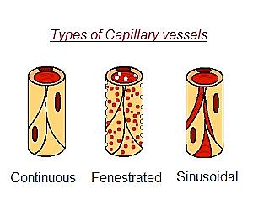
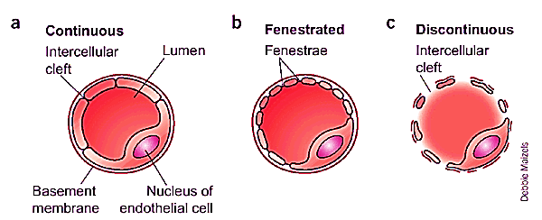
Types of capillaries
Continuous
(Somatic)
Fenestrated
(Visceral)
Discontinues
(Sinusoidal)

Slide 6
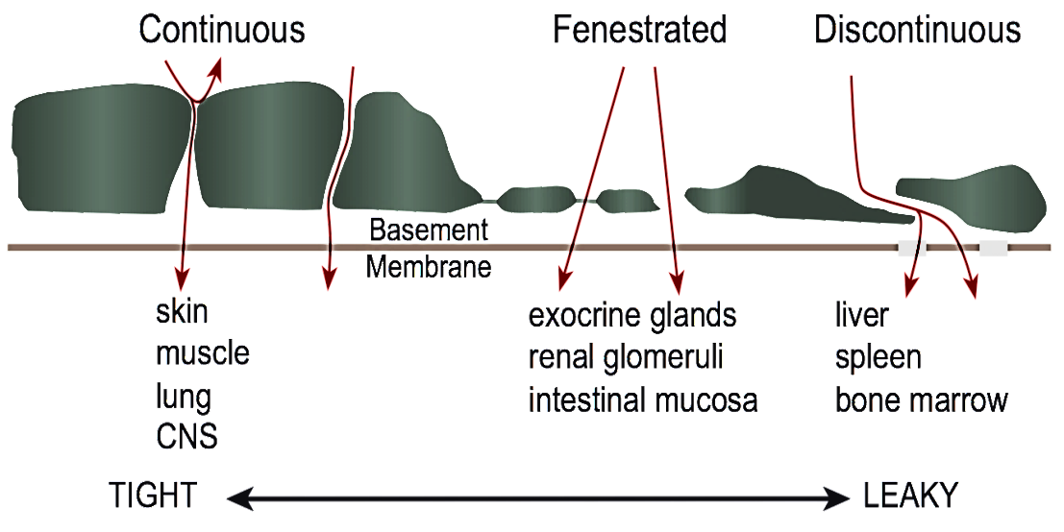
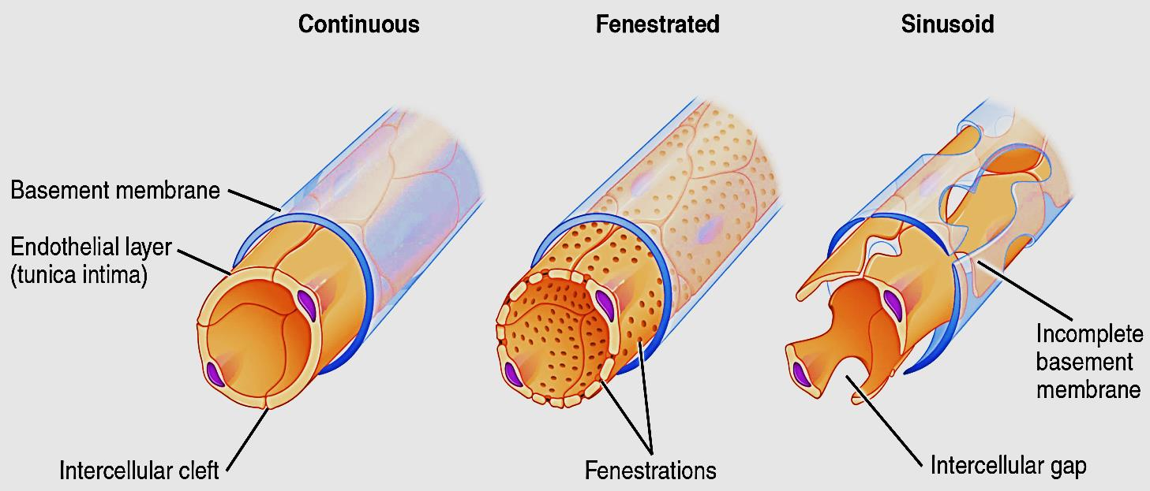
Continuous (somatic): has the lowest permeability ( water, ions, lipid soluble m.)
Pinocytosic vesicles
Fenestrated (visceral): pores has or has no diaphragm. relatively high permeability
Sinusoidal:
Extremely high permeability (cells
& serum proteins)
Depending on the structure of the endothelial cells & continuity of the basal lamina

Slide 7
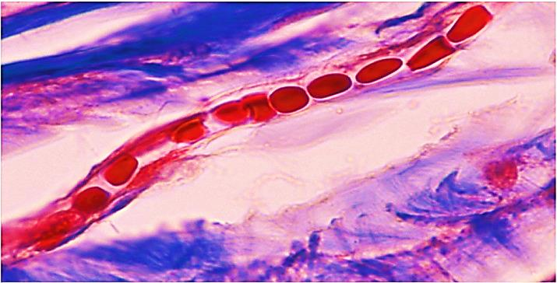
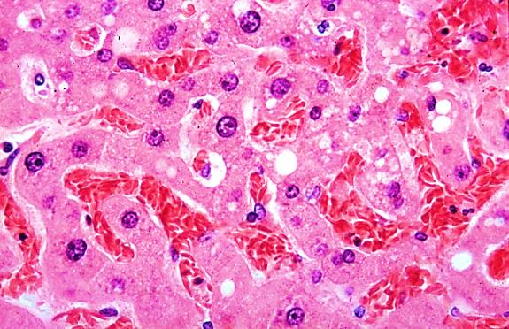
Blood capillary | Blood sinusoid
1- Narrow regular lumen (5-8 µm) | 1-Wide irregular lumen (30-40 µm)
2- Uniform diameter | 2- Variable diameters & tortuous
3-Continuous or fenestrated endothelium | 3- Always fenestrated
4- Complete basal lamina | 4- Incomplete basal lamina
5-Surrounded with Pericytes | 5- Contain macrophages e.g. Littoral cells (spleen), Kupffur cells (liver)
6-Present in all tissues | 6- present in certain sites as :bone marrow, spleen, liver& Endocrine glands.

Slide 8
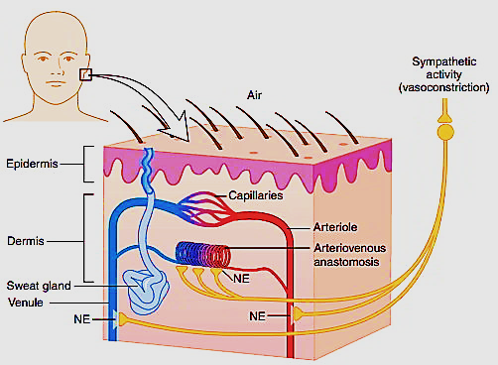
Arterio- venous anastomosis (AVA)/ Shunt
Direct connection between arterioles & venules without passing through capillary bed
A- contraction of pre- capillary sphincters
Blood will pass through thoroughfare channel
B- AV anastomosis: small vessels connect
directly arterioles to venules
Function: regulation of :
- Body temp e.g skin
- Blood flow in genital organs
Thoroughfare channel

Slide 9
Post -capillary venules
Post- capillary venules Form when
capillaries unit
Structure similar to capillaries
Are the primary sites at which WBCs leave the circulation at sites of infection or tissue damage
Respond to vasoactive agents e.g. histamine also site of exchange of materials between tissue fluid & blood
The venules converge into collecting venules → muscular veins

Slide 10
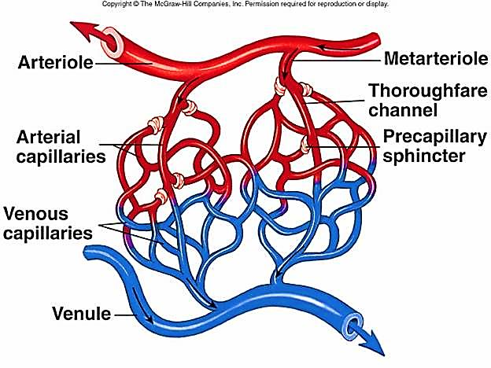
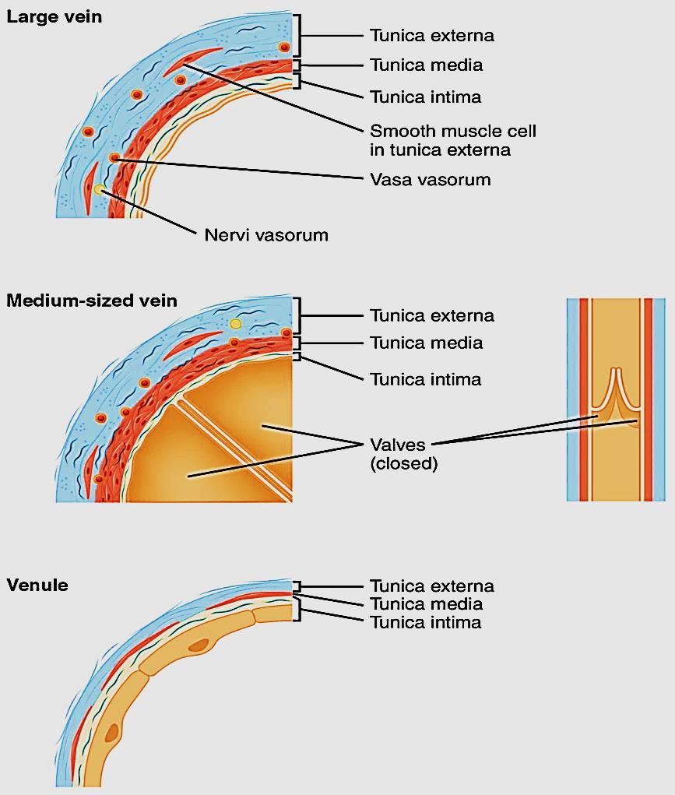
venules
The smallest veins (20- 30 µm)
Intima: endothelium + basal lamina
Media: pericytes+ reticular fibers
+ 1 or 2 layers of smooth ms cells
as the vessel ↑in diameter
Adventitia: relatively thick

Slide 11
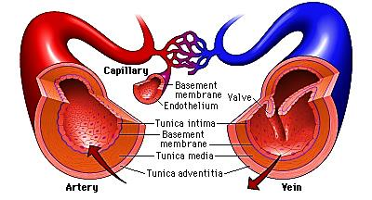
Medium size veins
Carry blood toward → heart
The blood pressure in veins is much lower than arteries
Veins have 3 tunics, but their wall is thinner & their lumen is wider than corresponding arteries
Special adaptation in the veins
helps return of blood to heart &
prevents its backflow is called valves
Valves absent in small & large veins
X

Slide 12
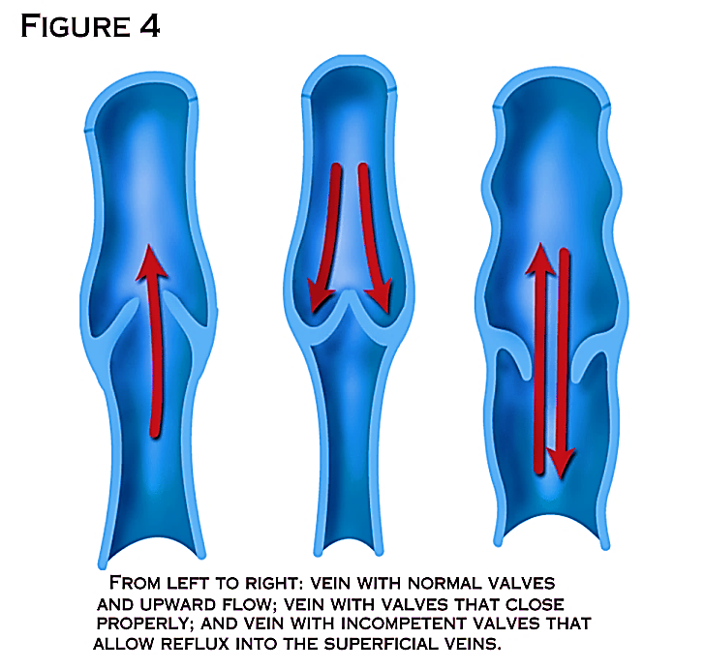
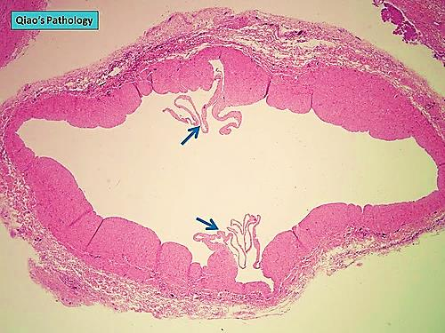
Valves:
are folds project from intima into lumen of the vein
Lined on both sides by endothelium,
their core formed of elastic tissue
X

Slide 13
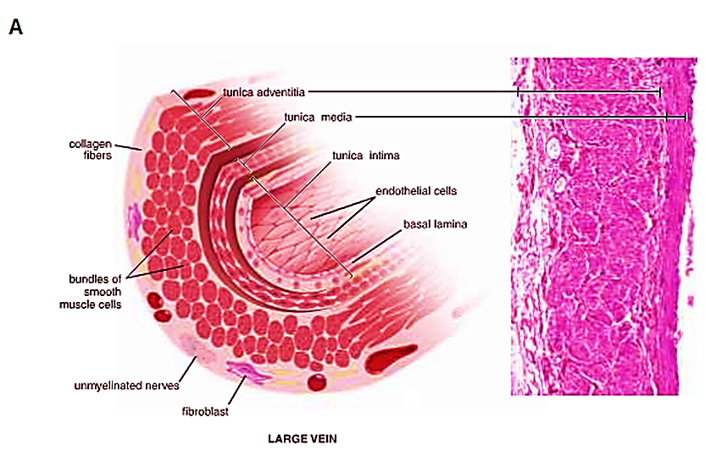
Vena cava (inferior & superior)
Tunica intima: thin
Endothelium – subendothelial CT– No IEL - No valves
Tunica media:
thin muscle layer, collagen,
few elastic
Tunica adventitia:
Thick, contains longitudinal
bundles of smooth ms fibers

Slide 14
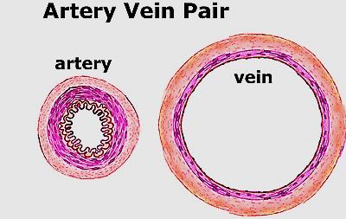
Medium sized artery and vein
Narrow lumen
Thick wall
No valves
Intima (thick,IEL)
Media (thick)
Adventitia (thin)
Rapid flow of blood
Wide lumen
Thin wall
Valves
Thin, no IEL
Media (thin)
Thick
Slow flow of blood

Slide 15
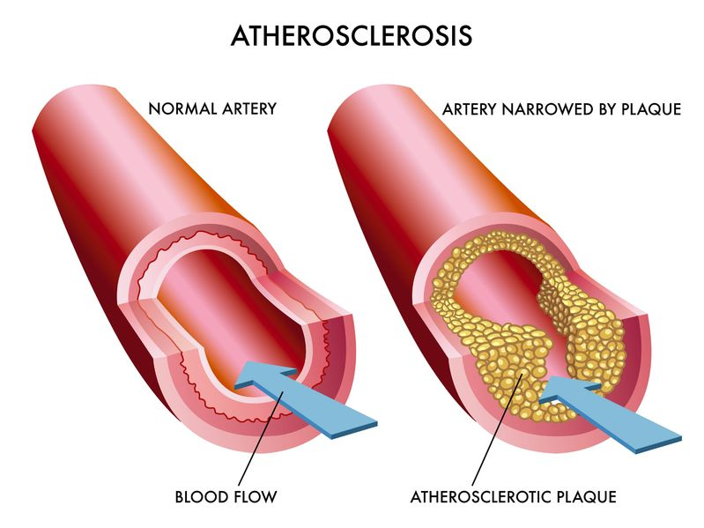
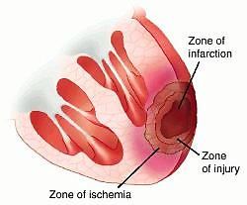
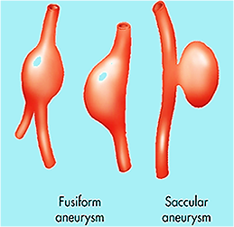
Medical applications
Atherosclerosis: focal thickening of the intima due to deposition of cholesterol (Foam cells)
Infarction: death of tissue due to lack of blood supply
Aneurysm: marked dilation of BV due to weakness of media →rupture & hemorrhage.

Slide 16
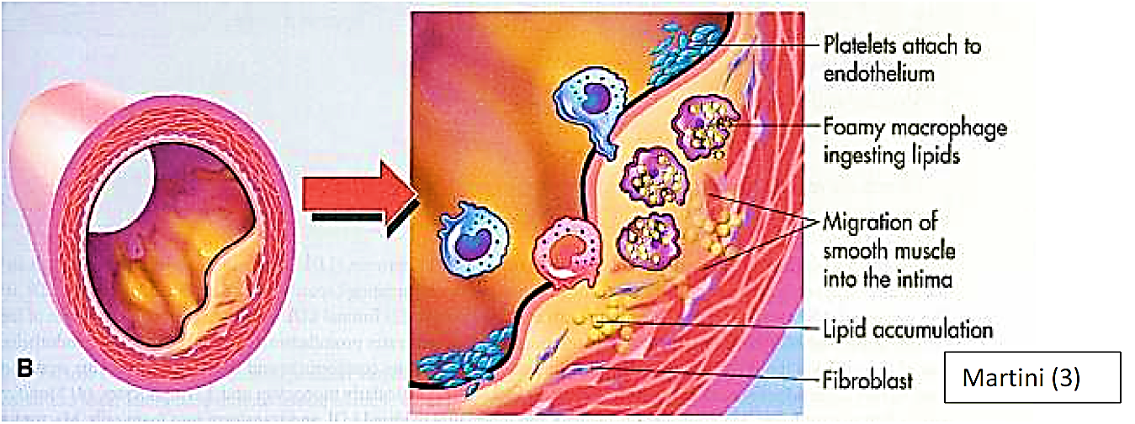
Foam cells

Slide 17
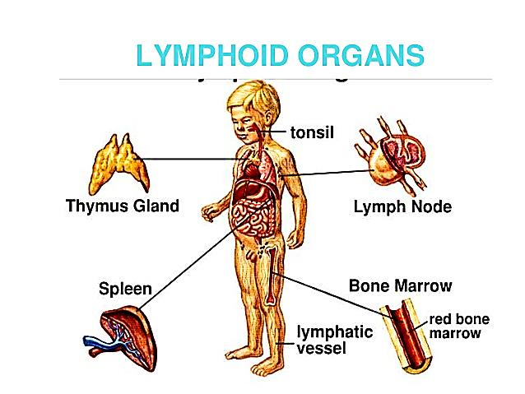
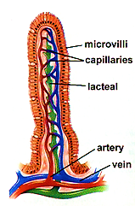
Lymphatic system consists of:
Lymphatic vessels
Lymphoid tissues & organs
Function:
Fluid balance: carry excess tissue fluid back to circulation
Fat absorption: transport fat from GIT to blood
Immunological & defense role: Produces, maintains & distributes lymphocytes and filtration of lymph & blood

Slide 18
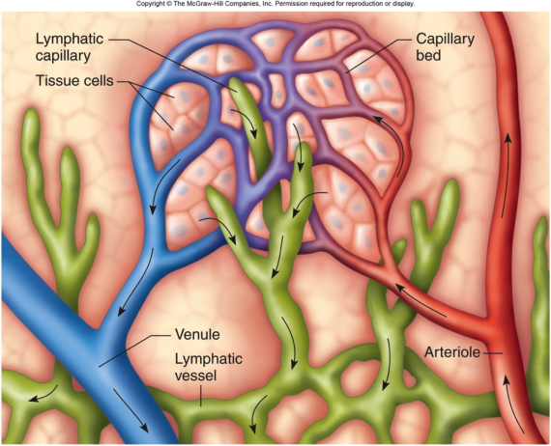
Lymphatic vessels
L. Capillaries
(Blind ended)
Medium size L. vessels (Valves)
L. Ducts
(like veins)

Slide 19
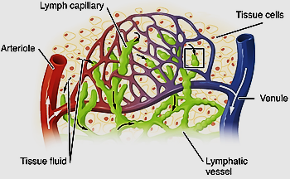
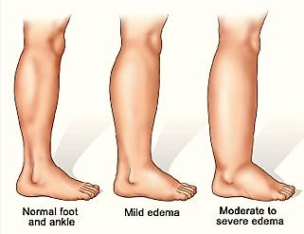
Lymph
Lymph is a colorless fluid that circulates through the lymphatic system
The lymph is formed when the interstitial fluid is collected through lymph capillaries

Slide 20
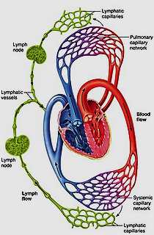
lymph composition continually changes as the blood and the surrounding cells continually exchange substances with the interstitial fluid
Similar to blood plasma except that it
also contains white blood cells
(lymphocytes & macrophages)
Lymph returns proteins and
excess interstitial fluid to the blood stream.
Lymph may pick up bacteria and bring them to lymph nodes where they are destroyed

Slide 21
lymph circulation: interstitial fluid drains into
lymph capillaries
↓
lymph vessels
↓
lymph nodes
↓
Lymphatic vessels
↓
Lymphatic duct
↓
ultimately emptying into the right or the left subclavian vein, where it mixes back with blood.

Slide 22
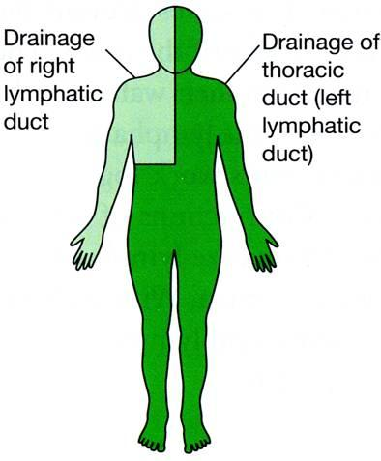
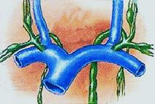
lymph vessels similar to veins in structure
lymph nodes, stations where filtration
of the lymph from bacteria take place
Lymphatic vessels ultimately drain lymph into 2 main ducts
Right lymphatic duct
Drains right side of head & neck,
right arm, right thorax →
into the right subclavian vein
Thoracic duct
Drains the rest of the body → into the left subclavian vein
Rt. subclavian vein
Lf subclavian vein

Slide 23
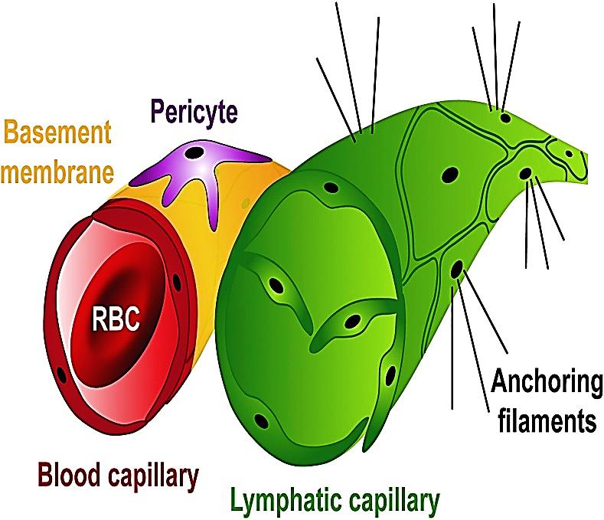
Structure of Lymphatic capillaries
Begin with a blind end
Have similar structure to blood capillaries but larger & more permeable consider as microcirculation
Made of single layer of overlapping endothelium with interrupted basal lamina
its endoth. Has NO (fenestrae, tight junction, pericytes)

Slide 24
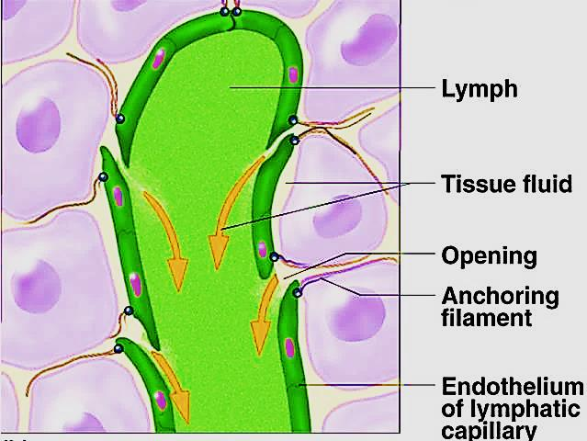
Lymphatic endothelial cells attached to anchoring filaments contains elastic fibers:
1- attach endothelial cells to surrounding tissue.
2- pull on → widen gap between endothelial cells→ draw
more fluid into lymphatic capillary
Endothelial cells are
one- way
swinging door

Slide 25
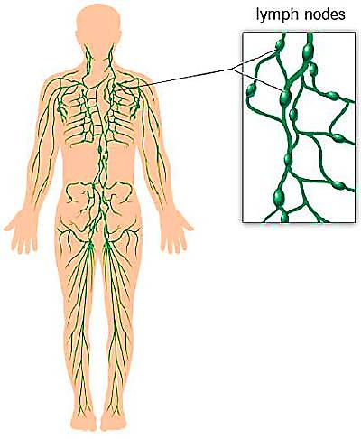
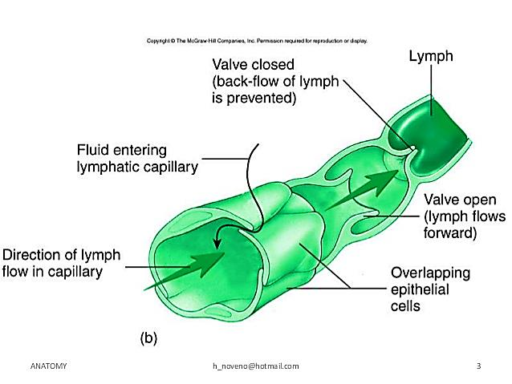
Structure of Lymphatic vessels:
Thinner wall + large lumen+ valves
Lymph nodes are found along their course
Drain lymph from lymph capillaries
Structure:
Endothelium - few smooth muscle cells- adventitia

Slide 26
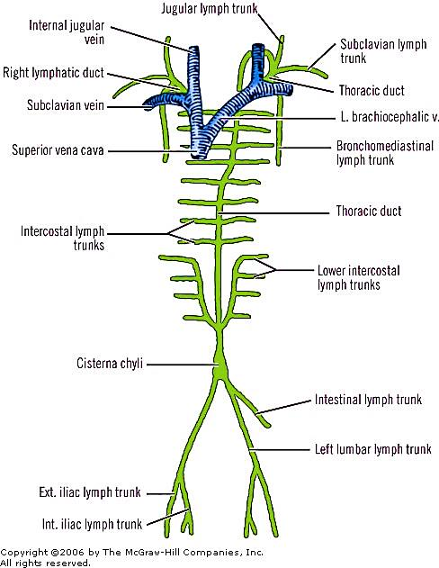
Structure of Lymphatic duct:
Large vessel that drain lymph into one of the subclavian veins
2 lymph ducts:
- Right lymphatic duct
- Thoracic duct
Similar in structure to large veins
Tunica intima: endothelium + CT
Tunica media: smooth ms. + elastic fibers
Tunica adventitia: CT + smooth ms.

Slide 27
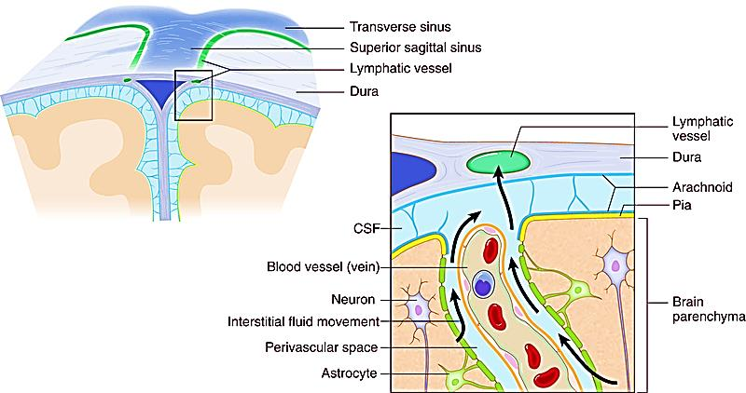
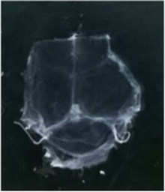
Central nervous system
Recently discovered in 2015 that CNS has
meningeal lymphatic vessels

Slide 28
Thank you

