Slide 1
Gout
Presented by:
Hamza Maharmeh
Israa Al-Ahmad

Slide 2
Gout
Introduction:
Gout is an inflammatory arthritis associated with hyperuricaemia and intra- articular sodium urate crystal deposition
Types:
Acute Gout
Chronic Interval Gout
Chronic Polyarticular Tophaceous Gout

Slide 3
Typical Presentation of Gout:
Acute gout presents typically in a middle- aged male with a sudden onset of agonizing pain, swelling and redness of the first MTP joint
The attack is precipitated by Alcohol intake, diuretic therapy, dehydration, or excess food.

Slide 4
Pathogenesis of Gout:
90% is caused by decreased urea excretion and 10% is caused by increased production of urea.
Serum Uric Acid is a balance between Urea production and Urea excretion (66% kidneys, 33% Intestines) .
Inflammation in the joint is caused by monosodium urate uptake by synovial macrophages that recruit neutrophils, which release IL-1b. This process is inhibited by colchicine.

Slide 6
Types of Gout:
Acute Gout
Sudden onset pain, swelling, and redness of joint (typically first MTP). May present as asymmetric polyarthritis (knee and thumb are commonly affected. Pain peaks after 24 hours, and resolves over 7 days typically. Desquamation of overlying skin is common during resolution. Pain recurs every 2 years typically.
Chronic Gout
Occurs after several untreated attacks with joint destruction and tophi formation. Can present with urate nephrolithiasis. Rare in developed countries.
Tophi:
Multiple painless nodules around the joint due to urate deposition. May cause ulceration and discharge.
1. Bone tophi: usually in elbows, knees, and extensor surface of forearms.
2. Soft tissue Tophi: can present in the external pinna of the ear, in the olecranon bursa, or Achilles tendon.

Slide 7
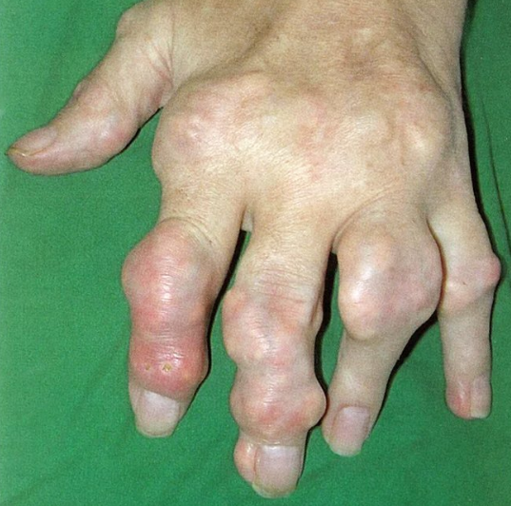
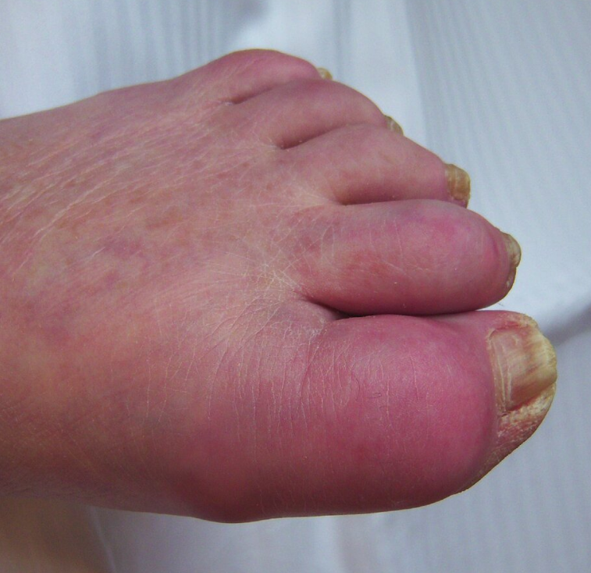
Tophi in Chronic Gout
Podagra in Acute Gout

Slide 8
Diagnosis
Arthrocentesis and synovial fluid analysis:
Synovial fluid analysis is the gold standard for diagnosing gout
Indications:
Uncertain clinical diagnosis
Higher probability of septic arthritis (fever, sepsis, trauma)
Characteristic findings
Polarized light microscopy: needle-shaped monosodium urate crystals that are negatively birefringent.
Crystals appear yellow when their optical axis is oriented parallel to the polarizer.
Crystals appear blue when their axis is perpendicular to the polarizer.
Synovial fluid cell count: WBC > 2000/μL with > 50% neutrophils
Gram stain: negative; useful for ruling out septic arthritis
Note:
Yellow and parallel both have double L

Slide 9
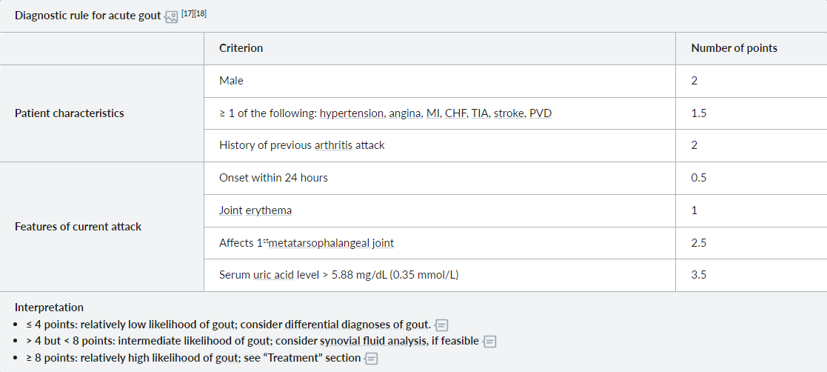
Diagnosis

Slide 10
Lab Investigations
CBC and ESR, CRP
WBC and ESR are typically elevated during acute attack
Acute gout flare:
often elevated (hyperuricemia) ; may also be normal or low
Intercritical stage or chronic gout:
Baseline levels are useful to determine the need for urate-lowering therapy.
A normal or low level has a very low negative likelihood ratio for (but does not rule out) a diagnosis of gout
Serum Uric Acid Levels
Contents
04
Contents

Slide 11
Imaging
Imaging is indicated if synovial fluid analysis is unsuccessful or cannot be performed, and the diagnosis remains uncertain. It can be used to identify supportive findings of gout but cannot rule out septic arthritis.
Ultrasound:
Signs of acute joint inflammation
Bone erosions
Signs of urate crystal deposition:
Double contour sign: a hyperechoic band of crystals covering the surface of the hypoechoic articular cartilage, which is over the hyperechoic bone contour
Tophi (pathognomonic for chronic gout)
X-ray:
Acute gout: typically normal, useful for ruling out a fracture in patients with post-traumatic joint inflammation
Chronic gout:
Punched-out lytic bone lesions with spiky periosteal appositions (overhanging edges), known as “rat-bite erosions”
Radiopaque in surrounding soft tissue
Joint space is preserved until late stages.

Slide 12
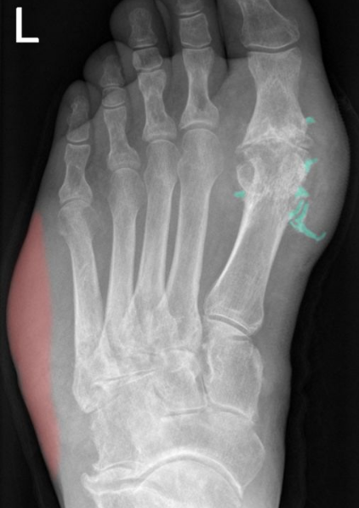

Slide 13
Treatment
In Acute Gout:
Treat immediately with NSAIDS: Naproxen or Diclofenac Sodium. Do not give aspirin (decreases urea excretion by kidney).
If patient has renal impairment or Peptic ulcer disease:
Colchicine:
Most effective within 12-24 hour of attack.
Side-effects:
Myelosuppression, rhabdomyolysis, cardiac toxicity, diarrhea (commonest).
2. IM or Intra-articular Methyl Prednisolone.

Slide 14
Treatment
In Chronic Gout:
Patients must be treated with urate lowering therapy (ULT). Anti-inflammatory drugs must be given a week before ULT, because ULT causes urate mobilization. Aim for: Urea: 2.1 mg/dl or less.
Never give ULT during acute attack, it will increase the severity and duration of the attack.
Do not give ULT for asymptomatic hyperuricemia.
Indication of ULT:
More than 2 attacks of gout per year
Chronic gout
Tophi formation
Can be given after first attack if:
ESRD
Uric acid more than 9 mg/dl
History of nephrolithiasis

Slide 15
Treatment
ULT:
First line:
Xanthine-Oxidase inhibitors:
Allopurinol: Preferred first-line therapy
Febuxostat: alternative first-line therapy
if persistent attacks or persistent elevated SUA levels:
Second line:
Uricosurics:
Probenecid: can be used alone, or in conjunction with XOI’s.
Losartan: is a uricosuric in patients with HTN and gout. Can be used to treat gout in metabolic syndrome.
if persistent attacks or persistent elevated SUA levels:
Third line:
Recombinant Uricase:
Pegloticase: do not use with uricosurics or XOI’s.

Slide 16
Calcium Pyrophosphate Deposition Disease:
Previously called Pseudogout
CPPD is an inflammatory arthritis associated with calcium deposition within articular cartilage (Chondrocalcinosis)
Mostly in adults above 60, males and females are equal in prevalence.

Slide 17
Typical Presentation of CPPD:
Typically presents in adult above 60 with Monoarthritis (rarely oligoarthritis) with longer acute attacks than gout.
Typically affects knee and wrist joint. Rarely hips and shoulders.
Can manifest with systemic symptoms: Chills and fever.
Mostly self-limited.

Slide 18
Types of CPPD:
Acute CPPD:
Chronic CPPD:
Acute attack of pain and swelling in the affected joint
Monoarthritis (occasionally oligoarthritis)
Most commonly affects the knee and wrist; can also affect other large joints (hips, ankles)
Typically self-limited
Can occur spontaneously or be triggered by joint trauma/surgery or acute illness
A. Osteoarthritis-like CPPD presentation:
Most common form of CPPD disease
Characterized by progressive joint degeneration:
Usually polyarticular; can occur in joints not typically affected by OA of the knee)
More severe than typical OA
Often associated with pseudogout-like flares of acute inflammatory arthritis
B. Rheumatoid arthritis-like CPPD Presentation:
Manifests similarly to rheumatoid arthritis, with polyarticular distribution associated with morning stiffness
In contrast to typical RA, joint involvement may be asymmetric and sequential.

Slide 19
Diagnosis
1. There are no diagnostic criteria for CPPD. Diagnosis is based on confirming CPP crystals in synovial fluid, identifying the symptoms, and confirming cartilage calcification on imaging.
2. Measure serum uric acid to rule out Gout.
Arthrocentesis and synovial fluid analysis:
Characteristic findings
Polarized light microscopy: Rhomboid-shaped crystals that are positively birefringent.
Crystals appear yellow when their optical axis is oriented perpendicular to the polarizer.
Crystals appear blue when their axis is parallel to the polarizer. (opposite of gout)
Synovial fluid cell count: WBC > 2000/μL with > 50% neutrophils. (same as gout)
Gram stain: negative; useful for ruling out septic arthritis

Slide 20
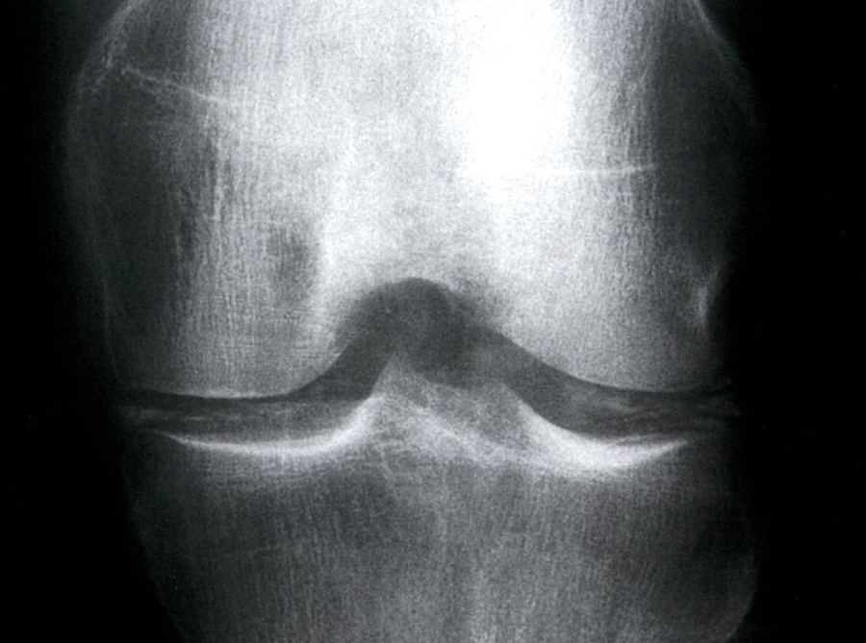
Common joints with calcification:
Annulus fibrosus of vertebral disc
Menisci of the Knee

Slide 21
Treatment
There is no treatment that can prevent CPP crystal deposition in joints
Treatment is symptomatic:
NSAIDS
Colchicine
Intra-articular steroids

Slide 22
Thank You

