Slide 2
Biosynthesis of F.A.s
- F.A.s biosynthesis starts with acetyl CoA.
The enzyme systems are involved in this process.
1- Extra-mitochondrial (cytosolic) system. 2- Microsomal system.
Requirements; acetyl CoA, NADPH+H+ and group of enzymes called collectively fatty acid synthase complex.
Acetyl CoA formed from pyruvate within the mitochondria doesn’t
diffuse readily to the cytosol, the principal site of F.A. synthesis.
-Translocation to cytosol involves condensation with oxaloacetate to
form citrate. (CITRATE SHUTTLE)
When citrate is formed in excess of TCA cycle requirement, it
diffuses into cytosol.
By the aid of ATP citrate lyase, citrate is splitted down into acetyl CoA
and oxaloacetate.
Acetyl CoA may also pass through mitochondrial membrane into
cytosol in the form of acetyl carnitine by carnitine acetyl transferase

Slide 3
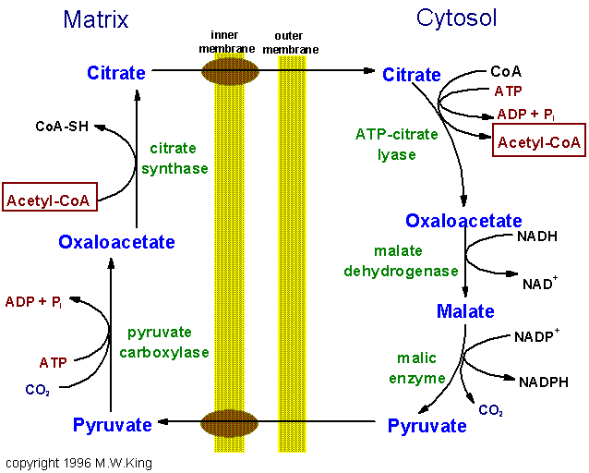

Slide 4
Note: Acetyl CoA used for fatty acid synthesis always derived from
glucose and never from fatty acids. This is because insulin hormone
secreted after meal stimulates both glucose oxidation (+acetyl CoA) and lipogenesis (=Fatty acid synthesis) and Inhibits lipolysis (+Fatty acid oxidation+Acetyl CoA).
NADPH+H+: It is provided by 3 sources:
a) Pentose phosphate pathway.
b) Action of cytoplasmic isocitrate dehydrogenase on isocitrate. It is
similar to mitochondrial one but it uses NADP+ as hydrogen carrier.
c) Action of malic enzyme on malate to produce pyruvate:
This enzyme is a dimer i.e. formed of 2 subunits.
Each unit, which is called monomer, contains 7 enzymes and a terminal protein called acyl carrier protein (ACP).

Slide 5
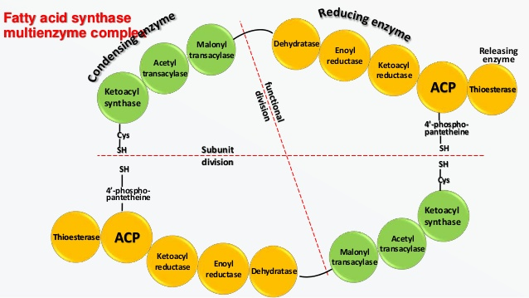
ACP is a protein contains the vitamin pantothenic acid in the form of phosphopantotheine. ACP is the part that carries the acyl group.
Each monomer contains 2 –SH groups, one provided by phosphopantotheine and attached to ACP. The other is provided by cysteine attached to the enzyme 3- ketoacyl synthase.
The 2 monomers are arranged head to tail, so the -SH group of ACP of one monomer is very close to the -SH group provided by 3- ketoacyl synthase of the other monomer.

Slide 6
Extra-mitochondrial system
It is the only system responsible for de novo synthesis of F.A.s from
acetyl CoA, free palmitate is the main product.
Site:
Intracellular location: Cytosol.
8 molecules of acetyl CoA (C2) are used in the formation of palmitate
(C16)
7 acetyl CoA are converted into malonyl CoA by the enzyme acetyl
CoA carboxylase.
The process occurs in 7 repeated cycles, each requires 2 mol of
NADPH+H⁺ , and liberates 1 mol of CO₂ and 1 mol of H₂O.
Acetyl CoA + 7 Malonyl CoA + 14 NADPH+H⁺
Palmitic acid+ 8 COA+ 14 NADP+ 7 CO₂+ 6 H₂O ??

Slide 8
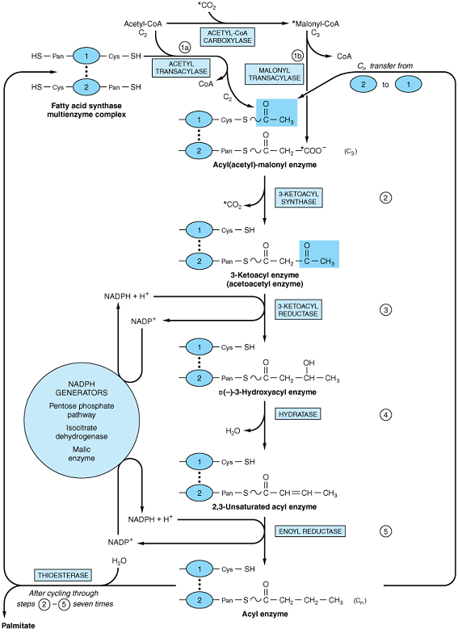

Slide 9
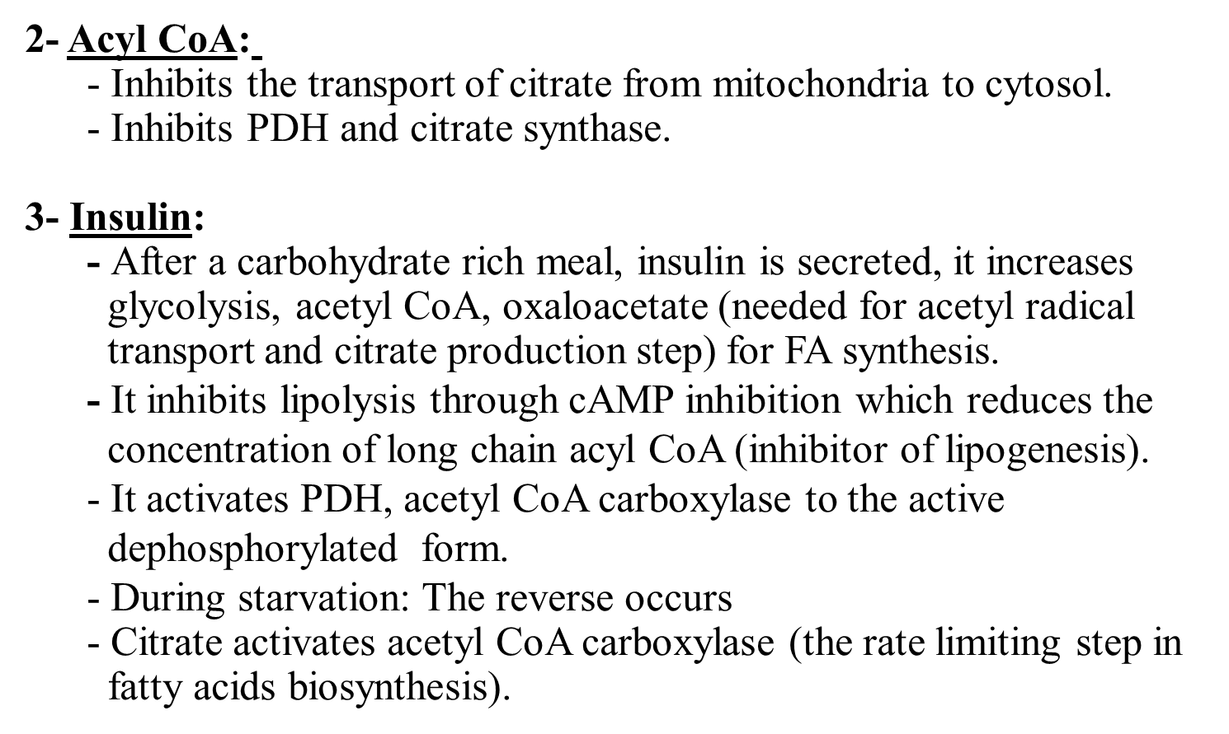

Slide 10
Fate of palmitate:
1. Esterification:
Palmitate esterifieid with glycerol to from acylglycerols or with
cholesterol to form cholesteryl ester.
2. Chain elongation:
Palmitate may be elongated to form a longer fatty acid.
3. Desaturation: i.e. synthesis of unsaturated fatty acid: palmitate may undergo desaturation to form palmitoleic acid.
4. Sphingosine formation:
It is formed by condensation of palmityl CoA and the amino acid serine

Slide 11
MICROSOMAL PATHWA Y FOR FA TTY ACID SYNTHESIS:
This is probably the main site for the elongation of existing long chain fatty acid molecules i.e. production of fatty acids longer than 16 carbon atoms.
A. The elongated molecules are derived from :
1. Palmitate : by cytoplasmic pathway .
2. fatty acids of diet.
B. The microsomal pathway needs malonyl CoA as acetyl donor and NADPH+H+ as coenzyme .
C. Function : This system becomes active during myelination of nerves in order to provide C22 and C24 fatty acids which are present in sphingolipids

