Slide 1
Skeletal system
DR. ESSMAT AL OMARI
Consultant Radiologist
Mu’tah University

Slide 2
Skeletal system
What is the skeletal system ?
Is all of the bones in the body and the tissues such as tendons, ligaments and cartilage that connect them.
The average adult human skeleton has around 206 bones.
These bones meet at joints, the majority of which are freely movable, making the skeleton flexible and mobile.

Slide 3
Skeletal system / 2 investigation
Plain film:
Plain films still remain the mainstay of radiological investigation of the skeletal system .
views should always be obtained in two projections.
Ultrasound :
neonatal hip for congenital dislocation .
soft tissue lesions , abscesses and masses .
joint effusions .
Notes:
We need 2 views

Slide 4
CT in skeletal system
CT is very helpful in :
assessment of bone tumours prior to surgery .
evaluation of certain fractures , such as the acetabulum, spine and calcaneum .
study of the spinal column .

Slide 5
MRI / Skeletal system
MRI assists the investigation of bone tumours, soft tissue masses and joint .
MRI is extremely sensitive in injuries to cartilage , muscle , ligaments, menisci and tendons.

Slide 6
Osteoporosis
Is a generalized decrease of bone mass.
Radiological investigation:
Bone densitometry.
Plain x-ray film:
Detection of osteoporosis on plain film requires a reduction in bone mass of at least 30%.
Osteoporosis result in a loss of bone density, decrease in the number of trabeculae and coarse striations.

Slide 7
Osteoarthritis (degenerative joint disease)
Is a degenerative condition affecting the articular cartilages and subjacent bone.
Is part of the normal ageing process.
Secondary osteoarthritis results from previous trauma and joint infection.
Any joint may be affected, but the knees, hips, shoulders and hands are frequently involved.

Slide 8
Osteoarthritis / 2
Radiological features:
Osteophytes formation: are spurs of bone which forms at joint margin.(NEW BONE) DUE TO INFALMMATION
Joint space narrowing.(contain synovial F) IT IS THE MOST IMPORTANT SIGN
Sclerosis with Secondary degenerative cysts formation. DENSE LINE IN BONE DUE TO NECROSIS
Loose bodies: result from separation of cartilage and osteophytes. OSTEOPHYTES IN THE JOINT SPACE

Slide 9
Frontal view of both knee joints X-ray
Narrow joint space (yellow), osteophytes (red), sclerosis (white),
no loose bodies And mild medial dislocation(MINIMAL SUBLAXATION)
Notes:
مهم فيي الامتحان

Slide 10
WE TAKE LATERAL VEIW TO SEE DISLOCATION OF THE JOINT AND THE PATELLA
Narrow joint space (yellow), osteophytes (red), sclerosis (white), loose body (green) and moderate dislocaction
Notes:
WE TAKE LATERAL VEIW TO SEE DISLOCATION OF THE JOINT AND THE PATELLA

Slide 11
Spine assessment :
Alignments (normal or abnormal)
Height of vertebral bodies (indicate compression fracture)
Density
Joint space
ALIGNMENTS NEEDED TO SEE IF THERE IS DISLOCATION ( CUZ IN THE SPINE IT IS SIGNIFICANT )
AND LOOK AT THE A AND B LINE (THE VERTEBRAL BODIES SHOULD BE ALL INTACT BETWEEN THESE 2 IMAGINARY LINES)
Notes:
ALIGNMENTS NEEDED TO SEE IF THERE IS DISLOCATION ( CUZ IN THE SPINE IT IS SIGNIFICANT )
AND LOOK AT THE A AND B LINE (THE VERTEBRAL BODIES SHOULD BE ALL INTACT BETWEEN THESE 2 IMAGINARY LINES)

Slide 12
C1
Trachea ,odontoid process of C2 (red), ant.arch-tubercle- of C1 (yellow), atlantoaxial joint (green), transverse process (blue)

Slide 13
Lateral view of cervical spine : normal alignments and vertebral bodies density , and normal height of cervical bodies and narrow OF DISC space between C5-C6 , scleroses and osteophytes ( ARROW INDICATES C2 THAT IT IS ELONGATED ALWAYS مشان العد
Notes:
CERVICAL SPINE X-RAY LATERAL VIEW

Slide 14
DIAGNOSIS: OSTEOARTHRITIS
Lateral view of cervical spine : normal alignments and vertebral bodies density , and abnormal height of cervical body of C6 (compression fracture) and narrow space between C6-C7 , scleroses and osteophytes
Notes:
DIAGNOSIS: OSTEOARTHRITIS

Slide 15
Osteomyelitis (FINAL EXAM)
Is an infection of bone, staphylococcus
Aureus is responsible for the majority of cases.
Radiological features:
May be normal for up to 10 days.
The earliest sign is soft tissue swelling due to edema, redness and pain.
Periosteal reaction
Bone destruction

Slide 16
Malignant bone tumour
Are destructive lesions , often associated with periosteal reaction , and have a wide zone of transition between normal and abnormal bone.
The most common malignant bone tumour is a metastasis and it’s often solitary .

Slide 17
Malignant bone tumors / 2
Radiological features :
Plain film: shows an area of bone destruction
CT and MRI are the best imaging modalities to evaluate tumours and determine bone and soft tissue involvement
Features that may be verified by CT / MRI:
- tumour vascularity
- infiltration of surrounding tissue
- relationship to nerves and vessels

Slide 18
Malignant bone tumours / 3
The most common primary malignant bone tumors are:
Osteogenic sarcoma
Ewings tumour
Chondrosarcoma
Fibro sarcoma
Giant cell tumor

Slide 19
Multiple Myeloma
Is a cancer of plasma cells (malignant proliferation).
The most common bones involved are:
the skull, spine, pelvis and ribs.
The disease may occur in a disseminated form, or as a localized solitary mass (Plasmacytoma).
Notes:
PTN of all ages come in generalized bonache

Slide 20
Multiple Myeloma / 2
Radiological features:
At time of presentation 80% have skeletal abnormalities.
Plain films reveal:
- Generalized oteoporosis (decrease bone density)
- Compression fractures of the vertebral bodies.
- Scattered multible lytic lesions with well defined margins

Slide 21
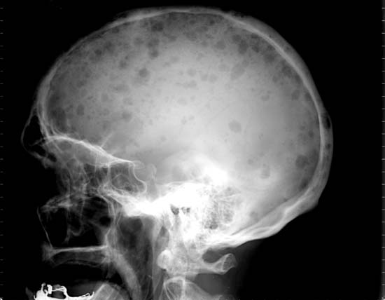
Skull > should do two view X-ray : lateral and frontal
Lateral view of skull X-ray multiple well-defined osteolytic lesions
Male : MM or lung CA
Female : breast CA

Slide 22
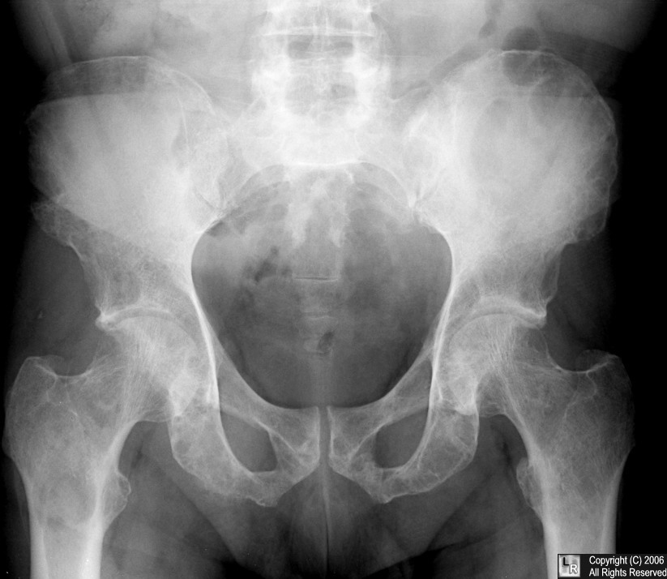
MM: multiple lytic lesions

Slide 23
Bone metastasis
Are the most common malignant bone tumors.
Any primary tumor may metastasize to bone, but the most frequents are:
Breast: usually lytic in nature but may be sclerotic(dense) or mixed.
Prostate: the vast majority are 90% sclerotic(dense).
Lung: lytic lesion.
Kidney, thyroid: lytic lesions
Adrenal gland: predominantly lytic.
Notes:
Malegnants:: primary ➔ osteosarcoma
Secondary (metastasis)
Benign in bones ➔ osteocyst

Slide 24
Multiple well defined lytic lesion involve all the skull and decrease bone density with no pathological fracture
Dd: MM(most common in old male) or metastasis (male mainly from the lung/ female mainly from the breast)

Slide 25
Frontal view of pelvis X-ray, showing pathological dislocation of RT hip joint Because of large lytic lesion in Rt. Iliac bone
Dx: Malignant lesion

Slide 26
Frontal view of pelvic and abdomen region X-ray.
Showing:
Diffuse metastasis involve all skeleton , hyperdense vertebral bodies and scleroting mets.
Suggesting prostate CA

Slide 27
Skeletal Trauma
Plain films are the initial evaluation of a patient with suspected skeletal trauma.
At least two views (A.p, and lateral) should always be obtained.
In any significant head or spine injury, CT scan is the initial investigation.
CT will detect fractures as well as underlying intracerebral hemorrhage or contusions.

Slide 28
FRACTURES
Fracture: is a break in the continuity of bone or cartilage.
Closed fracture: Fracture with intact skin.
Open fracture: Fracture with skin and soft tissue wound connecting the fracture to the external environment.

Slide 29
Types of fracture
Linear fracture. With NO FRAGMENTS OR DISLOCATIONS
Comminuted fracture: a fracture with multiple fragments
Avulsion fracture: a fragment of bone is detached from the site of a ligament or tendon insertion.
Pathological fracture: a fracture through diseased bone. ANEMIA OSTEOPROSIS METASTASIS (WITH NO HISTORY OF TRAUMA OR NOT HARD TRAUMA)

Slide 30
Greenstick fracture: Incomplete fracture that usually occurs in children . The bone may also buckle without an actual break.
Compression fracture: force is applied in the longitudinal axis of bone, usually occurs in the spine.(DECREASE IN HIGHT OF THE BONE)
Depressed fracture: usually occurs in the skull.
Articular fracture: fracture that involves the joint surface of bone. XXXXXXX
EPIPHYSIAL PLATE FRACTURE: in long bones in the joints

Slide 31
Stress fracture: Is incomplete fracture caused by repeated stress , or over-use to bone, in the form of a fine crack.
most common in the proximal shaft of the tibia and fibula (long distance runners and ballet dancers).
March fracture: is a type of stress fracture, also known as fatigue fracture of second and third metatarsal bones caused by recurrent overstress, is more common in soldiers.

Slide 32
Lateral view of skull X-ray for child, showing linear fracture along the occipital bone and 15cm in long
And we need to take CT image to see the soft tissue and the side of the fracture if lft or rt
Notes:
And we need to take CT image to see the soft tissue and the side of the fracture if lft or rt

Slide 33
Linear fracture of the 3rd metacarpal bone.

Slide 34
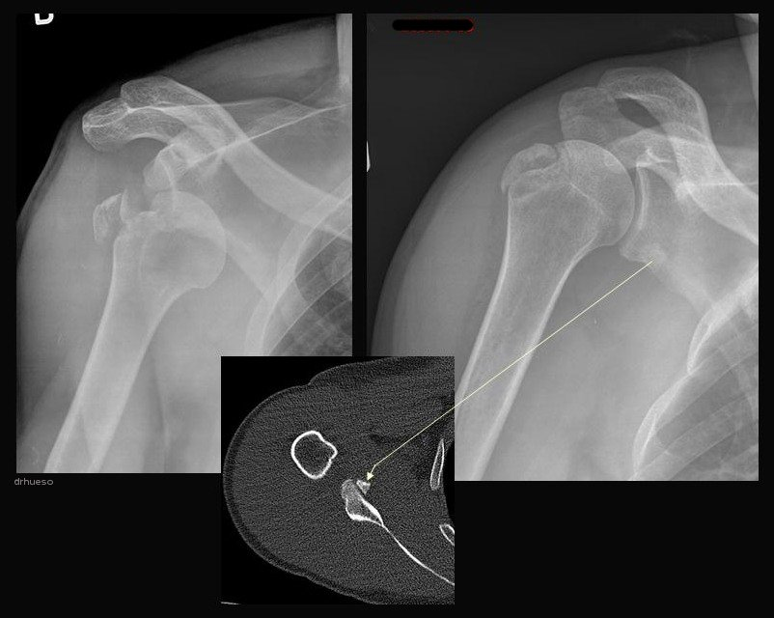
The head of humerous is dislocated from the glenoid fossa (red)
The left picture shows the joint after reduction , notice the bone fragment from the greater tuborosity (yellow), and the fracture in the greater tuborosity (blue).

Slide 35
Anterior view of lt. hand X-ray, showing scaphoid bone fracture

Slide 36
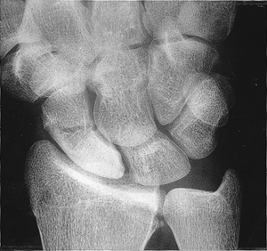
X-ray of Rt. Hand showing scaphoid fracture with avascular necrosis (hyperdense) of proximal part of bone

Slide 37
Ct-scan of brain of soft tissue window, showing odema and deprseed fracure in lt. occipital bone
And there is gas buble in lesion
Ct-scan of brain of bone window, showing deprseed fracure in lt. occipital bone

Slide 38
Ant. Show linear fracture of distal end of Rt. Radius .
Lateral show moderate dislocation of fracture fragment Epiphysial plate fracture with dislocation of the joint
Notes:
Epiphysial plate fracture with dislocation of the joint

Slide 39
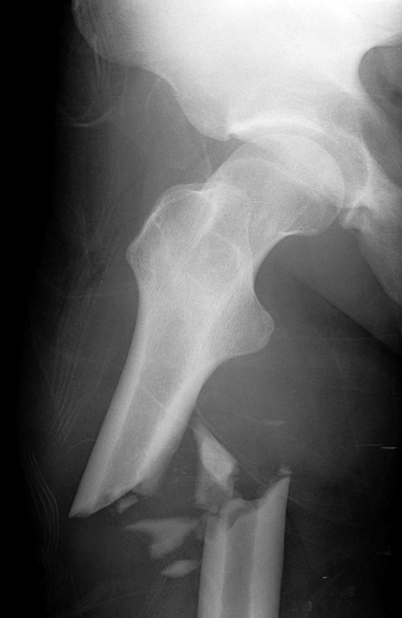
Frontal view of hip joint X-ray
Showing comminuted and open facture of femur bone with lateral dislocation of proximal part .

Slide 40
Lateral and anterior view of Lt. hand show greenstick fracture
Notes:
Buckling and step like deformity indicating greenstick fracture

Slide 41
Frontal view of Rt. Shoulder joint X-ray, showing large well defined hypodense osteolytic lesion in head of humerus and
well-defined oval in shape , and pathologic fracture ➔ it goes with cyst

Slide 42
SPINAL INJURIES
The spinal injury can be classified in three types:
1 - Compression fracture.
2- Burst fracture/ as comminuted
3- Fracture-Dislocation.

Slide 43
T12
L2
Compression fracture : loss of height of L1 mainly anteriorly, bone fragment anteriorly & posteriorly (red) and intact alignments and density of bodies

Slide 44
Burst fracture

Slide 45
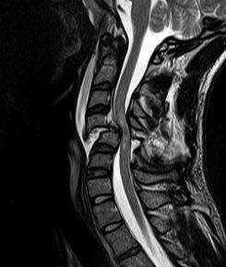
Fracture dislocation , most dangerous
fracture
Abnormal alignments

