Slide 1
Diverticular disease of GI system Supervised by : Dr. Emad abo rajooh, Dr.ahmade alslehaate Presented by : Mohammad alrfou , Suheib alsmerat
.

Slide 2
Diverticula (hollow out-pouchings) are a common structural
abnormality. They can be classified as:
1 Congenital. (True) All three coats of the bowel are present in
the wall of the diverticulum (e.g. Meckel’s diverticulum).
2 Acquired. (Fulse )There is no muscularis layer present in the
diverticulum (e.g. sigmoid diverticular disease ,esophageal diverticulie

Slide 3
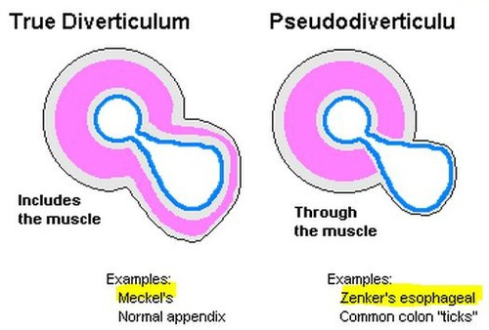
Layers of diverticulum
True: mucosa,submucousa ,mascularis propria and serosa.
Fulse:mucosa ,submucousa, and serosa like in rectosigmiod diverticulum or adventitia like in esophageal diverticulum.

Slide 4
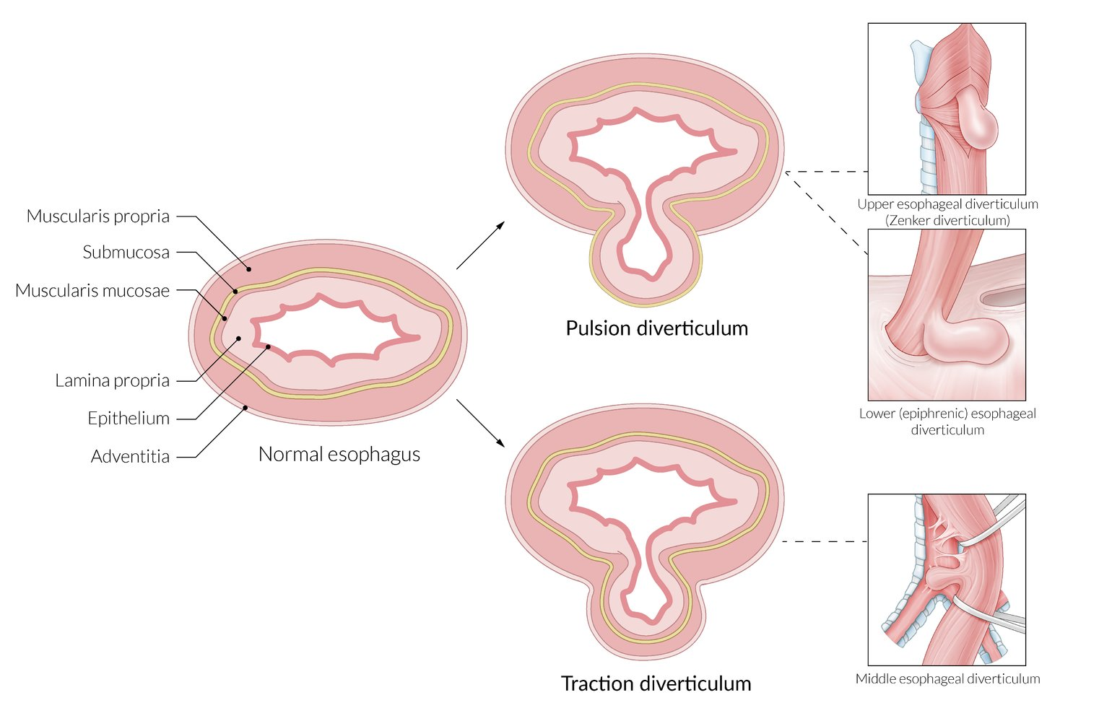
Acquired diverticulum have two types according to mechanism of its formation into
1-pulsion type: rectosigmoid and zenker diverticulum
Increase in intraluminal pressure lead to pulsion of mucosa and submucousa through mascularis propria
Traction type: middle esophageal and acquired type of gastric diverticulum
Traction forces from adjacent inflammatory process or fibrotic healing In adjacent Structure

Slide 5
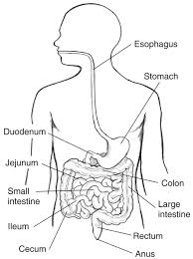
The diverticulum can involve:
Esophagus
Stomach
Small bowel
Cecum
Large bowel

Slide 6
Pharyngeal and oesophageal diverticula
Most oesophageal diverticula are pulsion diverticula that develop at a site of weakness as a result of chronic pressure against an obstruction.
Symptoms are mostly caused by the underlying disorder unless the diverticulum is particularly large.

Slide 7
Traction diverticula are much less common .
. They are mostly a consequence of chronic granulomatous disease affecting the tracheobronchial lymph nodes due to tuberculosis, atypical mycobacteria or histoplasmosis.
Fibrotic healing of the lymph nodes exerts traction on the oesophageal wall and produces a focal outpouching which is usually small and has a conical shape.
There may be associated broncholithiasis, and additional complications may occur, such as aerodigestive fistulation and bleeding.

Slide 9
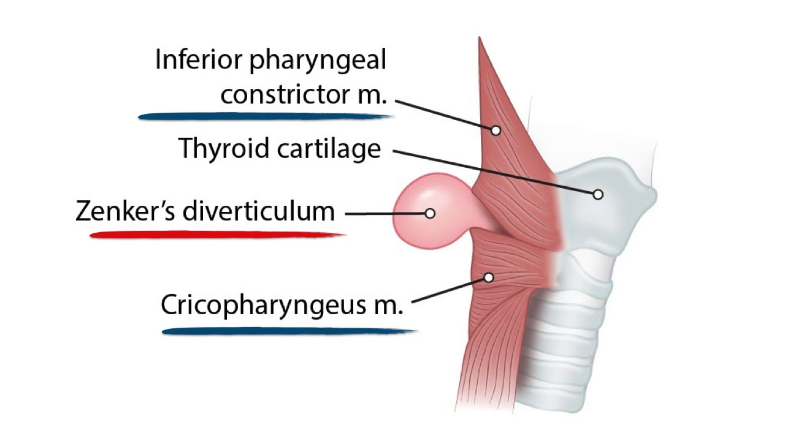
Zenker’s diverticulum (pharyngeal pouch) is not really an oesophageal diverticulum as it protrudes posteriorly above the cricopharyngeal sphincter through the natural weak point (the dehiscence of Killian) between the oblique and horizontal (cricopharyngeus) fibres of the inferior pharyngeal constrictor.

Slide 10
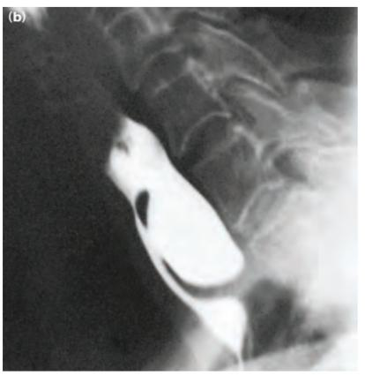

Slide 11
The exact mechanism that leads to its formation is unknown, but it involves loss of the coordination between pharyngeal contraction and opening of the upper sphincter. Lead to increase intrluminal pressure and pulsion of mucosa and sub mucosa through mascular layer.
When the diverticulum is small, symptoms largely reflect this incoordination with predominantly pharyngeal dysphagia. As the pouch enlarges, it tends to fill with food on eating, and the fundus descends into the mediastinum. This leads to halitosis and oesophageal dysphagia

Slide 12
Treatment can be undertaken endoscopically with a linear cutting stapler to divide the septum between the diverticulum and the upper oesophagus
or can be done by open surgery
involving pouch excision. All techniques
have good results

Slide 13
Midoesophageal diverticula are usually small traction diverticula of no particular consequence.
pulsion diverticula may found in the midoesophagus
But traction type is more common and asscioted with granulomatous disease so it also more common in tracheoesophegial fistula formation .

Slide 14
Epiphrenic diverticula are pulsion diverticula situated in the lower oesophagus above the diaphragm
They may be quite large, but cause surprisingly few symptoms.
They again probably reflect some loss of coordination between an incoming pressure wave and appropriate relaxation of the LOS.
Large diverticula may be excised, and this should be combined with a myotomy from the site of the diverticulum down to the cardia to relieve functional obstruction.

Slide 15
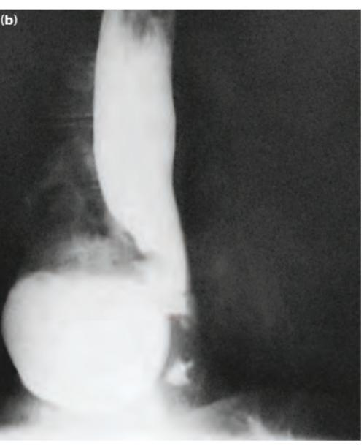

Slide 16
Diffuse intramural pseudodiverticulosis is a rare condition in which there are multiple tiny outpouchings from the lumen of the oesophagus.
The pseudodiverticula are dilated excretory ducts of oesophageal sebaceous glands.
Esophageal diverticula is indicator for motality disorder and not necessarily the cause of the symptoms

Slide 17
Gastric diverticulum
Gastric diverticula (GD) are outpouchings of the stomach wall that often form in the fundus.GD are the least common gastrointestinal diverticula, and are very rare anatomic abnormalities overall. In fact, they are usually discovered incidentally during routine diagnostic testing
They arise with equal distribution between men and women, and patients characteristically present between 50 and 70 years of age.

Slide 18
Symptoms
most individuals with GD are asymptomatic, others can present with variable abdominal symptoms, including epigastric pain and discomfort, nausea, vomiting, dyspepsia, early satiety, a vague sensation of postprandial fullness, belching, halitosis, anorexia, and dysphagia .Occasionally, complications, such as ulceration, upper gastrointestinal bleeding, hemorrhage, perforation, and malignant transformation, can develop that may be life-threatening and are indications for surgical management . The rarity of this disorder, as well as the presence of a vague and nonspecific symptomatology, necessitates a high clinical index of suspicion .

Slide 19
Acquired | Congenital
Fulse involved just mucosa and submucosa | True involved all layers | True or false
Less common 30% | More common 70% | Prevalence
Antrum | Fundus If near to pylorus think about aberrant panceratic tissue | Site
Two mechanism Pulsion:increase intraluminal pressure (chronic cough) Traction :contraction force from adherent inflammatory process (peptic ulcer) | Congenital | Mechanism

Slide 20
Investigation
More often, GD are usually discovered incidentally during routine diagnostic investigation of common gastrointestinal symptoms. However, the methods used to detect them can fail, and, thus, a combined diagnostic approach should be used . GD can be identified through radiological examinations (upper gastrointestinal contrast radiographic study and abdominal CT scanning with oral contrast administration) and upper gastrointestinal endoscopic examinations . ​ ​ ​
It is advised to perform a careful endoscopic examination and obtain biopsies from GD with suspicious, raised, or irregular borders because it have potential risk of malignancy.

Slide 21
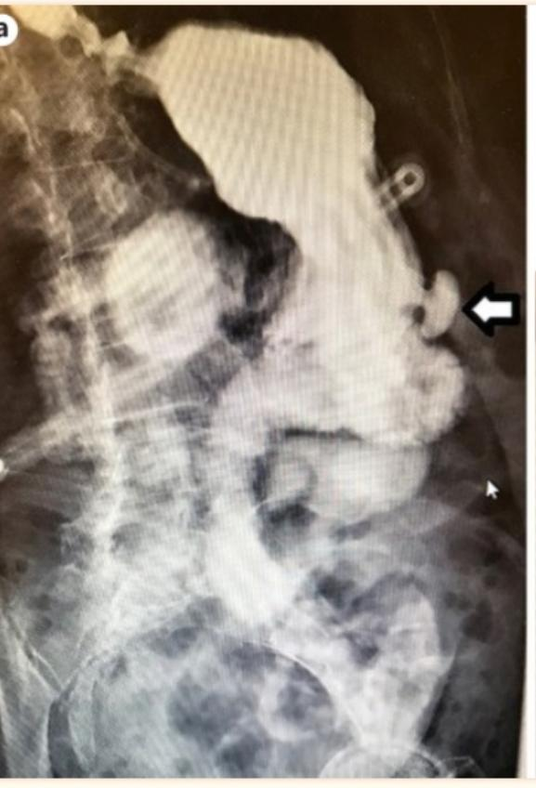
Upper gastrointestinal contrast radiographic study. Oral contrast was administered through a gastrostomy tube. The patient was discovered to have a gastric diverticulum (arrows) along the greater curvature of the distal stomach.

Slide 22
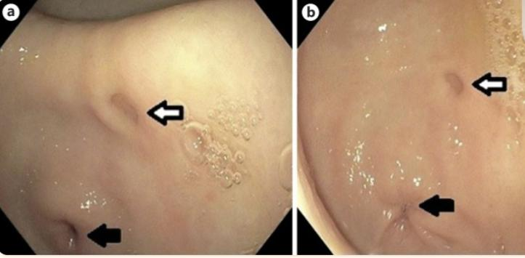
Endoscopic view of a gastric diverticulum (white arrows) located in the antrum. The pylorus (black arrows) is visible in the lower left part of the images

Slide 23
Management
management of GD depends largely on the severity of the presenting complaints. It is well documented that asymptomatic individuals do not require any treatment and can be left alone . Symptomatic diverticula usually treated with ppi or antacid,medical management is first plain of treatment until there is indication for surgical management.

Slide 24
Surgical management
Surgical resection continues to be the main treatment when the GD are large (> 4 cm in diameter), patients are still symptomatic after PPI therapy, and complications, such as ulceration, upper gastrointestinal bleeding, hemorrhage, perforation, and malignant transformation, have occurred
Open or laprascopic aprouch
Laprascopic is preferable
Resection of diverticulum or incorrect part of stomach

Slide 25
Small bowel diverticulum
Acquired
These invariably develop in the jejunum and arise from the mesenteric side of the bowel as a result of mucosal herniation at the point of entry of the blood vessels.
There is thus no muscularis layer present in the wall "False"
. Jejunal diverticulae can vary in size and are frequently multiple. They are commonly asymptomatic and present as an incidental finding at surgery or on radiological imaging.

Slide 26
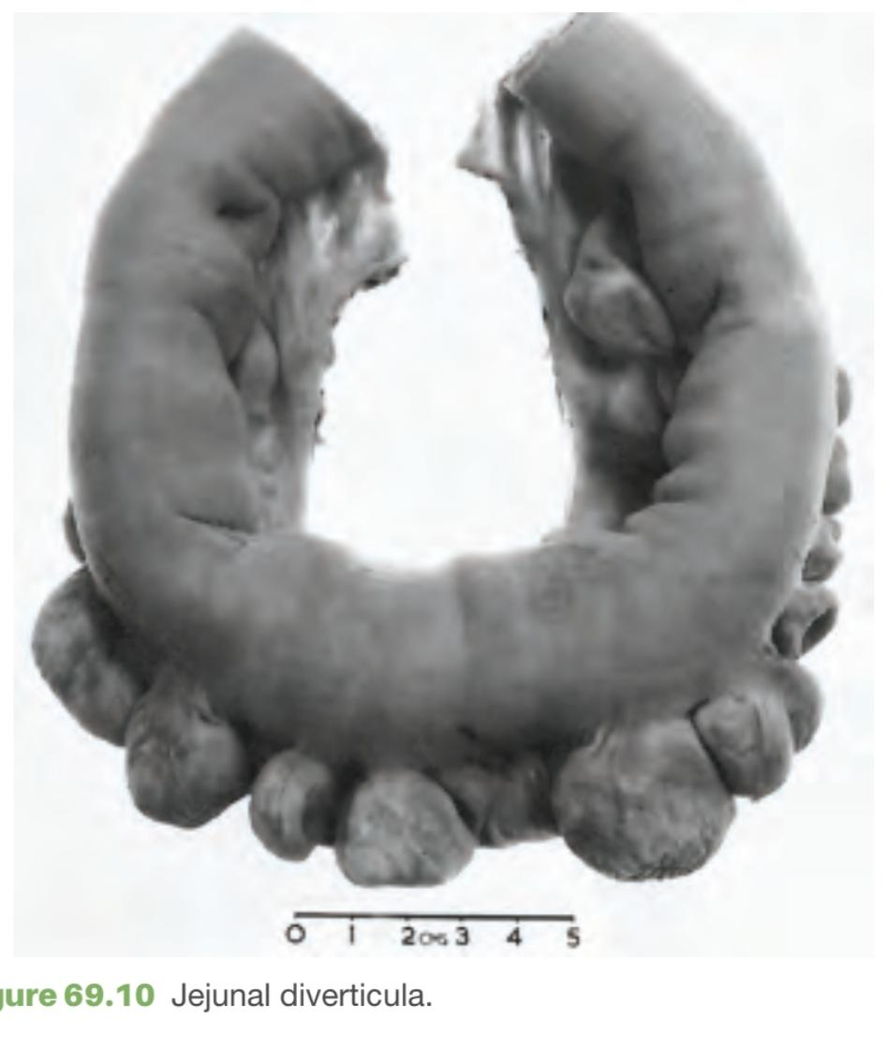
they can result in malabsorption, as a result of bacterial stasis.
or present as an acute abdominal emergency if they become inflamed or perforate.
Bleeding from a jejunal diverticulum is a rare complication (compared with sigmoid diverticular disease).

Slide 27
Elective resection of an affected small bowel segment that is causing malabsorption can be effective, provided there is only a limited amount of jejunum affected by the condition.
If perforated jejunal diverticulitis is found at emergency laparotomy, a small bowel resection should be performed and a decision made between anastomosis and stoma formation.
This will depend on the degree of contamination, physiological stability and local resources for managing a patient with a high output jejunostomy.

Slide 28
Complications resulting from extensive jejunal diverticulosis can be extremely difficult to treat. In severe cases, much of the proximal small intestine may be involved, effectively precluding resection. Prolonged antibiotic therapy for bacterial overgrowth may be preferable, and antibiotics (metronidazole, ciprofloxacin, rifaximin) are frequently rotated in an attempt to avoid the development of antibiotic resistance.
Limited resection, leaving remaining segments of affected jejunum, may be feasible, but may also fail to deal adequately with bacterial overgrowth, recurrent attacks of inflammation or bleeding.

Slide 29
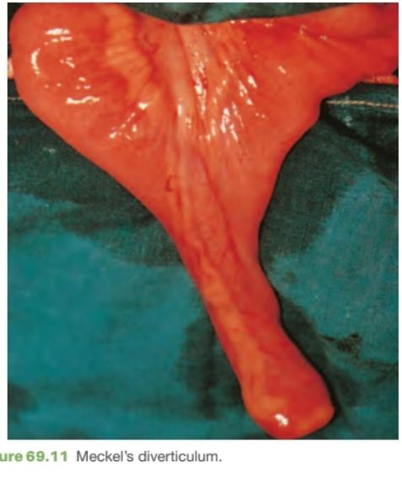
Meckel’s diverticulum
Meckel’s diverticulum is a persistent remnant of the vitellointestinal duct and is present in about 2% of the population.
It is found on the antimesenteric side of the ileum, commonly ,approximately 60cm from the ileocaecal valve and is classically 5cm long .

Slide 30
Meckel’s diverticulum is a congenital diverticulum. It contains all three coats of the bowel wall and has its own blood supply. It may be vulnerable to obstruction and inflammation in the same way as the appendix; indeed, when a normal appendix is found at surgery for suspected appendicitis, a Meckel’s diverticulum should be looked for by examining the small bowel, particularly if free fluid or pus is found.

Slide 31
In approximately 20% of cases, themucosa of a Meckel’s diverticulum contains heterotopic epithelium of gastric, colonic or pancreatic type. The presence of heterotopic mucosa may predispose to the development of complications.
The vast majority of Meckel’s diverticulae are asymptomatic and Meckel’s diverticulum is notoriously difficult to see with contrast radiology.
Meckel’s diverticulum may, however, present clinically in the following ways:

Slide 32
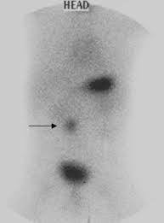
1.Haemorrhage. If gastric mucosa is present, peptic ulceration can occur and present as painless dark rectal bleeding or melaena. If the stomach, duodenum and colon are excluded as a source of bleeding by endoscopy, radioisotope scanning with technetium-99m may demonstrate it.
2Diverticulitis. Meckel’s diverticulitis presents like appendicitis, although if perforation occurs the presentation may resemble a perforated duodenal ulcer.

Slide 33
.3Intussusception. A Meckel’s diverticulum can be the lead point for ileoileal or ileocolic intussusception.
.4Chronic ulceration. Pain is felt around the umbilicus, as the site of the diverticulum is midgut in origin.
.5Intestinal obstruction. A band between the apex of the diverticulum and the umbilicus (also part of the vitellointestinal duct) may cause obstruction directly, or by predisposing to the development of a volvulus around it . .
6 Perforation

Slide 35
When found in the course of abdominal surgery, a Meckel’s diverticulum can safely be left alone, provided it has a wide mouth and is not thickened.
When there is doubt, it can be resected.
The finding of a Meckel’s diverticulum in an inguinal or femoral hernia has been described as ‘Littre’s hernia’.

Slide 36
Summary box

Slide 37
Meckel’s diverticulectomy
A broad-based Meckel’s diverticulum should not be amputated at its base and invaginated (as for an appendix), as there is the risk of stricture and of leaving heterotopic epithelium behind.
It is safer simply to excise the diverticulum, either by resecting it and suturing the defect at its base, or with a linear stapler-cutter.
If the base of the diverticulum is indurated, it is on balance more logical to perform a limited small bowel resection of the involved segment followed by an anastomosis.

Slide 38
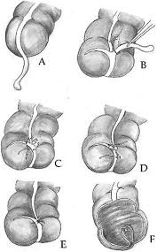

Slide 39
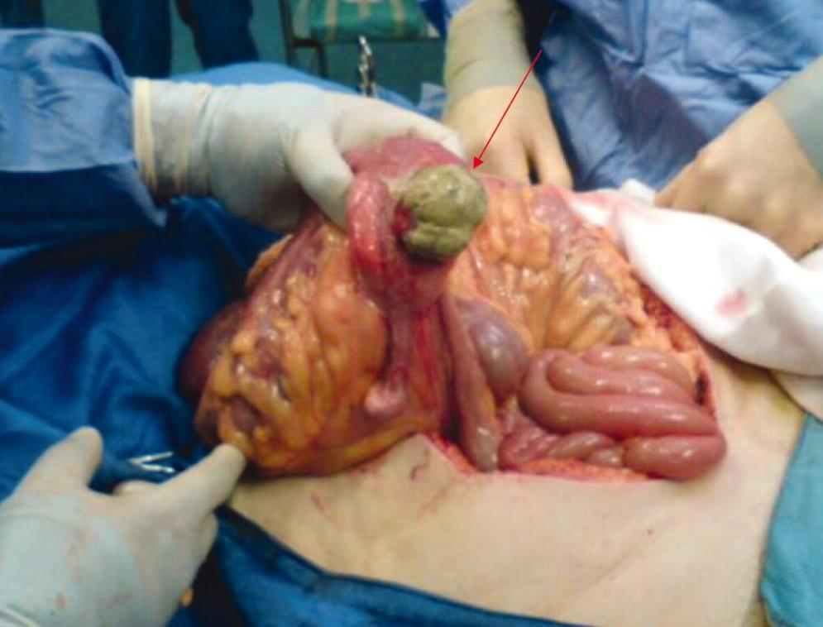
Cecal diverticulum
The cecal diverticula are usually solitary and are situated in the area from 1 cm proximal to 2 cm distal to the ileocecal valve. Most of them arise from the anterior aspect of the cecum; therefore when inflamed they tend to perforate and cause acute, localized peritonitis. However, an acutely inflamed solitary cecal diverticulum is an uncommon cause of an acute abdomen

Slide 40
The cecal diverticulum is a rare disease with reported incidence of 0.04% to 2.1% (1–3). The condition is uncommon in the Western countries, where 85% of diverticulum occurs more commonly in the descending and sigmoid colon rather than in cecum .
. The etiology of solitary cecal diverticulum remains still unclear, but its congenital origin seems possible as it includes all layers of the colonic wall. The average age for the development of this condition is about 43.6 years with male predominance.

Slide 41
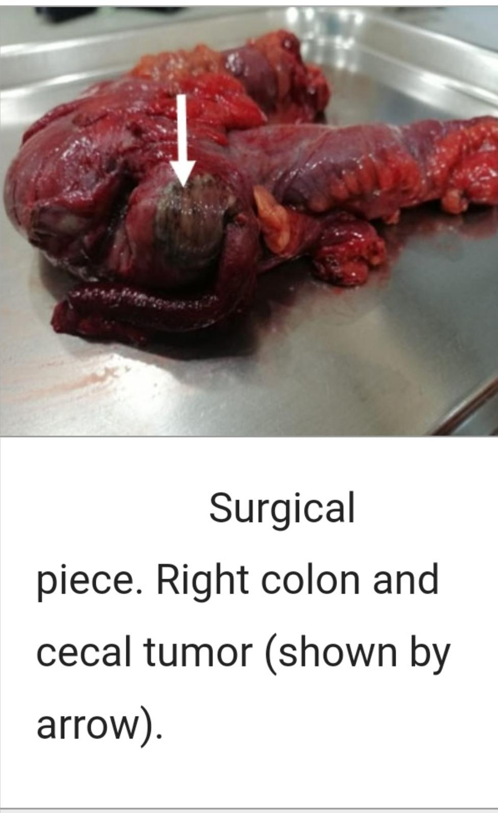
The disease is frequently misdiagnosed at the time of its occurrence. The symptoms and signs of the disease are well known to closely mimic acute appendicitis with abdominal pain, low-grade fever, nausea, vomiting, abdominal tenderness, and leukocytosis . Most authors agree that only few of the patients are correctly diagnosed with acute diverticulitis preoperatively, since it is clinically indistinguishable from appendicitis and is often confused with carcinoma of the cecum during the operation

Slide 42
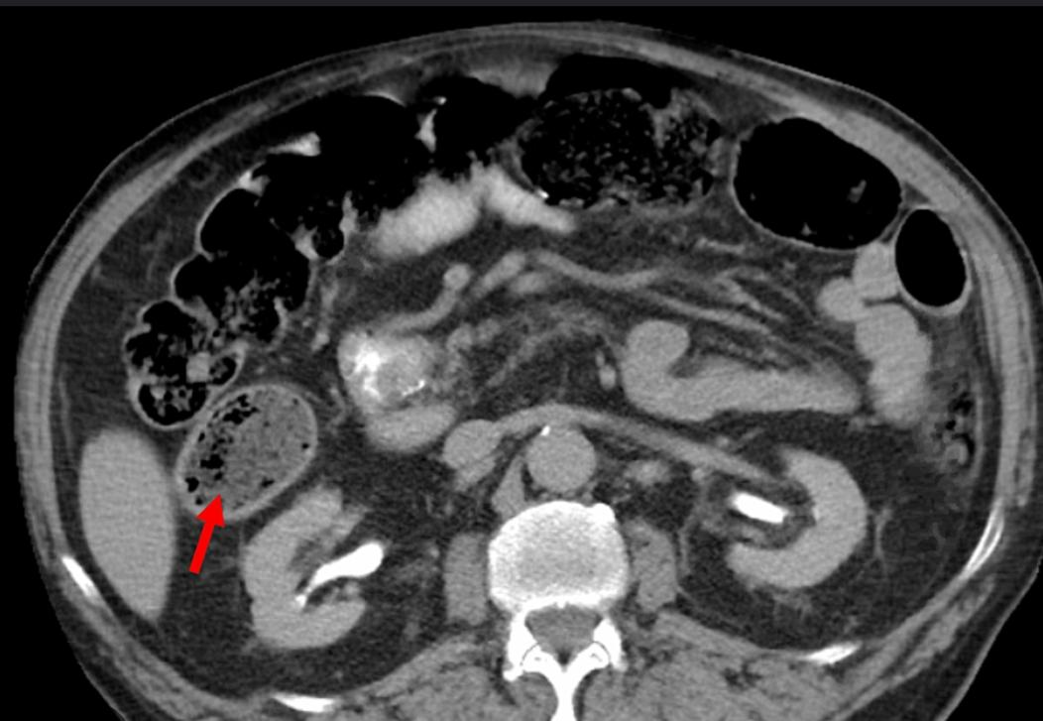
Imaging studies on the other side could distinguish between right-sided diverticulitis and acute appendicitis with high accuracy and therefore they have the benefit of avoiding unexpected findings during the operation . In most cases, the correct diagnosis of cecal diverticulitis is often made intraoperatively during exploration of suspected acute appendicitis . However, even intraoperatively, the correct diagnosis is often indistinguishable from acute appendicitis due to extensive inflammation.

Slide 43
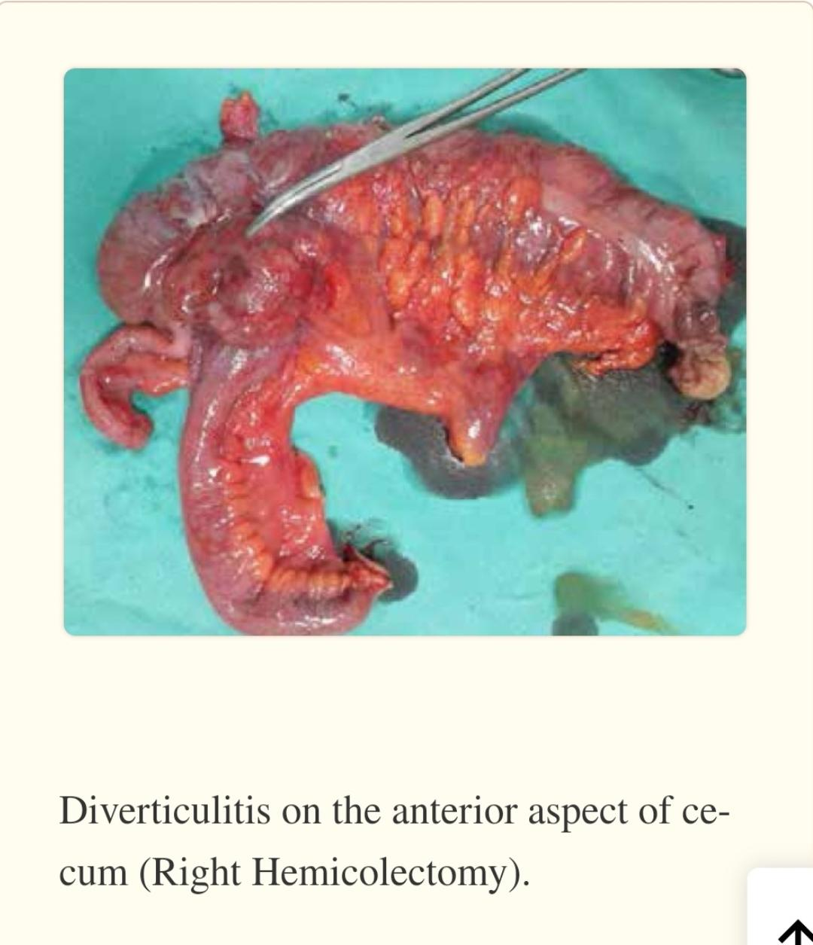
Controversies exist regarding the optimal management in nonperforated cecal diverticulitis, ranging from conservative approach with intravenous antibiotics to surgical procedures such as diverticulectomy and right hemicolectomy . The management approach should be based on the clinical presentation of the patient, the intraoperative findings, and the surgeon’s experience.

Slide 44
Colonic diverticula
Diverticula are found in the left colon in around 75% of over 70 year olds in the Western world.
The condition is overwhelmingly found in the sigmoid but can affect the whole colon.
Diverticula are most often asymptomatic (diverticulosis) and found incidentally, but they can also present clinically with sepsis or haemorrhage.

Slide 45
Aetiology
Epidemiological studies indicate that diverticular disease is a consequence of a refined Western diet, deficient in dietary fibers.
The combination of altered collagen structure with ageing, disordered motility and increased intraluminal pressure, most notably in the narrow sigmoid colon, results in herniation of mucosa through the circular muscle at the points where blood vessels penetrate the bowel wall"false"
The rectum has a complete muscular coat and a wider lumen and is thus very rarely affected.
Diverticular disease is rare in Africa and Asia where the diet is high in natural fibre

Slide 46
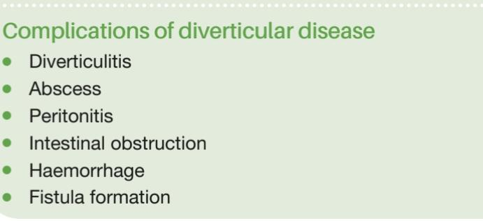
Complications of diverticular disease
The majority of patients with diverticula are asymptomatic but historical studies suggest that somewhere between 10 and 30% will have symptomatic complications

Slide 47
1Pain and inflammation (diverticulitis).
2 Perforation: most often contained leading to pericolic abscess formation but occasionally leading to generalised peritonitis.
3 Intestinal obstruction: progressive fibrosis can cause stenosis of the sigmoid and large bowel obstruction or loops of small intestine can adhere to an inflamed sigmoid, resulting in small bowel obstruction.
4 Haemorrhage: diverticular disease may present with profuse and recurrent) colonic haemorrhage due to erosion of vessels adjacent to a diverticulum.
5 Fistula formation (colovesical, colovaginal, enterocolic, colocutaneous): occurs in 5% of cases, colovesical fistulation is most commonly seen.

Slide 48
Clinical features
In mild cases, symptoms such as distension, flatulence and a sensation of heaviness in the lower abdomen may be indistinguishable from those of irritable bowel syndrome.
These symptoms are thought to result from a combination of increased luminal pressure affecting wall tension and increased visceral hypersensitivity.
Surgical treatment is rarely, if ever appropriate for diverticular disease in the absence of complications

Slide 49
Diverticulitis typically presents as persistent lower abdominal pain, usually in the left iliac fossa. There may be accompanying diarrhoea or constipation.
The lower abdomen is
tender, especially on the left, but occasionally also in th
right iliac fossa if the sigmoid loop lies across the midline.
The sigmoid colon may be tender and thickened on palpation
and rectal examination may reveal a tender mass if an abscess
has formed.
Distinguishing between diverticulitis and abscess
formation is difficult on clinical grounds alone and radiological imaging is essential.
Generalised peritonitis as a result of
free perforation presents in the typical manner with systemic
upset and generalised tenderness and guarding

Slide 50
Haemorrhage from colonic diverticula is typically painless and profuse. Bleeding from the sigmoid will be bright red with clots, whereas right-sided bleeding will be darker.
Torrential bleeding is fortunately rare and, in fact, more commonly due to angiodysplasia, but diverticular bleeding may persist or recur requiring transfusion and resection.
The presentation of a fistula resulting from diverticular disease depends on the site. The most common colovesical fistula results in recurrent urinary tract infections and pneumaturia (flatus in the urine) or even faeces in the urine. Colovaginal fistulae are more common after hysterectomy.
Colocutaneous fistulation is rare in the absence of prior intervention (e.g. Radiologicaldrainge
Rarely, diverticular disease may perforate into the retroperitoneum, leading to a psoas abscess, and even groin fistulation.

Slide 51
Classification of contamination
The degree of infection has a major impact on outcome in acute diverticulitis. Patients with inflammatory masses have a lower mortality than those with perforation (3% versus.
33%).
Classification systems have been developed for acute diverticulitis to try and rationalise the literature, the most commonly used being the Hinchey classification

Slide 53
Radiology
Plain radiographs can demonstrate a pneumoperitoneum.
Spiral CT has excellent sensitivity and specificity for identifying bowel wall thickening, abscess formation and extraluminal disease and has revolutionised the assessment of complicated diverticular disease

Slide 54
. On identification of abscesses in stable patients, drainage may be carried
out percutaneously, avoiding the need for laparotomy/laparoscopy.
Contrast studies and endoscopy are usually avoided for 6 weeks after an acute attack for fear of causing perforation.
They are used subsequently, however, to exclude a coexisting carcinoma and assess the extent of diverticular disease. Contrast examination or CT can demonstrate a fistula.

Slide 56
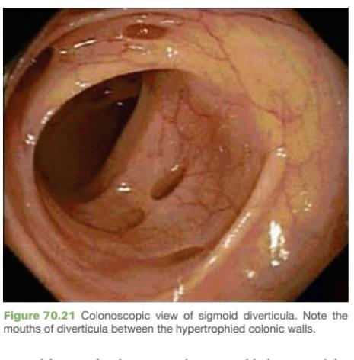
Colonoscopy
Endoscopic assessment may demonstrate the neck of diverticulie within bwoel lument

Slide 57
Narrowarea of diverticular disease may be impassable because of severity of disease and there is a significant risk of endoscopic perforation.
Biopsies may be taken if possible and corroboration with barium enema or CT virtual colonoscopy is required.
Excluding a carcinoma may not always be possible and may represent an indication for resection.

Slide 58
Management
Patients are frequently recommended to take a high-fibre diet and bulk-forming laxatives.
Antispasmodics may have a role if recurrent pain is a problem.
Acute diverticulitis is treated by intravenous antibiotics (to cover gram-negative bacilli and anaerobes) alongside appropriate resuscitation and analgesia

Slide 59
Management in acute attack
Nil by mouth to ‘rest the bowel’ and catheterisation to reduce the risk of colovesical fistulation are often advocated, but there
is little evidence to support these practices.
A CT scan can confirm the diagnosis and assess for complications.
After the acute attack has subsided the bowel should be investigated by endoscopy, barium enema or CT virtual colonoscopy.
Some pericolic abscesses can be drained percutaneously.
A diameter of 5cm is frequently regarded as the cut off between an abscess likely to settle with antibiotics and one likely to require intervention.

Slide 60
Operative procedures for diverticular disease
The aim of emergency surgery is to control peritoneal infection; indications are generalised peritonitis and failure to respond to optimum medical management.
Laparotomy for diverticular disease in the acute setting has considerable risk with mortality in most series of 15% and, in the case of faecal peritonitis, mortality approaches 50%.

Slide 61
Laparotomy and thorough washout of contamination are performed and then a choice has to be made between a Hartmann’s procedure (sigmoid resection with formation of left iliac fossa colostomy and closure of the rectal stump)
And resection with colonic washout and anastomosis (with consideration of a defunctioning loop ileostomy).
majority of emergency operations for perforated diverticular disease are Hartmann’s procedures

Slide 62
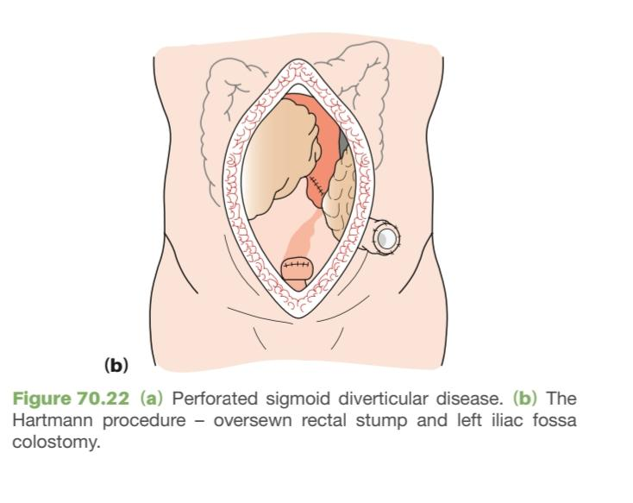

Slide 63
Elective surgery is usually undertaken for management of complications.
Diverticular fistulae can only be cured by resecting the affected bowel, although a defunctioning stoma can ameliorate symptoms.
In colovesical fistula the sigmoid can often be pinched off the bladder and the sigmoid resected.
If an anastomosis is performed, it is wise to place an omental pedicle between the bowel and bladder to prevent recurren Fistulation

Slide 64
Haemorrhage from diverticular disease should be distinguished from angiodysplasia.
It usually responds to conservative management and only occasionally requires resection.
Where available, angiography is helpful to localise bleeding points.
On-table lavage and colonoscopy may be necessary to localise the bleeding site.
If the source cannot be located, then subtotal colectomy and ileostomy may be the safest option

Slide 65
Indications for surgery in an elective setting, in the absence of complications of the disease, are controversial.
There are undoubtedly a small number of patients with recurrent attacks who should be offered an elective sigmoid colectomy (with anastomosis).
This could be performed laparoscopically in experienced hands with a likely swifter recovery as well as improved cosmesis.

Slide 66
Cohort studies suggest that in patients under 50 years old admitted with diverticulitis, 25% will have a further episode.
This may be used as an argument for offering elective resection but equally suggests that 75% will not get another severe attack.
There has been an increasing tendency, in recent years, to treat even patients with recurrent attacks of diverticulitis conservatively in the absence of complications.

Slide 67
Principles of surgical management

Slide 68
Thank you
Source.
Bailey & Love's Short Practice of Surgery, 27th Edition
Website PMC

