Slide 1
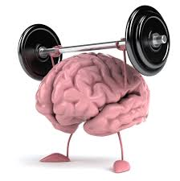
Brain Energy Metabolism II
Dr. Nesrin Mwafi
Biochemistry & Molecular Biology Department
Faculty of Medicine, Mutah University

Slide 2
Glucose Metabolism Produce Energy
Glucose metabolism in the brain is similar to that in other tissues. In an aerobic conditions, it includes three principle metabolic pathways:
Glycolysis
Tricarboxylic acid cycle (TCA) or Krebs cycle
Oxidative phosphorylation and the electron transport chain (ETC)

Slide 3
1. Glycolysis
Glycolysis is the metabolic pathway which converts glucose (C6) into pyruvate (C3)
It occurs in the cell cytosol . Glycolysis is a sequence of ten oxygen-independent and enzyme-catalyzed steps with the intermediates provide entry points to the cycle
When the glycolysis end products (pyruvate and NADH) are disposed in presence of O2, the process is then called aerobic. Alternatively, in an anaerobic conditions, the products are removed via the lactic acid fermentation process

Slide 4
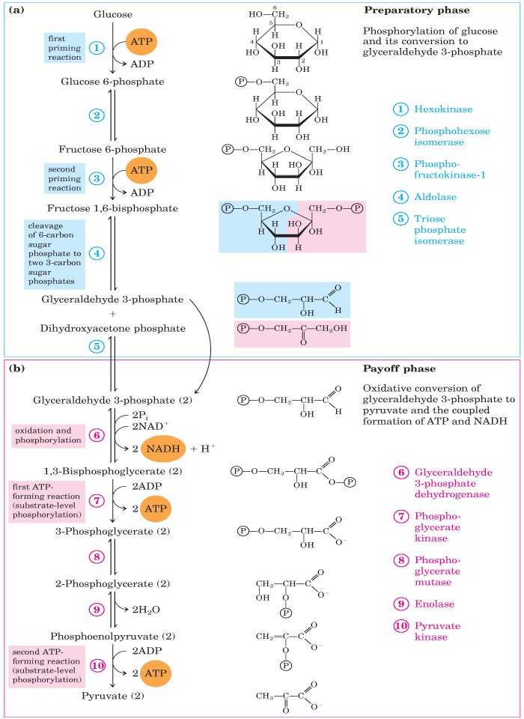
1. Glycolysis
The entire pathway is divided into two distinct phases:
Energy Investment Phase (Preparatory Phase)
Energy Generation Phase (Pay Off Phase)
Phosphoglucose

Slide 5
a) Preparatory Phase
Phosphoglucose

Slide 6
a) Preparatory Phase
Step 1: This first priming reaction is important to maintain the influx of glucose and at the same time to trap the transported glucose molecules inside the cell
Step 2: Phosphoglucose isomerase (PGI) interconverts G6P and F6P. Indeed, Mannose and Fructose can enter the glycolytic pathway at this point
Step 3: This is a rate limiting or key regulatory step because phosphofructokinase-1 (PFK-1) is an allosteric enzyme and its activity can be controlled
Step 4: The cleavage to 2 triose phosphates: DHAP (dihydroxyacetone phosphate) and GADP (glyceraldehyde-3-phosphate)
Step 5: Isomerization of DHAP by triose phosphate isomerase (TPI) to proceed further in glycolysis

Slide 7
b) Pay Off Phase
Phosphoglucose

Slide 8
b) Pay Off Phase
Step 6: Dehydrogenase enzyme catalyzes the oxidative phosphorylation of GADP (electron donor) into super-high-energy compound (1,3-BPG) and the transfer of electrons into the coenzyme NAD⁺(electron acceptor) forming NADH
Step 7: The first ATP molecule is generated by the substrate-level phosphorylation process catalyzed by phosphoglycerate kinase (PGK)
Step 8: Phosphoglycerate mutase (PGM) catalyzes the internal shifting of P group from C3 to C2
Step 9: The synthesis of the second super-high-energy compound phosphoenolpyruvate (PEP) in a simple dehydration reaction catalyzed via enolase enzyme
Step 10: The second ATP molecule is generated by the substrate-level phosphorylation process catalyzed by pyruvate kinase (PK). Pyruvate is the final product of glycolysis

Slide 9
Metabolic Fates of Pyruvate in Brain

Slide 10
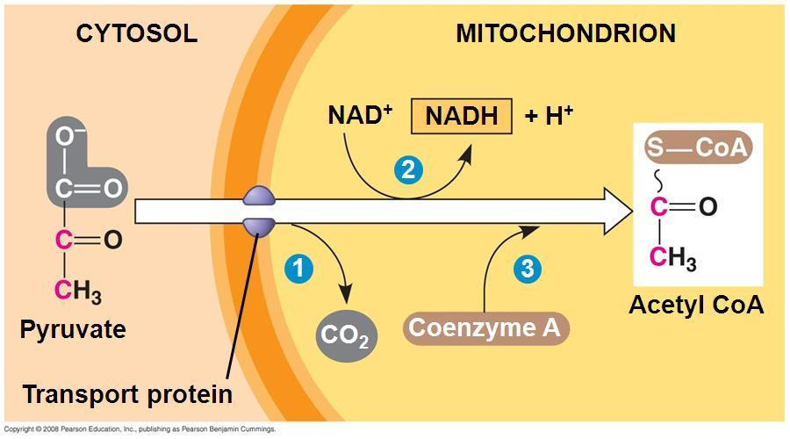
Metabolic Fates of Pyruvate in Brain
Pyruvate dehydrogenase complex

Slide 11
Metabolic Fates of Pyruvate in Brain
(Astrocytes)

Slide 12
Metabolic Fates of Pyruvate in Brain

Slide 13
Metabolic Fates of Pyruvate in Brain
Glucose
Glucose-6-phosphatase
Glycogen in
(Astrocytes)
(Astrocytes)

Slide 14
Glycogen in Brain
Very limited amount of glycogen (3-12 μmol /g tissue) is stored in brain predominantly in astrocytes
Actually its role as energy source during hypoglycemia is restricted to few minutes
Glycogenolysis or glycogen mobilization is the process of glycogen breakdown to glucose units. It occurs in the cytosol of glycogen-containing cells such as brain
Glycogenolysis produces monomers of glucose 1-phosphate which is then converted to G6p by phosphoglucomutase enzyme

Slide 15
Glycogenolysis

Slide 16
Fates of Glucose 6-phosphate
The produced G6p has many possible routes. In brain, G6p molecules join the glycolysis and used as fuel.
Indeed, due to the lack of glucose 6-phospatase enzyme in brain and muscle tissues, G6p can’t be converted back to glucose to be released in the blood as the case in liver cells

Slide 17
Acetyl CoA Fate
Sources of Acetyl CoA: fat metabolism (fatty acids β-oxidation, reversible) and CHO metabolism (pyruvate, irreversible)
Fates of Acetyl CoA:
It can enter the Krebs cycle for energy production
Used for biosynthesis of fatty acids but not CHO
Formation of ketone bodies (Ketogenesis)

Slide 18
Ketogenesis
Ketogenesis is the process of ketone bodies production from acetyl CoA mainly in the mitochondrial matrix of hepatocytes
Ketogenesis occurs when acetyl CoA accumulates beyond its capacity to be oxidized (via Krebs cycle) or used for fatty acids synthesis (lipogenesis)
When acetyl CoA level is high, 2 molecules of acetyl CoA undergo a reversal of thiolase reaction to acetoacetyl CoA which reacts with a third molecule of acetyl CoA to produce β-hydroxy-β-methylglutaryl-CoA (HMG-CoA)
HMG-CoA is converted to acetoacetate which undergoes either NADH-dependent reduction to β-hydroxybutyrate (reversible reaction) or spontaneous decarboxylation to acetone (in very small amounts)

Slide 19
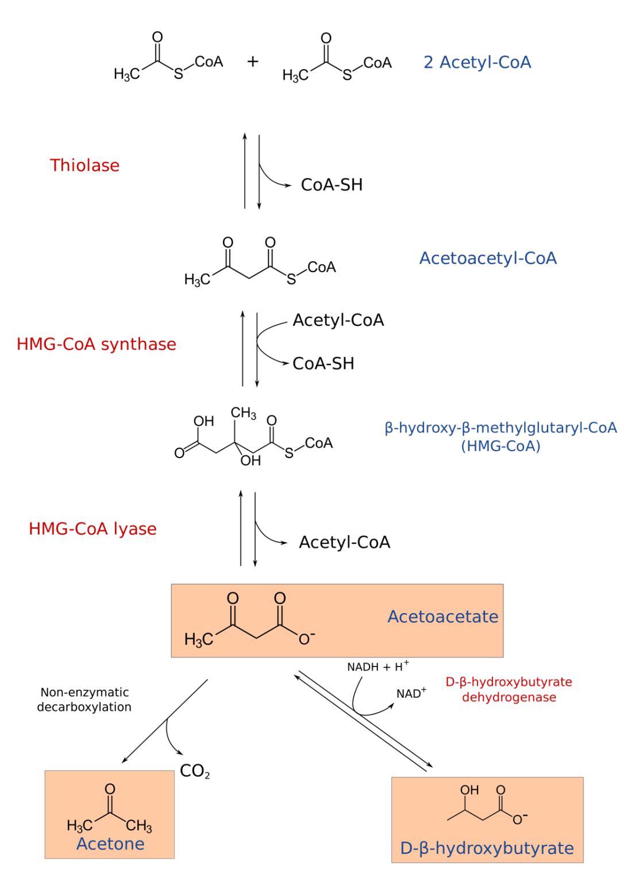
Ketogenesis
Rate limiting step

Slide 20
Ketogenesis
Ketone bodies are produced in the liver from accumulated Acetyl CoA during ketogenic conditions (uncontrolled diabetes and starvation) due to enhanced fat catabolism (β-oxidation of fatty acids)

Slide 21
Ketone Bodies
Ketone bodies (KB) are three water soluble molecules: acetoacetate, β-hydroxybutyrate (β-HB) and acetone
Ketone bodies are important metabolic fuels for many peripheral tissues under normal conditions, particularly skeletal muscles, and during starvation they become the brain's major fuel source
Ketone bodies transported from liver to other tissues where both acetoacetate and β-hydroxybutyrate can be reconverted to acetyl CoA for energy production, a process called ketolysis which occurs in mitochondria of extrahepatic tissues
The reconversion first involves the transfer of all β-HB into acetoacetate followed by the enzymatic transfer of CoA moiety from succinyl-CoA to acetoacetate yielding acetoacetyl CoA and succinate (rate limiting step). Finally, thiolase converts acetoacetyl CoA to two molecules of acetyl CoA which enters Krebs cycle for energy production

Slide 22
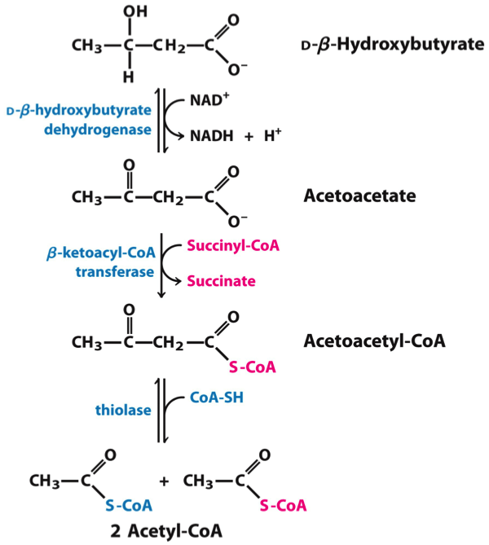
Oxidation of Ketone Bodies (Ketolysis)
3-oxoacid CoA-transferase 1 (OXCT1) also known as succinyl-CoA-3-oxoacid CoA transferase (SCOT) is present sufficiently in extra-hepatic tissues including brain. In contrast, the liver does not contain this enzyme therefore can’t oxidize ketone bodies or use them as a fuel
SCOT
+ ATP
+ ADP

Slide 23
Blood-Brain Barrier (BBB)
BBB is a highly selective membrane which allows only very specific molecules to access the CNS so protecting the brain from circulating toxic substances and invading foreign bodies (e.g. bacterial infection)
Therefore, BBB has a critical role in cerebral homeostasis
The cellular and structural components of BBB:
Non-fenestrated endothelial cells (ECs) which are connected via tight junctions thus prevent paracellular diffusion. Endothelial cells are supported by a continuous basement membrane (BM)
Astrocytes send processes called end-feet which surround capillary walls to additionally support the ECs and maintain the BBB integrity
Pericytes are embedded in the BM. They have a role in BBB development (e.g. formation of tight junction)

Slide 24
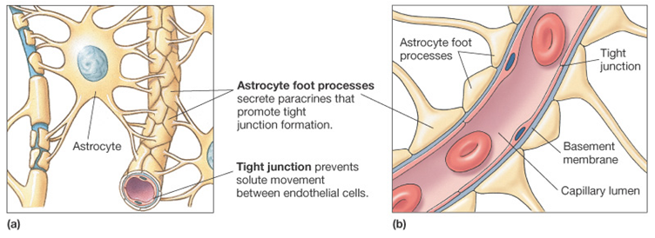
Blood-Brain Barrier BBB
v
Blood
Astrocyte end-foot
Brain

Slide 25
Glucose Transporters
Energy substrates cross BBB and reach brain cells via specific transport mechanisms. For example, glucose is hydrophilic molecule which enters the cells through glucose transporters (GLUT), a family of glycosylated transmembrane proteins
In brain, seven transporters are expressed in a cell-specific manner:
55-KDa isoform of GLUT1 essentially localized on endothelial cells of BBB
45-KDa isoform of GLUT1 is localized predominantly in astrocytes (star-shaped non-neuronal cells)
GLUT3 is specific for neurons with GLUT8 and 4 predominate on cell body and proximal dendrites respectively
GLUT5 is localized in microglial cells (resident macrophages of the brain)

Slide 26
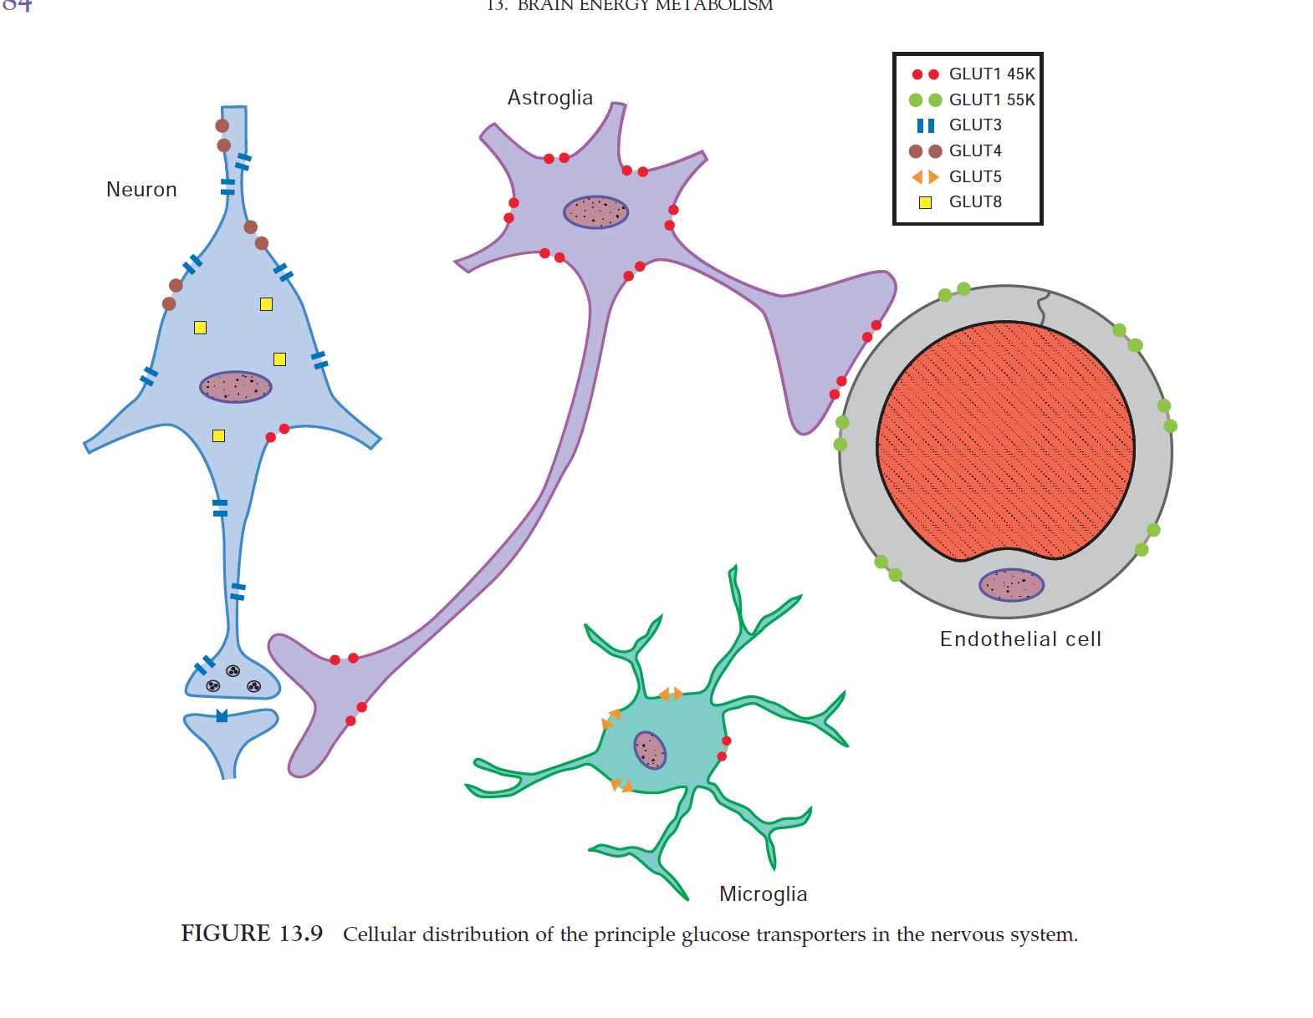
Glucose Transporters

