Slide 1
RECOMMENDED INVESTIGATIONS FOR RECURRENT FIRST TRIMESTER AND ONE OR MORE SECOND TRIMESTER MISCARRIAGES

Slide 2
Thrombophilia
 | Acquired (APS)
Recommendation | • Women with recurrent miscarriage should be offered testing for acquired thrombophilia, particularly for lupus anticoagulant and anticardiolipin antibodies, prior to pregnancy.
To diagnose APS | • Clinical — The presence of either vascular thrombosis or pregnancy morbidity • The woman should have two positive tests at least 12 weeks apart (and at least 6 weeks post miscarriage) for either lupus anticoagulant or aCL antibodies of IgG and/or IgM class present in medium or high titre. • Anti-beta-2-glycoprotein-I antibody IgG and/ or IgM class in high titre • Anticardiolipin antibodies are detected using enzyme-linked immunosorbent assay (ELISA)

Slide 3
Thrombophilia
 | Inherited
Recommendation | • Women with second trimester miscarriage may be offered testing for Factor V Leiden, prothrombin gene mutation and protein S deficiency.
 | Testing may be offered with second trimester miscarriage for Factor V Leiden, prothrombin gene mutation and protein S deficiency. and, in the case of the latter, at least 6 weeks postpartum and in the absence of hormonal medication. Studies have not found a persistent association between recurrent and/or second trimester miscarriage and protein C deficiency, antithrombin deficiency therefore do not recommend testing.

Slide 4
Anatomical factors
Recommendation | • Women with recurrent miscarriage should be offered assessment for congenital uterine anomalies, ideally with 3D ultrasound.
 | 3D ultrasound is recommended as the first line for the diagnosis of congenital anomalies, reserving MRI and endoscopic evaluation for complex anomalies when a diagnosis cannot be reached with 3D ultrasound The inclusion of saline infusion with the 3D ultrasound assessment may be particularly useful for the diagnosis of intrauterine adhesions if these are suspected based on the clinical history (e.g. prior surgical management of miscarriage with subsequent oligomenorrhoe). Studies have not found a persistent association between recurrent and/or second trimester miscarriage and protein C deficiency, antithrombin deficiency therefore do not recommend testing.

Slide 5
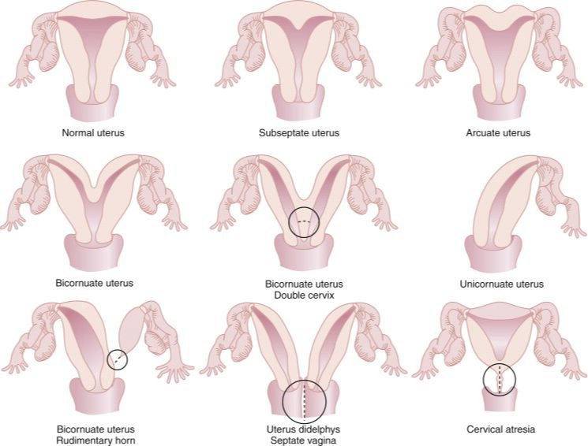

Slide 6
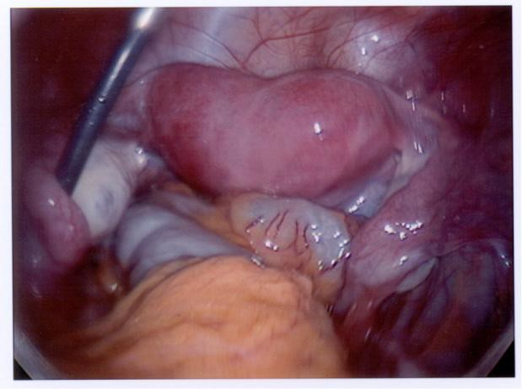
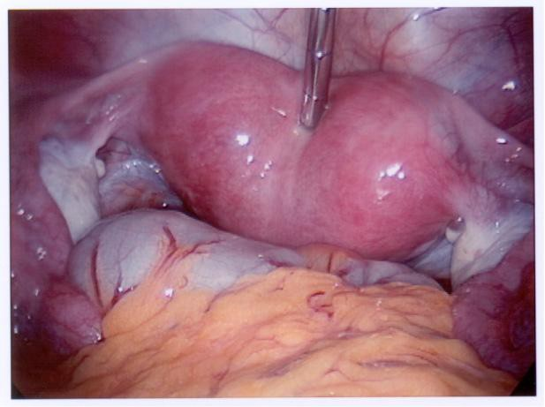
Most common uterine anomaly, and carries the poorest outcomes

Slide 7
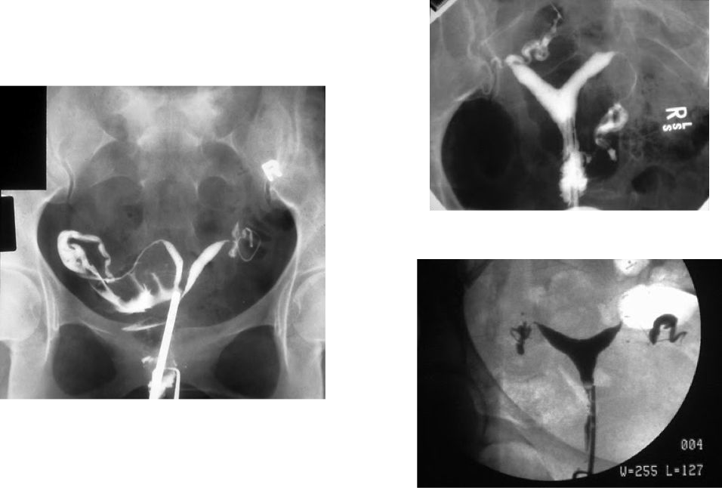
Bicornuate uterus
Hysterosalpingography

Slide 8
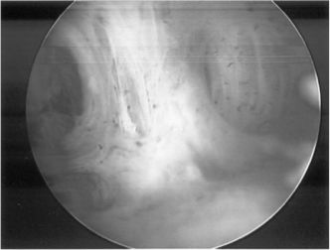
Intrauterine adhesions

Slide 9
Endocrine factors
Recommendation | • Women with recurrent miscarriage should be offered thyroid function tests and assessment for thyroid peroxidase (TPO) antibodies.
 | Studies have reported a significant association between TPO antibodies, thyroid dysfunction and recurrent miscarriage. Other endocrine assessments are not routinely indicated unless there is a clinical suspicion of pathology e.g. diabetes and hyperprolactinaemia.

Slide 10
Infective factors
Recommendation | Women with recurrent miscarriage should not be routinely offered infection screening Screening at 16 weeks GA if there is vaginal discharge
 | Systematic screening and subsequent treatment for bacterial vaginosis in women with low-risk pregnancies showed no evidence of risk reduction of late miscarriage or spontaneous very preterm birth. Studies have suggested a higher subsequent miscarriage rate in women with recurrent miscarriage and untreated chronic endometritis versus no endometritis or treated endometritis.

Slide 11
Male factors
Recommendation | • Although there appears to be an association between sperm DNA fragmentation and miscarriage, couples with recurrent miscarriage should not be routinely offered sperm DNA testing.
Immune factors
Recommendation | • Women with recurrent miscarriage should not be routinely offered immunological screening (such as human leukocyte antigens, cytokine and NK cell tests).

Slide 12
Genetic
Recommendation | Cytogenetic analysis should be offered on pregnancy tissue of the third and subsequent miscarriage(s) and in any second trimester miscarriage. In recurrent miscarriage, parental peripheral blood karyotyping should be performed for couples in whom testing of pregnancy tissue reports an unbalanced structural chromosomal abnormality. Analysis is indicated but testing of the pregnancy tissue is unsuccessful or there is no pregnancy tissue available for testing, parental karyotyping should be offered.

Slide 13
When used in combination with routine investigations into recurrent miscarriage, cytogenetic analysis of the pregnancy tissue have shown to provide a diagnosis in over 90% of couples.
This lead to a number of advantages, such as:
Identifying those with balanced chromosome rearrangements, who may benefit from genetic counselling and potential targeted therapies
Providing an answer. Not having a diagnosis has been associated with feelings of uncertainty, frustration
Reducing the chance of women and people pursuing non- evidenced based therapies
Providing further insight into the causes of miscarriage through assessing pregnancy tissue with advanced molecular studies

Slide 14
Techniques for analysis of pregnancy tissue
Conventional karyotyping via tissue culture,
fluorescence in situ hybridisation (FISH),
array comparative genomic hybridisation (array CGH),
single nucleotide polymorphism (SNP) array
next generation sequencing (NGS)

Slide 15
References
Regan, L., Rai, R., Saravelos, S. H., & Li, T. C. (2023). Recurrent MiscarriageGreen‐Top Guideline No. 17. Bjog: An International Journal of Obstetrics and Gynaecology. https://doi.org/10.1111/1471-0528.17515
Preterm labour and birth NICE guideline. (2015). Available at: https://www.nice.org.uk/guidance/ng25/resources/preterm-labour-and-birth-pdf-1837333576645?fbclid=IwAR1ISGQQ6n5mAfbJ0j1PrxqzGN00WmjuQ6m-uMVvNJSQ37ZvVOXkHoOD7VY [Accessed 28 Sep. 2023].
‌

Slide 16
Treatment options for recurrent first and second trimester miscarriage

Slide 17
Thrombophilia
 | Aquired
Recommendation | Aspirin and heparin (unfractionated heparin [UFH] or LMWH should be offered to women with APS (e.g. 75 mg aspirin orally and 40 mg subcutaneously enoxaparin starting from a positive pregnancy test until at least 34 weeks of GA.
 | This treatment combination significantly reduced the miscarriage rate by 54%
 | Studies reported no difference in efficacy and safety between UFH or LMWH when combined with aspirin in the treatment
 | • Pregnancies associated with APS treated with aspirin and heparin remain at high risk of complications during all three trimesters •Aspirin and/or LMWH does not increase the live birth rate in women with unexplained recurrent miscarriage, may be associated with adverse effects and should therefore not be used

Slide 18
Thrombophilia
 | Inherited
Recommendation | There is lack of evidence to support routine treatment for women with Factor V Leiden, protein S deficiency and prothrombin gene mutation. A decision to treat women with recurrent miscarriage or second trimester loss can be individualised and should involve a discussion with the woman, considering the risk factors, such as maternal risk of thrombosis
 | • Thromboprophylaxis could be considered for women with Factor V Leiden, protein S deficiency and prothrombin mutation, when there are risk factors for thrombosis and/or a history of second trimester miscarriage, particularly with evidence of placental thrombotic lesions

Slide 19
Genetic factors
 | Inherited
Recommendation | • Preimplantation genetic testing for structural rearrangements (PGT-SR), formerly known as pre-implantation genetic diagnosis (PGD), or gamete donation. • Assisted reproduction (IVF/ICSI) combined with PGT-SR with the aims of selecting embryos not affected by parental chromosomal rearrangement and proceeding with embryo transfer.
 | • Preimplantation genetic testing for aneuploidy (PGT- A), formerly known as preimplantation genetic screening (PGS), in conjunction with IVF/ICSI is also a treatment option for women with recurrent unexplained miscarriage. • Identification and transfer of what are thought to be genetically normal embryos will lead to an increased likelihood of live birth

Slide 20
Anatomical factors
 | Congenital uterine anomalies
Recommendation | • Hysteroscopic septum resection should be considered for women with recurrent first or second trimester miscarriage
 | • latest publication in 2023, including 27 studies and 1506 patients, showed that hysteroscopic septum resection was associated with an increased live birth reduced miscarriage rate and reduced preterm birth rate.

Slide 21
Anatomical factors
 | Acquired uterine anomalies
Recommendation | Counselling and the choice of expectant versus surgical options ought to be individualised as studies suggests a potential benefit from the resection of submucosal myomas, However, hysteroscopic myomectomy prior to assisted reproduction did not find a significant reduction in miscarriage rates.

Slide 22
Endocrine factors
Recommendation | • Thyroxine supplementation is not routinely recommended for euthyroid women with TPO who have a history of miscarriage • Thyroxine supplementation may be considered for women with moderate SCH (TSH more than 4 mIU/l) • but not routinely recommended for women with mild SCH (TSH more than 2.5 mIU/l)
Thyroid peroxidase (TPO) antibodies that increase the risk of developing subclinical hypothyroidism (SCH) | • In cases of TPO euthyroid antibody status, TSH measurement at 7–9 weeks of gestation and in each sub- sequent trimester because of the risk of progression to hypothyroidism. • Clinical hypothyroidism, thyrotoxicosis, diabetes, hyperprolactinaemia) should be treated in women with recurrent miscarriage as they would be treated preconceptionally for any woman

Slide 23
Endocrine factors
Recommendation | • Progestogen supplementation should be considered in women with recurrent miscarriage who present with bleeding in early pregnancy (400 mg micronised vaginal progesterone twice daily at the time of bleeding until 16 weeks of gestation). • supplementation should be used with caution in asymptomatic women with unexplained recurrent miscarriage
 | • Studies showed that progesterone versus placebo or no treatment showed a lower risk of miscarriage and higher live birth rate but No statistically significant differences in preterm birth, neonatal mortality and fetal genital anomalies.

Slide 24
Immune factors
Recommendation | • Immunotherapy (e.g. paternal cell immunisation, third-party donor leucocytes, trophoblast membranes and intravenous immunoglobulin [IVIg]) is not recommended for women with recurrent miscarriage. • Immunotherapy is expensive and has potentially serious adverse effects including transfusion reaction, anaphylactic shock and hepatitis.
 | • There are no published data on the use of anti-tumour necrosis factor (TNF) agents to improve pregnancy outcome in women with recurrent miscarriage. • Further, anti-TNF agents could potentially cause serious morbidity including lymphoma, granulomatous disease such as tuberculosis, demyelinating disease, congestive heart failure.

Slide 25
Male factors
Recommendation | There is no evidence to recommend treatments for male factors. Interventions could include lifestyle modifications (i.e. smoking cessation, weight loss/exercise, reduction in pollutant exposure), treatment of infections, control of diabetes, treatment of varicocele, antioxidant therapy, sperm selection.

Slide 26
Unexplained recurrent miscarriage
Endometrial scratch | • Endometrial scratch is not recommended in women with recurrent miscarriage.
Psychological support | • Women with unexplained recurrent miscarriage should be offered supportive care, ideally in the setting of a dedicated recurrent miscarriage clinic. • These women and their partners can be reassured that the prognosis for a successful future pregnancy with supportive care alone is in the region of 75% However, the prognosis worsens with increasing maternal age and the number of previous miscar- riages .

Slide 28
Management of subsequent miscarriages
Recommendation | • Provisions should be made for women and people to receive appropriate supportive care in terms of communication with healthcare professionals, ultrasound examinations and access to services in case of subsequent miscarriage(s). • Particularly if there have been plans in place regarding the management of possible future miscarriage, such as collection of pregnancy tissue for cytogenetic analyses. This can be organised for spontaneously miscarried pregnancies or those undergoing manual vacuum aspiration or surgical management of miscarriage.

Slide 29
Management of subsequent miscarriages
study in women with recurrent miscarriage reported that women preferred the following supportive care options for their next pregnancy | Plan with one doctor who shows understanding, takes them seriously, has knowledge of their obstetric history, listens to them, gives information about recurrent miscar- riage, shows empathy, informs on progress and enquires about emotional needs. Ultrasound examination during symptoms, directly after a positive pregnancy test and every 2 weeks. If a miscarriage occurred, most women would prefer to talk to a medical or psychological professional afterwards. Majority of women expressed a low preference for ad- mission to a hospital ward at the same gestational age as previous miscarriages

