Slide 2
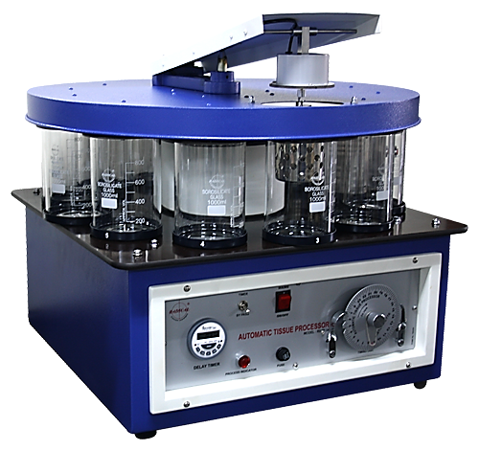
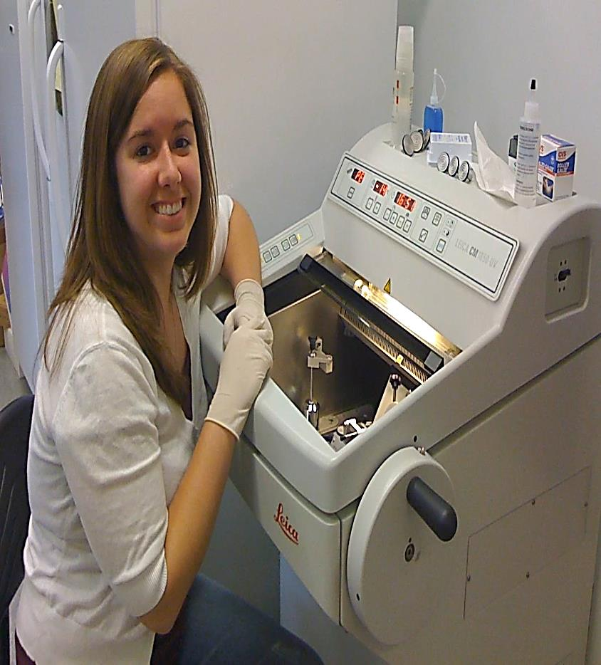
Microtechniques( cell Bio-2)

Slide 3
Micro techniques
For
Light microscopy
I
Paraffin
II Freezing

Slide 4
I: Paraffin technique
Technique used to prepare the tissues for light microscopy
it includes the following steps:
1. Fixation : in appropriate solution (formol saline)
2. Dehydration and clearing : in alcohol then xylol
3. impregnation & Embedding : in paraffin wax
4. Sectioning : by microtome
5. Mounting : on glass slides
6. Staining of the sections

Slide 5
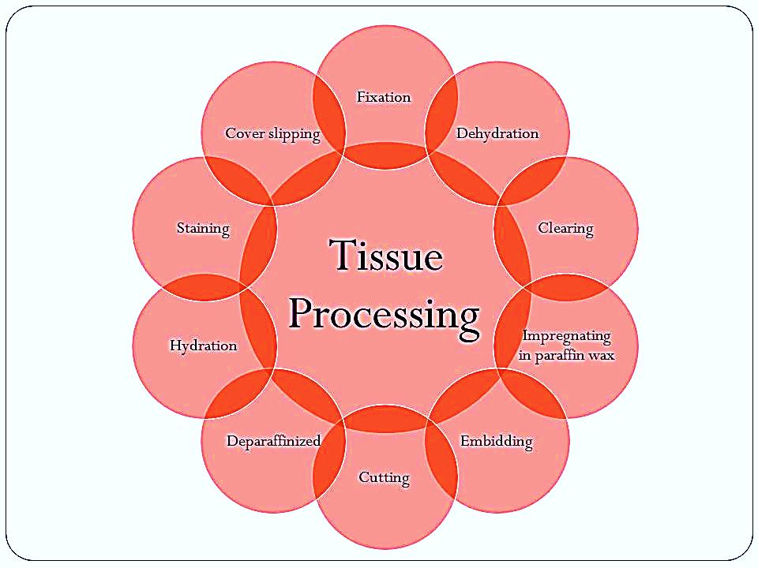

Slide 6
Fixation
To maintain the tissue in as life-like state as possible,
Sample for analysis is directly placed into a fixative solution upon removal from the body
Fixation is done as soon as possible to prevent autolysis and to preserve the morphology.
For LM:
Formol saline or
70% alcohol
For EM: a mixture of
Glutaraldehyde
Osmium tetroxide

Slide 7
Advantage of fixation :
Hardens the tissue by coagulating its protein → Facilitate the process of cutting & staining & examination
Prevent putrifaction & stop autolytic changes by killing bacteria
Preserves the molecular & morphological structure of the tissue

Slide 8
Dehydration & clearing
Dehydration : Is done by treating the specimen with ascending concentration of alcohol ( 50% → 70%→ 100%) ….. Gradual removal of water from the specimen
Clearing : with this process the tissue become translucent the tissue is treated with xylol or benzol …to remove the alcohol

Slide 9
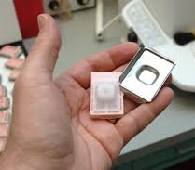
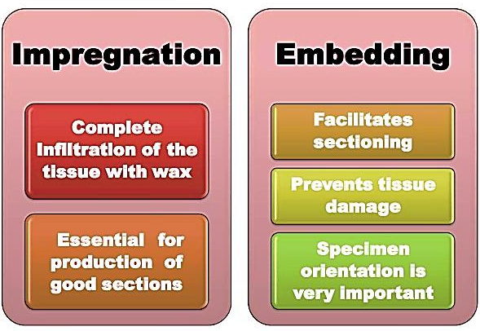
Impregnation & Embedding
Impregnation :
Tissues are placed in molten soft paraffin wax
The wax infiltrates the tissue & occupies all
the spaces that were originally occupied with water
Embedding:
Tissue are placed in molten hard paraffin wax
The tissue is placed in the
center of the paraffin,
which hardens as it cools
→ paraffin block

Slide 10
Automatic tissue processor
steps required to take animal or human tissue from fixation to the state where it is completely infiltrated with soft paraffin wax then to be embedded for section cutting on the microtome.

Slide 11
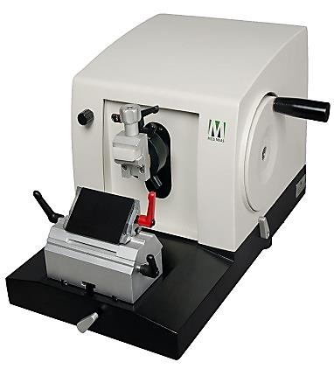
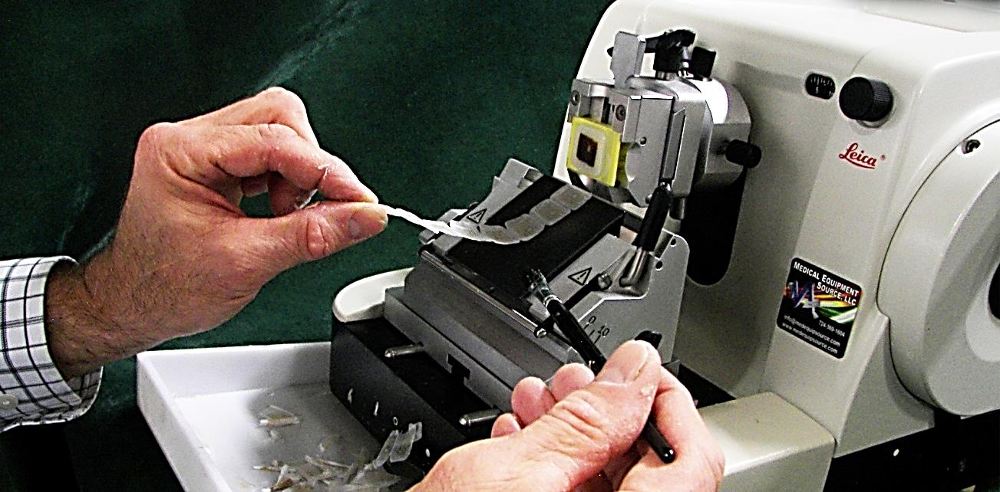
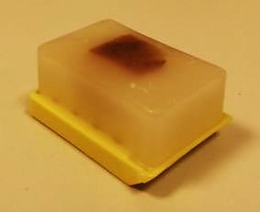
Sectioning by Microtome
A microtome is a mechanical device used to cut extremely thin slices of a fixed tissue block
known as sections.
It holds the block of hard paraffin with the tissue in its center against a sharp metal knife that used to cut the block into thin sections (3-10 microns) as it moves up and down.

Slide 12
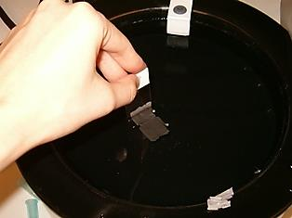
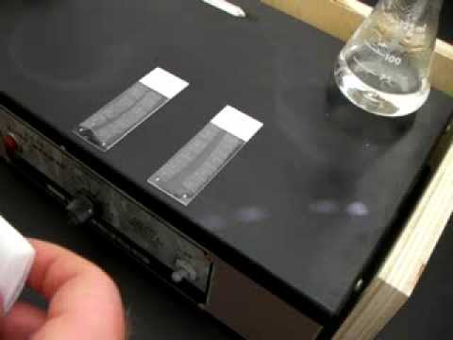
mounting
Tissue sections are put on glass slides smeared with egg albumin , warmed on a hot plate to dry the. Sections are now ready to be stained

Slide 13
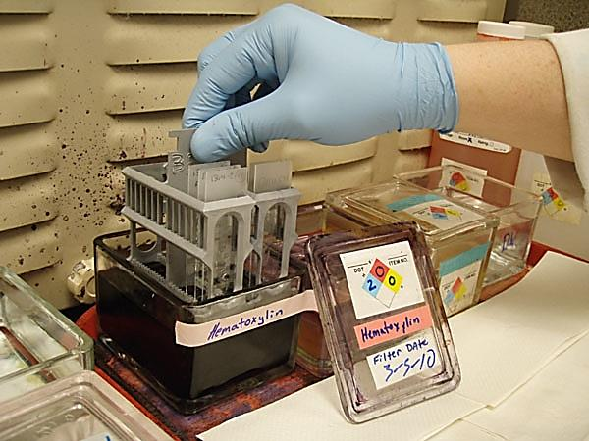
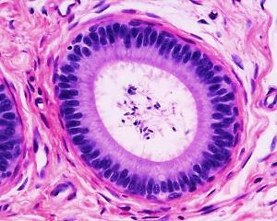
Staining
The sectioned tissue to be studied using the light microscope must be stained since most tissues are colorless
Dyes (stains) which are basic or acidic are used

Slide 14
Staining
Routine stains
H&E
Special stains
e.g. Ag & orcein,
trichrome….etc

Slide 15
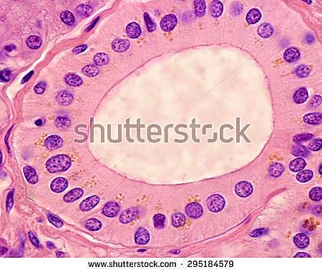
Common histological stains
Hematoxylin (H) : blue basic dye. Stains acidic components of the cell with a blue color e.g. nucleus,
Basophilic structure=blue
Eosin (E): red acidic dye. Stains basic components of the cell with a red color e.g. cytoplasm (proteins)
Acidophilic structure=red

Slide 16
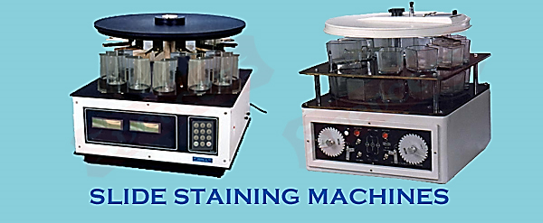

Slide 17
II. Freezing technique
Fresh frozen tissues are cut using freezing microtome (cryostat), then rapidly stained.
Advantages:
Rapid technique for diagnosis of tumors.
No fixation , no dehydration& no chemicals are used, so useful for histochemical (enzyme staining) studies.
Disadvantages:
non serial & Fragmented sections .
Cannot be preserved for a long time.

Slide 18
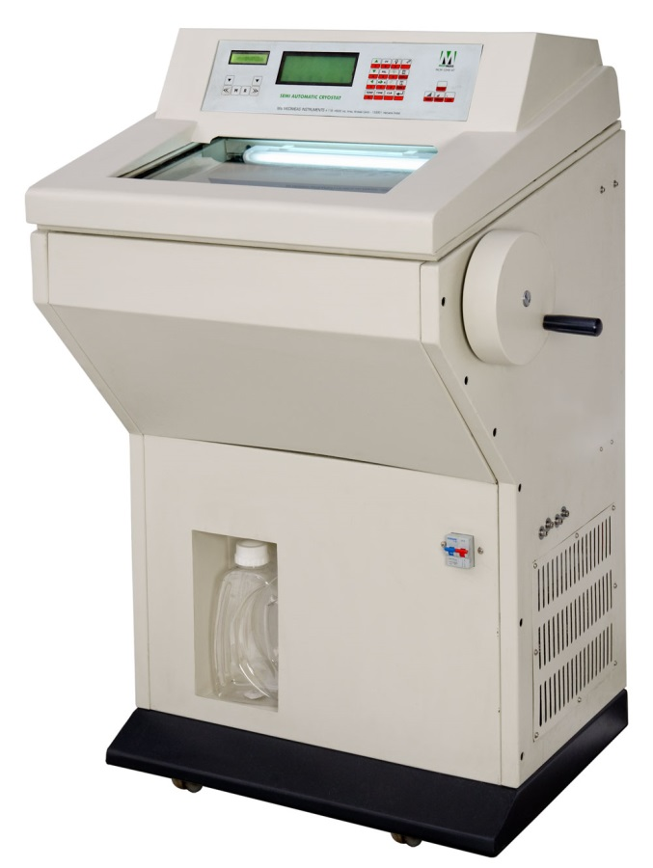
Histochemical stain:
Stain used selectively to demonstrate enzyme or chemical component of the cells ( e.g. alkaline phosphatase enzyme)
(Relate structure to function)
Immuno-histochemical stain:
use Labeled antibodies to localize specific cell & tissue antigens .The combination of Ag & Ab gives a colored reaction ( labeling use : fluorescein , rhodamine)
This method use to:
localize hormonal receptors on different cells
Tissue markers to detect cancer cells
cryostat

Slide 19
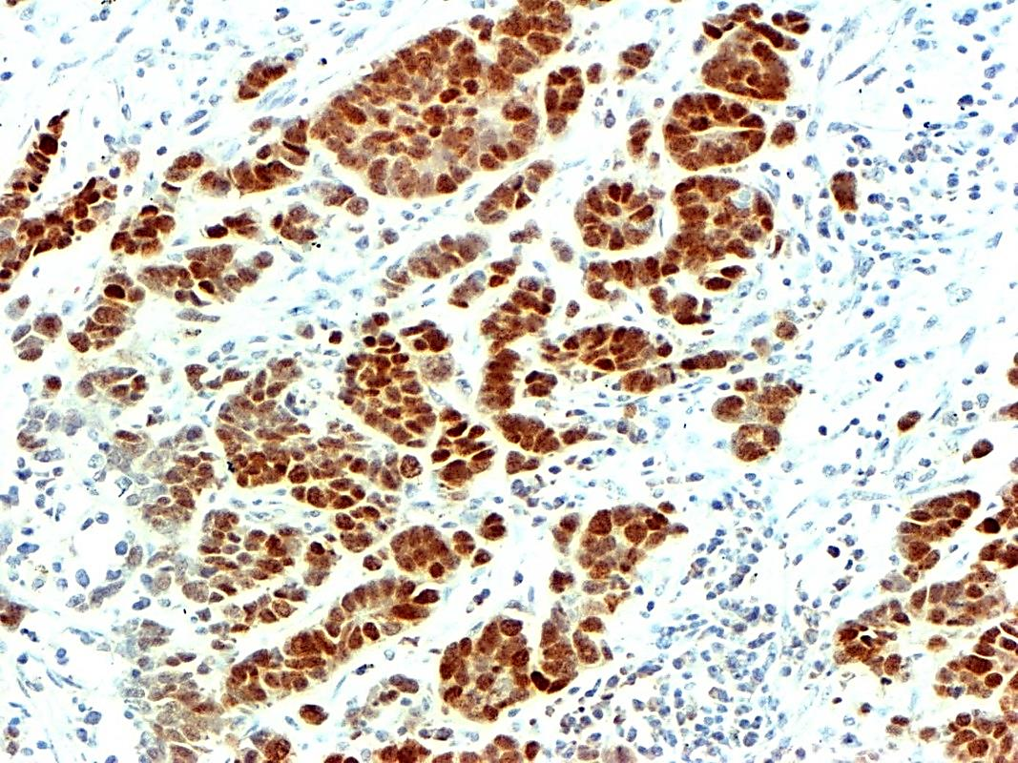
Histochemistry
Alkaline phosphatase enzyme
immunohistochemistry

Slide 20
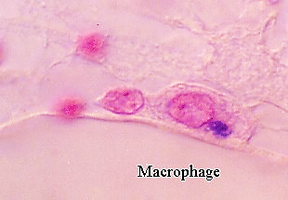
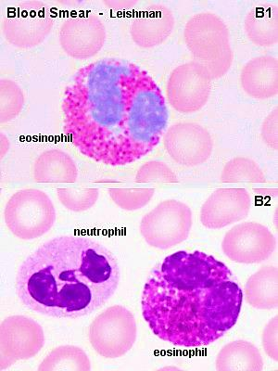
Vital stain:
staining the living cells inside the living animal. Done by injecting the dye into living animal prior to examine the tissue . E.g. staining phagocytic cells with trypan blue & Indian ink
Neutral stain:
mixture of acidic & basis stains to stain
nuclei & cytoplasm
e.g. Leishman stain → stains blood films
→ demonstrate blood cells

Slide 21
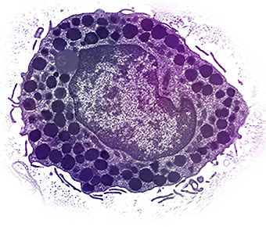
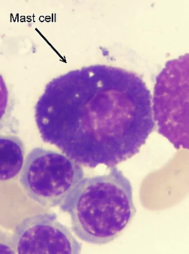
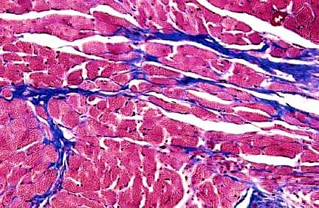
Metachromatic stain:
Stain which gives the tissue new color different from that of the stain e.g. toluidine blue when stains mast cells gives violet color (different from the blue color of the stain). Phenomenon called metachromasia.
Trichrome stains:
3 stains used in combination to give 3 colors to different tissue Components e.g. collagen fibers
Mast cell

Slide 22
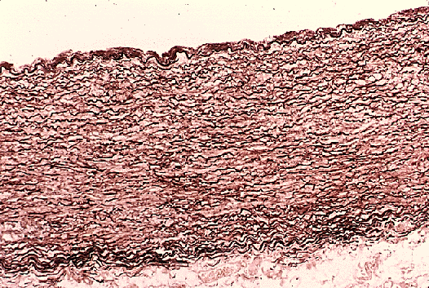
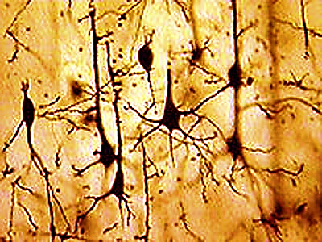
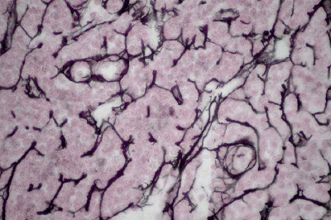
Orcein stain : stains elastic fibers brown ( wall of aorta)
Silver (Ag) stain: nerve cell brown & reticular fibers black

Slide 23
Molecular analysis
It means biochemical analysis of certain components of the cell. It is usually quantitative in nature.
Examples are:
Protein-electrophoresis
DNA – electrophoresis
Fluorescent In situ hybridization ( FISH technique)
Detection of certain ions in the cell e.g. Ca, Fe….etc.

Slide 24
Protein electrophoresis: Proteins carry a positive or a negative electrical charge, and they move in fluid when placed in an electrical field. Proteins will be separated according to their charge & molecular weight
DNA electrophoresis: is technique used to identify, quantify, and purify nucleic acid fragments ( -ve charged).
Samples are loaded into wells of an agarose or acrylamide gel and subjected to an electric field, causing the negatively charged nucleic acids to move toward the positive electrode.

Slide 25
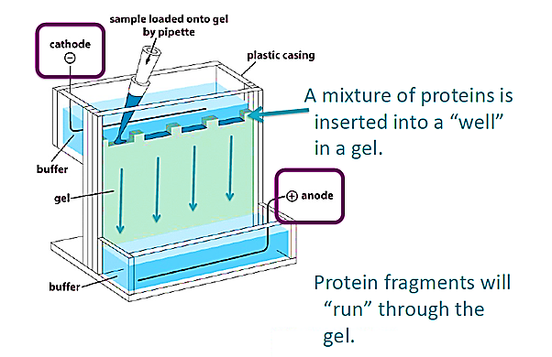
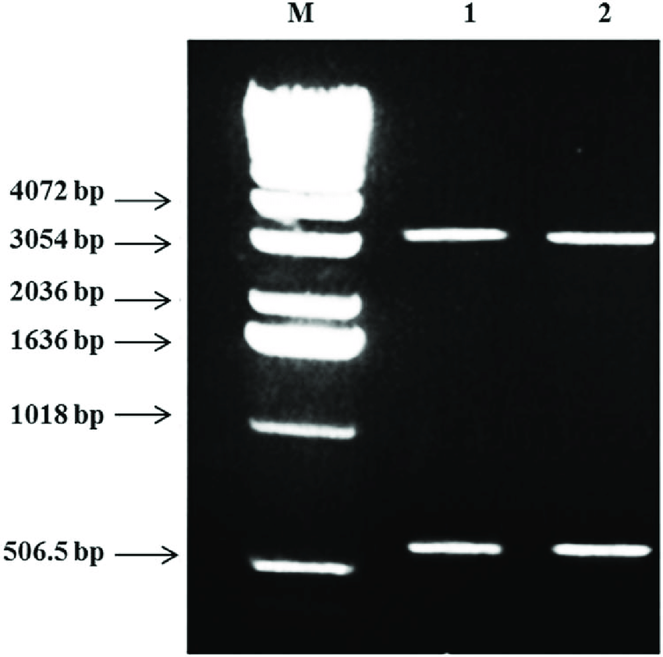
DNA fragments of known lengths
Fragment size usually referred
to as base pair (bp)

Slide 26
Fluorescent In situ hybridization ( FISH technique):
Molecular cytogenetic technique, use to localize the site of the genes on chromosomes using a fluorescent probe
fluorescent probe:
fragment of DNA or RNA of variable length which can be radioactively labeled (probe)
It can be used in DNA or RNA
samples to detect the presence
or absence of nucleotide
sequence that are complementary
to the sequence on the probe

Slide 27
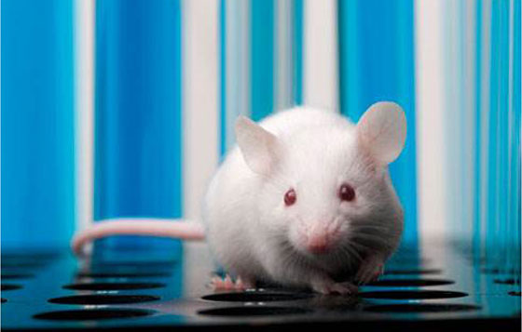
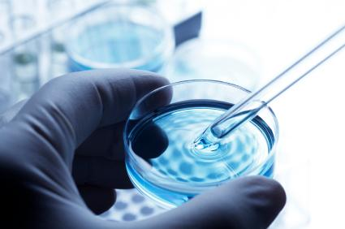
Methods of tissue study
1-In vivo studies: within the living body . Study of tissues after doing any experiment inside the living body.
2-In vitro studies: outside the body Study of tissues outside their normal biological
context

Slide 28
Cell and Tissue Culture
In vitro cultivation of tissues & cells at defined temperature(37C) using an incubator & supplemented with a medium containing cell nutrients & growth factors(like animal serum) is collectively known as tissue culture.
Different types of cells can grow in cultures as:
white blood cells, fibroblasts, skeletal and cardiac
muscle, epithelial tissue (liver, breast, skin, kidney)
and many different types of tumor cells.

Slide 29
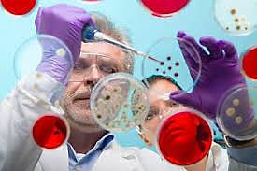
Medical uses of tissue culture:
used in studying chromosomal patterns of individuals …. Karyotyping, gene therapy
Used in researches of cancer
Used in cultivation of bacteria, viruses, in order to prepare different vaccination
Study the effects of new drugs

Slide 30
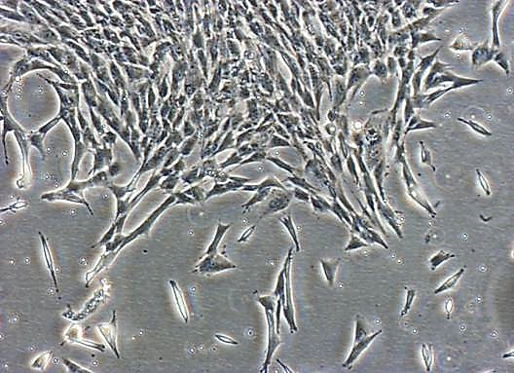
Cell culture
Cells can be isolated from the body for in vitro culture in several ways:
1- white blood cells can be easily purified from blood and grown in culture.
2- Cells of tissues can be released
from tissues by enzymatic digestion
Using enzymes such as collagenase and trypsin which break down the extracellular matrix.

Slide 31
Primary cultures:
Refer to the cells that are cultured directly from a subject (parent cells).
Secondary cultures:
Once the parent cells reach confluence they have to be sub-cultured (i.e. passaged) by transferring them to a new vessel with fresh growth medium to provide more room for continued growth
Confluence:
stage in which the cells (1ry or 2ry) become adherent to & covering most of the culture surface forming monolayer( e.g. 25%, 50%, 100%)

Slide 32
cell line:
a cell culture developed from a single cell and therefore consisting of cells with a uniform genetic make-up is called cell line
Cell lines have a limited life span, and as they are passaged
immortalized cell line
Has acquired the ability to proliferate indefinitely.
It is obtained from subcultures of the primary culture

Slide 33
Cell fractionation
It means isolation of the cell components (nucleus & organelles) while preserving its individual function to study the features of each.
This is done by the use of centrifugation at different speeds and periods of time.
Nuclei are the first to be separated followed by different organelles

Slide 34
The sediment at the bottom of the tube is called pellet, the less dense component at the top is called supernatant

Slide 35
Thank you

