Slide 1
Fungal & Amoebic Meningitis NS1 Module 2021-2022
Dr. Mohammad Odaibat
Mutah University
Faculty of Medicine

Slide 2
Objectives
An overview of the protozoa classification.
The protozoa associated with the CNS infections.
The fungal infections of the CNS infections.
Their mode of transmission.
Treatment .
Prevention.

Slide 3
(The phylum Sarcomastigophora (Protozoa
The phylum Sarcomastigophora belongs to the Protista kingdom and it includes many unicellular autotrophic or heterotrophic organisms. It is characterized by flagellae, pseudopodia, or both.
The phylum classification
The amoeba groups
The Flagellates group
Entamoeba histolytica
Entamoeba dispar
Naegleria fowleri
Acanthamoeba spp.
Balamuthia spp.
Trichomonas vaginalis
Giardia duodenalis
Leishmania spp.
Trypanosoma brucei gambiense and rhodesiense
Trypanosoma cruzi

Slide 4
The amoeba groups
Amoeba are single celled protozoa.
Most protozoa are free-living and have little or no impact on human health.
They are found throughout the environment, particularly in soil and water.
However, there are three free-living amoeba that have been associated with serious human infections.
They are: Acanthamoeba spp., Balamuthia mandrillaris, and Naegleria fowleri

Slide 5
Pathogenic free living amoeba are
Naegleria fowleri
Acanthamoeba species
Causative parasite of
Causative parasite of
Granulomatous amoebic encephalitis (GAM)
keratitis
Chronic granulomatous infection of the skin.
Primary amoebic meningo-encephalitis (PAM).

Slide 6
Distribution
Acanthamoeba species are found worldwide:
Most commonly in soil, dust, fresh water, marsh, and sea water.
In swimming pools, hot tubs and drinking water systems (e.g., slime layers in pipes and taps)
In heating, ventilating and air conditioning (HVAC) systems and humidifiers.
Balamuthia mandrillaris:
Found in soil.
Naegleria fowleri:
Is a heat-loving (thermophilic).
Commonly found around the world in warm fresh water (e.g., lakes, rivers, hot springs).
In soil.

Slide 7
Transmission
N. fowleri:
Occurs when water containing amebae enters the nose.
Trophozoites penetrate the nasal tissue and migrating to the brain via the olfactory nerves causing PAM.
Acanthamoeba spp:
The trophozoites are the infective forms.
Through eye, the nasal passages, cuts or skin wounds or by being inhaled into the lungs, it can invade the CNS by hematogenous dissemination in individuals with compromised immune systems. .
When enter the eye they can cause severe keratitis in healthy individuals, particularly contact lens users.
Balamuthia mandrillaris:
When dust containing the trophozoites enter the respiratory system or through the skin, it can invade the CNS by hematogenous dissemination causing GAE or disseminated disease, or skin lesions in individuals with compromised immune systems.

Slide 8
N. fowleri
Epidemiology
This parasite largely affects children and young adults through full-body contact with warm fresh water, and is almost always fatal.
The organism exists in trophozoite, flagellate, and cyst forms.
It enters the nasal passages and traverses the nasal mucosa and the cribriform plate as an ameboid form to the olfactory nerves of the CNS.
Amoeba are the only form found in tissue.
Notes:
This parasite largely affects children and young adults through full-body contact with warm fresh water, and is almost always fatal.
The organism exists in trophozoite, flagellate, and cyst forms. The trophozoite is an active feeding form that feeds on bacteria and organic matter.
Infection results from full-body contact with water containing the bi-flagellate para­site form. The parasite enters the body through the nasal passages and traverses the nasal mucosa and the cribriform plate as an ameboid form to the olfactory nerves of the cen­tral nervous system. Here, the amebas, which are the only form found in tissue, produce a severe purulent, hemorrhagic inflammatory reaction, which extends perivascularly from the olfactory bulbs to other regions of the brain. The infection is characterized by the rapid onset of severe bifrontal headache, seizures, and at times abnormalities in taste or smell. The disease runs an inexorably downhill course to coma, ending fatally within a few days.
Because there are no distinctive clinical features to differentiate this infection from acute pyogenic bacterial meningoencephalitis or viral meningoencephalitis, it is imperative for the physician to obtain information regarding the patient’s contact with water within the past few days. A careful examination of the cerebrospinal fluid may often provide a pre­sumptive diagnosis of Naegleria infection. The fluid is usually bloody and demonstrates an intense neutrophilic response. The protein level is elevated and the glucose level decreased. No bacteria can be demonstrated on stain or culture. Early examination of a wet mount preparation of unspun spinal fluid reveals typical trophozoites. Staining with specific fluo­rescent antibody confirms the identification

Slide 9
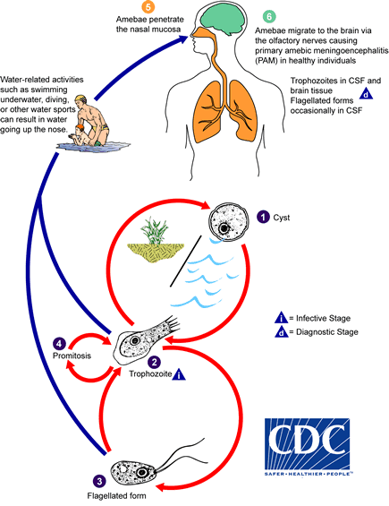
Transmission-
N. fowleri

Slide 10
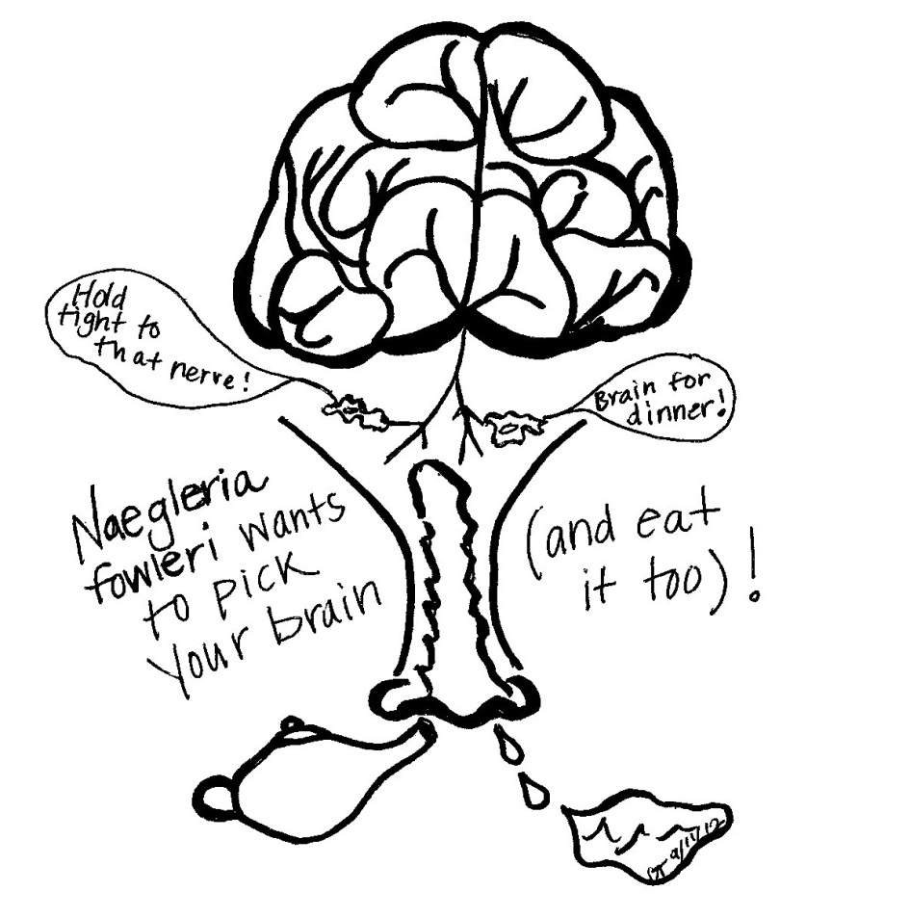
Incubation Period and Illness Duration
Naegleria fowleri:
Incubation period: symptoms start 1-14 days (median 5 days) after exposure.
Death: occurs 1-18 days (median 5 days) after symptoms begin

Slide 11
Clinical Illness-(PAM)
Primary Amebic-Meningoencephalitis (PAM)
Clinical Case Definition:
An infection presenting as meningoencephalitis or encephalitis.
The clinical course:
Stage 1 Symptoms: begin within 1 to 14 days post amebic exposure and include severe headache, fever, nausea and vomiting.
Stage 2 Symptoms: include stiff neck, confusion, lack of attention to people and surroundings, loss of balance, seizures, and hallucinations.
After the start of symptoms, death usually occurs within 1 to 18 days (median 5 days) of onset of stage 2 symptoms. Final cause of death is brain swelling and deterioration of tissue.

Slide 12
Treatment- (PAM)
Medical:
Amphotericin B intrathecally in severe cases +Miconazole (IV injection) + Rifampicin (orally).
Surgical:
Hydrocephalus may necessitate shunting.

Slide 13
Laboratory Diagnosis- (PAM)
Head CT scanning or MRI
Lumber puncture for CSF analysis
Culture of CSF
Fluorescent antibodies test
PCR
sensitive diagnostic test
Trophozoite & cyst
The primary diagnostic tool
Help in detection of the numerous trophozoites in brain tissue
Should precede lumber puncture if signs of increased intracranial pressure were found.
1- CSF is purulent ( no bacteria), ↑ neutrophils, RBCs, protein levels & ↓ glucose level.
2- Trophozoite and flagellate form were found in CSF.

Slide 14
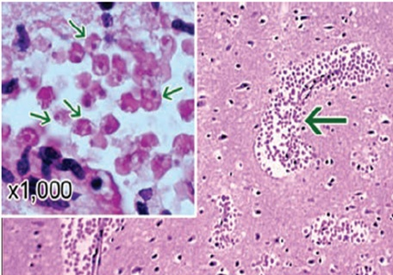
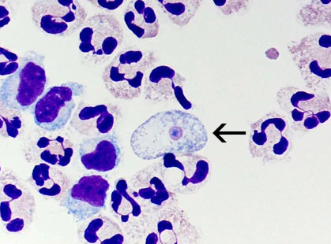
N. fowleri
Diagnosis:
The protein level is elevated and the glucose level decreased.
Staining to confirms the identification.
CSF
No bacteria
Trophozoites in brain tissue
intense neutrophilic response
Notes:
This parasite largely affects children and young adults through full-body contact with warm fresh water, and is almost always fatal.
The organism exists in trophozoite, flagellate, and cyst forms. The trophozoite is an active feeding form that feeds on bacteria and organic matter.
Infection results from full-body contact with water containing the bi-flagellate para­site form. The parasite enters the body through the nasal passages and traverses the nasal mucosa and the cribriform plate as an ameboid form to the olfactory nerves of the cen­tral nervous system. Here, the amebas, which are the only form found in tissue, produce a severe purulent, hemorrhagic inflammatory reaction, which extends perivascularly from the olfactory bulbs to other regions of the brain. The infection is characterized by the rapid onset of severe bifrontal headache, seizures, and at times abnormalities in taste or smell. The disease runs an inexorably downhill course to coma, ending fatally within a few days.
Because there are no distinctive clinical features to differentiate this infection from acute pyogenic bacterial meningoencephalitis or viral meningoencephalitis, it is imperative for the physician to obtain information regarding the patient’s contact with water within the past few days. A careful examination of the cerebrospinal fluid may often provide a pre­sumptive diagnosis of Naegleria infection. The fluid is usually bloody and demonstrates an intense neutrophilic response. The protein level is elevated and the glucose level decreased. No bacteria can be demonstrated on stain or culture. Early examination of a wet mount preparation of unspun spinal fluid reveals typical trophozoites. Staining with specific fluo­rescent antibody confirms the identification

Slide 15
N. fowleri (KEY CONCLUSIONS)
N. fowleri infections are acquired by full body contact with warm (greater than 40°C) water sources.
Infections are caused by flagellated trophozoites contacting the nasal mucosa and migrating to the brain.
Dealth due to meningoencephalitis usually follows in 5 to 6 days.
Presumptive diagnosis is usually bacterial or viral meningoencephalitis.
It is imperative for the physician to obtain information regarding the contact with water within the past few days to differentiate it form bacterial or viral meningoencephalitis

Slide 16
Acanthamoeba & B. mandrillaris
Epidemiology
The caustve agents of GAE.
They are ubiquitous in soil, fresh and salty water, heating, ventilating and air conditioning units, humidifiers, Jacuzzis, dialysis machines, and dust.
Infections usually involve older, immunocompromised persons.
The ameba probably reaches the brain by hematogenous dissemination from an unknown primary site, possibly the respiratory tract, skin, or eye.
History of freshwater swimming is generally absent.
Notes:
Granulomatous amebic encephalitis (GAE) is caused by one of seven species of free-living amoebabelonging to the genus Acanthamoeba. These amoebaare ubiquitous worldwide and have been described from soil, fresh and brackish waters, cooling towers of electric and nuclear power plants, heating, ventilating and air conditioning units, humidifiers, Jacuzzis, hydrotherapy pools, dental irrigation units, dialysis machines, dust, cell cultures, and vari-ous clinical samples. They have also received attention because they may serve as hosts for a wide variety of bacterial pathogens.
The epidemiology of Acanthamoeba encephalitis has not been clearly defined. Infections usually involve older, immunocompromised persons, and a history of freshwater swimming is generally absent. The ameba probably reaches the brain by hematogenous dissemination from an unknown primary site, possibly the respiratory tract, skin, or eye. Metastatic lesions have been reported. Histologically, Acanthamoeba infections produce a diffuse, necrotizing, granulomatous encephalitis (Figure 52–6), with frequent involvement of the mid-brain. Both cysts and trophozoites can be found in the lesions. Cutaneous ulcers and hard nodules containing amoebahave been detected in patients with AIDS.
The clinical course of Acanthamoeba disease is more prolonged than that of Naegleria infection and occasionally ends in spontaneous recovery; the disease in immunocompromised hosts is invariably fatal. The spinal fluid usually demonstrates a mononuclear response.

Slide 17
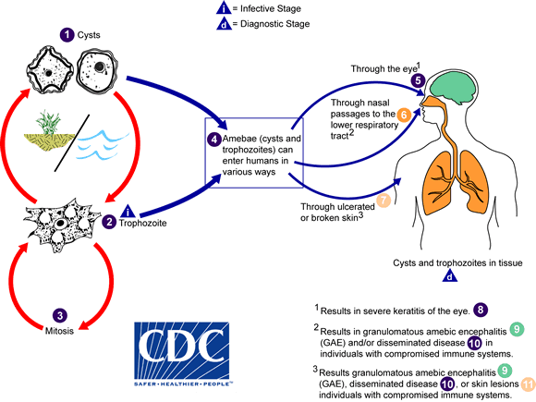
Acanthamoeba spp & Balamuthia mandrillaris

Slide 18
Acanthamoeba & B. mandrillaris
The clinical course
The clinical course of is more prolonged than that of Naegleria and occasionally ends in spontaneous recovery.
The disease in immunocompromised hosts is always fatal.
Histologically, infections produce a diffuse, necrotizing, granulomatous encephalitis.
Both cysts and trophozoites can be found in the lesions.
Notes:
Granulomatous amebic encephalitis (GAE) is caused by one of seven species of free-living amoebabelonging to the genus Acanthamoeba. These amoebaare ubiquitous worldwide and have been described from soil, fresh and brackish waters, cooling towers of electric and nuclear power plants, heating, ventilating and air conditioning units, humidifiers, Jacuzzis, hydrotherapy pools, dental irrigation units, dialysis machines, dust, cell cultures, and vari-ous clinical samples. They have also received attention because they may serve as hosts for a wide variety of bacterial pathogens.
The epidemiology of Acanthamoeba encephalitis has not been clearly defined. Infections usually involve older, immunocompromised persons, and a history of freshwater swimming is generally absent. The ameba probably reaches the brain by hematogenous dissemination from an unknown primary site, possibly the respiratory tract, skin, or eye. Metastatic lesions have been reported. Histologically, Acanthamoeba infections produce a diffuse, necrotizing, granulomatous encephalitis (Figure 52–6), with frequent involvement of the mid-brain. Both cysts and trophozoites can be found in the lesions. Cutaneous ulcers and hard nodules containing amoebahave been detected in patients with AIDS.
The clinical course of Acanthamoeba disease is more prolonged than that of Naegleria infection and occasionally ends in spontaneous recovery; the disease in immunocompromised hosts is invariably fatal. The spinal fluid usually demonstrates a mononuclear response.

Slide 19
Incubation Period and Illness Duration
B. mandrillaris and Acanthamoeba spp:
Incubation period: Weeks to months (or longer).
Duration of illness: Weeks to months

Slide 20
Laboratory Diagnosis- (GAM)
1- CSF:
Trophozoites and/or cysts are rarely seen in the CSF.
A negative test on CSF does not rule out infection because the organisms are not commonly present in the CSF.
Every effort should be made to obtain brain tissue in order to diagnosis GAE.
2- Tissue:
The diagnosis can be made by microscopic examination of tissue sections from biopsy specimens (skin lesions or brain tissue) stained with hematoxylin and eosin (H&E) or periodic acid-Schiff (PAS) which might demonstrate trophozoites and/or cysts.
3- PCR or immunohistochemical or IF.

Slide 21
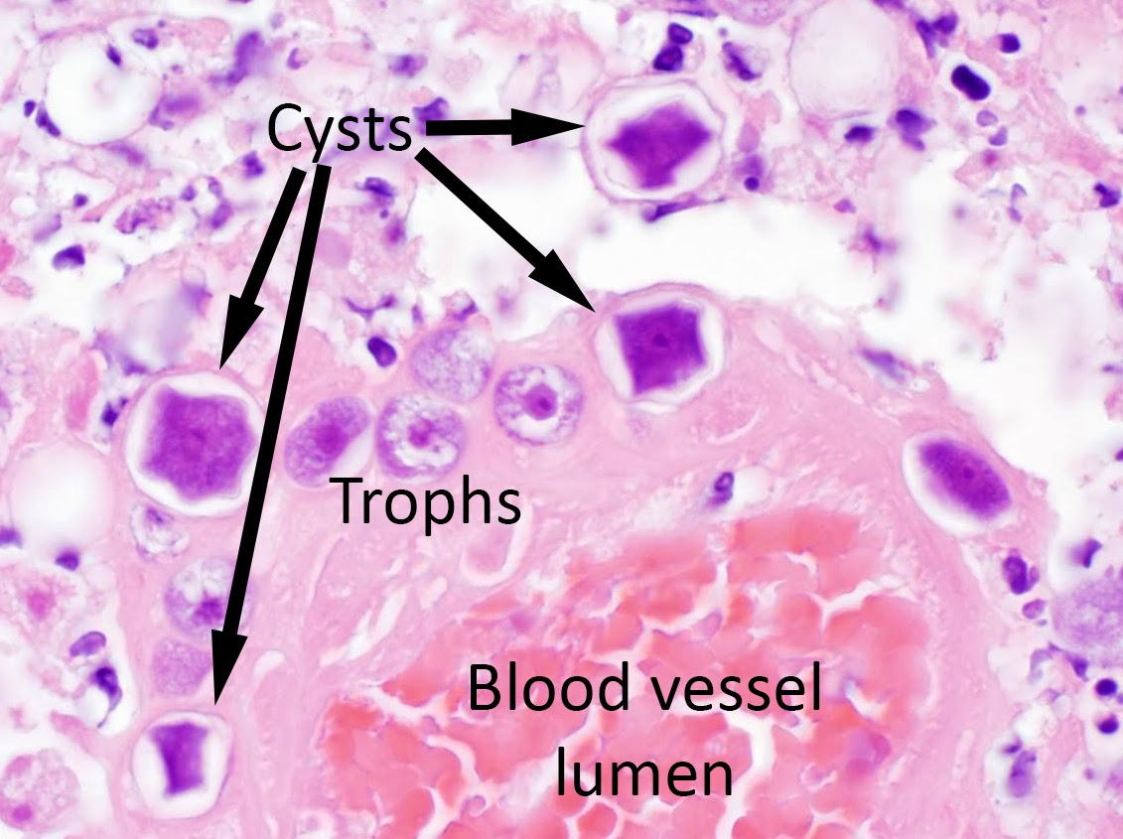
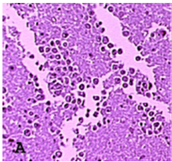
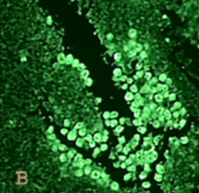
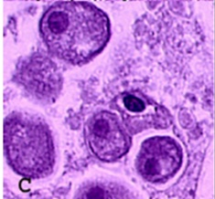
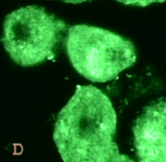
Trophozoites and Cysts of Acanthamoeba species/Balamuthia mandrillaris
The diagnosis can be made from microscopic examination of stained smears of biopsy specimens (brain tissue, skin, cornea) or of corneal scrapings, which may detect trophozoites and cysts.
Tissue staining
IF staining

Slide 22
Clinical Illness
Granulomatous amebic encephalitis (GAE)
Clinical Case Definition
An infection presenting as meningoencephalitis or encephalitis.
GAE can include general symptoms and signs of encephalitis.
Laboratory Confirmation:
Same as Naegleria but differs in:
In lumber puncture: No trophozoites appear in the CSF.

Slide 23
Acanthamoeba & B. mandrillaris
KEY CONCLUSIONS
The primary routes of exposure is not well defined by may be oral or through the skin and rarely involve water contact.
Infections with these parasites are more prolonged than those involving Naegleria.
Granulomatous encephalitis, keratitis, and skin lesions are most commonly reported.

Slide 24
Treatment- (GAE)
Medical:
Ketoconazole and amphotericin B (alone or in combination).
Sulfadiazine may be indicated.
Surgical:
Same as Naegleria.

Slide 25
Control Measures
Naegleria fowleri
Avoid water-related activities in bodies of warm freshwater during periods of high water temperature and low water levels.
Hold the nose shut or use nose clips when taking part in water-related activities.
Balamuthia mandrillaris and Acanthamoeba spp. :
There are no specific prevention and control measures.
Recommend that anyone experiencing symptoms be evaluated by a physician.
They mainly affects those who are immunocompromised.

Slide 26
Communicability of Amebic meningitis/encephalitis
Amebic meningitis/encephalitis is not spread from person-to-person (except in the case of transmission through transplantation of organs from an infected donor).

Slide 27
Laboratory Safety
Free living amebae could pose a potential safety risk to laboratory staff, particularly when large numbers are present in culture.
Personal protective equipment (laboratory gown and gloves with eye protection) should be worn at all times,.
Individuals with immunosuppressive illnesses or open wounds in exposed areas of skin may be at greater risk of infection when working with cultures of free living amebae.

Slide 28
Fungal meningitis (Cryptococcosis)
It is a fatal fungal disease caused by Cryptococcus neoformans.
General characters of C. neoformans:
Yeast cells, oval in shape with a gelatinous capsule.
Found in soil contaminated with the excreta of birds specially pigeons' feces.
It is an opportunistic fungus affecting mainly immunosupressed persons specially AIDS patients.

Slide 29
Fungal meningitis (Cryptococcosis)
PATHOGENESIS
After being inhaled, cryptococci reach the alveoli, where production of the polysaccharide capsule (many immunosuppressing actions).
If engulfed by macrophages, C neoformans is able to survive and multiply by altering its metabolic pathways and by inducing melanin production, which interferes with oxidative killing mechanisms.
C. neoformans cross the blood–brain barrier using macrophages (Trojan horse model) or by the interaction between the components on the microbial surface and the proteins on the endothelial cells of the brain microvasculature.
Infections in immunologically normal people are very rare,
Person-to-person transmission has not been documented

Slide 30
Cryptococcosis-Risk groups
Diseases as AIDS, lymphoma, sarcoidosis, liver cirrhosis, lung & heart diseases.
Long term corticosteroids therapy.
Diabetes.
Pregnancy.

Slide 31
Cryptococcosis-Pathogenesis & Symptomatology
Depending on the virulence of the yeast strain and the immune status of the host, C. neoformans can either cause latent infection (in which the yeast cells remain dormant in the body) or symptomatic disease.
Treatment
Combination of amphotericin B and flucytocine.

Slide 32
Clinical pictures
Respiratory symptoms (pneumonia like illness)
Dissemination of the infection mainly with AIDS
Fever, cough, chest pain & dyspnea
To CNS causing meningoencephalitis
To skin, eyes, bones & joints
Headache, fever.
Neck pain.
Nausea and vomiting.
Sensitivity to light
Mental status range from confusion to coma.
If left untreated, cryptococcal meningoencephalitis may lead to brain damage, hearing loss & hydrocephalus
Notes:
Unlike bacterial infections of the CNS, cryptococcal meningitis usually has a slow, insidious onset with relatively nonspecific findings until late in its course.
Common symptoms include intermittent headache, irritability, dizziness, and difficulty with complex cerebral functions, appearing over weeks or months.
Fever is usually, but not invariably, present. Seizures, cranial nerve defects, and papilledema may appear later in the clinical course, as may dementia and decreased levels of consciousness. A more rapid course may be seen in AIDS patients, and 5% to 15% of these patients may have symptomatic infection at some point. Although the onset of illness may be subacute, cryptococcal infection of the CNS is usually fatal if not recognized and treated.
Like many other pathogenic fungi that enter the host through the lung, most initial pulmonary infections are minimally symptomatic. Infections can be truly clinically inapparent, or they may manifest as a self-limited respiratory illness. However, cryptococcal pneumonia can be progressive and severe in immunocompromised patients. In either case, no clinical findings are sufficiently specific to suggest the etiology.
Dissemination of infection occurs almost exclusively in immunocompromised patients, sometimes targeting the skin and bones. Classically, cryptococcal skin lesions are papular or nodular, often with a central umbilication and remarkable for their lack of inflammation. The diagnosis is sometimes made when lesions are biopsied as suspected neoplasms.

Slide 33
Diagnosis
Specimens: Sputum, CSF, blood
Microscopic Examination
Blood or CSF culture
Detection of Cryptococcous antigen in CSF by
PCR
Dipstick test
A new method for detecting Cryptocoocal antigen in patient's serum
CSF examination by using India ink showing the oval yeast surrounded by unstained capsule.
Latex agglutination test & ELISA.
Rapid & sensitive methods for diagnosis
Rapid (takes 10 minutes), sensitive & inexpensive

