Slide 1
Biochemistry of Taste and Smell
Dr. Nesrin Mwafi
Biochemistry & Molecular Biology Department
Faculty of Medicine, Mutah University

Slide 2
Chemical Senses
Taste (Gustation) and Smell (Olfaction) are chemical senses as they are stimulated by chemical compounds which bind the specialized receptors that they contain.
Upon binding, the generated impulse is sent to the brain and then registered as a certain taste or smell
The term “flavour” is used as an alternative to “ taste” to avoid confusion with flavour referring to the overall perception that results from both taste and smell.

Slide 3
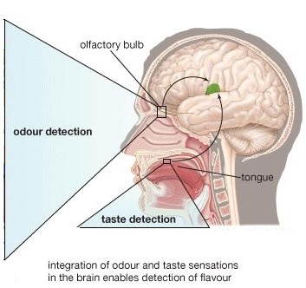
Detection of Flavour
Flavour = Taste + odour

Slide 4
Chemical Senses
Taste (Gustation) and Smell (Olfaction) are chemical senses as they are stimulated by chemical compounds which bind the specialized receptors that they contain.
Upon binding, the generated impulse is sent to the brain and then registered as a certain taste or smell
The term “flavour” is used as an alternative to “ taste” to avoid confusion with flavour referring to the overall perception that results from both taste and smell.
Flavour of food protects us from poisons (mostly taste bitter) and spoiled food (taste sour).

Slide 5
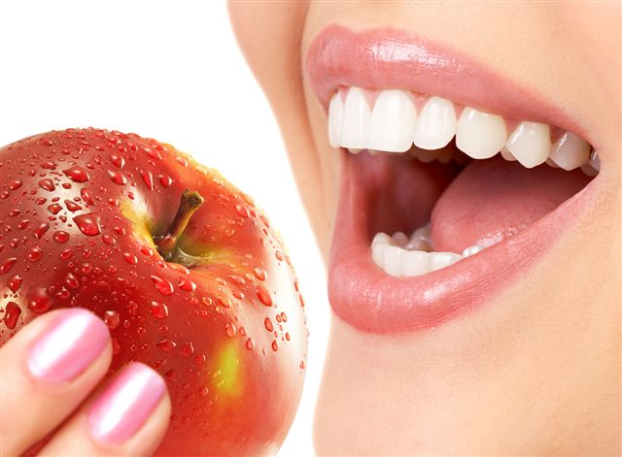
Taste

Slide 6
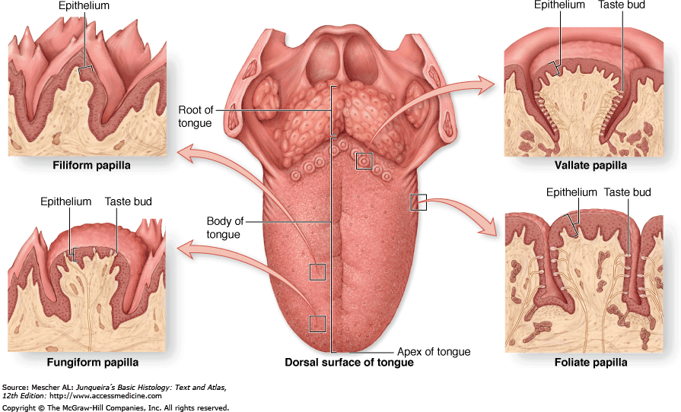
Gustatory System
Posterior
Anterior

Slide 7
Lingual Papillae
There are 4 types of papillae scattered on the surface of human tongue:
Circumvallate papillae: 8-12 dome or V-shaped papillae present at the back of the tongue
Foliate papillae: leaf-like (4-5) short vertical folds located on the sides at the back of the tongue
Fungiform papillae: mushroom-shaped projections mostly present on the tip and sides of the tongue
Filiform papillae: threadlike structures scattered on the frontal 2/3 of the tongue. They are the only papillae that don’t contain taste buds (mechanical papillae)
Taste buds are also scattered throughout the mouth and throat (e.g. soft palate and epiglottis). These assist the primary taste buds located in papillae.

Slide 8
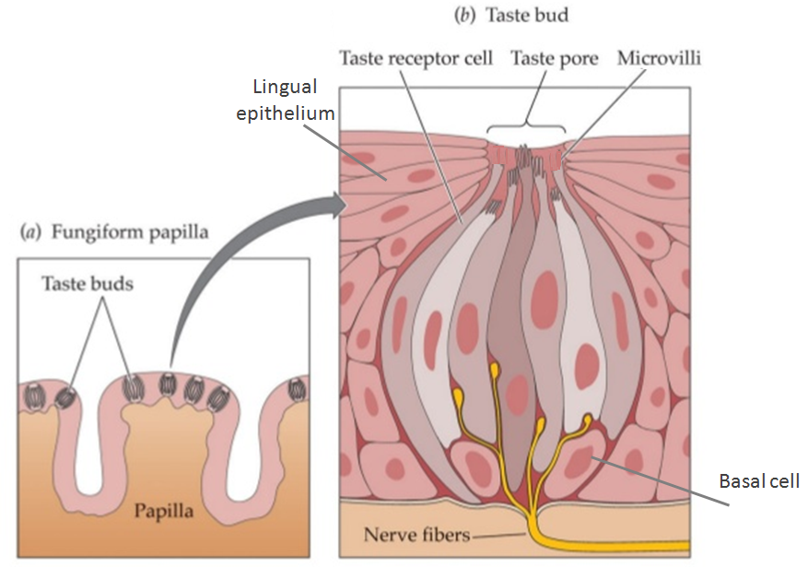
Taste Buds & Taste Receptors
microvilli
Supporting cell
Taste receptor cell
Supporting cell

Slide 9
Taste Buds & Taste Receptors
Taste buds are flask-shaped structures surrounded by epithelial cells. They contain the taste receptor cells (chemoreceptor cells)
Each taste bud is made up of 50-150 elongated cells arranged around a central taste pore:
Taste receptor cells (TRCs): spindle-shaped neuroepithelial cells with microvilli projecting from the apical end whereas the other end is innervated by afferent nerve fibers. Each TRC has a particular receptor on its apical surface to bind specific tastant.
Supporting cells: columnar cells that support TRCs
Basal cells: cells that migrate from the adjacent lingual epithelium into the bud and differentiate into TRCs (regeneration time every 10 days)

Slide 10
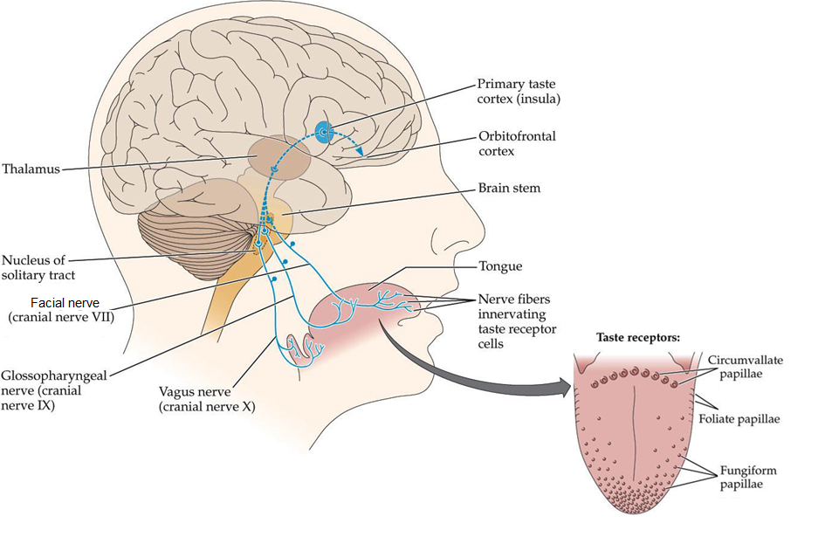
Taste Signal Transmission

Slide 11
Taste Signal Transmission
Three cranial nerves are involved in the transport of
taste message to the brain:
Facial nerve (cranial nerve VII) carries taste sensations from the anterior two thirds of the tongue and soft palate
Glossopharyngeal nerve ( cranial nerve IX) carries taste sensations from the posterior one third of the tongue
Vagus nerve ( cranial nerve X) carries taste sensations from the back of the oral cavity (e.g. pharynx and epiglottis)

Slide 12
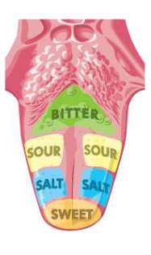
The Five Basic Tastes
There are 5 primary taste sensations:
Sweet taste: usually indicates energy rich nutrients (e.g. glucose)
Salty taste: allows modulating diet for electrolyte balance (e.g. NaCL)
Sour taste: typically the taste of acids (e.g. lemon)
Bitter taste: allows sensing of diverse natural toxins. Bitter tastants include alkaloids like quinine and caffeine
Umami taste: the taste of amino acid glutamate found in breast milk (10X) & many foods (e.g. meat, tomatoes, mushrooms, onions)
Sweet/Umami
Tongue map

Slide 13
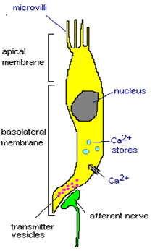
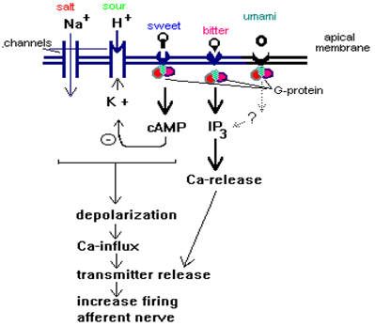
The Principle of Taste Stimulus Transduction
Tastants
Ion channels
GPCRs

Slide 14
Molecular Mechanism of Taste Perception
Taste sensation is realized in the mouth when the chemicals in food are dissolved by saliva and the free floating molecules enter a taste bud through the pore at its center
Flavor molecules (tastants) fit into receptors on the microvilli at the top of the cell (TRC), causing electrical changes (depolarization) that increase the intracellular level of Ca⁺ ions (either released from intracellular Ca⁺ stores or influx through voltage-gated Ca⁺ channel ) thus releasing neurotransmitters onto the nerve ending at the bottom of the cell
The taste message is then carried to the brain by the appropriate cranial nerve: VII, IX or X

Slide 15
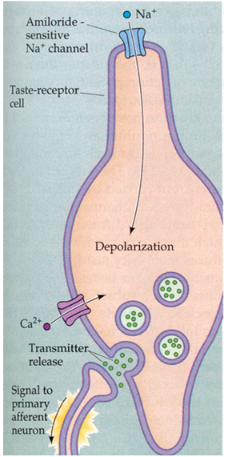
Salty Taste Perception
With salty substances (e.g. table salt or NaCl), the Na+ ions influx through amiloride -sensitive Na+ channels expressed on the surface of cells in the tongue
This causes the depolarization of the cell → the influx of Ca²⁺ (voltage-gated Ca²⁺channels) triggers the release of neurotransmitters at the synapse to the attached sensory neuron and fires an action potential

Slide 16
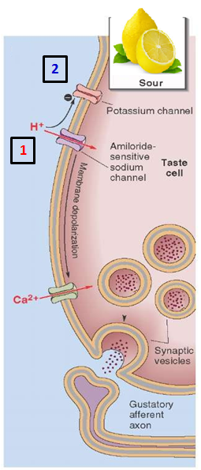
Sour Taste Perception
Sour taste can result from either the passage of H⁺ ions through amiloride -sensitive Na⁺ channels or from the blockade of K⁺ channels, which are normally open at resting potential → membrane depolarization
These channels are permeable to protons when salivary Na⁺ concentration is low. At high Na⁺ concentration, protons block Na⁺ flux through the channels and inhibit the response to NaCl.

Slide 17
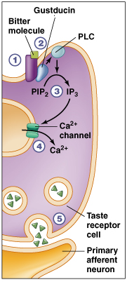
Bitter Taste Perception
Although at least one bitter stimulus “quinine” may depolarize taste cells by blocking apical K⁺ channels, most bitter stimuli are thought to bind to G protein-coupled receptors (GPCRs) of the
family T2R receptors.
Binding of bitter tastant to T2R receptor stimulates the membrane-bound G-protein “gustducin” which activates phospholipase C (PLC) to increase production of inositol 1,4,5- trisphosphate (IP3) as a second messenger that causes the release of Ca²⁺ from intracellular stores.
Quinine
Ca+
stores

Slide 18
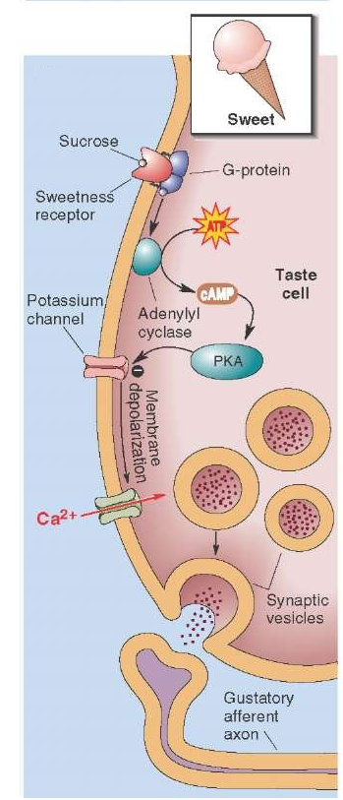
Sweet Taste Perception
Sweet receptor is heteromeric GPCR made of two subunits: T1R2 and T1R3 proteins. This receptor can respond to both natural and non-carbohydrate artificial sweeteners (e.g. saccharin and aspartame)
Substances that generate the sense of sweet flavour (e.g. fructose sugar) act on receptors that are coupled with G- proteins. Activation of G proteins results in activation of adenylate cyclase (AC) which increases the levels of cAMP (second messenger). cAMP activates a protein kinase (PKA) that depolarizes the receptor cells by closing K+ channels at the basolateral membrane.
Artificial sweeteners were found to act via the alternative signaling pathway : through the generation of the second messenger IP3 which induces the release of Ca2⁺ from intracellular stores

Slide 19
Umami Taste Perception
Glutamate amino acid has a taste called Umami ( from the Japanese word for “delicious”), that is distinct from the other four basic tastes.
Umami taste is mediated by:
Metabotrophic glutamate receptor 4 “ mGluR4”
a G-protein coupled receptor. mGluR4 is also
expressed in certain regions of the brain.
The activation of these receptors causes Ca ²⁺ to be released from intracellular stores such as the endoplasmic reticulum (ER).
Heteromeric GPCR consists of T1R1 and T1R3 proteins. This receptor is broadly tuned to the 20 standard L-amino acids found in proteins (but not to their D-amino acid enantiomers). Activation of these receptors also increases the intracellular level of Ca ²⁺

Slide 20
smell

Slide 21
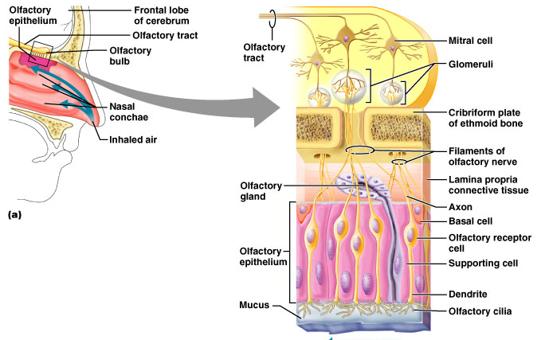
Olfactory System
.
.
.
.
.
.
.
.
.
.
.
.
Odorants

Slide 22
Olfactory System
The olfactory system is located at the dorsal roof of the nasal cavity. It consists of 3 main structures:
Olfactory bulb: it is an extension of the brain. It contains a bundle of nerves that carry the olfactory messages to the brain
Cribriform plate of ethmoid bone: a bone that separates the olfactory bulb from the olfactory epithelium. It has holes through which the olfactory receptor neurons send projections (axons) to the olfactory bulb
Olfactory epithelium: it consists of 3 different types of cells. Also, it contains the mucus secretory gland called “Bowman’s gland”.

Slide 23
Olfactory Epithelium
The olfactory epithelium layer contains 3 types of cells:
Olfactory receptor cells (olfactory sensory neurons ): these are bipolar neurons with their axons extended at the basal surface towards the olfactory bulb (where they make synapses with mitral and tufted neural cells). At the apical surface, these cells have projections called cilia which extend into the underlying mucus layer containing the dissolved odorants. Cilia have the odorant receptors (proteins).
Basal cells: responsible for regeneration of receptor cells every 6-8 weeks.
Supporting cells

Slide 24
Olfactory Bulb
The olfactory bulb contains structures called glomeruli (a spherical structures where the axonal ends of receptor cells cluster). Each glomerulus receives input primarily from olfactory receptor neurons that express the same olfactory receptors.
Mitral cells and tufted cells are neurons located in olfactory bulb. They form synapses with receptor cells inside glomeruli. They send olfactory inputs into brain for integration.

Slide 25
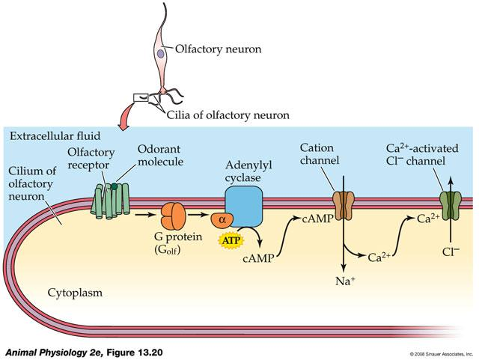
Cellular Mechanism of Olfactory Transduction

Slide 26
Cellular Mechanism of Olfactory Transduction
Each olfactory receptor cell is thought to contain a single type of olfactory receptor responding to a single type of odorant
1. The cilia of the olfactory sensory neurons are embedded in a layer of mucus in which odor molecules are dissolved.
2. Binding of odorant ligands with G-protein-coupled receptors activates olfactory specific G-protein (G olf ) by removal of GDP and substitution with GTP .
3. The active G-protein dissociates into β , γ and α-GTP subunits with the latter activating the enzyme adenylate cyclase.
4. The adenylate cyclase increases the formation of cAMP from ATP.
5. The increased amount of cAMP (second messenger) opens cAMP-gated cation channels causing the influx of Na+ and Ca+² ions

Slide 27
Cellular Mechanism of Olfactory Transduction
6. This causes membrane depolarization
7. The depolarization is further amplified by Ca+² activated Cl⁻ channels (outflow of Cl⁻ )
8. The increased intracellular calcium ion concentration initiates calcium mediated exocytosis of neurotransmitter vesicles
9. The neurotransmitter molecules are released inside the synaptic cleft and diffuse towards the postsynaptic membrane (mitral or tufted cells of the olfactory bulb)

