Slide 1
Animal poisoning
Snake bite

Slide 2
Out of more than 3000 species of snakes in the world, some 600 are venomous.
37 species have been recorded from Jordan, only 7 are venomous
Snakes are classified to 2 major families: Elapidae and Viperidae
Snakebites are more common among males compared to females

Slide 3
Palestine Viper

Slide 4
Arabian saw-scaled viper, Burton’s carpet-viper النشارة او السجادة الشرقية

Slide 5
Black Desert Cobra

Slide 7
Pathophysiology of envenomation:
Locally acting toxins: cause tissue destruction through diverse mechanisms (eg, phospholipase A [PLA ], phosphodiesterases, hyaluronidases, peptidases). It is manifested as swelling, blistering, ecchymosis, tissue necrosis, and pain. local manifestations are commonly seen after snakebites by Viperid snakes. Local effects are minimal or absent after bites of many elapid snakes.

Slide 8
2- Systemically acting toxins – Systemic toxins may target a wide variety of tissues including
Neurotoxins: affect neuromuscular junction (NMJ) result in paralysis.
Myotoxins :– may act either systemically or locally produce rhabdomyolysis.
Systemic hemostasis toxins: increase bleeding tendency, with resulting consumptive coagulopathy and hemorrhage. The coagulopathy can usually be reversed by timely administration of antivenom. Less commonly, clotting and thrombosis.
Cardiotoxic effect: Myocarditis, pericarditis and arrhythmias.
Kidney: either direct toxic effect or secondary to hypothesnion, rhabdmyolysis and hamelysis.
Allergic reactions: due to release of histamine.

Slide 9
It is to be mentioned that:
Family Viperidae is mainly vasculotoxic
Family Elapidae is mainly neurotoxic.

Slide 10
Clinical presentation:
(I)Local manifestations:
-All these manifestations are more marked with the hemorrhagic vipers' bites, and less marked with paralytic snakes (Cobra). They are in the form of:
(1) Fang marks: they are variable in shape, depth, number, and the distance between marks according to the snake species, but are usually 1-2, with hemorrhagic edema, which may extend to involve the entire limb as in case of vipers.
(2 ) Local pain: It varies from mild to intolerable pain.
(3) Swelling and edema.
(4) Hemorrhagic bullae & regional lymphadenopathy.
(5) Tissue necrosis at the site of bite.

Slide 11
Systemic manifestations:
Neuromuscular junction: Ptosis, Diplopia, Dysphagia, Bulbar palsy: "drooling“ pooling of secretions in pharynx, Dyspnea, Limb weakness.
Coagulopathy: bleeding tendency.
Cardiovascular: hypotension, arrythmia, ECG changes.
Rhabdomyolysis: red urine, oliguria.

Slide 12
A patient bitten by D. palaestinae (Palestine viper), showing extensive hemorrhage (Source: Dr. Malik Dabbas, Royal Medical Services, Jordan)

Slide 13
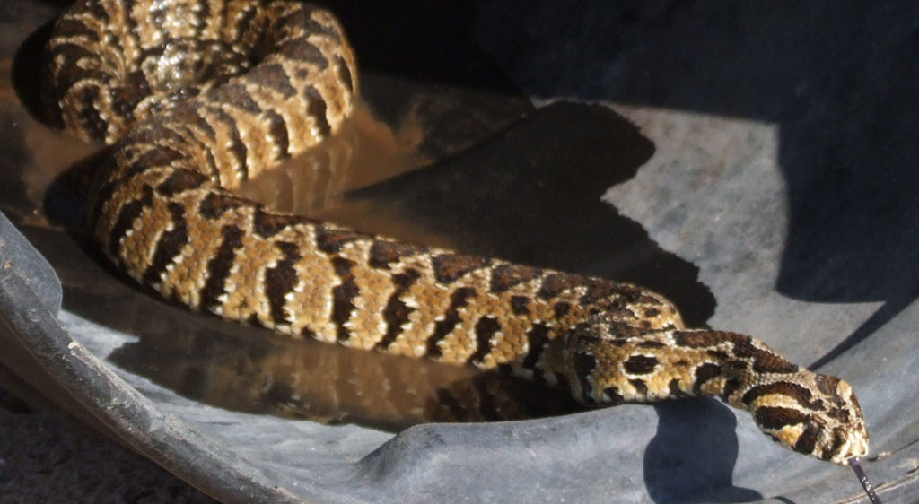
Daboia palaestinae

Slide 14
Investigations:
*Baseline studies, including: C.B.C., serum electrolytes, urine &stool analyses.
* Coagulation studies, including: coagulation time, bleeding time, platelet count,
prothrombin time, partial thromboplastin time (PTT) &fibrinogen level and
fibrin split products.
*BUN &serum creatinine.
*Arterial blood gases: monitor acid-base balance.
*Serum muscular enzymes (S.G.O.T., S.G.P.T., C.P.K.) to detect the occurrence of rhabdomyolysis.
*ECG and continuous cardiac monitoring.

Slide 15
General principles
Remove
Remove any jewelry from the affected extremity.
Immobilize
Immobilize the injured part of the body.
Fashion
Fashion a splint out of any rigid object.
Do not allow
Do not allow the victim to walk because exertion and, with bite wounds on the lower extremity, local muscle contraction may increase snake venom absorption.
Pressure
Pressure bandage immobilization is recommended in paralytic snake.

Slide 16
Methods to avoid
● Incision and oral suction
● Mechanical suction devices
● Cryotherapy
● Surgery
● Tourniquets

Slide 18
(II)Definitive therapy: (At hospital):
Life-threatening manifestations: advanced life support.
Specific measures (Antivenom):
Antivenom is a suspension of venom-neutralizing antibodies from the sera of hyper- immunized animals (horses) & so we must do sensitivity test before injection.
The available in Jordan is a polyvalent one
Antivenom regimen is illustrated in the following table

Slide 19
4) Symptomatic &supportive measures
Envenomation | Reaction | Dose (Vials)
None | - No local & no systemic manifestations (dry bite or nonvenomous snake) | Nothing, just observation
Minimal | - Local with no systemic manifestations | 3-5 vials
Moderate | -Local manifestations beyond the site of bite, moderate manifestations and laboratory changes. | 5-10 vials
Severe | -Severe local manifestation and severe systemic manifestations with serious laboratory changes. | 10-15 vials or more.

Slide 20
Scorpion sting

Slide 21
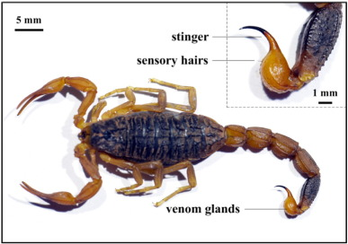
In Jordan, 18 species (of 1400 worldwide) and subspecies of scorpions belonging to 2 families (Buthidae and Scorpionidae). Buthidae is the largest and the most dangerous family.
In 2011, 340 cases of scorpion sting were reported in Jordan. Irbid is the highest governorate.
Envenomation occurs through stinging, not biting by stinger in the scorpion tail.

Slide 22
Scorpion venom:
Composition:
Low molecular weight proteins: mainly neurotoxic.
No or minimal enzymes: Phospholipase A .
Free amino acids: Tryptophan, histamine, serotonin…etc.
Action: It produces repetitive firing of the axons via creation a widened action potential through:
Maintenance of Na-channels open after depolarization.
Blocking the voltage-gated K-channels.

Slide 23
Clinical Presentation:
Generally, the scorpion stings are dangerous in children (below 10 years) and in elderly (above 60 years).
The clinical course of envenomation can be divided into 4 grades as in the following scale:
Grade I: Local pain or paresthesia at the site of sting.
Grade II: Pain or paresthesia away from the site of sting.
Grade III: One or more of the following systemic effects.
Grade IV: The patient has local &systemic effects.

Slide 24
Systemic manifestations:
General manifestations:
Sweating and cold extremities.
Thirst, dehydration and fever up to 42° C.
Neuropsychiatric manifestations
Cranial nerve dysfunction: blurred vision, dysphagia, tinnitus.
Neurological dysfunction: involuntary movememnts, agitations, convulsions, malignant hyperthermia, coma.
Cardiovascular manifestations:
Tachyarrhythmias & hypertension.
Heart failure, hypotension, and circulatory collapse.
Cardiomyopathy & toxic myocarditis.
ECG changes: Depressed S-T segment & inverted T-wave (injury pattern).

Slide 25
Respiratory manifestations:
Tachypnea &respiratory distress.
Rhonchi &crepitations.
Pulmonary oedema.
GIT manifestations: severe vomiting, diarrhea, and may be hematemesis.
Genitourinary manifestations: Priapism: It is a very common finding in scorpion sting, but its exact mechanism is unclear.

Slide 26
Investigations:
Complete blood count (C.B.C).
Serum electrolytes (Na, K, CL, HCO3….etc).
Arterial blood gases.
BUN & serum creatinine.
Serum enzymes (C.P.K., S.G.O.T., S.G.P.T.….etc.).
ECG, chest X-ray, and echocardiography.

Slide 27
Treatment:
First-aid measures: The same as in case of snake bite (See before).
Definitive Therapy: (At hospital) in the form of: No manifestations: Close observation for 3-4 hr. is usually needed.
Life-threatening manifestations: life support.
Specific measures (Antivenom): in clinical overt cases and after life support measures.
Skin test (hypersensitivity) must be performed before the administration to avoid anaphylaxis.
Dose: Infuse contents of 3 vials IV over 10 minutes; monitor for up to 60 minutes after completing infusion to determine if symptoms are resolved. Additional doses may be used if needed; infuse 1 vial at a time at 30-60 minutes intervals.
Symptomatic &supportive measures: analgesic for pain, antihypertensive, antitetanic, antibiotic….

