Slide 1
Urology Homework Group4(A)
Done by Nadine Othman

Slide 2
1-Indications for open surgery in BPH
Aseel sadaqa
Surgical removal of prostate gland under general or regional anesthesia .
Excellent outcomes in terms of improvement of symptoms , highest morbidity rate, associated with risk of significant blood loss
Reserved for patients with : 1-Very large prostate 2-Concomitant bladder stones or bladder diverticula 3-Inability to be positioned for transurethral surgery 4-Concomitant inguinal hernia 5-Long urethra 6-Urethral stricture 7-Intraoperative bleeding during TURP obscuring vision

Slide 3
2-Indications for surgery in BPH
Raghad alqazaqi
1- Failure of medical treatment 2- Refractory/Recurrent UTI 3- Recurrent gross hematuria 4- Refractory/Recurrent urinary retention 5- Renal insufficiency / deterioration 6- Secondary bladder pathological changes ( large diverticulum, stones )

Slide 4
3-Voided urine samples
Mohammad hashem
1- Vb1 : First 10 ml of urine, this represents :
- Urethra - Acute prostatitis 2- Vb2 : Midstream urine, this represents : - Bladder 3- Vb3 : First 10 ml of urine after prostate massage, this represents : - Chronic prostatitis 4- EPS : Expressed prostatic specimen, measured after prostate massage in chronic prostatitis

Slide 5
4- Acute urine retention Vs Chronic
Ro’aa jaradat
Acute urine retention: painful inability to void urine with relief of pain following drainage of the bladder by catheterization
Chronic urine retention: Failure to empty bladder despite maintaining an ability to urinate which result in elevated (PVR) urine volume

Slide 6
4- Acute urine retention Vs Chronic
 | Acute retention | Chronic retention
Voiding | Decreased (-) | Increased (+)
Obstruction | Complete | Partial
Pain | + | -
Suprapubic tenderness | + | +/-
Drainage volume | <800 ml | >800 ml
Uremia | - | +/-
Hydronephrosis | - | +
Post obstructive diuresis in chronic retention

Slide 7
5-Indications of JJ stent
Raghad haj-hasan
1- Relief of obstruction from ureteric stones, benign ureteric stricture or malignant stricture, the stent will relieve the pain caused by obstruction and reverse renal impairment if present. 2- Prevention of obstruction post ureteroscopy
3- Passive dilation of ureter prior to ureteroscopy
4- To ensure antegrade flow of urine following surgery or injury to ureter
5- Following endopyelotomy

Slide 8
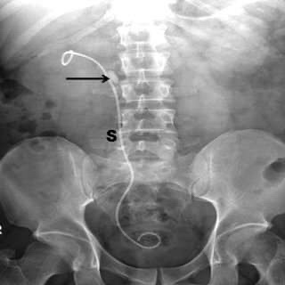
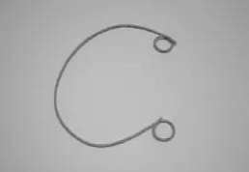
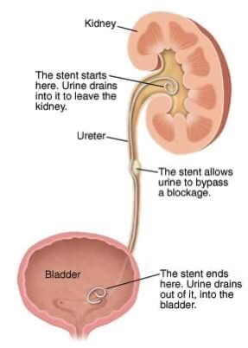
5-Indications of JJ stent

Slide 9
6- Types of UTI
Felasteen abed
Most common pathogen of UTI is E.Choli
Most common mode of infection is ascending from the periurethral, vaginal and fecal flora
Upper tract infection
1- Pyelonephritis ( acute , chronic ) mostly diagnosed clinically.
lower and upper tract symptoms present ( chills, fever, costovertebral angle tenderness, dysuria, urgency, frequency )
2- Ureteritis (ureter)

Slide 10
6- Types of UTI
Lower tract infection
1- Cystitis
2- Urethritis
3- Prostatitis
Lowe tract symptoms ( dysuria, frequency, urgency ) Upper tract symptoms ( chills, fever, costovertebral angle tenderness, nausea, vomiting)

Slide 11
6- Types of UTI
There is :
A- Symptomatic UTI :
There’s signs and symptoms of UTI and laboratory testing confirm the diagnosis
1- In urinanalysis (5-15) WBC per high-power
2- In culture 100,000 cfu/ml
- Isolated ( 5-6 months between attacks ) OR - Recurrent ( >3 attacks/year or >2 attacks/6months )
*Re- infection (new organism) *Persistent (because of inappropriate treatment)

Slide 12
6- Types of UTI
B- Asymptomatic UTI :
Urinanalysis and culture are negative and treatment only in case of pregnancy.
C- Complicated UTI :
Occur when anatomic abnormalities, immunocompromised, multi-drug resistant bacteria and cause functional or structural abnormalities
-Functional : renal failure, neurogenic bladder, VUR
-Structural : stricture, BPH, anatomic malformation
D- Uncomplicated UTI :
In healthy patients with normal urinary tract anatomy

Slide 13
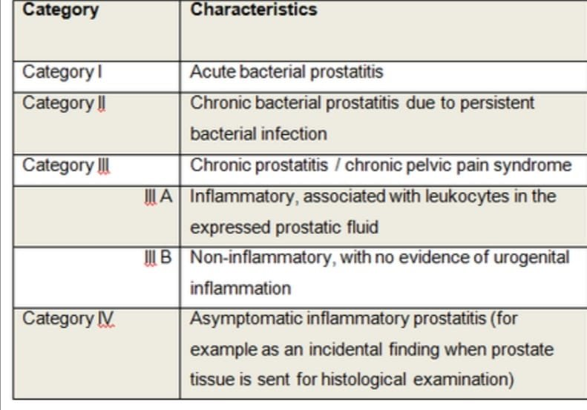
7-Types of prostatitis
Abla qudah

Slide 14
8-Ways of urine sampling
Aya tawalbeh
1- Voided Urine
Simplest ways:
A-Random specimen(for analysis)
B-First morning specimen(analysis and microscopic)
C-Midstream clean catch specimen(for culture and sensitivity testing)
2- Catheter collection specimen
-These specimens are obtained by investing a catheter or sterile flexible tube into bladder via urethra to withdraw urine
-When the patient is bedridden or can’t urinate independently

Slide 15
8-Ways of urine sampling
3- Suprapubic aspiration specimen
-This method is used when a bedridden patient can’t be catheterized or sterile specimen is required

Slide 16
9-Transurethral Resection Syndrome(TUR)
Lubna sameer
Arise from the infusion of a large volume of hypotonic irrigating solution into the circulation during endoscopic procedures (TURP, TURBT, PCNL)
Most commonly after prolonged TURP of large prostate
Irrigation fluid: glycine+water
During TURP this fluid enter the circulation leading to ( Hypervolemia, Hyponatremia )
Signs and symptoms Dilutional hyponatremia is the most important risk factor leading to the signs and symptoms
1- confusion 2- bradycardia 3- nausea,vomiting 4- seizures 5- hypertension due to fluid overload 6- visual disturbances (flashing light), in case of spinal anesthesia ( TURP due to glycine inhibitory neurotransmitter which affects on retina)

Slide 17
9-Transurethral Resection Syndrome(TUR)
Prevention : use a continuous irrigating cystoscope, limit resection time and avoid aggressive resection near the capsule
Treatment - for prolonged procedures, where greater degree of fluid may occur, measure serum Na+ >> give 20-40mg IV furosemide
1- If Na+ comes back normal >> you’ll have done little harm by giving furosemide 2- If it comes back Na+ <125mmol/l >> need more treatment and intervention to prevent development of severe TUR syndrome

Slide 18
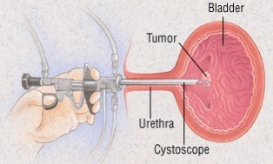
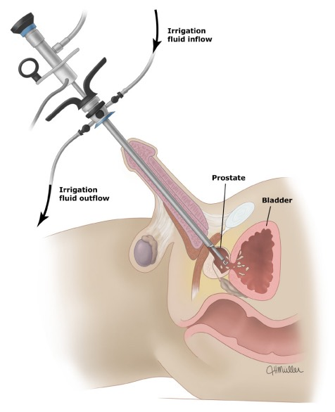
9-Transurethral Resection Syndrome(TUR)

Slide 19
10-Causes of urethral stricture
Abdulrahman bdeir
1- Trauma
2- Infection ( sexual transmitted disease )
3- Damage from surgical tools(catheter, endoscopy) ( iatrogenic )>>Most common cause
4- Congenital
5- Malignancies
6- Post-operative
7- Non-infectious inflammatory process

Slide 20
11-Types of foley’s catheter
Hadeel salameen
1- According to size
-In French, 1 French=0.33mm
- The size represents the external circumference of the foley’s catheter which represents the internal circumference of the urethra
- Usually start with 16 French ( in BPH/Large prostate, use larger size. In stricture, use smaller size )

Slide 21
11-Types of foley’s catheter
2- According to material
- Latex : Less biocompatible, more risk for UTI, more formation of biofilms so can’t be used longer than 3 weeks
- Silicon : More biocompatible, less risk for UTI, less risk for biofilms formation so can be used for up to 3 months

Slide 22
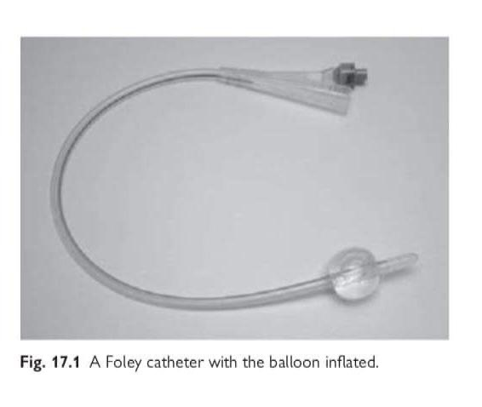
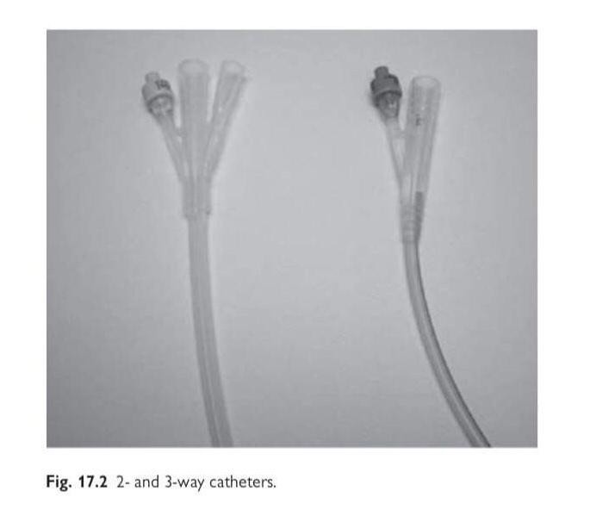
11-Types of foley’s catheter
3- According to number of ways
- One way-catheter : one time drainage or intermittent catheterization
-Two way-catheter : one way for drainage and the second for balloon
( to fix the catheter in the bladder )
- Three way-catheter : one way for drainage, second way for irrigation after bladder or prostate surgery ( blood should be irrigated and removed to prevent accumulation > clot retention > risk of perforation) and the third way for balloon inflation.

Slide 23
12-Grades of varicocele
Mohammad badwan
Subclinical : Non-palpable enlargement of the venous plexus of the spermatic tone, which is diagnosed only by ultrasound, angiography or any other imaging method
Grade I : Small palpable distensions detected during a Valsalva maneuver
Grade II : Moderate with easily palpable distention on upright examination
Grade III : Large visible veins on upright examination without palpation
Grade IV : Very large varicosities become visible immediately when the patient stands up, the varicosities are hypertensive and subcutaneous varices are present too

Slide 24
13-Testicular torsion VS Epididymorchitis
 | Testicular torsion | Epididymorchitis
Age | (10-30) years | (16-30)&(51-70) years
Pain | Sudden onset not affected by position | Gradual onset worse when standing
Onset | After exercise, sleep or minor trauma | Rarely after sleep
Time to presentation | < 6 hours | > 24 hours
Past episodes | Frequently >2weeks past | Only if previous infection
Severity | Peaks in hours | Peaks in days
Vomiting | Common from pain | Unusual
Fever | Up to 20% | Up to 95%
Swelling | After 12 hours | Common
Dysuria | Rare | Common
Urinanalysis | 30% have wbc/bacteria, voiding complication rare | 50% may be normal , voiding complication common
Physical exam | Cremasteric reflex - Prehn sign | + Cremasteric reflex + Prehn sign
Color Doppler | Decreased testicular flow | Increased testicular flow
Akram Oran

Slide 25
13-Testicular torsion VS Epididymorchitis
Management :
testicular torsion is managed by surgery ( Orchidopexy or Orchidectomy ) while epididymorchitis is managed by antibiotics and if it fails we do orchidectomy

Slide 26
14-Indications of surgery in varicocele
Tamara abbadi
1- Fertility problems
2- Pain
3- Abnormal semen analysis
4- Testicular asymmetry
5- Testicular atrophy
6- Grade III or higher in pediatric

Slide 27
15- Bladder cancer risk factors
محمد خالد العايد
1- Smoking: the most important risk factor, smokers are more likely to get bladder cancer 3 times more than non-smokers
2- Age: risk increases with age
3- Male gender
4- Exposure to certain chemicals ( eg : arsenic )
5- Previous cancer treatment: people who received radiation treatment aimed for pelvis have high risk of developing bladder cancer
6- Chronic bladder inflammation: like the inflammation that happens due to schistosomiasis infection and inflammation from long term use of urinary catheter
7- Family history of bladder cancer

Slide 28
16- Intravesical therapy of bladder cancer
Loulou mahmoud
Intravesical chemotherapy For low non-invasive bladder cancer after TURT within 6 hours then induction and maintenance Decrease risk of recurrence
Intravesical BCG immunotherapy For high grade bladder cancer after TURT and for carcinoma in situ Not done immediately after TURT or if there’s hematuria or immunosuppression Decrease risk of recurrence and progression

Slide 29
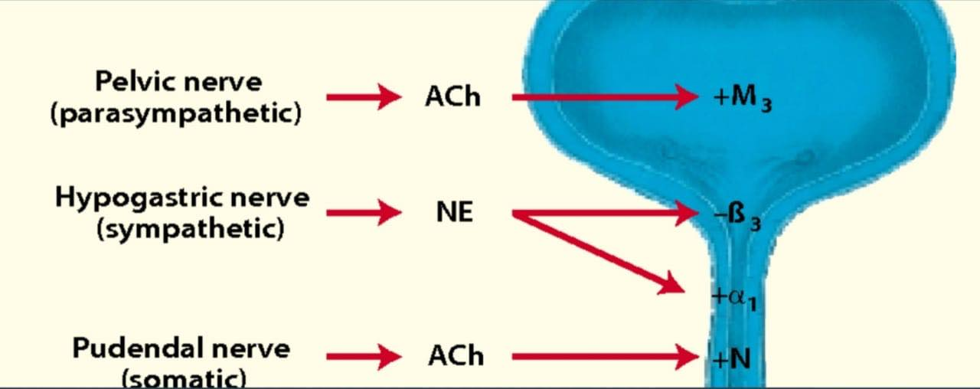
17- Autonomic nerve supply of urinary bladder
Etaf sha’ban
Sympathetic >> Hypogastric nerve (T12-L2) Relaxation of detrusor muscle promoting retention
Parasympathetic >> Pelvic nerve (S2-S4) M2 receptors ( more common and function in modulation of bladder function ) M3 receptors ( Less common but responsible for contraction )
Somatic >> Pudendal nerve

Slide 30
18- Treatment of bladder perforation
Rawan Fayumi
1-Emergency treatment of shock and hemorrhage
2-Surgical treatment
1- Penetrating injury>> surgical exploration and repair 2- Blunt injury A- Extraperitoneal>> Most cases managed with catheter drainage only for 1-3 weeks B- Intraperitoneal>> Surgical exploration and repair via transperitoneal approach, suctioning or urine from peritoneal cavity, closure of perforation, suprapubic and perurethral catheterization

Slide 31
19- Grades of renal trauma
Suha kaabneh
Grade I : Contusion or non-expanding subcapsular hematoma, no laceration
Grade II : Non-expanding perirenal hematoma, cortical laceration <1cm deep without urinary extravasation
Grade III : Cortical laceration >1cm deep without urinary extravasation
Grade IV : Laceration through corticomedullary junction into collecting system. Or vascular, segmental renal artery or vein injury with contained hematoma or partial vessel laceration or vessel thrombosis
Grade V : Shattered kidney or renal pedicle avulsion
Notes:
Know the indications for imaging in renal trauma and the management

Slide 32
20- Sperm parameters Collected after 2-7 days of sexual abstinence
Mohanad alzaben
Parameter | Lower limit reference
Sperm volume | 1.5ml
PH | => 7.2
Total sperm count | 39x10^6 per ejaculate
Sperm concentration | 15x10^6 per ml
Motility | 40% progressive + non progressive 32% progressive motility
Morphology | 4% Normal forms
Vitality | 58% live spermatozoa
Time to liquefy | 5-25 minutes
WBCs | < 1x10^6 per ml
MAR test(for anti-sperm antibodies) | <50% motile spermatozoa with bound particles

Slide 33
21- PSA (prostate specific antigen)
Mohmad zoubi
Is a blood test used primarily to screen for prostate cancer
Considered normal up to 4ng/ml
4-10ng/ml >> grey zone >> we go to PSA kinetics :
Total PSA = Free PSA(15%)+ Complexed PSA(85%)
Free to total PSA ratio < 18% ratio>> suggestion of cancer or other differentials (prostatitis) >18% ratio>> suggest benign cause
PSA Density = Serum PSA / Prostate volume >18% density>> suggestion of cancer <18% density>> suggestion of benign cause
PSA velocity Change of > 0.75 ng/ml/year associated with increase risk of cancer
PSA doubling time Used in staging and follow up of prostate cancer

Slide 34
22- Causes of elevated levels of PSA in men
Ena’am Doumi
Getting older
BPH
UTI and prostatitis
Ejaculation
Parathyroid hormone
Prostate injury
Surgical procedure involving prostate
Prostate cancer
In Females it increases in hyperandrogenic state

Slide 35
23- BPH medical treatment
Mohmad Rabai
Alpha 1 adrenergic antagonists ( Tamsulosin, Doxazosin ) Relax bladder neck muscle and prostate muscle fibers S.E >> Orthostatic hypotension
5-alpha reductase inhibitor ( Finasteride ) Shrink/Reduce the size of prostate by inhibiting conversion of testosterone into DHT and thus suppressing prostate growth S.E>> Decrease libido and ejaculation dysfunction
Anti-cholinergic Bladder muscle relaxant
PDE5 inhibitor ( Tadalafil )
Life style and home messages ( limit caffeine and alcohol, bladder training and schedule bathroom visits, healthy diets and exercise )

Slide 36
23- BPH medical treatment
Mohmad Rabai

Slide 37
24- Importance of antibiotics in patient with VUR
Ru’a Tafesh
Antibiotics ( continuous antibiotic prophylaxis ) LOWERS :
1- The occurrence of a subsequent UTI
2- The risk of renal scarring and damage
3- The upgrading of VUR

Slide 38
25- VUR: Abnormal backflow of urine from bladder to kidney that can cause the ureters and kidney to swell. Cystogram(MCUG) can be used to determine severity of VUR
Aseel Adnan
Grade I : Urine flow back into on or both of the ureters but doesn’t reach the kidney (urine reflux into non-dilated ureters)
Grade II : Flow back up to the kidney but doesn’t cause dilatation of renal pelvis
Grade III : Mild to moderate dilatation of the ureter, renal pelvis and calyces with minimal blunting at fornices
Grade IV : Moderate to severe dilatation of the ureter, renal pelvis and calyces with mild tortuosity
Grade V : Severe dilatation with severe tortuosity, blunting renal fornices, cortical thinning and ballooning
Notes:
Know the secondary causes of VUR and indications for surgery of VUR

Slide 39
26- Parts of the urethra
Ghazi Majali
Posterior urethra >> composed of the membranous and prostatic portions
Anterior urethra >> includes 3 segments ( bulbar urethra, penile urethra, fossa navicularis )

Slide 40
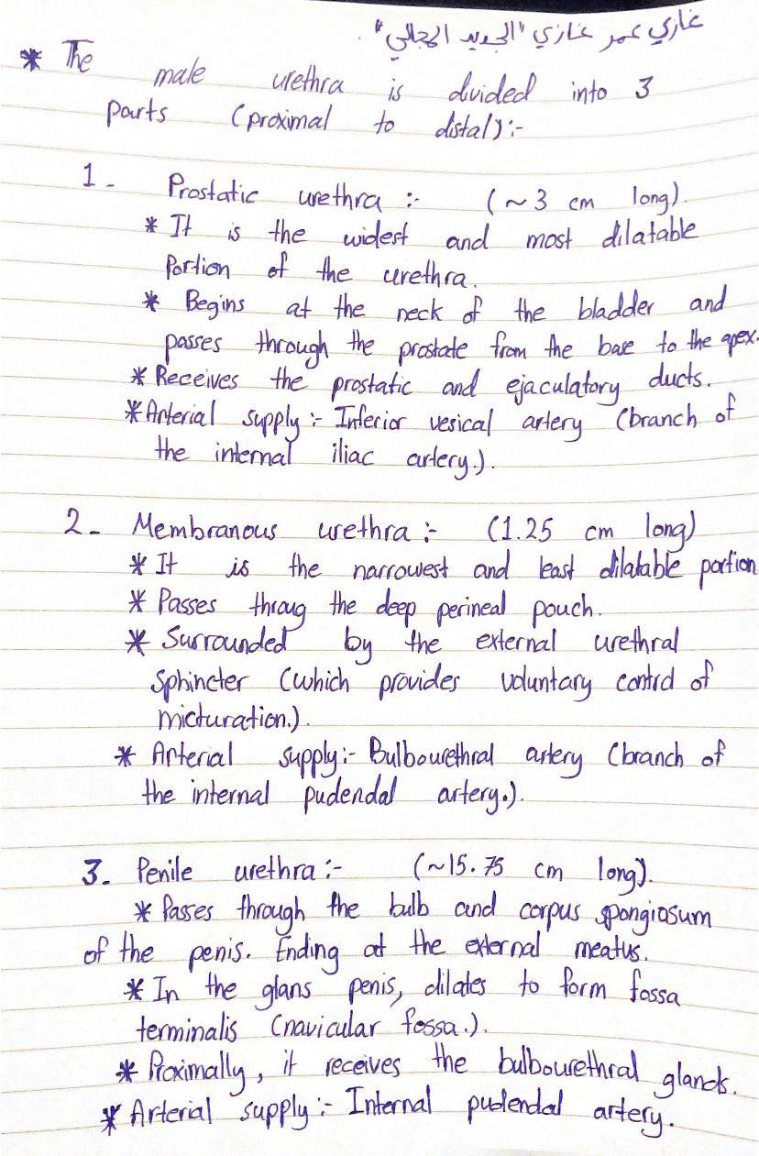
Ghazi Majali

Slide 41
27- Bladder cancer TNM
Shereen Alsheikh
Most common in older population and it’s 3times more common in males, it has several types including 1- Transitional cell carcinoma(90%) 2- Squamous cell carcinoma(8%) 3- Adenocarcinoma(2%)
Clinically presented as: Frequency, urgency, hematuria, dysuria, pelvic pain
Diagnosed by cystoscopy and biopsy mainly then TNM used to determine amount of spread..

Slide 42
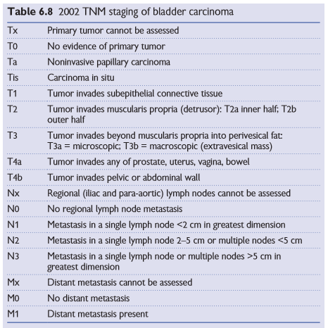
Shereen Alsheikh

Slide 43
28- Signs and symptoms of urethral trauma
Gharam Majali
Pain with voiding or inability to void
Blood at meatus/Blood at vaginal introitus
Perineal, scrotal, labial, penile ecchymosis and edema
Abnormal location of prostate on DRE high riding prostate or may appear to be absent
Blood on DRE or vaginal examination
Hematuria although not specific but hematuria on a first voided specimen may indicate injury
Hematoma or swelling

Slide 44
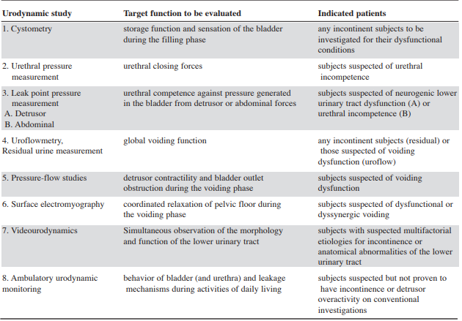
29- Urodynamic studies
Nadine Othman

Slide 45
30- Treatment protocol of prostate and bladder cancer
Khaled Samara
Prostate cancer - If life expectancy <10%, Watchful waiting
- If life expectancy > 10%, asses the risk
Low risk>> Active surveillance, PSA and biopsy every 6months-1year
Intermediate risk>> Radical prostatectomy - with mets>> short course ADT(androgen deprivation therapy) then radiotherapy
High risk -Localized>> Radical prostatectomy + EBT(extrabeam radiotherapy) -Local advanced>> neoadjuvant hormonal + EBT -Mets>> Hormonal therapy

Slide 46
Bladder cancer ttt if its T1 , T2
A -TURBT
Complications of TURBT are uncommon,including bleeding, sepsis, bladder perforation, incomplete resection,and urethral stricture.
Second resection: an early repeat TUR (within 2–6 weeks) should be undertaken:
(a) if the first resection was incomplete, (b) when the pathologist reports that the resected specimen contains no muscularis propria, or (c) if a high-grade, but apparently non-invasive, T1tumour has been reported since perhaps 10% (3–25%) of these G3pT1tumours are understaged T2 tumours.

Slide 47
in the absence of these indications for a second resection, review cystoscopy is performed at 3 months. If this demonstrates recurrence, 70% will recur further. If not, only 20% will recur further. If the bladder is clearat follow-up, subsequent cystoscopies are performed under local anesthetic at 9 months and thereafter annually for 5y
B - Alternatives to TURBT,Transurethral cystodiathermy or laser are accepted, quicker and less morbid.
If its T3 cystectomy
T4 chemo&radiotherapy

