Slide 1
Surgical Site Infection
Supervised by: Dr. Mahmoud Awaysheh
Presented by:
Maryam Abutouq
Aya Ertimat

Slide 2
Definitions
Surgical Site Infection (SSI): are Infections related to the operative procedure that occur at or near the surgical incision within 30 days of an operative procedure or within one year if an implant is left in place.
Nosocomial infection
Surgical Ward Infection
Surgical Site Infection

Slide 3
Classification
Anatomical
SWC
Timing
Severity
Superficial incisional SSI
Deep incisional SSI
Organ/Space SSI
Clean
Clean/contaminated
Contaminated
Dirty
Early
Intermediate
Late
Major
Minor

Slide 4
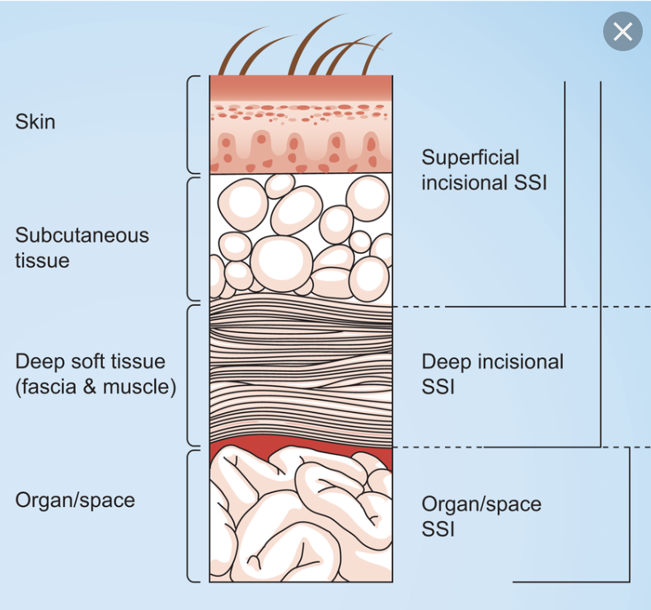
CDC* classification of SSI
* The Centers for Disease Control and Prevention

Slide 5
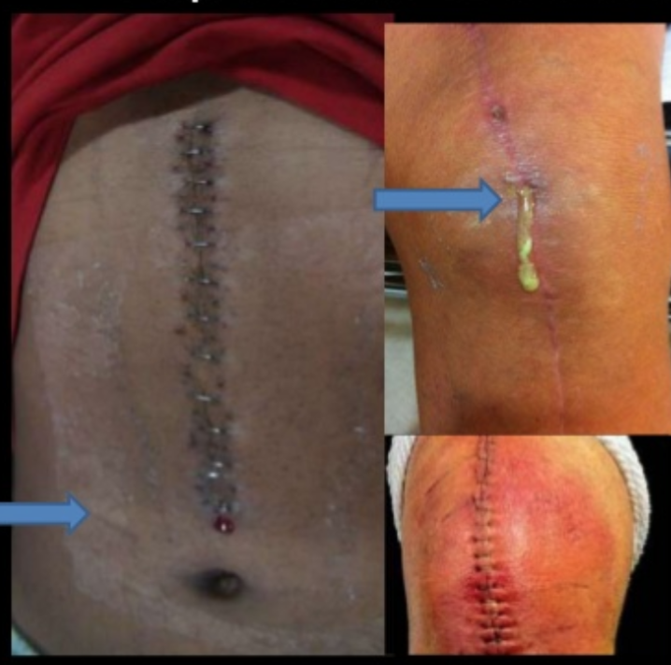
1) Superficial incisional SSI :

Slide 6
Infection involves only skin and subcutaneous tissue of incision.
At least 1 of the following:
Purulent drainage is present (culture documentation not required).
Organisms are isolated from fluid/tissue of the superficial incision.
At least 1 sign of inflammation (Localized pain or tenderness; localized swelling; erythema; or heat) is present.
The wound is deliberately opened by the surgeon.
Note: A wound is not considered a superficial incisional SSI if a stitch abscess is present; if the infection is at an episiotomy, a circumcision site, or a burn wound; or if the SSI extends into fascia or muscle.
Notes:
Note: A wound is not considered a superficial incisional SSI if a stitch abscess is present; if the infection is at an episiotomy, a circumcision site, or a burn wound; or if the SSI extends into fascia or muscle.
6

Slide 7
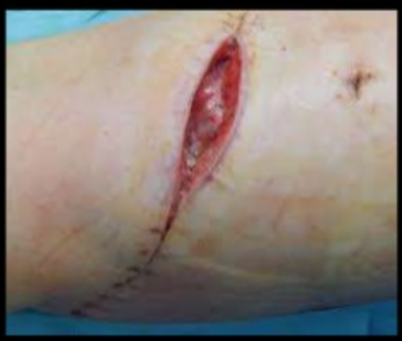
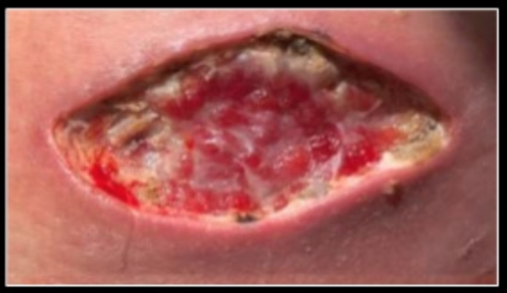

Slide 8
Involves deep soft tissues (eg, fascia and/or muscle)
At least 1 of the following:
Purulent drainage is present from the deep incision but without organ/space involvement.
Fascial dehiscence or fascia is deliberately separated by the surgeon because of signs of inflammation.
A deep abscess is identified by direct examination or during reoperation, by histopathology, or by radiologic examination.
patient has at least one of the following signs or symptoms: fever (>38°C); localized pain or tenderness.
Notes:
Involves deep soft tissues (eg, fascia and/or muscle) of the incision
Dehiscence: rupture along the surgical incision
8

Slide 9
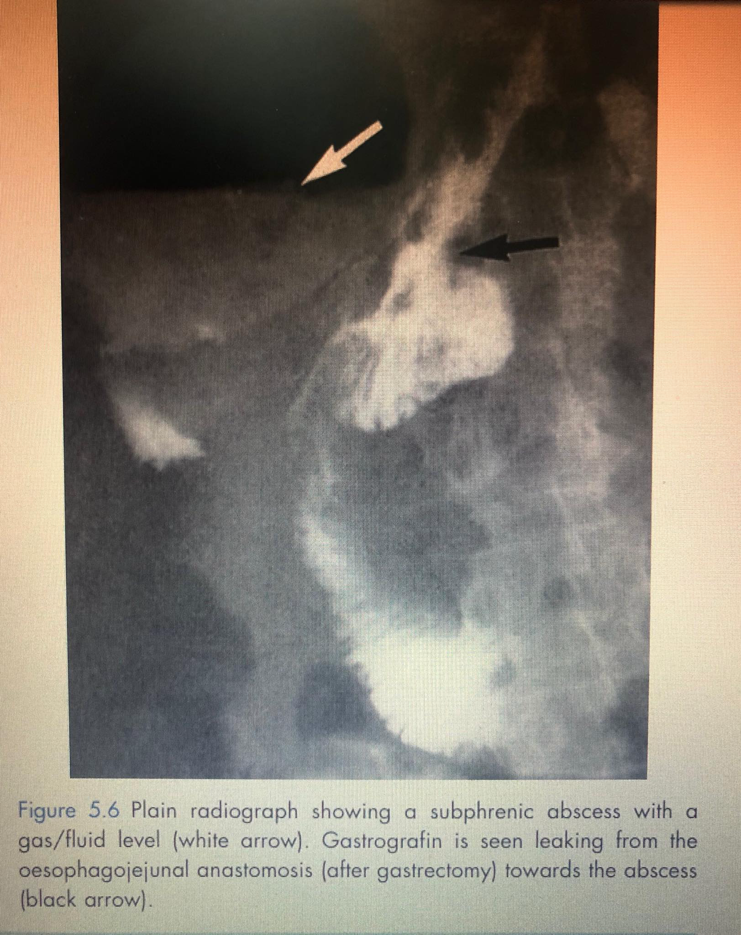
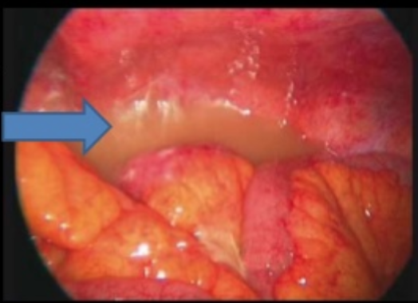

Slide 10
Infection involves any part of the anatomy in organs and spaces other than the incision, which was opened or manipulated during operation.
At least 1 of the following:
Purulent drainage is present from a drain placed by a stab wound into the organ/space.
Organisms are isolated from the organ/space by aseptic culturing technique.
An abscess in the organ/space is identified by direct examination, during reoperation, or by histopathologic or radiologic examination.
Notes:
Involves anatomical structures not opened or manipulated during the operation
10

Slide 11
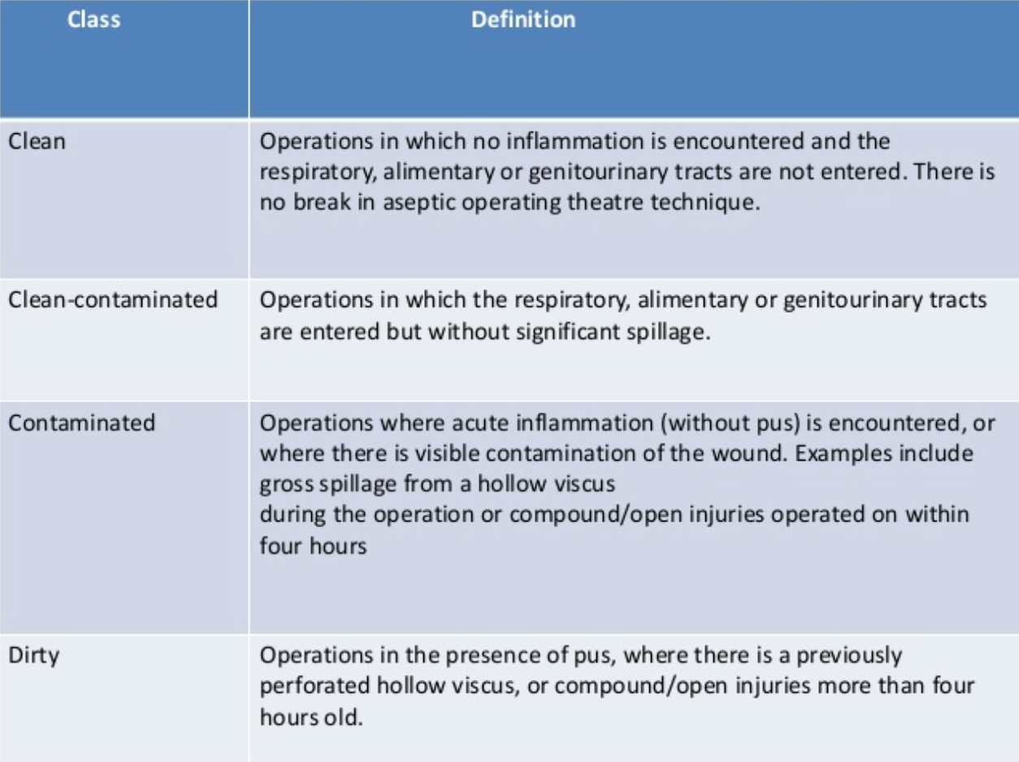
Surgical Wound Classification
Such as : hernia repair, elective cholecystectomy and thyroid surgery
Such as : Appendectomy

Slide 12
Timing
Early: Infection presents within 30 days of procedure.
Intermediate: Occurs between one and three months.
Late: Presents more than three months after surgery.

Slide 13
Severity
Minor: Wound infection is described as minor when there is discharge without cellulitis or deep tissue destruction and patient is not systemically ill & no discomfort.
Major: When there is pus discharge spontaneously or needs a secondary procedure to drain it with tissue breakdown , Partial or total dehiscence of the deep fascial layers of wound, patients are systemically ill .. Tachycardia , pyrexia , raised white counts.

Slide 14
Source of infection
Surgical site infections may be caused by endogenous (primary) or exogenous (secondary) microorganisms. Most SSIs are caused by endogenous microorganisms present on the patient’s skin when the surgical incision is made. Gram-positive bacteria such as Staphylococcus aureus. Surgical site infections may also be caused by organisms within the patient’s body that are exposed during surgery (perforated peptic ulcer, mucous membranes or bowel) .
Exogenous sources of microorganisms include surgical instruments, operating room surfaces, the air and team.
Causative pathogens depend on surgical site; for example, the risk of developing SSI from enteric gram-negative microorganisms increases with surgery on the gastrointestinal tract.

Slide 15
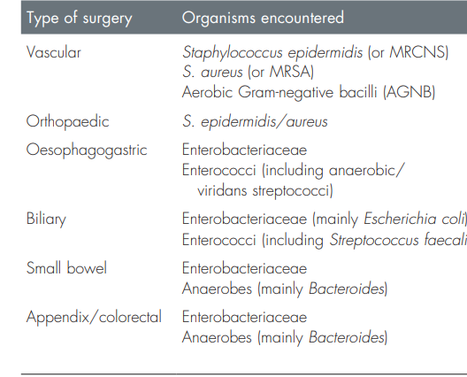
Most common pathogens responsible for SSI.

Slide 16
Systemic factors:
Age
Smoking
Hypovolemia, poor tissue perfusion.
Metabolic: malnutrition (including obesity), diabetes, uraemia, jaundice.
Disseminated disease: cancer and acquired immunodeficiency syndrome (AIDS)
Iatrogenic: radiotherapy, chemotherapy, steroids

Slide 17
Wound characteristics:
Wound classification
Nonviable tissue in wound; Hematoma.
Foreign material, including drains and sutures.
Poor skin preparation, including shaving; and pre-existing body site infection

Slide 18
Operative characteristics:
lengthy operation (>2 h).
Intraoperative contamination.
Poor surgical technique.
Site of operation.
Prolonged duration of hospital stay.
Blood transfusion and emergency surgery.

Slide 19
Complications of SSI
Wound dehiscence
Sepsis
Suppressed and delayed wound healing
Fistula and Sinus formation
Incisional Hernia
Poor quality or abnormal scar formation (hypertrophic scar)

Slide 20
PREVENTION of SSI
Notes:
Prevention is the key of management of surgical infections. While the risk of developing a post-surgical infection is small, the consequences can be devastating Here are some recommendations that you can use to help prevent infection at the time of your surgery.

Slide 21
Why we Prevent SSI?
Notes:
Patients that develop SSI have twice the mortality and are: 60% more likely to spend time in ICU , 5 times more likely to be readmitted
SSI increases length of stay in hospital by an average of 7.5 days , cost effective

Slide 22
Patients that develop SSI have twice the mortality and are: 60% more likely to spend time in ICU , 5 times more likely to be readmitted
SSI increases length of stay in hospital by an average of 7.5 days ,
cost effective

Slide 23
Measures can be taken to prevent the SSIs in three large category:
preoperative phase
intraoperative phase
postoperative phase
Notes:
The majority of surgical site infections are preventable.

Slide 24
preoperative phase 1.preparation of patient
1. Short preoperative hospital stay
2. Identify & treat all remote infections.
3. Patient is advised to take a shower and dressed
with the theatre wear.

Slide 25
Hair removal
Patients undergoing any surgical procedure, hair should either not be removed or, if absolutely necessary, it should be removed only with a clipper.
may be necessary to facilitate
Adequate exposure and preoperative skin marking.-
-Suturing
-And the application of wound dressings can be complicated by the presence of hair

Slide 26
preoperative phase preparation of patient
Keep the patient as short as possible in the hospital

Slide 27
Prophylactic antibiotic:
How: Intravenous administration
When: At induction of anesthesia is optimal.
In long operations, those involving the insertion of a prosthesis, when there is excessive blood loss or when unexpected contamination occurs, antibiotics may be repeated 8 and 16 hours later.
.

Slide 28
Whom: 1. clean surgery involving the placement of a prosthesis or implant.
2. clean-contaminated wound
3. contaminated wound
Which: the antibiotic that has activity against the pathogen most likely to be encountered in the procedure.

Slide 29
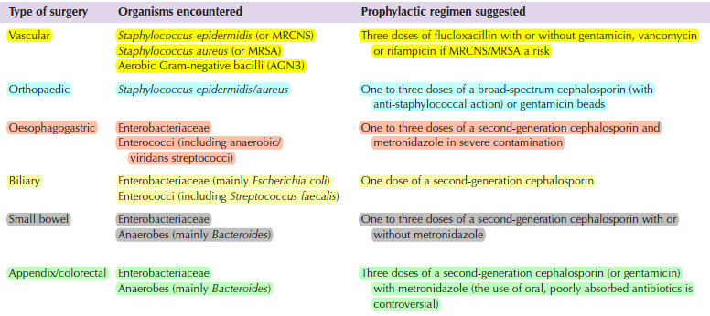

Slide 30
Lower limb amputation should be covered against C.perfringens using 1.2 g of benzylpenicillin intravenously at induction of anaesthesia and 6
hourly thereafter for 48 hours.
Never continue prophylaxis for more than 48 h

Slide 31
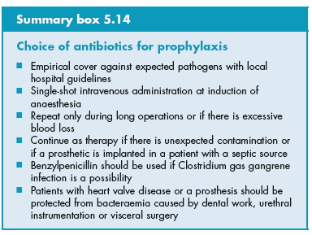

Slide 32
Prolonged use of prophylactic antibiotics may:
- Mask signs of established infection, making diagnosis difficult.
- Increase number of resistant pathogens
- Serious hypersensitivity

Slide 33
Mechanical Bowel Preparation
The panel suggests that preoperative oral antibiotics combined with mechanical bowel preparation (MBP) should be used to reduce the risk of SSI in adult patients undergoing elective colorectal surgery .

Slide 34
MBP involves the preoperative administration of substances to induce voiding of the intestinal and colonic contents.
The most commonly used cathartics for MPB are:
- polyethylene glycol
- sodium phosphate

Slide 35
Enhanced nutritional support
the administration of oral or enteral multiple nutrient-enhanced nutritional formulas for the purpose of preventing SSI in underweight patients who undergo major surgical operations.

Slide 36
nutritional formulas contain any combination of arginine, glutamine,omega-3 fatty acid and nucleotides.
Malnutrition, including protein-energy and
micronutrient deficiencies, continues to be a major public health problem, particularly in developing countries.

Slide 37
Perioperative fluid therapy prevents tissue
hypoxia by maximizing the cardiac output and thus improving arterial oxygenation
In addition, sufficient tissue oxygenation is essential for collagen synthesis and wound repair

Slide 38
perioperative blood glucose control
Blood glucose levels rise during and after surgery due to surgical stress.
hyperglycaemia is associated with an increased risk of SSI and therefore an increased risk of morbidity, mortality and higher health care costs in both
diabetic and non-diabetic patients

Slide 39
Maintaining normal body temperature (normothermia)
the use of warming devices in the operating room and during the surgical procedure for patient body warming with the purpose of reducing SSI.

Slide 40
preoperative phase staff
1. The doctor shall use aqueous antiseptics, with scrubbing including the nails. Subsequent scrubbing should merely involve washing to the elbows
2. Medical staff should always wash their hands
between patients.
3.Keep fingernails short; do not wear artificial nails.
4. Do not wear arm/hand jewelry
Notes:
Personnel with skin lesions that are draining are to be excluded from duty until treated and the infection has resolved.

Slide 41
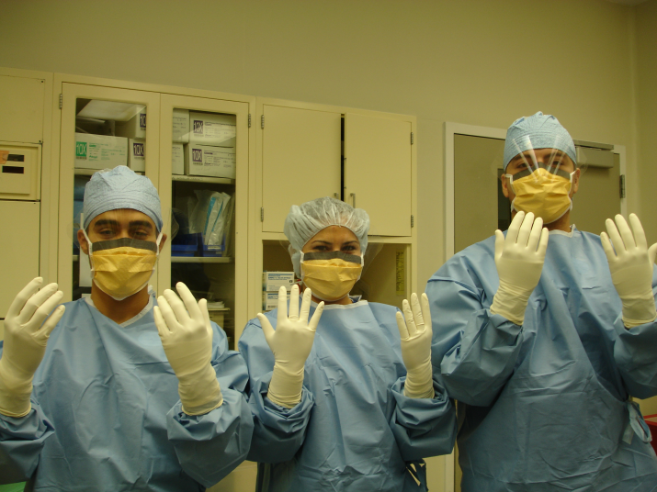
preoperative phase staff
Wearing sterile gloves ,masks ,cap ,and gowns
surgeons scrub hands
Notes:
or the first operation of the day, aqueous antiseptics should be useScrub hands and forearms as high as the elbows for at least 2-5 minutes with appropriate antiseptic.
Shoe covers are not necessary.
After scrub, keep hands up with elbows flexed and away from the body; use a sterile towel to dry the hands and put on a sterile gown and glovesd, and the scrub should include the nails

Slide 42
Intraoperative stage:
1. application of an alcoholic antiseptic is adequate for skin preparation of the operative site.
2. Numbers of staff in the theatre and movement in and out of theatre should be kept to a minimum
3. Operator skill in gentle manipulation and dissection of tissues to avoid dead spaces and hematomas formation.
4. In severely contaminated wounds, such as an incision made for drainage of an abscess, it is logical to leave the skin open. Delayed primary or secondary suture can be undertaken when the wound is clean and granulating.

Slide 43
Intraoperative phase
Prepare the skin at the surgical site immediately before incision using an antiseptic preparation
Notes:
Some times healthcare providers will remove the hair around the surgical site before surgery ,they will use electric clippers to do this . Razors can cause nicks and cuts in the skin that could increase the risk of an infection
• Prepare the skin at the surgical site immediately before incision using an antiseptic (aqueous or alcohol-based) preparation: povidone-iodine or chlorhexidine are most suitable.
Sterile surgical instruments and solutes should be assembled just prior to use.
All surgical instruments should be sterilized according to guidelines. Flush sterilization should only be used for instruments that are required for immediate patient use .
The third issue is oxygenation. The fresh, hemostatic surgical incision is a hypoxic, ischemic environment.
Maintaining or increasing oxygen delivery to the wound by increasing the inspired oxygen concentration administered to the patient perioperatively has also been shown to reduce the incidence of SSIs. It is presumed that increased oxygen availability is a positive host factor, perhaps via enhanced production of oxidant products that facilitate phagocytic eradication of microbes
Maintain optimal oxygenation during surgery. In particular, give patients sufficient oxygen during major surgery and in the recovery period to ensure that a haemoglobin saturation of more than 95% is maintained.

Slide 44
Adult patients undergoing general anesthesia with endotracheal intubation for surgical procedures should receive an 80% fraction of inspired oxygen (FiO2) intraoperatively and, in the immediate postoperative period for 2-6 hours to reduce the risk of SSI.

Slide 45
There is evidence that an optimized blood flow to the surgical incision reduced SSI rates through the avoidance of hypothermia, hypoxia and decreased perfusion
Patients are routinely given 100%
oxygen for 30 seconds to 2 minutes prior to
intubation and then maintained on either
“normoxia”, defined as oxygen at 30% or 35%
FiO2, or “hyperoxia”, defined as oxygen at 80%
FiO2.

Slide 46
Ventilation of surgical theater
-Positive pressure to corridors
-A minimum of 20-25 air exchanges per hour
-Filter air

Slide 47
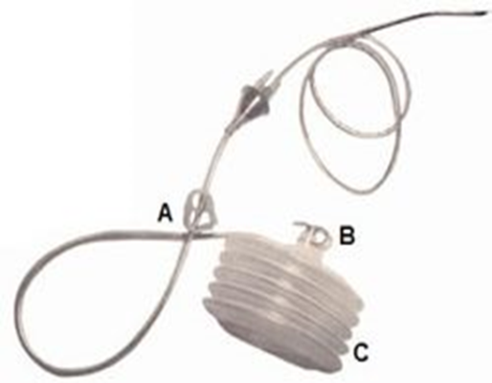
Asepsis & surgical technique:
Handle tissue gently
Maintain effective homeostasis
Minimize devitalized tissue
If drainage is necessary use closed suction drain placed through a separate incision distant from the operative incision
Remove the drain as soon as possible

Slide 48
Incisional wound irrigation
Intraoperative wound irrigation is the flow of a
solution across the surface of an open wound to achieve wound hydration and it is widely practised to help prevent SSI
Physical clearance :
removing cellular debris, surface bacteria and body fluids

Slide 49
Postoperative phase
Sterile dressing for 24-48h post. op.
Wash hands before & after dressing changes
Use sterile technique for dressing changes
Educate the patient & family regarding proper incision care , symptoms of infection , & need to report such symptoms
Prolonged and carefully audited follow-up with primary care doctors after patient’s discharge.

Slide 50
Advanced dressings
It is common
The dressing acts as a physical barrier to protect the wound from contamination from the external environment until the wound becomes impermeable to microorganisms.
The dressing can also serve to absorb exudate from the wound and keep it dry.

Slide 51
Surgical site infection
Management

Slide 52
Management of surgical wound infection
1. Empirical antibiotics then start definitive antibiotics following culture results
2. Removal of sutures/ clips to drain any pus collection
3.Removal of dead (necrotic) or infected skin tissue within a surgical wound.
4.monitor closely for signs of systemic infections or sepsis

Slide 53
Empirical antibiotics
First-line antibiotic therapy (‘empirical’ or ‘blind’ therapy) should cover the most likely infecting pathogens
Uses :
high risk ….e.g., ruptured appendicitis)
Significant contamination has occured during surgery(e.g., spillage of colon contents).
Duration : for short duration (3-5 days) till we switch to specific therapy after culture & sensitivity

Slide 54
The empiric choice of drugs must Depends on :
the organisms most often cultured from similar infections in previous patients,
Results of Gram stains

Slide 55
Clean-contaminated surgery
metronidazole, co-amoxiclav.
for patients at risk for candidiasis : (DM , immune-compromised )
empiric antifungal therapy (fluconazole , amphotericin
cephalosporins , ampicillin/sulbactam
community-acquired infections
appendectomy for gangrenous, perforated appendicitis, or bowel resection for intestinal perforation,
against aerobes and anaerobes
(ciprofloxacin plus metronidazole)
Notes:
Mastectomy : imipenem/cilastatin or meropenem

Slide 56
Cephalosporin
Cefuroxime , cefotaxime
-Effective in intra-abdominal skin and soft-tissue infections,
being active against Staphylococcus aureus and most Enterobacteriaceae.
-cephalosporins may be combined with anaminoglycoside, if anaerobic cover is needed.

Slide 57
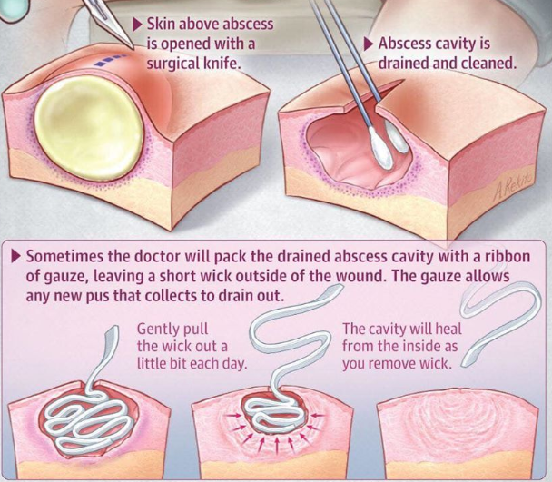
Incision and drainage
Decreases the pressure &the number of bacteria and so decreases the spread of toxins and bacteria.
abscess +systemic manifestations = surgical emergency.
Fluctuation is a reliable ( but late sign ) of a subcutaneous abscess.
Abscesses need drainage with curettage
Deep :may be drained by a catheter placed percutaneously under guidance by CT or U/S.
If the abscess is inaccessible …operative drainage

Slide 58
Debridement
removal of dead (necrotic) or infected skin tissue within a surgical wound.
Wound debridement can:
help healthy tissue grow
minimize scarring
reduce complications of infections

Slide 59
Biological
enzymatic
Debridement methods
Surgical
autolytic
Mechanical

Slide 60
Biologic Debridement
Notes:
Lucilia sericata

Slide 61
Biologic Debridement
uses sterile larvae of the Lucilia sericata species of the green bottle fly.
appropriate in large wounds where a painless removal of necrotic tissue is needed
The mechanism of action of mega therapy/debridement :
3-Bacteriocidal, as the larvae ingest and digest bacteria
2-Inhibiting bacterial growth by producing in releasing ammonia into the wound bed which increases the wound pH
3-Direct ingestion of necrotic tissue
Contraindications to biological debridement are an abdominal wound contiguous with the intraperitoneal cavity, in patients with immunosuppression therapy, and wounds in proximity to areas afflicted by septic arthritis.
Notes:
They secrete “proteolytic enzymes that break down necrotic tissue and then ingest the liquefied tissue

Slide 62
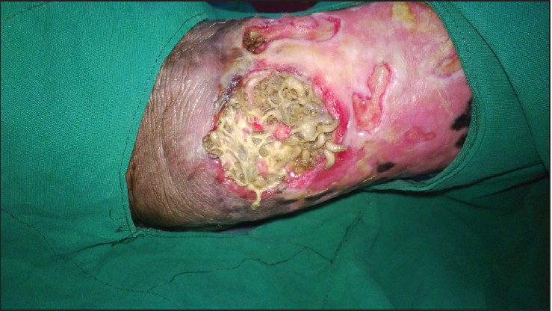

Slide 63
Enzymatic Debridement

Slide 64
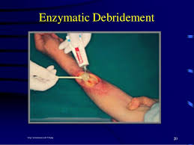
Enzymatic Debridement
This is a selective method for debridement of necrotic tissue using an exogenous proteolytic enzyme, collagenase. Collagenase digests the collagen in the necrotic tissue allowing it to detach.
Advantages:
1- Selective
2- Effective in combination with other debridement techniques
 Disadvantages:
1- Enzymatic use is prolonged more than necessary, increasing costs
2- Can be slow – 3-30 days to achieve a completely clean wound bed (it is faster than autolysis however)
3- May be inactivated by contact with heavy metals (zinc or silver)
3- Risk of maceration and infection
4- Requires frequent dressing changes (1-3 times per day)
Notes:
 Cannot be used on dry wounds …
relative contraindication of enzymatic debridement is its use in heavily infected wounds.

Slide 65
Autolytic debridement
Notes:
The process of using the body’s own mechanisms (enzymes) to remove nonviable tissue”
enzymes called matrix metalloproteinases (MMPs), which are produced by damaged tissue

Slide 66
Autolytic debridement
This type of debridement is a natural process by which endogenous phagocytic cells and proteolytic enzymes break down necrotic tissue
May be accomplished by the use of any moisture-retentive dressings, i.e. hydrocolloids, hydrogels, hypertonic dressings/gels, and/or transparent films
It is indicated for noninfected wounds
Notes:
The process of using the body’s own mechanisms (enzymes) to remove nonviable tissue”
enzymes called matrix metalloproteinases (MMPs), which are produced by damaged tissue

Slide 67
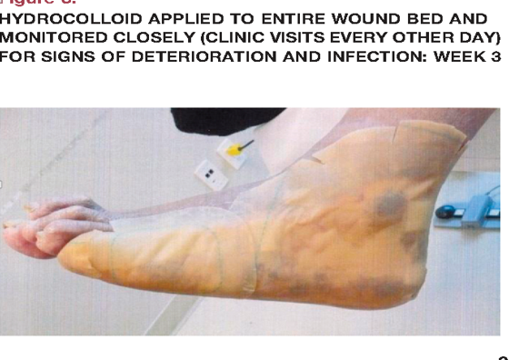
Advantages:
1- Painless in the majority of people with wounds
2- Effective and easy to perform
3- Selective
4- Low cost
 Disadvantages:
Slow

Slide 68
Mechanical Debridement
Notes:
nonselective type of debridement, meaning that it will remove both devitalized tissue and debris as well as viable tissue.
It is usually carried using mechanical force: wet-to-dry dressing , or wound irrigation.

Slide 69
Mechanical Debridement
nonselective type of debridement, meaning that it will remove both devitalized tissue and debris as well as viable tissue.
It is usually carried using mechanical force: wet-to-dry, or wound irrigation.
Indication : acute and chronic wounds with moderate to large amounts of necrotic tissue
contraindications :
1- presence of granulation tissue in a higher amount than the devitalized tissue
2- inability to control pain
3- patients with poor perfusion
Notes:
Disadvantages (wet-to-dry gauze): • Non-selective • Rarely applied correctly • Painful • More costly (labor and supplies) • May cause maceration

Slide 70
Surgical Debridement with Sharp Instruments
this is a type of debridement where devitalized tissue (slough, necrotic, or eschar) in the presence of underlying infection is removed using sharp instruments such as a scalpel, curettes, scissors, or other sharp instruments
Sharp-instrument debridement can be combined with all the other methods of debridement during the perioperative period.
Disadvantages of surgical debridement :
bleeding and possible general complications from the anesthesia.
Contraindicated :
in patients with an intact eschar and no clinical evidence of an underlying infection

Slide 71
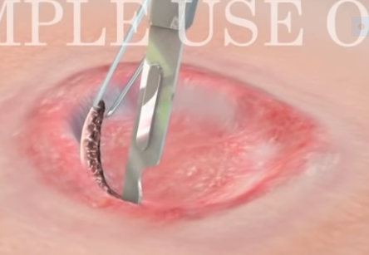
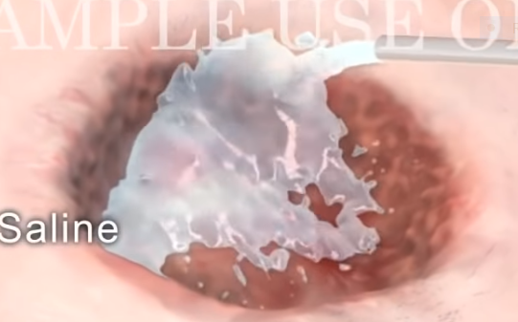
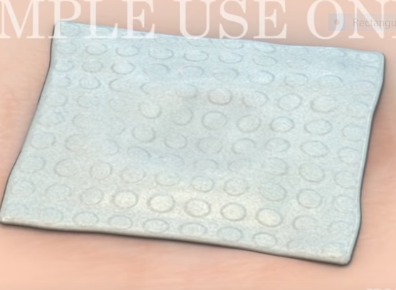

Slide 72
Start debriding from the base of the wound (The reason for starting from base of the wound is that because the blood from upper margins fall into base and give false impression of red bleeding tissue)
Debride tissues until red bleeding margins are seen
Irrigate the area with normal saline and bactericidal agent such as hydrogen peroxide
Dry the area with clean sponge and do dressing

Slide 73
The open wound often is allowed to heal by secondary intention, with dressings being changed twice a day.

Slide 74
Specific therapy

Slide 75
Escherichia coli
Antibiotic Class | mechanism of action
Penicillins (Piperacillin) | Cell wall synthesis inhibitors (bind penicillin-binding protein)
Penicillin/beta lactamase inhibitor combinations (Ampicillin-sulbactam) | Cell wall synthesis inhibitors/beta lactamase inhibitors
First-generation cephalosporins (Cefazolin) | Cell wall synthesis inhibitors (bind penicillin-binding protein)
Second-generation cephalosporins Cefoxitin, Cefotetan, Cefuroxime | Cell wall synthesis inhibitors (bind penicillin-binding protein)
Third- and fourth-generation cephalosporins Ceftriaxone, Ceftazidime, Cefepime, Cefotaxime | Cell wall synthesis inhibitors (bind penicillin-binding protein)
Aminoglycosides (Gentamicin) | Alteration of cell membrane, binding and inhibition of 30S ribosomal unit
Fluoroquinolones Ciprofloxacin | Inhibit topoisomerase II and IV (DNA synthesis inhibition)
Notes:
Cell membrane :
Piperacillin
Ampicillin-sulbactam
cephalosporins
Carbapenems
Protein synr=thesis :
minoglycosides
Trimethoprim-sulfamethoxazole (co-trimoxazole)
Dna :
Fluoroquinolones

Slide 76
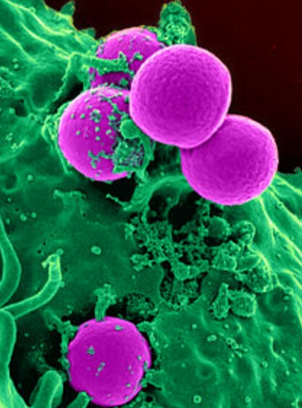
MRSA (methicillin-resistant Staph.aureus)
Glycopeptides (Vancomycin)
Daptomycin
Clindamycin
Notes:
Cell wall synthesis inhibition (peptidoglycan synthesis inhibition) : vancomycin
Daptomycin : Binds bacterial membrane, results in depolarization, lysis
Clindamycin: inInhibits 50S ribosomal activity (protein synthesis inhibition

Slide 77
MSSA = methicillin-sensitive Staph. aureus)
Penicillin/beta lactamase inhibitor combinations
*Ampicillin-sulbactam
*Ticarcillin-clavulanate
*Piperacillin-tazobactam
1st – 4th Generation cephalosporins +5th CS
Fluoroquinolones (ciprofloxacin)

Slide 78
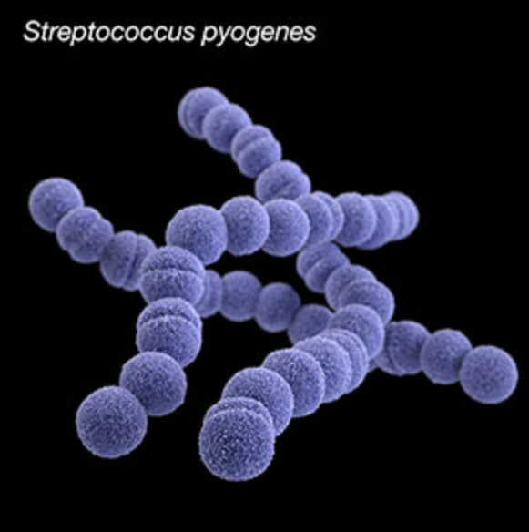
Strep. Pyogenes
Penicillins: (Penicillin G, Nafcillin, Piperacillin)
1st CS (cephazolin)
2nd CS (cefoxitin)
3rd (ceftriaxone)
Tetracyclines (Monocycline, Doxycycline)
Notes:
Tetracyclines : Bind 30S ribosomal unit (protein synthesis inhibition)

Slide 79
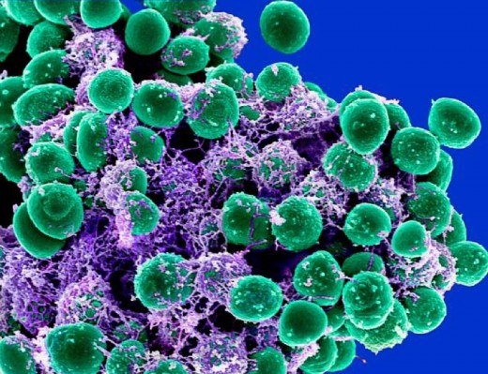
staph epidermidis
Vancomycin
Ceftaroline
Ciprofloxacin
Piperacillin-tazobactam

Slide 80
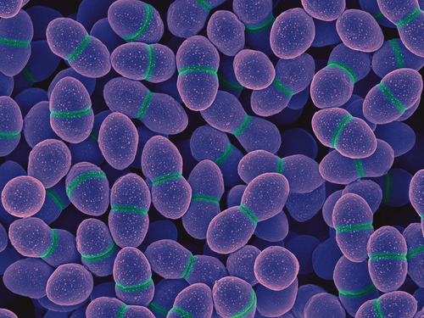
ENTEROCOCCUS
Vancomycin
Gentamicin

Slide 81
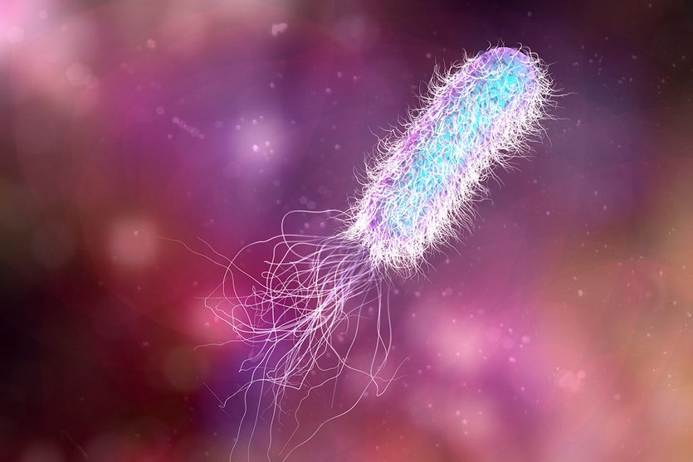
pseudomonas aeruginosa
Piperacillin
Piperacillin-tazobactam
Ceftazidime
Cefepime
Gentamicin
Ciprofloxacin
Notes:
ndications for combination: mixed infection :
Peritonitis due to perforated PU (aerobic, anaerobic).
- After hysterectomy (aerobic, anaerobic).
- We can use Metronidazole+ Ampicillin + Garamycin

Slide 82
.Penicillins:
- Common agents: Penicillin G, Penicillin V, Ampicillin, Amoxicillin and Methicillin.
Spectrum: Gm +ve (mainly) e.g. staph & streptococci & Gm-ve bacteria
.Cephalosporins :
-1st Gephalosporins e.g. cephalothin ) active against Gm+ve bacteria but not MRSA.
- 2nd generation Cephalosporins e.g. cefamandole ) active against Gm-ve but less active against Gm +ve.
- 3'd generation Cephatosporins: very effective against Gm-ve but less against Gm+ve infection.
- Some agents in 2nd and 3'd generations are effective against anaerobes
Aminoglycosides:
- Mode of action: interferes with bacterial protein synthesis.
- Common agents: Gentamycin, Tobramycin & Amikacin.
- Spectrum: Gm-ve aerobic organisms (mainly) with little activity against Gm+ve and anaerobic organisms.
Quinolones:
- Common agents: Naldixic Acid, Norfloxacin & Ciprofloxacin (fluroquinolone).
- Spectrum: Gm-ve aerobic bacteria

Slide 83
Glycopeptides:
Mode of action: interferes with bacterial cell wall synthesis.
- Gommon agents: Vancomycin
Tetracycline & Ghloramphenicol:
- More active against anaerobic organisms.
- Their use in surgical patients has been replaced by more effective drugs.
Co-trimoxazole:
- Effective against a variety of Gm-ve aerobic bacteria & some unusual infections in the immunosuppressed patients as those caused by pneumocystis carinii & nocardia asteroids.
Metronidazole: - Excellent anaerobic activity but no effect against aerobic organisms.
Ervthromvcin (Macrolides):
- Active mainly against Gm +ve bacteria & is usually used in patients sensitive to B-lactam agents.
Glindamycin:
- Very effective against anaerobes & has some Gm +ve activity.

Slide 84
When to stop?
When complete assurance that infection has been eradicated
Normal WBC count
No more of bands of PMNs
No fever (<38°C)

Slide 85
Specific local wound infections
Tetanus
NECROTISING FASCIITIS
GAS GANGRENE

Slide 86
Tetanus
Tetanus is caused by the Clostridium tetani bacterium
predisposing factor :
The anaerobes organisms flourish more in wounds with low oxygen tension as :
1- deep wound >1cm
2- tissue anoxia from haemorrhage and shock
3- associated with pyogenic infection (which consumes local oxygen )
Notes:
Gram + anaerobes bacilli

Slide 88
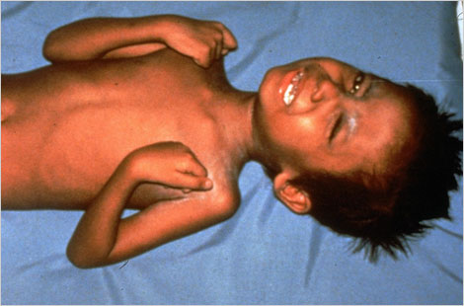
CLOSTRIDIUM TETANI
preventative treatment : Prophylaxis with tetanus toxoid is the best preventative treatment.
Treatment :
Neutralize toxins with tetanus immunoglobulin
minor debridement of the wound
antibiotic treatment with benzylpenicillin
Relaxants may be required
ventilation in severe forms
Notes:
Admition to icu (risk of reflux spasm )
Prophylactic intubation should be seriously considered in all patients with moderate-to-severe clinical manifestations
Tracheostomy should be performed in patients requiring intubation for more than 10 days.

Slide 89
Gas gangrene
organism is Clostridium perfringens.
Predisposing factor :
The anaerobes organisms flourish more in wounds with low oxygen tension as :
1- lacerated wounds involving bulky muscle
2- ischemia of muscles or devitalized tissue
3- contaminated above knee stump by stool if patient suffer from faecal incontinence

Slide 90
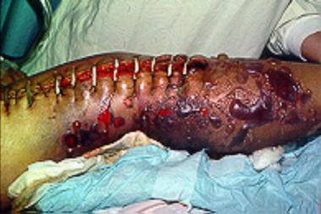
Gas gangrene
large doses of IV penicillin
aggressive debridement
amputation of the infected limb
Hyperbaric oxygen (HBO) therapy
Notes:
Tense swollen limb
Wound stitches are under tension
Foul odor exudate from wound
Black color skin
Colostomy in extensive perineal infection

Slide 91
Necrotizing fasciitis
Organisms : mixed microbial flora
Perdisposing factor : immunocopramised patient e.g. diabetic patient

Slide 92
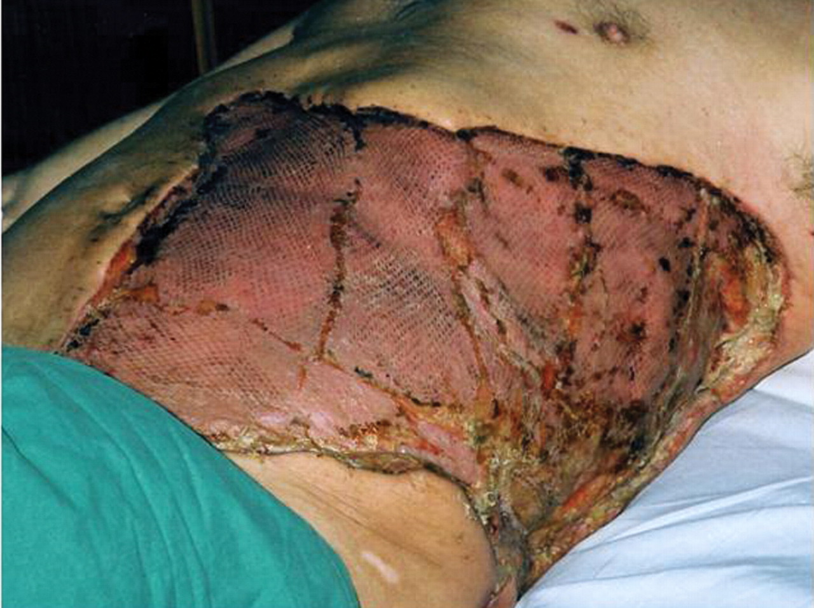
Necrotizing fasciitis
Broad-spectrum antibiotic therapy must be combined with aggressive circulatory support.
Locally, there should be wide excision of necrotic tissue and laying open of affected areas.
The debridement may need to be extensive, and patients who survive may need large areas of skin grafting
Notes:
Late signs of necrotising fasciitis with extensive cellulitis, induration, skin necrosis, and formation of haemorrhagic bullae
Penicillin + gentamycin

Slide 93
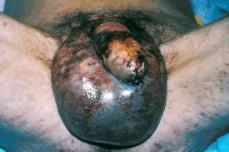
Fournier Gangrene
polymicrobial necrotizing fasciitis of the perineal, perianal, or genital areas.
Comorbid risk
Diabetes
-Alcohol misuse
-Immunosuppression
-Chemotherapy
-Chronic cortiosteroid use
-HIV
-Leukaemia
-Liver disease

Slide 94
Aetiology of Fournier's gangrene
Urogenital:
Urethral stricture
Indwelling catheter
Traumatic catheterisation
Urethral calculi
Prostatic biopsy
Vasectomy
Anorectal
Perianal abscess
Rectal biopsy
Anal dilatation
Haemorrhoidectomy
Rectosigmoid malignancy
Appendicitis
Diverticulitis
Gynaecological
Infected Bartholin's gland
Septic abortion
Episiotomy wound
Coital injury
Genital mutilation

Slide 95
History
- fever
- Intense genital pain and tenderness that is usually associated with edema of the overlying skin; pruritus may also be present
- erythema of the overlying skin
- Dusky appearance of the overlying skin; subcutaneous crepitation
- Obvious gangrene of a portion of the genitalia; purulent drainage from wounds
Notes:
ever
Pain and swelling in the genitals or anal area
Unpleasant odor coming from the affected skin tissue
Crackling sound when touching the affected area
Dehydration
Anemia

Slide 96
the definitive diagnosis of Fournier gangrene is provided by examination with the patient under anesthesia followed by incision into the area of greatest clinical concern. If frankly gangrenous tissue is found or purulence is drained, the diagnosis of Fournier gangrene is established

Slide 97
Treatment
aggressive resuscitation
Provide airway management if indicated, give supplemental oxygen.
broad-spectrum antibiotics
Surgery to remove the dead and dying tissue and to confirm the diagnosis.
Reconstruction : Primary closure of the skin, if possible
Local skin flap coverage
Split-thickness skin graft
Muscular flaps, which are used to fill a cavity (eg, ischiorectal space)

Slide 98
references
Bailey & Love’s , 27th EDITION
Schwartzs-Principles-of-Surgery-Tenth-Edition.

