Slide 1
Vestibular apparatus
By
Dr. Nour A. Mohammed
MUTAH SCHOOL OF MEDICINE

Slide 2
Vestibular apparatus
The organ that detects the sensation of equilibrium
It is composed of:
Bony part (bony labyrinth) which consisted of 3 bones semicircular canals & vestibule
Membranous part
which consisted of 3 semicircular canals ampullae,
2 sacs utricle and saccule(the Macula)
Between the bony and membranous labyrinth, there is a fluid called perilymph and inside the membranous labyrinth there is another fluid endolymph.

Slide 3
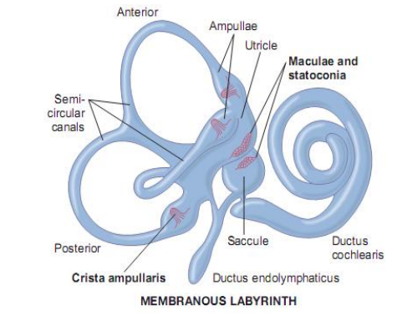

Slide 4
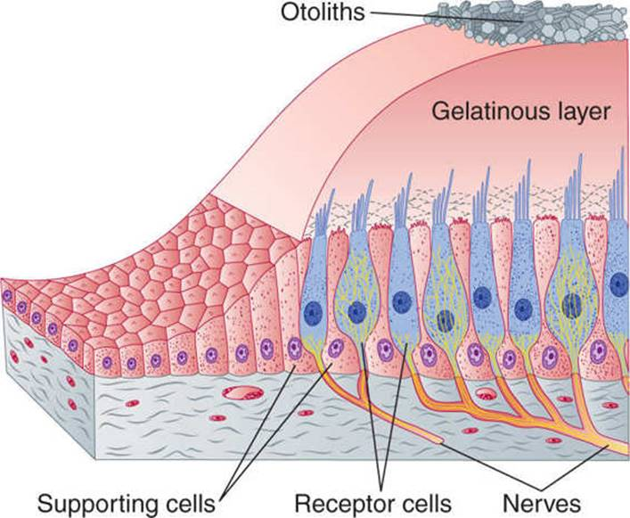
With the head in the erect position, the macula of the utricle is in the horizontal plane while that of the saccule is vertical.
The non-auditory labyrinth in each side is composed of:
(A) The utricle and saccule (Two sacs inside the bony vestibule ) Contain sensory organ called the Macula
The macula is formed of a ridge of columnar epithelium with hair cells having 50-70 stereocilia and one large kinocilium on one side. These cilia covered with gelatinous material, embedded on its top calcium carbonate called Otoliths or Otoconia. With the head in the erect position, the macula of the utricle is in the horizontal plane while that of the saccule is vertical.

Slide 5
Mechanism of action
Bending the cilia of hair cells to side of Kinocilium → depolarization of hair cells and increase its discharge in the vestibular nerve.
Bending the cilia to the opposite side causes hyperpolarization of hair cells and inhibition of afferent impulses.
As the hair is stimulated when otoconia pull on them, each group of hair is oriented in a different direction so, each position of head detected by a particular group of hair .

Slide 6
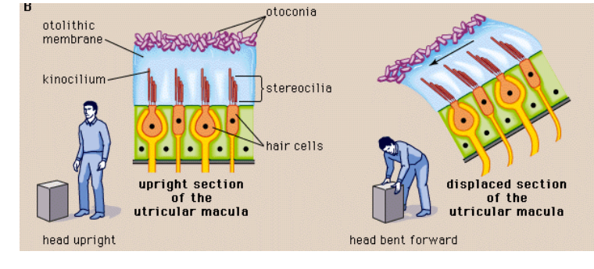

Slide 7
Function of the Macula
Orientation of the head in space (static equilibrium):
If the head in normal erect position ð equal impulses from Rt. & Lt. maculae.
Titling the head to Rt. → the otoliths of Rt. side displaced by gravity and bending the hair cells →↑ rate of discharge from Rt. utricle and ↓ discharge from Lt. utricle → sensation of tilting of head to right.
2. Receptors for linear acceleration:
When the body is suddenly forward accelerated, the otoconia (which have greater inertia than surrounding fluid) displaced backwards → bending of cilia → stimulation of hair cells → false sensation of falling backwards → automatic leaning the body forwards for proper equilibrium.

Slide 8
Function of the Macula
3. Receptors for orientation during swimming under deep water:
proprioceptive impulses are absent in this condition. Because, water press allover the body by equal pressure So, any one with inner ear disease must avoid swimming. Because, if he closes his eyes he will immediately sink.

Slide 9
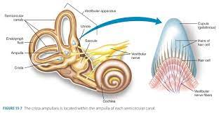
With the head in the erect position, the macula of the utricle is in the horizontal plane while that of the saccule is vertical.
The non-auditory labyrinth in each side is composed of:
(B) Semicircular canals: sensory organ (Crista ampullaris)
The crista composed of ridge of columnar hair cells. The hair is embedded in gelatinous material called cupula, and each cell contains 40-70 stereocilia and one large kinocilium.

Slide 10
Mechanism of action
SCC are stimulated by angular acceleration (rotation)
Bending of cilia in Direction of Kinocilium causing Depolarization of hair cells & Discharge of impulses in the vestibular nerve on same side.
In horizontal (lateral) canals the kinocilium is present towards the utricle. So, crista is stimulated when it bends towards the utricle.
In the vertical canals the opposite occur

Slide 11
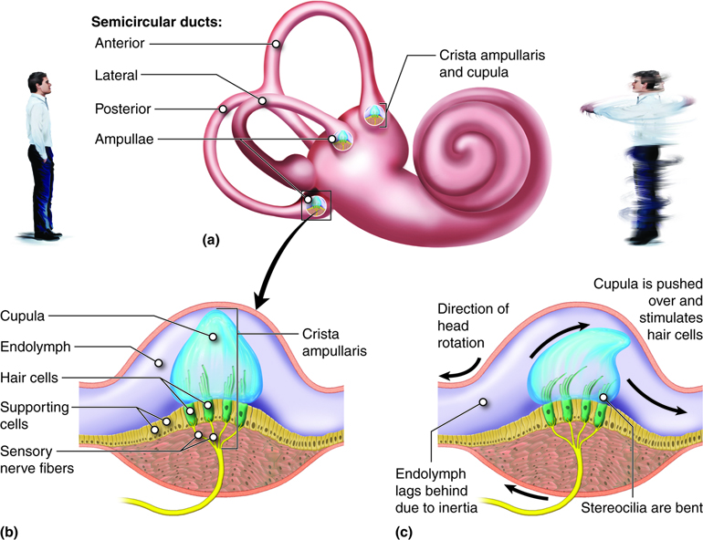

Slide 12
Function of the Crista ampullaris
Mode of action of SCC in angular acceleration:
During rest: these is equal impulses are discharged from SCC of both sides.
During rotation to right the following occurs:
At the beginning of rotation:
The endolymph by its inertia rotates to Lt (opposite to side of rotation) → bending both cristae to left.
The Rt. crista bends towards the utricle so it is stimulated →↑ impulse frequency.
The Lt. crista bends away from the utricle so it is inhibited (hyperpolarized) →↓ impulse frequency.
This unbalanced discharge gives the CNS the sensation of rotation to the Rt.

Slide 13
Function of the Crista ampullaris
After 20-30 seconds of rotation: as the rotation continues the inertia is overcome and the endolymph moves at the same rates as its bony canal so the cupula return to their normal position by their elasticity → the sensation of rotation disappear.
At the stoppage of rotation: the endolymph due to its momentum (force keeping it moving) continue to move to the Rt. after stoppage of rotation → bending the cristae to right → stimulation of left crista → false sensation of rotation to left (vertigo).
After 20-30 seconds of stoppage: The movements of endolymph stop and cupula return to its resting position due to their elasticity → sense of rotation stops.

Slide 14
Vertigo:
Definition: It is a false sensation of counter rotation felt on stoppage of rotation → disturbance in equilibrium.
Results of stimulation of SCC
Vertigo:
Definition: It is a false sensation of counter rotation felt on stoppage of rotation → disturbance in equilibrium.
2) Nystagmus:
Definition: It is a rhythmic oscillatory movement of the eye according to direction of rotation.
Aim: to fix objects in the field of vision for long period.

Slide 15
Results of stimulation of SCC
3) Autonomic reactions: due to impulses from SCC to autonomic centers in reticular formation causing nausea, vomiting, bradycardia, hypotension, sweating & pallor.
4) Post-rotatory reaction (past-pointing Barany’s test): after end of rotation to right the person feels false sensation of rotation to left.
So ,if he is asked to touch a point on the wall "he determined it previously before closing the eye” he will point to the right of the point to compensate false sensation of rotation to left.

Slide 16
Results of stimulation of SCC
5) Changes in muscle tone:
stimulation of SCC causes increase in muscle tone on the same side and decrease in opposite side to support the body posture.

Slide 17
Results of stimulation of SCC
Meniere's disease:
it is due to increased pressure in the endolymph of unknown causes. It is characterized by attacks of vertigo, nystagmus, vomiting, loss of equilibrium, and tinnitus or even defective hearing acuity.
In severe cases surgical removal of the vestibular nerve becomes the only treatment to avoid severe, vertigo and loss of equilibrium.

