Slide 1
Post Partum Hemorrhage
Malek Al Qasem, MD
MFM- Mutah University

Slide 2
Introduction
Postpartum haemorrhage is a major cause of maternal morbidity and mortality accounting for 25% of maternal deaths worldwide

Slide 3
Definitions
PPH is defined as:
Blood loss ≥500cc after normal vaginal delivery
>1000cc blood loss after cesarean section or
>1500cc blood loss after elective CS hysterectomy
>3000-3500ccl for emergent Cesarean hysterectomy
ACOG 10% drop in hematocrit value between admission & PP period, or a need for blood transfusion

Slide 4
Classification of PPH
Primary: Blood loss within 1st 24 hours of delivery. (EARLY)
Secondary: Blood loss from 24 hours to 12 weeks postpartum. (LATE)

Slide 5
Causes of Primary Post Partum Hemorrhage
Uterine (90 %)
Non-uterine (10%)
Uterine atony (70-80%)
Abnormal placental separation: Retained placental products , Abnormal placentation
Uterine rupture
Uterine inversion
Lower genital tract lacerations
Pelvic hematomas
Coagulation disorders
Notes:
Coagulation disorders;(Abruptio placentae, Retained dead fetus,Amniotic fluid embolism,Inherited coagulopathy )

Slide 6
What are the mechanisms of and risk factors for postpartum haemorrhage?
4 Ts

Slide 7
Atonic postpartum haemorrhage
Prolonged labour : more lactic acid in the uterine muscle
Over distended uterus : Multiple pregnancy Polyhydramnios, Large fetus
Obesity
Pyrexia during labour
Previous PPH or manual removal of placenta
Abruption/previa
Fetal demise
Gestational hypertension
Bleeding disorder

Slide 8
Predisposing Factors- Antepartum
Previous PPH or manual removal of placenta
Abruption/previa
Fetal demise
Gestational hypertension
Over distended uterus
Bleeding disorder

Slide 9
Predisposing factors- Intrapartum
Operative delivery
Prolonged or rapid labour
Induction or agumentation
Choriomnionitis
Shoulder dystocia
Internal podalic version
Coagulopathy

Slide 10
Postpartum causes
Lacerations or episiotomy
Retained placental/ placental abnormalities
Uterine rupture / inversion
Coagulopathy

Slide 11
Rare causes of primary postpartum haemorrhage include uterine inversion placenta percreta as well as extra-genital bleeding

Slide 12
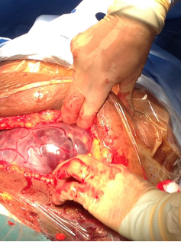

Slide 13
The commonest cause of secondary postpartum haemorrhage is Endometritis

Slide 14
The blood flow to the uterus at term >37 weeks is approximately 1000 mL of blood every minute
A fetus at term receives about 200 mL/kg/minute from the placenta

Slide 15
Obstetric shock index
Pulse rate divided by systolic blood pressure
PR/SBP
PR/SBP >1 has been shown to be associated with
substantial postpartum haemorrhage and the need for intensive resuscitation and blood transfusion

Slide 16
Prevention
Be prepared
Active management of third stage
Prophylactic oxytocin :10 U IM ,5 U IV bolus ,10-20 U/L N/S IV @ 100-150 ml/hr
Gentle cord traction with surapubic presser

Slide 17
Diagnosis
Assess in the fundus
Inspect the lower genital tract
Explore the uterus
Retained placental fragments
Uterine rupture
Uterine inversion
Assess coagulation

Slide 18
MANAGEMENT OF PPH

Slide 19
Management algorithm
HAEMO-STASIS

Slide 20
H—Ask for help and hands on uterus (uterine massage
A—Assess (that is, ABC) and resuscitate (that is, intravenous fluids crystalloid , send CBC ,X mach, Coagulation screen
E—Establish etiology, ensure availability of blood, and ecbolic (drugs that induce contractions of the uterus, oxytocin or ergometrine)
M—Massage the uterus
O—Oxytocin infusion (10 U/hour) or intramuscular prostaglandins (250 μg)
S—Shift to theatre, with aortic compression, bimanual compression, or anti-shock garment (for low resource settings before transfer to a tertiary center) as appropriate

Slide 21
T—Tamponade by balloon or uterine packing after exclusion of retained tissue and trauma. Administer intravenous tranexamic acid (1 g)
A—Apply compression sutures on the uterus (B-Lynch or modified technique)
S—Systematic pelvic revascularization (uterine, ovarian, quadruple. or internal iliac)
I—Interventional radiology and, if appropriate, uterine artery embolization
S—Subtotal or total abdominal hysterectomy

Slide 22
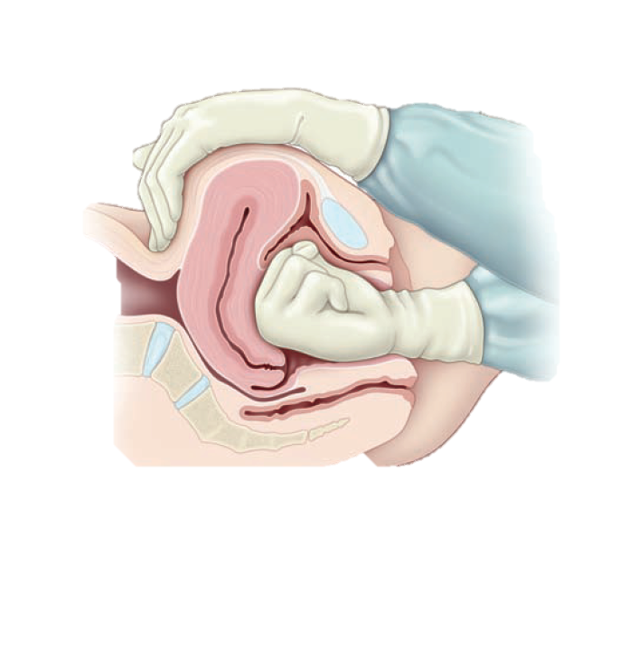
Bimanual compression of the uterus
Uterus

Slide 23
Replacement of Inverted Uterus

Slide 24
Drugs used in treatment of postpartum haemorrhage
First line drugs
Oxytocin :which is secreted by the supraoptic and paraventricular nuclei of the hypothalamus and is stored in the posterior pituitary gland)
Mode of action—Myometrial contraction and retraction; increases basal uterine tone
Side effects—Nausea, vomiting, headache
Ergometrine (ergot alkaloid)
First line drug in developing countries
Mode of action—Arterial vasoconstriction and myometrial contraction
Side effects—Vomiting, headache, hypertension, chest pain, palpitations, bradycardia, Raynaud’s syndrome, pulmonary oedema

Slide 25
Second line drugs :
Tranexamic acid
Mode of action—Anti-fibrinolytic which prevents the breakdown of preformed blood clot and therefore stabilizes the clot
Side effects—Hypotension, diarrhea, thromboembolic events
Recent Cochrane review of 10 randomized controlled trials (RCTs) reported that blood losses >400 mL or >500 mL and >1000 mL were less common in women who received tranexamic acid compared with placebo or no intervention (risk ratios 0.52 (95% confidence interval 0.42 to 0.63) and 0.40 (0.23 to 0.71), respectively

Slide 26
Misoprostol
(prostaglandin analogue)
Mode of action—Myometrial contraction
Side effects—Diarrhoea, rash, dizziness, vomiting
Not found to be effective after administration of oxytocin and may increase adverse effects
Prostaglandins F2α
Mode of action—Myometrial contraction
Side effects—Bronchospasm, cardiovascular system collapse, dyspnoea, hypertension, vomiting, pulmonary oedema
No robust evidence of effectiveness

Slide 27
Carbetocin :
(synthetic oxytocin analogue)
Mode of action—Myometrial contraction
Side effects—Diarrhoea, hypotension
Cochrane review of 11 RCTs concluded that use of carbetocin statistically significantly reduced the need for therapeutic uterotonics (risk ratio 0.62 (0.44 to 0.88) compared with oxytocin for women who underwent caesarean section but not for vaginal delivery There was no robust evidence to suggest that carbetocin was better than oxytocin in reducing postpartum haemorrhage, and its cost effectiveness remains unclear

Slide 28
Syntometrine :
(combination of 5 units of oxytocin and 0.5 mg of ergometrine)
Mode of action—Myometrial contraction
Side effects—Nausea, vomiting, diarrhoea
Cochrane review of 4 RCTs that compared carbetocin and syntometrine showed a lower mean blood loss in women who received carbetocin (mean difference −48.84 mL (95% CI −94.82 to −2.85 mL

Slide 29
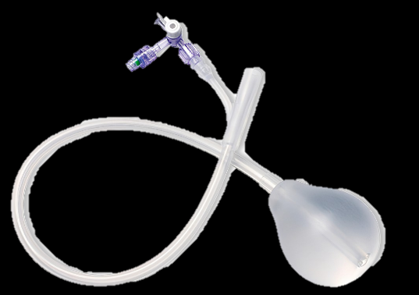
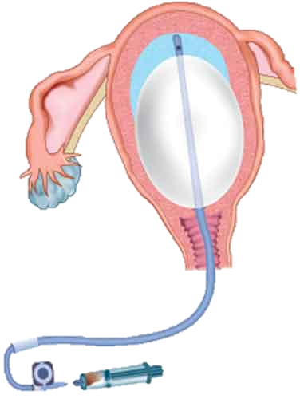
Uterine balloon temponade

Slide 30
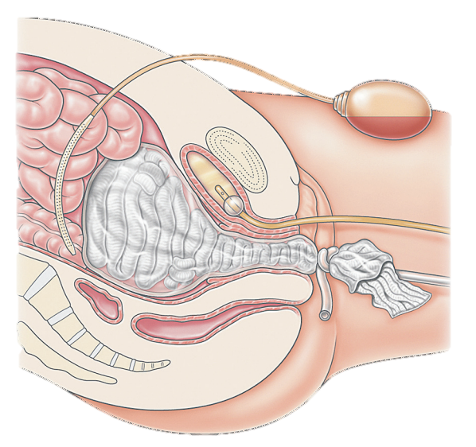
Uterine Packing

Slide 31
Stepwise Uterine Devascularization Technique
* Unilateral uterine vessel ligation .
* Bilateral uterine vessel ligation .
* Bilateral low uterine vessel ligation .
* Unilateral ovarian vessel ligation .
* Bilateral ovarian vessel ligation .
* Internal Iliac Artery Ligation

Slide 32
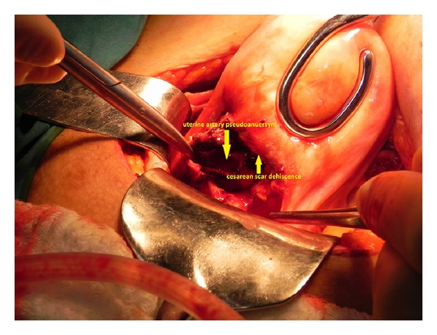
1-Uterine artery ligation
*It’s a fertility preserving procedure.
* It is hemostatic by reducing pulse pressure to uterus as 90% of its blood supply is from uterine vessels.
* Collateral circulation & recanalization of uterine vessels will be established within 6-8 wks .
*It has a success rate of 95 %

Slide 33
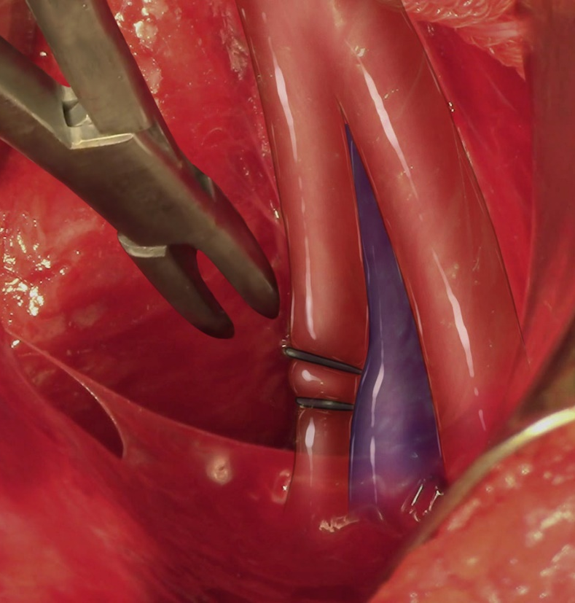
2-Internal iliac artery ligation
Bilateral ligation of the artery reduces the pelvic arterial blood flow by 49% and pulse pressure by 85% . After bilateral ligation of IIA in the long term period, the collateral circulation will maintain the re-functioning of the IIA
40-60% success rate.
Currently has fallen out of favor because of difficult techniques, instead ,a stepwise progression of uterine-ovarian vessel ligation should be rapidly performed.

Slide 34
3-Angiographic Selective Embolization
* 90-100 % Success.
*ASE seems to be indicated in patients with birth canal trauma or uterine atony or DIC.
Done in centers with interventional radiologists .
*Complications:-
1) Fever 2)pelvic infection
3)contrast media nephrotoxicity 4) buttock claudication
They are rare only reported in 6-7% of the cases.

Slide 35
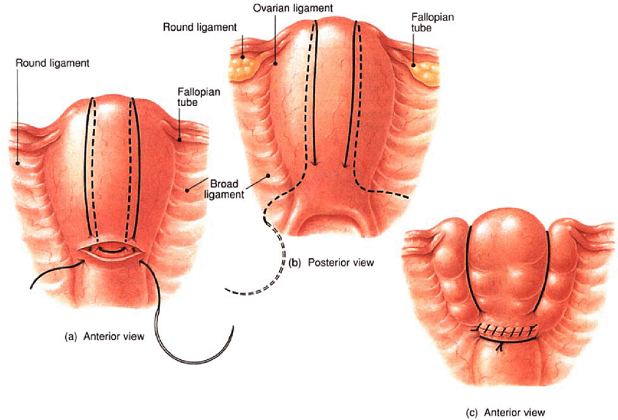
4-B-Lynch Suture
* B-Lynch is a uterine compression suture, which apposes the anterior and posterior wall through a pair of vertical brace sutures which are put around the uterus.
* It helps us effectively to avoid the need for hysterectomy in patients in whom medical treatment have failed to stop intractable PPH due to uterine atony.

Slide 36
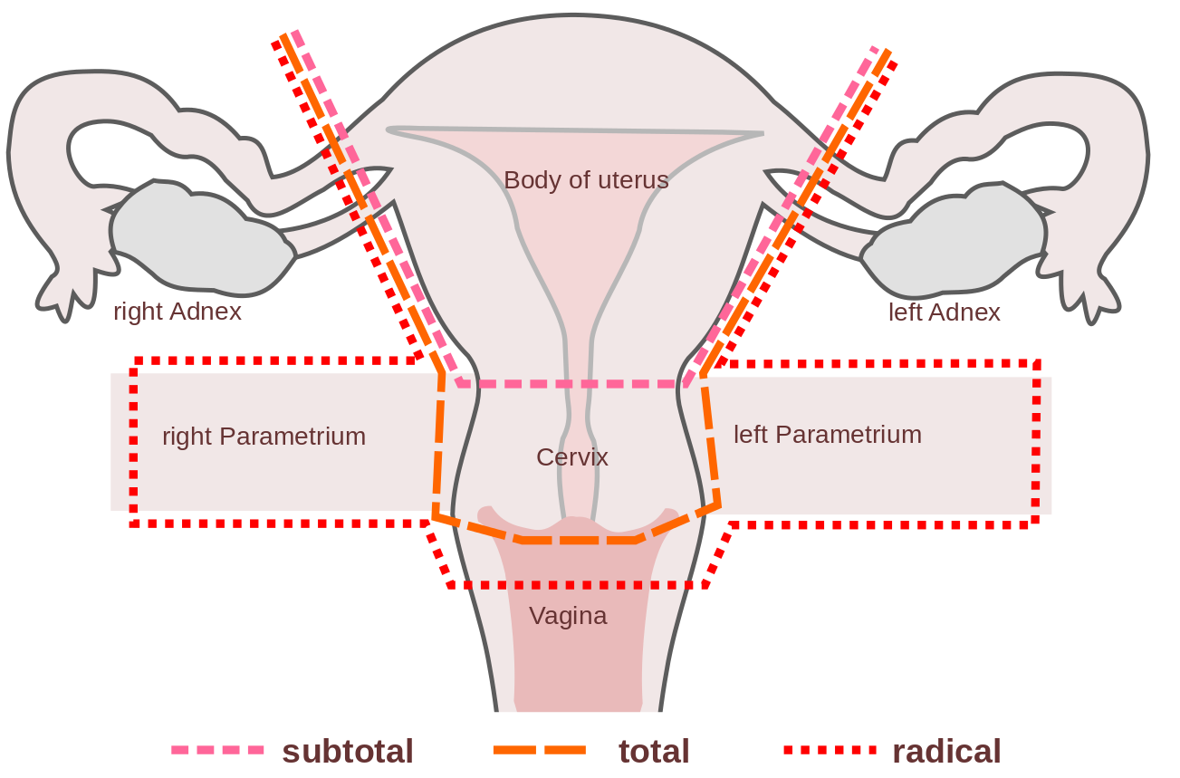
If patient doesn’t want to preserve fertility :
Hysterectomy is done

Slide 37
Maternal morbidity
Transient or permanent renal damage
Acute respiratory dysfunction
Abscess formation 2ry to infection of pelvic hematomas
Frequent need for additional surgical procedures
Transfusion related hepatitis & AIDS
Long term sequel: Sheehan’s Syndrome

Slide 38
Conclusions
Postpartum hemorrhage remains the second leading direct cause of maternal deaths in the north Europe and the leading cause of maternal mortality in the world
Poor uterine tone accounts for about 70-80% of all cases of primary postpartum haemorrhage, whereas endometritis is the commonest cause of secondary postpartum haemorrhage presenting up to 12 weeks after delivery
Tranexamic acid is recommended for all women with atonic and traumatic postpartum haemorrhage as well as for ongoing haemorrhage during a caesarean section
Refer women with secondary postpartum haemorrhage after birth for ultrasonography to exclude retained products of conception or endometritis
Start broad spectrum antibiotics in women with secondary postpartum haemorrhage due to endometritis

Slide 39
Conclusions
Check the woman’s temperature and exclude uterine tenderness, offensive vaginal discharge, or failure of uterine involution (2ry PPH)
If a woman presents with vaginal bleeding up to 12 weeks after delivery , do you palpate her abdomen for uterine size, tone, and tenderness?

Slide 40
The uterus should not be palpable per abdomen by day 14 a palpable uterus at this stage should make you suspect endometritis or retained products of conception

Slide 41
Thank you

