Slide 1
Septic arthritis

Slide 2
Septic arthritis
Infection in a joint
Infected
Joint
Inflamation

Slide 3
Causative agents :
Staphylococcus aureus
Group A streptococcus
Neisseriae Gonorrhoea
H. influenzae
( is an important pathogen unless they have been vaccinated against this organism.)
First most common cause

Slide 4
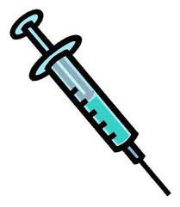
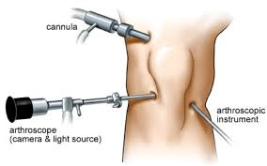
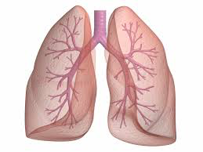
Route for bacterial entry:
Skin infection
(S.aureus )
Injection into the joint space
Penetrating injuries
STI
surgery under septic technique
Osteomyelitis
URTI
LRTI
Notes:
URTI : upper respiratory tract infection
LRTI: lower respiratory tract infection
STI : sexually transmitted infection

Slide 5
Pathology:
There is an acute synovitis with a purulent joint effusion and Synovial membrane becomes edematous, swollen and hyperemic and an increase in synovial ﬂuid .
As pus appears in the joint, articular cartilage is destroyed by bacterial and cellular enzymes.
If the infection is not arrested the cartilage may be completely destroyed.
Pus may burst out of the joint to form abscesses and sinuses.
With healing there may be :
(1) complete resolution and a return to normal
(2) partial loss of articular cartilage and ﬁbrosis of the joint
(3) loss of articular cartilage and bony ankylosis
(4) bone destruction and permanent deformity of the joint.
Notes:
In infants the entire epiphysis, which is still largely cartilaginous, may be severely damaged.
In older children, vascular occlusion may lead to necrosis of the epiphyseal bone.
In adults the effects are usually conﬁned to the articular cartilage, but in late cases there may be extensive erosion due to Synovial proliferation and ingrowth.
=======================================➔
bony ankylosis union of the bones of a joint by loss of articular cartilage, resulting in complete immobility.

Slide 6
With any Monoarthritis , it's important to role out septic arthritis .
Why?!?
A delay in diagnosis and treatment, particularly with septic arthritis, can have catastrophic results including sepsis, bacteremia, joint destruction, or death.

Slide 7
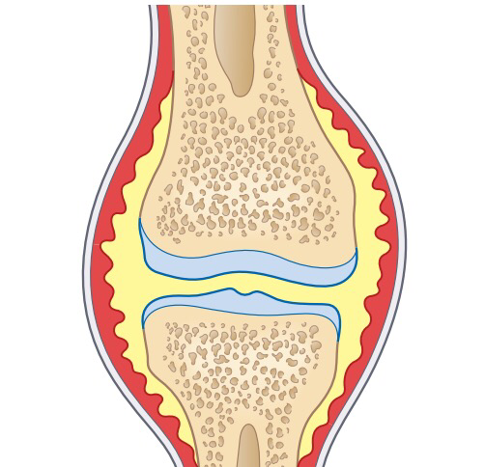
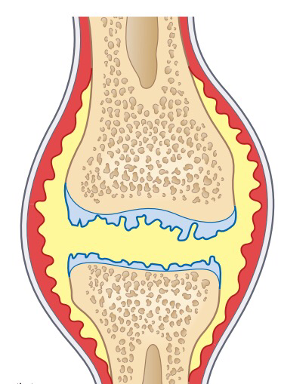
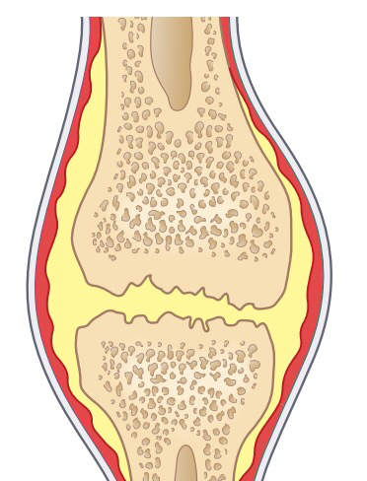
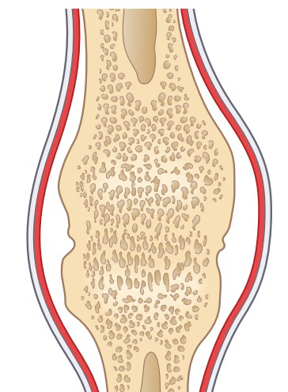
Septic arthritis is Medical Emergency , require rapid diagnosis &immediate management to avoid Irreversible joint damage .
infection spreads through the joint
there is an acute synovitis with a purulent joint
Effusion.
articular
cartilage is eroded;
the articular cartilage is attacked by bacterial and cellular enzymes.
Healing start , the raw articular surfaces may adhere.
Healing then leads to fibrous or bony ankylosis.
If the infection is not arrested, the cartilage may be completely destroyed

Slide 8
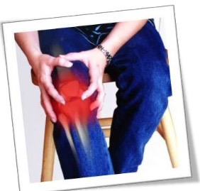
1.acute pain and swelling in a single large joint
-any joint can be affected , Knee is the most commonly affected joint in adults, hip in children.
Clinical features:
All movements are grossly restricted and often
completely abolished by pain and spasm
(pseudoparesis).
2.Signs of Inflammation :
Redness
Warmth
Tenderness
3. Fever
Suspicion may be aroused by an unexplained deterioration in the patient’s
general condition
4.'silent’ joint infection:
rheumatoid arthritis
corticosteroid treatment
Notes:
Patients with rheumatoid arthritis, and especially
those on corticosteroid treatment, may develop a
‘silent’ joint infection. Suspicion may be aroused
by an unexplained deterioration in the patient’s
general condition; every joint should be carefully
examined.

Slide 9
In adults
Often involve a superficial joint (knee, wrist, finger, ankle or toe)
Joint painful, swollen and inflamed
Unable to bear weight
Warm and tender
Evidence of gonococcal infection or drug abuse
Patients with RA and on corticosteroids may develop silent joint infection

Slide 10
In children
Acute pain in a single large joint (commonly the hip)
Reluctance to move the limb (pseudoparesis)
Fever
Rapid pulse
Joint swelling and redness
Joint tenderness
All movements are restricted and often completely abolished by pain and spasm.

Slide 11
Kocher criteria: (for child with painful hip) : 1. non-weight-bearing on affect side . 2. ESR greater than 40 mm/hr . 3.fever. 4.WBC count of >12,000 mm3.
- when 4/4 criteria are met, there is a 99% chance that the child has septic arthritis .
when 3/4 criteria are met, there is a 93% chance of septic arthritis .
- when 2/4 criteria are met, there is a 40% chance of septic arthritis .
- when 1/4 criteria are met, there is a 3% chance of septic arthritis .

Slide 12
epiphyseal plate prevents infection from entering joint space in older children.
but apparently does not act as a barrier in infants.
synovial membrane inserting distally to epiphysis .
allowing bacteria to spread directly from t he metaphysis to joint space .
metaphysis of shoulder, hip, radial head, and ankle remain intracapsular during early childhood .
the hip joint seems especially prone to sepsis from adjacent osteomyelitis .
synovial reflections over the metaphyseal bone decrease with age .

Slide 13
Examination
pain in groin area that occasionally radiates down the medial side of thigh .
- progressive accompanied by spasm of the hip muscles .
- hip in flexion and external rotation & decreased internal rotation compared to the normal hip .
patient resists all attempts to move hip .
palpate the SI joint for local tenderness .

Slide 14
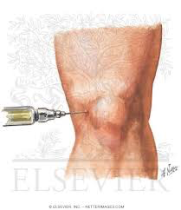
Investigation::
Imaging::
X-Ray :
-widening of the joint space (due to the effusion)
-Later, when the articular cartilage is
attacked, the ‘joint space’ is narrowed
In advanced cases there are signs of bone destruction.
Radio-isotope imaging and MRI
are helpful for detecting signs in difficult sites such as the sternoclavicular and sacroiliac joints.
CBC -----( elevated WBC)
CRP
ESR
confirmed by joint aspiration and immediate microbiological culture and sensitivity .
Blood cultures

Slide 15
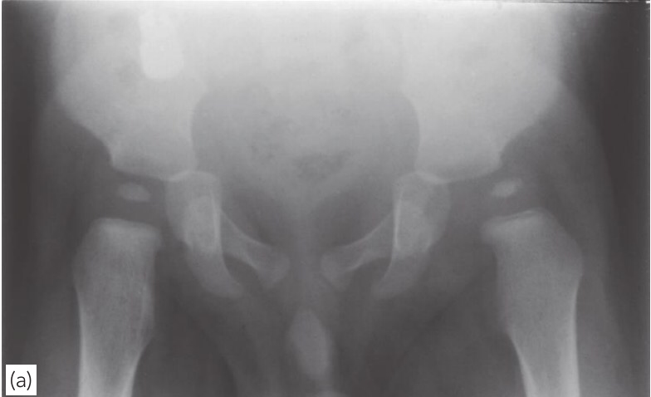
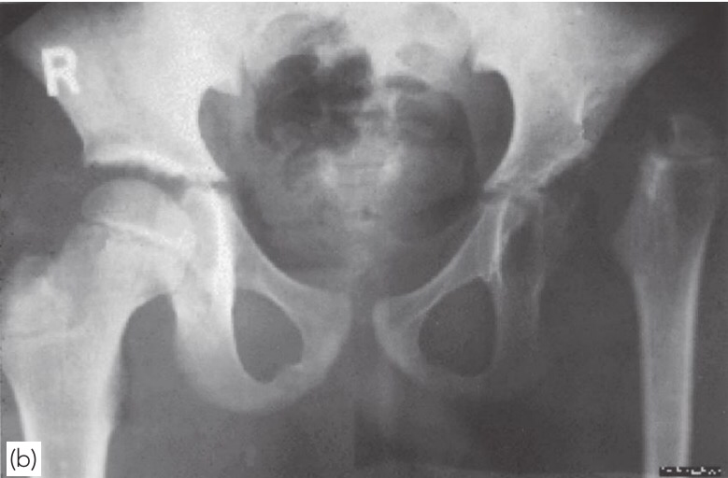
x-ray:
(a) In this child the left hip is subluxated and the soft tissues are swollen.
(b) If the infection persists untreated, the cartilaginous
epiphysis may be entirely destroyed leaving a permanent
pseudarthrosis (Tom Smith’s dislocation).

Slide 16
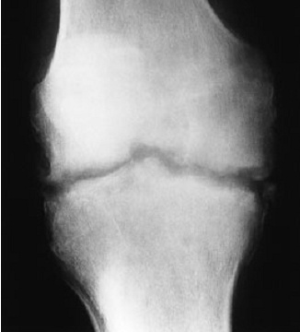
Septic arthritis in an adult knee joint .

Slide 17
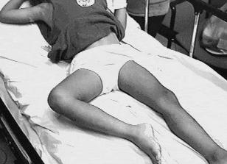
Position of patient with septic arthritis ➔ flexion and external rotation → max stretch to the joint capsule
Notes:
Position of patient with septic arthritis ➔ flexion and external rotation → max stretch to the joint capsule
X ray➔➔ joint blurring

Slide 18
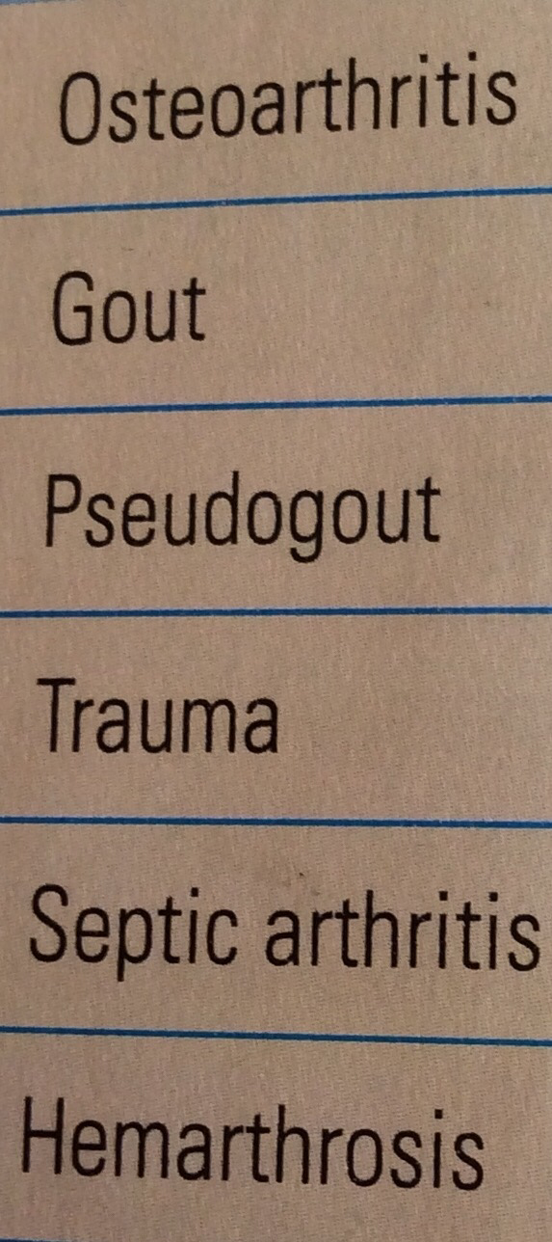
Osteomyelitis near a joint may be indistinguishable
from septic arthritis; the safest is to assume that
both are present.
An acute haemarthrosis, either post-traumatic or
due to a haemophilic bleed, can closely resemble
infection. The history is helpful and joint aspiration
will resolve any doubt.
Gout and pseudogout in adults can be
indistinguishable from joint infection and cellulitis.
Aspirated fluid may look turbid but the presence
of urate or pyrophosphate crystals will confirm the
diagnosis.
Mono articulate joint pain

Slide 20
Complications::
■ Dislocation: a tense effusion may cause
dislocation.
■ Epiphyseal destruction: in neglected infants the
largely cartilaginous epiphysis may be destroyed,
leaving an unstable pseudoarthrosis .
■ Growth disturbance: physeal damage may result
in shortening or deformity.
■ Ankylosis: if articular cartilage is eroded, healing
may lead to ankylosis.

Slide 21
Treatment ::
Treatment is then started without further delay
Antibiotics
Intravenous ------ a third-generation cephalosporin will cover both Gram-positive and Gram-negative organisms
------Once the bacterial sensitivity is known the appropriate drug is substituted.
Intravenous administration is continued for several weeks and is followed by oral
antibiotics for a further 2 or 3 weeks.
Splintage
The joint must be rested either on a splint or in a widely split plaster.

Slide 22
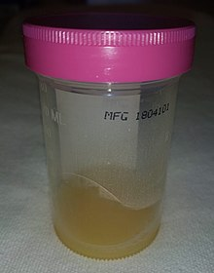
Drainage
pus is drained and the joint washed out
-------open operation (the best to done )
-------repeated needle aspiration and irrigation(superficial joint )
-------arthroscopy (knee joint)
Once the patient’s general condition is good
and the joint is no longer inflamed, gentle and
gradually increasing movements are encouraged.
But if articular cartilage has been destroyed, the
aim is to keep the joint immobile in the optimum
position while ankylosis is awaited.

Slide 23
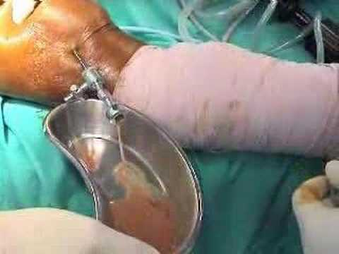

Slide 24
Summary
Acute monoarthritis should be evaluated emergently to roll out septic arthritis.
Untreated septic arthritis can lead to a very serious complications. (joint destruction an sepsis)
Appropriate history and examination are crucial.
Aspiration is the key method for diagnosis and identifying the organism.
Early treatment with IV antibiotics and leg splinttage.

