Slide 1
Hemolytic Anemia
Hemoglobinopathies
Sura Al Rawabdeh MD
3 - April- 2023

Slide 2
Hemolytic anemia Outlines
Definition
Causes and Features
Hereditary Spherocytosis
G6PD deficiency
Immune mediated hemolytic anemia
PNH
Hemolytic Anemia Due to Mechanical Trauma to RBC

Slide 3
Hemolytic anemia
Hemolytic anemias are a diverse group of disorders that have as a common feature accelerated red cell destruction (hemolysis).
There are several ways to organize hemolytic anemias.
One approach groups them according to whether the pathogenic red cell defect is intrinsic (intracorpuscular) or extrinsic (extracorpuscular) .
A second more clinically useful approach groups hemolytic anemias according to whether hemolysis is primarily extravascular or intravascular.
Extravascular hemolysis is caused by defects that increase the destruction of red cells by phagocytes, particularly in the spleen

Slide 4
Intrinsic (Intracorpuscular) abnormalities: A.Hereditary defects 1.Defects in RBC membrane: Spherocytosis 2.Enzyme defects: G6PD Deficiency 3. Disorder of Hemoglobin synthesis: - Structurally abnormal hemoglobin synthesis (Hemoglobinopathies): Sickle cell disease - Deficient globin synthesis: Thalassemia syndromes B. Acquired Defects 1. Membrane defect: PNH (paroxysmal nocturnal hemoglobinuria)

Slide 5
Destruction can occur : 1. Intravascular 2. Extravascular ( Within tissue macrophage, mainly liver and spleen)
Hemolytic anemia

Slide 6
Clues? Intravascular Hemolysis: - Hb-uria, Hb-emia, and Hemosiderinuria - Unconjugated hyperbilirubinemia and Jaundice ( Due to conversion of heme to bilirubin) - Marked decrease in Haptoglobin (circulating protein that binds and clears free hemoglobin) - Incresed LDH (Lactate dehydrogenase)

Slide 7
Hemolytic Anemia
Extravascular Hemolysis: - More common - No Hb-uria, Hb-emia, and Hemosiderinuria
- Jaundice - Mild decrease in Haptoglobin - Splenomegaly

Slide 8
Extrinsic (Extracorpuscular) abnormalities:
Antibody- mediated
Mechanical trauma to red cells
Infection: Malaria

Slide 9
Features of Hemolytic Anemia
Shortened RBCs survival
Elevated erythropoietin level leading to increased erythrpoiesis (erthyroid hyperplasia) and early release of RBCs from marrow
Reticulocytosis in peripheral blood
Retention of the products of degraded red cells (including iron) by the body.
Jaundice and Increase LDH
In severe hemolytic anemia: Extramedullary hematopoiesis in the liver, spleen, and lymph nodes.

Slide 10
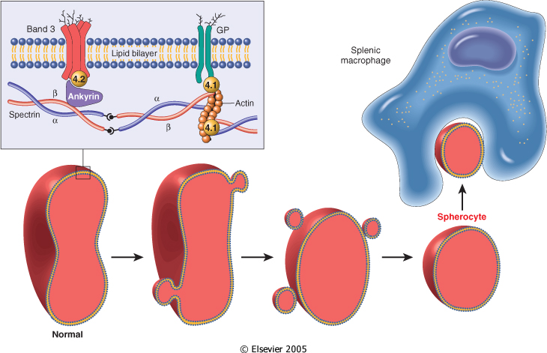
HEREDITARY SPHEROCYTOSIS
Inherited defect in red cell membrane
Fromation of spherocytes, nondeformable cells: highly vulnerable to sequestration and destruction in the spleen

Slide 11
HEREDITARY SPHEROCYTOSIS
Etiology: mutations in Spectrin, Ankyrin, and band 3
General features:
Autosomal dominant trait
Spherocytes in peripheral blood: Dark red, lack central pallor, Increase MCHC
High reticulocyte count
Increased osmotic fragility especially after incubation for 24 hours at 37ºC (in hypotonic)
Destruction in the spleen
Splenomegaly
Splenectomy helps in correcting anemia, but red cell defect persist

Slide 12
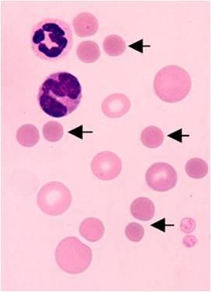
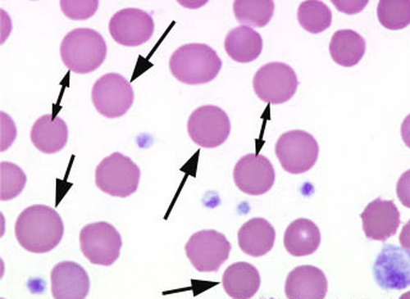
Notes:
12

Slide 13
CLINICAL FEATURES
Anemia, splenomegaly and jaundice
Severity of anemia correlates with spectrin deficiency.
Complications:
Gallbladder stones
Aplastic crisis: Due to infection by Parvovirus B19

Slide 14
G6PD Deficiency

Slide 15
Role of glucose-6-phosphate dehydrogenase (G6PD) in defense against oxidant injury
The disposal of H2O2, a potential oxidant, is dependent on the adequacy of reduced glutathione (GSH), which is generated by the action of NADPH. The synthesis of NADPH is dependent on the activity of G6PD

Slide 16
G6PD
G6PD gene located on chromosome X.
Decrease in GSH causes hemolysis in cells exposed to oxidant agent.
In the A- (African) type: Normal enzyme but decrease half life
Only aging RBCs have decreased G6PD
(Med) Mediterranean type: more severe, Enzyme deficiency

Slide 17
G6PD deficiency
Patients are asymptomatic until exposed to environmental factors that produce oxidants and so hemolysis:
Drugs: eg. Antimalarial, sulfonamides, furantoins,…etc.
Favism
Products of free radicals in infections.
Features of Extra/Intravascular hemolysis
Oxidation leads to denaturation of globin chains, and precipitation at membranes forming Heinz bodies
RBCs: Bite cells and Heinz bodies
Males more vulnerable than female

Slide 18
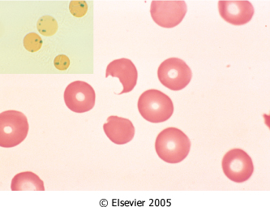
Notes:
18

Slide 19
IMMUNE HEMOLYTIC ANEMIA
Due to antibodies
Antibodies may arise spontaneously or be induced by exogenous agent such as chemicals or drugs.
Uncommon and classified according to:
The nature of the antibody
The presence of predisposing conditions.

Slide 20
Diagnosis
Detection of antibodies and/or complement on red cells:
- Direct Coombs antiglobulin test
- Indirect Coombs test

Slide 21
COOMB’s Test

Slide 23
IMMUNE HEMOLYTIC ANEMIA
Warm Antibody: IgG type active at 37 ºC
80% of immune hemolytic anemia
Primary (70%)
Secondary:
B cell lymphoid neoplasm (CLL)
SLE
Drugs
Cold Antibody: IgM type active below 30ºC
Acute
Infectious mono
Mycoplasma infection
Chronic:
Idiopathic
B cell Lymphoid neoplasm (Lymphoplasmacytic lymphoma)

Slide 24
Paroxysmal Nocturnal Hemoglobinuria
Acquired mutations in gene PIGA (required for the synthesis of phosphatidylinositol glycan (PIG), a membrane anchor that is a component of many proteins).
The affected and thus deficient (GPI-linked proteins) include several proteins that limit the activation of complement: CD59, a potent inhibitor of C3 convertase.
PIGA-deficient precursors give rise to red cells that are sensitive to complement-mediated lysis

Slide 25
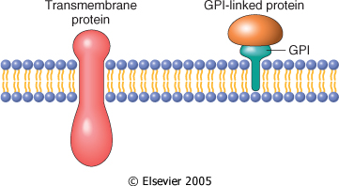
Two kinds of membrane proteins: trans membrane and glycosyl phosphatidyl inositol (GPI)-linked
The latter are anchored to cell membranes through a covalent attachment to a glycosyl phospatidyl inositol moiety.
In PNH, GPI cannot be synthesized, leading to a global deficiency of GPI-linked membrane proteins
)
Notes:
25

Slide 26
PNH
Young adults
Chronic hemolysis
Normochromic normocytic anemia
Reticulocytosis
Venous thrombosis
Diagnosis:
- Positive sucrose hemolysis test
- Positive acidified serum test (Ham test): low sensitivity and specificity
- Flow cytometry for expression of CD59, CD55
Notes:
26

Slide 27
Hemolytic Anemia Due to Mechanical Trauma to RBC
Etiology
Artificial valves
Microangiopathic hemolytic anemia
DIC
Malignant hypertension
TTP
Hemolytic uremic syndrome
Morphology
Significant poikilocytosis with helmet cells/ schistocytes , burr cells, and triangle cells

Slide 28
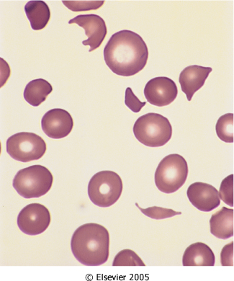

Slide 29
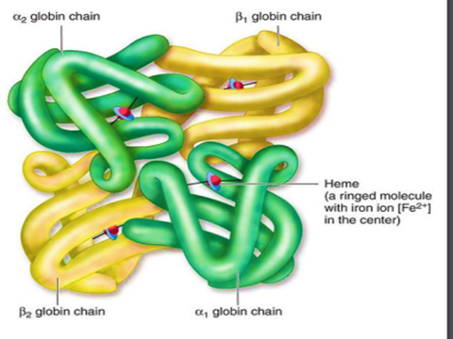
HEMOGLOBINOPATHIES

Slide 31
Hemoglobin types
Normal types of hemoglobin include:
Hemoglobin (Hgb) A, the most common type of hemoglobin in healthy adults
Hemoglobin (Hgb) F, fetal hemoglobin. This type of hemoglobin is found in unborn babies and newborns. HgbF is replaced by HgbA shortly after birth.
If levels of HgbA or HgbF are too high or too low, it can indicate certain types of anemia.

Slide 32
NORMAL HUMAN HEMOGLOBINS
Hemoglobin A (α2β2): 95% of adult hemoglobin
Hemoglobin A2 (α2δ2): 3% of adult hemoglobin
Hemoglobin F (α2γ2) :
75% at birth
< 5% at 6 months
< 1% in adults
Notes:
32

Slide 33
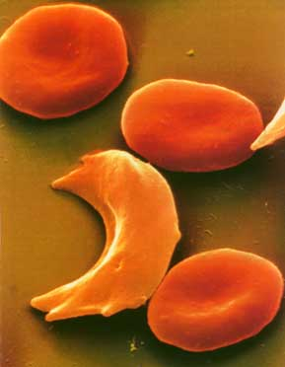
SICKLE CELL DISEASE
Most common familial hemolytic anemia in the world
Recessive inheritance
Point mutation resulting in the substitution of valine for the glutamic acid at the 6th position of the β chain of Hb
Notes:
33

Slide 34
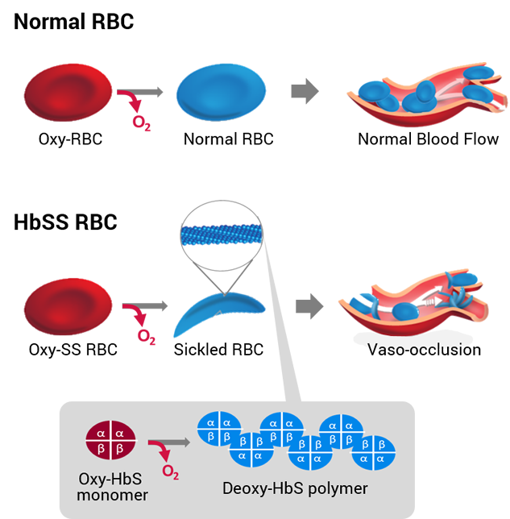

Slide 35
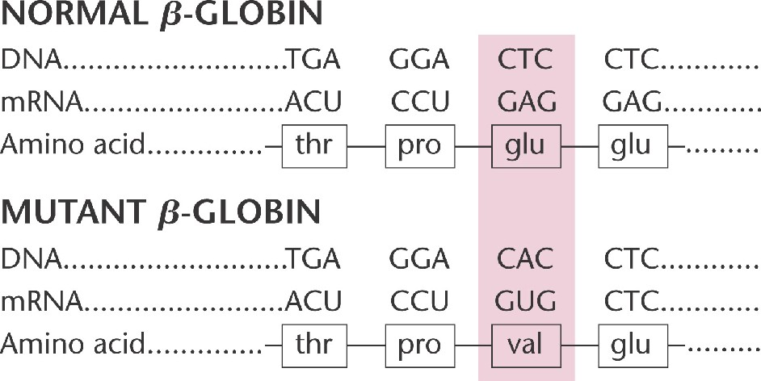

Slide 36
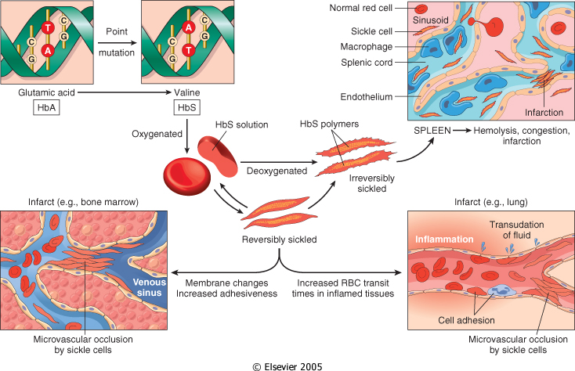
Notes:
36

Slide 37
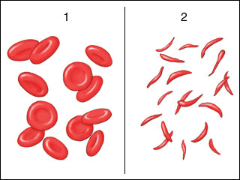
Normal RBCs
Sickled RBCs

Slide 38
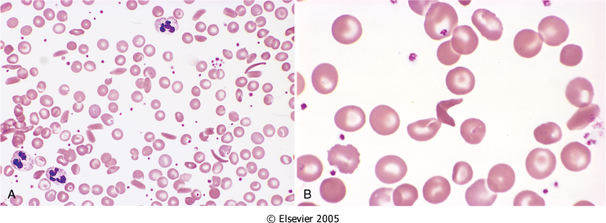

Slide 39
FACTORS AFFECTING THE DEGREE OF SICKLING
Presence of Hb other than HbS:
Heterozygous HbA: HbS 60:40: - Sickle cell trait
HbC: Mutant β-globin, lysine residue instead of the normal glutamic acid residue at position 6: aggregate with HbS
HbSC is a milder form the disease
HbF: Newborns with sickle cell anemia do not manifest the disease until HbF falls to adult levels, generally around the age of 6 months.
Notes:
39

Slide 40
(2) Intracellular Concentration of HbS:
Red cell Dehydration: Increase MCHC, Facilitates sickling
(3) Transit time for red cells through microvasculature
Sickling in microvascular beds is confined to areas of the body in which blood flow is sluggish: Spleen and BM
Inflammation: slows the flow by increasing the adhesion of leukocytes and RBC’s
Notes:
40

Slide 41
CLINICAL CONSEQUENCES OF SICKLE CELL DISEASE
(1) Chronic hemolytic anemia (life span decreased from a normal 120 days to 20 days) to 10-20 days.
(2) Microvasculature obstruction: Ischemic tissue damage: Pain Crises
bones, liver, kidneys, skin, retina,…etc.
(3) Crises:
Vaso-occlusive or painful crises
Aplastic crises: Due to infection by Parvovirus B19
Hemolytic crises

Slide 42
Extramedullary hematopoiesis
There is a compensatory hyperplasia of erythroid progenitors in the marrow:
Causes bone resorption → secondary new bone formation → prominent cheekbones and changes in the skull resembling a “crewcut” in radiographs.
Extramedullary hematopoiesis may appear in the liver and spleen.

Slide 43
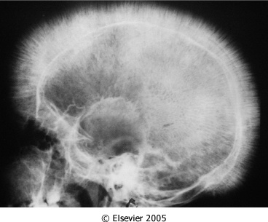
Notes:
43

Slide 44
Splenomegaly- auto splenectomy
In children: moderate splenomegaly due to red pulp congestion caused by entrapment of sickled red cells.
chronic splenic erythrostasis → hypoxic damage and infarcts, which over time reduce the spleen to a useless fibrous tissue (autosplenectomy) → Increased risk of infections
Confers protection against Plasmodium falciparum malaria

Slide 45
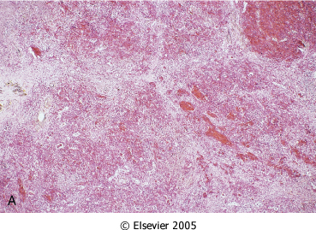
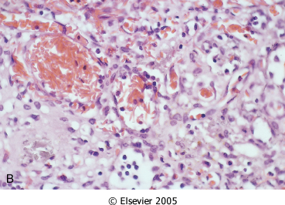
Spleen in Sickle Cell Anemia

Slide 46
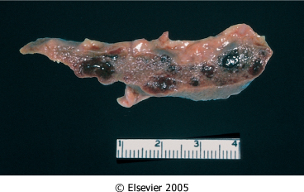
Figure 13-12: Splenic remnant in sickle cell anemia. (Courtesy of Drs. Dennis Burns and Darren Wirthwein, Department of Pathology, University of Texas Southwestern Medical School, Dallas, TX.)

Slide 47
Complications
Acute chest syndrome
Stroke
Two leading causes of ischemia-related death

Slide 48
Laboratory diagnosis of sickle cell anemia
Clinical History:
- Asymptomatic till 6 months of age.
- Moderate to severe anemia (6-8 g/dl).
- Unremitting course punctuated by sudden crises
CBC and blood smear
Hemoglobin electrophoresis

Slide 49
Notes:
HPLC
49

Slide 50
Treatment 1- Adequate hydration 2- Pain relief 3- Antibiotic therapy 4- Hydroxyruea 5- In severe cases, exchange transfusion to reduce the Hgb S.

Slide 51
Thalassemia

Slide 52
FEATURES OF THALASSEMIAS
Inherited
Mutations that decrease globin chain synthesis (Alpha or Beta) leading to hypochromic microcytic anemia.
Quantitative defect → Imbalance of globin chains →
Reduced Hb synthesis and anaemia
Precipitation of abnormal Hb → haemolysis and ineffective erythropoiesis
§ Alpha
§ Beta
§ Delta-beta
§ Gamma-delta-beta
Notes:
52

Slide 53
β −Thalassemia

Slide 54
Mutations associated with β-thalassemia :
(1) β0: No β-globin chains are produced
(2) β+: Reduced (but detectable) β-globin synthesis.
Mutations leading to aberrant RNA splicing are the most common cause of β-thalassemia

Slide 55
β −Thalassemia
β-thalassemia minor ( β-thalassemia trait):
Persons inheriting one abnormal allele
Asymptomatic or mildly symptomatic.
β-Thalassemia major:
- Persons inheriting any two β0 and β+ alleles
Notes:
55

Slide 56
Mechanisms of Anemia
Reduced synthesis of β-globin → Inadequate HbA formation → hypochromic microcytic anemia
Imbalance in β- and α-globin chain synthesis → excess unpaired α chains → aggregate into insoluble precipitates → bind and severely damage the membranes of both red cells and erythroid precursors → ineffective erythropoiesis
Few red cells that are produced have a shortened life span due to extravascular hemolysis

Slide 57
β−THALASSEMIA MAJOR
Genotype: β⁰/β⁰, β⁺/β⁺, β⁰/β⁺
Age of manifestations: 6-9 months
Hb. Level: 3-6 gm/dl (if un-transfused)
Transfusion dependent

Slide 58
β−THALASSEMIA MAJOR
Very high HbF, absent or decreased HbA, HbA2 Normal or increased
Expansion of bone marrow, impair bone growth: Skeletal deformities
Extramedullary hematopoiesis and hepatosplenomegaly
Stunted growth and cachexia
Secondary hemochromatosis: May lead to cardiac dysfunction
Bone marrow transplantation at an early age is the treatment of choice

Slide 59
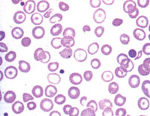
Hypochromic microcytic RBCs in Thalassemia

Slide 60
β −THALASSEMIA MINOR
Heterozygous for β⁰ ορ β⁺ gene
increased HbA2 (> 3.5%) and/or HbF (1- 5%)
Mild microcytic anemia (Hb 9-11 g/dL)
Differential Dx: Iron deficiency anemia

Slide 61
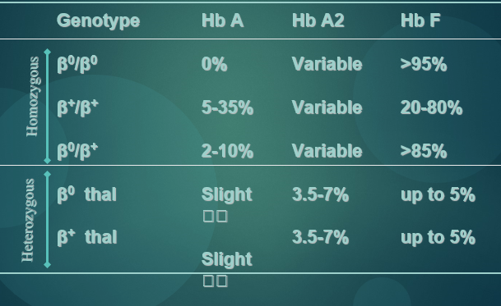
Genotype
β⁰/β⁰
β⁺/β⁺
β⁰/β⁺
β⁰ thal
β⁺ thal
Hb A
0%
5-35%
2-10%
Slight 🡫
Slight 🡫
Hb A2
Variable
Variable
Variable
3.5-7%
3.5-7%
Hb F
>95%
20-80%
>85%
up to 5%
up to 5%
Homozygous
Heterozygous

Slide 62
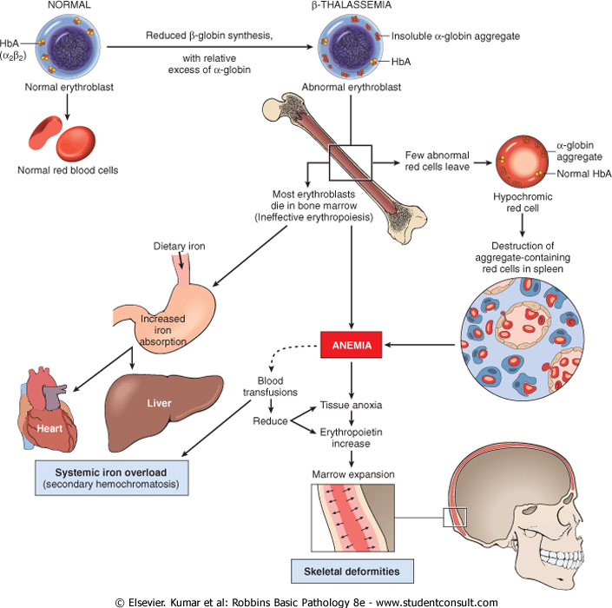
Downloaded from: StudentConsult (on 30 January 2012 05:46 PM)
© 2005 Elsevier

Slide 63
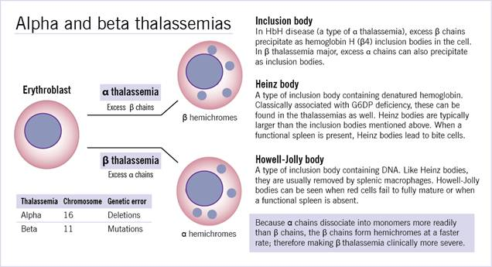

Slide 64
α- Thalassemia

Slide 65
α-Thalassemia
Caused mainly by deletions involving one or more of the a-globin genes.
Severity of the disease is proportional to the number of a-globin genes that are missing

Slide 66
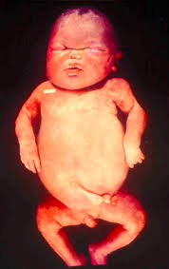
α-Thalassemia
-α/αα: silent carrier state, asymptomatic
--/αα, -α/-α : α thal minor, asymptomatic
--/-α : Excess beta: Beta 4: HbH disease
--/-- : Excess Gamma : Hb Barts
Death in utero (Hydrops fetalis)
Notes:
66
--/αα α thal minor, asymptomatic more common in Asia
Higher risk of producing offspring with severe a thalassemia
-α/-α α thal minor, asymptomatic more common in Africa

Slide 68
Questions
GOOD LUCK

