Slide 1
Mi management

Slide 2
Myocardial infarction
MI one of ischemic heart disease , occurs when there is a diminished blood supply to the heart due to blockage of the coronary vessels which leads to myocardial cell damage and ischemia (necrosis).
( time is muscle ) The faster blood flow can be restored the better chance the patient has of minimizing irreversible death of the cardiac cells.
Also known as heart attack

Slide 3
Type of MI
: based on which artery was occluded
A- anterior MI : caused by occlusion of LAD artery
B- posterior MI : caused by an occlusion of left circumflex artery
C- inferior MI : caused by occlusion of right coronary artery
1

Slide 4
2
:based on ECG findings
A_ ST segment elevation infarct : transmural (involves entire thickness of wall) mostly larger B_ Non ST segment elevation infarct : subendocardial (involves inner one third to the half of the wall) tends to be smaller , similar to unstable angina which can be distinguished by cardiac enzymes

Slide 5
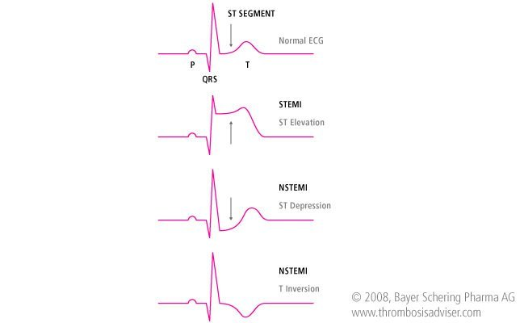

Slide 6
Clinical findings
1- chest pain : intense substernal with pressure sensation
2- onset : rapid over a few minutes
3- radiating to the neck , jaw , sometimes epigastrium
4_nausea and vomiting
5_ diaphoresis ( excessive sweating )
7- feeling of impending death ( angor animi )
8- prolonged duration
9- not relieved by rest or nitrate
10- usually very severe

Slide 7
Risk Factors of MI
Stress , stimulants (caffeine)
Smoking
Obesity
Diabetes and hypertension
Diet (high cholesterol )
Race ( higher in African American males )
Age (over 50 )
Sex ( men more women)

Slide 8
Diagnosis
ECG
Cardiac biomarkers
Full blood count (FBC)
Echocardiography
Electrolytes, urea, creatinine (EUC).
Glucose & lipid profile

Slide 9
How to diagnosis MI
Requires at least 2 of the following criteriae
Prolonged ischemic-type chest discomfort.
Serial ECG changes.
Elevation of cardiac markers in serum.

Slide 10
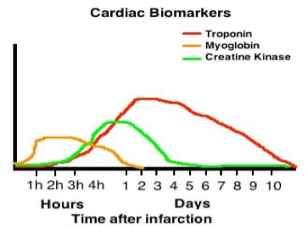
Biomarkers ECG

Slide 11
Principles of MI Management
Patients should ideally be managed in a dedicated cardiac unit, where the necessary monitoring and resuscitation facilities are available.
Clinical risk factor analysis using tools such as the GRACE score should be performed to identify patients that should be selected for intensive therapy, and specifically early inpatient coronary angiography
If there are no complications and risk factor analysis shows that angiography is not required, the patient can be mobilized from the second day and discharged after 2–3 days.
Establish the IV access

Slide 13
GRACE Score
The GRACE Score is prospective studied scoring system used to risk stratify patients with ACS to estimate their in-hospital and 3-month to 3-year mortality.
Global registry of acute coronary events.
Involves 8 variables :
1- killip class
2- age
3- Heart rate
4- SBP
5- serum creatinine level
6- cardiac arrest at admission
7- elevated cardiac enzymes
8- ST - segment deviation

Slide 14
Killip class
Classing system used in patients with acute myocardial infarction (heart attack ) taking into account physical examination and the development of heart failure
Class I : no evidence of heart failure
Class II : mild to moderate heart failure ( eg. S3 gallop , jugular venous distention )
Class III : overt pulmonary edema
Class IV : cardiogenic shock

Slide 15
GRACE Score

Slide 16
A 68 year old male having SBP 99mmhg , heart rate 95/min , killip class II , serum creatinine level 76umol/L. He has st segment elevation and elevated cardiac enzymes , what is the probability of in hospital death ?
Answer : 18%

Slide 17
Definitive
STEMI
NSTEMI
Initial
Management

Slide 18
Initial Management
1-Admit patient to a cradiac monitored floor (CCU ) and establish IV access. Give sup-plemental oxygen for hypoxia and analgesics( nitrates, morphine ).
2- Medical Therapy
A- Aspirin
B- P2Y12 Inhibitors( Clopidogrel ,Ticagrelor )
C- b-Blockers
D- ACE Inhibitors
E- Statins
F- Oxygen
G- Nitrates
H- Morphine
I- Heparin

Slide 19
Definitive Management STEMI Management
Emergency Revascularization
Benefit highest when performed early (within 90 min of hospital arrival for all patient with STEMI or LBB
Methods of Revascularization
Percutaneous coronary intervention (PCI)
Coronary artery bypass grafting (CABG)
Thrombolytic therapy

Slide 20
Percutaneous coronary intervention (PCI)
This preferred treatment for STEMI as long as it can be performed as quickly as possible (door to balloon time less than 90 min ) and by skilled personnel.
Also preferred in patients with contraindications for thrombolytic therapy; no risk for intracranial hemorrhage.
It is proved to reduce mortality.
Clopidogrel or ticagrelor therapy should be initiated in all patients who undergo PCI and receive a stent.
Dual antiplatelet treatment with aspirin and a P2Y12 inhibitor (clopidogrel or ticagrelor) should continue according to the type of stent.

Slide 21
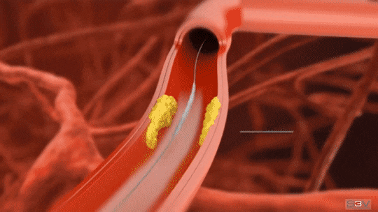
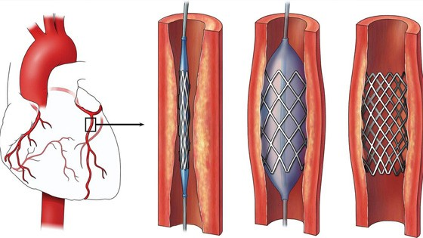
Percutaneous coronary intervention (PCI)
This preferred treatment for STEMI as long as it can be performed expeditiously (door to balloon time less than 90 min ) and by skilled personnel.
Also preferred in patients with contraindications for thrombolytic therapy; no risk for intracranial hemorrhage.
It is proved to reduce mortality.
Clopidogrel or ticagrelor therapy should be initiated in all patients who undergo PCI and receive a stent.
Dual antiplatelet treatment with aspirin and a P2Y12 inhibitor (clopidogrel or ticagrelor) should continue for 30/12 months according to the type of stent.

Slide 22
Thrombolytic therapy
It is useful for patients who present later, and for those in whom PCI is contraindicated.
Early treatment is crucial to salvage as much of the myocardium as possible, Administer as soon as possible up to 24 hours after the onset of chest pain, Outcome is best if given within the first 6 hours.
Indications: ST-segment elevation in two contiguous ECG leads in patients with pain onset within 6 hours who have been refractory to nitroglycerin.
Alteplase has been shown to have the best outcomes among thrombolytic medications, and is the first choice in many centers, despite its high costs.
Alternatives include streptokinase, Tenecteplase, reteplase, lanoteplase, and urokinase.

Slide 23
Absolute Contraindications to Thrombolytic Therapy:
Trauma: Recent head trauma or traumatic CPR.
Previous stroke.
Recent invasive procedure or surgery.
Dissecting aortic aneurysm.
Active bleeding or bleeding diathesis.
Pregnancy
Complications : internal bleeding , hypotension or some parts of the broken clot may go and cause infarctions in other areas.

Slide 24
Coronary Artery Bypass Grafting (CABG)
Less often used than the other two in the acute setting.
Benefits of CABG include low rates of event-free and reintervention-free survival.
It remains the procedure of choice in patients with severe multivessel disease and complex coronary anatomy
Urgent/emergent CABG is typically performed only in the setting of mechanical complications of an acute MI, cardiogenic shock, life-threatening ventricular arrhythmias, or after failure of PCI.
It is almost never performed in the acute setting on a stable patient.

Slide 25
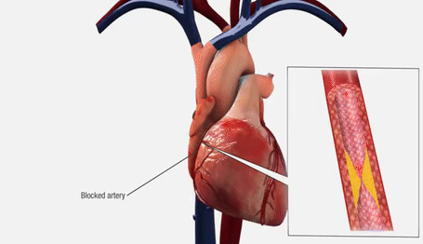

Slide 26
Definitive Management NSTEMI Management
We do Risk Stratification to determine if the patient needs special intervention or monitoring is good enough.
High risk patients
Low-intermediate risk patients
Antiplatelets (clopidogrel)
Anticoagulants (heparin)
Beta blocker
Revascularization
Monitoring ECG/ cardiac biomarkers
If there is no changes— cardiologist
On going management
Maintenance pharmacological therapy

Slide 27
Rehabilitation
Cardiac rehabilitation is a physician-supervised regimen of exercise and risk factor reduction after MI (e.g. smoking, diet, alcohol).
Shown to reduce symptoms and prolong survival.

Slide 28
Case scenario
55 year-old-man comes to emergency department with crushing chest pain radiating to left arm and jaw. Patient is a smoker & past medical history is significant for type 2 diabetes for last 12 years and hypertension with poor compliance to medications . ECG was performed which shows ST segment elevation. Cardiac markers are also elevated. How will you manage this patient?
On examination:
HR: 124 , BP: 118/90 , RR: 29, Sp02: 94%

