Slide 1
ELBOW , RADIOULNAR JOINTS
By
Dr Abulmaaty Mohamed Assistant professor Anatomy & Embryology Mutah University

Slide 2
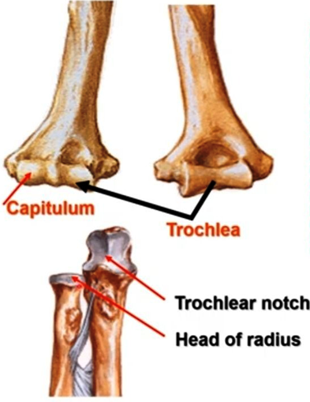
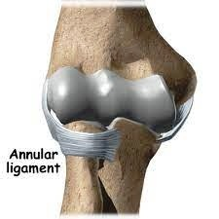
ELBOW JOINT
Type:- Synovial
Variety:- Hinge
Articular Surface:-
Above:-
Trochlea, capitulum of humerus articulate with Below:-
trochlear notch of ulna & head of radius respectively

Slide 3
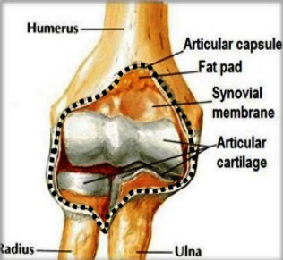
ELBOW JOINT
Capsule
Attachment:
Superiorly:-
Front :-Above the coronoid and radial fossae
Back :- above olecranon fossa
Medially:-root of medial epicondyle
Laterally:- root of lateral epicondyles
Inferiorly:-
Front :- margins of the coronoid process and annular ligament
Back :- margins of olecranon process
Characters:
Thin in front &back to allow flexion and extension
Thick on sides to prevent adduction and abduction

Slide 4
ELBOW JOINT
Synovial membrane:-
Lines the capsule and covers the non articular structures

Slide 5
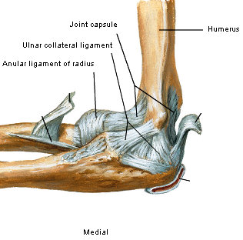
ELBOW JOINT
Ligaments:-
Radial collateral (Lateral) ligament
Fan shaped
Extends from lateral epicondyle to annular ligament
Ulnar collateral (medial) ligament
Triangular formed of 3 bands
Anterior band:- from medial epicondyle to medial border of coronoid process
Posterior band: from medial epicondyle to medial border of olecranon process
Oblique band:- from medial border of coronoid to medial border of olecranon process

Slide 6
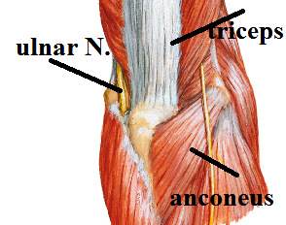
ELBOW JOINT
Relations
Anteriorly:
Brachialis separating it from
median nerve,
brachial artery,
biceps tendon
Posteriorly: triceps & anconeus
Medially: ulnar nerve, CFO
Laterally:- radial nerve, CEO

Slide 7
ELBOW JOINT
Nerve supply:
receives branches
ulnar,
median,
radial,
Musculocutaneous
Movements
Flexion: brachialis,
biceps,
brachioradialis:- flexion of midpronated forearm
Extension: triceps,
anconeus

Slide 8
RADIOULNAR JOINTS

Slide 9
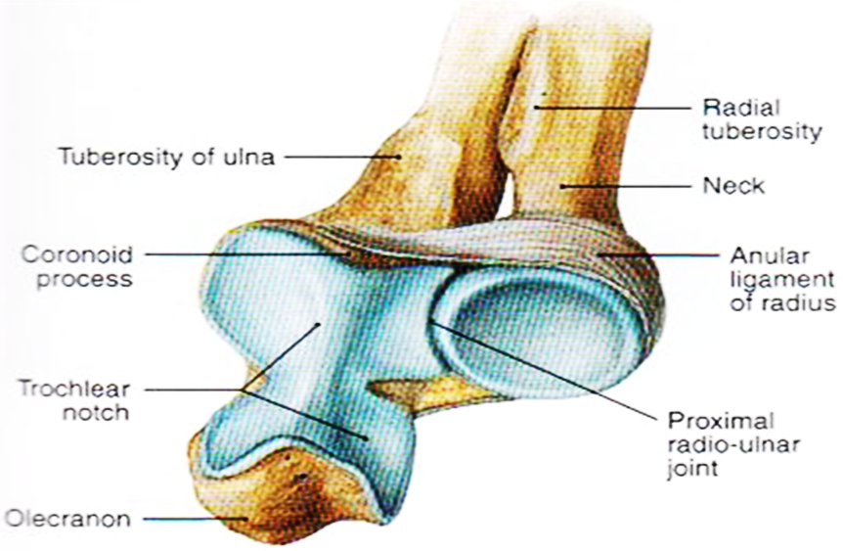
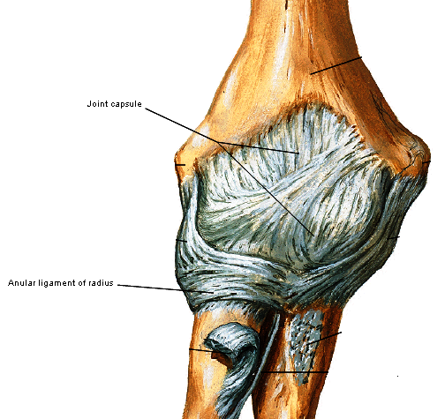
A- SUPERIOR RADIOULNAR JOINT
Type:- Synovial
Variety:- Pivot
Articular Surface:-
-Articular circumference of head of radius
-Radial notch of ulna & annular ligament
Capsule:-
covers the annular ligament
continuous above with capsule of elbow joint
Synovial membrane:-
continuous with that of elbow joint
Ligaments:-
Annular ligament:-Strong fibrous band surrounds the head of radius
Attached to margins of radial notch of ulna

Slide 10
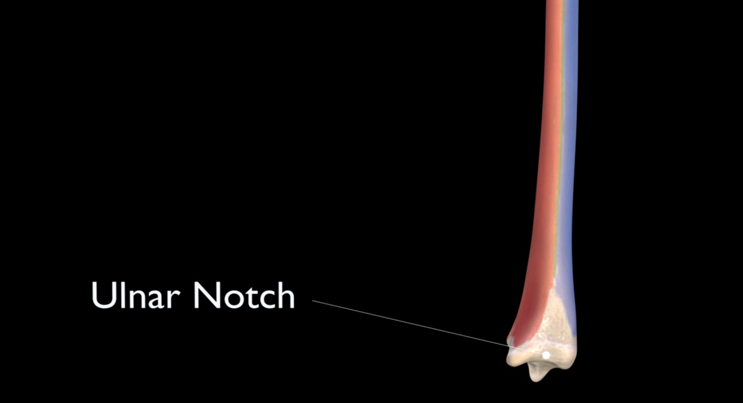
B- INFERIOR RADIOULNAR JOINT
Type:- Synovial
Variety:- Pivot
Articular Surface:-
-Head of ulna
-ulnar notch of radius
Capsule:-
attach to margins of the articular surface
Synovial membrane:-
line the capsule

Slide 11
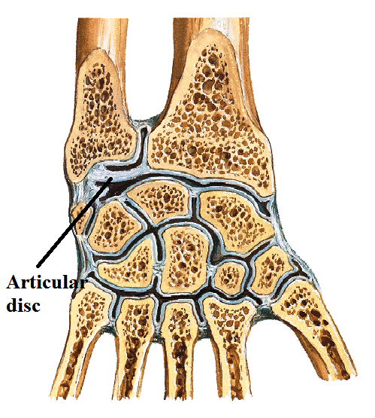
B- INFERIOR RADIOULNAR JOINT
Articular disc
-triangular
-fibrocartilagenous disc
-Extends from styloid process of ulna to inferior margin of ulnar notch of radius -separates inferior radioulnar joint from wrist joint

Slide 12
RADIOULNAR JOINT
Movements of radioulnar joints
pronation: (radius cross the ulna to direct palm backwards)
Initiated by :brachioradialis
Completed by:
pronator teres
Pronator quadratus
supination: (radius parallel to ulna to direct palm forwards)
Initiated by: brachioradialis
Completed by:
Supinator: when forearm is extended
Biceps: when forearm is flexed

Slide 13
c- middle RADIOULNAR JOINT
Type:- Fibrous joint
2 parts
Oblique cord:-
Fibrous band extends from ulnar tuberosity to shaft of radius below radial tuberosity
Interosseous membrane:-
-Fibrous membrane extends between interosseous border of radius & ulna
-Its fibers directed downwards and medially from radius to ulna
-Function
Binds radius to ulna
shock absorption
Gives origin to deep muscles of forearm

Slide 14
THANQ

