Slide 1
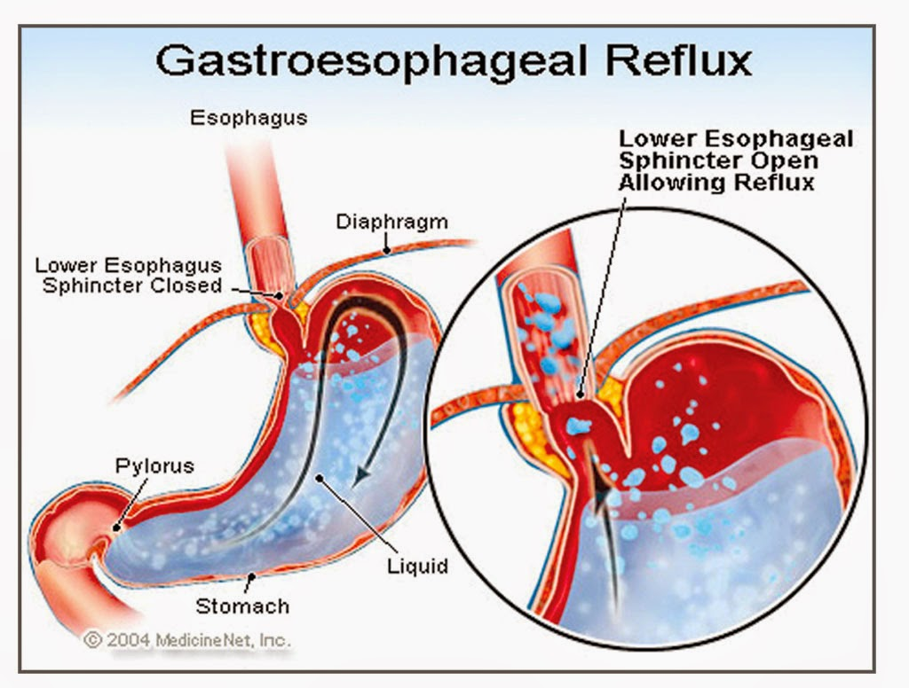
Gastroesophageal reflux
Haitham Al-dmour, md

Slide 2
Definitions
GER: return of gastric contents into the esophagus
GERD: when reflux associated with complication, as FTT, recurrent pneumonia, esophagitis, strictures, etc

Slide 3
GER is physiological
GERD is pathological
Secondary to other known condition
Can be differentiated by frequency of symptoms, but by the presence of complications or not

Slide 4
Definition
Regurgitation “spitting up”: effortless passage of gastric content to the mouth and pharynx
Vomiting: forceful expulsion of gastric contents out of the mouth.

Slide 5
GER is common
½ of infants less than 3 months vomits at least once daily
2/3 of infants by age of 4 months will have GER
By 12 months only 5% of infants
Reﬂux symptoms (heartburn, epigastric pain, and regurgitation) affect up to 7% of school-age children and 8% of adolescents

Slide 7
Pathophysiology

Slide 8
Pathophysiology
LES in infants is very short <1 cm. In adults, the LES ranges from 3-6 cm
LES in infants is located more superiorly than in adults and is subjected to negative intrathoracic pressure during inspiration
The LES lengthens and moves more inferiorly during the first year of life

Slide 9
Pathophysiology
GER results from relaxation of the lower esophageal sphincter (LES).
In healthy infants and children, relaxation of the LES is transient. In infants, gastric distention associated with large volume feeds portends more frequent transient LES relaxations.
Delayed gastric emptying also can increase the frequency of transient LES relaxations. Esophageal clearance and mucosal defense (secretions) play a signiﬁcant role in prevention of esophagitis.
In neurologically impaired children, decreased basal LES tone also is likely to contribute to GER.

Slide 10
Most of the infantile reflux is NON acidic reflux : formula

Slide 11
Symptoms of GER
GER = Regurgitation =‘Happy spitter’
GERD associated with failure to thrive, feeding difﬁculties, or irritability, the most common symptom noted by caregivers
In older children, heartburn, regurgitation, and epigastric pain are the most common signs associated with GERD.

Slide 13
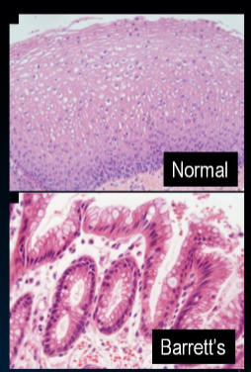
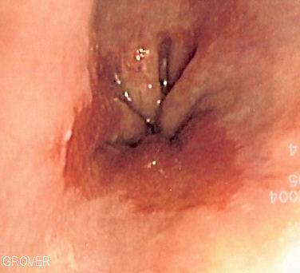
GIT
Reflux esophagitis
Frequency and severity of symptoms does not predict development of esophagitis
Barrett esophagus
Rare in pediatric
0.25% of endoscpies of pediatrics
1-3% progress to adenocarinoma
Familial
Esphageal stricture 5%

Slide 14
Respiratory
Pneumonia
Asthma
Upper airway symptoms

Slide 15
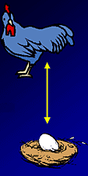
Asthma
Does GERD cause asthma?
Aspiration to lungs and hyperresponsiveness
Vagal mediated bronchial spasm
Doses asthma cause GERD?
High intrathoracic pressure, LES relaxation
Increased abdominal pressure

Slide 16
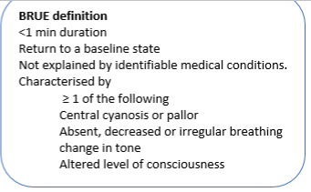
ALTE
Rarely caused my GERD

Slide 17
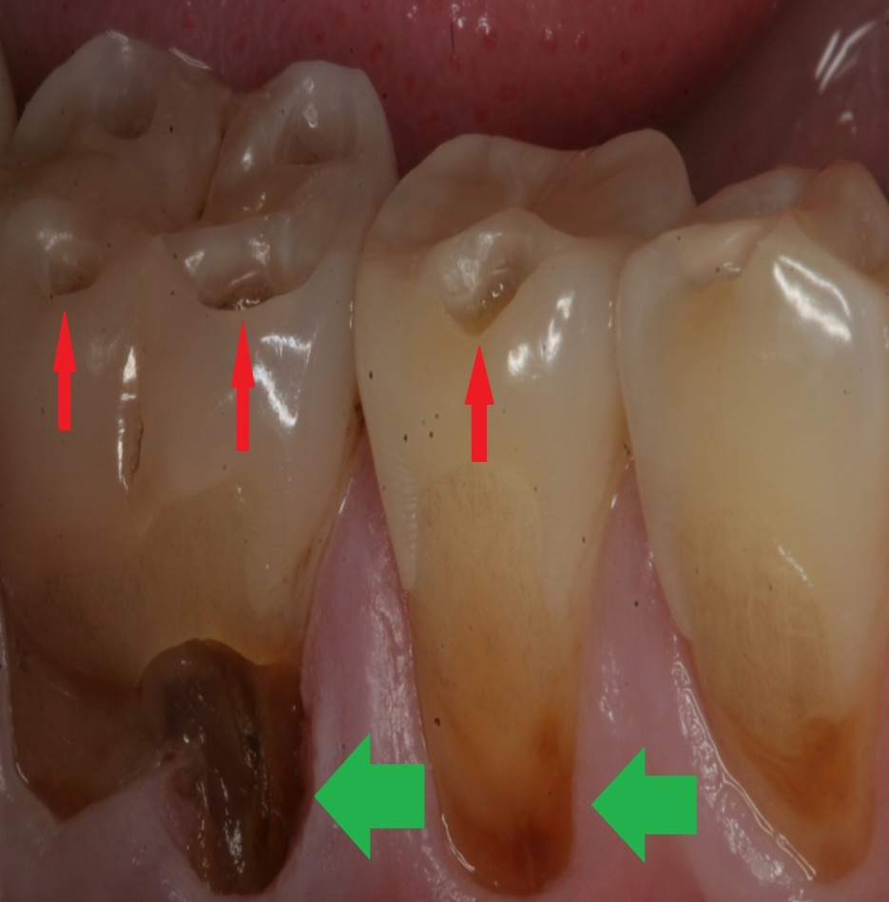
Dental erosion

Slide 18
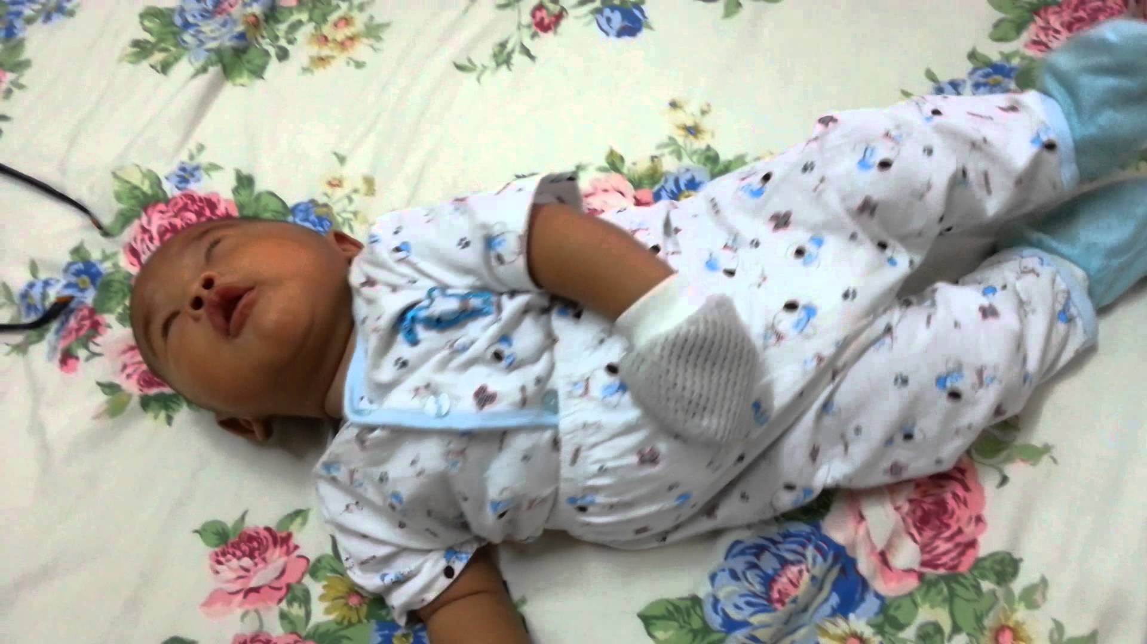
Sandifer syndrome = GERD + opsthatnous position
Vagal reflex
Responds to acid supression

Slide 19
Differential Diagnosis
Neurologic Meningitis Increased intracranial pressure Migraine Respiratory Post tussive emesis Pneumonia Renal Obstructive uropathy Renal insufﬁciency Cardiac Congestive heart failure Behavioral Overfeeding Self-induced emesis Metabolic galactosemia fructosemia Urea cycle defects congenital adrenal hyperplasia | Infection Sepsis Meningitis Gastroenteritis Urinary tract infection Otitis media Anatomic/Obstructive Foreign body Pyloric stenosis Malrotation Intussusception Gastrointestinal Eosinophilic esophagitis Pill esophagitis Infectious esophagitis Achalasia Hepatitis Pancreatitis

Slide 20
Diagnosis
The history and examination alone may be sufficient to diagnose benign GER
Investigations are reserved for infants and children who have complications related to GERD and to evaluate for other causes of vomiting.

Slide 21
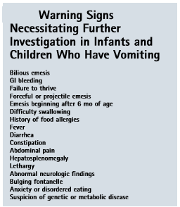
History and exam
Vomitting
Age of onset
Bile stained
Forceful or effortless
Fever
Feeding history
Past medical history
Prematurity
Neurologic problems,
Growth or developmental
Food allergy
Growth parameters
A thorough examination
Notes:
should include volume and frequency of feedings, type of formula,preparationofformula,andpositioningoftheinfant during the feeds.

Slide 22
GER typical presentation
Early onset
Non projectile vomiting, non bile stained
After feeding
Happy spitter
Most of the time small amount
family history
No fever or diarrhea
Gaining weight

Slide 23
GERD Versus GER
Irritability
Not gaining weight
Associated complication
Vomitus may be bloody
Predisposing factor (Seconary)

Slide 24
Risk of severe GERD
Neurologic impairment
Obesity
Cystic fibrosis
Esophageal atresia
Malrotation
Hiatal hernia
Prematurity
Family history of GERD
Notes:
bedifﬁculttodiagnoseGERDinneurologicallyimpaired children

Slide 25
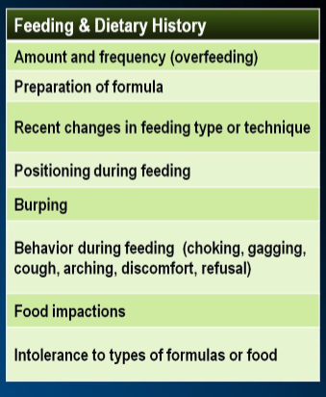

Slide 26
EMPIRIC TRIAL OF ACID SUPPRESSION
A 4-week trial is suggested in older children and neurologically intacts

Slide 27
pH probe
To records the number and duration of acid reflux episodes
If the infant has > 12 episodes in 24-hours with decreased pH as detected by the probe, the infant is at risk of esophagitis
A nomal pH study dosen’t role out GER

Slide 28
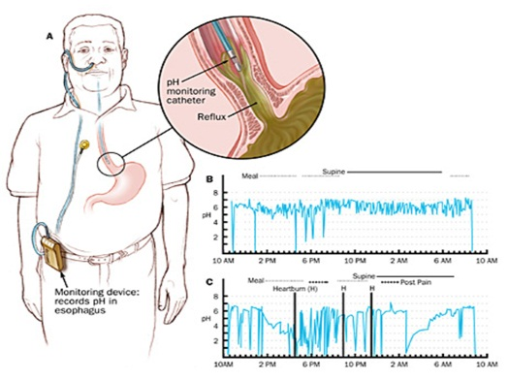

Slide 29
pH probe
Reﬂux index: percentage of study during which the pH is <4.0
Symptom index: the number of times a particular symptom associated with acid reﬂux occurs divided by the total number of times that particular symptom is recorded.

Slide 30
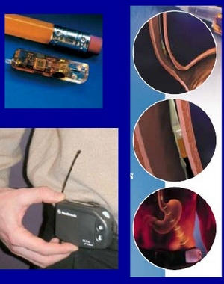
pH probes
Can not detect non-acid reflux episodes
Esophageal pH monitoring is effective also for evaluating the efficacy of acid suppression therapy.

Slide 31
COMBINED MULTIPLE INTRALUMINAL IMPEDANCE AND PH MONITORING. (MII)
Dectect acid, weak acids, and non acid reflux

Slide 32
Upper GI exam
To role out anatomic abnormalities in the vomiting child, such as pyloric stenosis, and esophageal stricture
Also shows motility disorders as achalasia
It should not be used to diagnose GERD because nonpathologic reﬂux frequently is detected during this study.

Slide 33
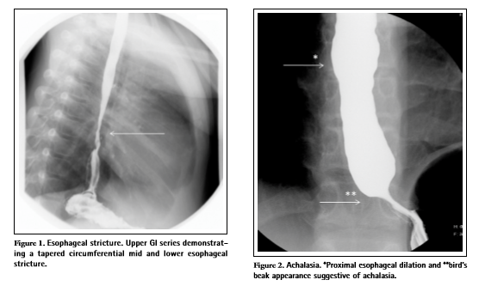

Slide 34
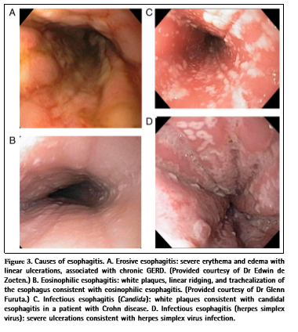
with biopsy Upper endoscopy
Can be used for diagnosis of esophagitis
Also used for diagnosis of PU, and crohn disease

Slide 35
Nuclear scintigraphy
Not routinely used
Usful to check aspiration (GERD)
To see where the formula goes after normal feeding
An isotop labeled formula is given and baby is monitored for GER for 1 hour after feeding
Diagnostic if material is seen in the lung
Also used to assess gastric emptying

Slide 36
Esophageal manometry
Assess esophageal peristalsis and LES pressures
Diagnosis of esophageal motility disorders, such as achalasia
Manometry can not be used to diagnose GERD or predict success with therapy because it cannot determine whether any reﬂux (acid or nonacid) or esophagitis is present.

Slide 37
Treatment of GER
Elevation of head on bed
Don’t encourage sleeping on prone position
Thickening of formula, using 1-2 tablespoon rice cereals, per ounce formula
AR formula
A trial of low allergy formula for 2 weeks ??

Slide 38
pharmacologic measures in GERD only
When previous measures fail
esophagitis
PPI
Omeprazole
Lanzoprazole
Emeprazole
Pantoprazole
Rapeprazole

Slide 39
pharmacologic measures
H2 blockers
Ranitidine
Famotidine
nizatidine
prokinatics
Metochlopramide
Erythromycin
Notes:
Bethanechol
crisapride

Slide 40
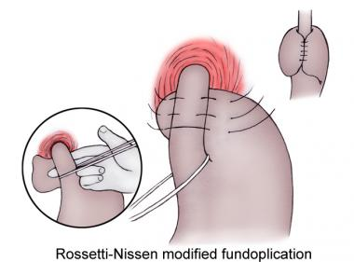
Surgical
FUNDOPLICATION: reserved for neurologically impaired patients
Also for GERD complications refractory to management
Post operative risk of pneumonia is the same as gastrojujenal feeding

Slide 41
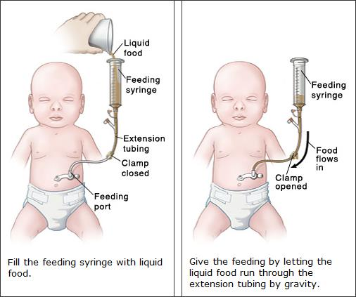

Slide 42
THANK U

