Slide 1
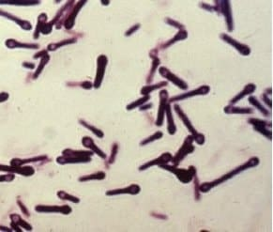
Clostridium tetani
Presented by
Associate Professor Dina Abou Rayia

Slide 2
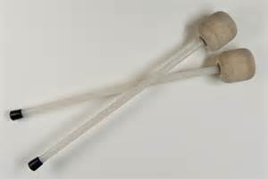
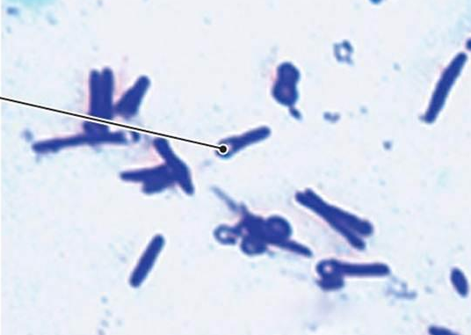
Morphology
Slender gram-positive rods, non-capsulated
Motile by flagella
Endospores forming at the end giving the rods a drumstick appearance
The organism is sensitive to heat, but spores are very resistant to heat and the usual antiseptics. They are also relatively resistant to phenol and other chemical agents.
The spores are widely distributed in soil and the intestines of animals
Endospore

Slide 3
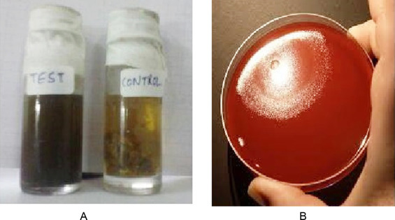
Culture and biochemical reaction
The organism is obligatory anaerobe and can’t grow in the presence of oxygen
It grows well on cooked meat broth and on blood agar incubated anaerobically, they form a thin film
The organism ferments no sugar

Slide 4
Tetanus

Slide 5
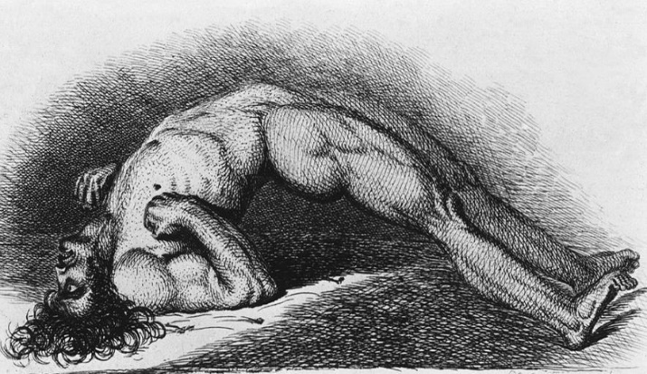
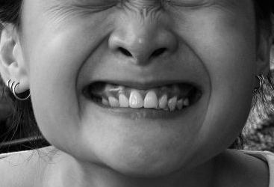
Tetanus (Lock jaw)
A serious disease caused by C. tetani and characterized by generalized muscle spasms, hyperreflexia, and seizures.

Slide 6
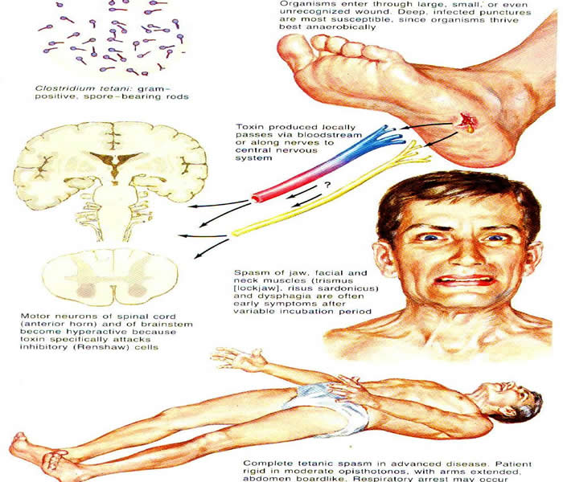
Mode of transmission
- The spores of C. tetani are commonly found in the soil, dust, and manure.
- They enter through skin breaks such as cuts (major or minor) or puncture wounds by a contaminated object, may follow burn, animal bite, otitis media, etc.…….
- It is not transmitted from person to person (not contagious)
Pathogenesis:
The spores that contaminate wounds in the presence of anaerobic condition will germinate, multiply and produce two types of toxins:
- Tetanolysin: has no relation with tetanus
- Tetanospasmin neurotoxin
- Tetanospasmin reaches the CNS via the blood and retrograde spread occurs also through nerve axons until reaching the motor nuclei of cranial nerves or ventral horn of the spinal cord

Slide 7
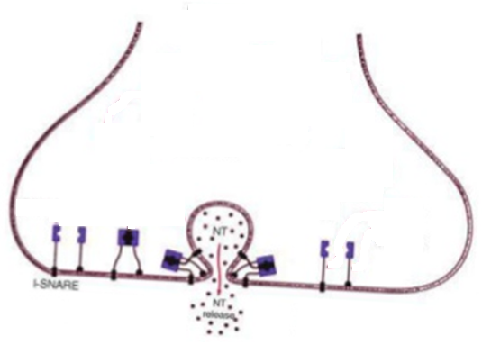
Interneurone
TeNT
Motor neuron
Tetanospasmin cleaves the synaptobrevin which is required for the fusion of vesicles containing inhibitory neurotransmitters (e.g. GABA) with the membrane resulting of neurotransmitter release inhibition
NT: neurotransmitter
TeNt: tetanospasmin neurotoxin

Slide 8
Wound associated aerobic bacterial infection effect on C. tetani
???????????????????????????????????????????

Slide 9
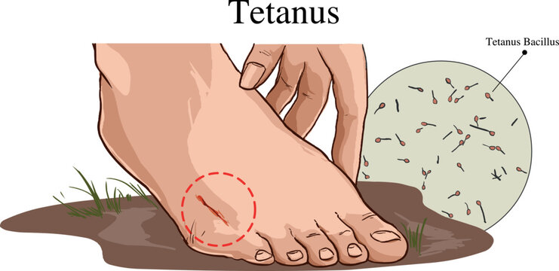
Clinical picture of tetanus
The incubation period:
Ranges from 3 to 21 days (average 8 days)
Tetanus has two different forms based on the clinical findings:
Local (including cephalic).
Generalized (including neonatal).

Slide 10
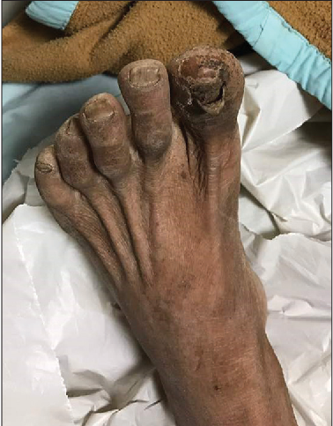
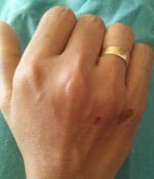
Forms of tetanus
Local tetanus
Is an uncommon form of the disease, in which patients have persistent contraction of muscles in the same anatomic area (at the site of injury)
These contractions may persist for many weeks before gradually subsiding.
Local tetanus may precede the onset of generalized tetanus.
Only about 1% of cases are fatal.

Slide 11
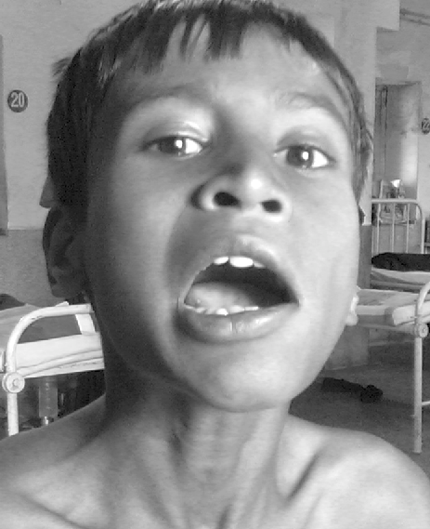
Forms of tetanus
Cephalic tetanus
Is a rare form of the disease (type of localized tetanus)
Occasionally occurring with otitis media, ear infections, or following injuries to the head
There is an involvement of the cranial nerves, especially in the facial area.
If the cranial nerves are involved in localized cephalic tetanus, the pharyngeal or laryngeal muscles may spasm, with consequent aspiration or airway obstruction, and the prognosis may be poor.

Slide 12
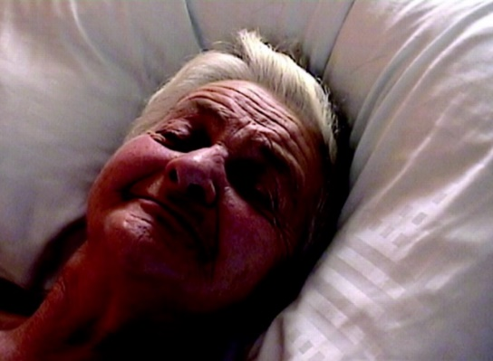
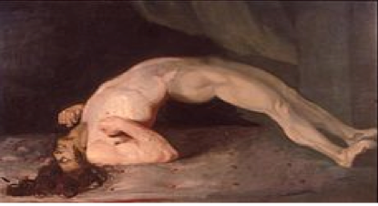
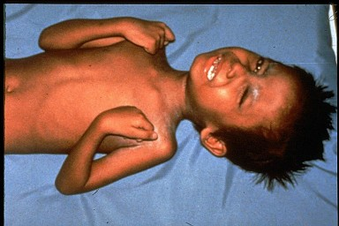
Forms of tetanus
Generalized tetanus
The most common type (about 80% of reported tetanus)
The first sign is trismus or lockjaw, followed by stiffness of the neck, difficulty in swallowing, and rigidity of abdominal muscles.
Other symptoms include elevated temperature, sweating, elevated blood pressure, and episodic rapid heart rate.
Spasms may occur frequently and last for several minutes. Spasms continue for 3–4 weeks.
Complete recovery may take months.

Slide 13
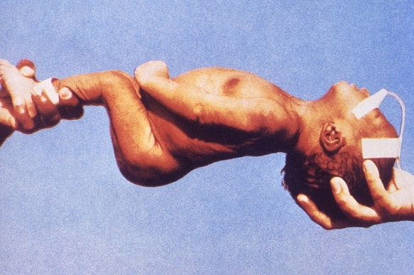
Forms of tetanus
Neonatal tetanus (Tetanus neonatorum)
Is a form of generalized tetanus that occurs in newborn infants.
Neonatal tetanus occurs in infants born without protective passive immunity because the mother is not immune
It usually occurs through infection of the unhealed umbilical stump, particularly when the stump is cut with an unsterile instrument
Neonatal tetanus is common in some developing countries
Neonates show signs of being generally irritable, muscle spasms, and poor ability to take in liquids (poor sucking response), usually seen in neonates about 7-10 days old

Slide 14
Complications
Laryngospasm (spasm of the vocal cords) and/or spasm of the muscles of respiration leads to interference with breathing.
Fractures of the spine or long bones may result from sustained contractions and convulsions.
Hyperactivity of the autonomic nervous system may lead to hypertension and/or an abnormal heart rhythm.
Cases most likely to be fatal are those occurring in persons 60 years of age and older (18%), and unvaccinated persons (22%).

Slide 15
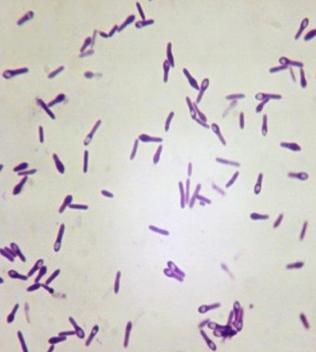
Diagnosis
History
Clinical picture
Laboratory:
Specimen: swab from the lesion
Culture on blood agar incubated anaerobically ??
Biochemical reaction ??
Animal pathogenicity

Slide 16
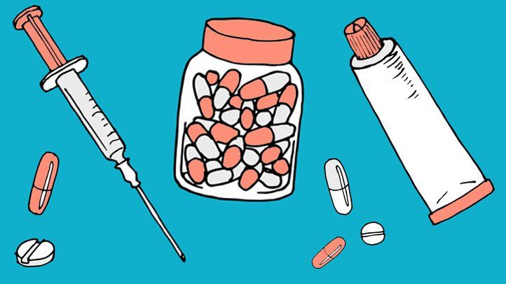
Treatment
Toxin neutralization
Airway management
Antibiotics
Proper wound care
Sedative
Supportive therapy
- Penicillin
- Metronidazole
- Doxycycline
Benzodiazepines to control muscle spasm
Very important
-Proper wound cleaning and debridement may be needed
IV fluids and pain killer
Used to neutralize unbound toxins
Called human tetanus immunoglobulin (HTIG)
Recommended dose (3000-6000 units IM with average 500 units)
????
Which is started first
wound debridement or antitoxin and why ????

Slide 17
Prophylaxis
Active immunization
Passive immunization
- Tetanus toxoid is given with diphtheria toxoid and pertussis vaccine as DPT at the age of 2, 4, 6 months
Booster dose at 1 year and school entry
Booster dose of DT is given every 10 years
Individuals wounded with previous history of vaccination 5 or more years should receive a booster dose
Booster dose for pregnant women
-Individual wounded without previous history of vaccination or vaccinated more than 10 years ago should receive HTIG (250-500 units IM) and this passive immunization should be accompanied with active immunization

Slide 18
When to seek tetanus medical care???
If the wound is large, contains crushed tissues, or is heavily contaminated
If individuals have a recent injury and are starting to experience muscle cramps or spasms at or near the injury
If individuals have trouble swallowing or have muscle spasms in the facial muscles

Slide 20
Clostridium botulinum

Slide 21
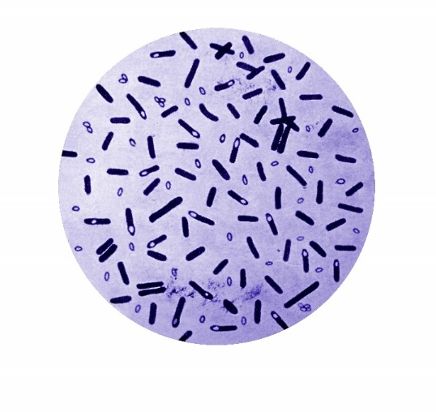
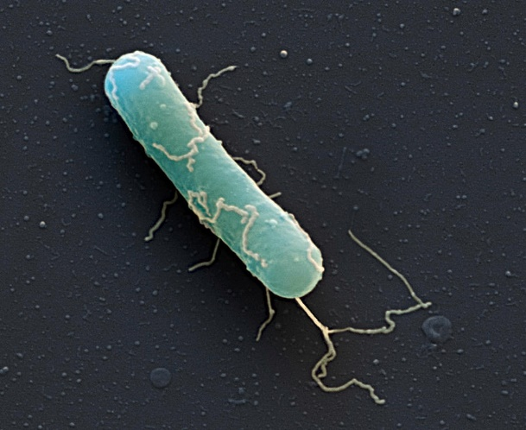
Morphology
Gram-positive large straight rods, motile, non-capsulated
Spore-forming which is oval, central, or subterminal
Found in the soil and domestic animal intestines
Obligatory anaerobe

Slide 22
Botulinum toxin
Botulinum toxins
Seven different types of neurotoxins: A to G
Four of these (types A, B, E, and rarely F) cause human botulism. Types C, D, and E cause illness in other mammals, birds, and fish.
All cause flaccid paralysis
Only a few nanograms can cause illness
The most lethal known toxin
Destroyed by boiling
Mode of action
Neurotoxin production > stomach absorption > circulation > Neuromuscular junction (NMJ) > inhibition of acetylcholine release at the neuromuscular junction > flaccid descending motor paralysis
Botox is a commercial preparation of exotoxin A used to remove face wrinkles

Slide 23
Clinical forms of botulism
Food-borne botulism
Wound botulism
Infant botulism
Occurs when C. botulinum grows and produces toxins in food prior to consumption
Food commonly responsible include home-canned food, canned green beans, mushrooms, and tuna fish
No fever may be nausea and vomiting
Muscle paralysis leads to diplopia, dysphagia, and respiratory muscle paralysis
Wound botulism is rare
Caused by contamination of wounds with C. botulinum spores, subsequent spore germination, and toxin production.
This form of the disease has been associated with substance abuse, particularly when injecting black tar heroin.
The symptoms are similar to foodborne botulism but may take up to 2 weeks to appear.
Occurs due to ingestion of spores in baby’s food where they germinate in the gut and produce the toxin (intestinal flora not well developed yet)
Affects infants below 1 year (94% below 6 months) causing floppy child syndrome
They develop constipation, poor feeding, muscle weakness, and finally muscle paralysis

Slide 24
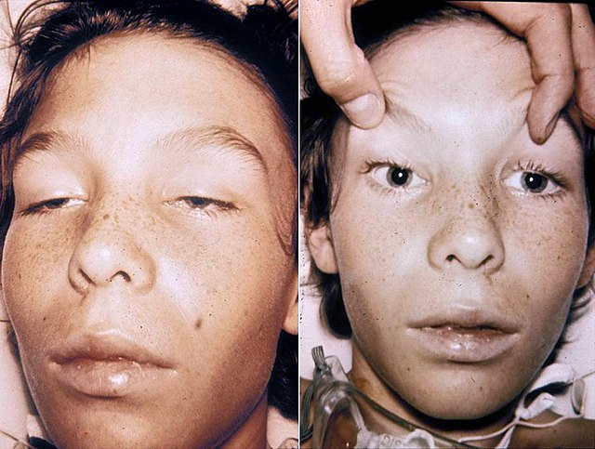
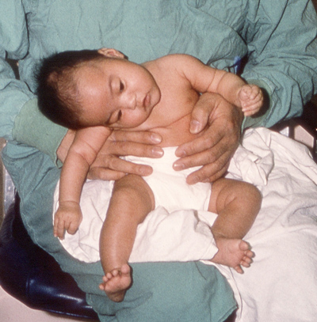
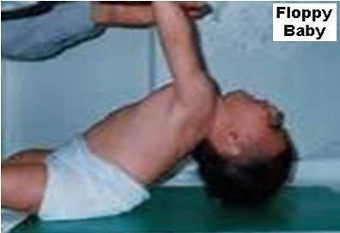
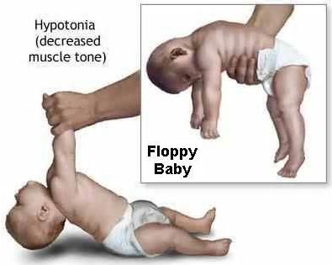

Slide 25
Diagnosis
History ??
Clinical ??
Laboratory:
Toxin detection in patient serum, food remnants, or bowel contents by immunological tests (e.g., ELISA) or animal inoculation.
Culture to detect organisms is rarely done.

Slide 26
Treatment
Once botulism is suspected, treatment should be started immediately.
Trivalent antitoxin (types A, B, and E) is given.
Respiratory support
Wound care
Prevention
Proper cooking and heating of food
Avoid suspicious canned food (swollen cans)
Proper processing, preservation, and canning of food

Slide 28
Case 1
A 4-year-old boy presented to the hospital with a one-week history of general malaise, and progressive anorexia. Three days prior to hospital presentation, he had started to refuse all food and fluids, accompanied by progressive dysphagia and difficulty in opening the mouth.
History: revealed that the boy had recently injured his left big toe. This had resulted in a small local hematoma and loose toenail
Physical examination: afebrile, irritable and anxious boy gently playing at the table, with trismus and mild dehydration. After being asked to walk, he showed muscle spasms of the back and thighs evidently worsening during examination

Slide 29
Case 2
A twenty-one-year girl student had spent a day with her grandparents. During her drive back to the campus, her vision became blurry, and she was forced to pull over to the side of the road. As she sat in her car, her vision worsened. She opened the car hood in hope of attracting aid and tried to relax. In a short time, a highway officer pulled over and approached her. By this time, she was having trouble swallowing and speaking clearly. The officer took her to the emergency hospital.
History: The girl described that she ate with her grandparents and that all the food was homemade and canned by her grandmother.
Physical examination: the patient was lethargic and unable to breath

