Slide 1
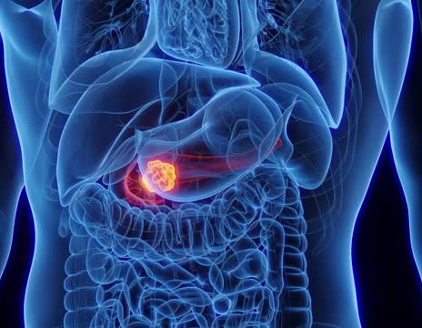
PANCREATIC TUMOR
Supervised by :
Dr Mohammad Nofal
Presented by :
Nosaiba Saraireh
Ayah Tarawneh
Roqea Khamaiseh
Adan Omaireen

Slide 2
Pancreatic tumors can be either :
Benign (Non cancerous).
Malignant (Cancerous).
The pancrease contains both :
Exocrine cells which produce enzymes for digestion.
Endocrine cells which produce hormones like insuline.
Tumors can arise from either cell type :
Exocrine tumors (Non endocrine).
Endocrine tumors (Islet cell tumors).

Slide 3
Exocrine tumors :
1. Dutal adenocarcinoma
- Most common type of malignant pancreatic tumors.
- ⅔ Head of pancreas.
- Agressive.
2. Cystadenocarcinoma
3. Periampullary carcinoma (Jaxtapancreatic carcinoma)
- Refers to tumors near the pencrease and inculdes : carcinoma of the ampulla, lower common bile duct and duodenum.

Slide 4
Endocrine tumors :
- Less common than non endocrine tumors.
- Generally benign and have a better prognosis.
- Sometimes multiple.
1. Insulinoma
- Most common.
- Arise from beta cells.
- Secrete insulin.
- Often benign but can be malignant (<10%)
- Whippel's triad.
2. Gastrinoma (Zollinger-Ellison syndrome)
- Arise from G cells.
- Secrete gastrin.
- The majority (60%) are malignant.
- Most common tumor associated with MEN 1.

Slide 5
3. Glucagonoma
- Arise from alpha cells.
- Secrete glucagon.
- Usually malignant (80%).
4. VIPoma
- Arise from islet cells.
- Secrete vasoactive intestinal peptide.
- Associated with watery diarrhea, hypokalemia and achlorhydria (WADHA syndrome).
5. Somatostatinoma
- Arise from delta cells.
- Secrete somatostatin.

Slide 7
Evaluation of pancreatic tumors :
History.
Examination.
Investigations.
History :
Presenting symptoms :
Jaundice
Weight loss
Abdominal pain
Anorexia and nausea
New onset diabetes
Fatigue
Steatorrhea
Risk factors :
Smoking
Chronic pancreatitis
High alcohol consumption
Type 2 diabetes
Age >50 year
Inherited genetic syndromes (MEN1)

Slide 8
Examination :
General :
Jaundice
Cachexia
Pallor
Abdominal :
Palpable mass
Courvoisier's sign
Hepatomegaly
Ascitis

Slide 9
Investigations :
Laboratory :
CBC
LFT
CA 19-9
Imaging :
US
CT
MRI/MRCP
EUS
ERCP
PET
Biopsy

Slide 10
NON-ENDOCRINE NEOPLASMS: (ADENO-CARCINOMA OF PANCREAS)
- Ductal adeno carcinoma (arising in the exocrine part of pancreas) account for 90% of pancreatic tumor 2/3rd located in the head of pancreas.
- Cystadenocarcinoma and endocrine tumor account for most of the remains of malignancy.
- The exact causative factors responsible are unknown.
- The peak incidence in the 6th and 7th decade and more in men than women .

Slide 11
The predisposing factors are:
Diet (high protein & high fat)
Exposure to industrial carcinogens
Smoking

Slide 12
Spread of pancreatic tumors:
A. Local Invasion
B. Lymphatic
C. Blood
D. Via peritoneal & omental causing ascites

Slide 13
CLINICAL FEATURES:
The diagnosis of pancreatic cancer varies from the simple and clinically obvious to the most difficult and almost impossible the initial symptoms and signs depend on the site and extent of the pancreatic cancer.
Weight loss
Pain
Jaundice
Steatorrhoea
Diabetes Mellitus
Acute Pancreatitis
Malignant Ascites
Gastric Outlet Obstruction

Slide 14
Approach to Investigations:
(Selective Investigations)
⚫ Ultrasound Scan
⚫ C.T. Scan
⚫ MR Imaging Scan
⚫ ERCP
⚫ Histology & Cytology
⚫ Angiography (Coeliac, Superior - Mesenteric)
⚫ Laparoscopy

Slide 15
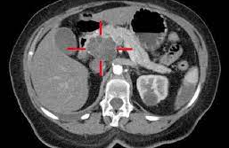
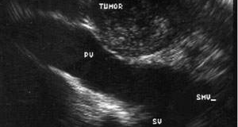
CT-SCAN
EUS

Slide 16
DELAY IN DIAGNOSIS:
■ Over 90% of patient with pancreatic cancer present in the late stage of their disease. At time no chance of cure.
■ The factors responsible for late diagnosis :
A. Tumor is asymptomatic in the early stage.
B. Patient delay.
C. Physician delay.
D. The patient may not have ready and easy access to competent diagnostic center .

Slide 17
MANAGEMENT OF PANCREATIC CANCER:
A. Surgical Treatment
B. Non Surgical Treatment

Slide 18
SURGICAL TREATMENT:
■ Pancreatic Cancer is essentially incurable since metastasis occurs at such early stage. Any treatment must be regarded as palliative.

Slide 19
SURGICAL OPTIONS:
⚫ For curative surgical treatment of cancer in the head of pancreas the optims are available:
A. Whipple operation (Pancreaticoduodenectomy)
B. Pylorus Preserving (Pancreaticoduodenectomy)
C. Total Pancreatectomy
D. Palliative Surgical Treatment (Surgical Bypass)
E. For tail of the pancreas (Distal pancreatectomy)
F. Body of the pancreas (Distal + removal of the body of the pancreas)

Slide 20
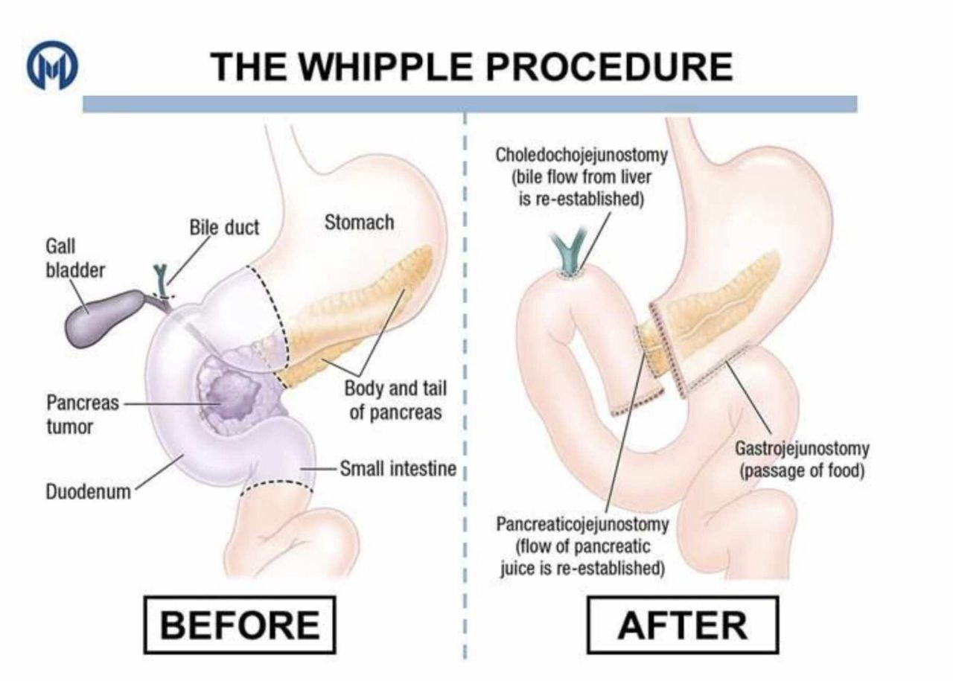

Slide 21
PRE-OPERATIVE PREPARATION OF THE PATIENT FOR MAJOR SURGERY:
1. All jaundiced patients must be kept in good state of nutrition and hydration.
2. Blood clotting deficiencies must be corrected.
3. Cardiopulmonary functioning carefully assessed.
4. Drainage procedure consider in certain cases.

Slide 22
NON-SURGICAL TREATMENT :
The following options available:
(Palliative procedure for non operable cases)
⚫ Percutaneous coeliac ganglion blockade. (For pain)
⚫ Stent to compress bile duct.
⚫ Combination of chemotherapy and radiotherapy may become alterative in the future.

Slide 23
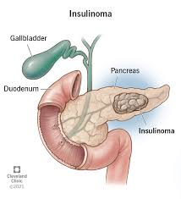
FUNCTIONING ENDOCRINE TUMOURS OF THE PANCREAS:
Endocrine tumer secret from langerhans cell ,ductless ,direct to blood
These are much less common than adeno carcinoma.
1- The beta cell tumors secrete (Insulin) and called INSULINOMAS .
2- Another functioning tumor secrete(Gastrin) called GASTRINOMA which come from the islets which cannot be classified into either alpha or be (non-beta).

Slide 24
Other tumors are:
A. Vipoma (Werner-Morrison syndrome, Pancreatic cholera) secret vasoactive intestinal peptide
B. Somastatinoma from delta cell
C. Glucagonoma
D. HP (Human Pancreatic Polypeptide tumours)
■ Slow growing and therefore carry much better prognosis.

Slide 25
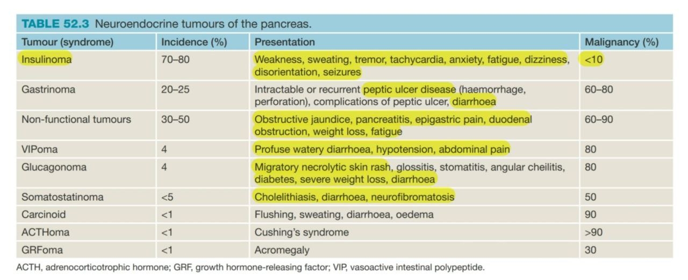

Slide 26
INSULINOMA
■ The commonest islet cell tumor and arise from the beta cell and situated anywhere on the surface or within the substance of the pancreas.
■ Most tumors are benign adenomas but 15% are low grade carcinomas and secrete (insulin).

Slide 27
CLINICAL FEATURES:
Whipple described a triad of features which typify the (insulinomas):
1. Fasting produces fainting ,sweating , dizzines ,tachycardia .
2. During these “attacks” there is hypoglycemia BG less than 50mg/dl .
3. The attacks may be relieved by ingestion of glucose.

Slide 28
INVESTIGATIONS
Measurement of blood sugar in an attack. Overnight fasting serum glucose.
insulin level (before & after overnight). Insulin level are estimated by radio-immunoassay.
Pre-operative localization of the tumor very important identification at operation can be difficult.

Slide 29
Lab see –decrease glucose and increase insulin ,C peptide
Localized tumer after biochemical work up may by diffecult .
Image :
Combination CT Scan and selective angiography
MRI
Us with or without biopsy

Slide 30
Different btw insulinoma and exogenous insulin abuse :
C peptide .
C peptide : low (type 1 DM)
normal(exogenous insulin use)
high (insulinoma)

Slide 31
TREATMENT:
1. If the tumor localized surgical resection is the trearment of choice also this apply to metastases.
2. If the tumors not localized during surgery (Intra operative USS can be done to localize the tumor) than resected.
3. Sub total distal resection for multiple tumors is appropriate.
4. With negative exploration it is appropriate to perform pancreatectomy distal to the superior mesenteric vessels.
5.The Hypoglycemic attacks may be relieved by diazoxide or streptazotocin.

Slide 32
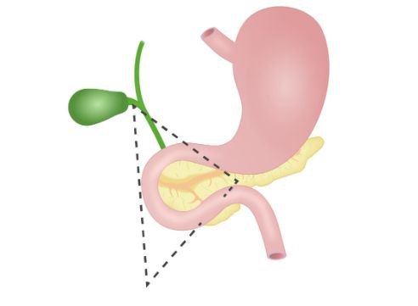
GASTRINOMA: (ZOLLINGER-ELLISON SYNDROME)
Neuroendocrine gastrin-secreting tumor malignant in 60 % (rare).
Cause :sporadic 75%,associated with MEN type 1 25%
arising from islets of Langerhans non –beta cell of pancreas and in the duodenal wall.
usually occur in gastrinoma triangle(junction btw cystic and CBD,2nd and 3rd part of duodenum,neck of pancreas).

Slide 33
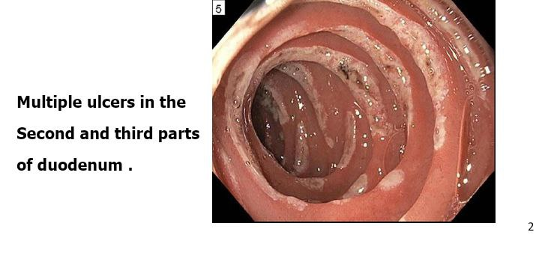
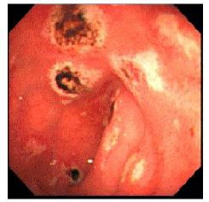
Multiple ulcers in atypical locations as(disal deudenum and jujinum

Slide 34
CLINICAL FEATURES:
■ The disease present as peptic ulcer disease in over 90%.
(recurrent,pain more severe than pu and resistance to medical treatment.
■ weight loss due to malabsorption ,diarrhea and steaorhea
■ All complications of peptic ulcer disease are present as acute hemorrhage , perforation and recurrent ulceration.

Slide 35
Diagnosis:
Labs:
1. fasting serum gastrin (FSG)…… more than 1000 pg/ml
2.Gastric ph ….less han 2
3.Secretin stimulation test
Localization :
EGD (ulcers) , imagine(CTorMRI w/ contrast)

Slide 36
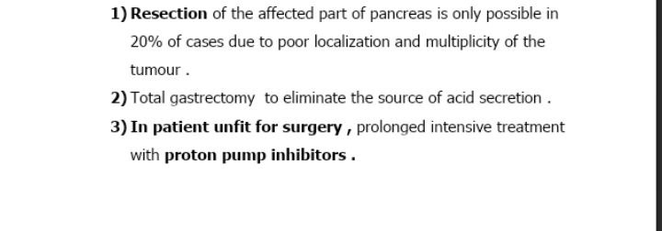
TREATMENT:
Medical therapy for control of the acid hypersecretion Omprazole 1st line ,famotidine 2nd
Line,somatostatin analogue
SURGERY:

Slide 37
Pancreatic tumor prognosis

Slide 38
THANK YOU

