Slide 1
Osteoporosis

Slide 3
What is Osteoporosis?

Slide 4
What is Osteoporosis?

Slide 6
What causes osteoporosis?

Slide 7
Common risk factors for osteoporosis

Slide 8
Do you have osteoporosis?

Slide 9
Bone Densitometry What is Bone Density Testing?

Slide 10
DEXA

Slide 11
DEXA

Slide 12
DEXA

Slide 13
Who needs bone densitometry? {osteoporosis screening)

Slide 14
Fracture risk

Slide 15
The categories for which bone densitometry is most often done are:

Slide 16
How is osteoporosis treated? {patient education}

Slide 20
Medications to strengthen bones and prevent fractures

Slide 22
How is osteoporosis treated?

Slide 24
Drug ‘Holiday’

Slide 28
Young women and pregnancy

Slide 29
summary

Slide 31
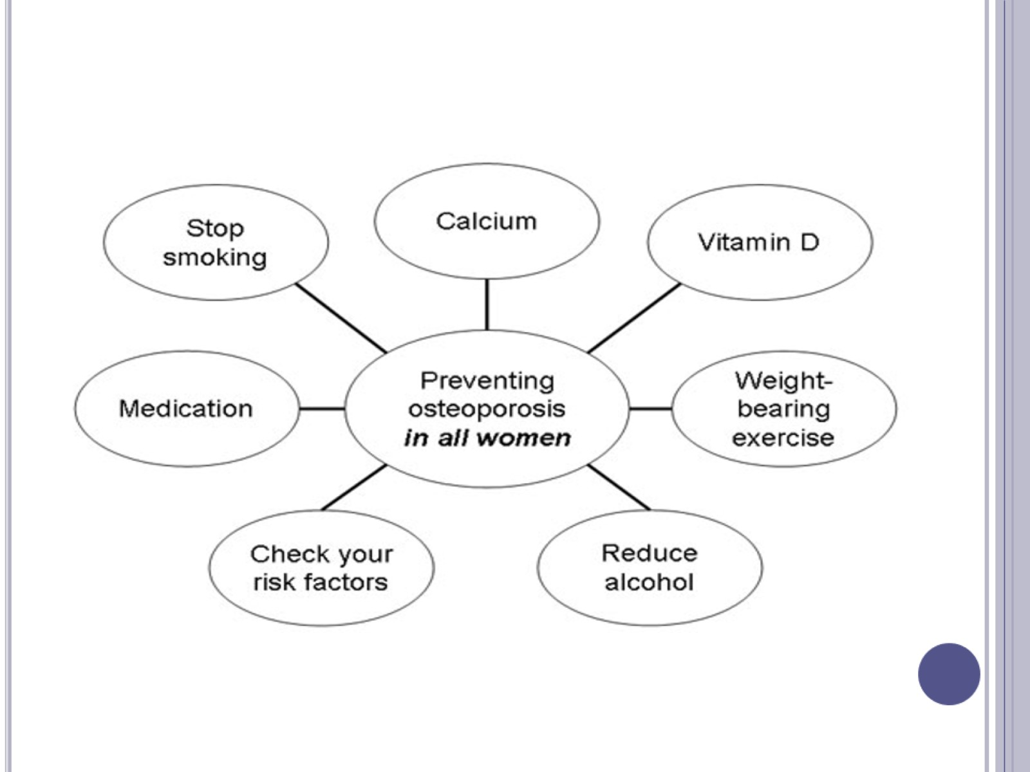

Slide 32
What is the broader health impact of osteoporosis?

Slide 33
Living with osteoporosis

Slide 34
Points to remember

