Slide 1
Mechanics of muscle contraction
DR. ARWA RAWASHDEH

Slide 2
Objectives
Define the microscopic skeletal muscle contraction

Slide 3
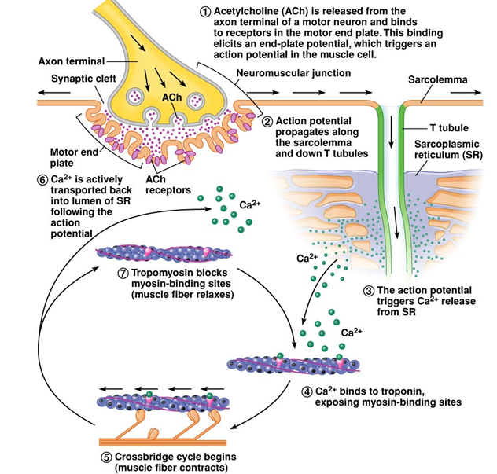
The mechanism of force generation in muscle

Slide 4
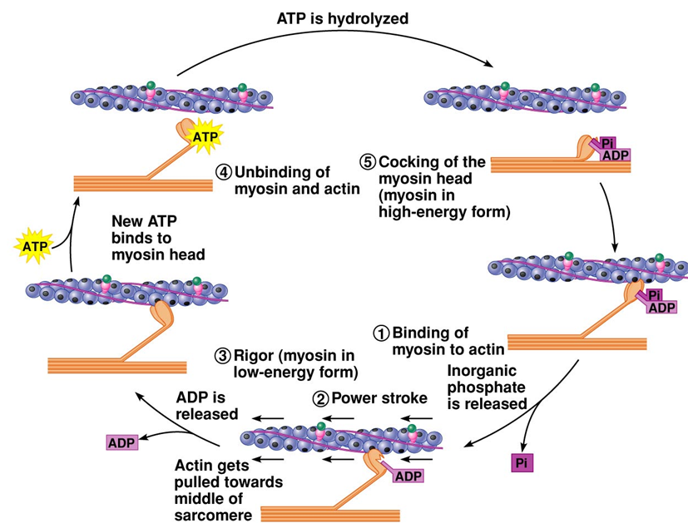

Slide 5
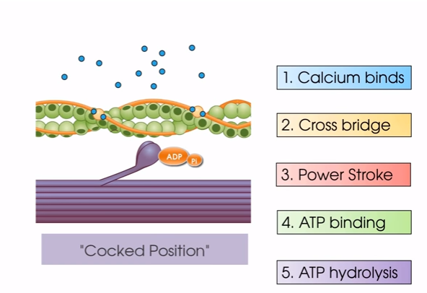

Slide 6
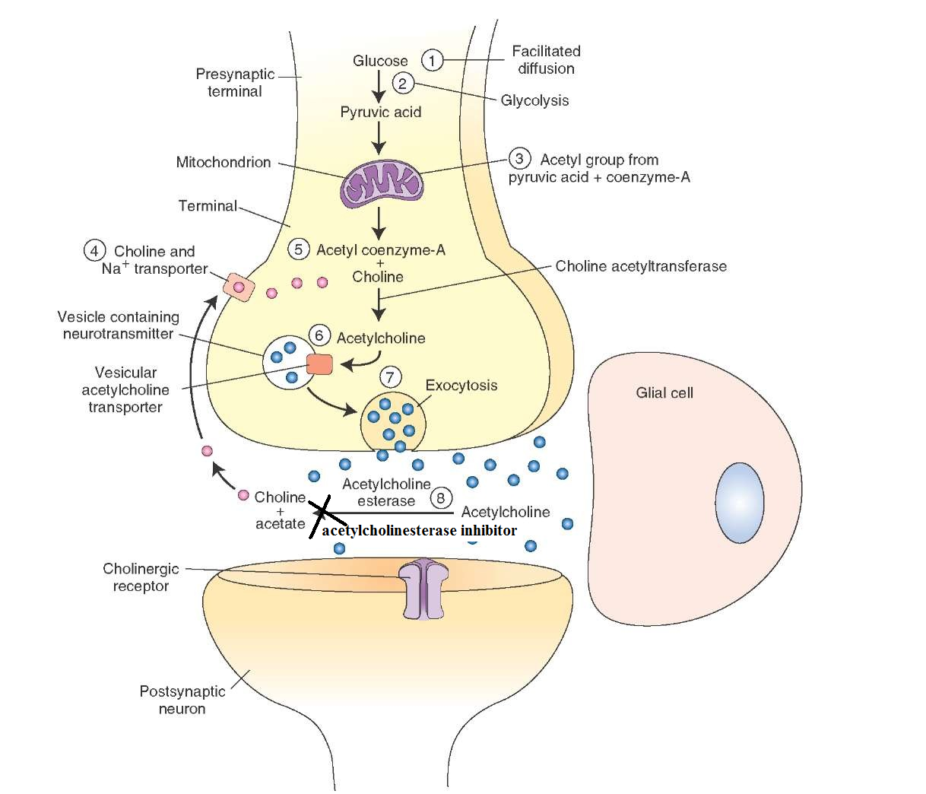
Spastic Paralysis
Ingestion of insecticides Killer
Nerve gas poison (Sarin)
Notes:
6

Slide 7
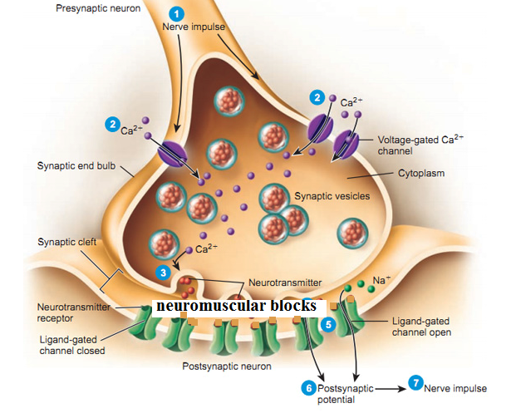
Flaccid Paralysis
Topical anaesthetic shot into this muscle; neuromuscular blocker
Relaxation of diaphragm during anaesthesia; neuromuscular blocker
Snake Bites (COBRA) ; neuromuscular blocker
Myasthenia gravis
is a relatively rare autoimmune disorder in which antibodies form against nicotinic acetylcholine (ACh) postsynaptic
Botulinum disease; prevent Ach release
Notes:
7

