Slide 1
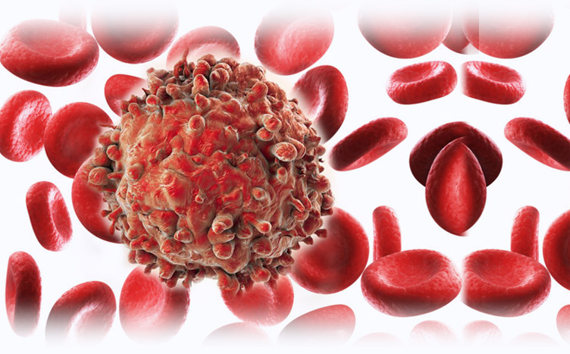
Neoplasia 3
Dr. Eman Kreishan, M.D.
27-12-2021.

Slide 2
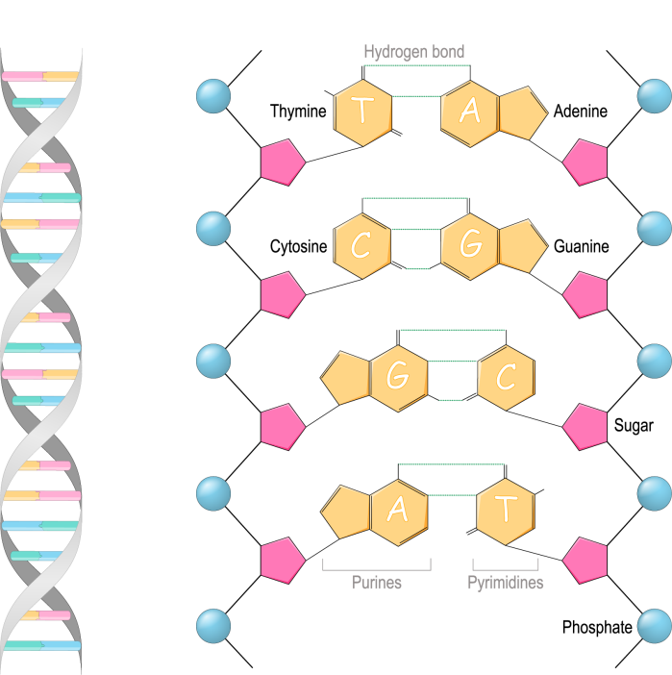
GENETIC LESIONS IN CANCER
The genetic changes found in cancers vary from :
point mutations involving single nucleotides to abnormalities large enough to produce gross changes in chromosome structure.

Slide 3
Driver and Passenger Mutations
Driver mutations are mutations that alter the function of cancer genes and directly contribute to the development or progression of a given cancer.
They are usually acquired, occasionally inherited.
passenger mutations are acquired mutations that are neutral in terms of fitness and do not affect cellular behavior.
passenger mutations are sprinkled throughout the genome.

Slide 4
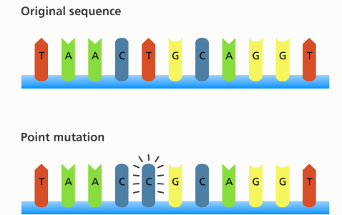
1.Point Mutations
change in single nucleotide of DNA.
Point mutations can either activate or inactivate the protein products of the affected genes depending on their precise position and consequence.

Slide 5
Point mutations that convert proto-oncogenes into oncogenes generally produce a gain of-function, e.g: RAS
point mutations in tumor suppressor genes reduce or disable the function of the encoded protein, e.g TP53.

Slide 6
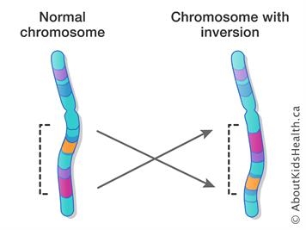
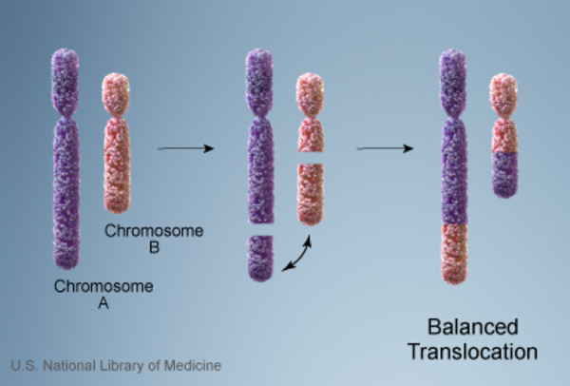
2.Gene Rearrangements
Gene rearrangements may be produced by chromosomal translocations or inversions.
Specific chromosomal translocations and inversions are highly associated with certain malignancies, e.g hematopoietic cells and mesenchymal neoplasms.

Slide 7
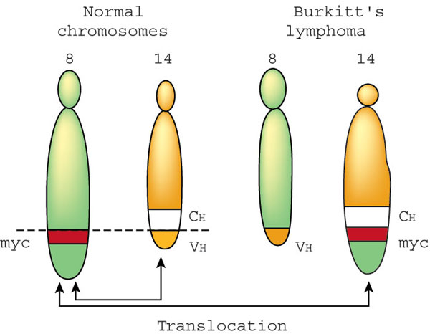
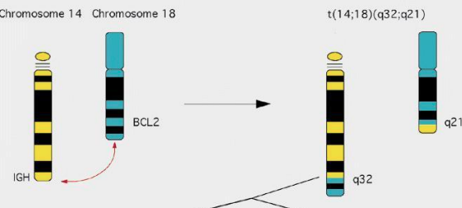
These rearrangements can activate proto-oncogenes in two ways:
a. Some gene rearrangements result in overexpression of proto-oncogenes by removing them from their normal regulatory elements and placing them under control of an inappropriate, highly active promoter or enhancer.
Burkitt lymphoma
Follicular lymphoma

Slide 8
b. Other oncogenic gene rearrangements create fusion genes encoding novel chimeric proteins.
E.g Philadelphia (Ph) chromosome in chronic myeloid leukemia, consisting of a balanced reciprocal translocation between chromosomes 9 and 22.
chronic myeloid leukemia

Slide 9
3. Deletions
Deletion of specific regions of chromosomes may result in the loss of particular tumor suppressor genes.
Examples:
deletions involving 13q14, the site of the RB gene, are associated with retinoblastoma.
deletion of 17p is associated with loss of TP53, arguably the most important tumor suppressor gene.

Slide 10
4. Gene Amplifications
Proto-oncogenes may be converted to oncogenes by gene amplification, with consequent overexpression and hyperactivity of otherwise normal proteins.
Two clinically important examples of amplification :
A. NMYC gene in neuroblastoma, and the amplification is associated with poor prognosis
B. HER2 gene in breast cancers

Slide 11
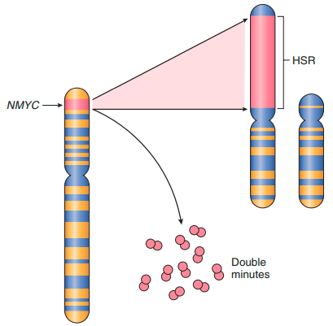
Amplification of the NMYC gene in human neuroblastoma. The NMYC gene, present normally on chromosome 2p, becomes amplified and is seen either as extrachromosomal double minutes or as a chromosomally integrated homogeneous-staining region (HSR).

Slide 12
5. Aneuploidy
Aneuploidy is defined as a number of chromosomes that is not a multiple of the haploid state; for humans, that is a chromosome number that is not a multiple of 23.
Having missing or extra chromosomes

Slide 13
CARCINOGENESIS:A MULTISTEP PROCESS
no single mutation is sufficient to transform a normal cell into a cancer cell.
Carcinogenesis is thus a multistep process resulting from the accumulation of multiple genetic alterations that collectively give rise to the transformed phenotype
during their course cancers generally become more aggressive and acquire greater malignant potential, a phenomenon referred to as tumor progression.

Slide 14
Cancers acquire more mutations with time, making the affected cells more adept at growth, survival, invasion, metastasis, or immune evasion.
This explain the tendency over time for cancers to become both more aggressive and less responsive to therapy.

Slide 16
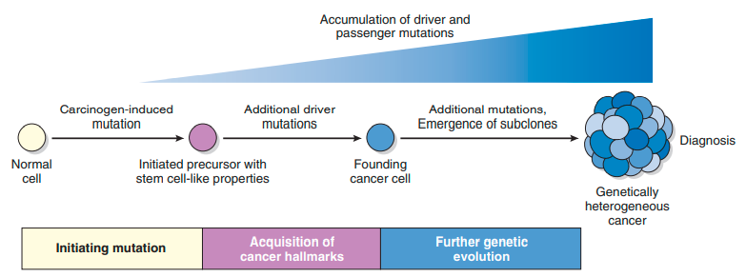
HALLMARKS OF CANCER

Slide 17
HALLMARKS OF CANCER
all cancers display eight fundamental changes in cell physiology, which are considered the hallmarks of cancer.
• Self-sufficiency in growth signals
• Insensitivity to growth-inhibitory signals
• Altered cellular metabolism
• Evasion of apoptosis
• Limitless replicative potential (immortality)
• Sustained angiogenesis
• Invasion and metastasis
• Evasion of immune surveillance

Slide 18
1. Self-Sufficiency in Growth Signals:
generally stems from gain-of-function mutations that convert proto-oncogenes to oncogenes.
Oncogenes encode proteins called oncoproteins that promote cell growth, even in the absence of normal growth-promoting signals.

Slide 19
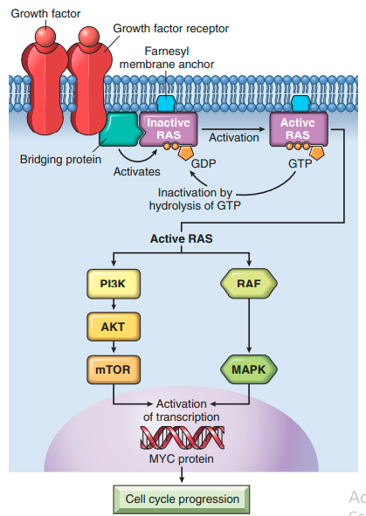

Slide 20
Under physiologic conditions, cell proliferation can be readily resolved into the following steps:
1. Binding of a growth factor to its specific receptor on the cell membrane
2. Transient and limited activation of the growth factor receptor, which in turn activates several signaltransducing proteins on the inner leaflet of the plasma membrane
3. Transmission of the transduced signal across the cytosol to the nucleus by second messengers or a cascade of signal transduction molecules
4. Induction and activation of nuclear regulatory factors that initiate and regulate DNA transcription and the biosynthesis of other cellular components that are needed for cell division, such as organelles, membrane components, and ribosomes
5. Entry and progression of the cell into the cell cycle, resulting ultimately in cell division

Slide 21
Each one of the listed steps is susceptible to corruption in cancer cells.
1. Growth Factors:
Cancers may secrete their own growth factors or induce stromal cells to produce growth factors in the tumor microenvironment, e.g, many glioblastomas secrete platelet-derived growth factor (PDGF) and express the PDGF receptor.
2. Growth Factor Receptors:
Many of the growth factor receptors function as oncoproteins when they are mutated or if they overexpressed, e.g overexpression involve the epidermal growth factor (EGF) receptor family in squamous cell carcinomas of the lung, glioblastomas, and epithelial tumors of the head and neck.

Slide 22
3. Downstream Signal-Transducing Proteins:
result from mutations in genes that encode components of signaling pathways downstream of growth factor receptors.
Two important oncoproteins in the category of signaling molecules are RAS and ABL.
4. Nuclear Transcription Factors:
Mutations in these factors result in continuous stimulation of nuclear transcription factors that drive the expression of growth-promoting genes, e.g MYC mutation.

Slide 23
2. Insensitivity to Growth Inhibitory Signals: Tumor Suppressor Genes
Remember:
oncogenes encode proteins that promote cell growth, the products of tumor suppressor genes apply brakes to cell proliferation.
Disruption of tumor suppressor genes renders cells refractory to growth inhibition and mimics the growth-promoting effects of oncogenes.

Slide 24
I. RB: Governor of the Cell Cycle:
RB, a key negative regulator of the cell cycle, is directly or indirectly inactivated in most human cancers.
Approximately 60% of retinoblastomas are sporadic, while the remaining ones are familial.
loss of normal RB genes predispose to:
Retinoblastomas
breast cancer.
small cell cancer of the lung.
bladder cancer.

Slide 25
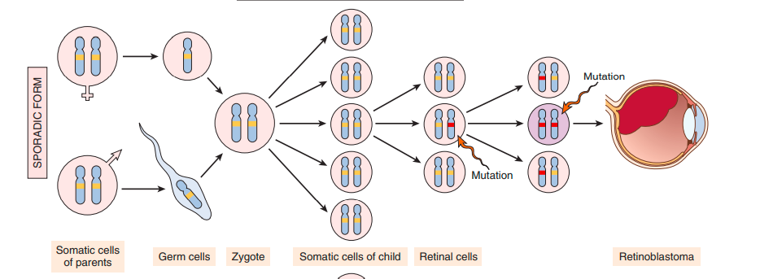
Sporadic cases:
Two mutations (hits) are required to produce retinoblastoma. These involve the RB gene, which has been mapped to chromosomal locus 13q14

Slide 26
• In familial cases, children inherit one defective copy of the RB gene in the germ line; the other copy is normal.

Slide 27
function of the RB
The function of the RB protein is to regulate the G1/S checkpoint, the portal through which cells must pass before DNA replication commences.
signals that promote cell cycle progression lead to the phosphorylation and inactivation of RB, while those that block cell cycle progression act by maintaining RB in an active hypophosphorylated state

Slide 28
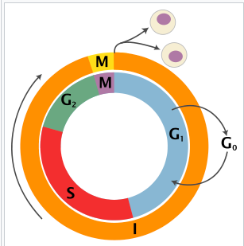
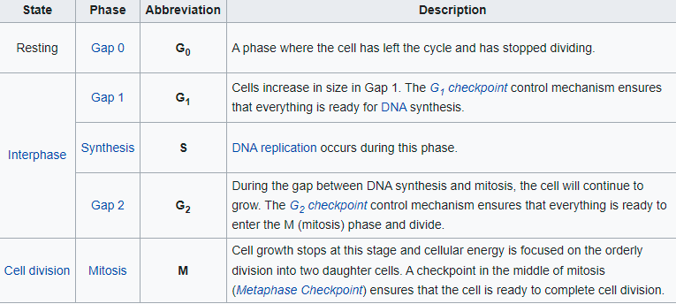

Slide 29
