Slide 2
Organ transplantation
we mean by organ: any part of the body: cells, tissues, blood or a complete organ.
The first discussion of this issue was on starting blood transfusion early in the twentieth century when a person looses blood due to an injury, a blood disease or during surgical interference.

Slide 3
Legal rules have been followed before blood transfusion
The need for the blood transfusion
- No alternative method of treatment
- No harm or damage to the donor
- Consent of the donor
- Under medical supervision
- The donor should be clinically free from a transmissible disease

Slide 4
Organ transplantation has been widely known in the mass media as offering new hope for thousands of ill patients .
The major clinical problems include tissue rejection , organ preservation, insufficient facilities and manpower , and the high cost of each operation . The law has an additional restriction

Slide 5
Types of organ transplantation :
1- Auto-transplant: from the same person to himself e.g. graft in plastic surgery. There is no legal or ethical obstacles as regards auto transplant.
2- Transplantation from a living person to another living one.
3- Transplantation from a dead to a living

Slide 6
Transplantation from a living person to another living one
- There should be no harm or danger on the donor’s life.
-The operation should be done in a recognized hospital.
-The donor should be related to the recipient up to the third degree, so as to prevent selling organs

Slide 7
Transplantation from a dead to a living
The importance of brain death appeared in recent years.
It is the irreversible cessation of all brain function including the brainstem. When the brain cells die, they do not grow back, thus any damage is permanent and irreversible function.

Slide 8
Nowadays modern resuscitative devices and techniques can maintain the function of the heart, lungs & visceral organs for a period of time after the brain stem centers have stopped

Slide 9
The development of transplant surgery and the need of viable organs have resulted in the need for accurate
determination of the medical criteria of brain death.

Slide 10
The medical criteria of brain death
Know cause of coma: structural brain damage.
Exclusion of revisable causes of coma as toxic or metabolic.
No hypothermia: temp more 35.
Absent brain stem reflexes:
No motor response within cranial nerves areas.
No pupillary response to light.
No corneal reflex.

Slide 11
No oculovestibular reflex.
No oculocephalic reflex
No gag reflex
Apnea test:

Slide 12
the rules that should be followed are:
1.Death certificate should be signed by three physicians of good qualification and not from transplant team.
2.The dead person should have given a will وصية before death or permission for transplantation.
3.Consent of his relatives.
These rules are put to prevent abuse and loss of confidence in physicians.

Slide 13
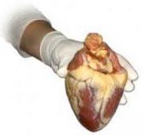
Organ donation and transplantation:
Adult of legal age and sound mind :
They must give informed consent for donation of their
organ voluntarily after being informed of potential risks.
Fetuses and anencephalics:
Organs from stillbirths and infants dying a disease are not suitable.
Although anencephalic infants have no higher cortical function they may have good brain stem function.
The legal criteria for brain death are not easily applied on them.

Slide 14
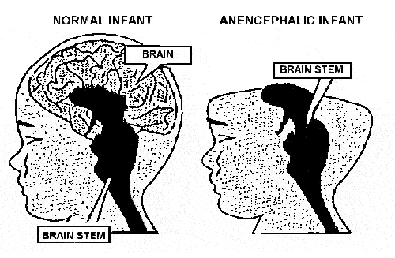
Maximal life support systems at birth and the organ are removed as soon as possible .
(2) As 1st approach but the organs are removed only after brain stem functions are stopped.
(3) Minimal care until he deteriorates, then placed on maximal life support systems, and organs are removed brain stem functions are stopped.
(4) Minimal care until the infant dies, and then the organ are harvested.
Approaches to organ donation from an encephalic infant:
The success rate was 100% for the 1st approach but
0% - 11% for the other 3 approaches

Slide 15
THANK YOU

