Slide 1
The Nervous Tissue

Slide 2
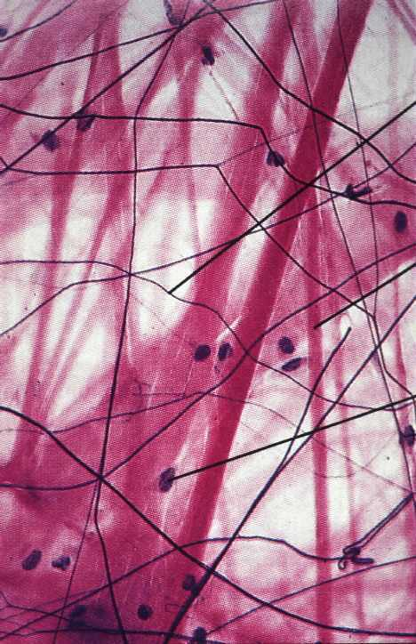
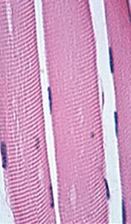
Categories of Tissue
Epithelial Tissue
Connective Tissue
Muscle Tissue
Nervous Tissue
Nervous tissue
Connective tissue
Muscular tissue
Epithelial tissue

Slide 3
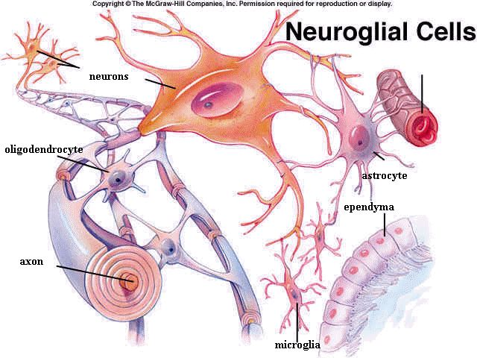
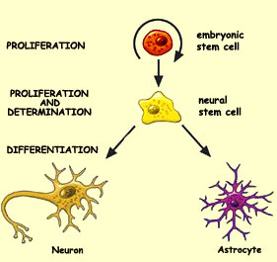
The Nervous Tissue
Contains two different varieties of cells
1. Neurons
2. Neuroglia = supporting cells

Slide 4
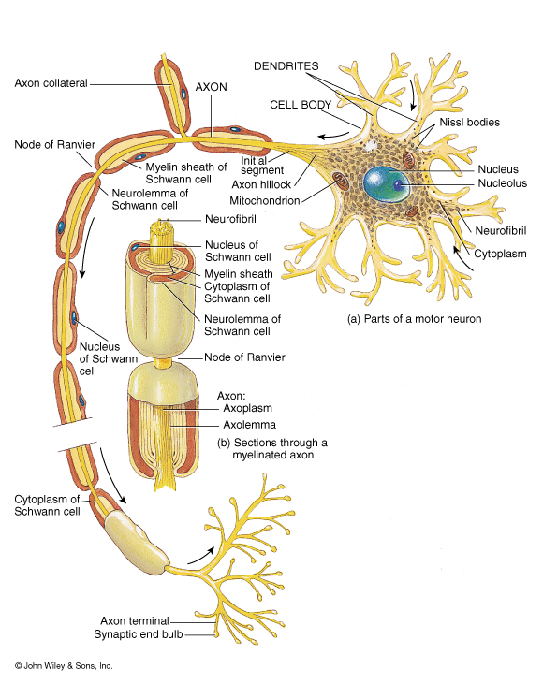
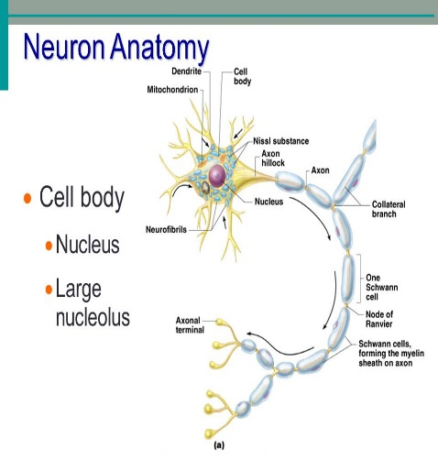
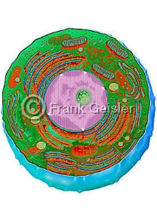
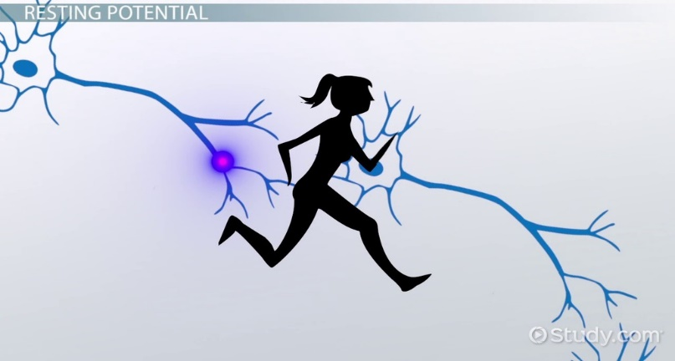
NEURON
Also called nerve cells
Structural unit of nervous system
Character:
Excitability
conductivity
Conduct messages in the form of nerve impulses from one part of the body to another = synapse

Slide 5
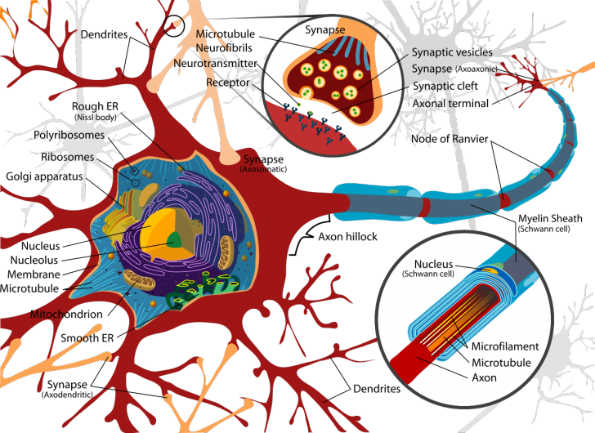
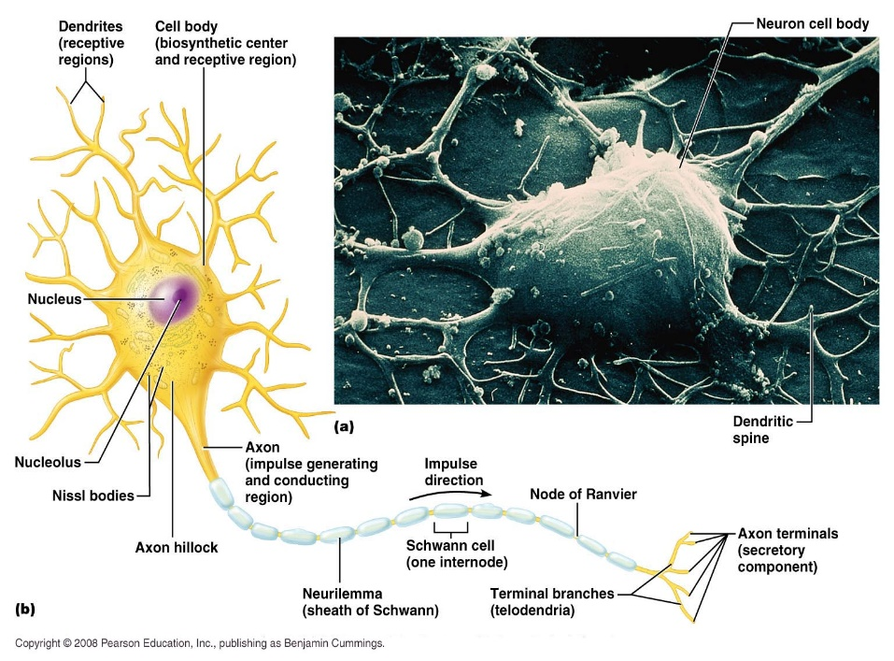
Structure of neuron
1- Cell body
= Soma
2-Cell processes
around
nucleus
axon
dendrites
perikaryon

Slide 6
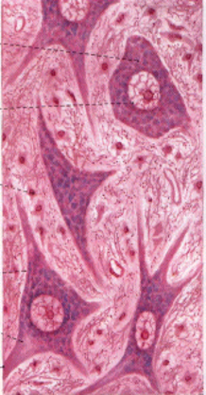
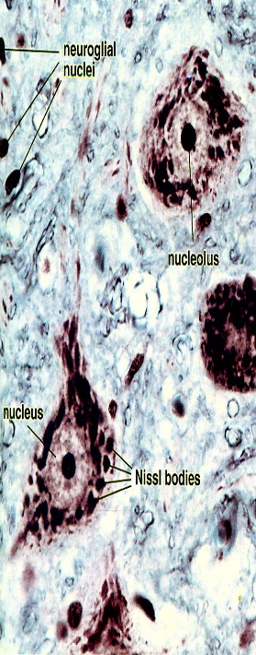
. Perikaryon = nerve cell body contains
Nucleus : large, central, active & prominent nucleolus
Rough endoplasmic reticulum (rER)
Nissl bodies are condensations of rER and free ribosomes.
for synthesis of structural and transport proteins (neurotransmitters)
Golgi apparatus : near to the nucleus .
Expected, since intense synthetic activity of neurotransmitters that must be packaged in vesicles.
Mitochondria : abundant for high energy requirements

Slide 7
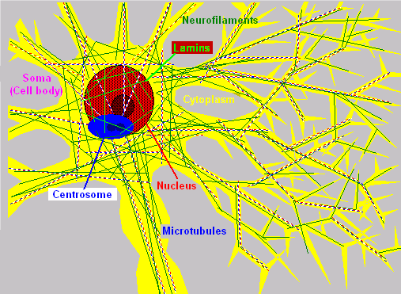
Cytoskeleton (neurofilaments , microtubules )
Two of the known roles of cytoskeletal components include maintaining the link structure or the physical form of neurons and transporting cell components from the soma to the synapses.
Inclusions :
pigment
residual bodies
increase with age.

Slide 8
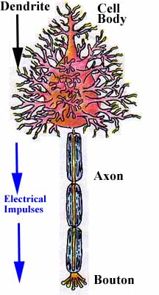
 | AXON | Dendrite
Origin | From axon hillock | From any part of cell
Number length | Always single long | Usually multiple Short
Thickness | Thin uniform | Thick near cell then tapers away
Branching | Does not branch except at its termination | Many branches.
Organelles | Few No Nissl bodies No golgi | Contains most of organelles Contain golgi + Nissl
Surrounding structures | Surrounded with sheaths | Not surrounded with sheaths
Direction of impulse | Away | Towards
The nerve cell processes:.
Axoplasm
Axolemma

Slide 9
Classification of neurons
Functionally
Morphologically
Sensory
Motor
Interneurons
Neurosecretory
Size
Golgi I (long axon )
Golgi II (short axon)
No of Processes
one Process
two Processes
more Processes

Slide 10
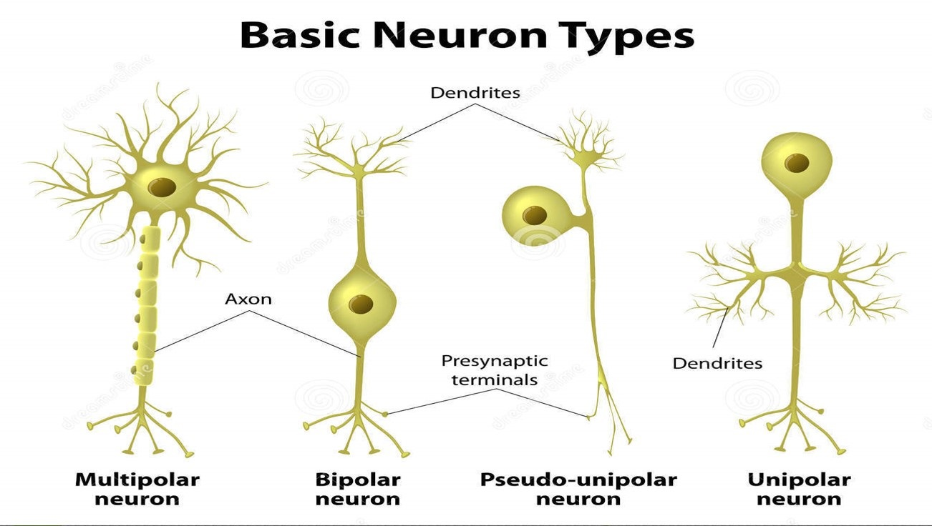
According to the number of processes

Slide 11
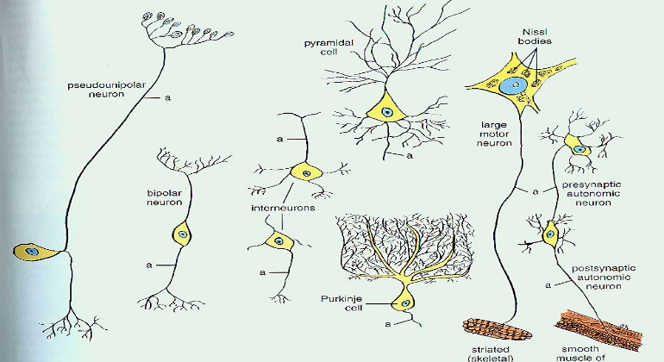
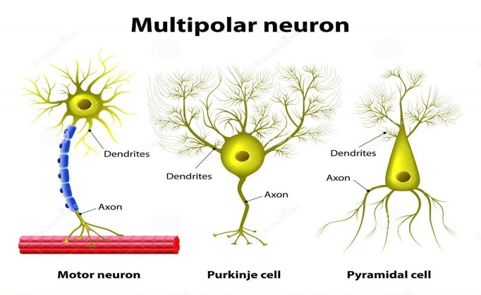
Multipolar Neurons
According to the shape of the cell body
Stellate
Pyramidal
Pyriform
Granule

Slide 12
Neuroglia
Definition :
Supporting cells of the nervous system
Stain :
Gold chloride
Silver stain
Immuno-histochemical
Shape :
Branching cells ….
Origin :
All ectodermal in origin except microglia derived from blood monocytes = mesodermal in origin

Slide 13
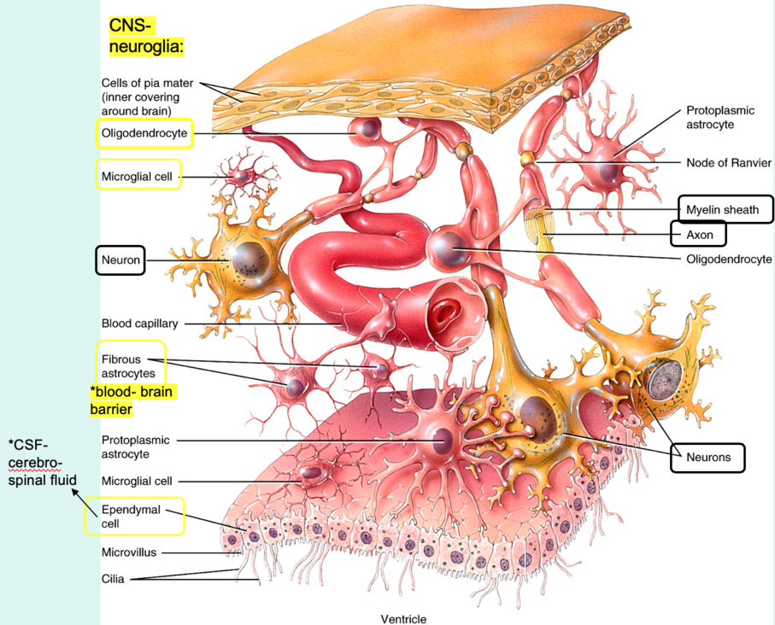
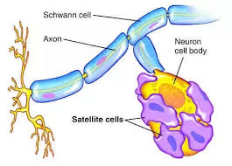
Site :
Inside CNS
macroglia =astrocytes, microglia, ependymal cell , oligodendroglia
Outside CNS= peripheral NS
Schwann cell, satellite cells in ganglia, pituicytes in posterior lobe of pituitary gland.

Slide 14
Types of neuroglia
Function | Location | Name of the cell
Regulate microenvironment B.B.B | CNS Grey & white matter | Astrocytes protoplasmic & Fibrous
Myelination of axon in CNS | CNS White & grey matter | Oligodendrocytes
Phagocytic | CNS Grey & white matter Mesodermal in origin | Microglia
Assist in producing & controlling composition of CSF | CNS Ventricle & central canal of spinal cord------with a ciliated simple columnar shape | Ependymal cell
Myelination of axon Structural support | PNS | Schwann cell
Regulate microenvironment of neurons | PNS In ganglia | Satellite cell

Slide 15
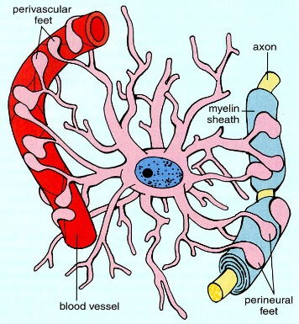
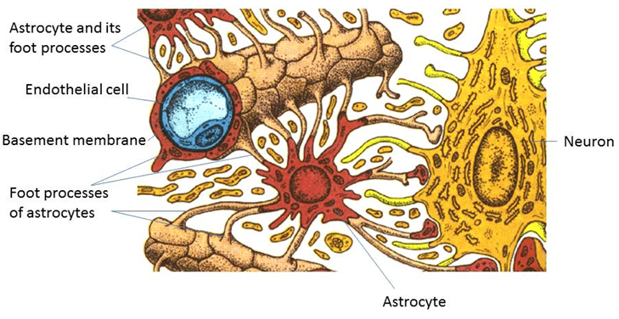
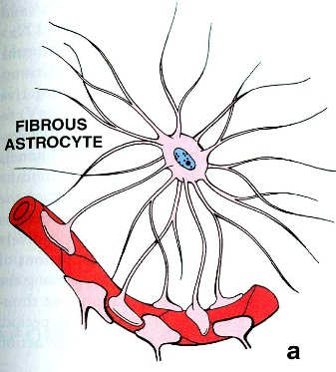
Protoplasmic Fibrous
Site | Gray matter | White matter
Processes No, length, thickness, course | Numerous, short thick & wavy | Fewer, longer, thinner & straight
GFAP | Few bundles | Rich in it

Slide 16
Neuron
Neuroglia
Large
Transmit nerve impulse
Not able to divide
Form synapse
Small
Not transmit nerve impulse
Able to divide
Not form synapse
Function of neuroglia
Supportive
Nutritive
Electrical insulation= formation of myelin sheath
Repair
Formation of blood brain barrier
Formation of CSF
Phagocytosis

Slide 17
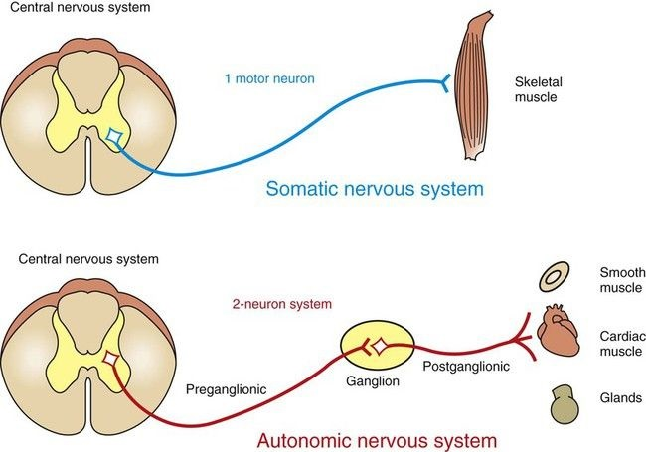
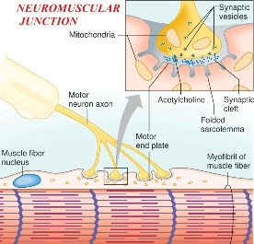
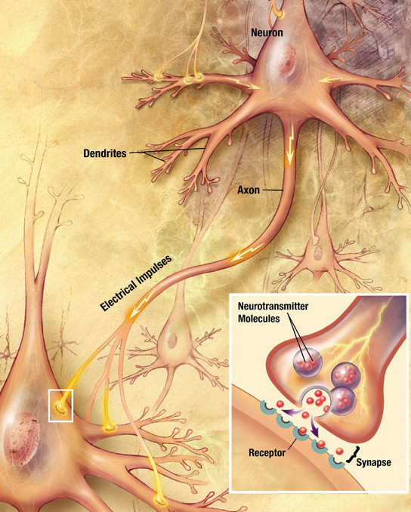
Synapse
Def : Synapse is a specialized area of functional contact .Through synapses nerve impulses are transmitted from a presynaptic neuron to a postsynaptic cell (another neuron, muscle or gland).

Slide 18
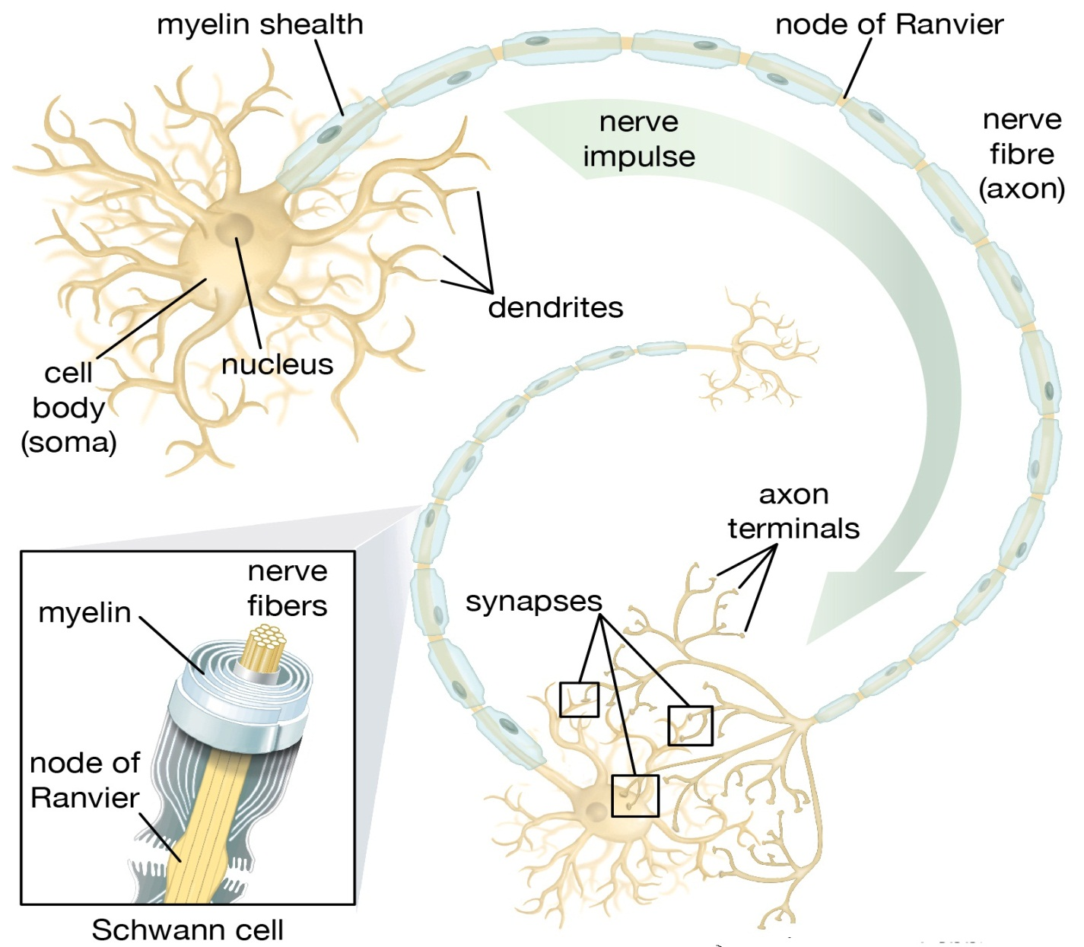
Classification of synapse:
1- According to the effect on the target neuron, synapse could be:
Excitatory
Inhibitory

Slide 19
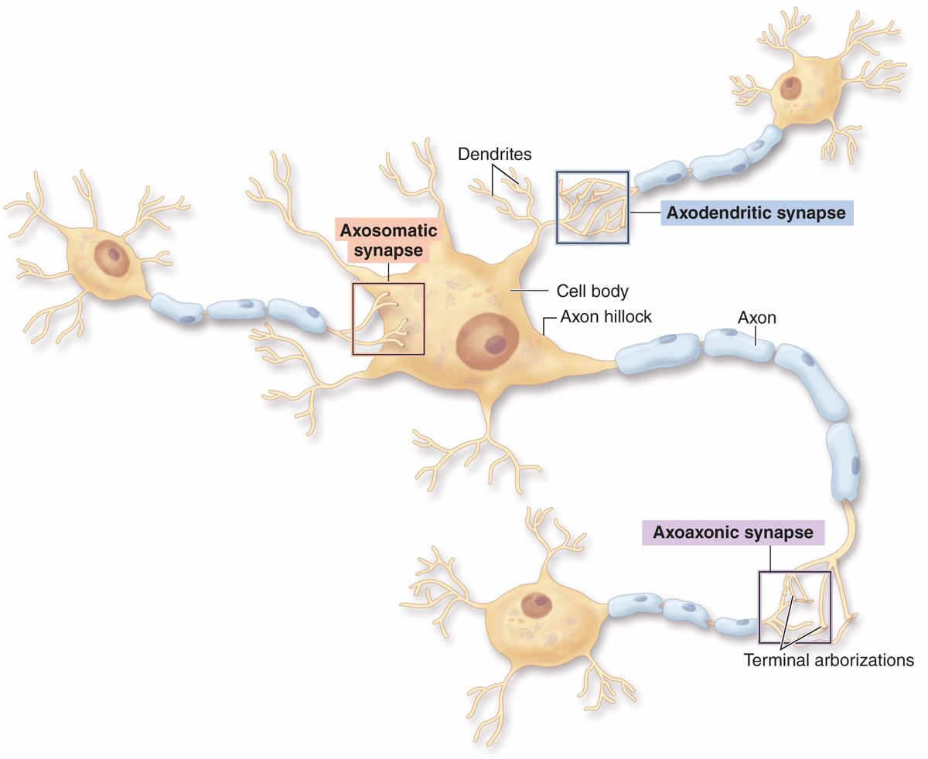
2- According to the components:
Axodendritic: between axon and dendrite
Axosomatic: between axon and cell body.
Axo-axonic: between two axons.
Dendrodendritic: between two dendrites.
Axodendritic and axosomatic synapses are common
axoaxonic and dendrodendritic synapses are rare.

Slide 20
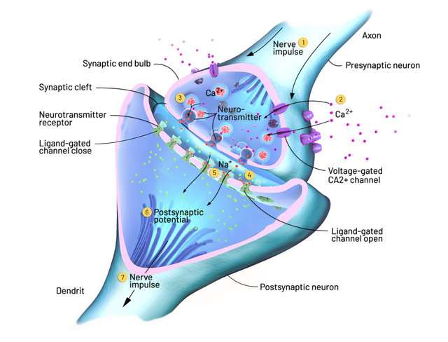
3- According to mode of transmission of nerve impulse:
1- Chemical synapse:
Number: The most common mode of communication between neurons.
Structure :With EM, chemical synapse is formed of:

Slide 21
Terminal bouton: It is a bulbous expansion "synaptic knob" found at the terminations of the axon.
It contains numerous mitochondria and many synaptic vesicles assembled around the presynaptic membrane. These membrane- bound synaptic vesicles are filled with the neurotransmitter e.g. acetylcholine and biogenic amines.
Presynaptic membrane:
it is the electron dense membrane of the axon terminal end at the site of synapse.
Synaptic cleft:
it is a gap of 20 nm between the pre and postsynaptic membranes. Into this gap the neurotransmitter is released by exocytosis.
Postsynaptic membrane:
It contains the specific receptors for the neurotransmitter.

Slide 22
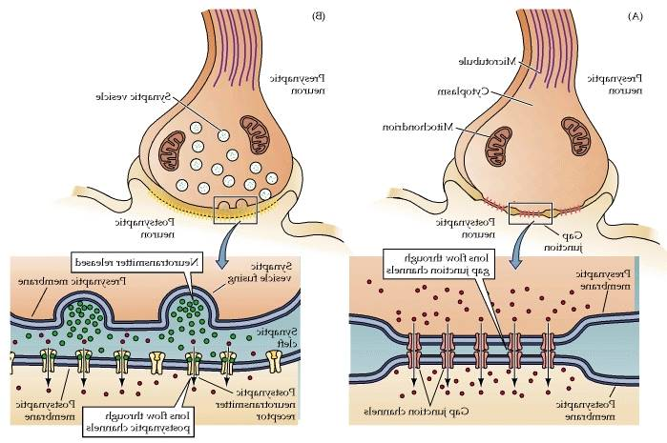
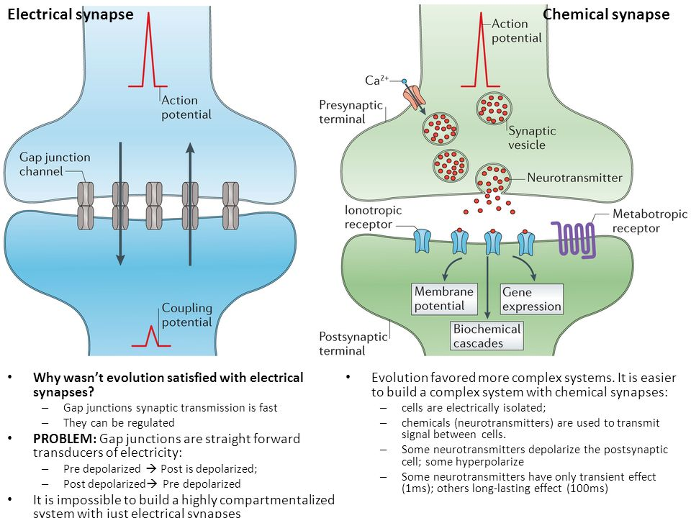
2- Electrical synapse:
Number: Few in the nervous system.
Structure: It is formed of gap junctions.
Function: It allows movement of ions between neurons "electrical coupling" thus permits the direct spread of electrical current from one cell to another.
Transmission of impulse: Direct, bidirectional and do not require release of neurotransmitters.

Slide 23
Myelin Sheath Segmented protein-lipoid sheath around most long or large-diameter axons Functions : 1. Protect and electrically insulate the axon 2. Increase speed of nerve impulse transmission

Slide 24
Myelin Sheaths in the PNS
Schwann cells wraps many times around the axon
Myelin sheath —concentric layers of Schwann cell membrane
Nodes of Ranvier ---????
Myelin sheath gaps between adjacent Schwann cells Myelinated nerve are separated by nodes of Ranvier, at these points , the axons are bare. Impulses jump from one node to the next
Unmyelinated Axons. Thin nerve fibers are unmyelinated. One Schwann cell may incompletely enclose 15 or more unmyelinated axons. Conduction in unmyelinated nerve is slower

Slide 25
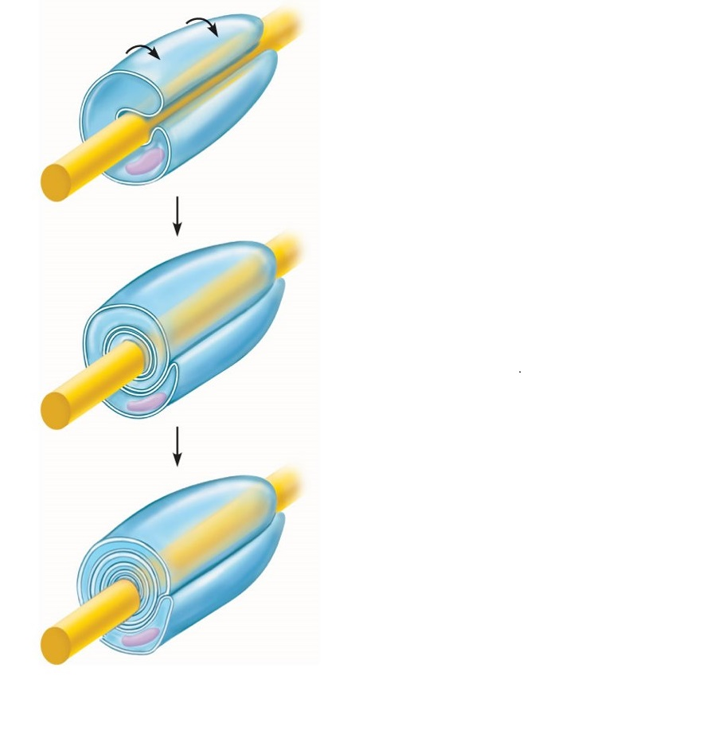
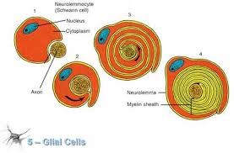
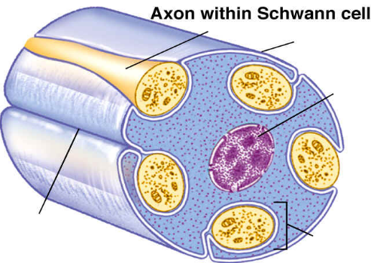
Schwann cell
plasma membrane
Schwann cell
Cytoplasm
Axon
A Schwann cell
envelopes an axon.
Schwann cell nucleus
The Schwann cell then
rotates around the axon,
wrapping its plasma
membrane loosely around
it in successive layers.
Neurilemma
Myelin sheath
Unmyelinated nerve fiber (axon)
Myelination of a nerve fiber (axon)------????

Slide 26
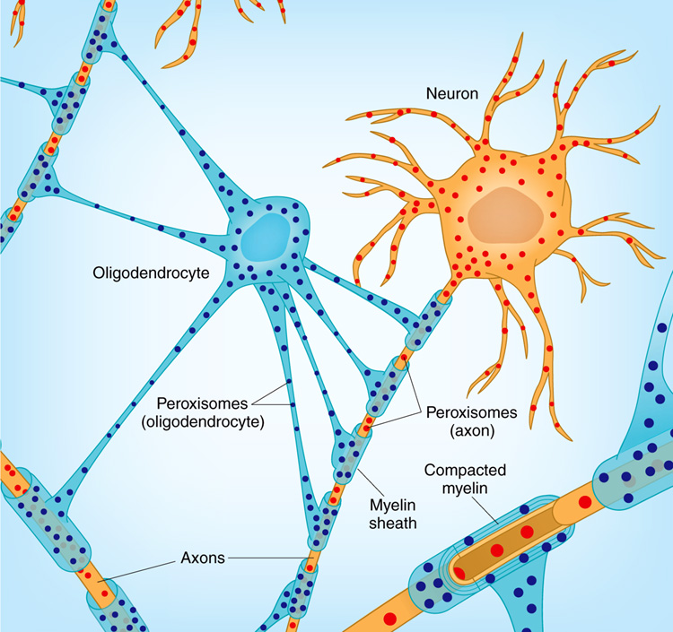
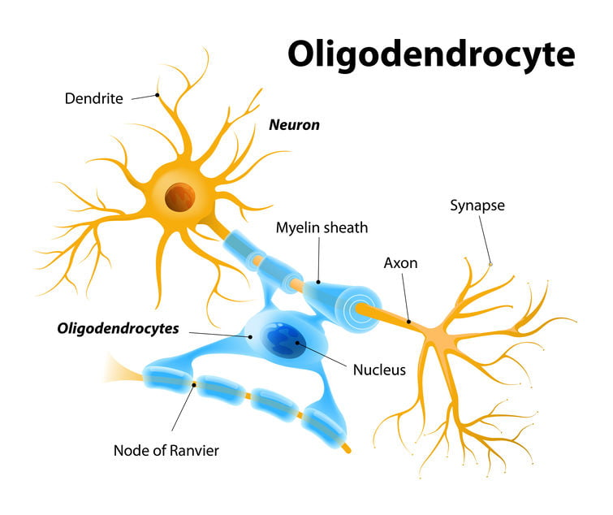
Myelin Sheaths in the CNS
Formed by processes of oligodendrocytes, not the whole cells
Nodes of Ranvier are present
No neurilemma
Thinnest fibers are unmyelinated

Slide 27
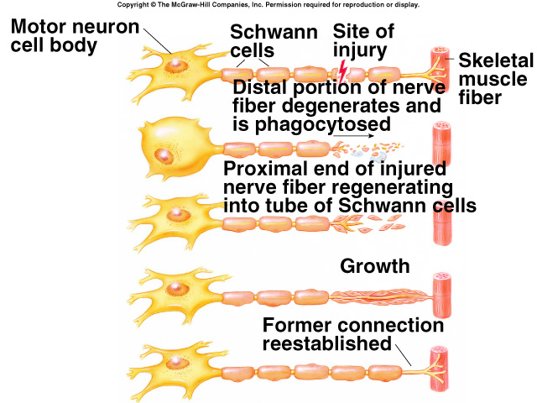
Response of neuron to injury
Damage to the cell body
- occurs as a result of injury or disease
- degeneration and permanent loss of neuron leading to atrophy of the innervated muscle
The perikaryon enlarges, eccentric nucleus and chromotolysis (loss of Nissl substance)
B. Damage to the axon
proximal portion
Retrograde degeneration
incomplete degeneration
Proximal degeneration perikaryon becomes active and Nissle body reappear

Slide 28
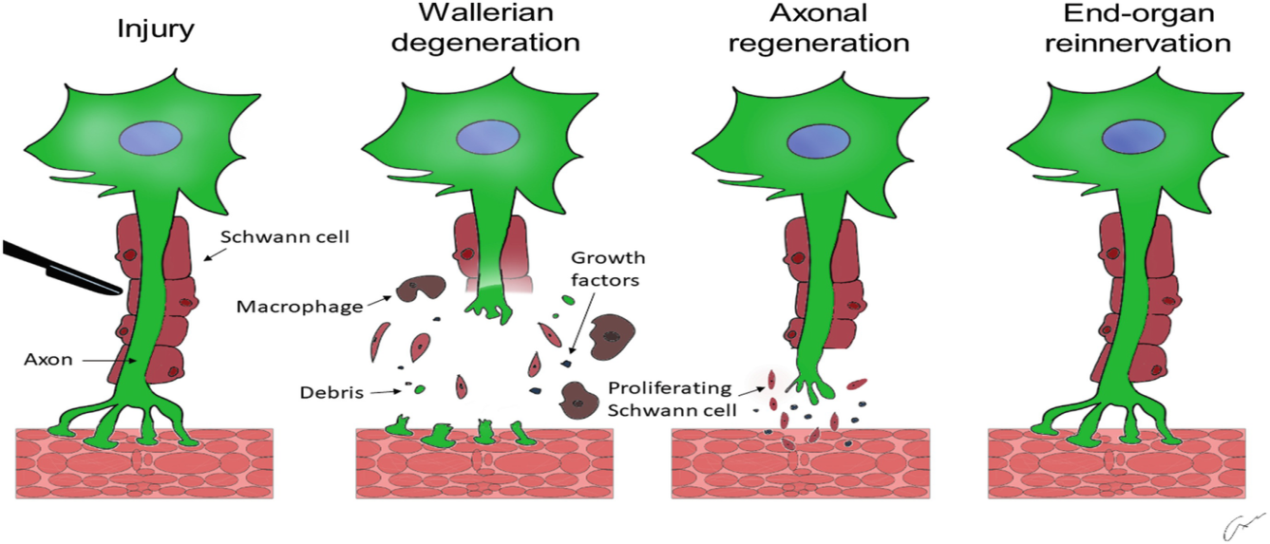
Damage to the axon
distal portion
Anterograde (Wallerian) degeneration
complete degeneration of the axon and myelin sheath, fragments phagocytoced by Schwann in PNS, microglia in CNS, and blood monocytes
Schwann cells start to divide and bridge the injured site forming large number of new nerve processes sprouts, neurites, from proximal portion
- neurites are guided and mylenated by Schwann cells across the injured site
- if the gap is too wide or the sprouts do not reestablish contact, the sprouts grow in disorganized manner forming neuroma causing atrophy to end-organ

Slide 29
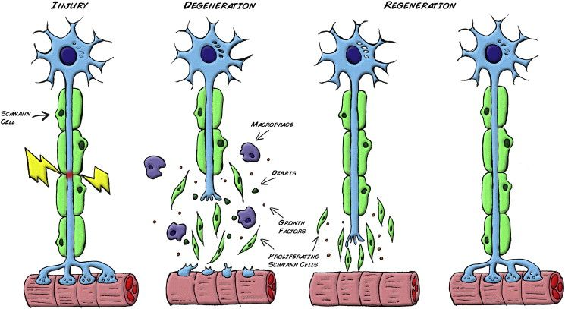

Slide 30
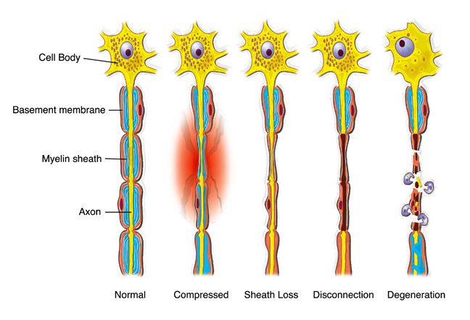
Nerves can be injured by:
ischaemia
Compression
traction
laceration
burning.
Damage varies in severity from: transient and quickly recoverable loss of function
to complete interruption and degeneration.
There may be a mixture of types of damage in the various fascicles of a single nerve trunk.

Slide 31
CLASSIFICATION of nerve injuries
First degree injury :transient ischaemia and neurapraxia, reversible.
Second degree injury:
axonotmesis. Axonal degeneration takes place but, because the endoneurium is preserved, regeneration can, lead to complete, or near complete, recovery without the need for intervention.
Third degree injury worse than axonotmesis. The endoneurium is disrupted but the perineurial sheaths are intact and internal damage is limited. The chances of the axons reaching their targets are good, but fibrosis will limit recovery.

Slide 33
Thank You

