Slide 1
ACUTE respiratory distress syndrome
Ahmad awedat
Maria qatawneh

Slide 2
Acute Respiratory Distress Syndrome
Any disease that causes diffuse acute inflammation in the lung is called acute lung injury(ALI).
If severe (severity defined by PF ratio) it is called acute respiratory distress syndrome(ARDS).
Associated with high mortality(≈40%)

Slide 3
It is characterized by :
• neutrophil sequestration in pulmonary capillaries
• increased capillary permeability
• protein-rich pulmonary oedema with hyaline
membrane formation
• damage to type 2 pneumocytes leading to surfactant
depletion
• alveolar collapse
• reduction in lung compliance.
The result is V/Q mismatch.

Slide 4
;

Slide 6
Clinical presentation
- Unexplained tachypnea ( the 1st sign often).
- Breathlessness
- Increasing hypoxemia with central cyanosis.
- Bilateral fine Inspiratory crackles throughout lung field.
CXR: bilateral diffuse
* ( The clinical symptoms and signs are not specific, sharing many features with other pulmonary conditions ) .

Slide 8
investigation
ABG
O2 ( acute respiratory alkalosis )
A-a gradient .

Slide 9
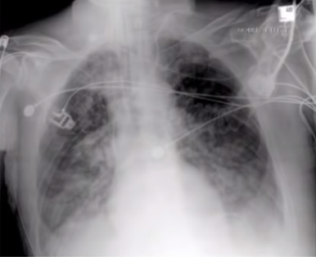
Chest X-ray
- diffuse bilateral alveolar infiltration

Slide 10
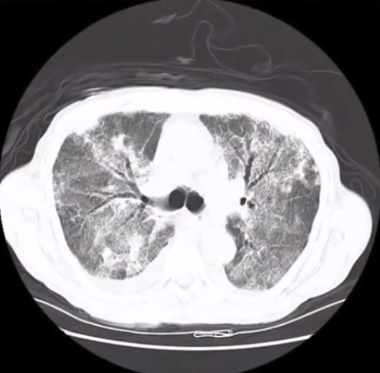
CT scan
Wide spread patchy
Air bronchogram

Slide 11
Criteria for diagnosis
Respiratory symptoms ( < 1 week )
X-ray / CT :bilateral opacification .
Rule out of other causes : - cardiogenic pulmonary edema ( most important to R/O) PCWP 18

Slide 12
Management of ARDS
This is based on treatment of the underlying condition (e.g..eradication of sepsis), supportive measures ,mechanical ventilation and avoidance of complications such as VAP and ventilator induced lung injury.

Slide 13
Oxygenation and mechanical ventilation:
- try to keep O2 sat. >90%
- almost all required intubation + mechanical ventilation
- Occasionally patients can be managed with non- invasive ventilation, but the failure rate is high and the majority will require endotracheal intubation.

Slide 14
Mechanical ventilation
-PEEP (stand for positive end-expiratory pressure)
is a positive pressure left in the chest at the end of exhalation ,the purpose of utilizing PEEP in mechanically intubated patient is to help prevent the alveoli from completely collapsing at end expiration.
Avoid ventilator induced lung injury (which arise from overdistended alveoli and cyclic opening and closing of atelectatic alveoli)
Use adequate but not excessive PEEP
Use low tidal volumes (VT)=6ml/kg
monitor end respiratory plateau pressure,maintain less than 30cm h2o

Slide 15
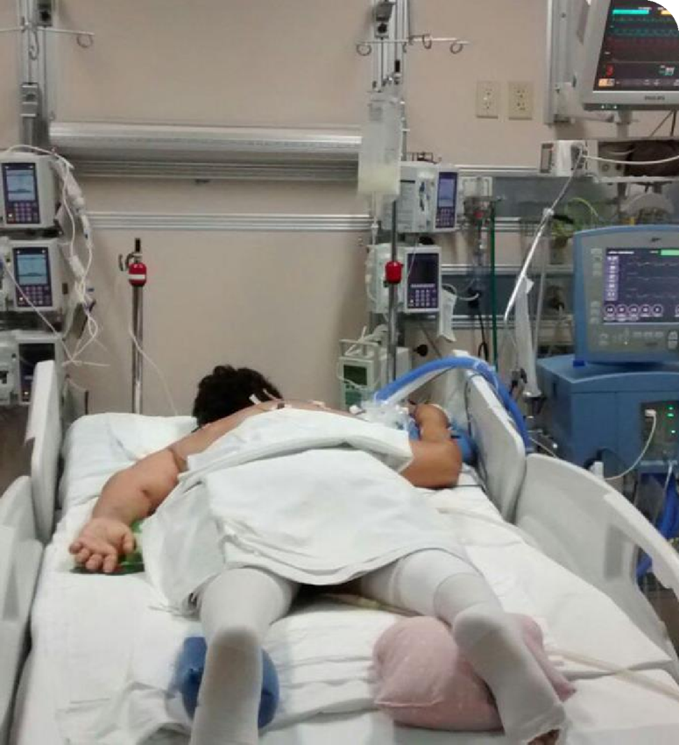
Prone positioning :
-Prone positioning stabilize anterior chest wall , causing improved physiology and recruitment of previously unused alveolar units.
-Was found to get the heart off of the left lower lobe and help with expansion.
-Complications of prone positioning, includes :
facial oedema, pressure sores, and dislodgement of catheters and endotracheal tubes,

Slide 16
Circulatory support:
- Volume overloaded should be avoided .
Keep patient slightly hypovolemic , (providing the patient is not in shock).
A central line is recommended to measure the central venous pressure (CVP), with regular assessments of fluid status.
-Fluid restriction + diuretics

Slide 17
Nutritional support :
- tube feeding are preferred over than parenteral nutrition , to maintain intestinal epithelium and it’s natural defense against bacteria .
Pain relief .

Slide 18
Treat underlying cause
In patients who have an infectious cause for ARDS (e.g., pneumonia or sepsis), the prompt initiation of antimicrobials is important.
Empirical antibiotics targeted at the suspected underlying infection should be used as soon as possible after obtaining appropriate cultures including blood, sputum, and urine cultures.
Once culture results are available, the antimicrobial regimen can be tailored for the identified organism.

Slide 19
prognosis
If ARDS is accompanied by sepsis, the mortality rate may reach 90%. The major causes of death in ARDS are the primary illness and secondary complications such as organ failure sepsis.
Most survivors of ARDS are left with some pulmonary symptoms (cough, dyspnea, sputum production), which tend to improve over time

Slide 20
Thank you

