Slide 1
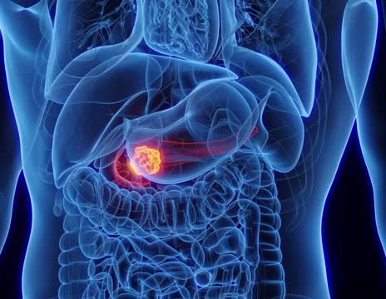
Pancreatic tumor
Done by :
Amr mobaideen Mohammad mushallah
Supervised by :
Dr mohammad nofal

Slide 2
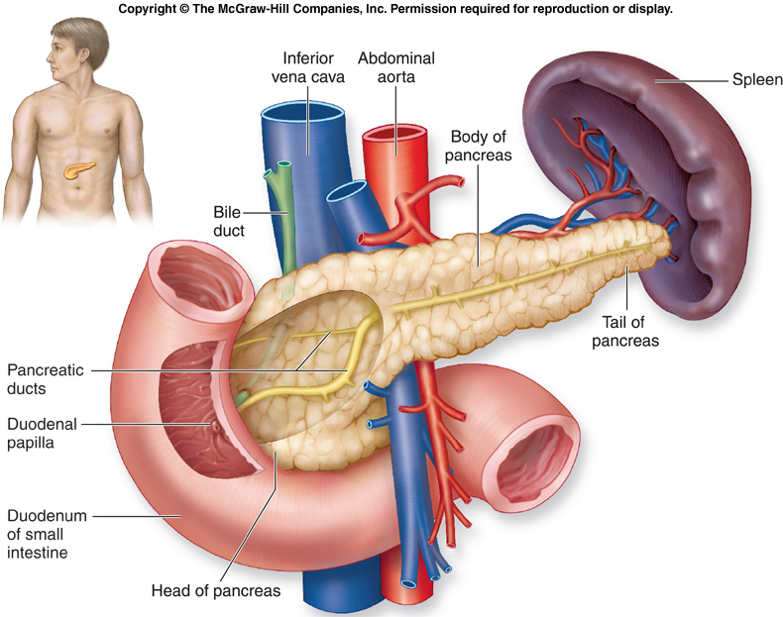
Anatomy
Retroperitoneal Organ
Weighs 75 To 100 G
15 To 20 Cm Long
Head
Neck
Body
Tail

Slide 3
TUMOURS OF THE PANCREAS
The tumors of the pancreas can be :
A. Non-Endocrine neoplasms (Exocrine)
B. Endocrine neoplasms

Slide 4
RISK FACTORS FOR THE DEVOLOPMENT OF PANCREATIC CANCER .
Demographic factors: Age (peak incidence 65–75 years) , Male gender, Black ethnicity
Environment/lifestyle: Cigarette smoking
Genetic factors and medical conditions : Family history (Two first-degree relatives with pancreas cancer: relative risk increases 18- to57-fold) , Germline BRCA2 mutations in some rare high-risk families, Hereditary pancreatitis (50- to 70-foldincreased risk), Chronic pancreatitis (5- to 15-fold increased risk), Lynch syndrome , Ataxia telangiectasia, Peutz–Jeghers syndrome, Familial breast–ovarian cancer syndrome, Familial atypical multiple mole melanoma, Familial adenomatous polyposis – risk of ampullary/duodenal carcinoma, Diabetes mellitus.

Slide 5
Malignant non-endocrine neoplasms(exocrine)
The most common are:-
- Ductal adenocarcinoma
- Cystadenocarcinoma
NOTE: Periampullary carcinoma is term used for juxta-pancreatic carcinomas.
They are three forms:-
 Carcinoma of the ampulla
 Carcinoma of the lower CBD
 Duodenal carcinoma

Slide 6
ENDOCRINE NEOPLASMS:
These are less common than non-endocrine tumors and generally benign and sometimes multiple.
They includes:
■ Insulinoma
■ Glucogonomas
■ Others:
- Gastrinomas
- Somatostatatinomas
- Vipomas (Vasoactive Intestinal Polypeptide)

Slide 7
EVALUATION OF PANCREATIC NEOPLASMS:
History
Clinical Examination
Investigations

Slide 8
The specific investigations:-
Ultrasound Scan
MRI
CT Scan
Histology & cytology
ERCP
Angiography
Laparoscopy

Slide 9
NON-ENDOCRINE NEOPLASMS: (ADENO-CARCINOMA OF PANCREAS)
- Ductal adeno carcinoma (arising in the exocrine part of pancreas) account for 90% of pancreatic tumor 2/3rd located in the head of pancreas.
- Cystadenocarcinoma and endocrine tumor account for most of the remains of malignancy.
- The exact causative factors responsible are unknown.
- The peak incidence in the 6th and 7th decade and more in men than women .

Slide 10
The predisposing factors are:
Diet (high protein & high fat)
Exposure to industrial carcinogens
Smoking

Slide 11
Spread of pancreatic tumors:
A. Local Invasion
B. Lymphatic
C. Blood
D. Via peritoneal & omental causing ascites

Slide 12
CLINICAL FEATURES:
The diagnosis of pancreatic cancer varies from the simple and clinically obvious to the most difficult and almost impossible the initial symptoms and signs depend on the site and extent of the pancreatic cancer.
Weight loss
Pain
Jaundice
Steatorrhoea
Diabetes Mellitus
Acute Pancreatitis
Malignant Ascites
Gastric Outlet Obstruction

Slide 13
Approach to Investigations:
(Selective Investigations)
 Ultrasound Scan
 C.T. Scan
 MR Imaging Scan
 ERCP
 Histology & Cytology
 Angiography (Coeliac, Superior - Mesenteric)
 Laparoscopy

Slide 14
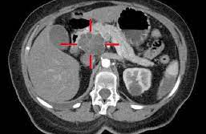
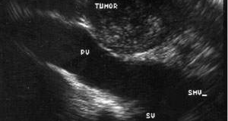
CT-SCAN
EUS

Slide 15
DELAY IN DIAGNOSIS:
■ Over 90% of patient with pancreatic cancer present in the late stage of their disease. At time no chance of cure.
■ The factors responsible for late diagnosis :
A. Tumor is asymptomatic in the early stage.
B. Patient delay.
C. Physician delay.
D. The patient may not have ready and easy access to competent diagnostic center .

Slide 16
MANAGEMENT OF PANCREATIC CANCER:
A. Surgical Treatment
B. Non Surgical Treatment

Slide 17
SURGICAL TREATMENT:
■ Pancreatic Cancer is essentially incurable since metastasis occurs at such early stage. Any treatment must be regarded as palliative.

Slide 18
Surgical Options:
 For curative surgical treatment of cancer in the head of pancreas the optims are available:
A. Whipple operation (Pancreaticoduodenectomy)
B. Pylorus Preserving (Pancreaticoduodenectomy)
C. Total Pancreatectomy
D. Palliative Surgical Treatment (Surgical Bypass)
E. For tail of the pancreas (Distal pancreatectomy)
F. Body of the pancreas (Distal + removal of the body of the pancreas)

Slide 19
Pre-operative preparation of the patient for major surgery:
1. All jaundiced patients must be kept in good state of nutrition and hydration.
2. Blood clotting deficiencies must be corrected.
3. Cardiopulmonary functioning carefully assessed.
4. Drainage procedure consider in certain cases.

Slide 20
NON-SURGICAL TREATMENT :
The following options available:
(Palliative procedure for non operable cases)
 Percutaneous coeliac ganglion blockade. (For pain)
 Stent to compress bile duct.
 Combination of chemotherapy and radiotherapy may become alterative in the future.

Slide 21
FUNCTIONING ENDOCRINE TUMOURS OF THE PANCREAS:
These are much less common than adeno carcinoma.
The beta cell tumors secrete (Insulin) and called INSULINOMAS .
Another functioning tumor secrete(Gastrin) called GASTRINOMA which come from the islets which cannot be classified into either alpha or be (non-beta).

Slide 22
Other tumors are:
A. Vipoma (Werner-Morrison syndrome, Pancreatic cholera)
B. Somastatinoma
C. Glucagonoma
D. HP (Human Pancreatic Polypeptide tumours)
■ Slow growing and therefore carry much better prognosis.

Slide 23
INSULINOMA
■ The commonest islet cell tumor and arise from the beta cell and situated anywhere on the surface or within the substance of the pancreas.
■ Most tumors are benign adenomas but 15% are low grade carcinomas and secrete (insulin).

Slide 24
CLINICAL FEATURES:
Whipple described a triad of features which typify the (insulinomas):
1. Fasting produces fainting.
2. During these “attacks” there is hypoglycemia.
3. The attacks may be relieved by ingestion of glucose.

Slide 25
INVESTIGATIONS
Measurement of blood sugar in an attack. Overnight fasting serum glucose.
insulin level (before & after overnight). Insulin level are estimated by radio-immunoassay.
Pre-operative localization of the tumor very important identification at operation can be difficult.
[Combination CT Scan and selective angiography]

Slide 26
TREATMENT:
1. If the tumor localized surgical resection is the trearment of choice also this apply to metastases.
2. If the tumors not localized during surgery (Intra operative USS can be done to localize the tumor) than resected.
3. Sub total distal resection for multiple tumors is appropriate.
4. With negative exploration it is appropriate to perform pancreatectomy distal to the superior mesenteric vessels.
5.The Hypoglycemic attacks may be relieved by diazoxide or streptazotocin.

Slide 27
GASTRINOMA: (Zollinger-Ellison Syndrome)
The tumor arising from the islets cell of Langerhans in the pancreas and in the duodenal wall.
The majority (60%) of these tumors are malignant.
They may be associated with (MEN 1)which are Parathyroid Hyperplasia, and Pituitary Adenoma.
Gastrinoma give rise to ZE Syndrome which consist of triad (hypersecretion of gastric acid, severe peptic ulceration and the presence of non-beta cell tumor of the pancreas or duodenum).

Slide 28
CLINICAL FEATURES:
■ The disease present as peptic ulcer disease in over 90%.They have typical pain more severe and less response to medical treatment.
■ Co-existing diarrhea.
■ All complications of peptic ulcer disease are present in (ZE-Syndrome) as acute hemorrhage , perforation and recurrent ulceration.

Slide 29
THE DIAGNOSIS OF ZE-SYNDROME:
 Severe peptic ulcer disease doesn’t respond to treatment.
 Multiple peptic ulcers or ulcers in unusual locations such as the distal duodenum or jejunum.
 Peptic ulcer disease associated with diarrhea.
Recurrent peptic ulcer disease following in acid reducing operation (surgery).
 Peptic ulcer is associated with MEN- 1 Syndrome.
 Marked elevation of serum gastrin.

Slide 30
TREATMENT:
Medical therapy for control of the acid hypersecretion in patient with ZE-Syndrome Omprazole considered the antisecretory drug of choice for all gastrinoma patients.

Slide 31
Surgical Treatment:
Tumor excision.
Total gastrectomy.
Patient with metastases should have medical therapy if fail total gastrectomy.
Gastrinoma patient with MEN 1 Syndrome and documented hyperparathyroidism should have parathyroid surgery performed prior to removal of gastrinoma.

Slide 32
Thank you

