Slide 1
Depressive Disorders
Summer of 2021
Dr. Yazan Al-Mrayat

Slide 2
Outlines
Epidemiology
Types of depressive disorders
Predisposing factors
Developmental implications
Background assessment data

Slide 3
Epidemiology
Major depressive disorder (MDD) is one of the leading causes of disability in the United States. In addition to the disability posed by the disorder itself, recent research links depression to an increased risk for coronary artery disease (another leading cause of death), especially in women younger than age 65.
In 2014, 6.6 percent of individuals ages 18 and older (15.6 million persons) had at least one major depressive episode in the past year. The lifetime prevalence of depression is about 17 percent, which makes it the most prevalent psychiatric disorder.
Further, there is evidence that the incidence of depression is increasing among American teens and young adults, particularly adolescent girls. From 2005 to 2014, the incidence rose from 4.5 to 5.7 percent among teenage boys and from 13.1 to 17.3 percent for teenage girls. The reasons for these increases are unclear, but the overall preponderance has led to the consideration of depression by some researchers as “the common cold of psychiatric disorders” and this generation as an “age of melancholia.”

Slide 4
Epidemiology
Age and Gender
Research indicates that the incidence of depressive disorder is higher in women than it is in men by almost two to one. Sadock and associates (2015) report that this finding is “an almost universal observation, independent of country or culture” (p. 349). The gender difference is less pronounced between ages 44 and 65, but after age 65, women are again more likely than men to be depressed. This occurrence may be related to gender differences in social roles and economic and social opportunities and the shifts that occur with age.

Slide 5
Epidemiology
Social Class
Some studies have indicated an inverse relationship between social class and report of depressive symptoms. However, there has yet to be a definitive causal structure in the relationship between socioeconomic status and mental illness. A National Center for Health Statistics report identified that for the 45 to 64 age group, depression was five times more prevalent among those below the poverty level. One study identified a greater increase in depression with age when compared to more affluent individuals.
Nauert (2010) reports on research that revealed current treatments were less effective for working-class individuals than for middle-class counterparts, regardless of whether they received therapy or medication. This finding may be influential in higher levels of depression among lower socioeconomic class members.

Slide 6
Epidemiology
Race and Culture
Studies have shown no consistent relationship between race and affective disorder. One problem encountered in reviewing racial comparisons involves the socioeconomic class of the race being investigated. Sample populations of nonwhite clients are often predominantly lower socioeconomic class populations that are compared with white populations from middle and upper social classes.
Other studies suggest a second problematic factor in the study of racial comparisons. Clinicians tend to underdiagnose mood disorders and over-diagnose schizophrenia in clients who have racial or cultural backgrounds different from their own. This misdiagnosis may result from language barriers between clients and physicians who are unfamiliar with cultural aspects of nonwhite clients’ language and behavior.

Slide 7
Epidemiology
Marital Status
A number of studies have suggested that marriage has a positive effect on psychological well-being compared to those who are single or do not have a close relationship with another person. Other studies have suggested that marital status alone is not a valid indicator of risk for depression. Some of those studies have identified age as an important variable in risk for depression among married and single individuals.
Lapate and associates (2014) report that marital stress was associated with increased risk for depression, suggesting that social stress may also be an important variable to consider.

Slide 8
Epidemiology
Seasonality
Studies exploring whether seasonality is a cause of depression have yielded varying results. The Diagnostic and Statistical Manual of Mental Disorders, Fifth Edition (DSM-5) (APA, 2013) uses the term seasonal pattern to describe and specify any depressive disorder that occurs at “characteristic times of the year” (p. 187). The authors note that episodes are most common in fall or winter, but some clients have recurrent summer episodes.
Authors of one large study report that prevalence rates of depression with seasonal patterns have varied from 1 percent to 12 percent, but in their study of 5,549 patients from primary care settings, there was no evidence of seasonal patterns for major depressive disorder.

Slide 9
Epidemiology
Seasonality
In another study, Cobb and associates (2014) found that a small but significant peak in depression symptoms occurred in winter months, but over 20 years of following those clients, the winter seasonal pattern was not stable.
Seasonal affective disorder (SAD) continues to be popularly referred to as a separate condition, although the DSM-5 does not list it as a distinct diagnosis. Reported benefits of light therapy may support a seasonal cause for depression during winter months when there is often less exposure to natural sunlight, but more research is needed to determine a causal relationship.

Slide 10
Types of Depressive Disorders
Major Depressive Disorder
MDD is characterized by depressed mood or loss of interest or pleasure in usual activities, impaired social and occupational functioning that has existed for at least 2 weeks, no history of manic behavior, and symptoms that cannot be attributed to use of substances or a general medical condition.
Additionally, the diagnosis of MDD is specified according to whether it is a single episode (the individual’s first encounter with a major depressive episode) or recurrent (the individual has a history of previous major depressive episodes).
The diagnosis will also identify the degree of severity of symptoms (mild, moderate, or severe) and whether there is evidence of psychotic, catatonic, or melancholic features.

Slide 11
Types of Depressive Disorders
Major Depressive Disorder
The presence of anxiety and severity of suicide risk may also be noted. MDD is differentiated from schizoaffective disorder, a condition in which the individual expresses symptoms of a mood disorder as well as symptoms of schizophrenia. The DSM-5 (APA, 2013) diagnostic criteria for major depressive episode are presented in Box 25–1.

Slide 12
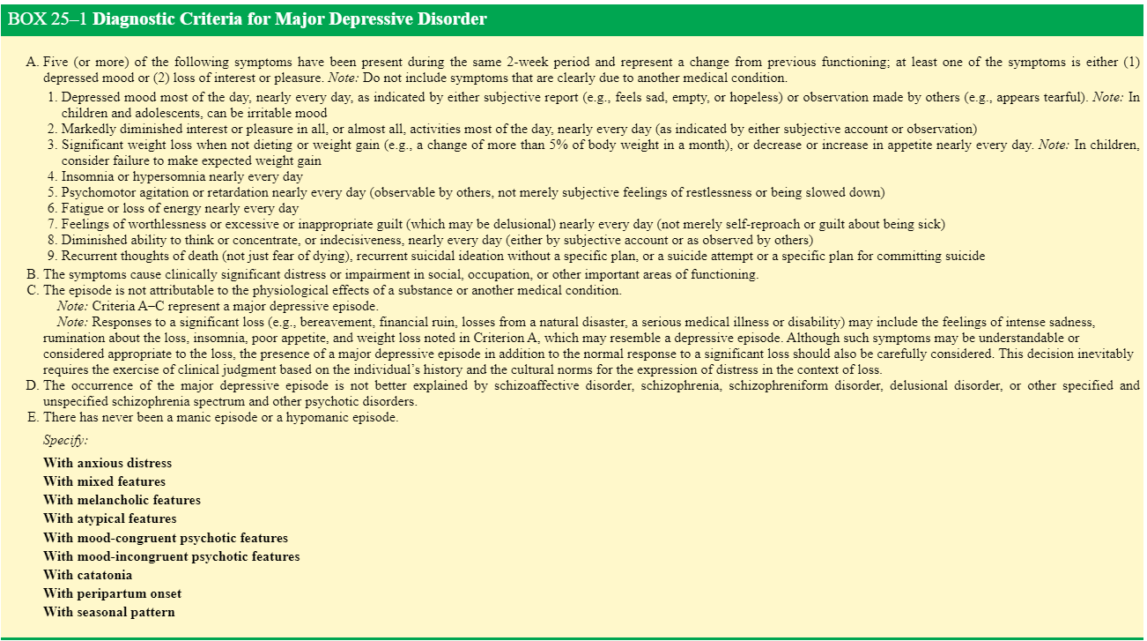

Slide 13
Types of Depressive Disorders
Persistent Depressive Disorder (Dysthymia)
Characteristics of dysthymia are similar to, if somewhat milder than, those ascribed to MDD. Individuals with this mood disturbance describe their mood as sad or “down in the dumps.” There is no evidence of psychotic symptoms. The essential feature is a chronically depressed mood (or possibly an irritable mood in children or adolescents) for most of the day, more days than not, for at least 2 years (1 year for children and adolescents). The diagnosis is identified as early onset (occurring before age 21 years) or late onset (occurring at age 21 years or older). The DSM-5 diagnostic criteria for persistent depressive disorder (dysthymia) are presented in Box 25–2.

Slide 15
Types of Depressive Disorders
Premenstrual Dysphoric Disorder
The essential features of premenstrual dysphoric disorder (PMDD) include markedly depressed mood, excessive anxiety, mood swings, and decreased interest in activities during the week prior to menses, improving shortly after the onset of menstruation, and becoming minimal or absent in the week postmenses (APA, 2013). The DSM-5 diagnostic criteria for PMDD are presented in Box 25–3.

Slide 17
Types of Depressive Disorders
Substance/Medication-Induced Depressive Disorder
The symptoms associated with a substance/medication-induced depressive disorder are considered the direct result of physiological effects of a substance (e.g., a drug of abuse, a medication, or toxin exposure). This disorder causes clinically significant distress or impairment in social, occupational, or other important areas of functioning.
The depressed mood is associated with intoxication or withdrawal from substances such as alcohol, amphetamines, cocaine, hallucinogens, opioids, phencyclidine-like substances, sedatives, hypnotics, or anxiolytics. The symptoms meet the full criteria for a relevant depressive disorder (APA, 2013).
A number of medications have been known to evoke mood symptoms. Classifications include anesthetics, analgesics, anticholinergics, anticonvulsants, antihypertensives, antiparkinsonian agents, antiulcer agents, cardiac medications, oral contraceptives, psychotropic medications, muscle relaxants, steroids, and sulfonamides.

Slide 18
Types of Depressive Disorders
Depressive Disorder Due to Another Medical Condition
This disorder is characterized by symptoms associated with a major depressive episode that are the direct physiological consequence of another medical condition (APA, 2013). The depression causes clinically significant distress or impairment in social, occupational, or other important areas of functioning.

Slide 19
Predisposing Factors
The etiology of depression is unclear. No single theory or hypothesis has been postulated that substantiates a clear-cut explanation for the disease. Evidence continues to mount in support of multiple causations, recognizing the combined effects of genetic, biochemical, and psychosocial influences on an individual’s susceptibility to depression.

Slide 20
Predisposing Factors
Biological Theories
Genetics
Affective illness has been the subject of considerable research on the relevance of hereditary factors. A genetic link has been suggested in numerous studies; however, a definitive mode of genetic transmission has yet to be demonstrated.
Twin Studies
Twin studies suggest a strong genetic factor in the etiology of affective illness, including depressive disorders. Heritability is estimated at 40 to 50 percent. Twin studies looking specifically at the major depressive disorders-recurrent unipolar (MDD-RU) identify the risk for MDD-RU at 37 percent for twins “with a substantial component of unique individual environmental risk but little shared environmental risk”. These findings suggest that while twin studies do identify genetic risk, they do not explain all depressions. Environmental risks not only are an important variable but are uniquely individual.

Slide 21
Predisposing Factors
Family Studies
Most family studies have shown that major depression is more common among first-degree biological relatives of people with the disorder than among the general population. The evidence to support an increased risk of depressive disorder in individuals with positive family history is quite compelling. It is unlikely that random environmental factors could cause the concentration of illness that is seen within families.

Slide 22
Predisposing Factors
Adoption Studies
Support for heritability as an etiological influence in depression comes from studies of the adopted offspring of biological parents with depression. Some studies have found a threefold increase in depression among children of biological relatives with affective illness, but other studies have found no difference in the rate of mood disorders. Conversely, adoption studies have also been used to examine the effects of being reared by an adoptive parent (particularly the maternal parent) with depression and the risks for depression in their nongenetically similar children.
Interestingly, these studies have demonstrated an increased risk of depression (as well as oppositional defiant disorder and conduct disorder) in adopted children that cannot be explained by genetics. Again, this finding suggests that environmental factors also play a role in the etiology of depressive illnesses.

Slide 23
Predisposing Factors
Biochemical Influences
Biogenic Amines
It has been hypothesized that depressive illness may be related to a deficiency of the neurotransmitters norepinephrine, serotonin, and dopamine at functionally important receptor sites in the brain. Historically, the biogenic amine hypothesis of mood disorders grew out of the observation that reserpine, an antihypertensive that depletes the brain of amines such as norepinephrine, was associated with the development of a depressive syndrome.
The catecholamine norepinephrine has been identified as a key component in the mobilization of the body to deal with stressful situations. Neurons that contain serotonin are critically involved in the regulation of many psychobiological functions, such as mood, anxiety, arousal, vigilance, irritability, thinking, cognition, appetite, aggression, sleep–wake cycles, eating, and intestinal motility.

Slide 24
Predisposing Factors
Tryptophan, the amino acid precursor of serotonin, has been shown to enhance the efficacy of antidepressant medications and on occasion to be effective as an antidepressant itself.
The level of dopamine in the mesolimbic system of the brain is thought to exert a strong influence over human mood and behavior. A diminished supply of these biogenic amines inhibits the transmission of impulses from one neuronal fiber to another, causing a failure of the cells to fire or become charged (see Figure 25–1).

Slide 25
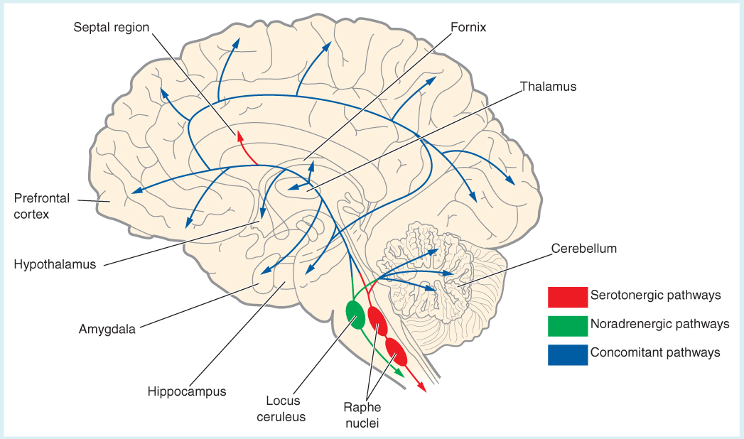
FIGURE 25–1 Neurobiology of depression.
Although other neurotransmitters have also been implicated in the pathophysiology of depression, disturbances in serotonin and norepinephrine have been the most extensively scrutinized.
Cell bodies of origin for the serotonin pathways lie within the raphe nuclei located in the brainstem.
Those for norepinephrine originate in the locus ceruleus. Projections for both neurotransmitters extend throughout the forebrain, prefrontal cortex, cerebellum, and limbic system.

Slide 26
Predisposing Factors
More recently, the biogenic amine hypothesis has been expanded to include another neurotransmitter, acetylcholine. Because cholinergic agents have profound effects on mood, electroencephalograms, sleep, and neuroendocrine function, it has been suggested that the problem in depression and mania may be an imbalance between the biogenic amines and acetylcholine. Cholinergic transmission is thought to be excessive in depression and inadequate in mania.
The precise role that any neurotransmitters play in the etiology of depression is unknown because these chemicals cannot be measured in the brain. It has been theorized that since selective serotonin reuptake inhibitors (SSRIs) are drugs that elevate serotonin levels, low serotonin levels in the brain must be responsible for depression. However, SSRIs also seem to be beneficial in the treatment of anxiety, leading to the hypothesis that low serotonin levels are responsible for anxiety.

Slide 27
Predisposing Factors
Further, too much serotonin has also been implicated in anxiety states and in schizophrenia. All of this seemingly contradictory information has led many current researchers to believe that neurotransmitters such as serotonin might be better explained as modulators of intense emotional states rather than associated with any one particular emotion.

Slide 28
Predisposing Factors
Physiological Influences
Depressive symptoms that occur as a consequence of a non-mood disorder or as an adverse effect of certain medications are called secondary depression. Secondary depression may be related to medication side effects, neurological disorders, electrolyte or hormonal disturbances, nutritional deficiencies, and other physiological or psychological conditions.

Slide 29
Predisposing Factors
Medication Side Effects
A number of drugs, either alone or in combination with other medications, can produce a depressive syndrome. Most common are those that have a direct effect on the central nervous system, such as anxiolytics, antipsychotics, sedative-hypnotics (including barbiturates and opioids), and anticonvulsant mood stabilizers. Many drugs used to treat general medical conditions have also been associated with inducing depression, and several are listed here:
Antimalarials
Antihypertensives and statins (including beta blockers and calcium blockers)
Antineoplastics
Dermatologics
Hormones (including contraceptives)
Nonnucleoside reverse transcriptase inhibitors (HIV medications)
Respiratory agents (leukotriene inhibitors)
Steroids
Smoking cessation agents (varenicline)
Vigabatrin (anticonvulsant)

Slide 30
Predisposing Factors
Neurological Disorders
An individual who has suffered a cardiovascular accident (CVA) may experience despondency unrelated to the severity of the CVA. These are true mood disorders, and antidepressant drug therapy may be indicated.
Brain tumors, particularly in the area of the temporal lobe, often cause symptoms of depression. Agitated depression may be part of the clinical picture associated with Alzheimer’s disease, Parkinson’s disease, and Huntington’s disease. Agitation and restlessness may also represent underlying depression in the individual with multiple sclerosis.

Slide 31
Predisposing Factors
Electrolyte Disturbances
Excessive levels of sodium bicarbonate or calcium can produce symptoms of depression, as can deficits in magnesium and sodium. Potassium is also implicated in the syndrome of depression. Symptoms have been observed with excesses of potassium in the body as well as in instances of potassium depletion.

Slide 32
Predisposing Factors
Hormonal Disturbances
Depression is associated with dysfunction of the adrenal cortex and is commonly observed in both Addison’s disease and Cushing’s syndrome. Other endocrine conditions that may result in symptoms of depression include hypoparathyroidism, hyperparathyroidism, hypothyroidism, and hyperthyroidism.
An imbalance of the hormones estrogen and progesterone has been implicated in the predisposition to PMDD, although the exact etiology is unknown. The interaction of these hormonal changes has an impact on serotonin levels, which may contribute to the depression associated with this disorder. It is also noted that individuals with PMDD often have underlying depression and anxiety, so it is possible that hormone changes are exacerbating an already existing condition

Slide 33
Predisposing Factors
Nutritional Deficiencies
Deficiencies in proteins, carbohydrates, vitamin B₁ (thiamine), vitamin B₂ (riboflavin), vitamin B₆ (pyridoxine), B₉ (folate), vitamin B₁₂, iron, zinc, calcium, chromium, iodine, lithium, selenium, potassium, and omega-3 fatty acids have all been associated with symptoms of depression. A recent large study also found that vitamin D deficiency was linked to depressive symptoms. It is not a surprise that individuals with anorexia nervosa, who have significant nutritional deficiencies, commonly have comorbid depression.
Other Physiological Conditions
Other conditions that have been associated with secondary depression include collagen disorders, such as systemic lupus erythematosus (SLE) and polyarteritis nodosa; cardiovascular disease, such as cardiomyopathy, congestive heart failure, and myocardial infarction; infections, such as encephalitis, hepatitis, mononucleosis, pneumonia, and syphilis; and metabolic disorders, such as diabetes mellitus and porphyria.

Slide 34
Developmental Implications
Childhood
Only in recent years has a consensus developed among investigators identifying major depressive disorder as an entity in children and adolescents that can be identified using criteria similar to those used for adults. It is not uncommon, however, for the symptoms of depression to be manifested differently in childhood, and the picture changes with age.
Up to age 3: Signs may include feeding problems, tantrums, lack of playfulness and emotional expressiveness, failure to thrive, or delays in speech and gross motor development.
Ages 3 to 5: Common symptoms may include accident proneness, phobias, aggressiveness, and excessive self-reproach for minor infractions. Mood-congruent auditory hallucinations are not uncommon. The incidence of depression among preschool children is estimated to be between 0.3 and 0.9 percent.

Slide 35
Developmental Implications
Ages 6 to 8: There may be vague physical complaints and aggressive behavior. Children in this age group may cling to parents and avoid new people and challenges. They may lag behind their classmates in social skills and academic competence.
Ages 9 to 12: Common symptoms include morbid thoughts, excessive worrying, and poor self-esteem. These children may reason that they are depressed because they have disappointed their parents in some way. There may be lack of interest in playing with friends. The incidence of depression among school-aged children is estimated to be around 2 to 3 percent.
Other symptoms of childhood depression may include hyperactivity, delinquency, school problems, psychosomatic complaints, sleeping and eating disturbances, social isolation, delusional thinking, and suicidal thoughts or actions.
The APA (2013) has included a new diagnostic category in the Depressive Disorders chapter of the DSM-5. This childhood disorder is called disruptive mood dysregulation disorder. The diagnostic criteria for disruptive mood dysregulation disorder are presented in Box 25–4.

Slide 37
Developmental Implications
Children may become depressed for various reasons. In many depressed children, there is a genetic predisposition toward the condition, which is then precipitated by a stressful situation. Common precipitating factors include physical or emotional detachment by the primary caregiver, parental separation or divorce, death of a loved one (person or pet), a move, academic failure, or physical illness. In any event, the common denominator is loss.
The focus of therapy with depressed children is to alleviate the child’s symptoms and strengthen his or her coping and adaptive skills, with the hope of possibly preventing future psychological problems. Some studies have shown that untreated childhood depression may lead to subsequent problems in adolescence and adult life. Most children are treated on an outpatient basis. Hospitalization of the depressed child usually occurs only if he or she is actively suicidal, when the home environment precludes adherence to a treatment regimen, or if the child needs to be separated from the home because of psychosocial deprivation.

Slide 38
Developmental Implications
Parental and family therapy are commonly used to help the younger depressed child. Recovery is facilitated by emotional support and guidance to family members. Medications such as antidepressants can be important in the treatment of children, especially for the more serious and recurrent forms of depression. The SSRIs have been used with success, particularly in combination with psychosocial therapies. However, because there has been some concern that the use of antidepressant medications may cause suicidal behavior in young people, the U.S. Food and Drug Administration (FDA) has applied a black-box warning to all antidepressant medications.
The National Institute of Mental Health (2016) stated: In some cases, children, teenagers, and young adults under 25 may experience an increase in suicidal thoughts or behavior when taking antidepressants, especially in the first few weeks after starting or when the dose is changed. This warning from the U.S. Food and Drug Administration (FDA) also says that patients of all ages taking antidepressants should be watched closely, especially during the first few weeks of treatment.

Slide 39
Developmental Implications
Adolescence
Depression may be even harder to recognize in an adolescent than in a younger child. Feelings of sadness, loneliness, anxiety, and hopelessness associated with depression may be perceived as the normal emotional stresses of growing up. Therefore, many young people whose symptoms are attributed to the “normal adjustments” of adolescence do not get the help they need. Depression is a major cause of suicide among teens, and suicide is the second-leading cause of death in the 15- to 24-year-old age group.
Common symptoms of depression in the adolescent are inappropriately expressed anger, aggressiveness, running away, delinquency, social withdrawal, sexual acting out, substance abuse, restlessness, and apathy. Loss of self-esteem, sleeping and eating disturbances, and psychosomatic complaints are also common.

Slide 40
Developmental Implications
What, then, differentiates mood disorder from the typical stormy behavior of adolescence?
A visible manifestation of behavioral change that lasts for several weeks is the best clue for a mood disorder. Examples include the normally outgoing and extroverted adolescent who has become withdrawn and isolates herself, the good student who previously received consistently high marks but is now failing and skipping classes, and the usually self-confident teenager who is now inappropriately irritable and defensive with others.

Slide 41
Developmental Implications
Adolescents become depressed for all the same reasons discussed under childhood depression. In adolescence, however, depression is a common manifestation of the stress and independence conflicts associated with the normal maturation process. Depression may also be the response to death of a parent, other relative, or friend or to a breakup with a boyfriend or girlfriend. This perception of abandonment by parents or the closest peer relationship is thought to be the most frequent immediate precipitant to adolescent suicide.
Treatment of the depressed adolescent is often conducted on an outpatient basis. Hospitalization may be required in cases of severe depression or threat of imminent suicide, when a family situation is such that treatment cannot be carried out in the home, when the physical condition precludes self-care of biological needs, or when the adolescent has indicated possible harm to self or others in the family.

Slide 42
Developmental Implications
Senescence
Depression is the most common psychiatric disorder of the elderly, who make up 14.5 percent of the general population of the United States. This is not surprising considering the disproportionate value our society places on youth, vigor, and uninterrupted productivity. These societal attitudes continually nurture the feelings of low self-esteem, helplessness, and hopelessness that become more pervasive and intensive with advanced age. Further, the aging individual’s adaptive coping strategies may be seriously challenged by major stressors, such as financial problems, physical illness, changes in bodily functioning, and an increasing awareness of approaching death. The problem is often intensified by the numerous losses individuals experience during this period in life, such as spouse, friends, children, home, and independence.
A phenomenon called bereavement overload occurs when individuals experience so many losses in their lives that they are not able to resolve one grief response before another begins. Bereavement overload predisposes elderly individuals to depressive illness. The elderly population is growing, and it is estimated that by 2030, one in five Americans will be over the age of 65 (CDC, 2013).

Slide 43
Developmental Implications
Although they make up only about 14.5 percent of the population, the elderly account for a proportionately larger percentage of suicides in the United States. In the 65 to 84 age group, the prevalence of suicide is 16.6 percent; the rate of suicide in those 85 years of age and older jumps to 19.3 percent. The highest number of these cases is among white men at almost four times the national rate.

Slide 44
Developmental Implications
Some symptoms of depression in the elderly are similar to those in younger adults. However, depressive syndromes are often confused by other illnesses associated with the aging process. Symptoms of depression are often misdiagnosed as neurocognitive disorder (NCD) when in fact the memory loss, confused thinking, or apathy symptomatic of NCD actually may be the result of depression. This condition is often referred to as pseudodementia.
The early awakening and reduced appetite typical of depression are common among many older people who are not depressed. Compounding this situation is that many medical conditions, such as endocrinological, neurological, nutritional, and metabolic disorders, often present with classic symptoms of depression. Many medications commonly used by the elderly, such as antihypertensives, corticosteroids, and analgesics, can also produce a depressant effect.
.

Slide 45
Developmental Implications
Postpartum Depression
The severity of depression in the postpartum period varies from a feeling of the blues, to moderate depression, to severe depression with psychotic features. About 50 percent of these episodes actually begin prior to delivery (APA, 2013), and the onset of symptoms during pregnancy, including the “baby blues,” increases risk for major depression in the postpartum period. Major depression with psychotic features occurs in about 1 or 2 out of 1,000 postpartum women.
Symptoms of the baby blues include worry, sadness, and fatigue after having a baby. These symptoms affect about 80 percent of mothers and usually subside on their own within a week or two.

Slide 46
Developmental Implications
Symptoms of moderate postpartum depression have been described as depressed mood varying from day to day, with more bad days than good, worsening toward evening and associated with fatigue, irritability, loss of appetite, sleep disturbances, and loss of libido. In addition, the new mother expresses a great deal of concern about her inability to care for her baby. These symptoms take from a few weeks to several months to abate.
Postpartum depression with psychotic features is characterized by depressed mood, agitation, indecision, lack of concentration, guilt, and an abnormal attitude toward bodily functions. The symptoms can be severe and incapacitating. There may be lack of interest in or rejection of the baby or a morbid fear that the baby may be harmed, accompanied by delusions and hallucinations. Risks of suicide and infanticide should not be overlooked. There is a 30 to 50 percent likelihood of postpartum psychosis recurring with subsequent pregnancies (APA, 2013).

Slide 47
Developmental Implications
The etiology of postpartum depression remains unclear. Baby blues may be associated with hormonal changes, tryptophan metabolism, or alterations in membrane transport during the early postpartum period. Besides being exposed to these same somatic changes, the woman who experiences moderate to severe symptoms probably possesses a vulnerability to depression related to heredity, upbringing, early life experiences, personality, or social circumstances.
A history of depression appears to be a risk factor for postpartum depression. The etiology of postpartum depression may very likely be a combination of hormonal, metabolic, and psychosocial influences.

Slide 48
Background Assessment Data
Symptomatology of depression can be viewed on a continuum from transient symptoms to severe depression according to severity of the illness. All individuals become depressed from time to time in response to life’s disappointments, and these symptoms tend to be transient. Severe depression, however, is marked by significant distress that interferes with social, occupational, cognitive, and emotional functioning.
The individual who is severely depressed may also demonstrate a loss of contact with reality. This level is associated with a complete lack of pleasure in all activities, and ruminations about suicide are common. MDD is an example of severe depression. A continuum of depression is presented in Figure 25–3.

Slide 50
Background Assessment Data
Transient Depression
Symptoms at this level of the continuum are not necessarily dysfunctional; in fact, they may be considered part of the broad range of typical human emotional responses that accompany everyday disappointments in life. Transient depression subsides quickly, and the individual is able to refocus on other goals and achievements. Alterations include the following:
Affective: Sadness, dejection, feeling downhearted, having the blues
Behavioral: Some crying possible
Cognitive: Some difficulty getting mind off of one’s disappointment
Physiological: Feeling tired and listless

Slide 51
Background Assessment Data
Mild Depression
Symptoms at the mild level of depression are like those associated with uncomplicated grieving. Alterations at the mild level include the following:
Affective: Denial of feelings, anger, anxiety, guilt, helplessness, hopelessness, sadness, despondency
Behavioral: Tearfulness, regression, restlessness, agitation, withdrawal
Cognitive: Preoccupation with the loss, self-blame, ambivalence, blaming others
Physiological: Anorexia or overeating, insomnia or hypersomnia, headache, backache, chest pain, or other symptoms associated with the loss of a significant other

Slide 52
Background Assessment Data
Moderate Depression
Dysthymia (also called persistent depressive disorder) is an example of moderate depression and represents a more problematic disturbance, which, according to the DSM-5, is characterized by symptoms that are enduring for at least 2 years (APA, 2013). Symptoms associated with this disorder include the following:
Affective: Feelings of sadness, dejection, helplessness, powerlessness, hopelessness; gloomy and pessimistic outlook; low self-esteem; difficulty experiencing pleasure in activities
Behavioral: Sluggish physical movements (i.e., psychomotor retardation); slumped posture; slowed speech; limited verbalizations, possibly consisting of ruminations about life’s failures or regrets; social isolation with a focus on the self; increased use of substances possible; self-destructive behavior possible; decreased interest in personal hygiene and grooming

Slide 53
Background Assessment Data
Cognitive: Slowed thinking processes; difficulty concentrating and directing attention; obsessive and repetitive thoughts, generally portraying pessimism and negativism; verbalizations and behavior reflecting suicidal ideation
Physiological: Anorexia or overeating; insomnia or hypersomnia; sleep disturbances; amenorrhea; decreased libido; headaches; backaches; chest pain; abdominal pain; low energy level; fatigue and listlessness; feeling best early in the morning and continually worse as the day progresses (possibly related to the diurnal variation in the level of neurotransmitters that affect mood and level of activity)

Slide 54
Background Assessment Data
Severe Depression
Severe depression (also called major depressive disorder) is characterized by an intensification of the symptoms described for moderate depression (see Box 25–2). Symptoms at the severe level of depression include the following:
Affective: Feelings of total despair, hopelessness, and worthlessness; flat (unchanging) affect, appearing devoid of emotional tone; prevalent feelings of nothingness and emptiness; apathy; loneliness; sadness; inability to feel pleasure.
Behavioral: Psychomotor retardation so severe that physical movement may literally come to a standstill, or psychomotor behavior manifested by rapid, agitated, purposeless movements; slumped posture; sitting in a curled-up position; walking slowly and rigidly; virtually nonexistent communication (when verbalizations do occur, they may reflect delusional thinking); no personal hygiene and grooming; social isolation is common, with virtually no inclination toward interaction with others

Slide 55
Background Assessment Data
Cognitive: Prevalent delusional thinking, with delusions of persecution and somatic delusions being most common; confusion, indecisiveness, and an inability to concentrate; hallucinations reflecting misinterpretations of the environment; excessive self-deprecation, self-blame, and thoughts of suicide
NOTE: Because of the low energy level and slow thought processes, the individual may be unable to follow through on suicidal ideas. However, the desire is strong at this level.
Physiological: A general slowdown of the entire body, reflected in sluggish digestion, constipation, and urinary retention; amenorrhea; impotence; diminished libido; anorexia; weight loss or weight gain associated with appetite changes; changes in sleep patterns, including difficulty falling asleep and awakening very early in the morning; feeling worse early in the morning and somewhat better as the day progresses (as with moderate depression, this may reflect the diurnal variation in the level of neurotransmitters that affect mood and activity)

Slide 56
Thank you!

