Slide 1
1- Pulmonary ventilation. By Dr. Sherif W. Mansour Prof. of Physiology , Mutah school of Medicine . 2022/2023

Slide 2
Respiration
It is the complex process by which O2 is taken from the atmosphere by inspiration, carried by the blood to reach to cells to be used in food oxidation and energy production and then CO2 resulted is extruded from the body by expiration.
-Steps of respiration:
1) Pulmonary ventilation: it is inflow of O2 from the atmosphere to alveoli and CO2 outflow to atmosphere.
2)Pulmonary perfusion: is the cardiac output of right ventricle (5 lit/min) to the lung to take O2 and get rid of CO2.
3)Exchange of gases: between pulmonary ventilation and perfusion via pulmonary membrane (Alveoli).
4) Gas carriage: by the blood to the left heart and then to all body.

Slide 3
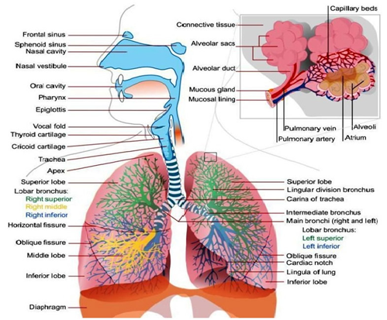
•The respiratory system consists of:
1) The respiratory passages. 2) The respiratory muscles.
3) The respiratory centers. 4) The pulmonary circulation.
I-The respiratory passages:
(A) Air conducting zone:
•Nose →larynx → trachea → 2 main bronchi → bronchioles → terminal bronchioles [first 16 divisions].
•No gas exchange occurs due to thick wall. It has an important protective functions. It contains circular cartilaginous rings to prevent its collapse and contains longitudinal elastic fibers to allow lengthening and shortness of bronchi with lung expansion and collapse.
(B) Transitional Zone: Between 17-20 divisions.
(C) Respiratory zone: Respiratory bronchioles → alveolar duct → alveoli [20-23 divisions].
In which gas exchange occurs with blood.

Slide 4
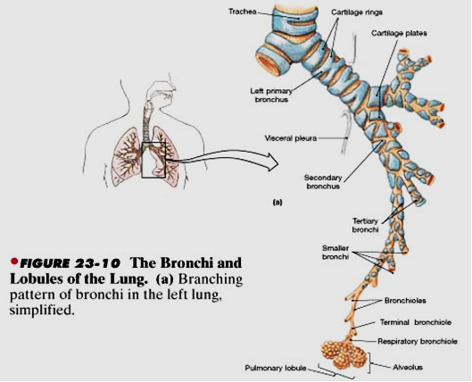
2) Respiratory muscles (The respiratory machine):
(A) Muscles of Normal inspiration:
1) Diaphragm: It performs 75% of normal inspiration.
•It is supplied by phrenic nerve from anterior horn cells of cervical 3, 4 & 5 segments.
•It contracts during inspiration and descends by 1 cm (but descend by 7 cm in forced inspiration) →↑ vertical diameter of the chest →↓ intra-alveolar pressure.
•Its sudden paralysis (as in hanging) → death.
2) External intercostal muscles:
•Oblique muscle - downwards and forwards from rib to rib below.
•They are innervated by intercostal nerves from T1-T11.
•When they contract → elevation of ribs & sternum leading to increase antero-posterior diameter of the chest and eversion of ribs leading to increase the transverse diameter.

Slide 5
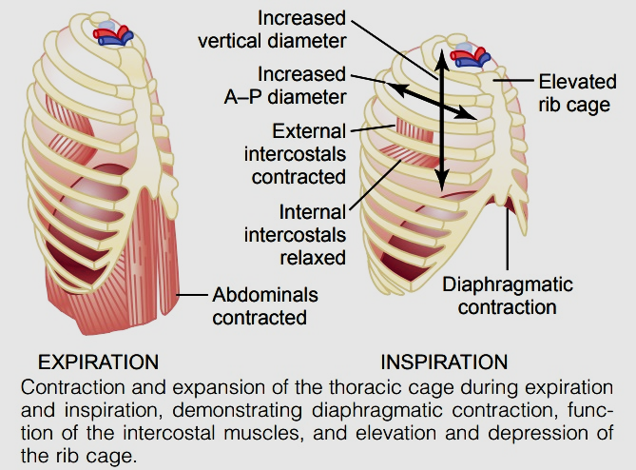
(B) Muscles of forced inspiration:
-Forced inspiration occurs voluntary (as in emotions , exercise) or in lung diseases by strong contraction of :
• Diaphragm & intercostal ms.
• Sternomastoid ms.→ elevates sternum.
• Serratus anterior ms. →elevates ribs.
• Scaleni muscle → elevates two first ribs.
• Elevator scapule and erector spinae muscles.
-By these muscles about 3 liters of air inspired/breath.

Slide 6
(C) Muscles of expiration:
1) Normal expiration: occurs passively due to relaxation of inspiratory muscle and elastic recoil of this muscle. So, there are not specific muscle for normal expiration.
2) Forced expiration:
A- Internal intercostal muscles:
- Oblique muscle – directed downwards and posteriorly.
- They are innervated by the intercostal nerves.
- When contract → downwards inwards of ribs and decrease chest volume and increase its pressure leading to expiration.
B- Abdominal muscles: Innervated by T1 – T12.
-When they contract →↑ intra-abdominal pressure → elevate diaphragm and expiration occurs.
-In strong forced expiration with closed glottis as during labour or defecation, all body muscles contract even mastication muscle.
N.B: Respiratory cycle is composed of active inspiration and passive longer expiration followed by expiratory pause in a rate of 12-16 cycles/min.
N.B: The expiratory pause is caused by:
1- Reflex stoppage of the activity of the inspiratory centers.
2- The time required for re-accumulation of Co2 after its wash by expiration to stimulate new inspiration.

Slide 7
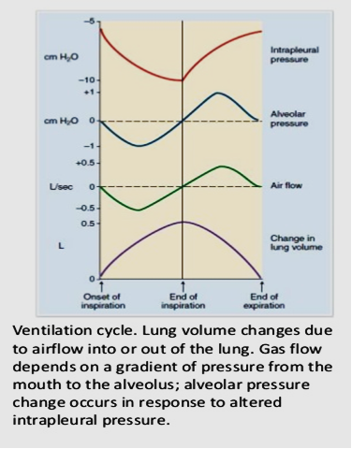
Respiratory pressures
A- Intrapulmonary (intra-alveolar) pressure):
•Definition: It is the pressure inside the alveoli during respiratory cycle.
•Value: - during normal inspiration = -1mmHg sub-atmospheric.
- during normal expiration = +1mmHg above atmosphere.
- during expiratory pause = zero (atmospheric).
- at end of forced inspiration = - 30 mmHg.
- at end of forced expiration = + 40 mmHg.
-during forced inspiration with closed glottis= - 80 mmHg.
-during forced expiration with closed glottis =+ 100 mmHg.
N.B.: Zero pressure in human body means atmospheric pressure.

Slide 8
B- Intra-pleural (intrathoracic) pressure (I.P.P.):
• Definition: it is the pressure in the space between the two layers of pleura (parietal layer which lines the thorax and visceral layer which covers the lungs).
•Value: - At end of normal inspiration = -6 mmHg.
- At end of normal expiration. = - 3 mmHg.
- At end of forced inspiration = -12 mmHg.
- At end of forced insp. with glottis closed=- 30 mmHg.
(Muller’manouver)
- At end of forced exp. + glottis closed = + 40 mmHg.
(Valsalva’manouver)
•Cause of negativity of I.P.P.:
-This negativity is due to continuous tendency of the lung to recoil against continuous tendency of the chest wall to expand. So, the two equal opposing forces cause negativity in pleural sac.

Slide 9
A -The recoil tendency of lung:
-At end of normal expiration (functional residual capacity) when respiratory muscle is relaxed the volume of lung and thorax = 2.5 liters.
-But the relaxation volume of the lungs = 1 liter.
-So the lung is distended from 1 lit. to 2.5 lit. and it has continuous tendency to recoil by:
1)The elastic fibers of the lung tissue, which stretched (1/3 recoil tendency).
2)The surface tension of the fluid lining the alveoli → tendency to collapse (2/3 recoil).
B-The expansion tendency of chest wall:
As the relaxation volume of chest = 5 liters. So, in the mid thoracic position (2.5 L) the chest is compressed and has tendency to expand by elasticity of muscles, tendons and tissue of chest.
•Functions of IPP:
1)It causes continuous expansion of the lungs.
2)It helps venous and lymph return.
3)It is a measure of lung elasticity as decrease elasticity in emphysema causes decrease the recoil and decrease the negativity of IPP.
N.B.: IPP becomes positive in:
1)Forced expiration as during talking or crying which causes bulging of neck veins due to decrease venous return.
2)Valsalva’s manouver (severe straining as in labour).
3)Tension pneumothorax.
4)Abnormal fluid in pleural sac as blood (haemo-thorax), pus (pyo-thorax), bile (chylothorax) or serous (hydro-thorax) which occur in malignancy or other diseases.

Slide 10
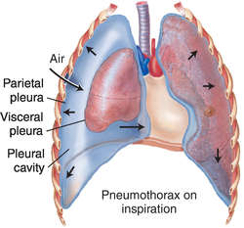
Pneumothorax
* Definition: it is presence of air in pleural sac.
* Causes and types:
Open pneumothorax: as stab chest wound with hole
in-between atmospheric air and pleural cavity → air enter
the pleural sac → collapsed lung with severe respiratory
distress and may cause death if bilateral wounds
(As, IPP = atmospheric p.)
2) Closed pneumothorax : as rupture of superficial alveoli → less effect as the air is absorbed (IPP return –ve pressure again).
3) Tension pneumothorax (valvular): in which rupture of alveoli and its visceral pleura act as valve allow entry and not exit of air → IPP becomes +ve with severe stress and collapse of the lung.
4) Artificial (therapeutic) pneumothorax: used in treatment of tuberculosis by injection of air intra-pleural to collapse the diseased lung preventing spread of infection to other lung.

Slide 11
Thank You

