Slide 1
obstetric shock
Done by :
Rand Mbaidin
Leen Mbaidin
Laith Haddadin
Weaam Maaitah
Michael Rabadi
Jeries Haddadin

Slide 2
Mrs. is a 33year old female patient married G3P3 . The patient was admitted for IOL due to PROM at 39weeks of gestation .After 12 hours from admission . she get delivered by vaginal delivery that was assisted by Episiotomy. The outcome was healthy boy weighted 3.8kg with no NICU admission. Patient was transferred to the ward .
Physical examination was done 2 hours post delivery . The patient was looking pale with shortness of breath .BP:80/60 PR : 108 b/min .Hb: 9 mg/ dl .other labs was normal . Abdominal palpation : soft lax abdomen with the uterus was 5 cm above the level of umbilicus. Vaginal examination showed active vaginal bleeding .
The patient was immediately transferred to the operating room . During this time uterine massaging was started and uterine packing was done . The patient was infused with 2 units of PRBCs and IV fluid. The bleeding was controlled .1 hour after , the patients vital sign was stable

Slide 3
Definition of shock
Shock is an acute circulatory failure leading to inadequate perfusion and delivery of oxygen to vital organs.
Types and causes
1)Hypovolemic Shock
2)Cardiogenic Shock
3)Obestructive Shock
4)Distributive Shock
In Obstetric cases shock is most commonly due to either hemorrhage or sepsis
Notes:
Oxygen delivery is an interaction of cardiac output, Blood Volume and systemic vascular resistance .

Slide 4
1) Hypovolemic Shock
Definition: medical or surgical condition in which rapid fluid loss results in multiple organ failure due to inadequate circulating volume and subsequent inadequate perfusion.

Slide 5
*Phases of Hemorrhagic Shock
Phase of compensation ( pre_shock state ):
Sympathetic stimulation: It is the initial response to blood loss leading to peripheral vasoconstriction to maintain blood supply to the vital organs.
Clinical picture: Pallor, tachycardia, tachypnoea
Phase of decompensation ( Shock state):
Blood loss exceeds 1000 ml in normal patient or less if other adverse factors are operating.
Clinical picture: is the classic clinical picture of shock.
Adequate treatment at this phase improves the condition rapidly without residual adverse effects.
The normal pregnant woman can withstand blood loss of 500 ml and even up to 1000 ml during delivery without obvious danger due to physiological cardiovascular and haematological adaptations during pregnancy.

Slide 6
Phase of cellular damage and danger of death:
Metabolic acidosis: due to anaerobic metabolism initiated after lack of oxygen.
Arteriolar dilatation: caused by accumulation of metabolites leading to pooling and stagnation of blood in the capillaries and leakage of fluid into the tissues.
Disseminated intravascular coagulation: caused by release of thromboplastin from the damaged tissues.
Cardiac failure: due to diminished coronary blood flow.
In this phase death is imminent, transfusion alone is inadequate and if recovery from acute phase occurs , residual tissue damage as renal and/ or pituitary necrosis will occur.

Slide 7
Classic Clinical Picture of Shock
Low blood pressure (not an absolute requirement)
→ SBP <90 mmHg, not seen in preshock state
Rapid weak (thready) pulse ( not in all type )
Cool Skin
→ vasoconstriction mechanisms to redirect blood from periphery to vital organs.
→ Exception is warm skin in early distribution shock.
Alterd Mental Status .
Oliguria or anuria (decrease kidney perfusion )
Metabolic Acidosis

Slide 8
Causes in pregnancy
1-Blood loss (obstetric hemorrhage)
In Jordan , HEMORRHGE is the leading cause of Maternal mortality .
Bleeding in early pregnancy
Antepartum hemorrhage :
Post partum hemorrhage
2-Fluid loss
3-Supine hypotension syndrome .
4-Splanchnic shock
Rapid evacuation of the uterine contents as in precipitate labour and rupture of membranes in polyhydramnios. This is accompanied by rapid accumulation of blood in the splanchnic area due to sudden relief of pressure.
5-Trauma
The most common form of hypovolemic shock in obstetrics is hemorrhagic shock

Slide 9
Classification of hemorrhagic shock (summary)
Classes | І | ІІ | ІІІ | ІV
Pulse | < 100 b/min | 100 - 120 b/min | 120 - 140 b/min | > 140 b/min
Bp | normal | Normal | ↓ | ↓↓
Urine output | Normal( > 30 ml / hr ) | 15-30 ml/hr | 5-15 ml/hr | < 5 ml / hr
% blood loss | Mild/(< 15 % ) | 15 -30 % | 30 -40 % | > 40%
Mental state | Anxious | Agitated | confused | drowsy or lethargic
Notes:
Class I 15%
Normal pulse & blood pressure.
Class II 20-25%
Tachycardia.
Tachypnoea.
Pulse pressure (<30mmHg).
Low systolic pressure.
Delayed capillary filling.
Class III 30-35%
Skin: cold, clammy and pale.
Severe drop in blood pressure.
Restlessness.
Oliguria (<30 ml/hour).
Metabolic acidosis (blood pH <7.5).
Class IV 40-45%
Profound hypotension.
The carotid pulse is the only felt one.
Irreversible shock

Slide 10
Management:
Start ABC
Adequate ventilation providing oxygen by mask, nasal tube or tracheal intubation if needed.
two large bore cannulas
Star IV FLUID
Folys catheter
At least 4 Blood Unit and FFP
Warmth, recumbent position with legs slightly elevated.
Morphine to alleviate pain and apprehension if needed.
Notes:
(for blood, fluids and drugs infusion which should be given by IV route in shocked patient) ) with blood sample collection for blood grouping, Rh & cross-matching, CBC, electrolytes, liver & kidney function tests, blood sugar and LDH and coagulation profile (PT, PTT, fibrinogen & FDPs).

Slide 11
History
Bleeding (Amount )
Triggering factors (e.g. postcoital bleed).
Associated with abdominal pain or contractions?
Fetal movement?
Abdominal Trauma ?
Smoking?
Last cervical smear (date/normal or abnormal)?
Examination
General : Pale , Confused
Pulse, blood pressure.
Is the uterus soft or tender and firm?
Fetal heart auscultation/CTG.
Speculum vaginal examination (Bivalved), with particular importance placed on visualizing the cervix (having established that placenta is not a previa, preferably using a portable ultrasound machine).

Slide 12
US :
Check fetal HR (Doppler)
Fetal presentation , EFW
Amniotic fluid index
Placental site
Check for retro placental hemorrhage

Slide 13
Drug therapy
Analgesics:10- 15 mg morphine IV if there is pain, tissue damage or irritability.
Sodium bicarbonate: if metabolic acidosis is demonstrated.
Vasopressors: to increase the blood pressure so maintain renal perfusion.
Dopamine: is the drug of choice.
ß -adrenergic stimulant: isoprenaline.
Corticosteroids: Hydrocortisone 200 mg daily.
- Its mode of action is controversial; it may decrease peripheral resistance and potentiate cardiac response so it improves tissue perfusion.

Slide 14
H—Ask for help and hands on uterus (uterine massage
A—Assess (that is, ABC) and resuscitate (that is, intravenous fluids crystalloid , send CBC ,X mach, Coagulation screen
E—Establish etiology, ensure availability of blood, and ecbolic (drugs that induce contractions of the uterus, oxytocin or ergometrine)
M—Massage the uterus
O—Oxytocin infusion (10 U/hour) or intramuscular prostaglandins (250 μg)
S—Shift to theatre, with aortic compression, bimanual compression, or anti-shock garment (for low resource settings before transfer to a tertiary center) as appropriate
T—Tamponade by balloon or uterine packing after exclusion of retained tissue and trauma. Administer intravenous tranexamic acid (1 g)
A—Apply compression sutures on the uterus (B-Lynch or modified technique)
S—Systematic pelvic revascularization (uterine, ovarian, quadruple. or internal iliac)
I—Interventional radiology and, if appropriate, uterine artery embolization
S—Subtotal or total abdominal hysterectomy

Slide 15
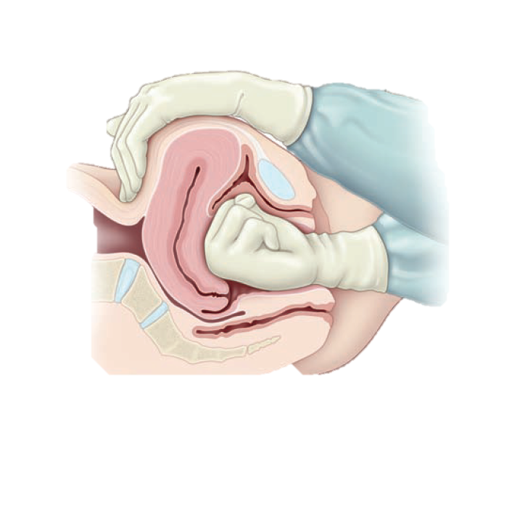
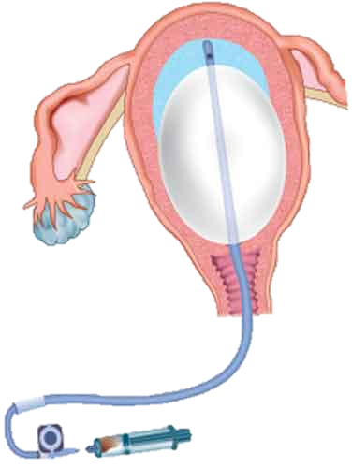
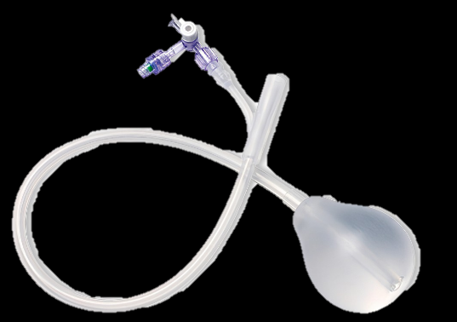

Slide 16
Complications of Hypovolemic shock
1) Acute renal failure.
2) Pituitary necrosis (Sheehan‟s syndrome) in PPH
3) Disseminated intravascular coagulation (DIC)
4) Death

Slide 17
Cardiogenic shock
Life threatening condition resulting from inadequate circulation of blood.
Rare in prgnanacy
What precipitate this condition?
1.Pregnancy puts a progressive strain on the heart as progresses.
2.Preexisting heart disease increase the risk
3.Due to ineffective contraction of the cardiac muscle
due to Myocardial infarction, Heart failure.
Incidence: Cardiac related mortality is the second most common cause of death in pregnancy

Slide 18
Signs and symptoms
Chest pain
Nausea and vomiting.
SOB
Profuse sweating
Confusion
Palpitation ,tachycardia
Syncope
Pale cold skin (low capillary refill)
Hypotension
Oliguria
How to treat?
o IV Fluids
o O2 supply
o Cardiac drugs as needed (dopamine, doputamine, epinephrine, NE

Slide 19
Neurogenic shock due to uterine inversion:
Stretching of the broad ligament or compression of the ovaries ( traction of suspensory ligaments as they are drawn together results in a parasympathetic reflex, which contributes to the acute symptoms (neurogenic shock).
the extent of the observed bleeding varies depending on the degree of prolapse.
the extent of shock is more than that attributable to the observed blood loss alone.
So the shock is Neurogenic in nature
Mx:
-Resuscitation
-Atropine and vasopressor agent may required due to bradycardia
Notes:
Neurogenic shock is a condition characterized by the presence of hypotension and bradycardia, due to a loss of sympathetic tone and an unopposed parasympathetic response.
It is mainly related to traumatic events involving the spinal cord but can also be related to nontraumatic causes.
No definitive test exists; thus, diagnosis is based on clinical history and physical findings. But even in patients with prior history of spine trauma, other common causes of shock may be ruled out first.
Signs and symptoms of neurogenic and non-neurogenic shock may overlap physiological changes that occur in the cardiovascular system during pregnancy; therefore, knowing these normal changes is vital in order to differentiate hemodynamic parameters altered by pregnancy from the ones altered by an underlying state of shock.
When approaching a pregnant woman with neurogenic shock in addition to physiological changes, gestational age must be taken in account.

Slide 20
Endotoxic (septic) shock
Remains an important cause of maternal death due to group A streptococcal infection contributing significantly.
To diagnose:
1- positive blood culture
2- hypotension despite of adeqate fluid resustation
Risk factors:
ruptured membranes, amniocentesis and other invasive procedures, cervical cerclage,
immunocompromised patients, immunosuppressant, obesity, diabetes, anemia. • urinary tract infections, vaginal discharge, previous pelvic infection, group B streptococcal infection, group A streptococcal infection in close contacts.

Slide 21
Obstetric Causes
Septic abortion.
Prolonged rupture of membranes.
Manipulations and instrumentations.
Trauma.
Retained placental tissues.
Toxic shock syndrome
Severe acute pyelonephritis.

Slide 22
Septic shock passes with 2 main stages:
Reversible stage: it has 2 phases:
Early (warm) phase: there are;
hypotension, (vasodilation )
tachycardia,
pyrexia,
rigors,
flushed skin,
patient is alert,
leucocytosis develops within hours.
Late (cold) phase: there are;
cold and clammy skin,
mottled cyanosis,
purpura,
jaundice,
progressive mental confusion,
coma.

Slide 23
Irreversible stage:
Prolonged cellular hypoxia leads to:
metabolic acidosis,
acute renal failure,
cardiac failure,
pulmonary oedema,
adrenal failure and ultimately death.

Slide 25
Severe sepsis may be defined as:
Temperature >38oC or <36oC.
Heart rate >100 beats per minute.
Respiratory rate >20 respirations per minute.
White cell count >12 × 109/l or <4 × 109/l with >10% immature band forms.
Severe sepsis has a higher maternity mortality and requires aggressive prompt treatment and timely involvement of the multidisciplinary team.

Slide 26
The Surviving Sepsis Campaign Resuscitation bundles have key points in the timely management of sepsis:
1.Obtain blood cultures prior to antibiotic administration.
2.Administer broad-spectrum antibiotic within 1 hour of recognition of severe sepsis.
-Every 1 hour delay in administrating antibiotics increases mortality by approximately 8%.
3.measure serum lactate
In the event of hypotension and/or a serum lactate ≥4 mmol/l : deliver an initial minimum 20 ml/kg of crystalloid or an equivalent.
If there is no response: administer vasopressors for hypotension that is not responding to initial fluid resuscitation to maintain mean arterial pressure (MAP) ≥65 mmHg.
In the event of persistent hypotension despite fluid resuscitation and/or lactate ≥4 mmol/l, aim to achieve a central venous pressure (CVP) of ≥8 mmHg or a central venous oxygen saturation ≥70% or mixed venous oxygen saturation ≥65%.

Slide 27
Surgical treatment:
Is indicated when there is retained infected tissues as in septic abortion. It should be removed as soon as antibiotic therapy and resuscitative measures have been started by:
suction evacuation,
or
hysterectomy in advanced infection.

Slide 28
Antibiotic use:
The selection of antibiotics should be guided by risk factors and potential sources of sepsis.
piperacillin/tazobactam or a carbapenem plus clindamycin
Co-amoxiclav:.
- Does not cover methicillin-resistant Staphylococcus aureus (MRSA), Pseudomonas or extended spectrum β-lactamase-(ESBL) producing organisms.
Metronidazole:
Clindamycin: covers streptococci and staphylococci including MRSA. Clindamycin also switches off exotoxin production.
Gentamicin:

Slide 29
Anaphylactic shock:
Anaphylaxis is a rare event during pregnancy, but its onset may trigger maternal hypotension leading to intrapartum asphyxia and, eventually, the risk of severe fetal brain damage. Furthermore, the risk of cesarean delivery in anaphylactic patients in pregnancy is high (74%).
Symptoms of anaphylaxis:
respiratory (e.g., wheeze, dyspnea)
gastrointestinal (e.g., vomiting, abdominal pain)
skin and mucosal (e.g., uritcaria, itchy rash, swelling of lips)
cardiovascular and central nervous systems (e.g., reduced blood pressure, feeling faint, headache).
Potential pregnancy‐related symptoms and signs of anaphylaxis are lower back pain, fetal distress, uterine cramps, preterm labor, and vulvar or vaginal itching
Notes:
Anaphylaxis may also trigger maternal hypotension and hypoxemia. Maternal hypoxemia and hypotension are potentially life‐threatening to both mother and fetus. Maternal hypoxemia can lead to intrapartum asphyxia, and maternal hypotension and vasoconstriction can result in decreased uterine blood flow.
Risks to the fetus include hypoxic–ischemic encephalopathy, severe central nervous system damage, or death.

Slide 30
Initial treatment includes
improving maternal airway, breathing, and circulation, removing causative agents, and injecting epinephrine in the mid‐outer thigh.
It is important to re‐evaluate the allergic symptoms of the patient, to prevent permanent damage to the fetus. If allergy symptoms recur or do not improve, epinephrine injection can be needed repeatedly every 5–15 min.
Patients may require cesarean delivery to avoid fetal hypoxemia and prevent severe fetus damage.
-The epinephrine auto‐injector should be prepared for pregnant women who has potential risk of anaphylaxis.
Notes:
- In cases of anaphylaxis during pregnancy, both mother and fetus must be treated. Therefore, the patient must be seen by a specialist team comprising obstetrics, neonatology, and anesthesiology for medical and surgical obstetric management, such as fetal monitoring, maternal treatment of threatened preterm labor, and preparing cesarean delivery.

Slide 31
Obstetric Shock
Hypotension without significant external bleeding may occasionally develop in an obstetric patient. This condition is called obstetric shock.
The causes of obstetric shock include
concealed hemorrhage within the uterus
uterine inversion
amniotic fluid embolism.
An improperly sutured episiotomy can lead to a concealed PPH
A soft tissue hematoma, usually of the vulva, may occur following delivery in the absence of any laceration.
Uterine rupture can also occur secondary to blunt abdominal trauma at the time of an automobile accident
Notes:
If the first suture at the vaginal apex of the episiotomy incision does not incorporate the cut and retracted arterioles, these can continue to bleed, creating a hematoma that can dissect cephalad into the retroperitoneal space. This may cause shock without external evidence of blood loss.

Slide 32
Management
During the diagnostic workup of an established hemorrhage, the patient’s vital signs must be monitored closely. However, young healthy women may tolerate and mask hypovolemia well.
The sensitivity and specificity of the vital signs are not absolute.
The estimated blood loss is commonly underestimated, and it should be replaced by quantitated blood loss, where sponges and pads are weighed and measured.
Multiple units of packed red blood cells must be typed and crossmatched, and IV crystalloids (such as normal saline or lactated Ringer solution) infused to restore intravascular volume.
Resuscitation with normal saline usually requires a volume of three times the estimated blood loss to replace the intravascular volume.
Notes:
During a massive hemorrhage, morbidity and/or mortality are reduced with an emphasis on early blood product replacement rather than crystalloid based resuscitation

Slide 33
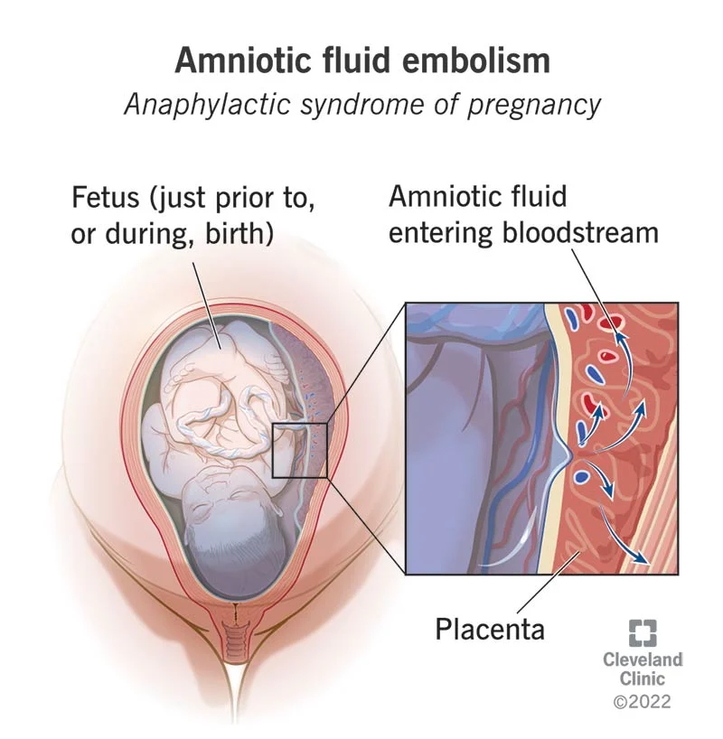
Amniotic fluid embolism
Amniotic fluid embolism (AFE) is a life-threatening obstetric emergency
It happens due to entering of amniotic fluid ,fetal cells hair and amniotic debris entering the maternal circulation causing cardio-pulmonary collapse .
incidence of AFE is estimated to occur between 1 in 8000 and 1 in 80,000 deliveries. The true incidence is unknown because of inaccurate diagnosis and inconsistent reporting of nonfatal cases.
Previous studies revealed mortality rates as high as 61-86%, but recent estimates suggest a case fatality of 13-26%. This decrease in risk for maternal mortality from AFE may be the result of early diagnosis and better resuscitative care as well as changes in case inclusion criteria
Neonatal survival 70%

Slide 34
Can't be predicted or prevented from occurring / Often isn't diagnosed until autopsy
Time of event :
- During labor / During CS / After normal vaginal delivery.
During second trimester .
it may also occur up to 48 h post delivery.
It can also occur during abortion, after abdominal trauma, and during amnioinfusion

Slide 35
Risk factors:
Fetal factors:
Fetal distress.
Fetal death.
Male baby.
Older maternal age.
Multiparty.
Intense contractions during labor.
Abdominal trauma
Cesarean section.
Induction of labor.
Placenta Previa.
Eclampsia.
Multiple pregnancy

Slide 36
Pathophysiology:
the exact pathophysiology is still unknown.
The process is similar to anaphylaxis than to embolism, so also termed as anaphylactic syndrome of pregnancy because fetal tissue or amniotic fluid components are not universally found in women who present with signs and symptoms attributable to AFE. In some women, AFE may lead to a mild degree of organ dysfunction while in others it may lead to coagulopathy, cardiovascular collapse, and death.
Notes:
Recent evidence suggests that the occurrence of AFE is not a consequence of the “simple” mechanical respiratory obstruction, but a humoral effect causing anaphylactoid reactions or complement activation.

Slide 37
entry of amniotic fluid into the maternal circulation
activates inflammatory mediators
humoral or immunologic response
This theory is supported by the fact that amniotic fluid contains vasoactive and pro- coagulant products including platelet-activating factor, cytokines, bradykinin, thromboxane, leukotrienes, and arachidonic acid.
Concentrations of tissue factor and tissue factor pathway inhibitor, which trigger intravascular coagulation, are higher in amniotic fluid than in maternal serum
It is speculated that maternal plasma endothelin concentrations are increased by entry of amniotic fluid into the systemic vasculature. Endothelin acts as a Broncho constrictor as well as a pulmonary and coronary vasoconstrictor, which may contribute to respiratory and cardiovascular collapse
The direct pro-coagulant property of amniotic fluid may explain the prevalence of disseminated intravascular clotting (DIC) in AFE.

Slide 38
The cause of AFE-associated reactions is explained by two hypothesis: The effect of amniotic fluid itself or a host idiosyncrasy ("hypersensitivity" reaction)
initial respiratory reaction
transient pulmonary vasospasm. Vasospasm may be caused by amniotic micro-emboli that trigger the release of arachidonic acid metabolites and leads to pulmonary hypertension, intrapulmonary shunting, bronchoconstrictionand severe hypoxia.
second manifestation
negative inotropism and left ventricular failure resulting in increasing pulmonary edema and hypotension quickly leading to shock.
The third manifestation
neurological response to the respiratory and hemodynamic injury, which may include seizures, confusion, or coma

Slide 39
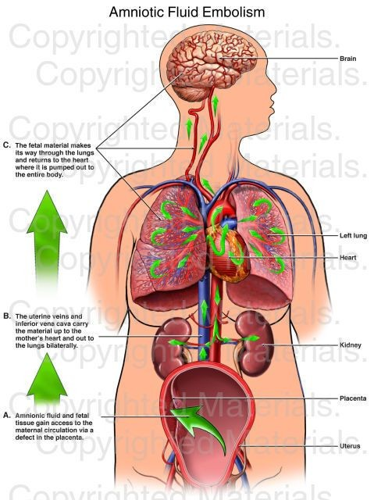
There are two clinical forms of AFE exist typical and atypical.
Typical, (classic) with three phases:
Phase 1-respiratory and circulatory disorders
Phase 2-coagulation disturbances of maternal hemostasis
Phase 3-acute renal failure and acute respiratory distress syndrome (ARDS), and leading to cardiopulmonary collapse.
Atypical:
In contrast to typical embolism
cardiopulmonary collapse does not occur in atypical embolism but the first symptom is life threatening hemorrhage due to DIC.
atypical embolism was observed during caesarean section or immediately after it, in cases of profound rupture of uterine cervix, as well as in the course of placenta abruption and in association with induced mid-trimester abortion.

Slide 40
Clinical presentation
Acute or sudden dyspnea (manifested as cough )
sudden chills, shivering, sweating
Altered mental status.
Hypotension: is the most common presenting sign and symptom (100%).
Cyanosis: Ventilation-perfusion mismatching as a result of pulmonary vascular constriction at the onset of AFE may explain sudden hypoxia and respiratory arrest.
Uterine atony :
Acute pulmonary hypertension and vasospasm results in right ventricular failure, hypoxia, and cardiac arrest
Coagulopathy or severe hemorrhage: Coagulation disorders are a prominent feature of the amniotic fluid syndrome. DIC is present in more than 83% of patients with AFE. The onset can occur as quickly as 10-30 min from the onset of symptoms or may be delayed by as long as 4 h.
Fetal bradycardia: In response to the hypoxic insult
Encephalopathy associated with AFE is thought to be secondary to hypoxia and includes a spectrum of symptoms ranging from altered mental state to seizures. Tonic-clonic seizures are seen in 10-50% of patients

Slide 41
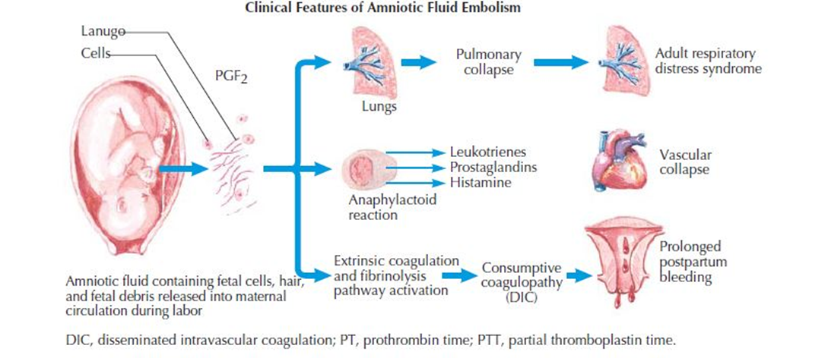

Slide 42
Four criteria must be present to make the diagnosis of AFE:
Acute hypotension or cardiac arrest.
Acute hypoxia.
Coagulopathy or severe hemorrhage in the absence of other explanations.
All of these occurring during labor, cesarean delivery, dilation and evacuation, or within 30 min postpartum with no other explanation of findings.

Slide 43
Diagnosis
continuous pulse oximetry and arterial blood gas (ABG
Serial complete blood counts and coagulation studies
Blood type and screen
Chest radiograph postero-anterior and lateral findings are usually nonspecific.
A 12-lead electrocardiogram may show tachycardia, ST-segment and T-wave changes, and findings consistent with right ventricle strain.
Lung scan may demonstrate some areas of reduced radioactivity in the lung field.
Increased serum tryptase, urinary histamine concentrations and significantly lower complement concentrations suggest an anaphylactoid process.
Decreased serum levels of C3 and C4 complement had sensitivities between 88% and 100% and a specificity of 100%.
Bedside trans-esophageal echocardiography may aid early diagnosis by showing acute pulmonary vasoconstriction, right ventricular dilation, and a collapsed left ventricle with leftward deviation of the intra-ventricular septum

Slide 44
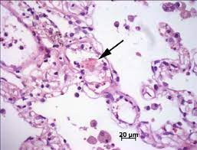
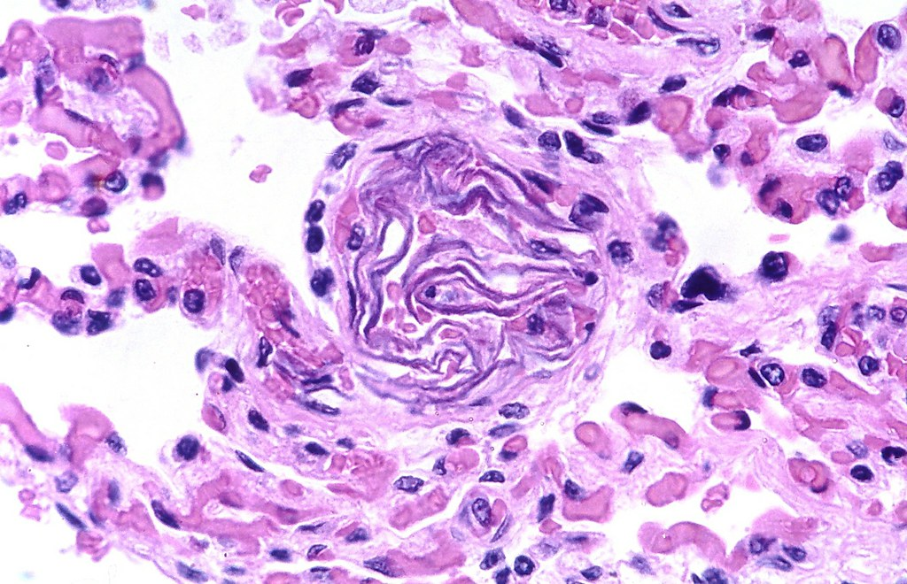
The most significant pathologic findings at autopsy are limited to the lungs.
Grossly, the lungs show evidence of pulmonary edema (in 70% of the cases).
Alveolar hemorrhage and pulmonary embolism of amniotic fluid materials are present; the presence of embolic particles is essential for diagnosis, but on histology they may be missed because of their small size.
Squamous within a pulmonary arteriole.
Alveolar tissue section. A fetal squamous
epithelial cell (arrow) derived from amniotic fluid is seen
in the pulmonary vasculature

Slide 45
Management goals :
Restoration of cardiovascular and pulmonary equilibrium immediately
Maintain systolic blood pressure > 90 mm Hg
Urine output > 25 ml/hr.
Arterial pO2 > 60 mm Hg.
Re-establishing uterine tone
Correct coagulation abnormalities

Slide 46
IMMEDIATE MEASURES :
Set up IV Infusion, O2 administration.
- Airway control : endotracheal intubation
- maximal ventilation and oxygenation.
LABS : CBC , ABG , PT , PTT , fibrinogen, Fibrin degradation products (FDP)

Slide 47
Management :
Oxygen: endotracheal intubation and positive pressure respiration is usually indicated as the patient is often unconscious
Aminophylline: to reduce bronchospasm.
Isoprenaline: to improve pulmonary blood flow and cardiac activity.
Digoxin and atropine: if central venous pressure is raised and pulmonary
secretions are excessive
Hydrocortisone:to cause vasodilatation and improves tissue perfusion
Bicarbonate solution: if there is respiratory acidosis.
Low molecular weight dextran: reduces platelets aggregation in vital organ.
Heparin: for treatment of DIC if there is no active bleeding.
Vaginal delivery: is safer than C.S. if the baby is not yet delivered

Slide 48
Uterine Inversion
Uterine inversion occurs when the uterine fundus turns partially or completely inside out the endometrial cavity in the third stage of labor
Just after the second stage of labor, the uterus is somewhat atonic, the cervix open, and the placenta attached.
It’s estimated to occur in 1 in 2500 deliveries.
It may occur with Vaginal or CS deliveries .
Notes:
Rare , but a life threatening Obstetrical Emergency If not promptly recognized and treated, uterine inversion can lead to severe hemorrhage and shock, resulting in maternal death.

Slide 49
Improper management of the third stage of labor can cause an iatrogenic uterine inversion
If the inexperienced physician exerts fundal pressure while pulling on the umbilical cord before complete placental separation (particularly with a fundal implantation of the placenta), uterine inversion may occur.
As the fundus of the uterus moves through the vagina, the inversion exerts traction on peritoneal structures, which can elicit a profound vasovagal response.
The resulting vasodilation increases bleeding and the risk of hypovolemic shock.
If the placenta is completely or partially separated, the uterine atony may cause profuse bleeding, which compounds the vasovagal shock.

Slide 50
Pathogenesis:
The pathogenesis of uterine inversion is incompletely understood.
It has been attributed to use of excessive cord traction and fundal pressure (Credé maneuver) during the third stage of labor, especially in the setting of an atonic uterus with fundal implantation of the placenta.
It is likely that other factors play a role since spontaneous inversions occur and inversion is rare even though cord traction and the Credé maneuver are common

Slide 52
Risk factors that predispose to Uterine inversion :
They are present in fewer than 50 percent of inversion cases.
1- Macrosomia
2- Rapid or prolonged labor.
3- Usage of uterine relaxant(tocolytics).
4- short umblical cord
5- Nullparity
6- placenta accreta

Slide 53
CLASSIFICATION:
Uterine inversion classified according to:
1.Severity of uterine inversion.
2.Timing of the event.

Slide 54
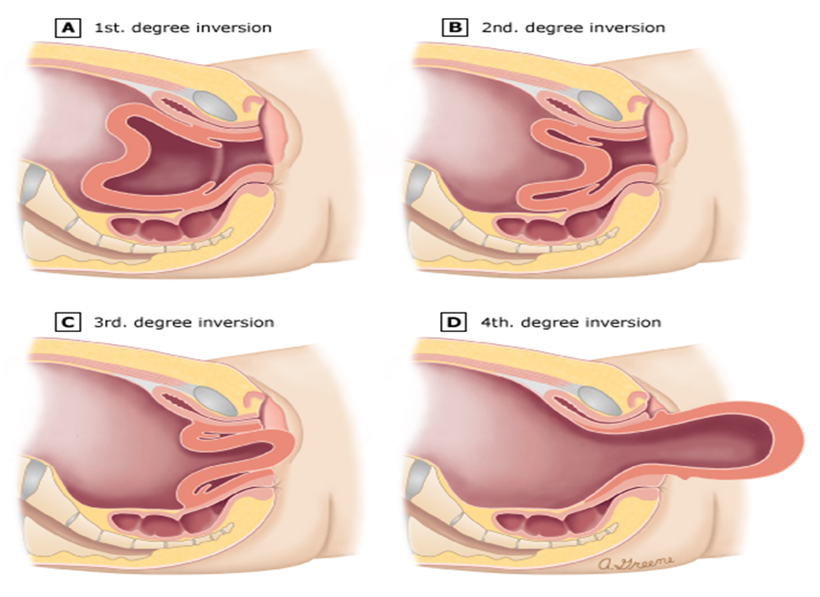
Severity of uterine inversion:
First Degree (incomplete) :
-Inverted uterine wall extends to but not through the cervix -The fundus is within the endometrial cavity
Second Degree (complete):
-Inverted uterine wall protrudes through the cervix os but remains in the vagina.
Third Degree (prolapsed ):
- Inverted uterine fundus extends outside the vagina.
• Fourth Degree(total):
-Total inversion; both the vagina and uterus are inverted

Slide 55
Clinical presentation:
Signs and symptoms include one or more of the following:
1)Mild to severe vaginal bleeding.
2)Mild to severe lower abdominal pain.
3)A smooth, round mass protruding from the cervix or vagina.
4)On abdominal examination, absence of uterine fundus.
5)urinary retention.

Slide 56
The most common presentation is complete uterine inversion with severe postpartum hemorrhage, often leading to hypovolemic shock.
Shock out of proportion to blood loss has been described and attributed to increased vagal tone from stretching of the pelvic parasympathetic nerves by Stretching of the broad ligament or compression of the ovaries as they are drawn together (neurogenic shock),
but this is controversial and may just reflect underestimation of blood loss
On vaginal examination, the inverted fundus fills the vagina, and providers may initially misdiagnose it as a protruding fibroid; however, on transabdominal palpation, the uterine fundus is absent at its expected periumbilical position

Slide 57
Incomplete uterine inversion occurs in approximately 10 percent
In contrast to complete inversion, blood loss may be minimal.
Examination through the dilated cervix reveals a mass (ie, fundus) in the uterine cavity; on abdominal examination, a cup-like defect (fundal notch) may be palpated in the area of the normally globular fundus.
In incomplete inversion there will be absence of heavy bleeding or careful examination of the fundus, these patients may not be identified for days or weeks.
 Because of increasing cervical constriction over time, delayed recognition of inversion is more likely to require surgical intervention to replace the uterus, and the uterus may become edematous and infected.

Slide 58
Diagnosis:
Mainly Clinically
-- Classic observations include :
1- Vaginal bleeding potentially leading to shock
2- appearance of a smooth rounded mass protruding from the cervix or vagina
3- Lack of palpation of fundus in its normal position .

Slide 59
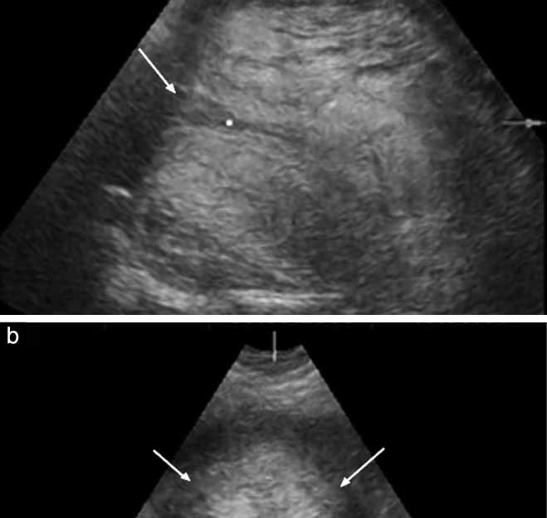
Ultrasound images of the uterus showing the inverted fundus as a central crater‐like depression (arrow) (a) and in the axial plane showing the constriction ring (arrows) (b).
In incomplete inversions :
a mass may not be seen externally, and postpartum hemorrhage is usually the most striking symptom.
Radiographic imaging (eg, ultrasound, magnetic resonance) is rarely necessary, but has been used to confirm inversion when the diagnosis was uncertain, and the patient was hemodynamically stable.
 Importantly, in women with significant vaginal bleeding, treatment should not be delayed for radiologic confirmation.

Slide 60
Differential diagnosis:
Prolapsed fibroid
(differentiated through abdominal examination for the fundus or by US).
Severe uterine atony.
Uterine rupture

Slide 61
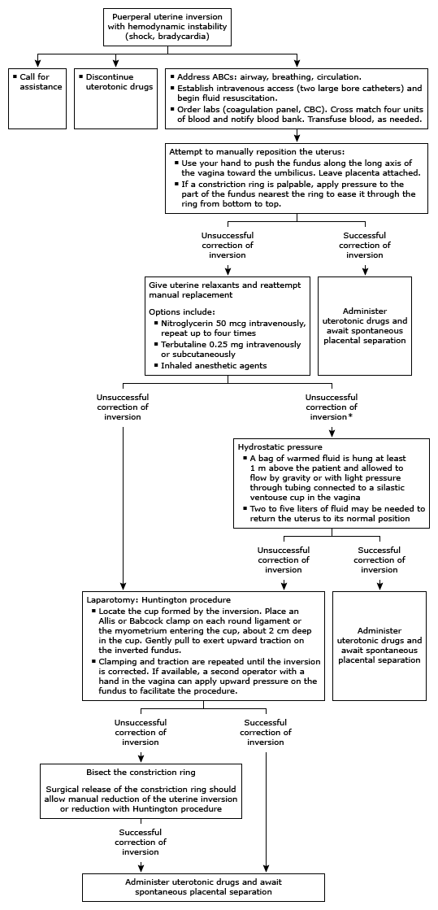

Slide 62
Management:
Goals:
Manage postpartum hemorrhage and shock, if present
Replace the uterus to its correct position
Prevent recurrent inversion
Discontinue uterotonic drugs ( oxytocin )

Nitroglycerin (glyceryl trinitrate administered IV)
Magnesium sulfate
Call for immediate assistance
place two large bore cannulas and begin infusion of crystalloid to support blood pressure
Management of the placenta — do not remove the placenta until the uterus has been replaced. Removing the placenta before replacing the uterus increases blood loss, which may be severe

Slide 63
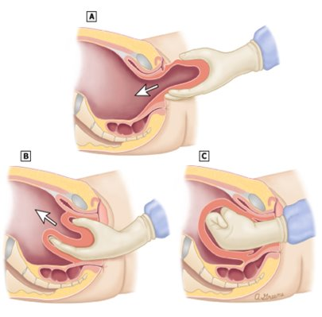
Immediately attempt to manually replace the inverted uterus to its normal position:
-This is best accomplished by placing a hand inside the vagina and pushing the fundus with the fist along the long axis of the vagina toward the umbilicus (Johnson maneuver).
the management of a uterine inversion requires quick thinking. The patient rapidly goes into shock, and immediate intravascular volume expansion with IV crystalloids is required

Slide 64
Secondary (surgical) interventions:
1) Huntington procedure.
2) Haultain procedure.
3) Hydrostatic reduction (if both are not possible)

Slide 65
Hydrostatic reduction
If manual reduction alone is not successful and surgical intervention is not possible.
simple hydrostatic pressure may be of great assistance in pushing the fundus back to its normal anatomical position
The possible complications associated with the procedure include: infection, failure of the procedure, and saline embolus.
The main problem with hydrostatic replacement is developing a good enough water seal to allow generation of adequate hydrostatic pressures to allow uterine replacement

Slide 66
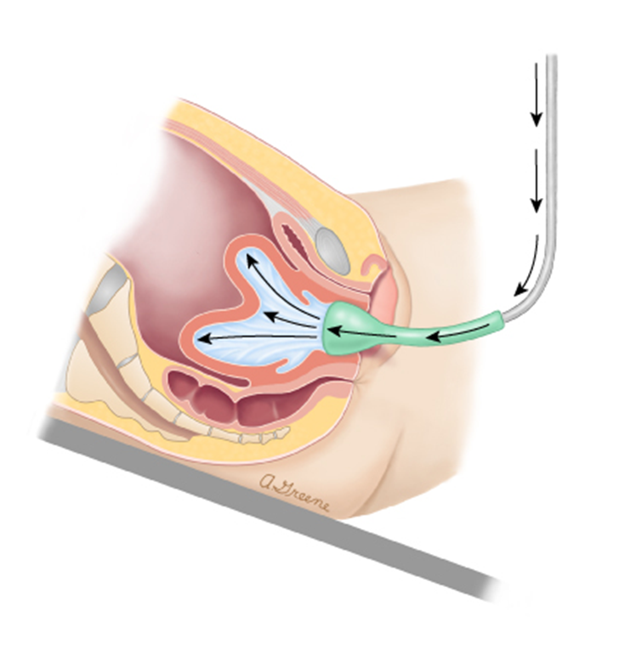
The patient is placed in reversed Trendelenburg -lithotomy position.
Warmed sterile saline is infused into the vagina.
The clinician’s hand or a silicone ventouse cup is used as a fluid retainer to generate intravaginal hydrostatic pressure and resultant correction of the inversion.
The bag of fluid should be elevated about 100 to 150 cm above the vagina to guarantee sufficient pressure for insufflation
The resulting intravaginal hydrostatic pressure may force the inverted fundus back to its normal position.
2 to 5 liters of fluid may be needed

Slide 67
Surgical options include Huntington and Haultain procedures:
laparoscopic-assisted repositioning, and cervical incisions with manual uterine repositioning.
The Huntington procedure involves laparotomy by gradually pulling on the round ligaments to restore the uterus to its proper position. In case the cervical ring is very tight, repositioning may be more easily achieved by incising the ring posteriorly with a vertical incision along with manual pushing of the fundus.
As with manual repositioning, after replacing the fundus, the anesthetic agent used to relax the myometrium is stopped, and uterotonic therapy is administered immediately, followed by repair of uterine incision. If these procedures are performed, then pregnancies in the future will require a cesarean delivery.
If the placenta is not separated from the uterus, then a hysterectomy may be necessary.

Slide 68
•Locate the cup formed by the inversion •Place a clamp, such as an Allis or Babcock clamp, on each round ligament entering the cup, approximately 2 cm deep in the cup. Clamp the myometrium if the round ligaments cannot be identified. •Gently pull on the clamps to exert upward traction on the inverted fundus •Repeatedly clamp in 2 cm increments along the ligament and exert traction until the inversion is corrected. This procedure is similar to the hand-over-hand movements used when pulling a line. If available, a second operator can place a hand in the vagina and apply upward pressure on the fundus to facilitate the procedure, or they can pull one of the clamps while the first operator pulls the other clamp.

Slide 69
Management of the placenta:
After the uterus has been replaced, the most conservative approach is to wait a spontaneous separation of the placenta, and performing manual extraction for usual obstetric indications (hemorrhage, prolonged third stage)
Prevent recurrent inversion:
Atony is common after restoration of the normal uterine position.
Once placental removal has been successfully accomplished, uterotonic agents are administered to induce myometrial contraction and maintain uterine involution, thereby impeding reinversion and reducing the risk of hemorrhage

Slide 70
THANK YOU

