Slide 1
DYSPHAGIA
Done by :
Lana Alhusban
Jude Al shawabkeh
Areen Gharaibeh

Slide 2
INTRODUCTION
Dysphagia defined as having difficulty or abnormality in swallowing which may affect any part of the swallowing pathway - so patient pay more time and effort in swallowing.
Patients complain that foods or liquids are no longer being swallowed easily and there is a sensation of food sticking .

Slide 3
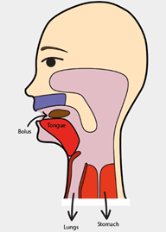
Physiology of swallowing:
The normal process of swallowing is anatomically classified into 3 phases :
Oral phase :
- voluntary
- formation of food bolus and passing it into oropharynx.
- The nerves involved are V & VII Nerves

Slide 4
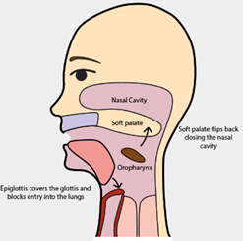
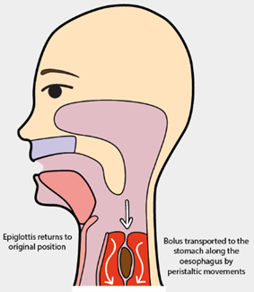
Pharyngeal phase :
- involuntary
- Closure of epiglottis and relaxation of upper esophageal sphincter.
The nerve involved is IX nerve
Esophageal phase :
- involuntary
- movement of bolus by gravity or peristalsis and relaxation of lower esophageal sphincter.
- The nerve involved is X nerve
***it occurs within approximately 10 seconds

Slide 5
Symptoms of dysphagia
Sensation that food is stuck in throat or chest
Coughing and choking
Odynophagia
Drooling of saliva
Food regurgitation
Frequent heartburn
Weight loss (if persistent)

Slide 6
Classification of dysphagia
Based on the location & cause of swallowing impairment, dysphagia can be classified into the following categories :
Oropharyngeal Dysphagia structural
Esophageal Dysphagia neurological

Slide 7
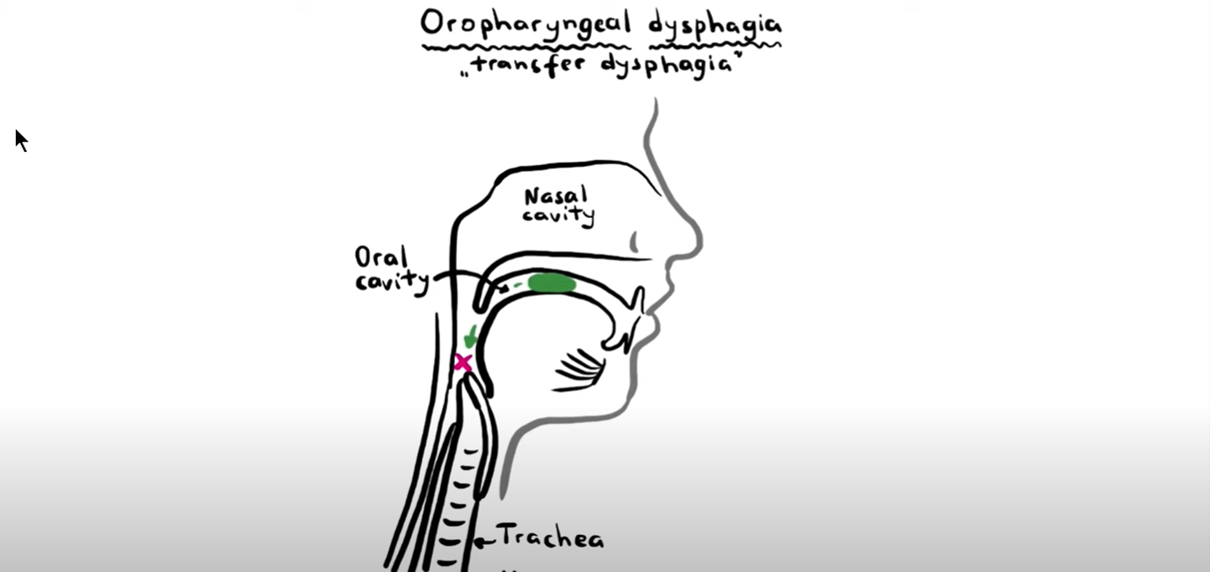
Oropharyngeal dysphagia
The inability to propel a food bolus successfully from the hypopharyngeal area through the upper esophageal sphincter into the esophageal body.
Patient presents with choking, nasopharyngeal regurgitation or tracheal aspiration
Usually occurs immediately within the 1st second after swallowing attempt.

Slide 8
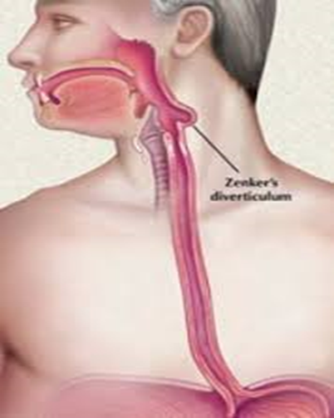
Oropharyngeal dysphagia could be due to :
Structural (obstructive) causes
Tongue or tonsil tumors
Thyromegaly
Past history of surgery or radiation therapy
Proximal esophageal web
Peritonsillar abscess
Zenker’s diverticulum :
( its an acquired sac originated from the pharyngeal esophageal junction )

Slide 9
Zenker’s diverticulum
1- Its an acquired sac originated from the pharyngeal
esophageal junction
2- Its considered when undigested food is brought up several hours after meal or if the patient
Reports hearing a gurgling noise in the chest

Slide 10
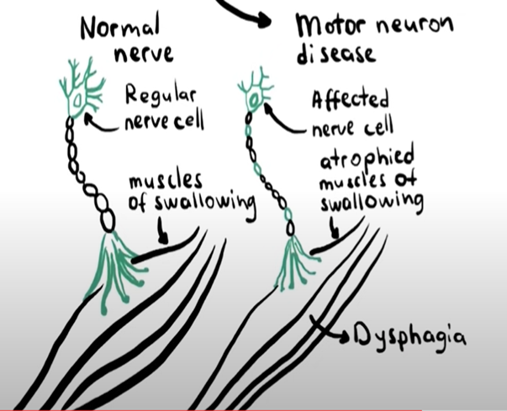
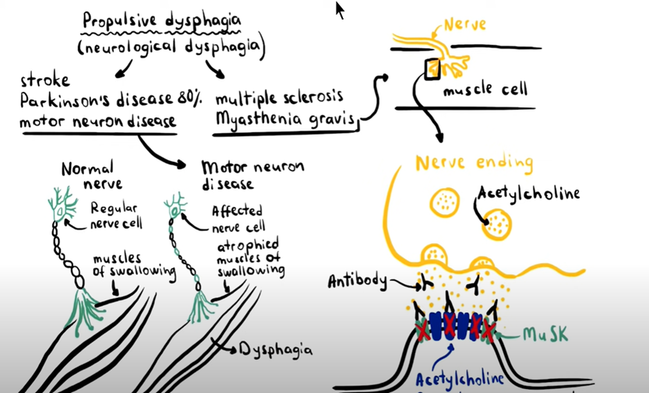
2. Neurological (Propulsive) causes :
Stroke
Parkinson's disease (in 80% of patients)
Motor neuron disease:
A neurodegenerative disease affecting motor neuron fibers causing
Muscle weakness and atrophy, such as ALS
Myasthenia gravis ( usually dysphagia is the only presenting symptom especially in old ages)
Multiple sclerosis

Slide 11
Esophageal dysphagia
Patient can initiate swallowing but there is a sensation of discomfort in mid-sternal region.
Usually, the site of sensation of discomfort is poorly correlated with the true site of obstruction.
Occurs after the 1st second of swallowing process
Caused by disorders that lead to obstruction or narrowing the esophageal lumen or by affecting its motility.
Usually swallowing of liquids doesn’t affect until the narrowing becomes extreme.
Same as oropharyngeal dysphagia, esophageal dysphagia could be due to structural or neurological causes .

Slide 12
Structural (obstructive) causes
A. Internal obstruction :
Esophageal carcinoma
Peptic strictures (could be due to long standing esophagitis or GERD)
foreign bodies
Lower esophageal (Schatzki) ring
Diverticula
Eosinophilic esophagitis
Medication-induced
B. External compression :
Mediastinal masses
Vascular compression (like aortic aneurysm)

Slide 13
Neurological (Propulsive) causes
Achalasia (impaired relaxation of lower esophageal sphincter)
Hypercontractile esophagus
Scleroderma (decrease motility of any part of GIT especially distal esophagus)
Reflux-related dysmotility
Chagas’ disease
Achalasia (impaired relaxation of lower esophageal sphincter)
Hypercontractile esophagus
Scleroderma (decrease motility of any part of GIT especially distal esophagus)
Reflux-related dysmotility
Chagas’ disease

Slide 15
Oropharyngeal | Esophageal
Failure of initiation of swallowing | There is initiation of swallowing
Within the 1st second | After the 1st second
Complications of dysphagia :
Choking
Dehydration
Malnutrition & weight loss
Aspiration pneumonia

Slide 16
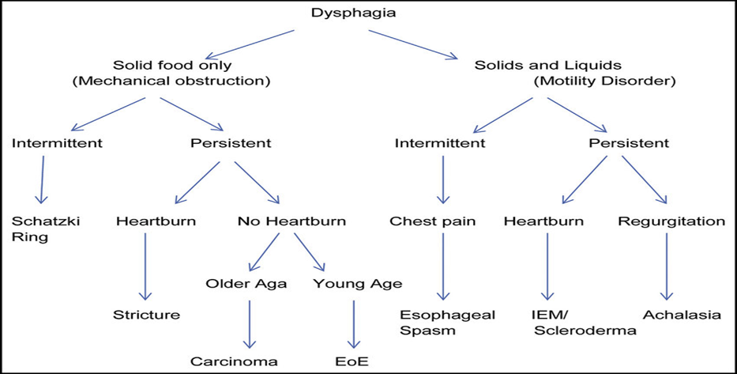
Diagnosis and investigation
*** dysphagia of solid food usually refers to structural causes while dysphagia of liquids & food usually refers to neurological causes
*** Progressive dysphagia that begins with solids and progresses into liquids may indicate malignancy

Slide 17
Diagnosis and investigation
barium swallow study
* looks at how you swallow different liquids and food, preferred when. a neurological cause is suspected)
* ideal first test as its readily available, cost effective and quick
* It’s performed after an overnight fast.
Barium X-Ray

Slide 18
3. Upper endoscopy
* ( preferred when a structural cause is suspected )
* allows for visual assessment of the mucosa
* can be diagnostic for example taking biopsies and therapeutic such as dilations
4. Other diagnostic approaches include:
* esophageal manometry (measures esophageal muscle contractions)
* For nutcracker oesophagus and oesophageal spasm
* pH monitoring ( in case of reflux esophagitis)

Slide 19
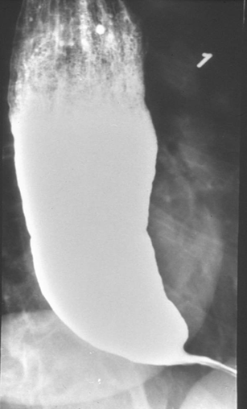
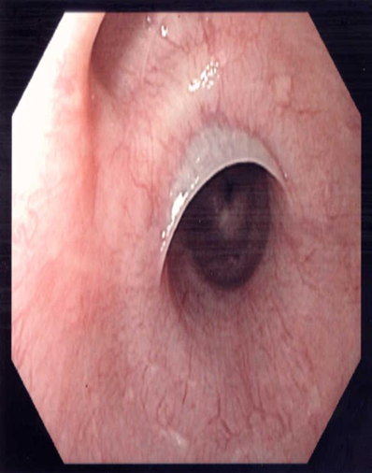
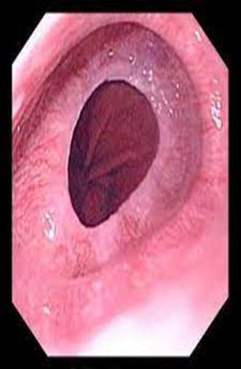
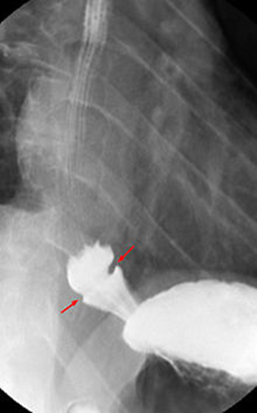
Achalasia
Proximal esophageal web
schatzki ring

Slide 20
Management of dysphagia
Treating underlying causes
Dietary changes
Swallowing exercise
Esophageal dilatation (for achalasia and peptic strictures by upper endoscopy)
Surgery

Slide 21
THANK YOU

