Slide 1
9- Higher function of neocortex. By Prof. Sherif W. Mansour Physiology dpt., Mutah school of Medicine.

Slide 2
-In the human brain, the neocortex is the largest part of the cerebral cortex, which is the outer layer of the cerebrum. The neocortex is made up of six layers, labelled from the outermost inwards, I to VI.
- The neocortex is divided, into frontal, parietal, occipital, and temporal lobes, which perform different functions.
-For example, the occipital lobe contains the primary visual cortex, and the temporal lobe contains the primary auditory cortex. Further subdivisions or areas of neocortex are responsible for more specific cognitive processes. In humans, the frontal lobe contains areas devoted to complex language processing localized to the ventro-lateral pre-frontal cortex (Broca's area). The neocortex has also been shown to play an influential role in sleep, memory and learning processes. Memories appear to be stored in the neocortex, specifically the anterolateral temporal lobe of the neocortex.

Slide 3
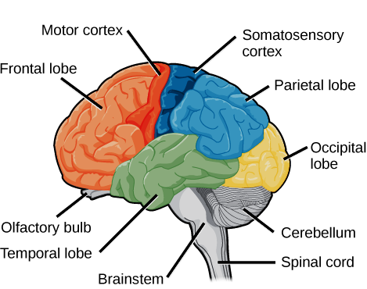

Slide 4
- The cerebral cortex surface is greatly increased by presence of sulci and fissures.
-The cerebral cortex is formed of 2 cerebral hemispheres which are separated by the longitudinal fissure .
-In the floor this fissure lies the "Corpus callosum" which connects the two cerebral hemispheres.
The cerebral cortex consists of 4 lobes : frontal, parietal, temporal and occipital. And according to physiological studies, Brodman divided cerebral cortex into 50 different areas numbered from 1-50 Brodman's area .
[I] The frontal lobe: Contain: -area 4 - area 6 - area 8
(1) Motor area 4:
-It is the primary motor area.
-It occupies the precentral gyrus of the frontal lobe anterior to the central sulcus.
-It is highly excitable due to the presence of large pyramidal cells (Betz cells).
*Representation of the body: The body is represented in an upside down ( head is below while lower limbs are up ), however the head is in the correct position i.e eye brows are up and chin is down and crossed manner (Lt. area control Rt. side of the body), and the representation depends on the activity of the muscle not depend on size of muscle.

Slide 5
* Layers of area 4: The cells are arranged in 6 vertical columns.
- Functions:
1-It is the main origin of the pyramidal tracts. 2- Initiate the fine discrete voluntary movements.
3-Facilitates stretch reflex and muscle tone.
* lesion of area 4:
1- Paralysis of the muscles of the opposite half of the body . 2- Hypotonia and hyporeflexia ,
3- Appearance of Babinisk's sign .
N.B.: 1-Area 4 shares in the extrapyramidal tract , So activation of area 4 after pyramidal tract lesion give response.
2-Muscles of the body which act together as respiratory muscles are bilaterally represented in area 4 of both sides.
3-In area 4 there is representation of the movement rather than representation of isolated muscles .i.e. stimulation of certain site of area 4 causes contraction of whole flexors or extensors rather than contraction of certain muscle.
4-Excitability of area 4 is increased by increased activity of other areas as sensory, visual or auditory area also by alkalosis.
5-Excitability of area 4 decreased by acidosis, hypoxia or by suppressor areas (4s,8s).

Slide 6
(2) Premotor area 6:
• It lies in front of area 4 (separated by area 4s). It is less excitable as it contains no Betz cells.
* Representation:
The body is represented in an inverted and crossed manner but is more rough than in area 4.
* Functions:
1-It is the main origin of extrapyramidal tracts but some origin of pyramidal.
2-It initiates generalized coordinated gross movements on the opposite side of the body.
3-It initiates subconscious associated movement as swinging of arm during walking.
4-It helps areas 4 in performing and initiating isolated skilled voluntary movements.
5-It inhibits muscle tone & stretch reflex. 6-It inhibits the grasp reflex.
7-It produces autonomic function on HR & ABP.
8- It contains important areas:
a- Broca’s area: (word formation areas)(area 44) it lies immediately anterior to area 4 and above the sylvian fissure in the dominant hemisphere, it is connected to area 4 to control movement of speech muscle.
b- Eye movement area: Lies above the Broca’s area, it is concerned with voluntary moving of the eye towards objects, also control eyelid movements.
c- Head rotation area: Lies above eye movement area, it is concerned with directing the head towards different objects.

Slide 7
d- Hand skilled area: Lies anterior to area 4 (region of hand & finer). The memory for voluntary skilled movements of the hand is retained in this area.
e- Exner’s area 45 (writing center): Lies above Broca’s area, it control the movements of arm muscle during writing via connection with area 4.
* Lesion of area 6:
1-Paresis (sever muscle weakness) in opposite side. 2-Increase muscle tone and exaggerated deep reflexes.
3-Reappearance of Babniski’s sign (fanning of 4 toes).
4-Motor apraxia: loss of ability to perform skilled educated movement due to damage of hand skilled area.
5-Motor aphasia: the person cannot express himself by spoken words due to damage of Broca’s area.
6-Loss of co-ordinated movement of eye and head due to lesion in eye movement and head movement areas.
7-Motor agraphia: the person cannot express himself by written words = damage of Exner’s area 45.
8-Autonomic disturbances. 9-Reappearance of Grasp reflex
(3) Area 8 (frontal eye field)
-It occupies the posterior part of the middle frontal gyrus.
- It is responsible for conjugate deviation of both eyes in the opposite side and share in accommodation reflex to near vision . - It is the origin of the cortico-nulcear tract.

Slide 8
[II] The parietal lobe:
Contains: -Sensory area 3, 1, 2 (area I). -Sensory area II -Sensory association area.
[A] Primary somatic area:
(1) Somatic sensory area I: In the post central gyrus of cerebral cortex (area 3, 1, 2).
*Representation of the body: The body is represented in an upside down and crossed manner and large area for lips, face and fingers especially thumb. according to tactile acuity and number of receptors All sensations from any part of the body are represented in its area.
* Functions:
It receives impulses from PVNT so act a centre for fine touch, proprioceptive sensation, vibration, fine gradations of temp.
* lesion: At first loss of all sensations in opposite side, then the protopathic sensations only are recovered.
(2) Somatic sensory area II: In upper wall of lateral fissure inferior to postcentral gyrus.
Representation: of the body is less sharp than area I and face lies anteriorly, arm centrally while legs posteriorly.
Functions: - A cortical centre of pain.
- Play a role in sensory control of motor function.
It receives impulses from both sides of the body, from sensory area I and from visual and auditory area.

Slide 9
[B] Somatic association area: (area 5 & 7): In parietal cortex behind sensory area I.
Function: receive impulses from sensory area I, PVNT and visual & auditory cortex. So it is concerned with the meaning of sensory information (stereognosis). Lesion: causes Asteriognosis: failure to recognize any object.
[III] The temporal lobe:
contains: -Auditory sensory area (area 41 & 42) (concerned with hearing sensation from both sides).
-Auditory psychic area (area 22) (concerned with interpretation of auditory impulses).
[IV] The occipital lobe: contains: -Visual sensory area (area 17) , which is the primary visual centre)
- Visual association area (area 18 & 19) , which is concerned with interpretation of visual impulses)
•The parieto-temporo-occipital association area: (Wernike’s area or area 37)
-It is concerned with interpretation of different sensations and present in the supra-marginal and angular gyri.
-It receives impulses from: • somatic association areas (area 5,7) parietal
• visual interpretative areas (area 18, 19) occipital. • auditory interpretative areas (area 22) temporal.
-This area is more developed in one hemisphere (dominant hemisphere) (left side in right handed people) and concerned with speech.
- Lesion leads to failure to pick up meaning of spoken & written words with aphasia.

Slide 10
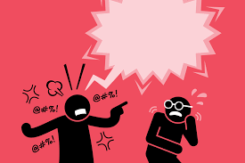
Speech
-It represents the highest function of cerebral cortex. -It may be in the form of written or spoken words.
*Centres of speech: (in the dominant hemisphere)
(1) Sensory speech centres:
a-Visual speech centres (area 18, 19) in occipital lobe to understand written words.
b-Auditory speech centres (area 22) in temporal lobe to understand spoken words.
(2) General interpretative area (Wernik’s area)
-Responsible for understanding the meanings and beginning the response to these words.
-It is a connection between sensory and motor centres.
(3) Motor speech centers:
a-Broca’s area: (face region ion premotor area 6) essential for vocalization of speech.
b-Exner’s area: (Hand region in premotor area 6) essential for expression of speech by writing.

Slide 11
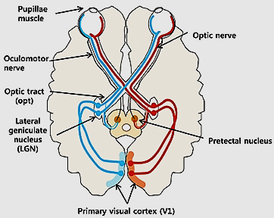
*Act of speech:
(1) Spoken speech:
Autitory sensory areas (areas 41 & 42) perceive the spoken words → auditory association areas (area 22) to understand words → general interpretative area (Wernicke's area) to understand the meaning and begin response by → impulse to Broca’s area to produce words → face area in area 4 → pyrmaidal tract to cranial nerve nuclei → to speech ms. (muscles of lips, tongue and larynx) → spoken speech.
37

Slide 12
(2) Written speech:
Visual sensory area (area17) perceive written words → visual association areas (18, 19) to understand → general interpretative area (Wernicke's area) to full comperhension → Exner’s area → hand area in motor cortex → pyramidal & extrapyramidal tracts to AHCs of hand ms. → expression of speech by writing.
* Aphasia = disturbance of speech:
It is the inability to express thoughts by spoken or written words due to vascular lesion in the dominant hemisphere.
(1) Sensory Aphasia:
(a) Visual aphasia: (word blindness)
- The patient sees but can’t understand written words.
- Due to lesion in visual speech centres (18, 19).

Slide 13
(b) Auditory aphasia: (word deafness)
-The patient hears but can’t understand spoken words. - Due to lesion in auditory speech centres (22)
(c) General sensory aphasia: (more common)
- The patient fails to understand and interpret the meaning of words and fails to express his thoughts into words.
- Due to lesion in general interpretative area.
(2) Motor aphasia:
(a) Broca’s aphasia: (Verbal or vocal)
-The patient understands spoken or written words and knows what he wants to say but he can’t express himself by spoken words.
-Due to lesion in Broca’s area (area 44) (speech ms. are intact).
(b) Agraphia:
-The patient understands spoken or written words and knows what he wants to write but he can’t express himself by written words.
-Due to lesion in Exner’s area (area 45) (Hand ms. are inatct).
(3) Global aphasia: -This is combination of sensory & motor aphasias due to excessive cerebral lesions.

Slide 14
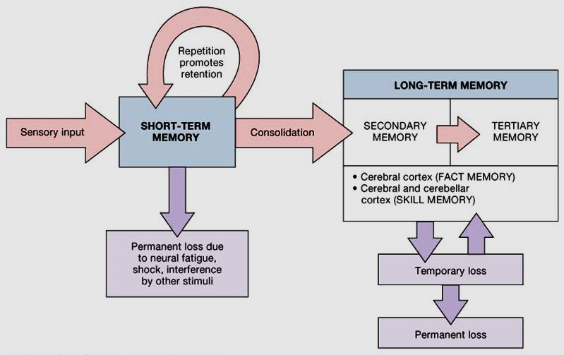
Memory
•Memory can be defined as positive recollections of the previous thoughts or educated information due to proper stimulation.
•Negative memory: by the basal limbic region which determine the information is important or no, the brain ignore many informations and remember one memory only at certain moment.
•Memory can be classified into:
(1) Immediate memory:
-Such as remember telephone number for few seconds .
-The mechanism is reverberating circuit or presynpatic facilitation (prolonged Ca⁺⁺ channel openning).

Slide 15
2) Short-term memory:
-Which lasts for few minutes up to days due to temporary changes in either presynaptic or postsynaptic membranes of certain neurons.
The process includes:
1) Stimulation of the facilitator neurons cause release of serotonin.
2) Serotonin activates a receptors in the sensory terminals causing activation of adenyle cyclase enzyme which leads to formation of cyclic AMP.
3) Cyclic A.M.P activates protein kinase in cell membrane causes phosphorylation of some proteins in cell membrane which leads to blockage of potassium channels in cell membrane .
4) Blockage of K⁺ channels leads to prolongation of action potential in pre-synaptic terminal with subsequent prolonged activation of Ca⁺⁺ pores leads to maintained Ca⁺⁺ influx with more and maintained release of chemical transmitter on postsynaptic neurons.
(3) Long-term memory:
Actually is due to actual structural changes at the synapses,
1) Permanent adhesion of synaptic vesicles to the pre-synaptic membrane .
2) Marked increase in surface area of pre-synaptic membrane which across it release of transmitter occur
3) Increase in enzymes and in protein synthesis which activate processes of transmitter formation and release.

Slide 17
Thank You

