Slide 1
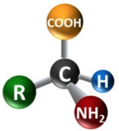
Amino Acids 2
Dr. Nesrin Mwafi
Biochemistry & Molecular Biology Department
Faculty of Medicine, Mutah University

Slide 2
Nutritional Classification
Standard amino acids are divided into three types according to the classification based on nutrition and body requirement:
Essential amino acids
Non-essential amino acids
Conditionally essential amino acids

Slide 3
Essential Amino Acids
Cannot be produced by the body
Must be supplied through diet
8 amino acids: valine, isoleucine, leucine, lysine, methionine, phenylalanine, threonine and tryptophan

Slide 4
Non-essential Amino Acids
Can be synthesized by the body
9 amino acids: Glycine, alanine, serine, cysteine, aspartic acid, glutamic acid, asparagine, glutamine and proline

Slide 5
Conditionally Essential Amino Acids
Synthesized in the body in insufficient amounts so should be supplied in diet (requirements are higher than production rate)
Essential only in certain cases: children, pregnant and lactating women. Also in certain genetic diseases.
3 amino acids : Histidine, arginine and tyrosine. For example, arginine and histidine are growth promoting factors and during growth are not synthesized in sufficient amounts so essential in growing children, pregnancy and lactation.

Slide 6
Conditionally Essential Amino Acids
On the other hand, tyrosine is produced from phenylalanine (essential amino acid), so if the diet is deficient in phenylalanine or if an individual is deficient in an enzyme required to convert phenylalanine to tyrosine (the inherited disease / inborn error of metabolism called phenylketonuria PKU), tyrosine will be required as well.

Slide 7
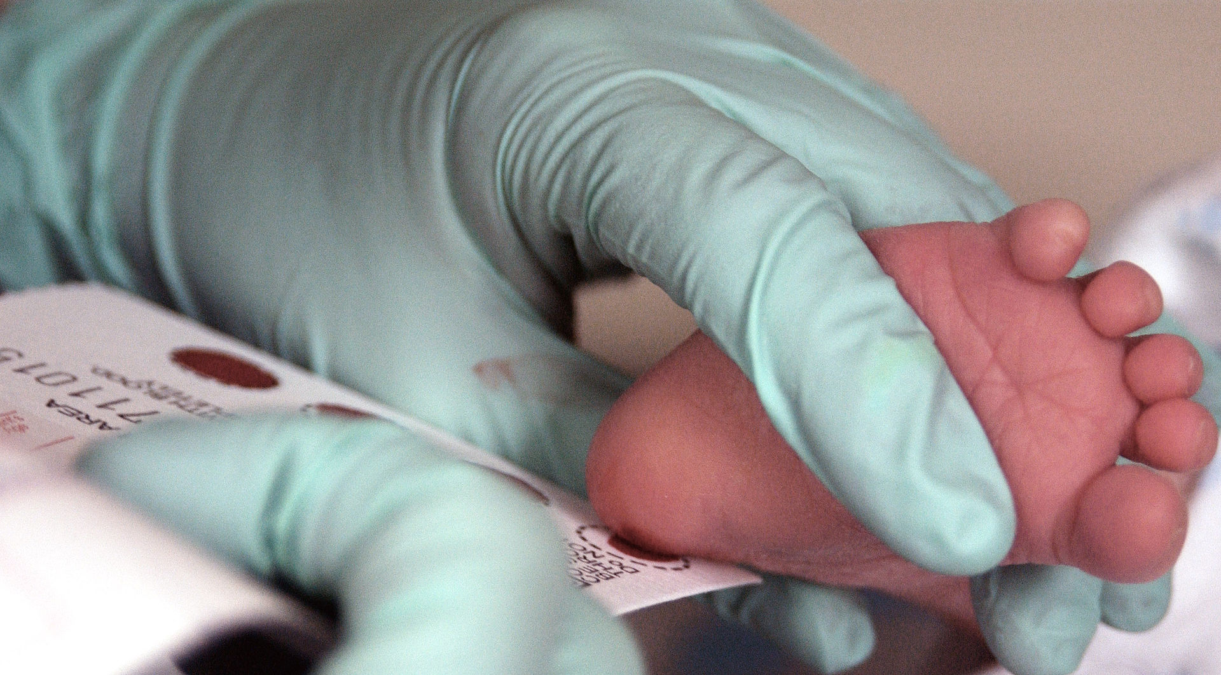
Phenylketonuria
The accumulated phenylalanine is toxic to brain and can lead to intellectual disability and mental disorders.
PKU is an autosomal recessive disease
Newborn screening program

Slide 8
Amino Acid Derivatives
The non-standard/ non-proteinogenic amino acids are either not found in proteins (e.g. carnitine and GABA) or have protein role but added to polypeptide chain during post translational modification process (e.g. hydroxyproline)
Non-standard amino acids that are found in proteins are formed by post-translational modification. These modifications are often essential for the function or regulation of a protein:
The carboxylation of glutamate occurring in proteins involved in blood-clotting cascade allows for better binding of calcium cations

Slide 9
Amino Acid Derivatives
The hydroxylation of proline in collagen protein is critical for maintaining connective tissues

Slide 10
Non-protein Functions
Some non-standard amino acids are not found in proteins. Examples include the neurotransmitter gamma-aminobutyric acid (GABA)
Many amino acids are used to synthesize other molecules called amino acid derivatives, for examples:
Tryptophan is a precursor of the neurotransmitter
serotonin
Tyrosine is a precursor of the thyroxin (thyroid hormone) and the catecholamine neurotransmitters like dopamine, adrenaline and noradrenaline
The local mediator histamine which is released during allergy is derived from the decarboxylation of histidine

Slide 11
Non-protein Functions
γ-aminobutyric acid (GABA) is the major inhibitory NT in brain. It is nonstandard amino acid derived from glutamate.

Slide 12
Non-proteinogenic Non-standard
Generally, nonproteinogenic nonstandard amino acids are derivatives of standard amino acids:
Post translational modification process
Other enzymatic reactions
Nonproteinogenic nonstandard amino acids may have protein role or nonprotein role (they are active by themselves and have a function

Slide 13
Proteinogenic Non-standard
Proteinogenic nonstandard amino acids are also derivatives of standard amino acids

Slide 14
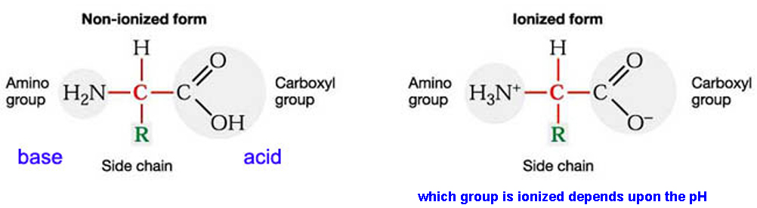
Amphoteric property of Amino Acids
Amino acids are amphoteric molecules (ampholytes) having both acidic (-COOH) and basic (-NH₂) groups
α-amino acids are ionized in aqueous solutions with the ionization state is dependent on the pH value

Slide 15
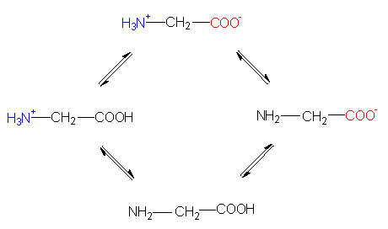
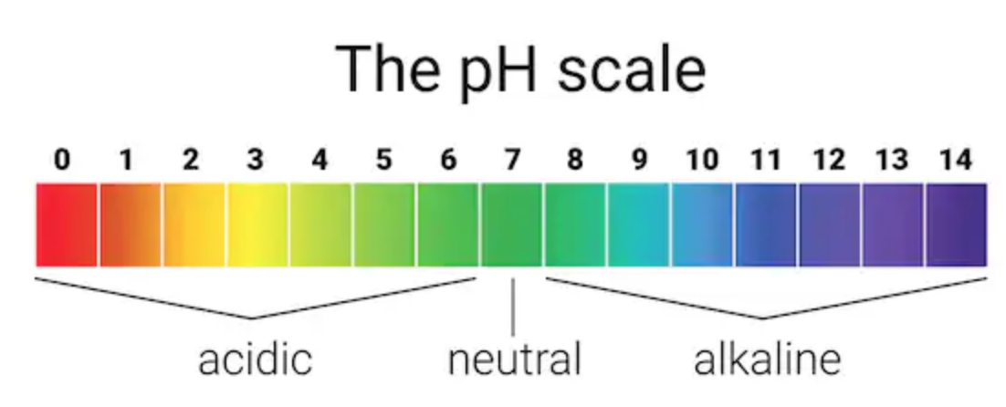
Ionization of Amino Acids
At very low pH values, these groups are fully protonated and at very high pH values, these groups are deprotonated. At intermediate pH, both are ionized
Intermediate pH
Net charge= 0
Neutral/Zwitterion
Low pH
High pH
Net charge= +1
Cation
Net charge= -1
Anion
State of glycine ionization in an acidic and an alkaline solution

Slide 16
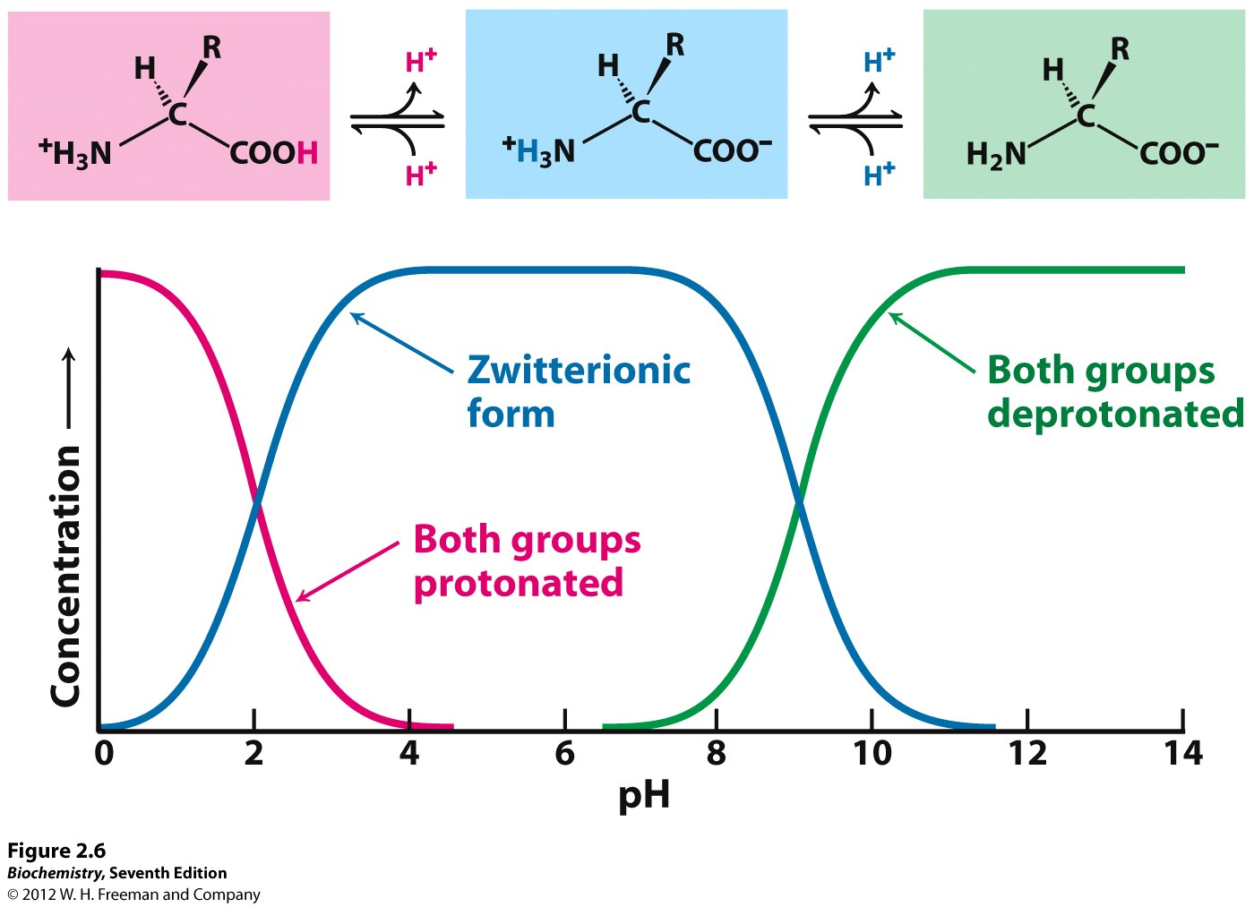
Amino Acids as Zwitterions
Zwitterions (dipolar molecules) have charged —NH₃⁺ and COO⁻ groups (both groups are ionized). Zwitterion is neutral as it carries + and - charges
Cationic
Neutral
Anionic
pK₁
pK₂
Net charge= +1
Net charge= 0
Net charge= -1

Slide 17
Isoelectric Point (pI)
Isoelectric point is the pH at which a particular molecule carries no net electrical charge (overall charge = zero)
At pI, zwitterion is the dominant form of the amino acids
pI = average of pK’s = ½ (pK₁ + pK₂)
Note: pK = -log [K] where K is the dissociation constant of a
weak acid or base
pK is the pH value at which half of the acid is dissociated

Slide 18
Isoelectric Point (pI)
For example, the simplest amino acid glycine has pK₁ = 2.34 and pK₂ = 9.6
pI = ½ (pK₁ + pK₂)
= ½ (2.34 + 9.6)
= 5.97

Slide 19
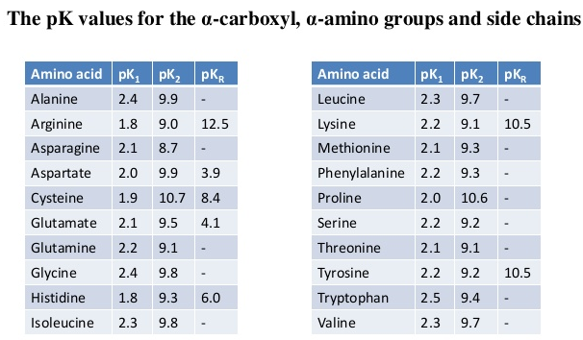
pKa values of Amino Acids

