Slide 1
SALIVARY GLAND
DISORDERS
Dr. Tariq Khaled Aladwan, MD.
Consultant General, Laparoscopic and
Oncoplastic Breast Surgery .
Faculty of Medicine, Mutah University.

Slide 2
OBJECTIVES
Introduction.
Anatomy.
Disorders of glands.
Clinical approach.
Surgical aspect.

Slide 3
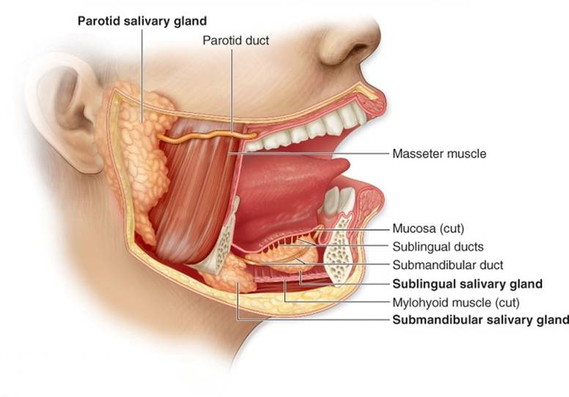
INTRODUCTION
Salivary glands:
are composed of 4 major glands, in addition to minor
glands.
Major:
2 parotid glands.
2submand-ibular gland
Minor:
Sublingual.
Multiple minor glands

Slide 4
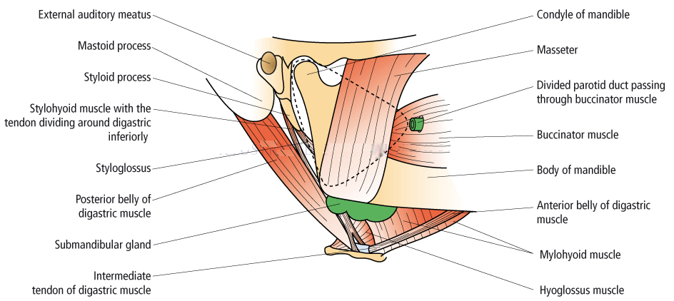
ANATOMY
1. PAROTID GLAND

Slide 5
Important structure that run through the parotid gland:
Branches of facial nerve.
Terminal branch of external carotid artery that divided into maxillary & superficial temporal artery.
The retromandibular vein ( post. Facial ).
Intraparotid lymph node.

Slide 6
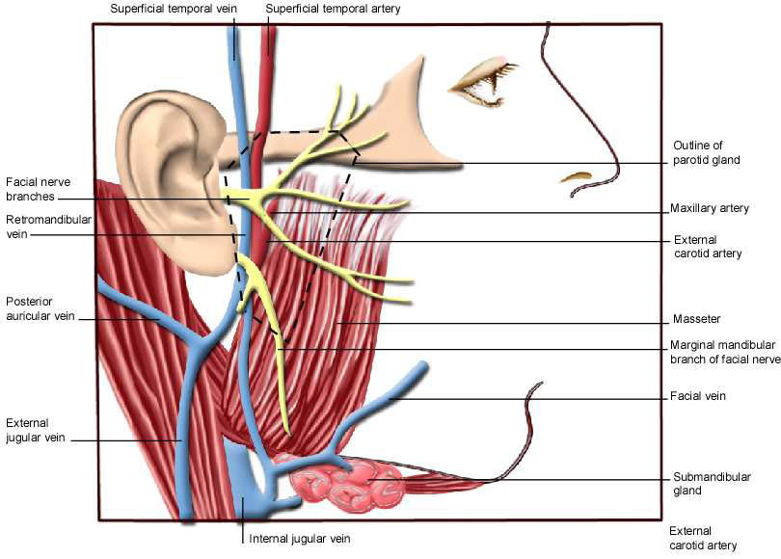

Slide 7
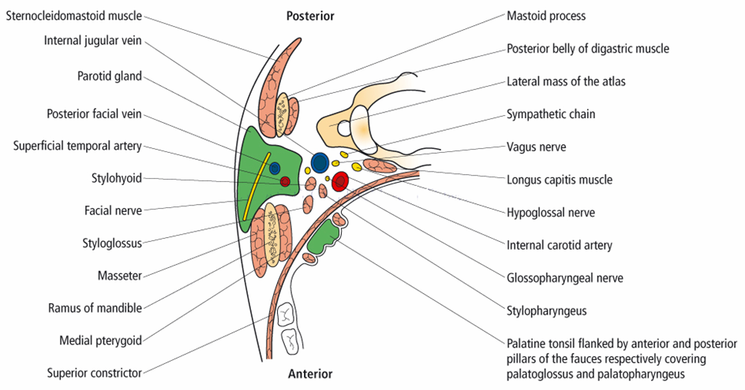

Slide 8
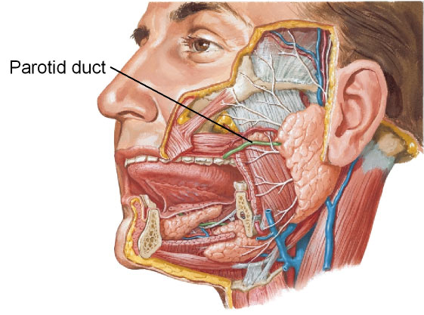
THE PAROTID DUCT:
Stensen’s duct is 5 cm long.
open opposite the second upper molar tooth

Slide 9
2. SUBMANDIBULAR GLAND
It’s paired of gland that lie below the mandible on either side.
Has 2 lobes, superficial & deep.
Warthon’s duct, drained submandibular gland that opens into anterior floor of mouth.
Anatomical relationship:
Lingual nerve.
Hypoglossal nerve.
Anterior facial vein.
Facial artery.
Marginal mandibular branch of facial nerve.

Slide 10
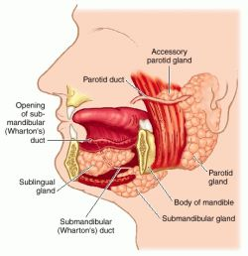

Slide 11
3. SUBLINGUAL GLAND
Lie on the superior surface of the mylohyoid muscle and are separated from the oral cavity by a thin layer of mucosa.
The ducts of the sublingual glands are called Bartholin’s ducts.

Slide 13
4. MINOR SALIVARY GLAND
About 450 lie under the mucosa
They are distirbuted in the mucosa of the lips, cheeks, palate, floor of mouth & retromolar area
Also appear in oropharyanx, larynx & trachea

Slide 14
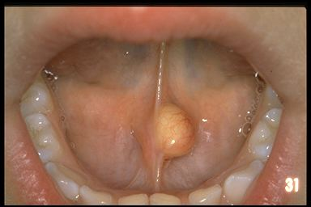
DISORDERS OF MINOR & SUBLINGUAL
SALIVARY GLAND
CYST
It’s either:
Extravasation cyst result from trauma to overlying mucosa.
Mucous retention cyst in the floor of the mouth due to obstruction.
RANULA extravasation cyst that arises from sublingual gland.

Slide 15
PLUNGING RANULA
It is rare form of mucus retention cyst arise from both sublingual & submandibular.
The mucus collects around the gland &penetrates the mylohyoid diaphragm to enter the neck.
Pt. presents with
Dumbbell shaped swelling , soft, fluctuant & painless

Slide 16
TUMORS
Tumors of minor & sublingual salivary gland are extremely rare.
90% are malignant.
Most common site: upper lip, palate & retromolar region.

Slide 17
Submandibular gland

Slide 18
* inflammatory diseases of the submandibular gland:
sialadenitis
Acute on chronic
chronic
Acute

Slide 19
Acute infections:
viral
mumps
Othe viral infections are extremly rare
bacterial
Most commonly due to obstruction…
Treatment: antibiotics and surgically

Slide 20
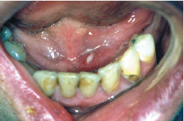
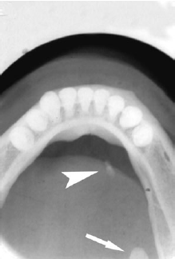
* trauma and obstruction:
Most common cause is sialolithiasis which 80% happens in the submandibular gland…
Presentation: painful swelling in submandibular area
What would aggreveate it?
Clinical findings: tender, pus draining
investigations : x-ray
Treatment: surgical

Slide 21
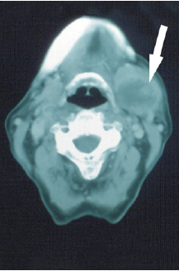
* tumors
They are very rare in this gland and 50% are benign…
Presentation
Investigations: CT and MRI…
Never do open biopsy but do FNA..
Treatment is surgical…

Slide 22
Parotid gland:

Slide 23
1-developmental
They extremly rare like agenesis, , duct atresia and congenital fistula formation…

Slide 24
2-inflammatory disorders
A- viral infections:
Mumps…
Mode of infection
Presentation
Diagnosis
Treatment is conservative
Complications: Orchitis, oophoritis, pancreatitis, sensorineural deafness, nemimgoencephalitis but they are rare…

Slide 25
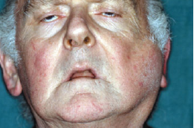
2- inflammatory disorders (cont.)
B- bacterial:
Precipitating factors??!
Causative organisms
Presentation
Treatment :conservative and it might need drainage…

Slide 26
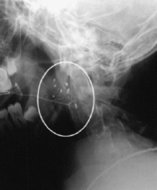
Recurrent parotitis of childhood:
This occurs in 3-6 years of age and the symptoms last for 3-7 days accompanied with fever and malaise…
Diagnosis is made by HX and sialography showing a characteristic snowstorm appearance…
Treatment: -antibiotics
-prophylactic antibiotics
-parotidectomy..

Slide 27
2- inflammatory disorders (cont)
C- chronic parotitis (HIV)?
It is pathognomonic for HIV…
Presentation : very similar to sjogran’s syndrome…
Differentiated by negative autoantibody…
On investigation : CT and MRI show characteristic swiss cheese appearance of the cysts…

Slide 28
treatment: Surgery to improve the appearance although it’s painless

Slide 29
3-Obstructive parotitis:
A- papillary obstruction:
It less common than in submandibular gland…
Most commonly due to trauma
Presentation
Treatment is papillotomy…

Slide 30
B- stone formation:
As mentioned before it is 80% in submandibular but only 20 % in parotid
Investigations:
position…
Treatment is surgical…

Slide 31
4- tumors:
The parotids are the commonest glands for tumors of salivary glands…

Slide 32
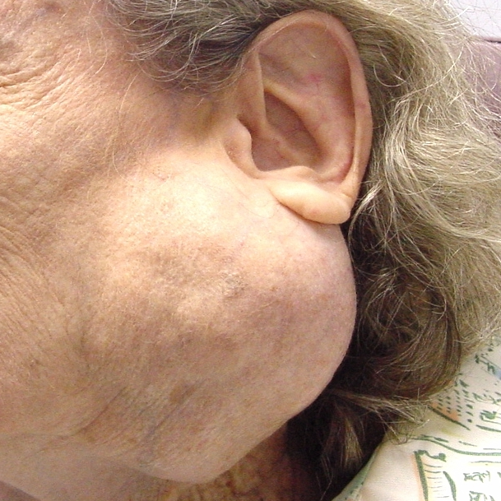
Slowly painless growing temor below the ear, or infront of it

Slide 33
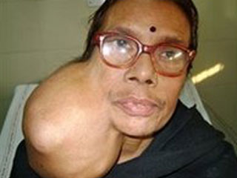
Sometimes on the upper aspect of the neck:

Slide 34
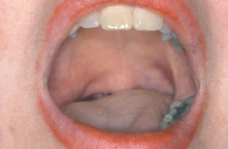
4-TUMORS (CONT)
If it arised from the accessory lobe it will look like a presistant cheek swelling…
If it arises from the deep lobe it will present as parapharyngeal mass…
Symptoms:
Difficult swallowing
Snoring
Clinical examination…

Slide 35
classification

Slide 36
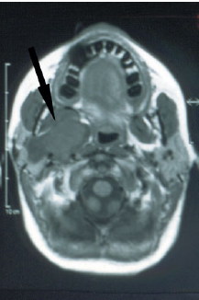
4-TUMORS (CONT)
Investigations:
CT AND MRI
FNA
OPEN BIOPSY IS CONTRAINDICATED…
TREATMENT:
SURGICAL…

Slide 37
OTHER RARE DISESASES:
1-granulomatous sialadenitis:
Mycobacterial infection:
Sarcoidosis
Cat scratch disease
Toxoplasmosis
Syphilis
Deep mycosis
Wgner’s granulomatosis
Allergic sialdenitis due to radiotherapy of the head and neck…

Slide 38
2- tumor like diseases:
They are a group of diseases that are hard to diagnose and are not under any group of the other diseases:
Sialadenosis
Adenomatoid hyperplasia
Multifocal adenomporphic adenomatosis

Slide 39
3- degenerative diseases:
Sjogran’s syndrome…:
Benign lymphoepithilial lesions
Xerostomia
Sialorrhea

Slide 40
A- sjogran’s syndrome:
It is an autoimmune condition causing progressive destruction of the salivary glands and the lacrimal glands…..
Presentation is xerostomia and keratoconjunctivitis…
They also present with pain and asendng infection
.females more than males 10:1
Parotis is more common

Slide 41
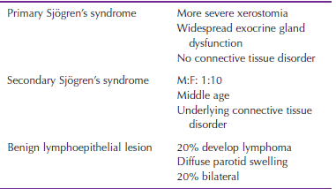

Slide 42
(Cont)
The charachtaristic feature is progressive lymphocytic infiltration acinar cell destruction and prolifration of duct epithilium…
Diagnosis based on history…
Treatment remains symptomatic:
Artificial tears…
Salivary substitiuants or water…
Floride to avoid dental carries…
Complications are B cell lymphoma

Slide 43
B-Xerostomia:
Normal salivary flow decreases with age…
Mostly in woman postmenopausal complaining of burning tongue of mouth..
Causes: -chronic anxiety and depression..
-dehydration…
-anticholinergic drugs…
-sjogran’s syndrome…
-radiotherapy of the neck and head

Slide 44
C-sialorrhea:
Causes: some infections and drugs…
Drooling:
In children that are mental handicap
Also in cerebral palsy
Management is surgical…
Bilateral submandibular duct repositioning and sublingual duct excision…
Bilateral submandibualr gland excision…
Bilateral submandibualr gland excision and repositioning of the parotis duct…

Slide 45
How to approach the patient clininally
History.
Clinical examination.
Investigation.

Slide 46
HISTORY
History of swellings / change over time?
Trismus?
Pain?
Variation with meals?
Bilateral?
Dry mouth? Dry eyes?
Recent exposure to sick contacts (mumps)?
Radiation history?
Current medications?

Slide 47
CLINCAL EX.
INSPECTION:
Asymmetry (glands, face, neck)
Diffuse or focal enlargement
Erythema extra-orally
Trismus
Medial displacement of structures intraorally?
Cranial nerve testing ( Facial , Hypoglossal nerve)

Slide 48
CLINCAL EX.
PALPATION:
Palpate for cervical lymphadenopathy
Bimanual palpation of floor of mouth in a posterior to anterior direction
Have patient close mouth slightly & relax oral musculature to aid in detection
Examine for duct purulence
Bimanual palpation of the gland (firm or spongy/elastic).

Slide 49
INVESTIGATION
Plain occlusal film.
CT Scan.
Ultrasound.
Sialography.
Radionuclide Studies.
Diagnostic Sialendoscopy²

Slide 50
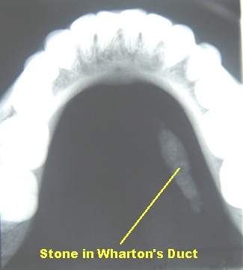
1.PLAIN OCCLUSAL FILM
Effective for intraductal stones, while….
intraglandular, radiolucent or
small stones may be missed.

Slide 51
2.CT-Scan
Large stones or small CT slices done.
Also used for inflammatory disorders
3. ULTRASOUND
Operator dependent, can detect small stones
(>2mm), inexpensive, non-invasive

Slide 52
4. SIALAOGRAPHY
Consists of opacification of the ducts by a retrograde injection of a water-soluble dye.
Provides image of stones and duct morphological structure
May be therapeutic, but success of therapeutic sialography never documented

Slide 53
4. SIALAOGRAPHY, cont
Disadvantages:
Irradiation dose
Pain with procedure
Perforation
Infection dye reaction
Push stone further
Contraindicated in active infection.

Slide 54
5. RADIONUCLIDE STUDY
is useful preoperatively to determine if gland
is functional.

Slide 55
6.SIALENDOSCOPY
Allows complete exploration of the ductal system, direct visualization of duct pathology
Success rate of >95%²
Disadvantage: technically challenging, trauma could result in stenosis, perforation

Slide 56
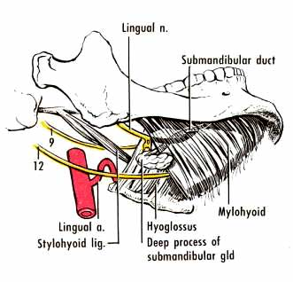
Surgical approaches to salivary glands:
A-stone removal:
-submandibular gland

Slide 57
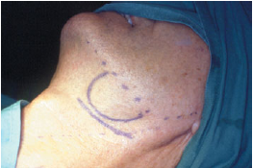
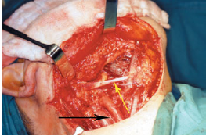
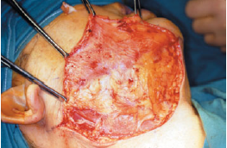
B- tumor excision: 1-submandibular gland
-intracapsular dissection -extracapsular dissection…(suprehyoid neck dissection)

Slide 58
So what are the indications of removal of the submandibular gland???

Slide 59
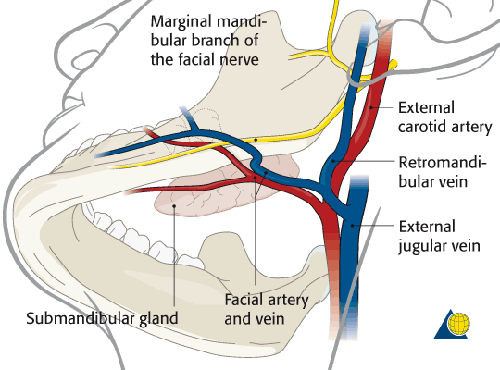
Structures to be preserved:
Facial nerve marginal branch
Platysma muscle fibers…
Facial artery
Hypoglossal nerve…
Lingual nerve
Anterior facial vein should be ligated

Slide 60
Complications of the surgery:
Hematoma
wound infection
marginal mandibular nerve injury
lingual nerve injusry
hypoglossal nerve injury
transection of the nerve to the myelohyoid muscle causing submental skin anesthesia…

Slide 61
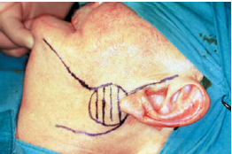
B-parotid gland:
Superficial parotidectomy:
If the tumor lies in the superficial lobe a superficial peotidectomy should be performed with preserving the facial nerve…
It is the commonest procedure…

Slide 62
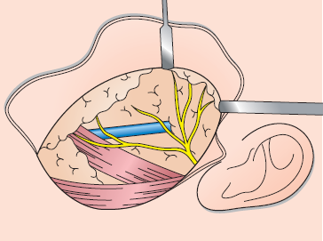
The facial nerve trunk
1-the inferior portion of the cartilaginous canal called conley’s pointer the facial nerve lies 1 cm deep and inferior to it’s tip
2-the upper border of the posterior belly of the digastric muscle…
The facial nerve is superior to it…
A nerve stimulator might come in handy…

Slide 63
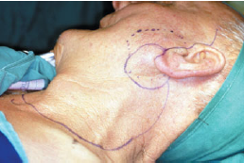
Radical protidectomy:
Whole gland is remover
Facial nerve is transected
Masseter muscle removed
Neck dissection

Slide 64
Complications:
Hematoma
Infection
Temporary facial nerve weakness.
Transection of the facial nerve and permenant facial weakness..
Sialocele…
Facial numbness.
Permenant numbness of the ear lobe due to transection of the great auricular nerve…
Frey’s syndrome

Slide 65
Frey’s syndrome:
Cause…
Prevention…
Treatment is incidence…
Antiperspirants like ALCL
Denervation by tympanic neurectomy
Injection of botulinum toxin to the skin area

Slide 66
refrences
Baily and love’s
Schwart’s
Browse
Manual of clinical syrgery…

