Slide 1
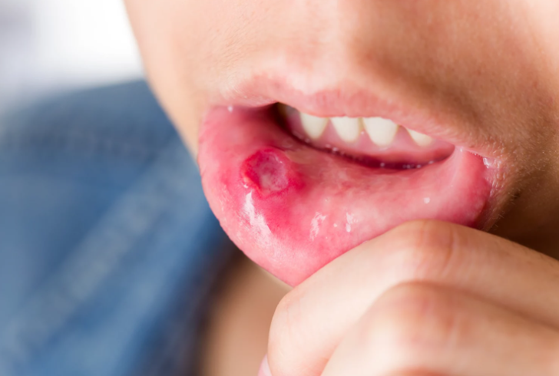
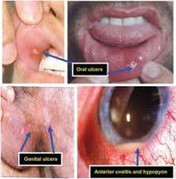
behcet’s syndrom
Prepared by :
Raneeem Swalgah Bara’ah Tarwaneh

Slide 2
Behcet syndrome
Its auto inflammatory and auto immune disorder
is rare and poorly understood condition that result in inflammation of blood vessels
A systemic vasculitis that is characterized by the deposition of immune complexes in arteries and veins of all sizes
Chronic
Relapsing _remitting
Occlusive vasculitis affecting multiple organ systems

Slide 3
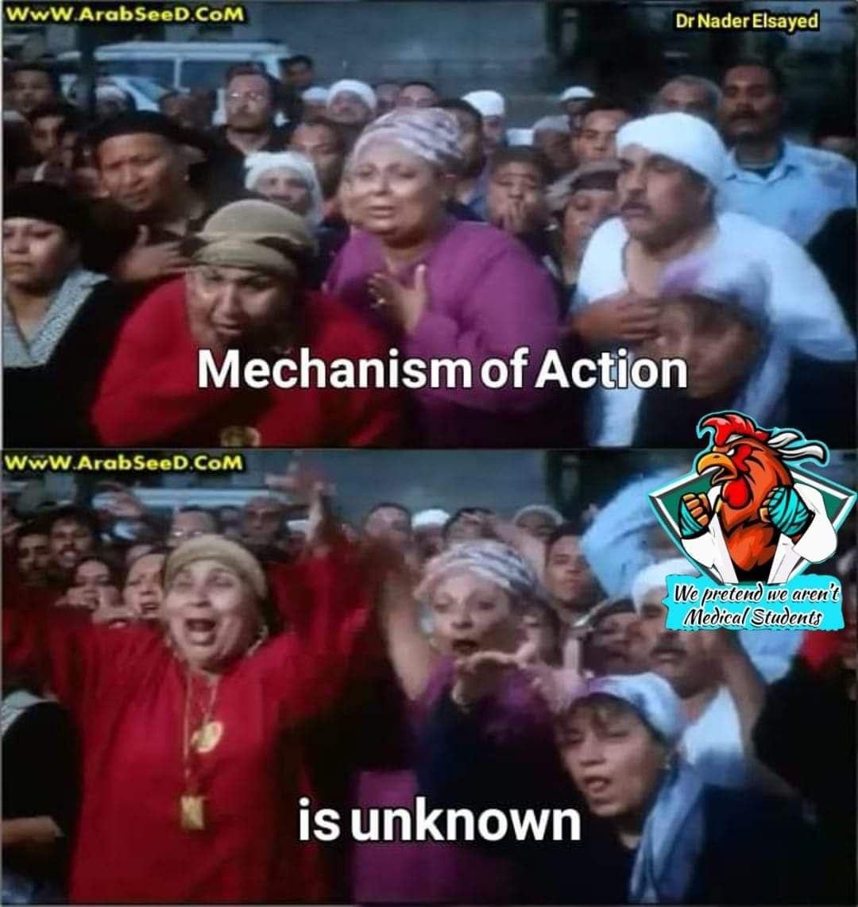
Epidemiology
Most common from the Mediterranean region to eastern Asia, with the highest prevalence observed in Turkey and Japan
Peak incidence: 20–40 year
Etiology: the undrlining cause is unknown
immunogenetics ,bacterial ,viral infection may have role(hsv_1 , hepatitis virus , streptococcal infection )
Associated with HLA-B51

Slide 4
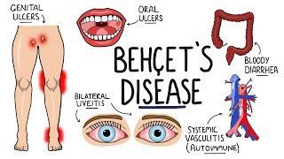
Clincal findings ;
Recurrent oral & genital ulcers, ocular lesions skin manifestations & arthritis / arthropathy most frequent clinical manifestations.
Behcet’s may occur at many sites throughout the body but the disease has a predilection for certain organs and tissues:
Mouth
Genitals
Eye
Skin
Lungs
Joints
Brain
Gastrointestinal Tract

Slide 5
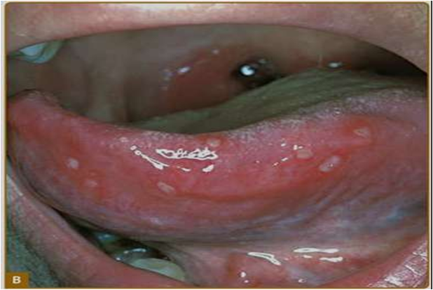
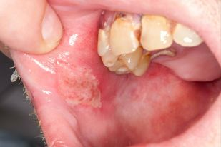
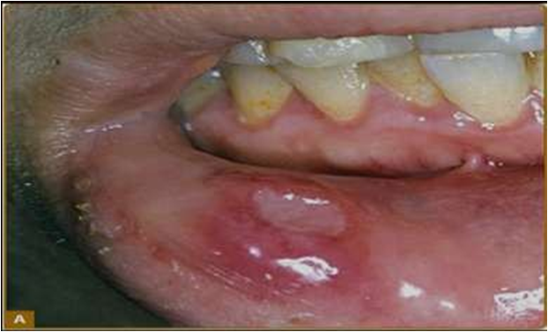
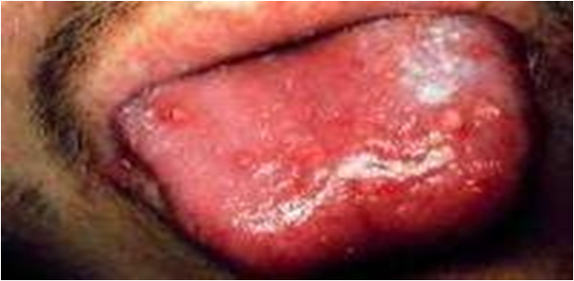
Mouth :
Aphthus users : the initial presenting symptom
painful lesions
3 types : minor , major , Herpetiform ulcer
Lesions can be shallow or deep (2-30 mm in diameter) and usually have a central, yellowish, necrotic base and a punched out, clean margin.
Appear singly or in crops, located anywhere in the oral cavity, persist for 1-2 weeks, and subside without leaving scars.
M/c sites - tongue, lips, buccal mucosa, and gingiva.
Tonsils, palate, and pharynx are less common sites.
Interval b/w recurrences ranges from weeks to months

Slide 6
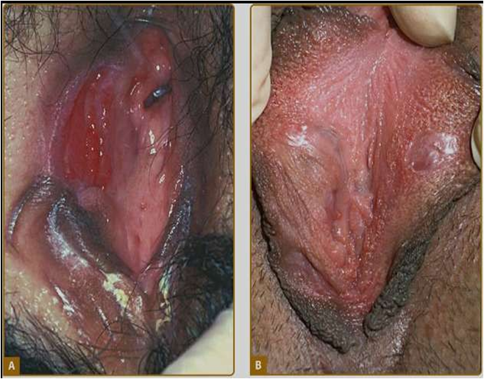
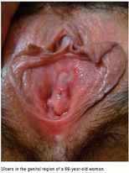
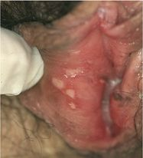
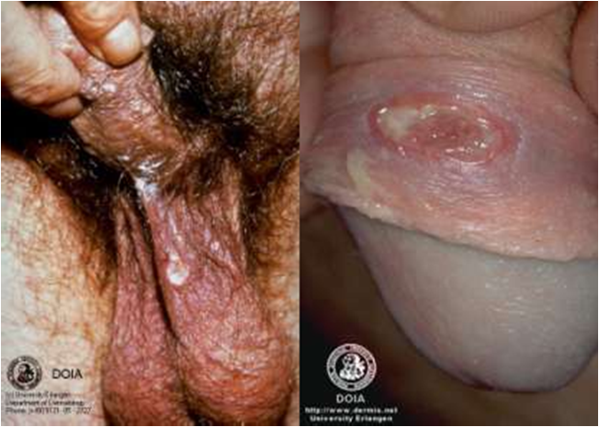
Genital manifestations:
Genital ulcers (M>F) resemble their oral ulcer but cause greater scarring.
In males, usually occur on scrotum, penis, and groin.
In females, occur on vulva, vagina, groin, and cervix
Ulcers may be found in urethral orifice and perianal area.
Epididymitis may arise in men

Slide 7
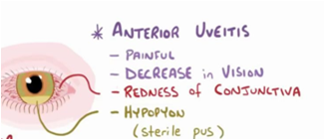
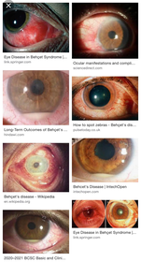
eye : Ocular manifestations
Eye : 50% of patients • More frequent/severe in males and younger patients
Uveitis :
*Typically bilateral , ant and pos uveitis
*Hypopon ( the inflammatory cells enter the ant. Chamber of the eye even no infection present )
- ***Usually occurs 2–3 years after the onset of oral and/or genital ulcer
Concerning symptoms:
Redness, pain, light sensitivity, blurred vision

Slide 8
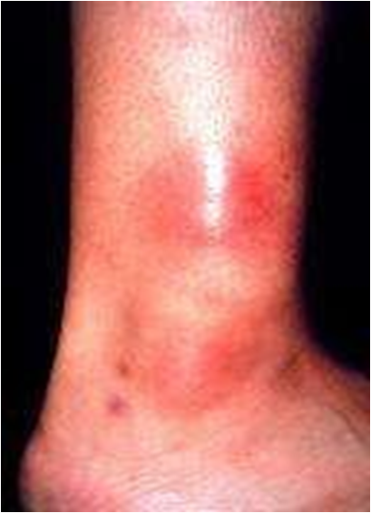
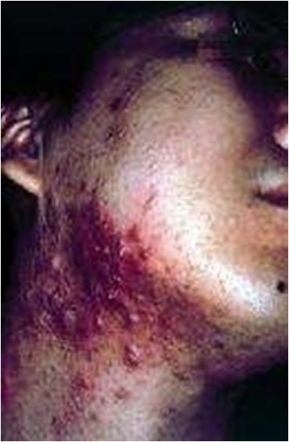
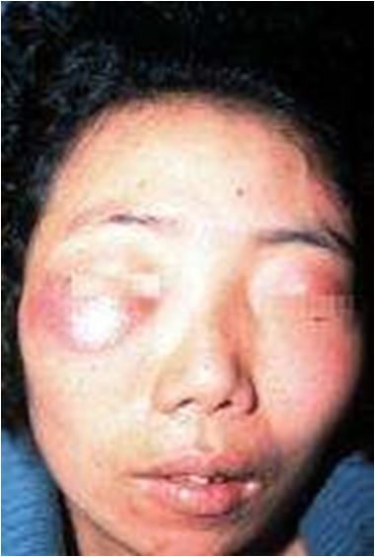
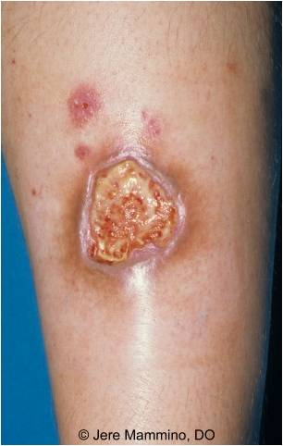
Mucocutaneous:
Skin :
Erythema nodosum–like lesions.
Papulopustular eruptions.
Sweet syndrome–like lesion.
Erythema multiforme–like lesions
Ulcers
Pyoderma gangrenosum

Slide 9
Gastrointestinal involvement
Clinical spectrum is enormously varied • Anorexia, vomiting, dyspepsia, diarrhoea, abdominal distension, abdominal pain and intestinal ulcers, occurring primarily in the ileum and colon and closely resembling Crohn disease, may occur.
Cardiac manifestations
Coronary vasculitis and thrombosis, pericarditis, myocarditis, endocarditis with granulomatous changes or fibrosis, regurgitation, and diastolic dysfunction
Lung involvement
Pulmonary vasculitis, hypertension, pleural effusions and Aneurysms
Neurologic manifestations
May present as meningoencephalitis, a multiple sclerosis–like illness, acute myelitis, stroke, or pseudotumor cerebri. Cerebral venous sinus thrombosis, Cranial nerve palsies, Brainstem lesions

Slide 10
Musculoskeletal
50% of patients
• Generally effects only 1 or few joints at a time
• Not deforming
• Most frequent joints include:
• Knees • Ankles • Wrists • Elbows
• Enthesitis (inflammation at the attachment of tendon to bone)
Arthritis (30–70%)Non-erosive, non-deforming, asymmetric mono-/oligoarthritis
Usually affects the knee, ankles, hands, and/or wrists
Vasculopathy
Superficial thrombophlibitis
Thrombosis of large veins (e.g., DVT,Budd-ciarry syndrome)
Arterial thrombosis
aneursym (e.g., pulm. Artrey anursym )

Slide 11
How is Behcet’s Disease Diagnosed
Diagnostic Criteria.
SYMPTOM - POINTS
Ocular lesions (recurrent) 2
Oral ulcers (recurrent) 2
Genital ulcers (recurrent) 2
Skin lesions (recurrent) 1
CNS symptoms 1
Vascular manifestations 1
Pathergy test (+ve) 1
Total - 10
Score>4 indicates Behcet disease

Slide 12
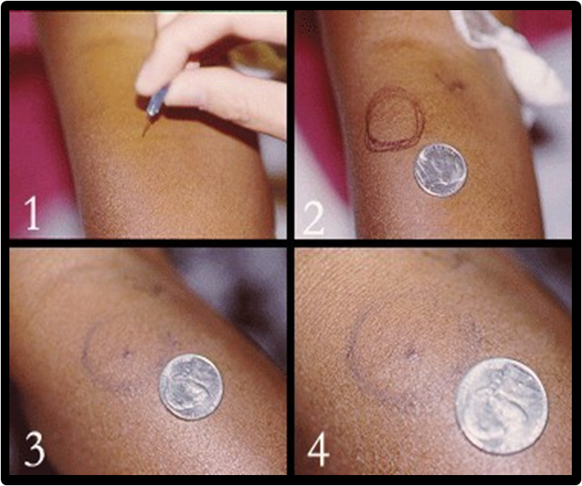
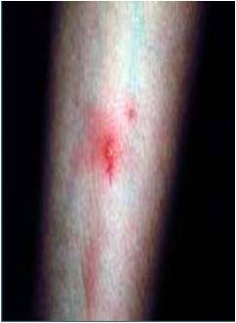
Diagnostic criteria (International Study Group criteria)
Recurrent oral ulceration at least three times within a 12-month period AND
≥ 2 of the following
Recurrent genital ulceration
Eye lesions
Skin lesions
Positive pathrgy test

Slide 13
Positive pathergy skin test: erthymatous papule or pustule 24–48 hours after a needle prick to a depth of 5 mm
Autoantibodies (e.g., ANA, ANCA,R.factor) are usually absent.
Nonspecific markers of inflammation may be present during flares (e.g., ↑ESR, ↑ CRP).

Slide 14
Pathergy skin testing
Pathergy reaction
A reactive skin response to local injury (e.g., trauma, needle puncture, surgical incision). In patients with Behçet disease, this can manifest as an erythematous papulopustular response. In patients with pyoderma gangrenosum, this can manifest as ulcerative lesions.

Slide 15
Treatment
Oral ulcers and/or genital ulcers : topical corticosteroid
Topical lidocaine for pain relief
skin lesions
Papulopustular lesions: See "Treatment“ of acne valgaris ”.
Erythema nodusm : colchicine
Arthritis: colchicine
Ocular disease, CNS disease, and/or vasculopathy
Systmic corticosteroids
Immunosuppressant therapy (e.g., azathioprine , infliximab, cyclosporine A, cyclophosphamide, IFN-α, methotrexate)

