Slide 1
Pulmonary volume and capacities
DR. Arwa Rawashdeh

Slide 2
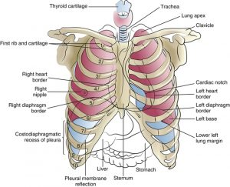
Quit normal breathing
Inspiration ( negative pressure)
Expiration ( positive pressure)
Intrapleural or intrathoracic pressure: is always negative due to dynamic harmonious antagonism between the chest wall and the lung

Slide 3
Mechanics of breathing
Intra plural pressure
-5 to -7 normal
Less negative emphysema
Zero at birth and stab wound without valve
Positive stab wound tension pneumothorax with valve and Valsalva maneuver

Slide 6
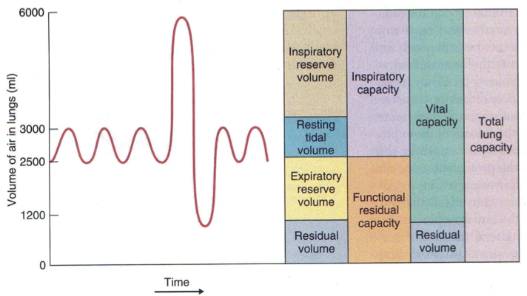
Lung volume and capacities
Volume: one thing
Capacity: more than one volume
Spirometer cannot measure
RV
FRV
TLC

Slide 7
Residual volume
RV: the air that remains in the lung after maximal forced expiration
Physiological significance
Maintain aeration of blood
Prevent sudden flotation of blood gases
Clinical significance
Obstructive lung disease ( emphysema)
RV/TLC>30% emphysema normal =21%
Forensic significance
Autopsy
Stillborn lung will sink in water
Child homicide lung float on water

Slide 8
VC= IRV+TV+ERV=4600mL
Male=2.5L/m2
Female = 2L/m2
Note
FVC (Timed ) 3600mL and VC ( not timed) 4600mL
Low vital capacity
Physiological
Pregnancy
Recumbent position
Pathological
Chest wall
Deformities in the bone ( kyphosis, lordosis…..)
Neuromuscular ( muscular dystrophy, myasthenia gravis………..)
Lung Obstructive ( emphysema)and restrictive ( pulmonary fibrosis)
Heart ( congestive heart failure) pulmonary edema
Abdomen Hepatomegaly splenomegaly and ascities

Slide 9
FEV1/FVC ratio
FEV1/FVC ratio: 4L/5L=80%
FEV1: the amount of air quickly and forcibly exhale in 1 second
FVC: the amount of air quickly and forcibly exhale after maximum inhalation ( timed)

Slide 10
Alveolar ventilation
External respiration
Pulmonary Ventilation
Alveolar ventilation
Perfusion
Diffusion
Internal respiration
Mitochondria
FIO2 PAO2 PaO2 SaO2 Carbmino-Hgb PVO2 CO2 breathout

Slide 11
Alveolar capillary membrane diffusion ( blood gas barrier)
Very thin Fibrosis = 1 micron
Huge surface area Pneumonectomy “ Restrictive”
6 layers
Fluid lining the alveoli Pneumonia ( consolidation)
Alveolar epithelium Emphysema
Epithelial basement membrane fibrosis
Fluid in interstitial space capillary endothelium pulmonary edema
Endothelium basement membrane
Simple diffusion no ATP
CO2 out
Narrow range of PH 7- 7.7

Slide 12
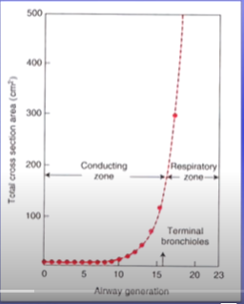
Cross sectional area of the airways

Slide 13
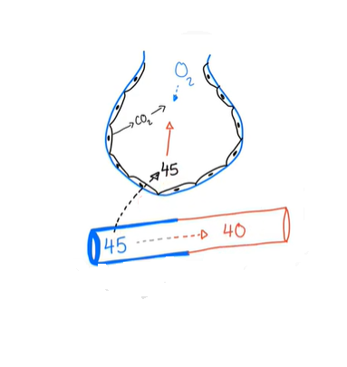
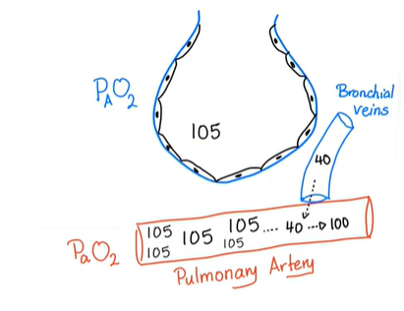
A-a gradient normal extrinsic restrictive lung disease A-a gradient abnormal intrinsic restrictive lung disease

