Slide 1
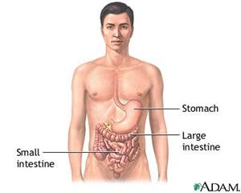
Lower GI Bleeding
Presented By: SARA and AREEN
Supervised By: Dr. Mahmoud Al-Awaysheh

Slide 2
Definition
Lower gastrointestinal tract bleeding is defined by any
bleeding in the GI tract distal to ligament of Treitz.
• Majority of the LGI Bleeding is self limiting.
• Only 10-20% patients presents with massive lower GI bleeding
• In 90% of the cases colon is the source of bleeding.
• Incidence increases with age.
• Most serious cause of significant LGI bleeding is
Diverticular diaease.

Slide 3
Presentation
Hematochezia: passage of fresh , bright, red blood in the stool .
Rectorrhagia: expulsion of fresh red bright blood without stool
Melena: black tarry offensive stools resulting from oxidation of Hb.
Notes:
Hematochezia
Melena
Colonic bleeding (maroon, jelly-like traces of blood in stools)
Rectal bleeding (streaks of fresh blood on stools)

Slide 4
LGIB can present as one of the following:
1. Massive bleeding:
Patients >65 years of age with multiple medical problems.
Presents as a large volume of bright red blood PR
Bleeding > 1.5 l / day
Hemodynamically unstable
SBP < 90 mmHg
Hr > 100/min
Low urine output
Hemoglobin level <= 6 g/dl
Most commonly due to
Diverticulosis
Angiodysplasia
Mortality rate may be as high as 21%

Slide 5
2. Moderate bleeding:
Patients with any age ,may present as hematochezia or melena .
Hemodynamically stable patients.
Initial ↓ in hematocrit level of 8 g / dL or less
Long list of diseases including: Anorectal, Congenital, Inflammatory, and Neoplastic.
3. Occult Bleeding:
Patients with any age, patients present with microcytic hypochromic anemia due to chronic blood loss.
Detected by routine chemical tests of the stool, with or without systemic evidence of chronic blood loss
10 ml. of blood loss / day is necessary to have stool occult blood positive.

Slide 6
Classification
Aetiology
Congenital :
Polyp’s / Meckel’s diverticulum
Inflammatory :
Ulcerative colitis / Crohn’s disease
Neoplastic :
Adenomas / Carcinomas / Polyps
Vascular :
Angiodysplasia / Ischaemic colitis / Vasculitis / Hamangioma
Clotting disorders :
Haemophilia / Leukaemia / Warfarin therapy / DIC
Miscellaneous :
Piles / Anal fissure / Injury to rectum

Slide 7
Site
Small Intestine :
Polyp’s / Meckel’s diverticulum / Ulcers / Tumours
/ Intussusception
Large intestine :
Angiodysplasia / Carcinomas / Colitis / Diverticulitis
Perianal :
Injury / Rupture(Haematoma /Anorectal abscess)
/ Carcinoma / Condyloma
Anal :
Piles / Anal fissure / Carcinoma / Fistula-in-ano

Slide 8
Causes of LGB

Slide 9
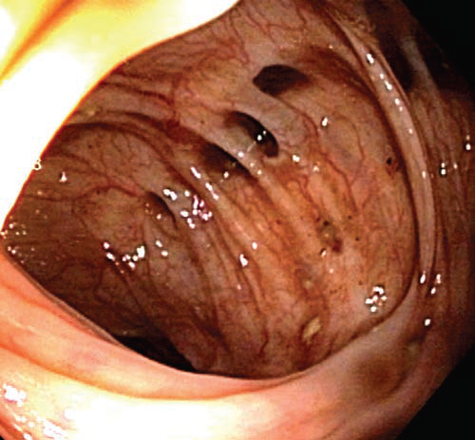
1- Diverticular Disease
Incidence : 50% above 65 years
Etiology : chronic constipation
Sac like protrusion in the colonic wall through a point of weakness

Slide 10
Diverticolosis Pathogenesis :
Chronic constipation Intraluminal colonic pressure muscle spasm and incordination.
Herniation of colonic mucosa and submucosa through a point of weakness in the muscular wall.

Slide 11
Pathology
Site
Sigmoid colon in 90% of cases
Clinical picture ( Diverticulosis )
Asymptomatic in 80% of cases or complains .
Recurent attacks of lower abdominal pain.
Distention and flatulence.
Rectal bleeding:
* may be first presentation
* massive bright red bleeding
* usually stop spontaneously

Slide 12
Complicated cases:
10-25%
A- Acute diverticulitis
As acute appendecitis but on left side (pyrexia, vomiting, anorexia ,generalized abdominal pain that shift and become localized to the left iliac fossa, tenderness and guarding in the left iliac fossa)
B- Chronic diverticulitis
Long history of :
recurrent attack of abdominal pain
passage of blood and mucosa per rectum
Others : abscess , fistula , perforation and intestinal obstruction
Notes:
Clinical features :
un complicated : Asymptomatic ,colicky abdominal pain, Flatulence ,Change in the bowel habit
Complicated :
Diverticulitis : chills ,nausea ,vomiting , dysuria , urgency and frequency . Physical examination may reveal tenderness in the affected area
Others : abscess , fistula , perforation and intestinal obstruction

Slide 13
Diagnosis :
The most accurate test is colonoscopy.
Barium studies are acceptable.
In case of diverticulitis the best initial test is a CT scan.
Colonoscopy and barium enema are dangerous in acute Diverticulitis because of increased risk of perforation. Infection weakens the colonic wall.
Treatment : High fiber diet , encourage physical activity,i.e walking , antispasmodic for pain.
IN case of diverticulitis give Ab . , IV FLIUD, rest in bed .
Notes:
.

Slide 14
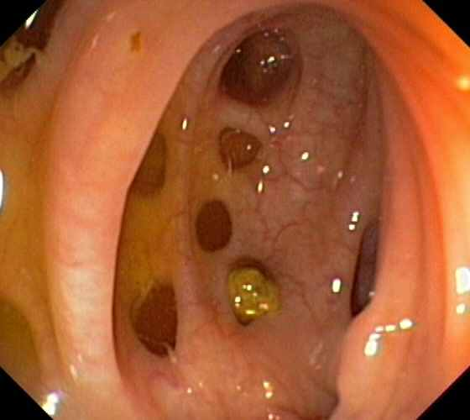

Slide 15
Meckel’s diverticulum is the most common congenital anomaly of the small intestine, It forms due to incomplete obliteration of the omphalomesenteric duct that connects the midgut lumen and yolk sac cavity early in fetal life * Painless intestinal hemorrhage accounts for 50% of all lower GI bleeding in patients younger than 2 years (most often presents with painless melena ) * A variety of tissues have been found in Meckel’s diverticulum, including gastric, pancreatic, colonic, jejunal, duodenal and endometrial. *The most common of these is gastric tissue, which is significant because gastric epithelium produces acid that can cause ulceration of adjacent mucosa . 99mmTc-pertechnetate scan detects the presence of gastric mucosa. Accumulation of pertechnetate in the right lower abdominal quadrant is diagnostic of a Meckel’s diverticulum that contains ectopic gastric mucosa. .
Meckel's Diverticulum :
Notes:
Meckel diverticulum is the most common congenital anomaly of the small intestine,
being present in 2% of the population.
▪ It forms due to incomplete obliteration of the omphalomesenteric duct that connects
the midgut lumen and yolk sac cavity early in fetal life.
▪ Meckel's diverticulum may present with rectal bleeding or intestinal obstruction;
however, most cases are asymptomatic.
▪ Remember the rule of 2's with Meckel's diverticulum: 2% of the population, 2 feet from
the ileocecal valve, 2 inches in length, 2% are symptomatic, and males are 2 times more
likely to be affected.

Slide 16
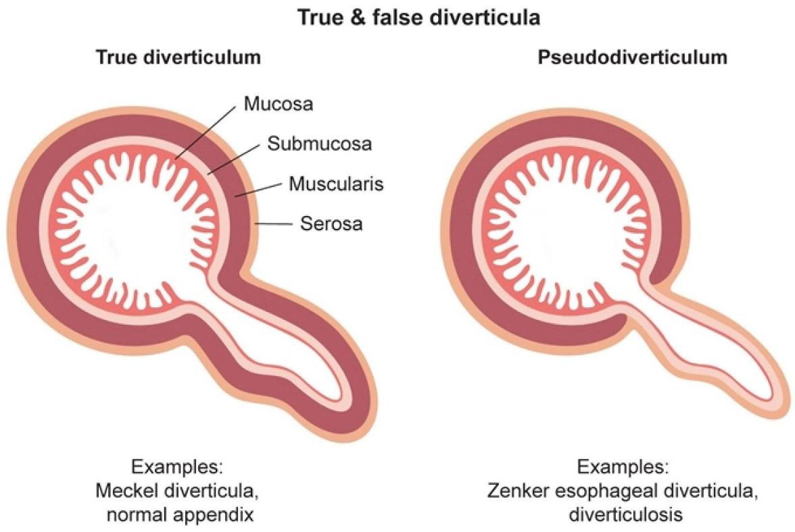
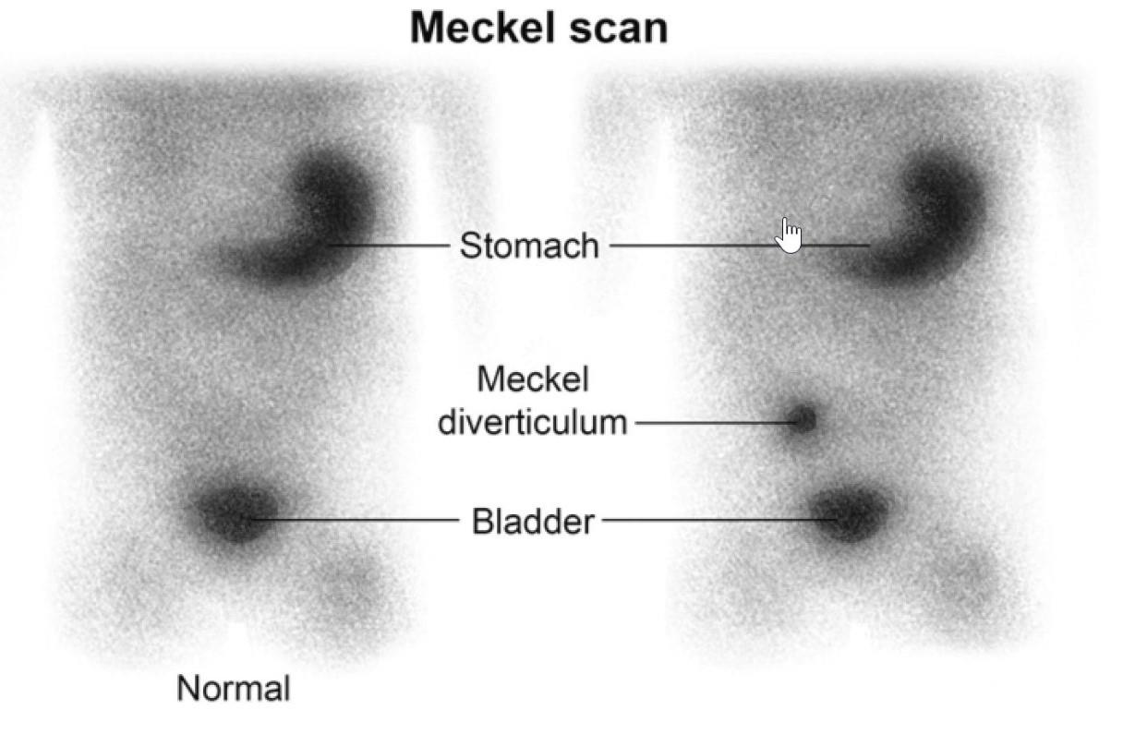

Slide 17
2- Inflammatory Bowel Disease
Symptoms
Pain
Ulcerative Colitis
Lower abdominal cramps
Relieved with Bowel Movement
Crohn's Disease
Constant pain often in right lower quadrant
Not relieved with Bowel Movement


Stool Blood
○

Grossly bloody stool in Ulcerative Colitis

Slide 18
Signs
Abdominal Mass
Ulcerative Colitis: No abdominal mass
Crohn's Disease: Mass often at Right lower quadrant


○
Gastrointestinal Tract Affected
Ulcerative Colitis
Affects only colon
Continuous from rectum
Crohn's Disease
Mouth to anus potentially affected
Discontinuous, "Skip" lesions


○
Bowel Tissue affected


Ulcerative Colitis: Mucosal disease (no granuloma) Crohn's Disease: Transmural disease (granulomas)

Slide 20
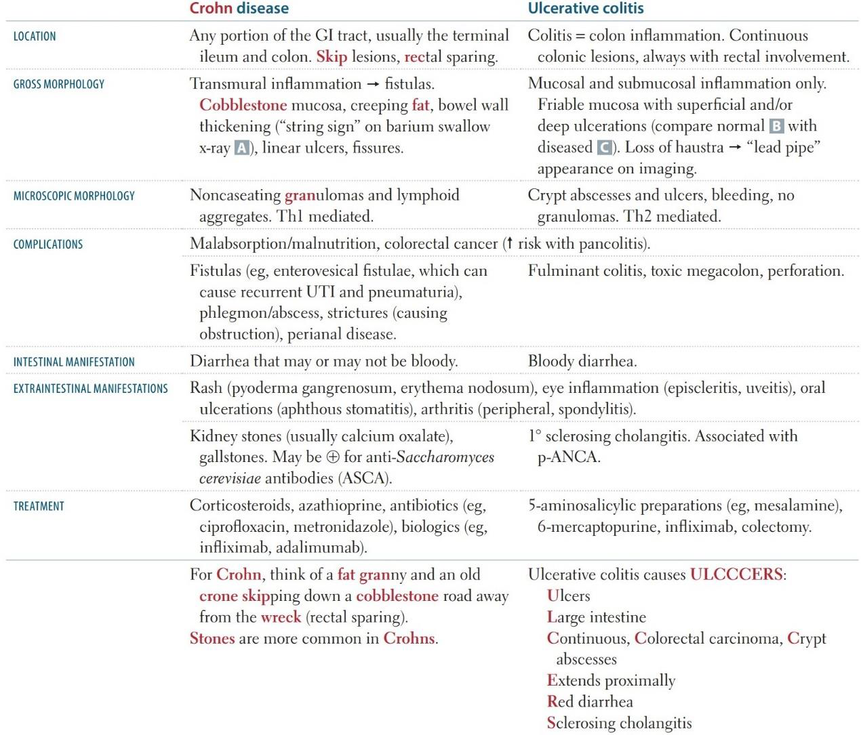
Notes:
3. Colonoscopy and biopsy are the tests of choice to diagnose ulcerative colitis
--------------
Diagnosis of chrons :
1.Plain abdominal X ray
2.Barium meal and follow through
3.C.T. scan ( thickening of wall)
4.U/S for complication
*Endoscopic visualization and biopsy are essential in the diagnosis of Crohn disease

Slide 21
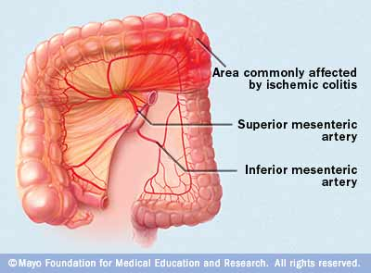
3- Ischemic colitis
Ischemic colitis occurs when blood flow to part of the large intestine (colon) is reduced, usually due to narrowed or blocked blood vessels (arteries). doesn't provide enough oxygen for the cells in your digestive system.
Incidence : over65 years
Risk factors include cardiac or vascular comorbidities such as diabetes or hypertension

Slide 22
Causes of Ischemic Colitis :
Hypoperfusion
Occlusive Disease (Thrombotic or Embolic)
Small Vessel Disease
Iatrogenic
Signs and symptoms :
Pain, tenderness, which can occur suddenly or gradually
Bright red or maroon-colored blood in your stool or passage of blood alone without stool
A feeling of urgency to move your bowels
Severe haemodynamic instability and acidosis.
Diarrhea
Nausea

Slide 23
4- Angiodysplasia
Angiodysplasia is a vascular malformation that is a cause of haemorrhage from the colon.
It is the most common vascular abnormality of the GI tract.
The malformations consist of dilated tortuous submucosal veins and in severe cases the mucosa is replaced by massive dilated deformed vessels.
may present as an isolated lesion or as multiple vascular lesions.
Typically in patients over 60 years.
Site: 77% → cecum and ascending colon
15% → jejunum and ileum (small intestine)
8% →The remainder of the GI tract.

Slide 24
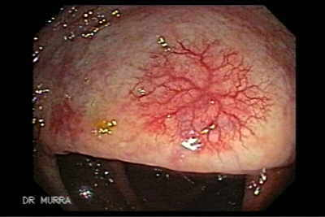
Angiodysplasia
Colonic Angiodysplasia
Multiple Gastric Angiodysplasias

Slide 25
Clinical Features
Asymptomatic – only diagnosed incidentally during colonoscopy (around 10% cases)
Painless occult PR bleeding (majority of case) patients can present with anemia
Bleeding stops spontaneously in over 90% of cases but is often recurrent.
About 10-15% of patients have massive painless bleeds, which may present as a black tarrey stool significant rectal bleeding that is often intermittent .
Bloody vomit frequently is observed in patients with angiodysplasia of the upper GI tract.
Notes:
Asymptomatic – only diagnosed incidentally during colonoscopy (around 10% cases)

Slide 26
In persistent or severe cases, when bleeding sites are identified, there are two main methods of treatment; endoscopic therapies and radiographic therapies (mesenteric angiography).
Indications for bowel resection in patients with angiodysplasia are:
Continuation of severe bleeding despite angiographic and endoscopic management (or such therapies are unavailable)
Severe acute life-threatening GI bleeding
Multiple angiodysplastic lesions that cannot be treated medically

Slide 27
A) HEMORRHOIDS
5- ANORECTAL DISEASE
Engorgement of venous plexuses of anus, rectum or both with protrusion of mucosa. It is one of the commonest cause of rectal bleeding
Causes :
Constipation
Diarrhea
Straining on stool
Pregnancy
Increased pelvic pressure (ascites, tumors)
Portal hypertension and CHF

Slide 28
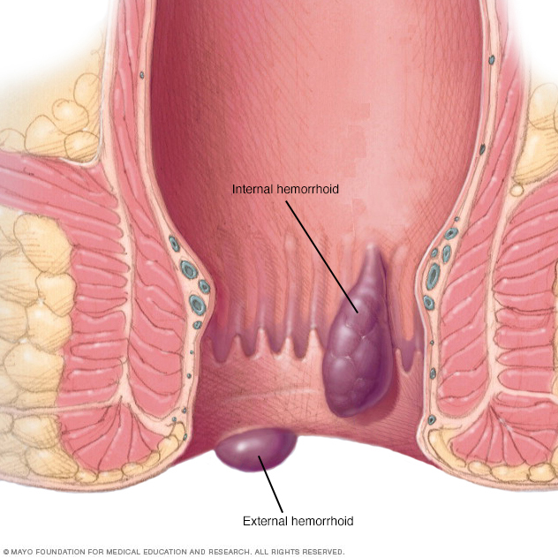
Types of HEMORRHOIDS :
INTERNAL HAEMORRHOIDS:
-Develops above the dentate line.
-Covered by anal mucosa.
-Lacks sensory innervation (painless)
-Bright red or purple in color.
-Internal H. drains into sup. Rectal veins → portal system

Slide 29
Grading for Internal type
Internal H. are classified by the degree of tissue prolapse into the anal canal.

Slide 30
EXTERNAL HAEMORRHOIDS:
-Arise below the dentate line.
-Covered by St. sq. epithelium(anoderm)
-Innervated by the inferior rectal nerve.
-External H. drains into inf. Rectal viens→ I.V.C.

Slide 31
Symptoms:
1- Grade 1 usually are asymptomatic
2-bleeding
3-prolapse
4-discharge
5-pruritis
6-pain
Examination:
The pt. should be in the left lateral position.
INSPECTION:
-1st degree H. show no outward abnormality
-2nd degree H. may show the skin covered components when the buttocks are separated or piles may prolapse when the pt. strains.
-3rd degree H. shows the red anal mucosa in their position.
Notes:
2-bleeding:
-the main and earliest symptom
-starts as bright red bleeding on the surface of the stool or on the toilet paper.
s painless, unless there is thrombosis, ulceration, or gangrene

Slide 32
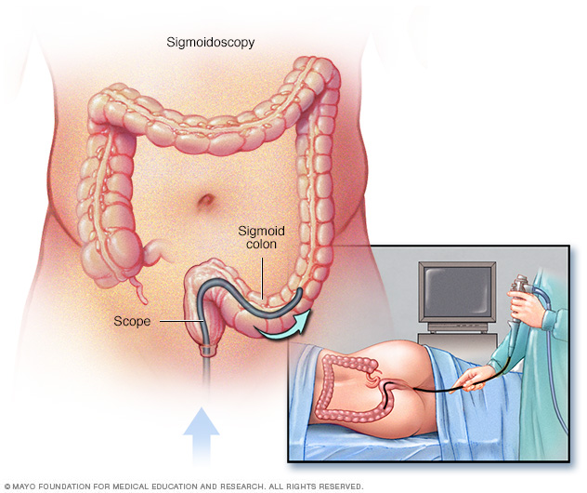
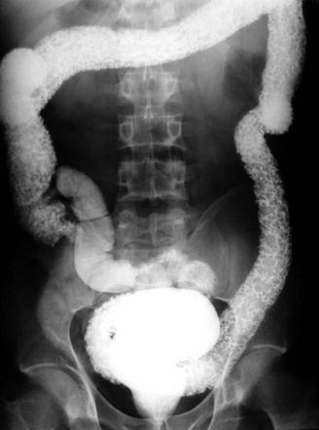
Investigation
1-Sigmoidscopy: essential to exclude rectal pathology as carcinoma or polyps.
2-Barium enema: indicated when sigmoidoscopy and proctoscopy can’t explain the symptoms.
3-CBC: anaemia, rarely happen in longstanding piles.
Complication
1- Anemia
2- Thrombosis
3- Gangerene
4- Strangulation
5- Fibrosis
6- Ulceration
7- Suppuration

Slide 34
Treatment
Asymptomatic hemorrhoids
Best left alone
Bulk-forming agents and avoidance of constipation
First-degree
Topical agents
If bleeding : injection sclerotherapy or infrared coagulation
Second-degree
Banding
Large size: banding
Third degree
Banding or surgery
Fourth degree
Surgery
Thrombosed external
Early: Excision
Later : Conservative
Notes:
s. These products contain ingredients such as witch hazel, or hydrocortisone and lidocaine, which can temporarily relieve pain and itchin

Slide 35
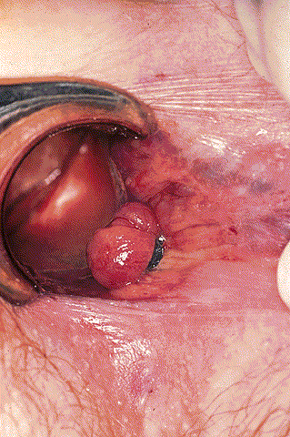
Banding

Slide 36
Hemorrhoidectomy
4th degree hemorrhoids
3rd degree with a large external component
Acute hemorrhoidal attack ( with gangrene, severe ulceration= emergency)
Complications of the procedure: Anal stenosis, post-operative haemorrhage.

Slide 37
B) Anal fissures
*Happens to young women.
- Anal fissures are characterized by longitudinal tears in the anal canal distal to the dentate line and are most common at the posterior midline.
- Most fissures are related to chronic constipation with high anal pressures and passage of hard stools.
They can also be seen with frequent diarrhea or anal sexual intercourse.
- There is exquisite pain with defecation and blood streaks covering the stools.
- The fear of pain is so intense that patients avoid bowel movements (and get constipated)and may even refuse proper physical examination of the area.
Notes:
- Examination may need to be done under anesthesia (the fissure is usually posterior, in the
midline).
- Initial treatment of anal fissures includes dietary modification (high-fiber diet, increased
fluid intake), stool softeners, and sitz baths to increase blood flow to the injured mucosa.
- A tight sphincter is believed to cause and perpetuate the problem, thus therapy is directed
at relaxing it: stool softeners, topical nitroglycerin, local injection of botulinum toxin, steroid
suppositories, or lateral internal sphincterotomy.
- Topical anesthetics (lidocaine) can enhance comfort. In addition, topical vasodilators
(nifedipine, nitroglycerin) can be used to reduce pressure in, and increase blood flow to, the
anal sphincter, facilitating healing

Slide 38
Examination may need to be done under anesthesia .
Initial treatment of anal fissures includes dietary modification (high-fiber diet, increased
fluid intake), stool softeners, and sitz baths to increase blood flow to the injured mucosa.
- A tight sphincter is believed to cause and perpetuate the problem, thus therapy is directed at relaxing it: stool softeners, topical nitroglycerin, local injection of botulinum toxin, steroid suppositories, or lateral internal sphincterotomy.
- Topical anesthetics (lidocaine) can enhance comfort. In addition, topical vasodilators (nifedipine, nitroglycerin) can be used to reduce pressure in, and increase blood flow to, the anal sphincter, facilitating healing.

Slide 39
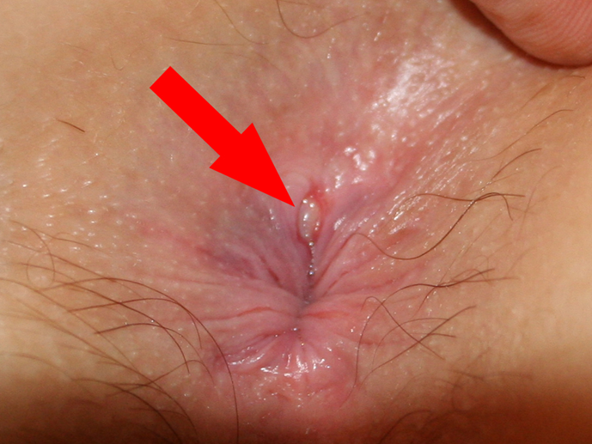
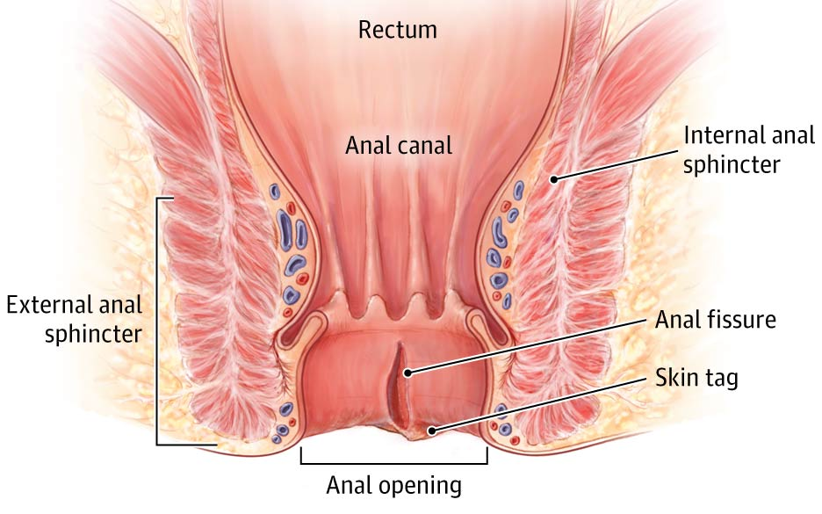
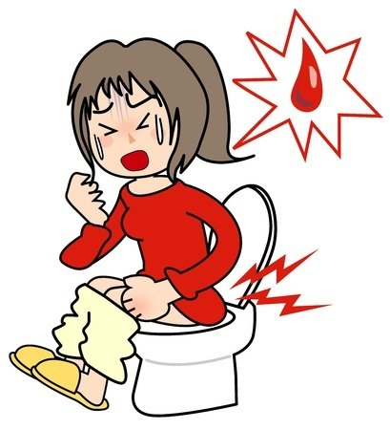
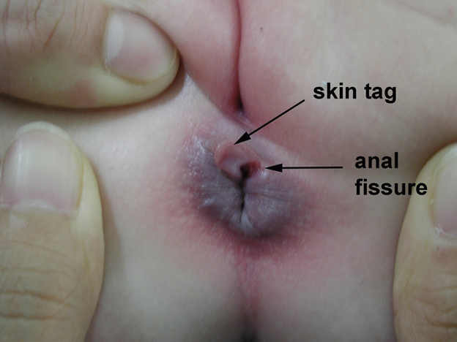
***

Slide 41
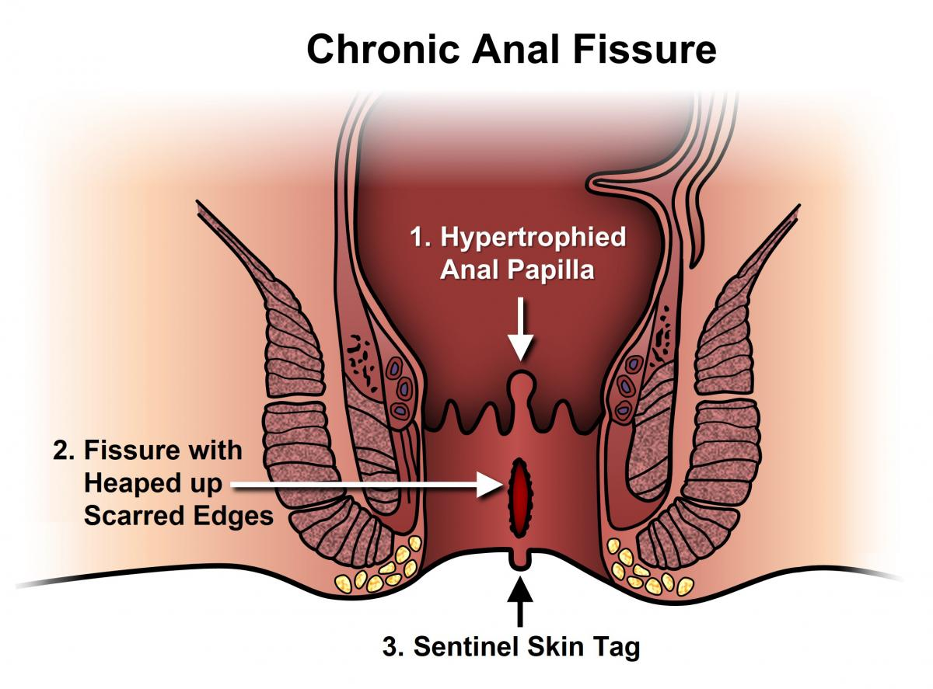
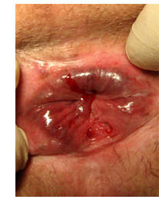

Slide 42
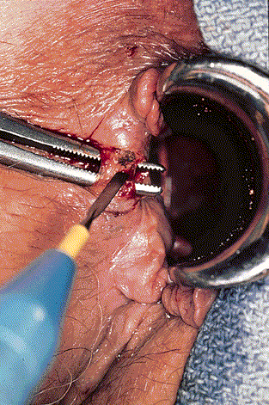
Surgical Treatment
Indications:
Chronic fissure
Failure of conservative treatment
The operation of choice is: partial lateral internal sphincterotomy

Slide 43
6- Colonic and rectal polyps
Defenition : tissue growth into bowel lumen, usually consisting of mucosa, sub mucosa or both
Anatomical classified : sessile , pudunculated
Histological classification:
Inflammatory( psuedopolyp): IBD
Hamartomatous : normal tissue in abnormal configuration
Hyperplastic : benign ( normal cells) no malignant potency
Neoplastic : proliferation of undifferentiated cells , premalignant or malignant cells

Slide 44
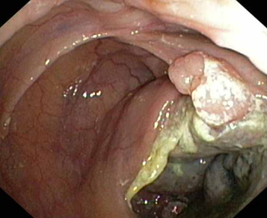
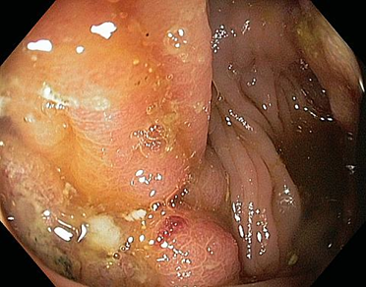
7-Colorectal cancer
Presentation depends on site:
 Left-sided: Altered bowel habit (constipation & diarrhoea), rectal bleeding bright red coating the stool, Tenesmus, Painful defecation .
 Right-sided: Weight loss, right abd pain/mass, tendency to bleed, blood mixed in with stools

Slide 45
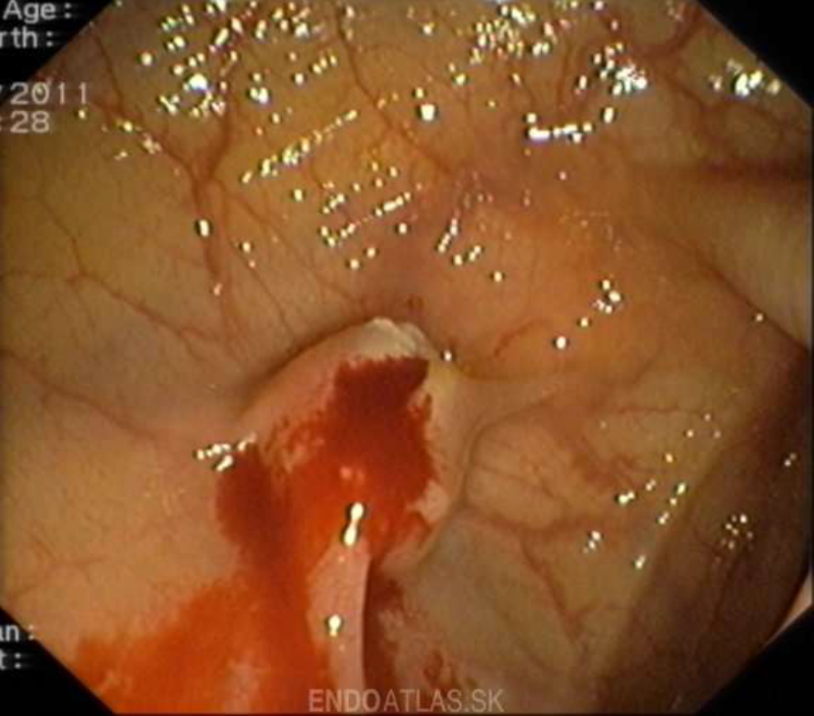
Postpolypectomy bleeding
*Bleeding recurs after approximately 1% of colonoscopic polypectomies.
*The bleeding occurs most commonly five to seven days after polypectomy but can occur from 1 to 14 days after procedure.
*It generally mild to moderate, with 50% to
75% of patients requiring blood transfusions.

Slide 46
History
The age of the patient:
≤ 50 yrs- infection, anorectal disease, IBD
> 50 yrs- malignancy, diverticulosis
Any age- piles
Document whether this is a first or recurrent episode of gastrointestinal (GI) bleeding.
Duration of bleeding
Color & amount of the blood
Relationship of bleeding to defecation( before, during (mixed into faeces or coating surface) or after)
• Associatiated symptoms eg, Painful defecation, abdominal pain
Notes:
Color of the blood to determine the site of bleeding

Slide 47
COLOUR OF BLOOD/ DISCHARGE
Bright red/ Fresh blood: Rectum and anus.
Dark blood:Upper GIT to above rectum.(coming from the ascending, transverse, descending or sigmoid colon )
Drugs eg: iron tablets- appear as greenish black formed stool.
Melena usually means bleeding in the stomach, such as bleeding from ulcers.
Discharge apart from blood:-
Mucus- irritable bowel syndrome
Copious mucus- villous adenoma, frank cancer of the rectum
Mucus and pus- IBD, diverticular disease
Notes:
Dark red-coming from the ascending, transverse, descending or sigmoid colon
Black(i.e melaena)-from the small intestine or higher

Slide 48
Its relation with the faeces
* Blood mixed with faeces means that the blood has come from bowel higher than sigmoid colon where the softness of the stool remains giving chance to the blood to mix with the faeces
* Blood on the surface of the faeces usually come from the rectum or anal canal
* Blood separate from the faeces may occur when bleeding occur at some other time than defaecation , carcinoma of the rectum when blood accumulates in the rectum and gives rise to desire to defaecate and only blood and mucus come out.Such bleeding may also occur in diverticulosis, diverticulitis, ulcerative colitis, polyp,prolapsed piles etc.
* Blood in the toilet paper is due to fissure-in-ano or external haemorrhoids.
Notes:
Blood in the toilet paper is only seen in case of minor bleeding from the anal skin either due to fissure-in-ano or external haemorrhoids.
When a child comes with bleeding per anum,a diagnosis of rectal polyp should be made until this is excluded by rectal examination.

Slide 49
DEFERENTIAL DIAGNOSIS
DIAGNOSIS OF CONDITIONS PRESENTING WITH RECTAL BLEEDING BUT NO PAIN:
Blood mixed with stool colon carcinoma
Blood streak on stool rectal carcinoma
Blood after defaecation haemorrhoids
Blood and mucus colitis
Blood alone diverticular disease
Melaena peptic ulcer
Notes:
Relationship of bleeding to
defecation?
• minor blood on toilet paper
• streaks of bright red blood
• Blood mixed stools
• Slash in pan
• Mixed with mucus

Slide 50
DEFERENTIAL DIAGNOSIS
DIAGNOSIS OF ANAL CONDITIONS WHICH PRESENT WITH:
PAIN AND BLEEDING:
Fissures , Fistula in Ano , Rup. Ano Rectal abscess
Injury
PAIN, LUMP AND BLEEDING:
Prolapsed haemorrhoids
Carcinoma of the anal canal
Prolapsed rectal polyp or carcinoma
Prolapsed rectum

Slide 51
Constapition and bleeeding : Hemorrhoids , colorectal malignancy , divertuclosis
Bloody diarrhea : infectious colitis , IBD , ischemic bowel disease
Painless bleeding : angiodysplasia , divertivular disease , hemorrhoids , neoplasms
Abdominal pain and bleeding : IBD , ischemic bowel disease , ruptured abdominal aortic aneurysm
Fever? Infectious colitis (amoebiasis, shigellosis); ulcerative colitis
Vomiting of blood : Bleeding above ligament of Treitz

Slide 52
Bleeding from other sites- indicates systemic disease/ drug induced bleeding
Weight loss, anorexia, abdominal pain, vomitting -Malignancy
Sexual abuse- trauma to anal canal
Tenesmus: ( rectal Ca, ulcerative proctitis, irradiation proctitis) or without tenesmus (colitis).
Pallor, dizziness, hypotension, tachycardia, angina, syncope, weakness, confusion
PERSONAL HISTORY :Smoking- peptic ulceration, colorectal Ca alcohol
Notes:
Hypovolaemia
– due to haemorrhage (e.g. pallor, dizziness
hypotension, tachycardia, angina, syncope,
weakness, confusion, stroke, myocardial
infarction/heart attack, and shock

Slide 53
Common Causes
Acute | Sub-acute / Chronic
Diverticular disease | Anal disease
Mesenteric ischaemia | Inflammatory bowel disease
Angiodysplasia | Large polyps
Ischaemic colitis | Carcinoma
Meckel’s diverticulum | Solitary rectal ulcer
Intussusception | Radiation enteritis

Slide 54
Medical history (including peptic ulcer disease, liver disease, cirrhosis, coagulopathy, inflammatory bowel disease [IBD], hemorrhoids, diverticular disease)
Drug history (e.g, nonsteroidal anti-inflammatory drugs (NSAIDs) and/or warfarin).
In patients with cancer, the history of radiation, chemotherapy, or both should be considered.
Notes:
past medical history
– constipation or diarrhea- (hemorrhoids, colitis),
– the presence of diverticulosis (diverticular
bleeding),
– receipt of radiation therapy (radiation enteritis),
– recent polypectomy (postpolypectomy bleeding),
and
– vascular disease/hypotension (ischemic colitis).
– anticoagulant
– A family history of colon cancer - colorectal
neoplasm

Slide 55
Past Medical History
Constipation or diarrhea- (hemorrhoids, colitis),
The presence of diverticulosis (diverticular bleeding),
Receipt of radiation therapy (radiation enteritis),
recent polypectomy (postpolypectomy bleeding),
Vascular disease/hypotension (ischemic colitis).
Anticoagulant
A family history of colon cancer - colorectal
Neoplasm
Systemic Enquiry: Mouth ulcers, Eye problems Skin changes Joint pain

Slide 56
Summary
Acute ,painless self limited bleeding in 70 – 80% of cases Diverticular bleeding.
Slow but repeated episodes of painless self limited hematochezia or melena Angiodysplasia.
Elderly patient with abdominal pain , rectal bleeding and diarrhea Ischemic colitis
Fever, bloody diarrhea, dehydration, and abdominal pain Infectious colitis.

Slide 57
Summary
Insidious bleeding with iron- deficiency anemia and syncope Colon Carcinoma.
Bloody diarrhea with pus, abdominal cramps, and dehydration Ulcerative colitis.
Painless fresh bleeding Hemorrhoids
(can also present with strangulation, hematochezia and pruritis)
Painful fresh bleeding Anal fissure

Slide 58
Physical Examination
Assessment of vital signs and postural hypotension.
- A drop in the orthostatic blood pressure >10 mm Hg or an increase in the pulse rate > 10 beats/min indicates that more than 800 ml of blood (> 15% of the total circulating blood volume) has been lost.
- Marked tachycardia and tachypnea + hypotension and depressed mental status indicates that more than 1,500 ml of blood (> 30% of the total circulating blood volume) has been lost .

Slide 59
RR, HR, and BP can be used to estimate degree of blood loss/hypovolaemia
 | Class I | Class II | Class III | Class IV
Volume Loss (ml) | 0-750 | 750-1500 | 1500-2000 | >2000
Loss (%) | 0-15 | 15-30 | 30-40 | >40
RR | 14-20 | 20-30 | 30-40 | >40
HR | <100 | >100 | >120 | >140
BP | Unchanged | Unchanged | Reduced | Reduced
Urine Output (ml/hr) | >30 | 20-30 | 5-15 | Anuric
Mental State | Restless | Anxious | Anxious/confused | Confused/ lethargic

Slide 60
Physical examination
Palpation of the abdomen for tenderness, hepatomegaly, or abdominal masses.(colorectal cancer)
Rectal examination: to exclude anorectal bleeding or a palpable rectal mass.
Thorough examination of the skin, oropharynx, nasopharynx, abdomen, perineum to evaluate for sources of bleeding.
NG tube is necessary to exclude UGIB.
It is essential to perform a rectal examination in all patients with lower GI bleeding to exclude a palpable rectal mass.
Notes:
It is essential to perform a rectal examination in all patients with lower GI bleeding to exclude a palpable rectal mass.

Slide 61
Proctoscopy:
*A proctoscope is a hollow, tube-
like speculam that is used for visual inspection of the rectum.
*The proctoscope is used in the diagnosis of hemorrhoid ,carcinoma of anal canal or rectum and rectal polyp.
*It is used therapeutically
for polypectomy and rectal biopsy.

Slide 62
MANAGEMENT
All patients:
Ensure patient is NPO.
Insert two large-bore peripheral IVs (for possible fluid resuscitation and blood transfusion) and obtain blood samples for laboratory studies (e.g., CBC, type and screen).
Consider the following prior to hemostatic procedures:
Pretreatment (e.g., IV PPI)
Anticoagulant reversal(e.g., for life-threatening bleeding)
Withholding antithrombotic agents
Conduct a focused history and examination

Slide 63
Does The Pt. Hemodynamically stable or not ?
Signs of hemodynamic compromise:
*Include postural changes with dyspnea, tachypnea, and tachycardia.
*An orthostatic drop in systolic blood pressure of more than 10 mm Hg or an increase in heart rate of more than 10 b/m is indicative of at least 15% of blood volume loss
*A hematocrit level of less than 18% or a decrease of about 6% is indicative of significant blood loss that requires blood transfusions.
*The goal is to achieve hematocrit level of approximately 20-25% in young patients and around 30% in high-risk, older patients

Slide 64
Stable patients
Restrictive transfusion strategy
Refer for endoscopy
Unstable patients
Follow an ABCDE approach.
Consider intubation to protect the airway
Urgent volume resuscitation for hemodynamic instability
IV fluid resuscitation
Liberal transfusion strategy: for hemorrhagic shock
Determine optimal dual diagnostic/therapeutic intervention in consultation with specialists..

Slide 65
Diagnostics
Occult GI bleeding
Initial screening: fecal occult blood test(FOBT), CBC (± iron studies)
No urgent endoscopy if FOBT is positive
Scant intermittent hematochezia
Initial screening for patients < 40 years old without features of underlying malignancy or IBD: DRE and sigmoidoscopy.
Colonoscopy indicated for patients with:
Nondiagnostic sigmoidoscopy
Unexplained red flag symptoms for malignancy or IBD (e.g., weight loss, altered bowel habits, iron deficiency anemia)
Other risk factors for colorectal cancer

Slide 66
Approach to overt GI bleeding
Supportive feature | Hematochezia Melena PLUS a known lesion in the right colon Previous episode of LGIB Known potential sources of LGIB
Testing for hemodynamically stable | stable hematochezia → colonoscopy→ if negative, perform esophagogastroduodenoscopy (EGD) Melena (more common with a UGI source of bleeding) → EGD → if negative, perform colonoscopy
Testing for hemodynamically unstable | Consider nasogastric tube aspiration to differentiate upper from lower GI bleeding In the case of massive, life-threatening bleeding: angiography If EGD and colonoscopy fail to locate the bleeding → evaluate small bowel bleeding or consider angiography for vascular etiologies (e.g., angiodysplasia

Slide 67
Laboratory Studies
Appropriate blood tests include
A complete blood cell (CBC)
Serum electrolytes
A coagulation profile, including activated partial thromboplastin time (aPTT), prothrombin time (PT), manual platelet count, and bleeding time.

Slide 68
Work Up
The 3 nonsurgical modalities used to diagnose lower gastrointestinal bleeding (LGIB) are: Colonoscopy ( GOLD Standard ) Radionuclide scans Angiogram

Slide 69
Colonoscopy
In most patients with LGIB, colonoscopy is the initial diagnostic method of choice. Colonoscopy is successfully used to identify the origin of LGIB in approximately 74-82% of patients.
Colonoscopy tends to result in improved patient outcomes. In patients who are hemodynamically stable with mild to moderate bleeding, diagnostic colonoscopy is the test of choice, because of its higher diagnostic yield and lower complication rate as compared with Angiography.

Slide 70
Colonoscopy
In addition to its diagnostic utility, colonoscopy offers the opportunity for therapeutic intervention in the treatment of vascular ectasias, diverticular bleeding, neoplastic lesions, and ulcerative processes.
Actively bleeding lesions can be treated with colonoscopic thermoregulation, epinephrine injection, photocoagulation, clip application, and a combination of these various methods.

Slide 71
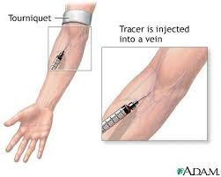
Radionuclide Scanning
Radionuclide scans frequently are performed before angiography, because the scans detect bleeding at a slower rate than what can be detected with angiography, thereby potentially eliminating the need for an invasive procedure.
-Negative findings on radionuclide scan make subsequent angiography less likely to be of benefit.
Sensitivity 97%, specificity 85%, predictive value 94-97%
detect bleeding at a slower 0.1 mL/min (0.1-0.5 mL/min) than what can be detected with angiography,

Slide 72
Angiography
In patients who are hemodynamically unstable and in patients with fast ongoing LGIB,
an angiography with or without a preceding radionuclide scan can be performed.
Angiography is performed when active bleeding that precludes colonoscopy occurs and after colonoscopy has failed to identify a bleeding site.
Selective mesenteric angiography can detect bleeding at a rate of more than 0.5 mL/min.

Slide 73
In a patient with active GI bleeding, the radiologist first cannulates the superior mesenteric artery, because most of the hemodynamically significant bleeding originates in the right colon. The extravasation of contrast material indicates a positive study finding. If the findings from the study are negative, the inferior mesenteric artery is cannulated, followed by the celiac artery.
Provides accurate localization of the bleeding
It has a therapeutic utility that includes the use of vasopressin infusion or embolization
It can be performed during active bleeding
Notes:
Superior then inferior then celiac
73

Slide 74
Cont.
Apart from colonoscopy, endoscopic procedures, such as esophagogastroduodenoscopy (EGD), wireless capsule endoscopy (WCE), push enteroscopy, and double-balloon enteroscopy, are used depending on the clinical circumstance. The sequence of using various modalities depends on such factors as rate of bleeding, hemodynamic status of the patient, and inability to localize bleeding with the initial modality.

Slide 75
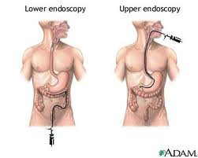
Patients who have experienced multiple episodes of LGIB without a known source or diagnosis should undergo elective mesenteric angiography, upper and lower endoscopy, Meckel scanning. Elective evaluation of the entire GI tract may identify uncommon lesions and undiagnosed arteriovenous malformations (AVMs).

Slide 76
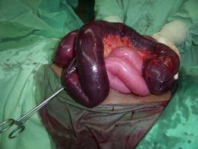
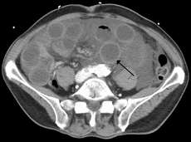
Othe Diagnostic Studies
CT. scan
Barium enema
Fecal occult blood testing
Notes:
Modalites

Slide 77
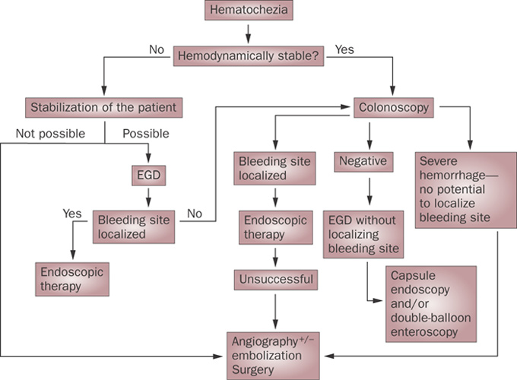
Notes:
esophagogastroduodenoscopy

Slide 79
Treatment
The management of LGIB has 3 components, as follows:
- Resuscitation and initial assessment
- Localization of the bleeding site
- Therapeutic intervention to stop bleeding at the site

Slide 80
*Once the bleeding site is localized, nonsurgical therapeutic options that may be considered include the following:
*Patient with presumed LGIB may undergo early sigmoidoscopy for the detection of obvious low-lying lesion
*Sigmoidscopy is useful in patient <40 years with minor bleeding
*Patient with hematochazia and hemodynamic instability should have upper endoscopy to role out the upper GI source of bleeding before lower GI tract

Slide 81
-Colonscopy after oral lavage solution is the procedure of choice in patient admitted with LGIB .
-In active LGIB angiogram can detect the site of bleeding (extravasation of contrast into the gut) and permit treatment with intraarterial infusion of vassopressin or emoblization

Slide 82
*Diverticular bleeding: Colonoscopy with bipolar probe coagulation, epinephrine injection, or metallic clips
*Recurrent bleeding: Resection of the affected bowel segment
*Angiodysplasia: Thermal therapy (eg, electrocoagulation, argon plasma coagulation)
*Conservative management, including nothing by mouth (NPO) and intravenous (IV) hydration in patients with ischemic colitis

Slide 83
In patients in whom the bleeding site cannot be determined, vasoconstrictive agents such as vasopressin (Pitressin) can be used. If vasopressin is unsuccessful or contraindicated, superselective embolization is useful.

Slide 84
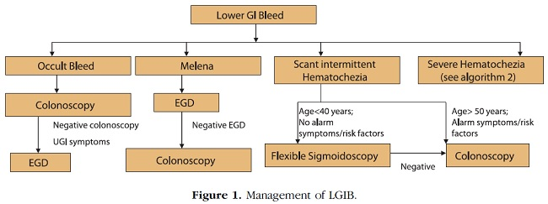
Therapeutic intervention to stop bleeding at the site

Slide 85
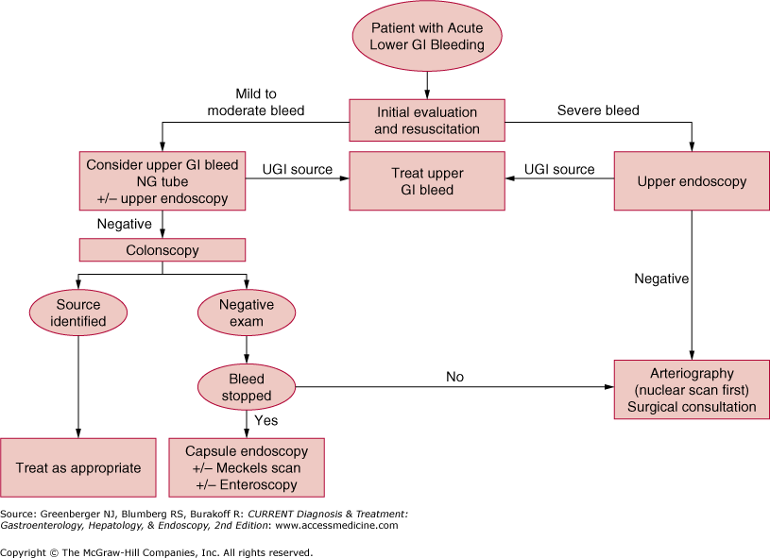

Slide 86
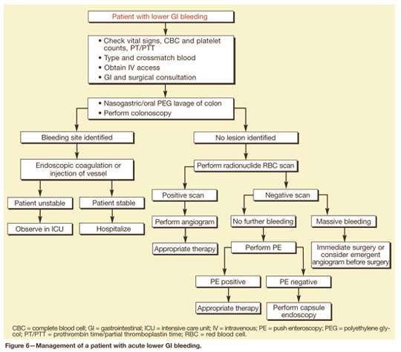

Slide 87
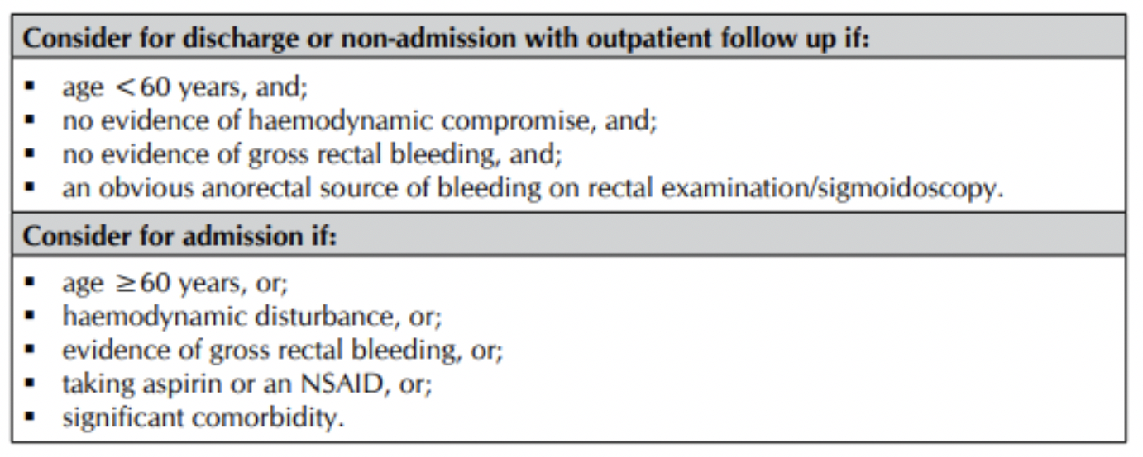

Slide 88
The indications for surgery include the following:
-Active persistent bleeding with hemodynamic -instability that is refractory to aggressive resuscitation
-Persistent, recurrent bleeding
-Transfusion of more than 4 units packed red blood cells in a 24-hour period, with active or recurrent bleeding
-Transfusion of more than 6 units of packed red blood cells during the same hospitalization

Slide 89
Thank You

