Slide 1
METABOLISM OF AMMONIA
Ammonia is formed in body from:
a) From amino acids: 1.Transdeamination in liver
2. amino acid oxidases and amino acid deaminases in liver and kidney.
b) Deamination of physiological amines:
by monoamine oxidase
)histamine, adrenaline, dopamine and serotonine(
C( Deamination of purine nucleotides: especially adenine nucleotides
deaminase
AMP
IMP + NH₃
Pyrimidine catabolism.
From bacterial action in the intestine on dietary protein& on urea in the gut.
NH3 is also produced by glutaminase on glutamine .

Slide 2
Metabolic Disposal of Ammonia
Ammonia is toxic to CNS, it is fixed into nontoxic metabolite for reuse or
excretion according to the body needs:
a) Formation of Glutamate:
GDH
T.A.
α -Amino acid
α -KG + NH
Glutamate
3
b) Glutamine Formation: Muscle, brain
Keto acid
NH₃
H2O
O NH
NH
2
2
Gln synthase
HOOC-CH₂-CH₂-CHCOOH
H₂N-C-CH₂-CH₂-CH-COOH
_{Mg}2+
Glutamate
ATP
ADP+Pi
Glutamine
Glutamine is storehouse of ammonia & transporter form of ammonia.
In brain, glutamine is the major mechanism for removal of ammonia while in liver is urea formation.
..Circulating glutamine is removed by kidney, liver and intestine where it is deamidated by glutaminase .
c) Urea formation

Slide 3
Glutaminase
H₂O
Glutamine
Glutamate + NH₃
This reaction is important to kidney due to kidney excretes NH₄ ion to keep
+
extracellular Na⁺ ion in body and to maintain the acid-base balance.
Glu.
Diet & Body protein
Diet & body protein
α−Α . a.
Purines,pyrimidines
Deaminase
Biosynthesis Of purine & Pyrimidine
Various nitrogen- containing compounds
glutamine
glutaminase
Kidney
GIT
Bacterial urease
Liver
Urine NH4+
Urine
urea
Kidney

Slide 4
c) Urea Formation
Urea is the principal end-product of protein metabolism in humans.
It is important route for detoxication of NH₃.
It is operated in liver, released into blood and
cleared by kidney.
Urea is highly soluble, nontoxic and has a high nitrogen content (46%), so …it represents about 80- 90% of the nitrogen excreted in urine per day in man
Biosynthesis of urea in man is an energy- requiring process.
It takes place partially in mitochondria and partially in cytoplasm.

Slide 5
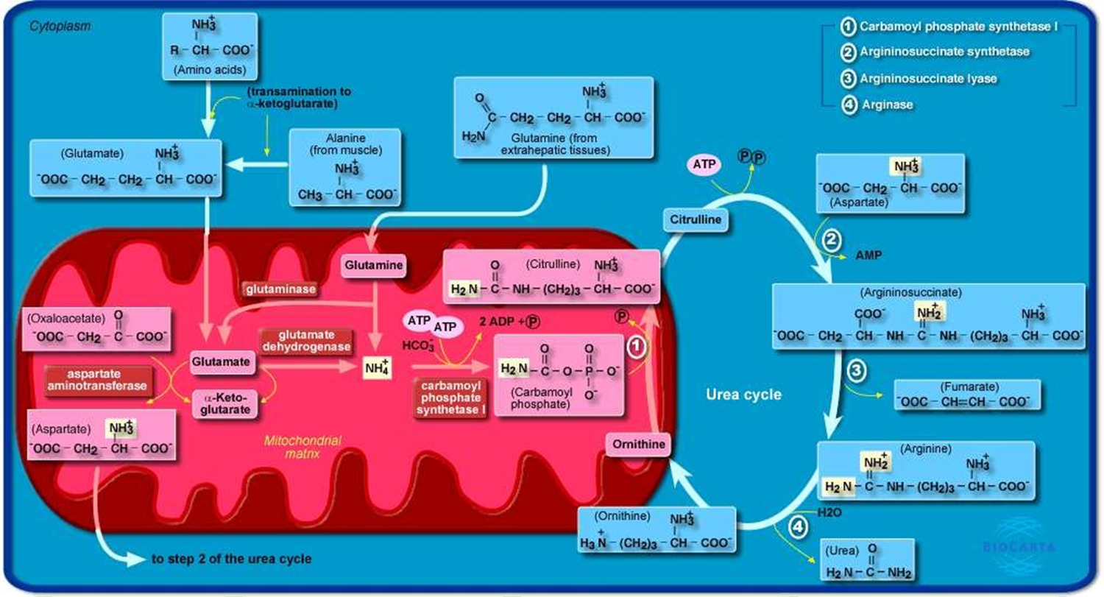
The Urea Cycle
(The Ornithine Cycle,
NAD
Kreb's Cycle):
MDH
NADH2
Glu
Glu

Slide 7
Metabolic Significant Aspects of Urea Cycle
Energy Cost:. Three ATP molecules and four high-energy phosphate bonds are utilized in the reactions..
urea cycle is related to TCA cycle:
CO₂
Aspartate arises via transamination of oxaloacetate with glutamate. Thus, depletion of oxaloacetate will decrease urea formation
Fumarate enters TCA cycle
Sources of Nitrogen in urea :free NH3 and aspartate.
N.B. glutamate is the immediate source of both NH₃ (via oxidative deamination by Glu. Dehyd.) and aspartate nitrogen (through transamination of oxaloacetate by AST).

Slide 8
Importance of Urea Cycle
Formation of arginine (in organisms synthesizing arginine) & formation of urea (in ureotelic organisms, man) due to presence of arginase.
Liver shows much higher activity of arginase than brain or kidney for formation of urea while in brain or kidney is the synthesis of arginine.
Synthesis of non-protein amino acids (ornithine and citrulline) in body.

Slide 9
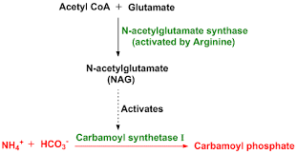
Regulation of Urea Cycle
Activity of individual enzymes:
THE RATE LIMITING STEPS a) carbamoyl phosphate synthase-1
Ornithine transcarbamyolase.
Arginase.
ϖ N-acetylglutamate is activator for carbamoyl phosphate synthase-1
It enhances its affinity for ATP.
It is synthesized from acetyl CoA and glutamate.
its hepatic concentration increases after intake of a protein diet, leading to an increased rate of urea synthesis.
ϖ Activity of ornithine transcarbamyolase
concentration of its co-substrate "ornithine".
is limited by the

Slide 10
-2 Regulation of the flux through the cycle:
Flux of ammonia:
by amino acids release from muscle (alanine, glutamine),
metabolism of glutamine in the intestine
3. amino acids degradation in the liver.
Availability of ornithine.
Availability of aspartate:
since aspartate is required in equimolar amounts with ammonia, this is satisfied by of transdeamination .
-3 Change in the level of Enzymes:
Arginase & other urea-forming enzymes are adaptive enzymes thus
a protein-rich diet will increase their biosynthesis rate & the opposite is true for low protein diet.
However, in starvation, where the body is forced to use its own tissue protein as fuel, there is an increase in urea-forming enzymes.
•
•
•

Slide 15
2. Metabolism of Serine: nonessential & glucogenic
It is synthesize from glycine or
intermediate of glycolysis,
all enzymes are activated by testosterone in liver, kidney & prostate.
CH₂OP Glu
CHOH Dehydrogenase
αKG
CH₂OP
C =o COOH
CH OP
PLP
2
CHNH₂
COOH
COOH
TA
NAD
NADH+H⁺
3-Phosphoserine
3- phosphoglycerate
3- Phosphopyruvate
NH 2
Phosphatase
HO CH₂ - CH - COOH
Serine
Pi
H₂O

Slide 16
Degradative Pathways of Serine:
1.
Serine Glycine CO2+NH3
(major)
2.
Ser. dehydratase
Pyruvate + NH₃
Serine
PLP
T.A. TCA
Alanine
CO₂ + H₂O
Glucose
Serine is important in synthesis of:
Phosphoprotein
Purines & pyrimidine
Sphingosine
Choline
Cysteine

