Slide 1
Renal Diseases I
INTRODUCTION TO ICU
Supervised by: Dr. Mohammed Malkawi
Introduced by: Loai Almoghrabi
Fatima Albustanji Rania Albustanji

Slide 2
INTENSIVE CARE UNIT
An intensive care unit (ICU), also known as an intensive therapy unit or intensive treatment unit (ITU) is a special department of a hospital or health care facility that provides intensive care medicine.
service for patients with potentially recoverable diseases who can be benefit from more detailed observation and treatment than is generally available in standard wards and departments
The intensive care unit is a designated area of a hospital facility that is dedicated to the care of patients who are seriously ill.

Slide 3
ICU: intensive care unit
●Highest level of continuous patient (maintenance, care, treatment)
●nurse :patient 1:1
●nurse in change 24 hr
●resident doctor 24 hr
●consultant frequent (visit 2-4hr)
●facilities to support organ system failure with full monitor care
The main functions of any ICU :
Provide optimum life support
Provide adequate monitoring of vital functions.

Slide 4
HDU: High dependency unit
A high-dependency unit is an area in a hospital, usually located close to the intensive care unit, where patients can be cared for more extensively than on a normal ward, but not to the point of intensive care. It is appropriate for patients who have had major surgery and for those with single-organ failure. Patients may be admitted to an HDU bed because they are at risk of requiring intensive care admission, or as a step-down between intensive care and ward-based care.
●nurse :patient 1:2
●nurse in change 24 hr
●resident doctor available immediately
●consultant frequent: per call or shift or round
●appropriate level of monitor , Specialist advice , Supportive care

Slide 5
Ward
- Block forming a division of a hospital (or a suite of rooms) shared by patients who need a similar kind of care.
●nurse :patient : NURSE/shift
●nurse in change : NURSE/room
●resident doctor available
●consultant frequent: per call or round
●facilities to support organ system failure: not necessary

Slide 6
DIFFERENT UNITS
There are verity of names depends on specific purpose and the degree of dependency of the patient
Many different hospitals have many different terms. Frequently seen are
MICU | = | Medical ICU
SICU | = | Surgical ICU
TICU | = | Trauma ICU or Transplant ICU
NICU | = | Neuro ICU or Neonatal ICU
PICU | = | Pediatric ICU
CVICU | = | Cardiovascular ICU
CCU | = | Coronary Care Unit
CICU | = | Cardiac ICU
BICU | = | Burn ICU
RCU | = | Renal care unit

Slide 7
PREPRATION OF THE UNIT
The unit should be kept ready all the time which should include the following:
1.special bed having the following facilities: -Head board should be detachable to facilitate intubation (in case of cardio pulmonary arrest)
-Bed should be firm and non yielding to facilitate cardiac massage
-Should have a tilting mechanism (to keep position of patient)

Slide 8
-Should have side rails to prevent falling (psychiatric and anxious patient)
-There should be a bed side locker an over bed table and a foot stool kept adjacent to the bed
2.Cardiac monitor system with alarm that may be connected to the central console
3.Oxygen and suction apparatus (preferably pipe line model)
4.Resuscitation unit containing the following:
Syringes, needles, IV cath, intravenous administration sets, blood sets, scalp vein sets and intra venous fluid

Slide 9
Spirit, swabs, adhesive plaster (micropore/transpore), torniquets and arm board
Airways, endotracheal tubes and laryngoscopes of different sizes
Ambu bag and suction catheters
Oxygen cylenders special trays such as tracheostomy tray, and catheterization tray
Drugs such as (antiarrhythmics, antianginals, antihypertensive, diuretics, anticoagulants, antibiotics, anticonvulsants etc…
Infusion pump

Slide 10
Following equipments should be easily available:
Defibrillator in working mode with electrodes and jell
Cardiac pacemaker with pacing catheters in the sterile tray
Mechanical ventilators (to ventilate the lungs in case of resp.arrest)
Facility for invasive and non invasive procedure like (CVP line, intra arterial pressure monitor )
Portable X-Ray machine
ECG machine
Oxygen therapy

Slide 11
Indications for admission
Pre and post-operative patients and who underwent major surgeries.
Craniotomy patients.
Thoracotomy patients.
Ultra major surgeries.
Unstable multiple trauma patients.
Patients with head or spine trauma requiring mechanical ventilation.
Any surgical patient who requires continuous monitoring or continuous life support

Slide 12
ICU PATIENTS
critical patients (multiple diagnoses, multi-organ failure, immunocompromised and major trauma and post surgery)
Move less
Malnourished
More obtunded / deaden (Glasgow coma scale)
Heart, kidney, liver failure etc…

Slide 13
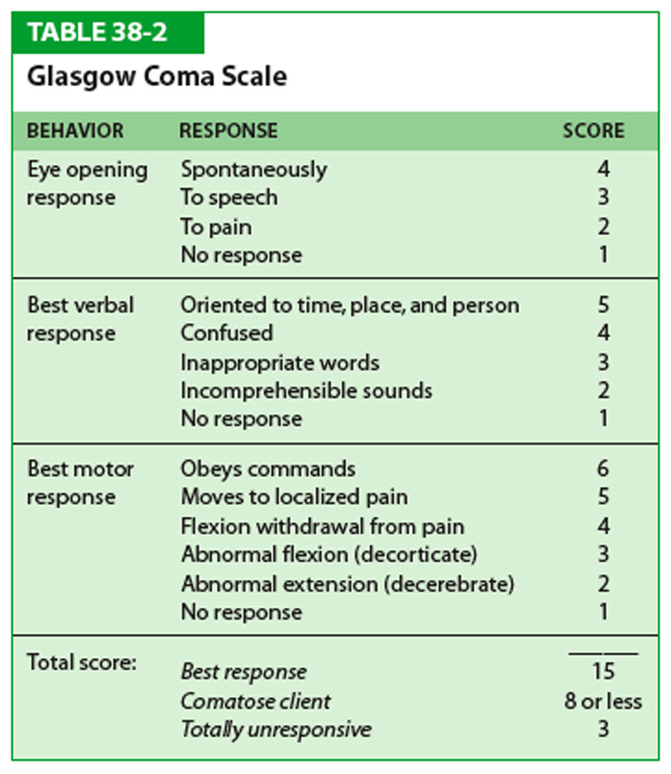

Slide 14
Admitted to ICU criteria in general
compromized airway
GCS ˂= 12
Unstable vital sign
pH ˂=7.2 or 7.5
PaCO2 ˃45-55
PaO2˂60 HYPOXIA
FiO2˃60%needed

Slide 15
Hypoxia classification PaO2 < 60 mmHg
1- Hypoxic Hypoxia in inadequate ventilation and oxygenation. altitude, asthma, Resp. disease
2- Anemic Hypoxia in inadequate hemoglobin content OR function. anemia , carboxy Hb , methemo Hb
3- Circulatory Hypoxia in inadequate perfusion CHF
4- Histotoxic Hypoxia in inability of the cells to utilize oxygen.
Cyanide, salicylic acid poisoning
5- DEMAND HYPOXIA increase O2 requirement fever, seizure .

Slide 16
hypoxemia S&S: restlessness, tachycardia, tachypnea, cyanosis
Cardiac irritability Obtundation Bradycardia Hypotension and Ischemia Cardiac arrest.
hypovolemia S&S: Dehydration+ Decrease B.P ,
Orthostatic hypotension ± decrease Hb level or blood volume

Slide 17
Intubation is the process of inserting a tube, called an endotracheal tube (ET), through the mouth and then into the airway. This is done so that a patient can be placed on a ventilator to assist with breathing during anesthesia, sedation, or severe illness.
Intubation indications: ☻apnea: as in - central decrease GCS ≤ 8 absent gag reflex - induced apnea General anesthesia - poisoning ☻ Resp. failure: - drugs arrest - diseases (ARDS, COPD, Asthma, sepsis) ☻ Resp. airway protection: - risk of aspiration - burn patients ☻ Resp. obstruction: trauma, tumor, laryngeal oedema, epiglottitis
☻hemodynamic instability: shock, cardiac arrest, sever hypothermia

Slide 18
Essential management in ICU: (FAST HUG)
F :feedings A : analgesia S : sedation T : thrombo-embolism prophylaxis
H : head of bed elevation (30 - 45 ) U : ulcer prophylaxis (stress ulcer, bed sore) G : glucose control

Slide 19
Monitoring System
Topics :
1- Non-Invasive BP measurement
2- Central line (central venous catheter)
3- Invasive arterial line
4- Capnography
5- Pulse oximeter
6- Arterial Blood Gas (ABG)
7- Temperature
8- Oxygen analyzer
9- Urine catheter

Slide 20
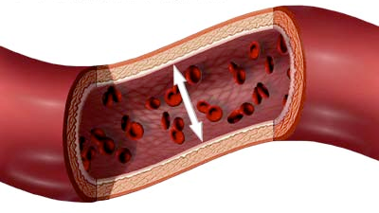
Noninvasive Blood Pressure (NIBP)
Non-invasive BP measurement provides either intermittent or continuous readings. Most commonly, an occluding upper arm cuff is used for intermittent non-invasive monitoring. BP values are then obtained either manually (by auscultation of Korotkoff sounds or palpation) or automatically (e.g., by oscillometry).
In ICU we monitor blood pressure every (1-4) hours.
Why do we monitor BP ?!
1.It Provides data for therapeutic decisions.
2. Important for determining organ perfusion.
3. One of the vital signs .

Slide 21
INVASIVE BLOOD PRESSURE MONITORING (IBP)
Invasive (intra-arterial) blood pressure (IBP) monitoring is a commonly used technique in the Intensive Care Unit (ICU) and is also often used in the operating theatre. This technique involves direct measurement of arterial pressure by inserting a cannula needle in a suitable artery
Arterial cannulation is used: - to access arterial blood sample, for checking ABG. - for arterial pressure monitoring
× But not for intra vascular drug administration.
A saline-filled tube is used to connect the cannula to the transducer, to the display.
It measures IBP on beat to beat basis.

Slide 22
CENTRAL VENOUS PRESSURE (CVP)
The CVP cannula is inserted in to the internal or external jugular vein or subclavian vein
The tip is situated approximately 2cm above the right atrium in the superior vena cava
They provide access for intra venous drugs particularly which produce irritation to peripheral veins e.g. strong potassium chloride

Slide 23
Complications of Central Line :
Pneumothorax
- 30% of all mechanical adverse events of Central Line insertion
- (for central lines placed in the chest); the incidence is thought to be higher with subclavian vein catheterization. In catheterization of the internal jugular vein, the risk of pneumothorax is minimized by the use of ultrasound
Haemothorax
Arterial puncture
Air embolism

Slide 24
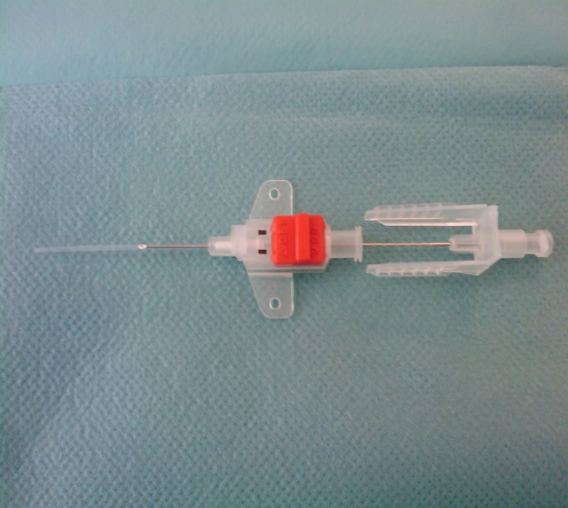
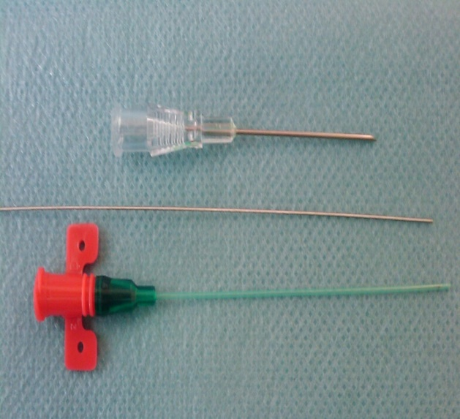
Arterial Line
Arterial lines are commonly used in critical care. They allow us to draw blood easily without having to stick the patient with a needle. They also allow us to draw blood tests that must be drawn from an artery (such as arterial blood gases). Arterial lines are also used when close blood pressure monitoring is required

Slide 25
Definition:
An arterial line or art-line is a thin catheter inserted into an artery.
Most commonly used in I.C.U and anesthesia to monitor the BP and it’s more accurate than measurement of BP by noninvasive means, and to obtain continuous samples for ABGs.
Arterial lines can be placed in multiple arteries, including: the Radial, Ulnar, Brachial, Axillary, Posterior tibial, Femoral, and Dorsalis pedis.
Mostly inserted in Radial artery because its larger and more superficial, Low complication
The second Most common is Femoral artery:larger and strong pulsation
The Optimal Technique (More accurate )

Slide 26
Allen’s test
Allen’s test is medical sign used physical examination of arterial blood flow.
It is used to determine collateral circulation between the Ulnar and Radial arteries to the hand.
recommended to do it before insertion radial arterial line.
Collateral flow should retain within 5-10 sec
More than 10 sec >> insufficient collateral blood flow
Disadvantage: Need Cooperation with the patient
Alternative: Doppler probe, Pulse oximeter , pletysmography

Slide 27
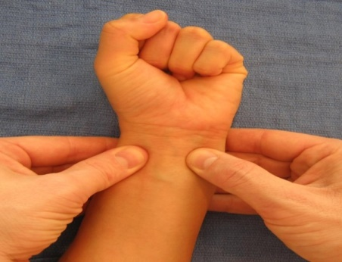
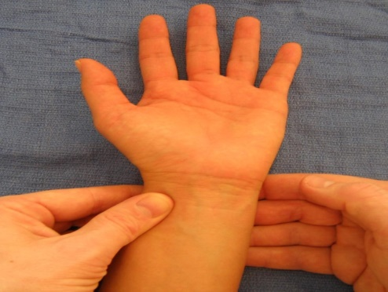
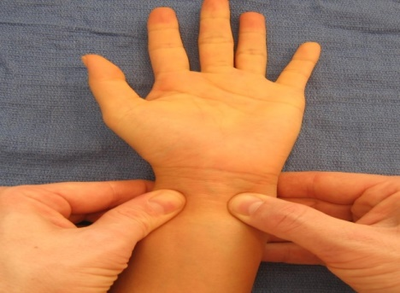
Allen test Technique
The hand is elevated and the patient is asked to clench their fist for about 30 seconds then pressure is applied over the ulnar and the radial arteries so as to occlude both of them.
While the hand is still elevated, ask the patient to open his hand and compare color: it should appear blanched (pallor may observed at finger nail)
Now release the ulnar pressure while maintaining the radial the red color should return quickly.
If red color fails to return, the test is considered abnormal and it suggests that the ulnar artery supply to hand is not sufficient .

Slide 28
Indications for Arterial Catheterization
Patient Factors:
The need for continuous BP measurement in patients who are morbidly obese and severely burned.
Patients with severe sepsis or shock.
Cardiac diseases .
Respiratory Failure.
Vasopressor requirement.
Hemodynamic instability.
Surgical considerations:
Cardiac Surgery.
Major surgery on aorta or carotid artery.
Neurosurgery as craniotomy or aneurysm clipping.
Anesthetic considerations:
Controlled hypotensive technique.
Inability to measure blood pressure non-invasively.

Slide 29
Arterial line Contraindications
Absolute Contraindications:
Absent Pulse.
Thromboangitis obliterans.
Full thickness burns over the cannulation site.
Raynaud syndrome.
Relative Contraindications:
Hemorrhage
Angiopathy
Coagulopathy
Atherosclerosis

Slide 30
Complication of Arterial line insertion
Common complications of arterial line placement are as:
- Temporary radial artery occlusion (19.7%)
- Hematoma /Bleeding (14.4%)
Less common and rare complications include the following:
- Localized catheter site infection
- Hemorrhage
- Sepsis
- Permanent ischemic damage
- Thrombosis
- Air embolism
- Carpel tunnel syndrome
- Arteriovenous fistula

Slide 31
Oxygen Saturation SpO2
The pulse oximeter measures the oxygen saturation
It is noninvasive and risk-free when used properly, the pulse oximeter should be used in all clinical settings in which there is a potential risk of arterial hypoxemia.
It provides an early and immediate warning of hypoxaemia
If SpO2 is below 95%, it means the O2 delivering system is inadequate to meet the needs of the tissue or poor cardiac output
Start O2 if SPO2 less than 95%

Slide 32
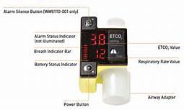
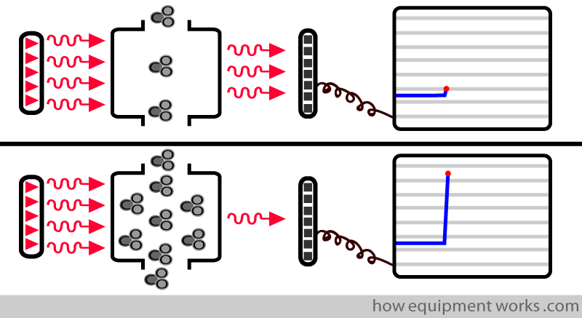
CAPNOGRAPHY
*Capnography is monitoring of the concentration or partial pressure of carbon dioxide (Co2) usually presented as graph.
1-A numerical value of the EtCO2 measured by capnometer.
2-A waveform of the concentration of CO2 present in the airway presented by capnogram.
*Capnographs in common use rely on the absorption of infrared light by CO2.
*As with oximetry, absorption of infrared light by CO 2 is governed by the Beer–Lambert law.

Slide 33
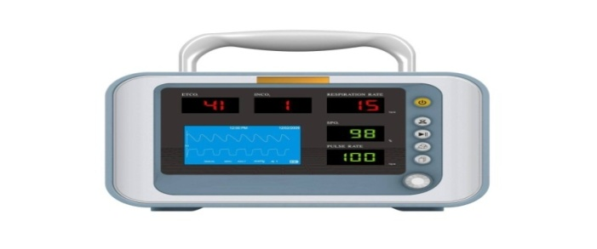
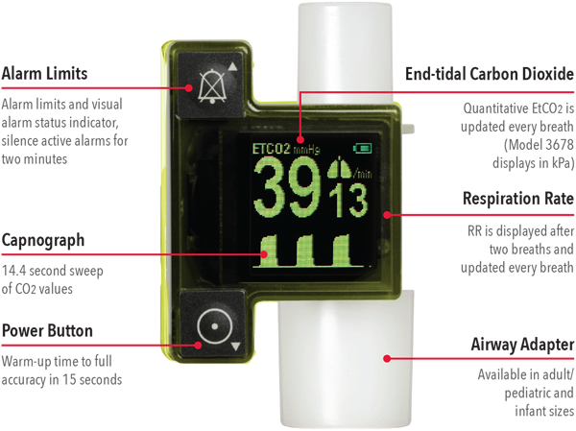
ETCO2
*is the partial pressure or maximal concentration of carbon dioxide (CO2) at the end of an exhaled breath, which is expressed as a percentage of CO2 or mmHg.
*The normal values are 5% to 6% CO2, which is equivalent to 35-45 mmHg.
*ETCO2 Less Than 35 mmHg
-“Hypocapnia”
- Respiratory Alkalosis
*ETCO2 Greater Than 45 mmHg
-“Hypercapnia”
- Respiratory Acidosis

Slide 34
Indications for Use - End-Tidal CO2 Monitoring
1-Validation of proper endotracheal tube placement
2-Detection and Monitoring of Respiratory depression
3-Hypoventilation
4-Obstructive sleep apnea
5-Procedural sedation
6-Adjustment of parameter settings in mechanically ventilated patients

Slide 35
Renal Diseases I
Arterial Blood Gas (ABG)

Slide 36
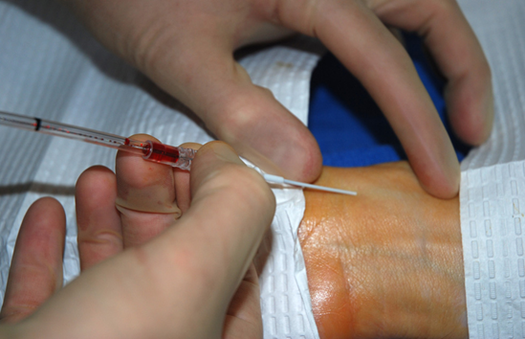
Arterial Blood Gases
ABG test measure the acidity (pH) and the level of oxygen and carbon dioxide in the blood from an artery .
This test is used to check how well your lungs are able to move oxygen in to the blood and remove carbon dioxide from the blood.
Blood drown from an artery (radial, brachial, femoral) where O2 and CO2 levels can be measured before they enter body tissues.
Used for management and diagnosis of patient’s oxygenation status (PaO2, SaO2), ventilation status (PCO2) and acid-base balance (pH, HCO3).

Slide 37
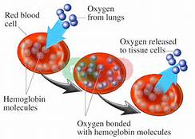
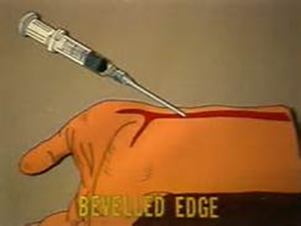
Normal ABG values
PO2 80 – 100 mmHg
PCO2 35 – 45 mmHg
pH 7.35 – 7.45
HCO3 22 – 26 mmol/L
SaO2 >95%
What artery to choose?
The radial artery, because it is superficial, has collaterals and easily compressed. It should almost always be the first choice.
Other arteries (femoral, dorsalis pedis, brachial) can be used in emergencies.

Slide 38
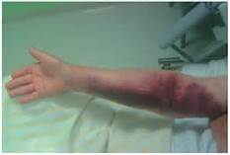
Contraindication
Complication
Most commonly Hematoma at the site.
Less common but important complications are thrombus in the artery and infection at the site.
Bleeding diathesis
AV fistula
Severe peripheral vascular disease, absence of an arterial pulse.

Slide 39
Patient Temperature
Temperature regulation is important to the survival of the patient
Although uncommon, hypothermia below 32° C is ominous.
Ventricular irritability increases, and if the temperature decreases to 28° C cardiac arrest is likely to occur.
Shivering can increase oxygen demand 135% to 468%, when respiratory and cardiovascular systems may be unable to respond normally to the increased demand.
Sites for monitoring body temperature:
Oral, Tympanic membrane, Esophageal, Nasopharyngeal, Pulmonary arterial blood, Rectal, Bladder, Axillary, Forehead.

Slide 40
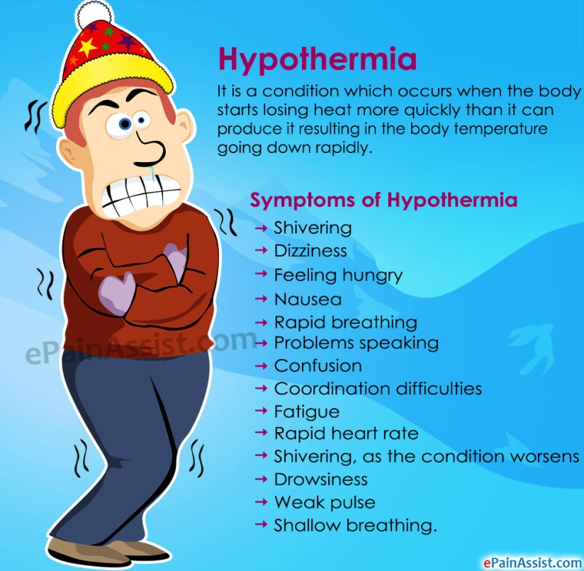
Hypothermia
Hypothermia is defined as a potentially dangerous drop in body temperature below 35°C (95°F), and can be the result of environmental forces (accidental hypothermia), a metabolic disorder (secondary hypothermia), or a therapeutic intervention (induced hypothermia).
Usually caused by prolonged exposure to cold temperatures.
Causes:
Cold exposure.
Certain medical conditions such as diabetes and thyroid conditions, some medications, severe trauma, or using drugs or alcohol all increase the risk of hypothermia.

Slide 41
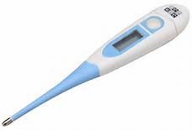
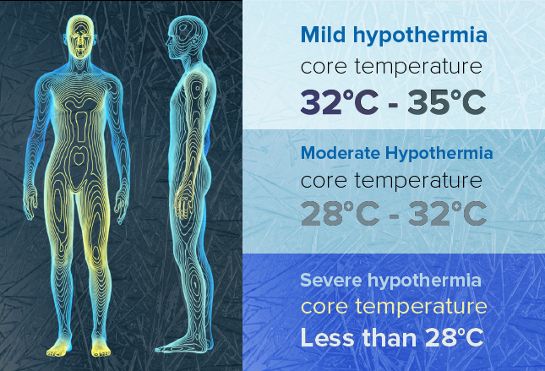
Temperatures for mild, moderate,
and severe hypothermia generally range from:

Slide 42
Mild Hypothermia (32 – 35°C )
shivering – not under voluntary control
Cold, pale skin from vasoconstriction to periphery (fingers, toes etc)
Confusion
Tachycardia
Moderate hypothermia (28 – 31.9°C )
reduced level of consciousness
loss of fine motor coordination, particularly in hands due to restricted peripheral blood flow
slurred speech
violent shivering
Bradycardia
Bradypnea
Lethargy

Slide 43
Severe hypothermia (< 28°C)
casualty falls to the ground, curls up into a fetal position to conserve heat
muscle rigidity develops because peripheral blood flow is reduced and due to lactic acid and carbon dioxide buildup in the muscles
the skin becomes pale
Patients are usually obtunded or comatose with dilated, fixed pupils
pulse rate decreases
No shivering
Hypotension
Oliguria
Edema
Arrhythmias

Slide 44
What Is the Management for Hypothermia ?
Hypothermia is a potentially life-threatening condition that needs emergency medical attention.
EXTERNAL REWARMING
Remove any wet clothes, hats, gloves, shoes, and socks.
Protect the person against wind, drafts, and further heat loss with warm, dry clothes and blankets.
Move gently to a warm, dry shelter as soon as possible.
Begin rewarming the person with extra clothing. Use warm blankets.

Slide 45
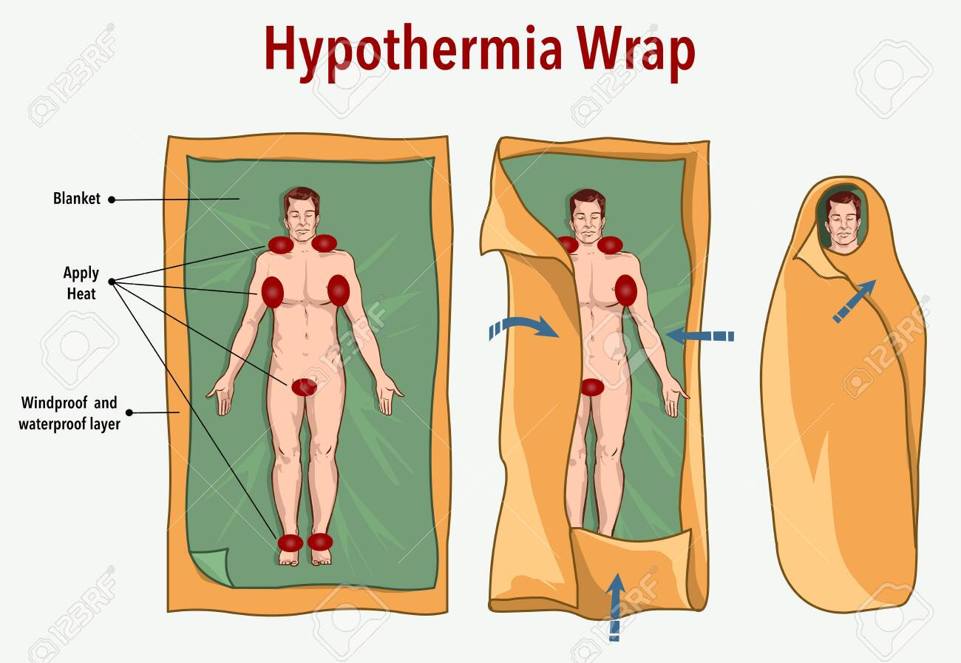
Take the person's temperature if a thermometer is available.
Offer warm liquids, but avoid alcohol and caffeine, which speed up heat loss. Don't try to give fluids to an unconscious person.
CPR should be continued, in the absence of signs of breathing or a pulse,
INTERNAL REWARMING: rewarm the core temperature. Hypothermia treatment may include warmed IV fluids, heated and humidified oxygen, peritoneal lavage (internal "washing" of the abdominal cavity), and other measures.

Slide 46
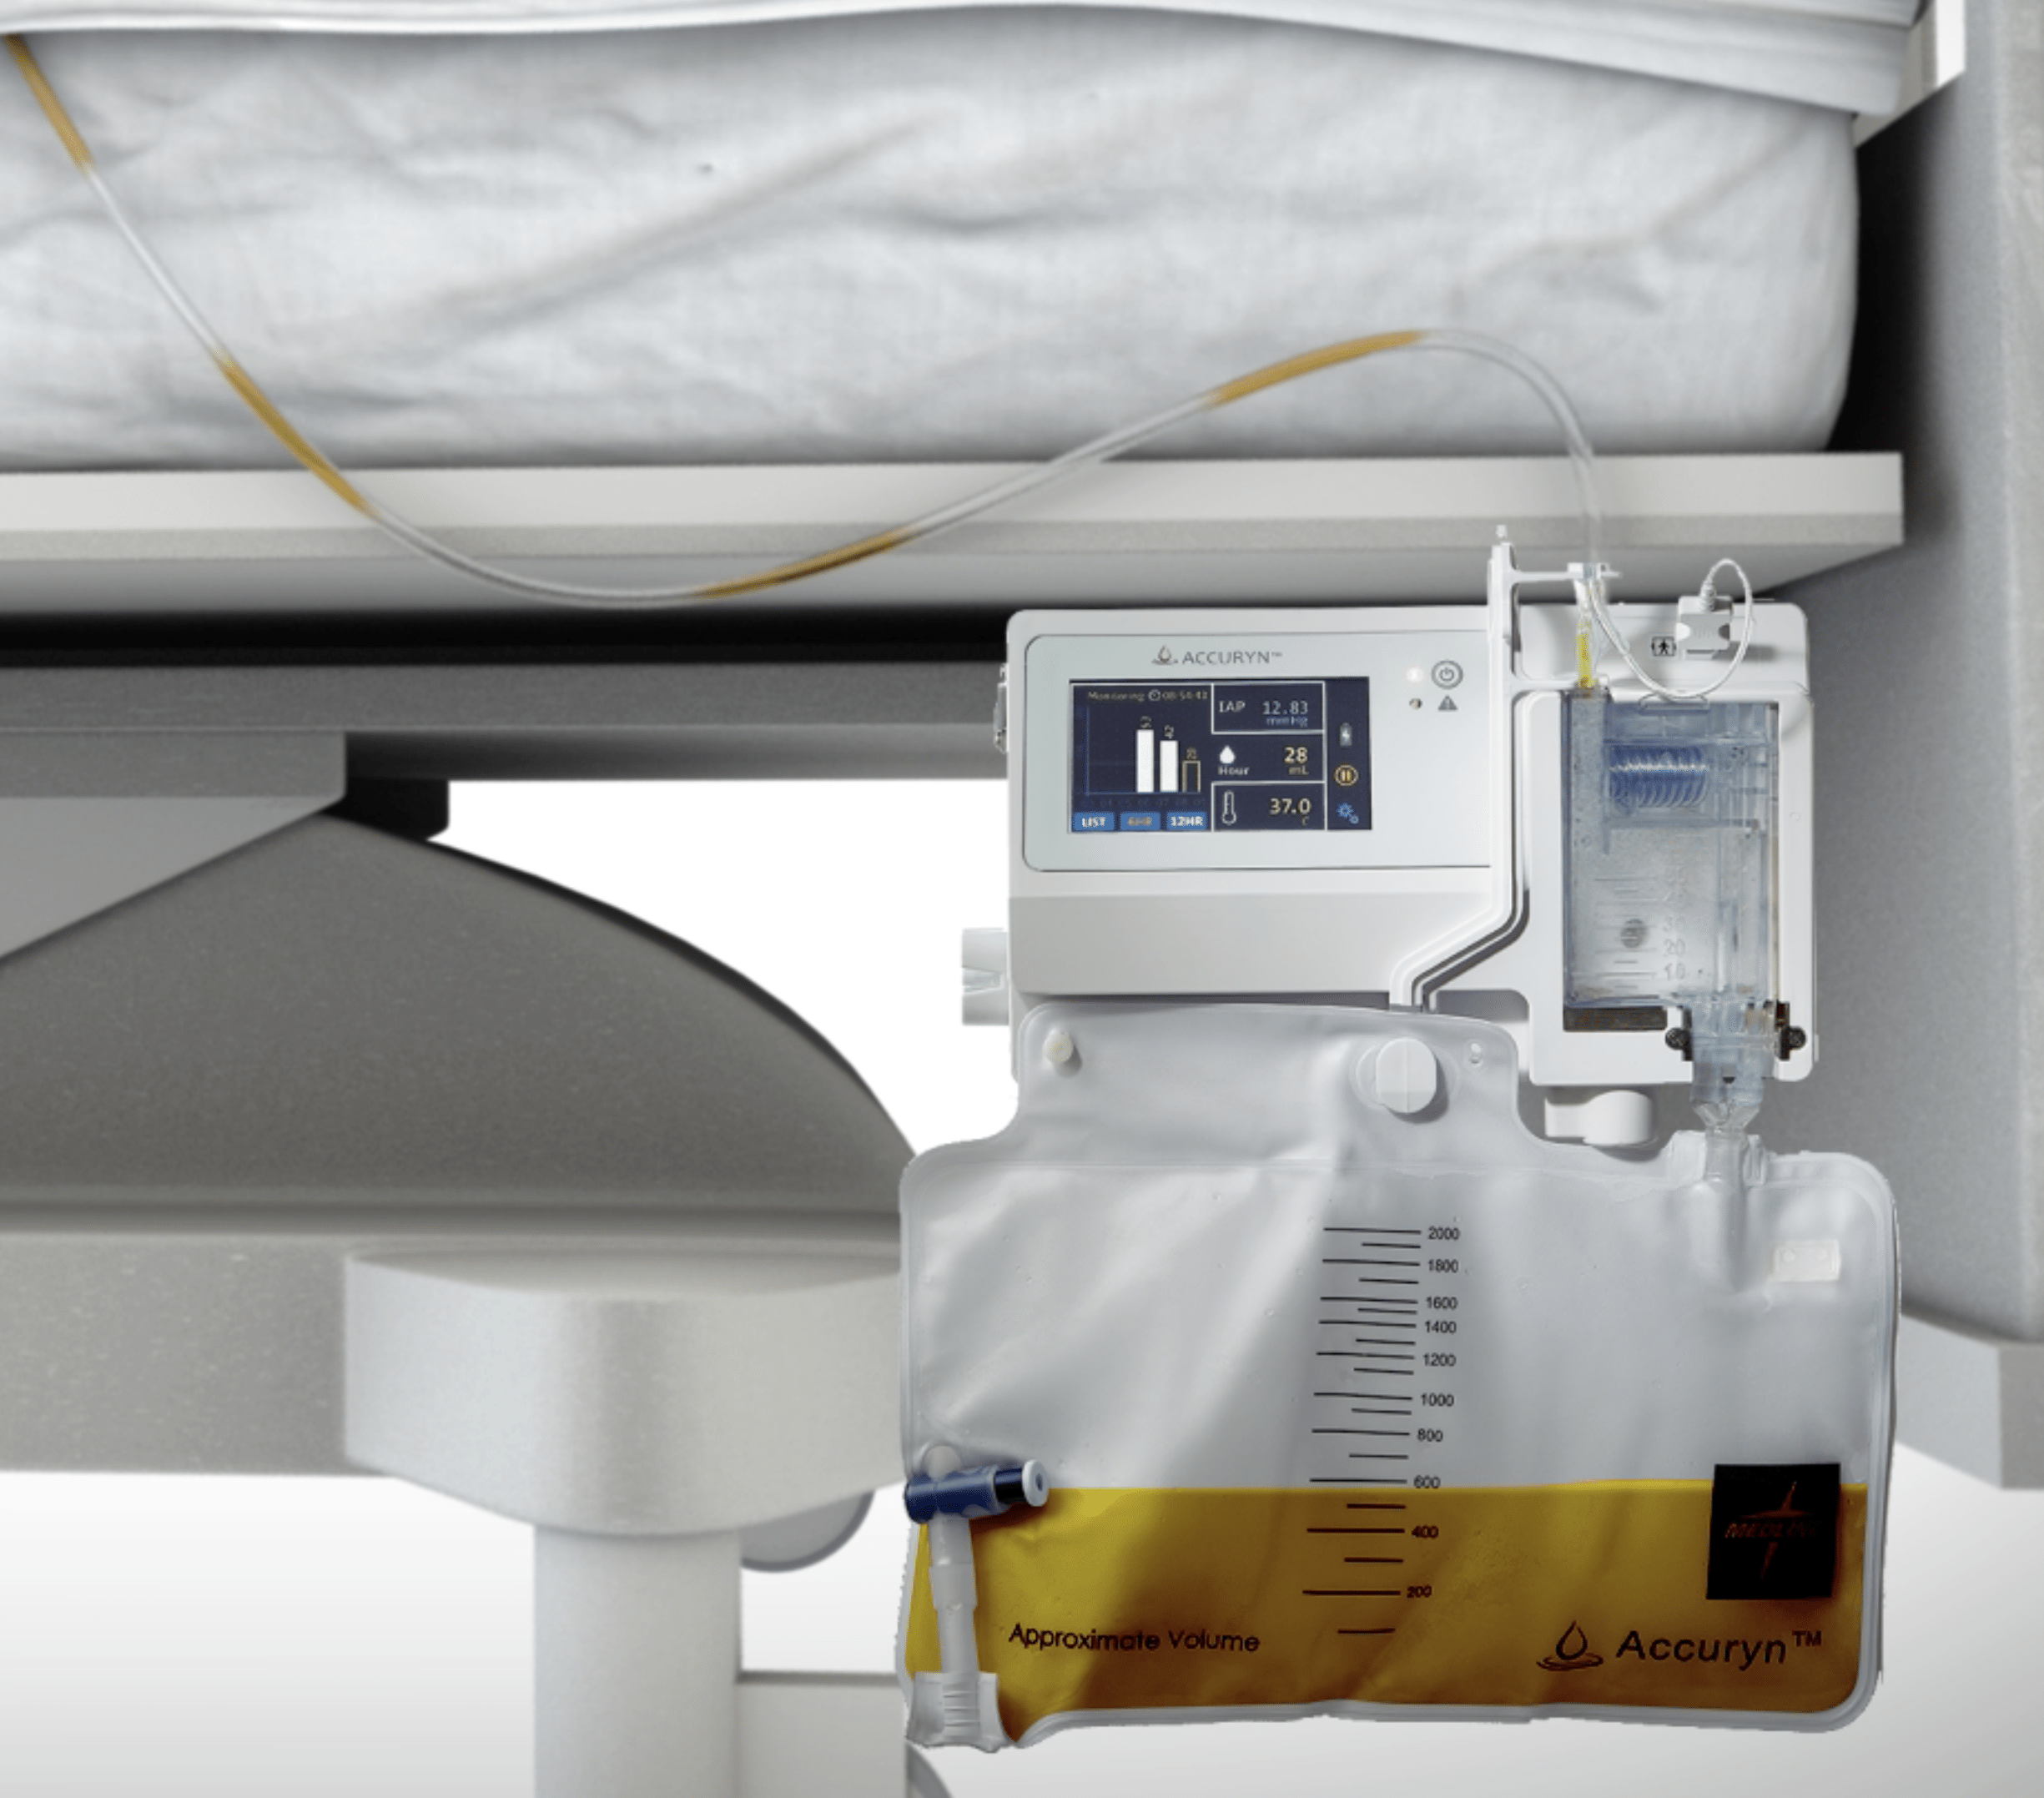
Renal Diseases I
Monitoring the Urine Output

Slide 47
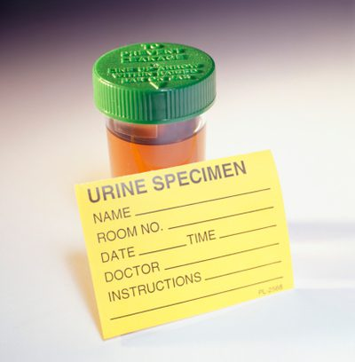
Urine output is the best indicator of the state of the patient’s kidneys. If the kidneys are producing an adequate amount of urine it means that they are well perfused and oxygenated. Otherwise, it is a sign that the patient is suffering from some complication.
Physical Characteristics of urine examination:
Volume
Color
Odor
pH
Specific gravity

Slide 48
Volume
Normal- 1-2.5 L/day.
Oliguria- Urine Output < 400ml/day. Seen in – Dehydration – Shock – Acute glomerulonephritis – Renal Failure
Polyuria- Urine Output > 2.5 L/day. Seen in – Increased water ingestion – Diabetes mellitus, insipidus, excessive use of diuretics, excess caffeine or alcohol.
Anuria- Urine output < 100ml/day. Seen in renal shut down Volume, obstruction, such as kidney stone or tumor.

Slide 49
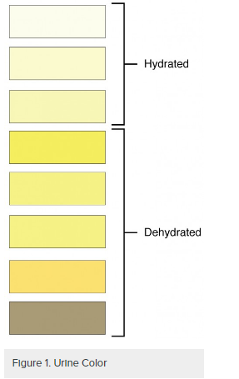
Color
Normal- pale yellow in color due to pigments urochrome, urobilin and uroerythrin.
Cloudiness may be caused by excessive cellular material or protein, crystallization or precipitation of non pathological salts upon standing at room temperature or in the refrigerator, also can be caused by urinary tract infections or obstructions.
Color of urine depending upon it’s constituents.
Abnormal colors:
Colorless – diabetes, diuretics.
Deep Yellow – concentrated urine, excess bile pigments, jaundice Color
Red urine - indicates red blood cells within the urine, a sign of kidney damage and disease.

Slide 50
Odor
Normal - aromatic due to the volatile fatty acids, On long standing(aged urine) – ammonical (decomposition of urea forming ammonia which gives a strong ammonical smell)
Foul, offensive - pus or inflammation
Sweet - Diabetes
Fruity - Ketonuria

Slide 51
PH
Reflects ability of kidney to maintain normal hydrogen ion concentration in plasma & ECF
Normally it is slightly acidic lying between 6 – 6.5. • Acidic Urine –Ketosis (diabetes), UTI- E.coli
Much of the variation occurs due to diet. For example, high protein diets result in more acidic urine, but vegetarian diets generally result in more alkaline urine Chronically high or low pH can lead to disorders, such as the development of kidney stones or osteomalacia.

Slide 52
Specific gravity
•the ability of the kidney to concentrate the urine relative to the plasma from which it is filtered.
• Normal :- 1.001- 1.040.
Increase in Specific Gravity - Low water intake, Diabetes mellitus, Albuminuruia, Acute nephritis. Decrease in Specific Gravity - Absence of ADH, Renal Tubular damage.

Slide 53
To measure urine output in critical care units, a Foley catheter is introduced through the patient’s urethra until it reaches his/her bladder. The other end of the catheter is connected to a graduated container that collects the urine. Periodically the nursing staff manually records the reading of the container of every patient, and operates a valve which releases the urine into a larger container.
To avoid urine reflux and minimize the risk of infection, the chamber should remain at a level below the bladder.
Keep the urinary catheter bag lower than the patient!!!
often only burn patients—for whom urine output monitoring is of paramount importance—have this parameter recorded every hour, while the remaining critical patients have it recorded every 2 or 3 hours.

Slide 54
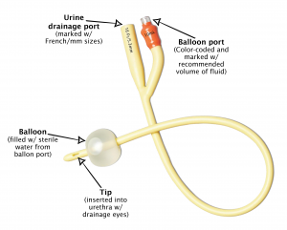
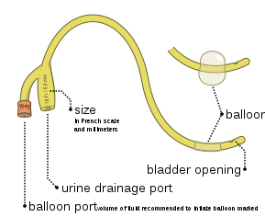

Slide 55
Complications of catheterization, urethral trauma & UTI. Rapid decompression of a distended bladder can cause hypotension.
An additional advantage of placing Foley catheter is the ability to include a thermistor in the catheter tip so that bladder temp can be monitored.
As long as urinary output is high, bladder temp. accurately reflects core temp.

Slide 56
Thank You !!

