Slide 1
BRAIN DEATH
Presented by : Anas Ganem
Mojahed Al-Harazneh
Done by : Mojahed Al-Harazneh

Slide 2
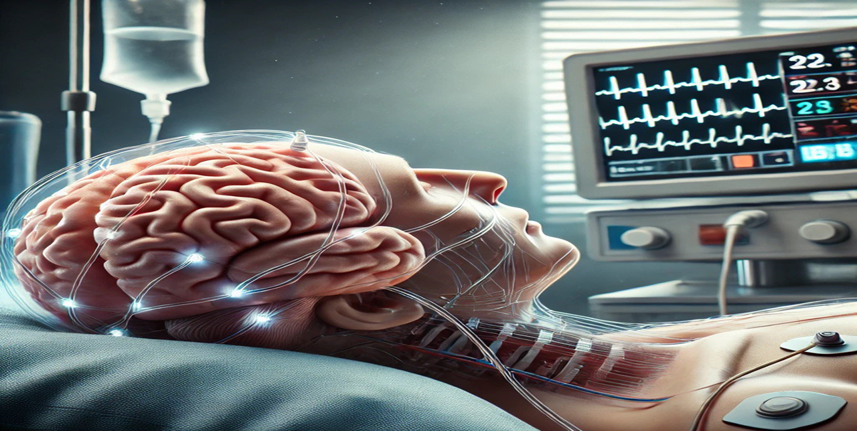

Slide 3
Table of contents
Death and its types
Glasgow coma scale
Survival window
Examination
BRAIN STEM REFLEXES

Slide 4
Death and its types
01

Slide 5
What do we mean by death ?
Death is an irreversible , biological event that consists of permanent cessation of the critical function of the organism as a whole , especially respiration and heart beat.

Slide 6
What do we mean by clinical death ?
Clinical death is the cessation of the circulatory and respiratory functions.

Slide 7
What do we mean by Brain death ?
Brain death ( aka Biological or Legal death ) is the irreversible damage and loss of functions of the entire brain ( the cerebrum and the brain stem ) which results in loss of consciousness and termination of vital signals from the brain stem.

Slide 8
Survival window
02

Slide 9
What does survival window mean ?
When it comes to the brain , the survival window refers to the critical time period during which the brain can survive without Oxygen before irreversible damage occurs.

Slide 10
Survival window
Clinical death will eventually progress into brain death , unless we revive the circulatory and respiratory systems by CPR and defibrillation to limit the brain damage.
Brain damage starts as early as 4-10 minutes after clinical death.
So , basically those 4-10 minutes are our “ survival window “.

Slide 11
Death pronouncement
Two physicians must be involved in examining then announcing death.
Criteria they should meet :
1- 5 years post bachelor degree of medicine and surgery.
2- Preferably neurologist or neurosurgeon.
3- They must not be previously involved with patient care.
4- They must not be with the organ transplant team.

Slide 12
When is the patient pronounced dead ?
1- GCS = 3
2- loss of brain stem reflexes.
3- absent motor activity.
4- positive apnea test ( done twice 12 hours apart ).

Slide 13
Glasgow coma scale
03

Slide 14
Glasgow coma scale
The Glasgow Coma Scale (GCS) was developed in 1974 by Graham Teasdale and Bryan Jennett, both professors of neurosurgery at the University of Glasgow in Scotland. It was created to provide a standardized way to assess the level of consciousness in patients who had suffered a head injury, particularly in emergency settings.
The GCS measures three key aspects of a patient’s response:
1. Eye opening (E)
2. Verbal response (V)
3. Motor response (M)

Slide 15
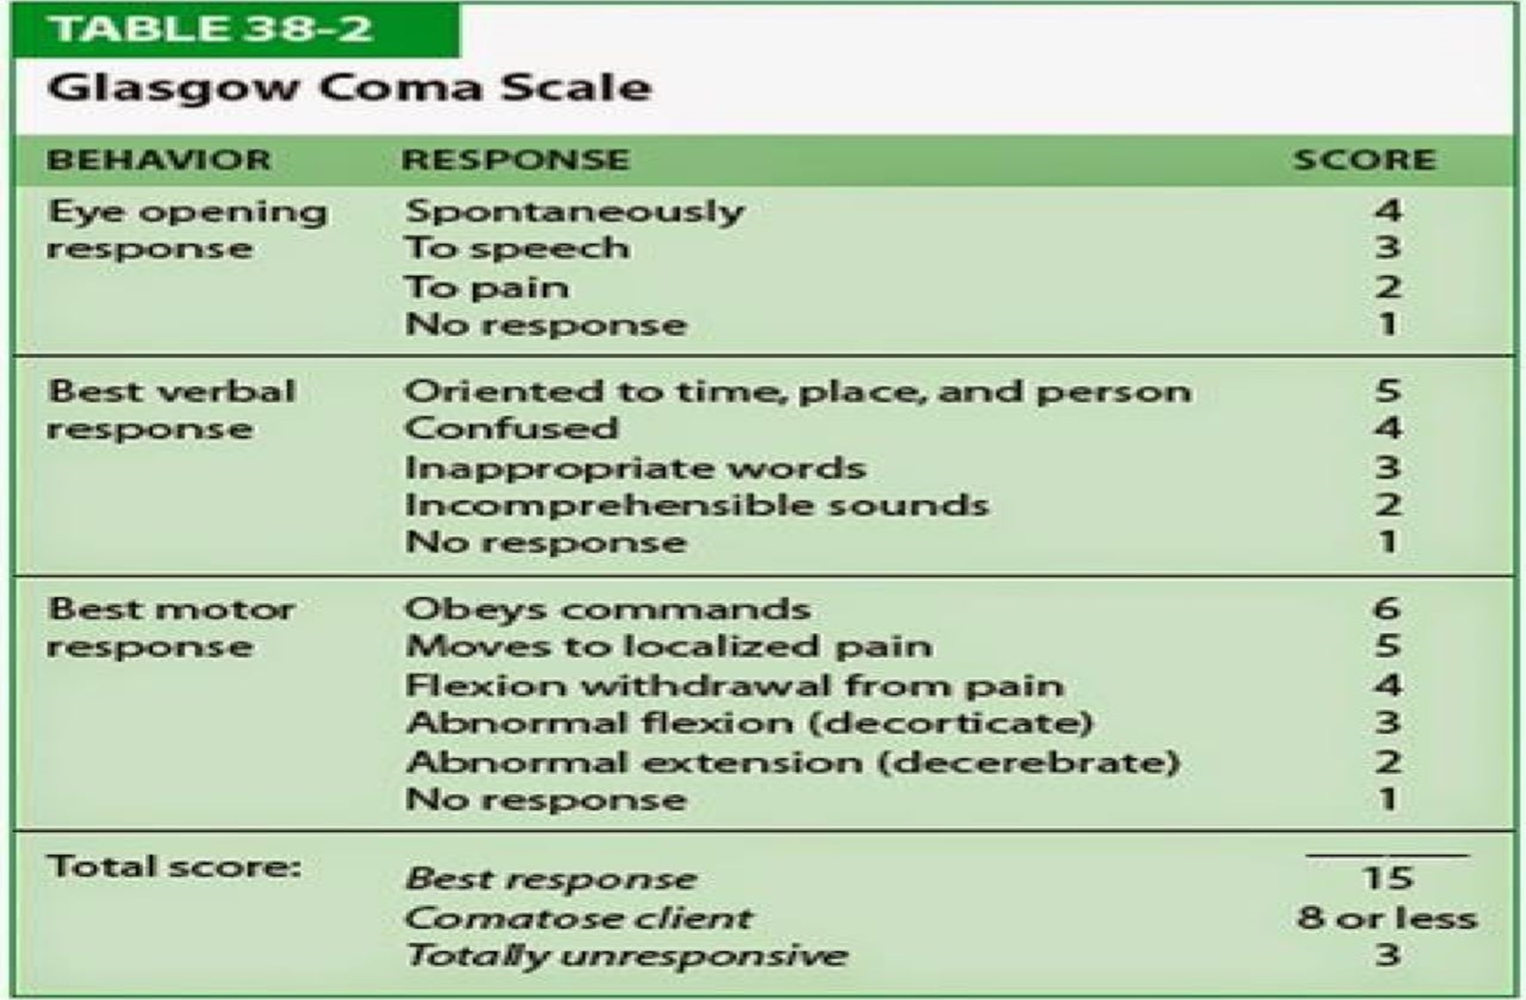

Slide 16
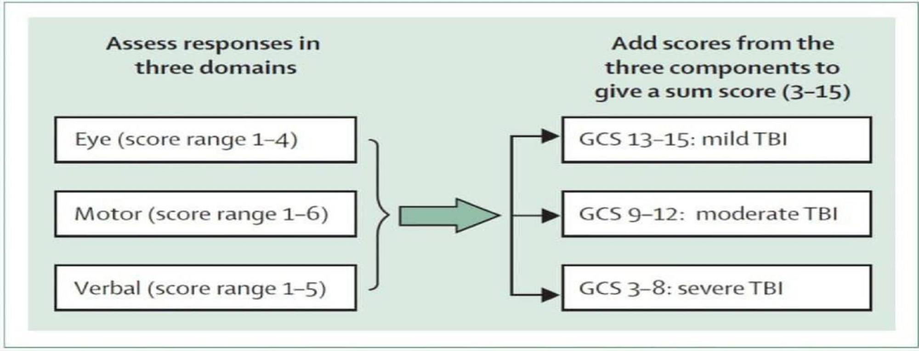
Glasgow coma scale

Slide 17
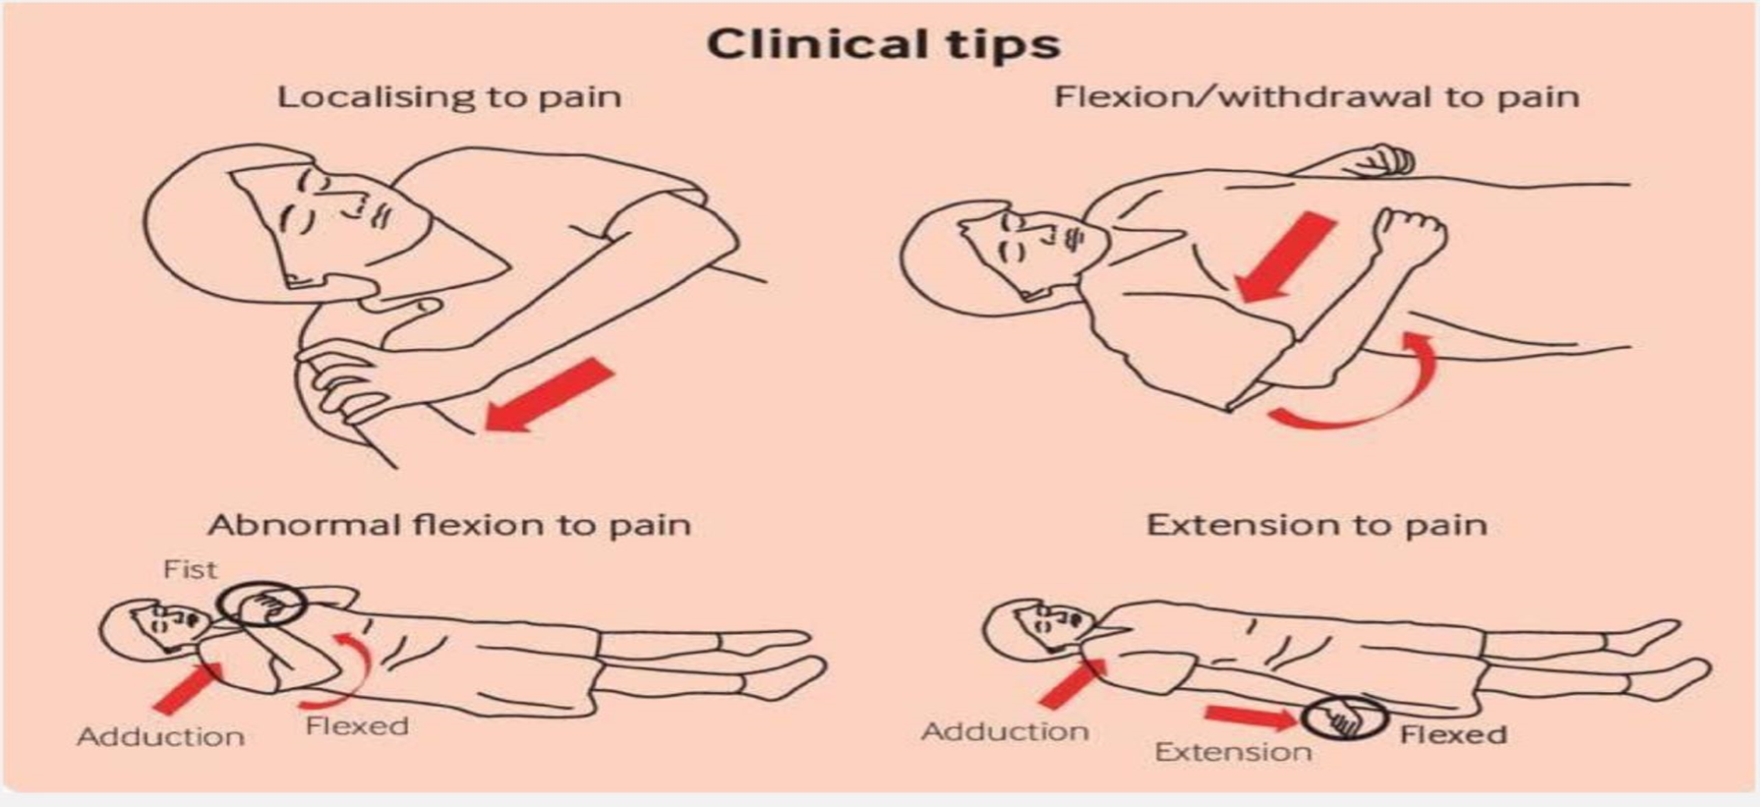
Glasgow coma scale

Slide 18
Examination
04

Slide 19
Examination
Before the examination , there are 4 things should be stabilized :
1- Stable vital signs.
2- Body temperature > 34 C.
3- Normal electrolytes and a free toxicology screen.
4- Normal PCO2 level ( 35-45 mmHg ).

Slide 20
BRAIN STEM REFLEXES
05

Slide 21
BRAIN STEM REFLEXES
Brain stem reflexes are involuntary responses that indicate brain activity. Common reflexes include the pupillary reflex and the corneal reflex. Absence of these reflexes is a significant indicator in the assessment of brain death and helps determine the integrity of brain function.

Slide 22
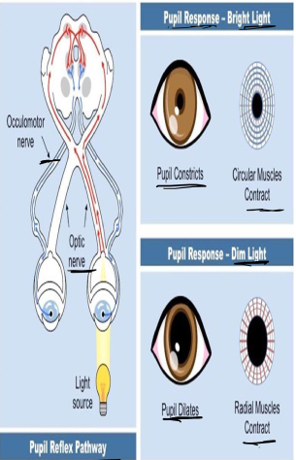
Pupillary Reflex Assessment
The pupillary reflex involves checking the reaction of pupils to light. In brain death, pupils remain fixed and dilated. This reflex is one of the first indicators assessed in determining brain function.

Slide 23
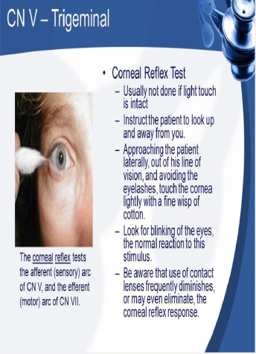
Corneal Reflex Testing
The corneal reflex is tested by lightly touching
the cornea. In a brain-dead patient, there is no
blink response. This reflex is critical in
assessing the integrity of brain stem function

Slide 24
Gag and Cough reflex
Additional reflexes such as the gag reflex and
cough reflex are also evaluated. The absence of
these reflexes supports the diagnosis of brain
death and indicates a non-functioning brain stem

Slide 26
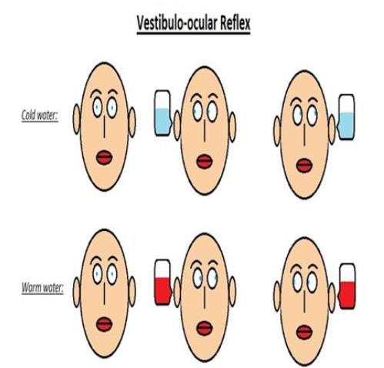
Cold caloric
The Cold Caloric Test involves irrigating the ear canal with cold water and warm water to assess vestibular function. This test evaluates the brainstem's response to temperature changes, helping to identify potential neurological deficits. A normal response indicates intact brainstem function, while an abnormal response can signal brain death.
Intitial eye movement = CSWO= Cold Same, Warm Opposite.
Nystagmus = COWS = Cold Opposite, Warm Same

Slide 27
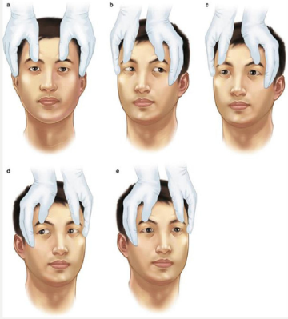
Doll's Eyes
The Doll's Eyes Test assesses the oculocephalic reflex, which helps determine brainstem integrity. When the head is turned, the eyes should move in the opposite direction if the brainstem is functioning properly. A lack of this reflex can indicate severe neurological impairment.

Slide 28
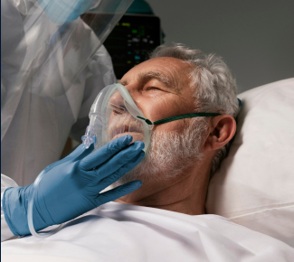
Apnea Test
The apnea test is a critical component in
diagnosing brain death. It measure the
ability to breathe independently. If the
patient does not initiate breathing when
carbon dioxide levels rise, it indicates the
absence of brain stem function,
supporting the diagnosis of brain death.

Slide 29
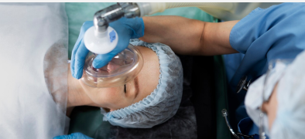
▪ We test for the respiratory centers in the medulla oblongata by sensitizing them with increasing PaCO2 up to 60mmHg (we anticipate visible signs of respiratory musculature contraction if the brain stem isn't severely damaged beyond repair).
▪ A common method of apnea testing involves disconnection of mechanical ventilation from the patient, followed by the insertion of a catheter or cannula into the endotracheal tube, down to the level of the carina, through which oxygen is delivered.
before we start , we hyperventilate the patient with 100% O2 - CPAP into tube with 6L of O2/min - ABG every min for 8-10 min
- we make sure that systolic blood pressure doesn't fall below 90mmHG during the entire test and the oxygen saturation level below 85% or else we stop and end the test and repeat it else time

Slide 30
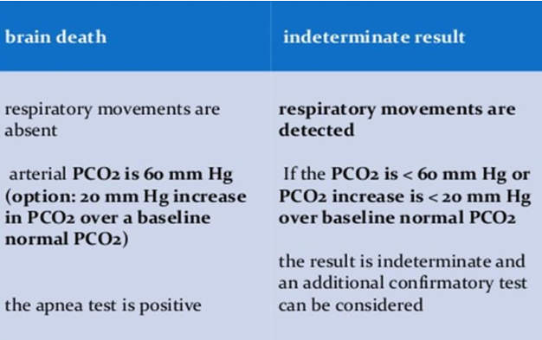
Positive Or Negative

Slide 31
After confirmation of brainstem death
▪ If the patient meets all criteria for brain death on both examinations,
this should be noted in the medical record at the time of the second exam.
▪ This time becomes the time of legal death declaration.
▪ If organ donation is considered,
the situation is discussed with the family,
primarily to ascertain the patient’s wishes about donation (if known).
▪ If donation is possible, intensive care of the body must be continued

Slide 32
Thanks!

