Slide 1
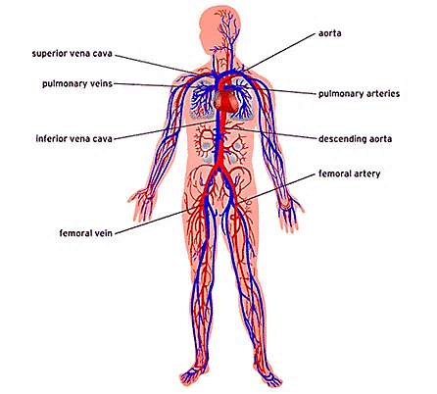
Vascular system practical slides 1st year

Slide 2
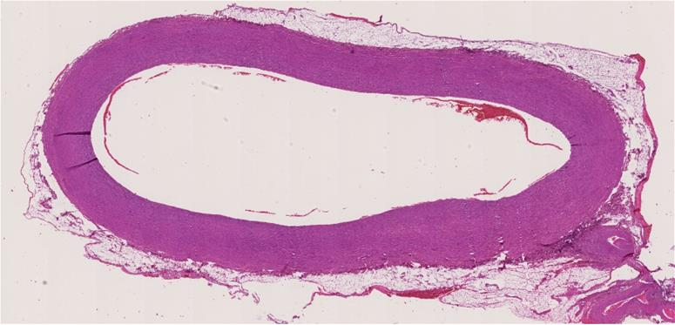
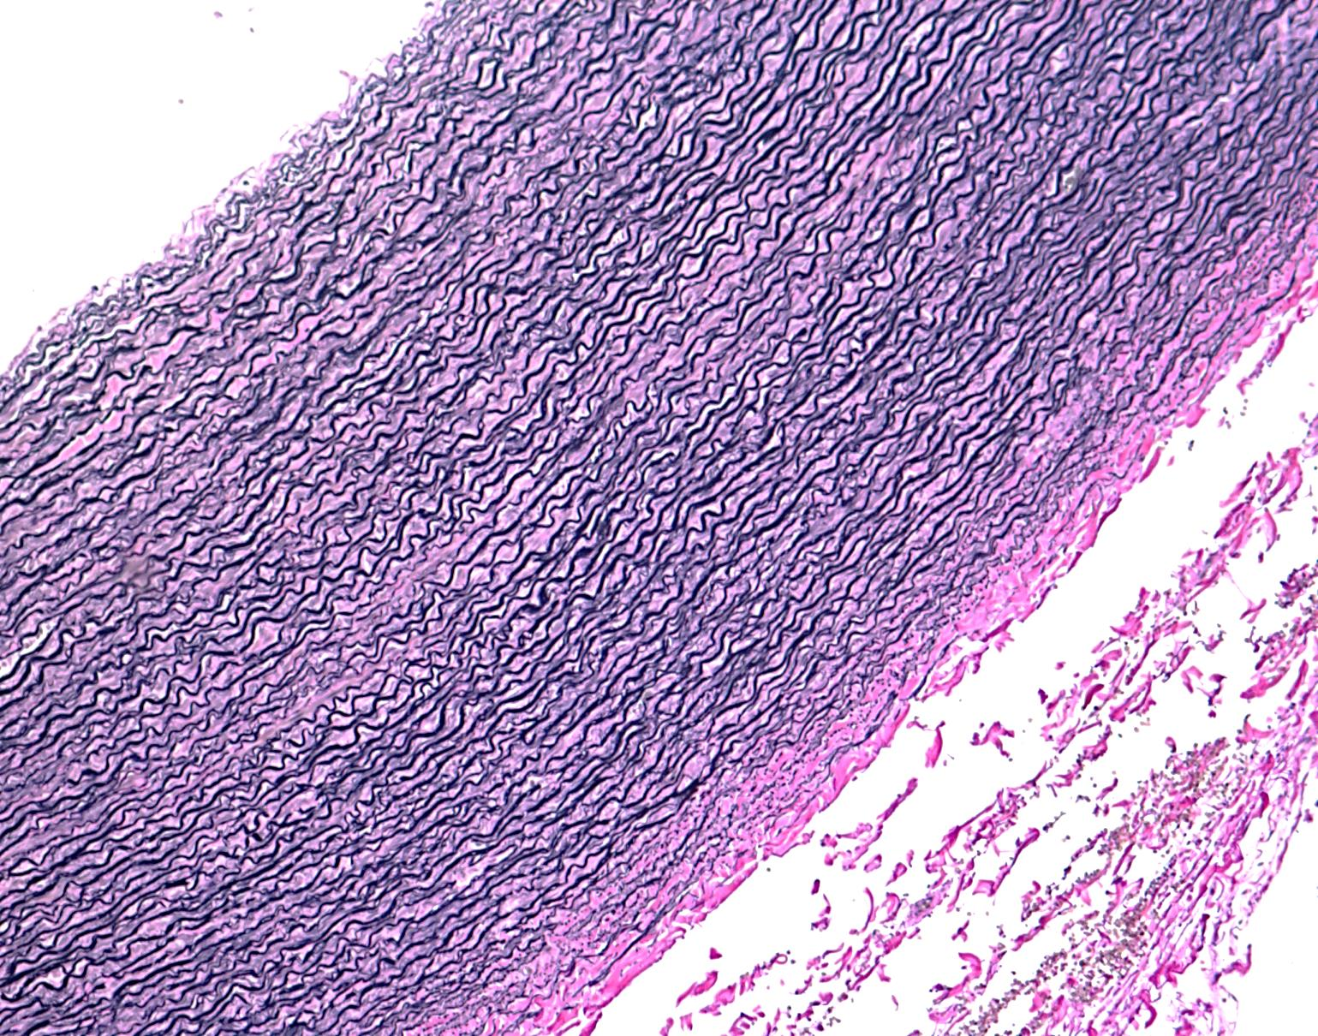
Aorta / Large elastic arteries
Tunica Media contains
elastic membranes
&fibers
Tunica adventitia

Slide 3
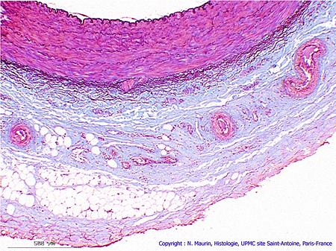
Vasa vasorum
Vasa vasorum
Tunica adventitia

Slide 4
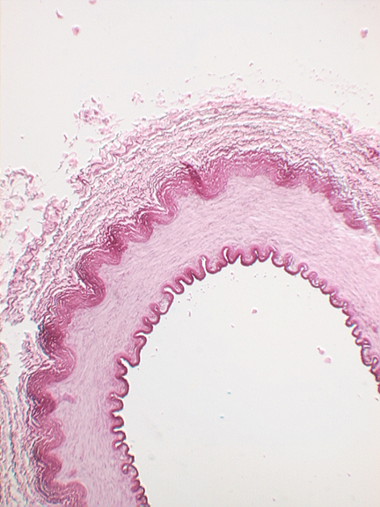
Basilar artery/ muscular artery
EEL
IEL

Slide 5
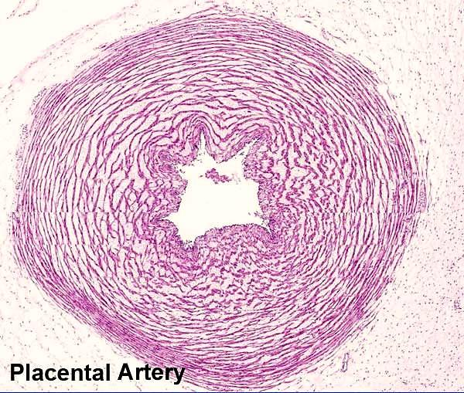
Umbilical cord /umbilical artery
Adventitia formed of Mucoid C.T

Slide 6
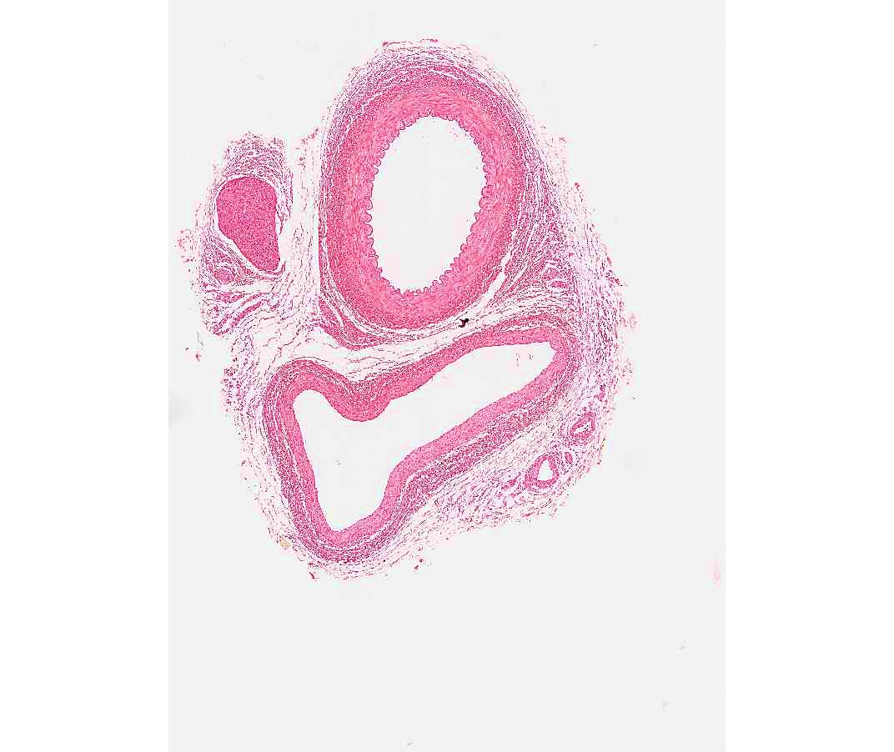
Medium size artery and vein
artery
vein

Slide 7
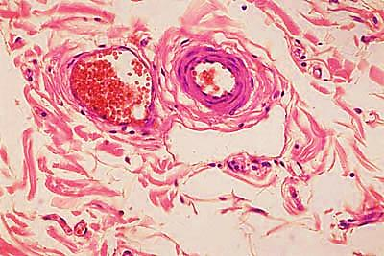
Arteriole / venule
venule
arteriole

Slide 8
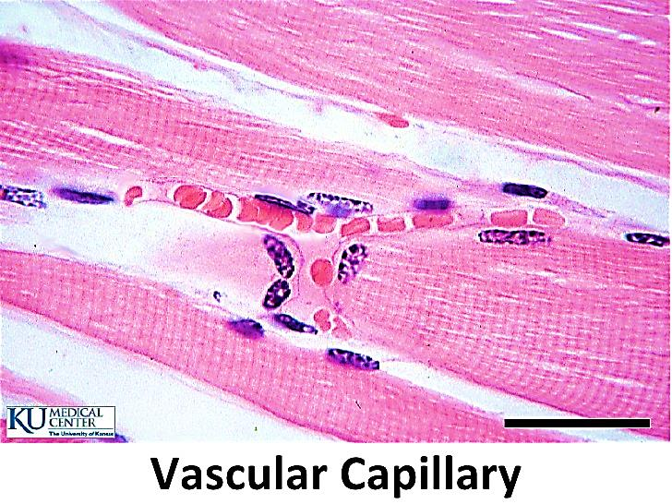
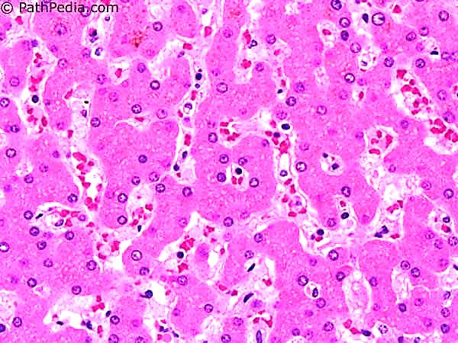
Capillary / sinusoids
Capillary
sinusoids

Slide 9
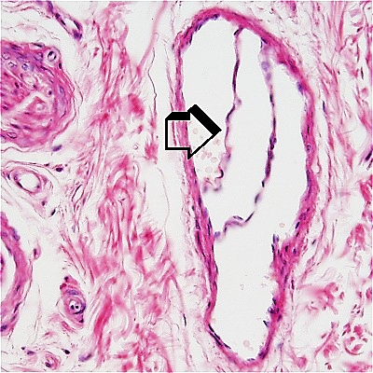
Vein /valve

Slide 10
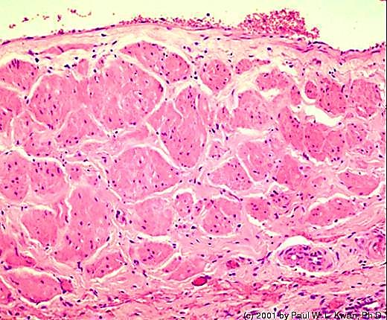
Vena cava
Longitudinal bundles of smooth muscles in tunica adventitia

Slide 11
Thank you

