Slide 1
UROGENITAL SYSTEM
External Genitalia (Male &Female)
Dr. Aiman Qais Afar AL-Maathidy
Surgical Anatomist
College of Medicine /University Of Mutah
2022-2023

Slide 2
External male genital organ
Penis
- This is the male copulatory organ. It is formed of two main parts.
1- Root of the penis: lies in the superficial perineal pouch.
Is made up of three masses of erectile tissue called:
the bulb of the penis and
the right and left crura of the penis

Slide 3
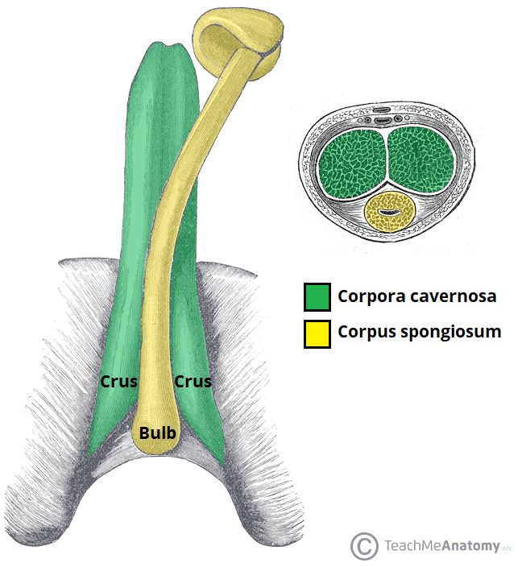
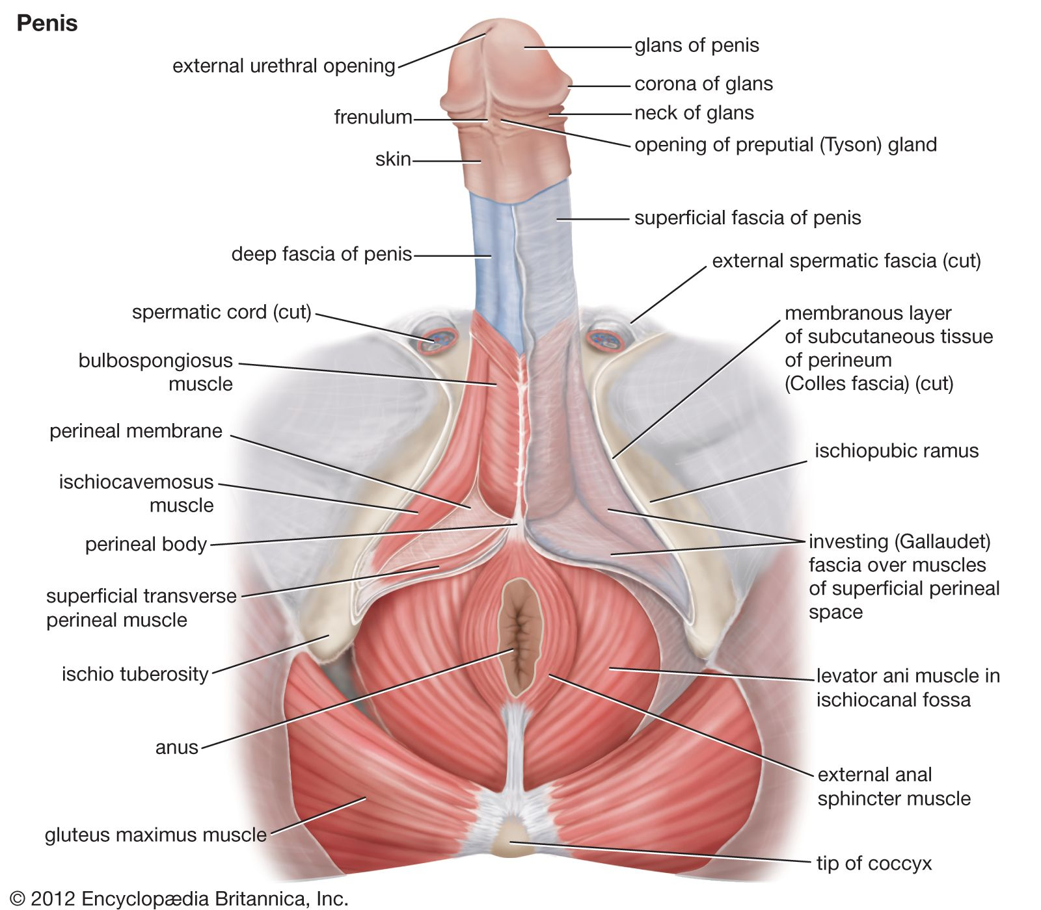
External male genital organ
1. Root of the Penis
The bulb is situated in the midline and is attached to the undersurface of the urogenital diaphragm
It is traversed by the urethra and is covered on its outer surface by the bulbospongiosus muscles
The bulb is continued forward into the body of the penis and forms the corpus spongiosum

Slide 4
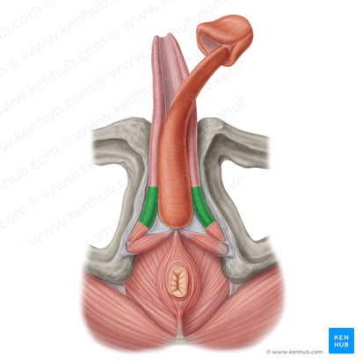
External male genital organ
1. Root of the Penis
Distally, the corpus spongiosum expands to form the conical glans of penis, or head of the penis
Each crus is attached to the side of the pubic arch and is covered on its outer surface by the ischiocavernosus muscle.
The two crura converge anteriorly and come to lie side by side in the dorsal part of the body of the penis, forming the corpora cavernosa

Slide 5
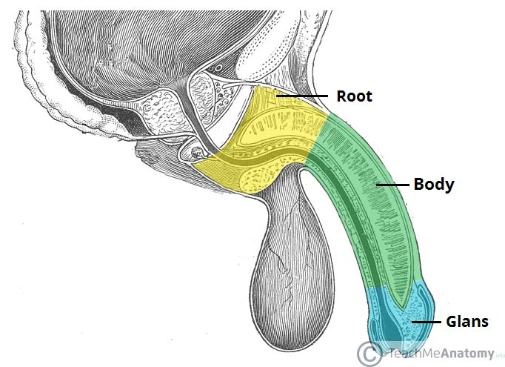
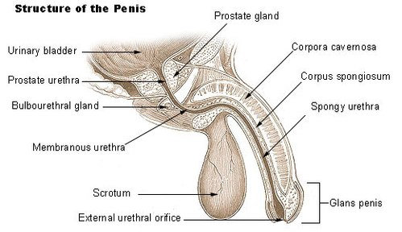
Penis
2- Body of the penis this is the free pendulous part.
- The end of the body is enlarged called the glans penis.
- The tip of the glans carries the external urethral orifice.
- The constriction between the body and the glans called neck of the penis.

Slide 6
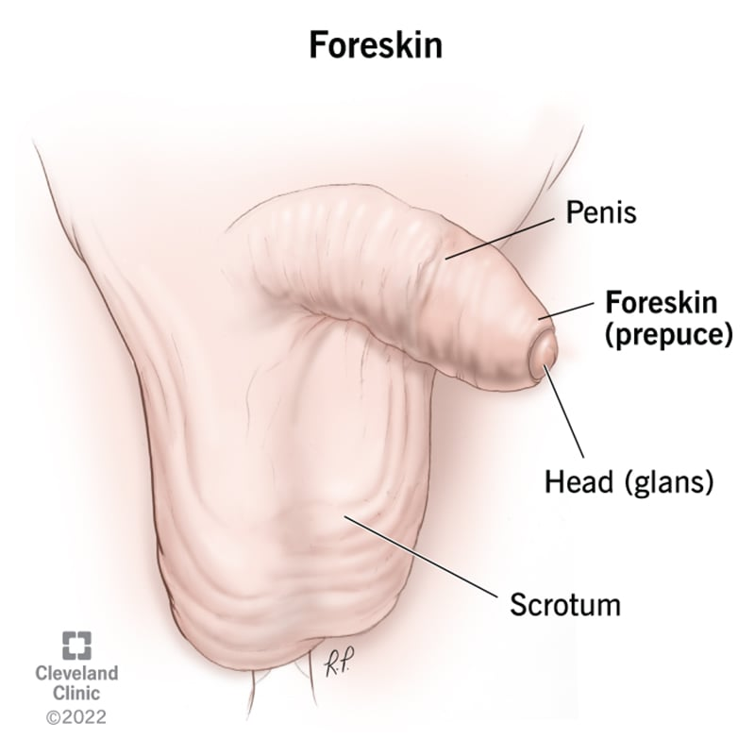
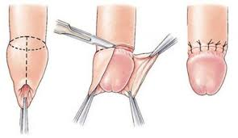
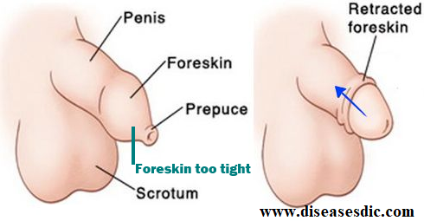
Penis
- Prepuce (Foreskin), skin folds cover the glans penis.
N.B; Circumcision is the removal of the greater part of the prepuce.
- The superficial fascia of the penis is devoid of fat.

Slide 7
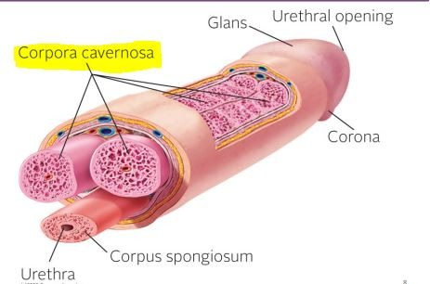
Penis
** Structures of the penis: The penis is formed of three elongated bodies
A- 2 corpora cavernosa: each one is continuous posteriorly with the crus.
- The deep artery of the penis runs in the center of the corpus cavernosum.
B- One corpus spongiosum: is continuous posteriorly with the bulb.
- It is traversed by the penile (spongy) urethra.

Slide 8
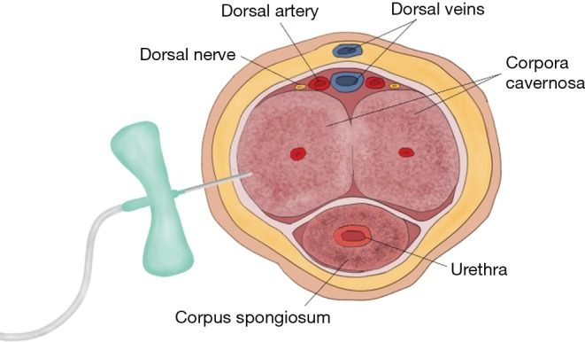
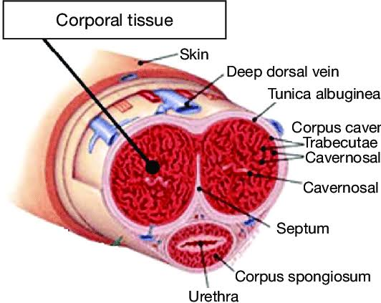
Penis
** Structures of the penis:
Body of the Penis is essentially composed of three cylinders of erectile tissue
The erectile tissue is made up of two dorsally placed corpora cavernosa and
A single corpus spongiosum applied to their ventral surface

Slide 9
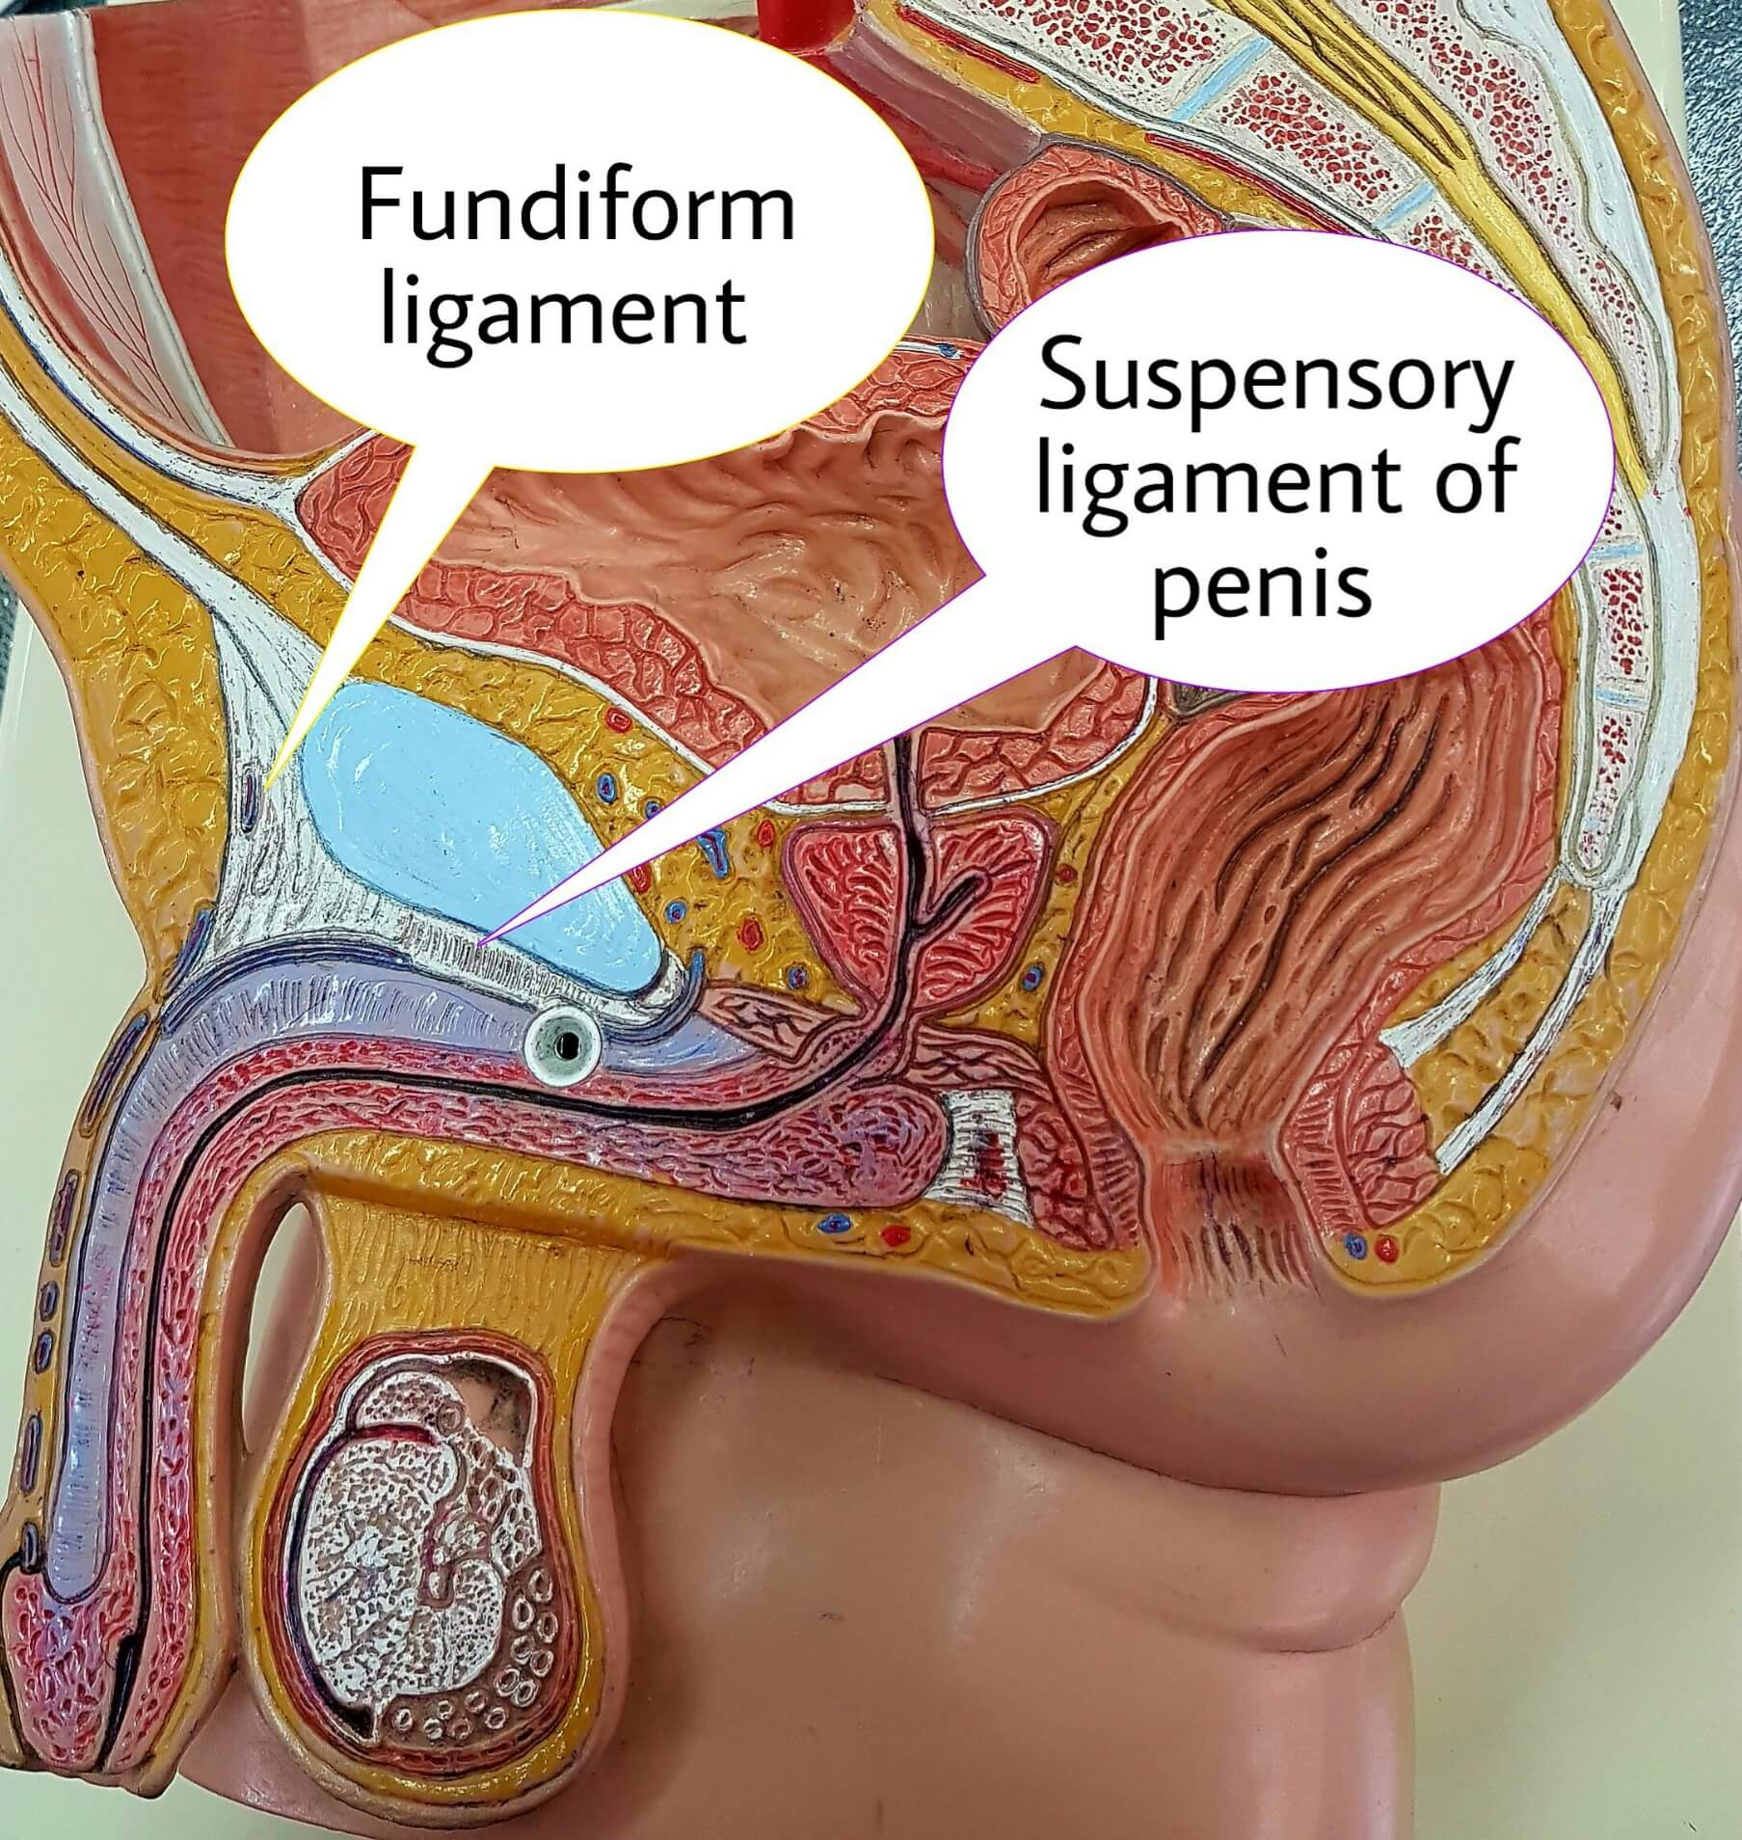
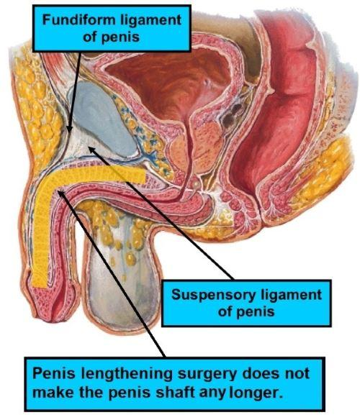
Penis
** Ligaments of penis,
1- Fundiform ligament arises from the lower part of the linea Alba.
2- Suspensory ligament arises from the symphysis pubis.

Slide 10
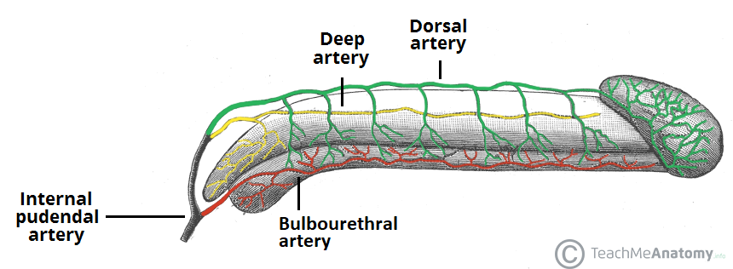
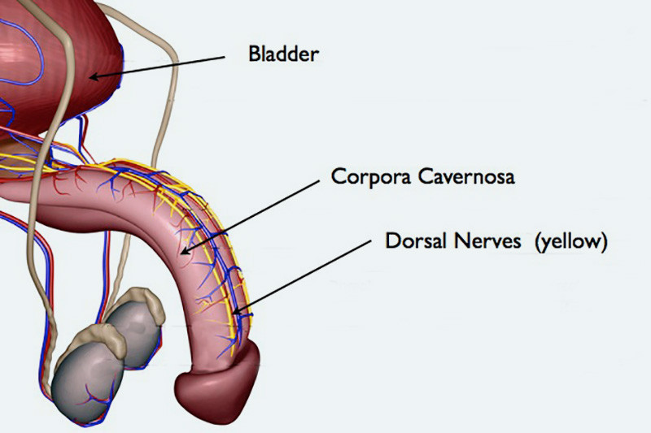
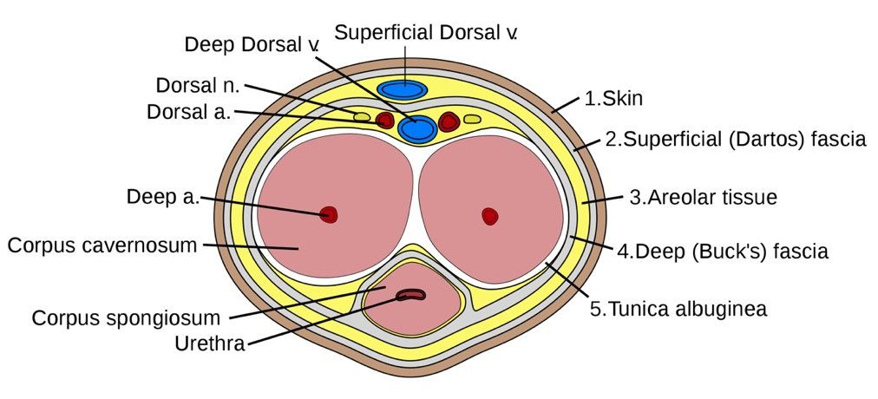
Penis
** Vessels and nerves of the penis
I- Deep artery of the penis. 2- Dorsal artery of the penis.
3- Urethral artery.
4- Dorsal veins of the penis. 5- Dorsal nerves of the penis.

Slide 11
Penis
Arteries
The corpora cavernosa are supplied by the deep arteries of the penis
The corpus spongiosum is supplied by the artery of the bulb and dorsal artery of the penis.
All the above arteries are branches of the internal pudendal artery.
Veins
The veins drain into the internal pudendal veins.

Slide 12
Penis
Lymph Drainage:
The skin of the penis is drained into the medial group of superficial inguinal nodes.
The deep structures of the penis are drained into the internal iliac nodes.

Slide 13
Penis
Sensory and sympathetic innervation is provided primarily by the dorsal nerve of the penis, a terminal branch of the pudendal nerve, which arises in the pudendal canal and passes anteriorly into the deep perineal pouch. It then runs to the dorsum of the penis, where it runs lateral to the dorsal artery
Branches of the ilioinguinal nerve supply the skin at the root of the penis.
Cavernous nerves, conveying parasympathetic fibers independently from the prostatic nerve plexus, innervate the helicine arteries of the erectile tissue.

Slide 14
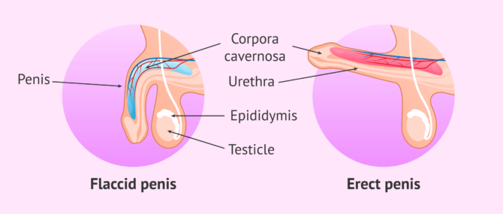
Penis
Erection of the penis
- Erection of the penis (or clitoris) is a purely vascular mechanism.
- Parasympathetic stimulation leading to rapid inflow of blood and filling of the erectile tissue of the corpora cavernosa and thus pressure over the draining veins, leading to erection of the penis (or clitoris).
- Ejaculation is sympathetic stimulation.

Slide 15
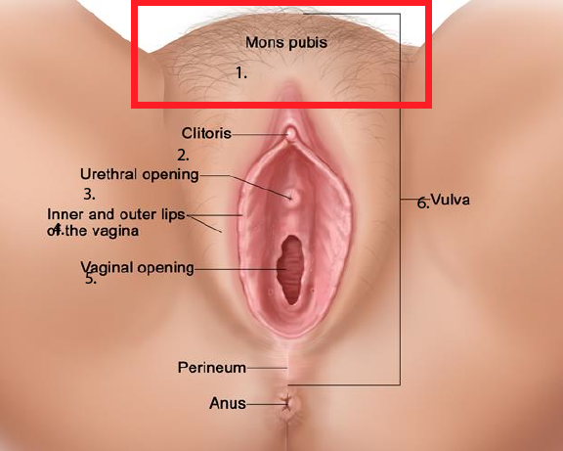
Female External Genital Organ
Vulva
- The vulva is formed of the following parts.
1- Mons pubis, collection of fat overlying the pubis. They are covered by hair after puberty.
2- Labia majora a pair of skin folds, they are covered by hair after puberty.

Slide 16
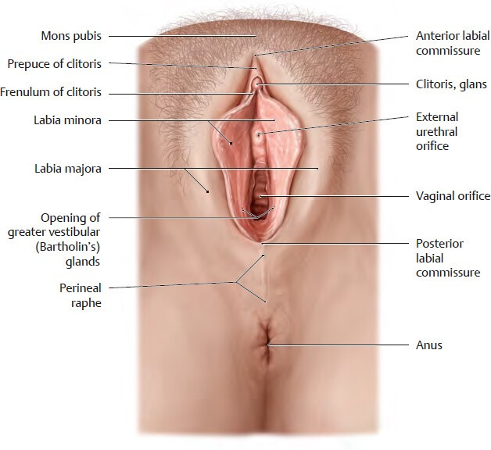
Vulva
3- Labia minora a pair of thin skin folds between the two labia majora.
a- Anteriorly: each fold divides into two portions:
The upper division passes above the clitoris to meet its fellow of the opposite side, forming the prepuce of the clitoris.
The lower division passes beneath the clitoris to meet its fellow of the opposite side forming the frenulum of the clitoris.

Slide 17
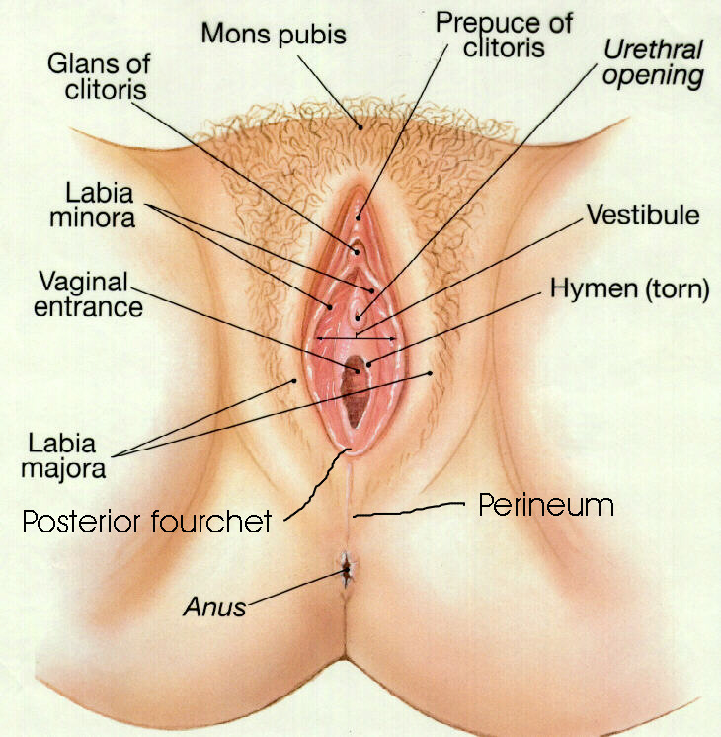
Vulva
b- The posterior ends of the labia minora are joined across the middle line by a fold of skin called the fourchette.

Slide 18
Vulva
4- Clitoris is an erectile organ, similar to the penis but is not traversed by the urethra.
- Its free end (very sensitive, plays important role in sexual response).
- It consists of two corpora cavernosa.
It is situated at the apex of the vestibule anteriorly .
The glans of the clitoris is partly hidden by the prepuce

Slide 19
Vulva
5- Vestibule this is the interval between the two labia minora.
It is a smooth triangular area bounded laterally by the labia minora
with the clitoris at its apex and the fourchette at its base
It receives the urethral orifice anteriorly and vaginal orifice posteriorly.
The vaginal orifice is closed by the hymen in virgins.

Slide 20
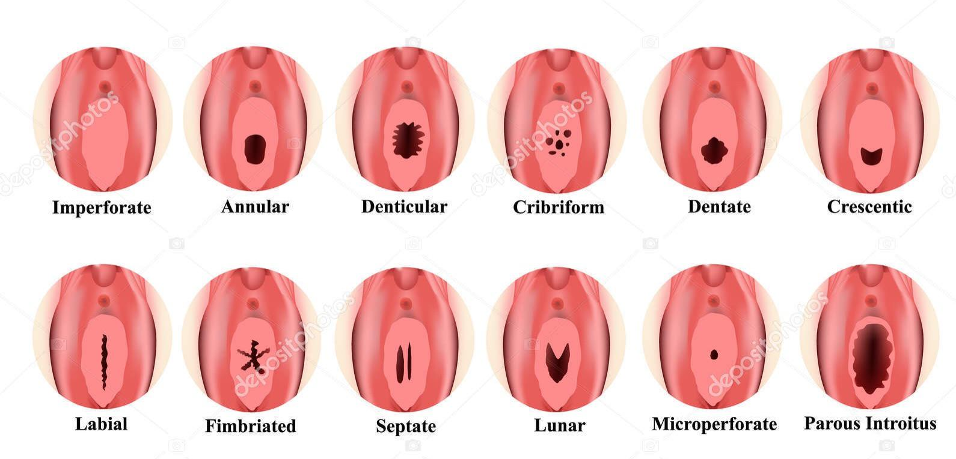
Vulva
The vaginal orifice is protected in virgins by thin fold of mucous membrane called the hymen, which is perforated at its center .

Slide 21
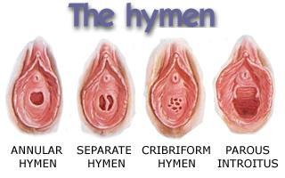
Variability in the shape of The hymen;
1- Ring shape (the commonest form).
2- Semilunar fold.
3- Cribriform.
4- It may be absent.
5- Complete septum called imperforate hymen.
6- It may persist after copulation.

Slide 22
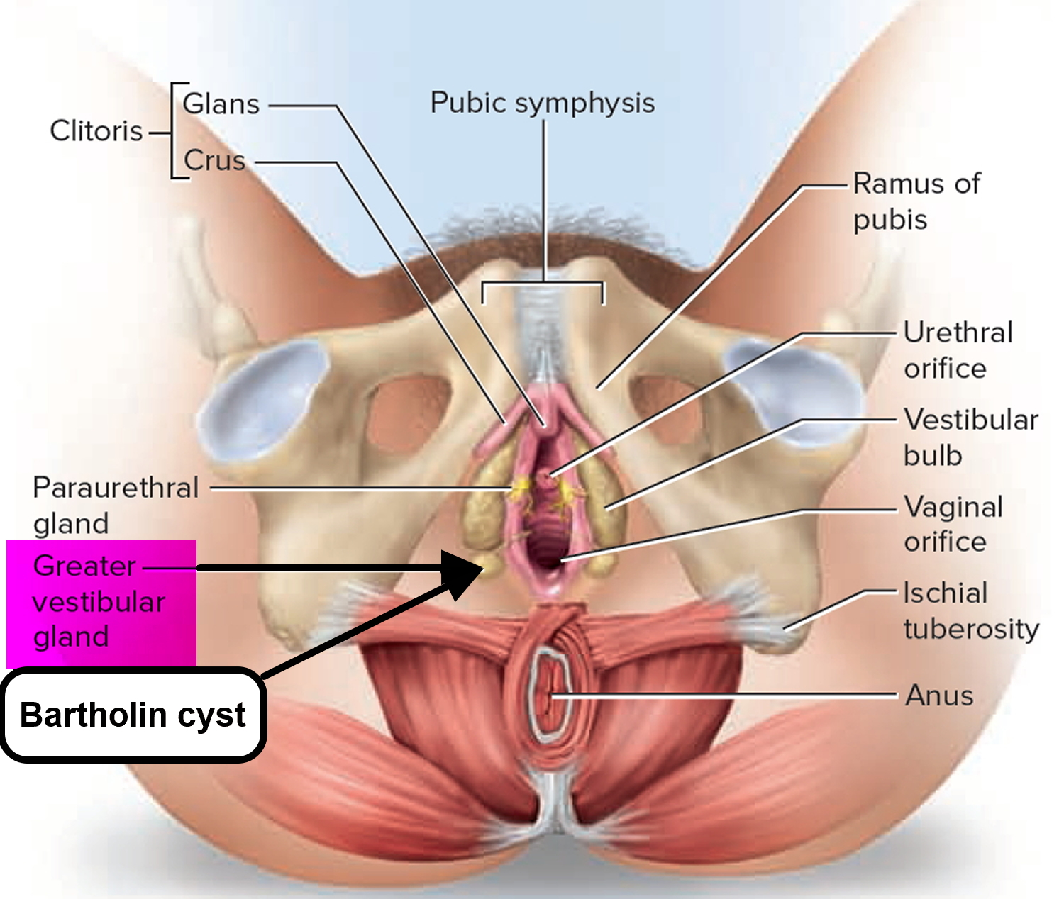
Vulva
6- Greater vestibular glands (Bartholin glands);
Are 2 small rounded of small mucus-secreting glands that lie under cover of the posterior parts of the bulb of the vestibule and the labia majora

Slide 23
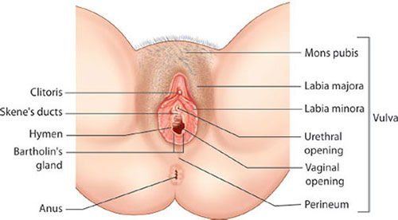
Vulva
6- Greater vestibular glands (Bartholin glands);
Each drains its secretion into the vestibule by a small duct, which opens into the groove between the hymen and the posterior part of the labium minus
These glands secrete a lubricating mucus during sexual intercourse

Slide 24
Vulva
Paraurethral Glands
The paraurethral glands, which correspond to the prostate in the male
Open into the vestibule by small ducts on either side of the urethral orifice
Lie within the wall of the distal female urethra and secrete mucus during sexual activity. Each gland is drained by a single paraurethral (Skene) duct.

Slide 25
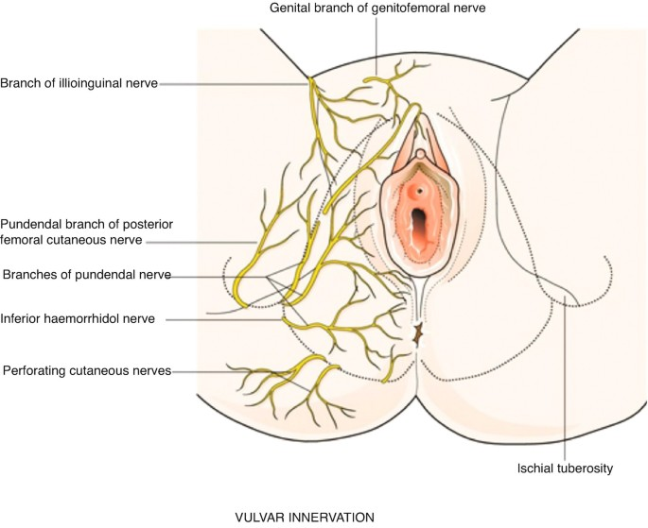
Vulva
Lymph Drainage
Medial group of superficial inguinal nodes
Nerve Supply
The anterior parts of the vulva are supplied by:
The ilioinguinal nerves
The genital branch of the genitofemoral nerves.
The posterior parts of the vulva are supplied by:
The branches of the perineal nerves and
The posterior cutaneous nerves of the thigh

Slide 26
** Female orgasm
Sexual excitement induces vascular dilatation and engorgement of the vulva.
It is parasympathetic as male.
The vagina becomes moistened by the mucus membrane.
The greater vestibular glands secret a small amount of fluid.
At the climax, there is series of involuntary muscle contraction.

Slide 27
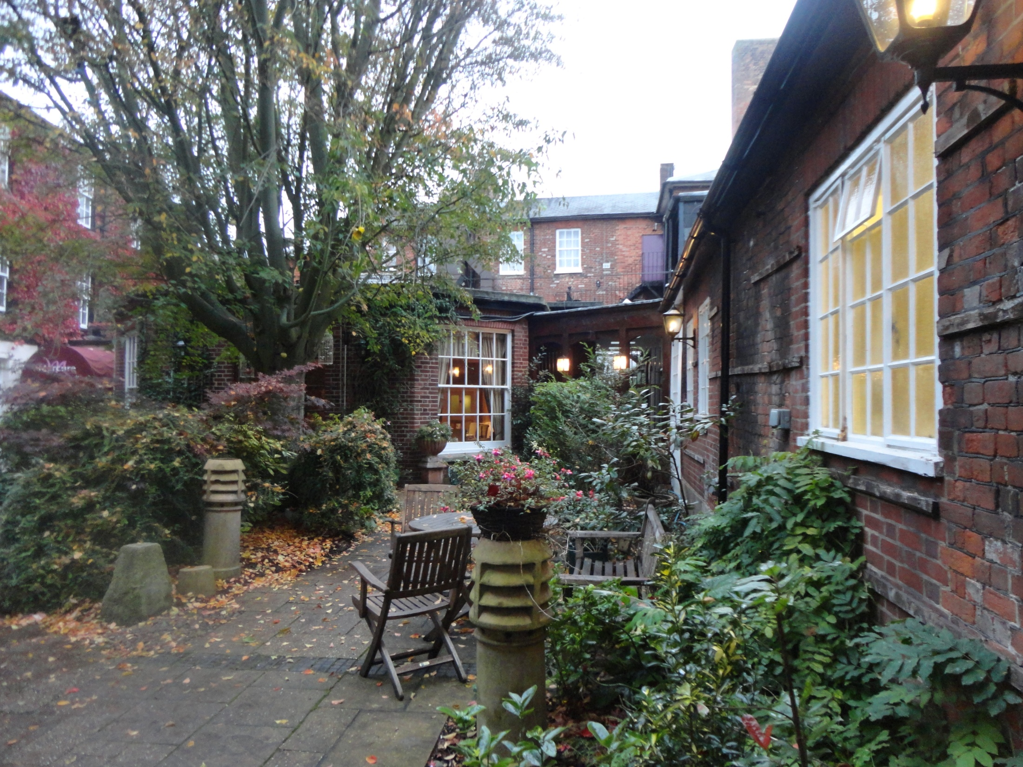
Dr. Aiman AL Maathidy
Surgical Anatomist

