Slide 1
Systemic sclerosis
Supervised by Dr.walid wadi
Presented by salma almawajdeh

Slide 2
Definition
Systemic sclerosis is a rare autoimmune connective tissue disease characterized by Skin thickening ,Vasculopathy (Raynaud's phenomenon) , fibrosis of the skin and other organs

Slide 3
Epidemiology
♀ > ♂ (∼ 5:1)
Higher incidence in African Americans
Peak incidence
30-40 years

Slide 4
pathophysiology
not completely understood, but several factors play a role in the development of the disease
Autoimmunologic component
Inflammatory synthesis of extracellular matrix: fibroblast proliferation and increased synthesis of normal collagen leading to fibrosis
Non-inflammatory vasculopathy: underlying mechanism of many of the more severe disease features, e.g., CAD, pulmonary artery hypertension, and renal crisis

Slide 5
2 types of the disease
lcSScl /limited /localised
dcSScl /diffuse/systemic
.rapid
.more internal organs involvement
. Trunk, face, and extremities
. Scleroderma renal crisis
Cardiac involvement
ILD
.indolent
.higher risk of PAH
. Neck, face, and distal limbs Sparing of the trunk
. Severe gastrointestinal involvement (e.g., bloating, constipation)

Slide 6
C R E S T syndrome
C
R
E
calcinosis
Raynaud
phenomenon
Esophageal hypomotility
s
T
sclerodactyly
Telangiectasia

Slide 7
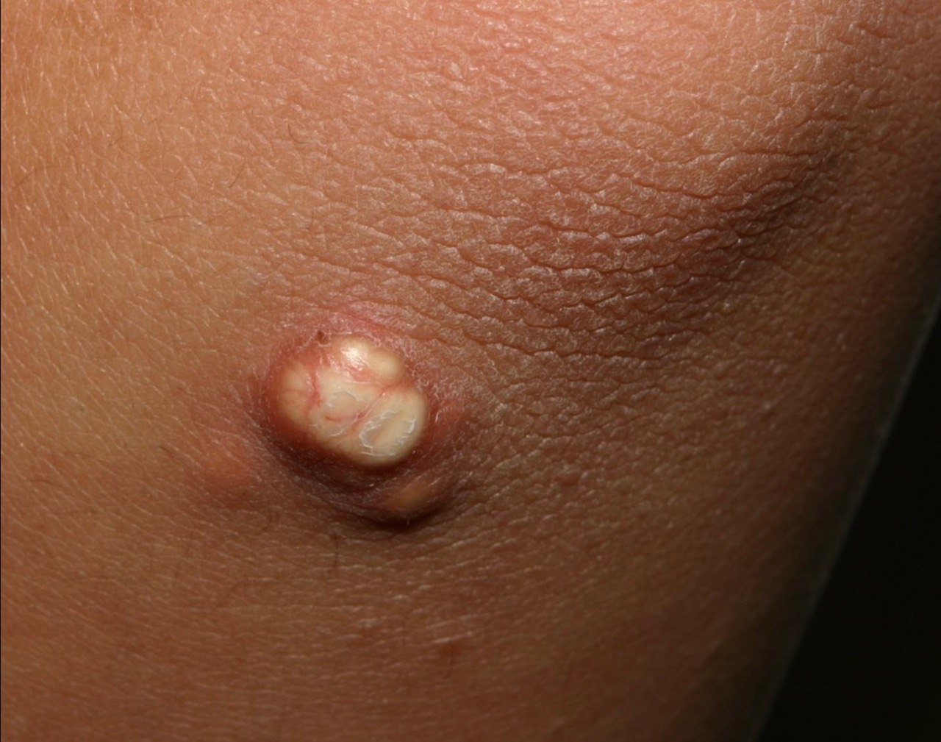

Slide 8
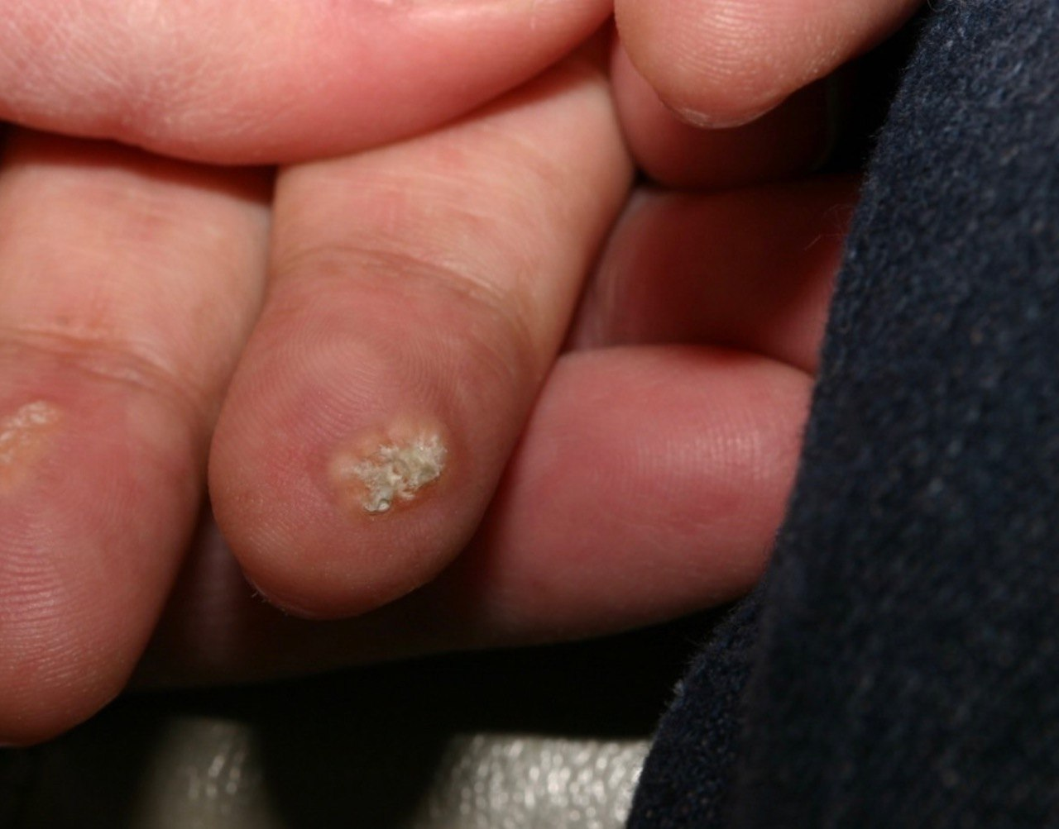

Slide 9
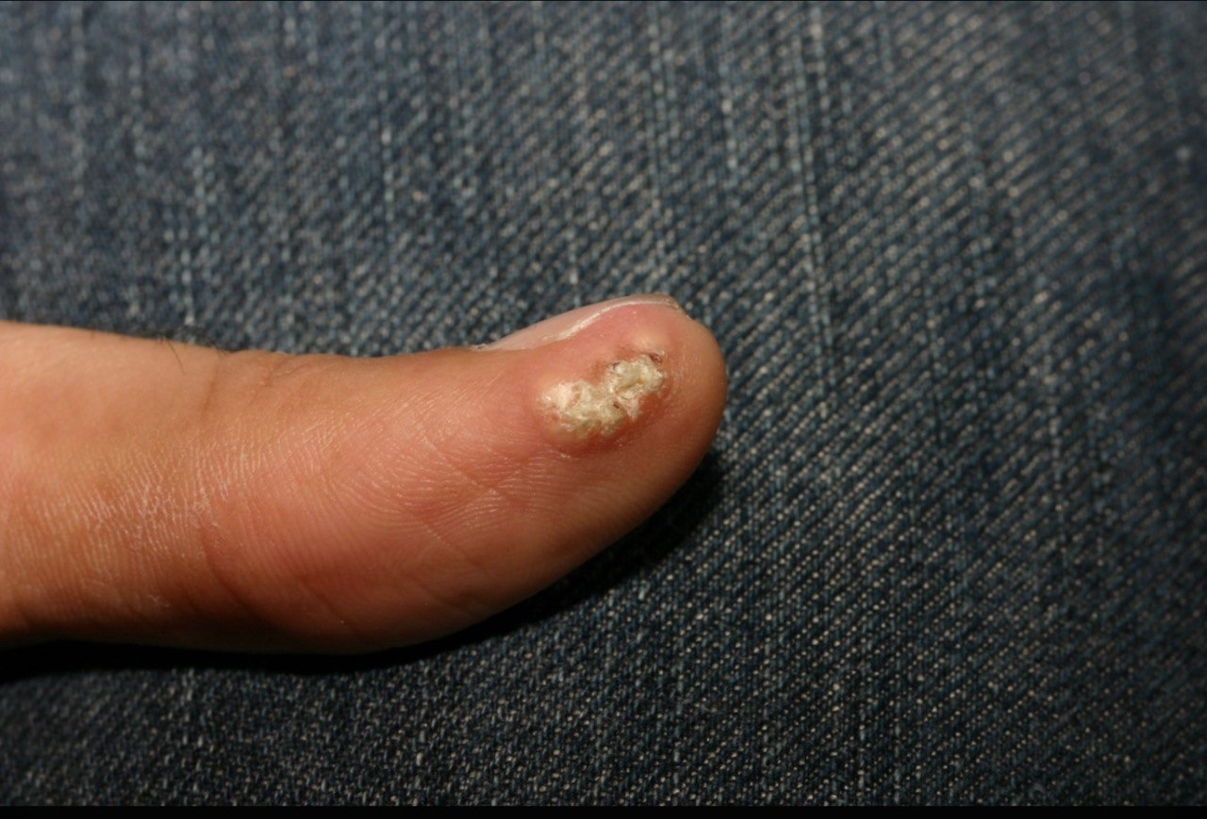

Slide 10
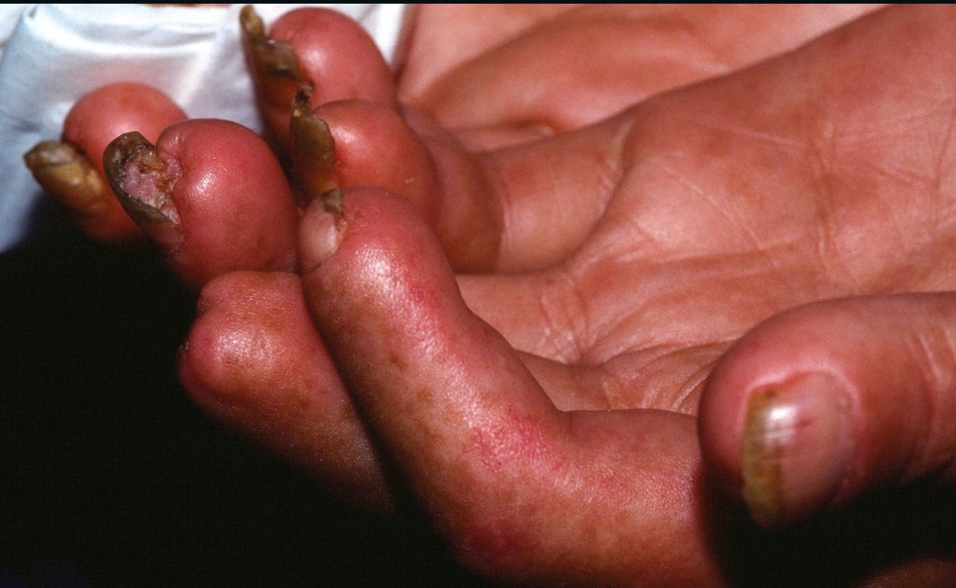

Slide 11
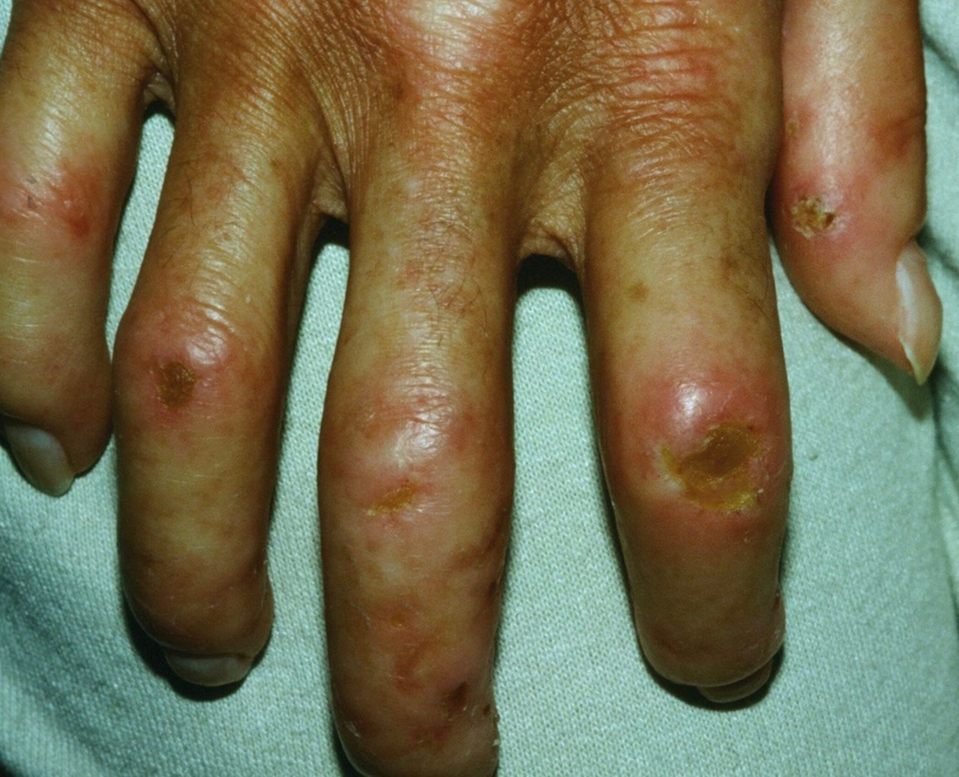

Slide 12
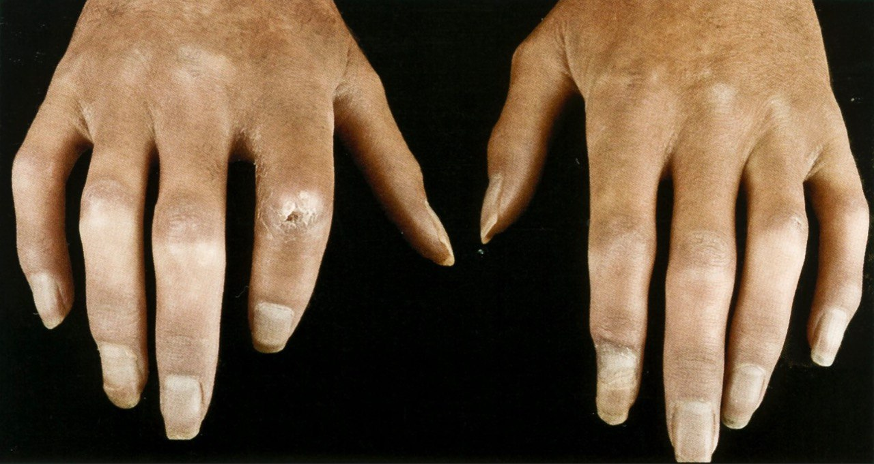

Slide 13
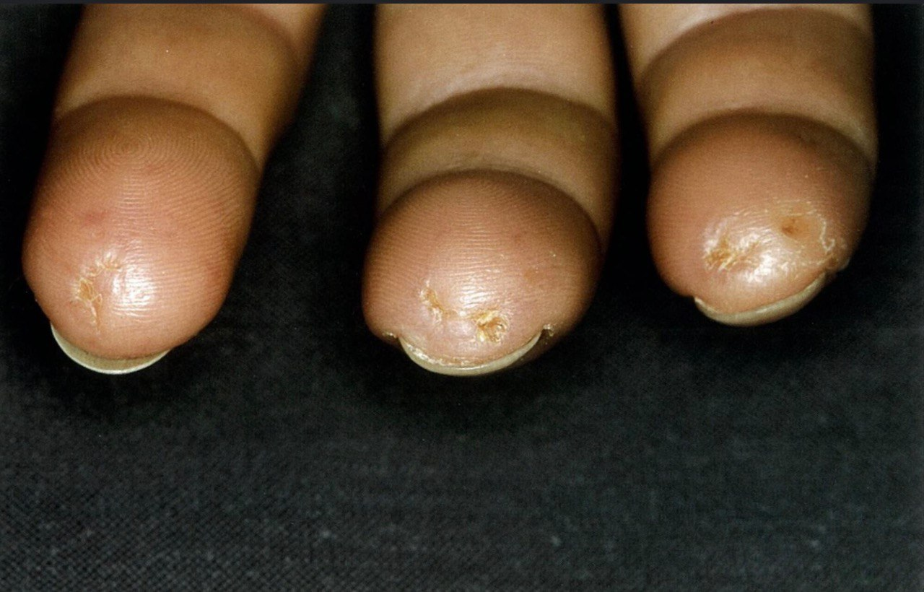

Slide 14
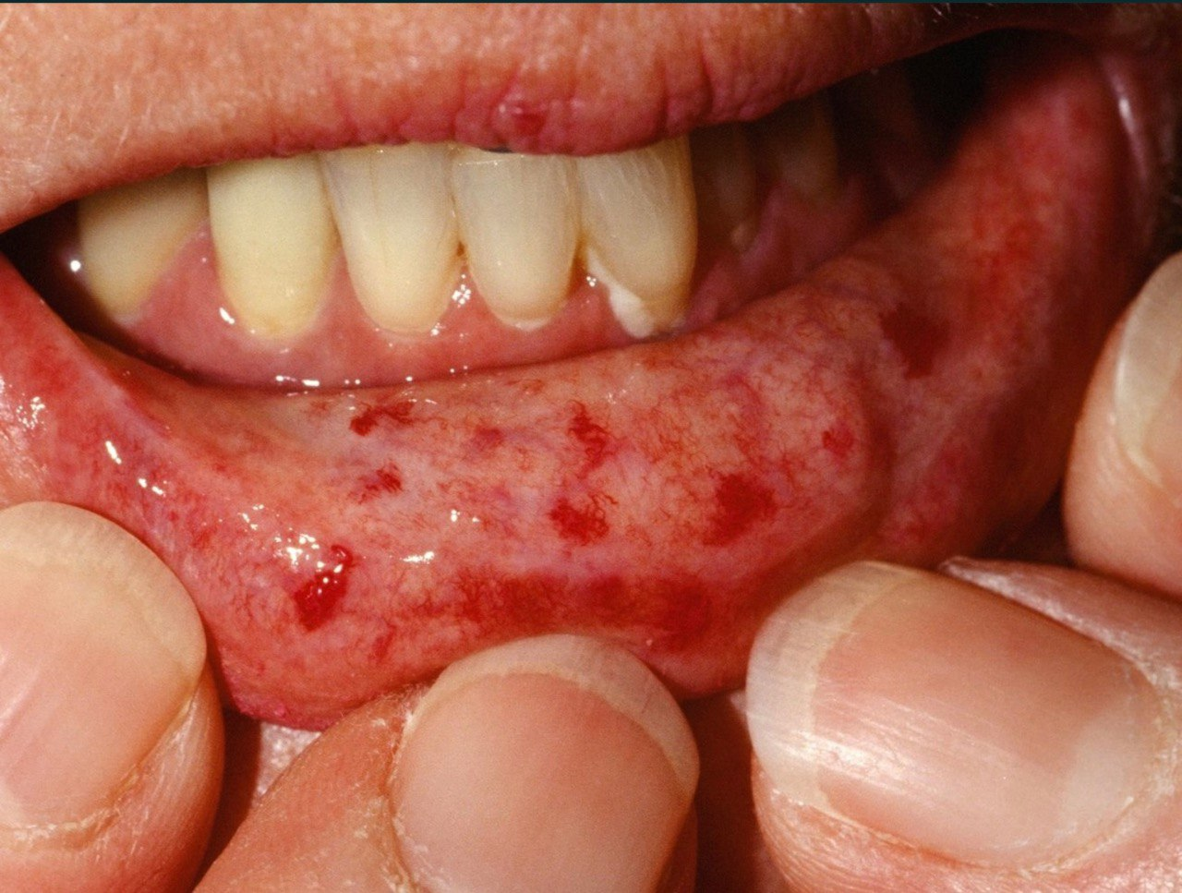

Slide 15
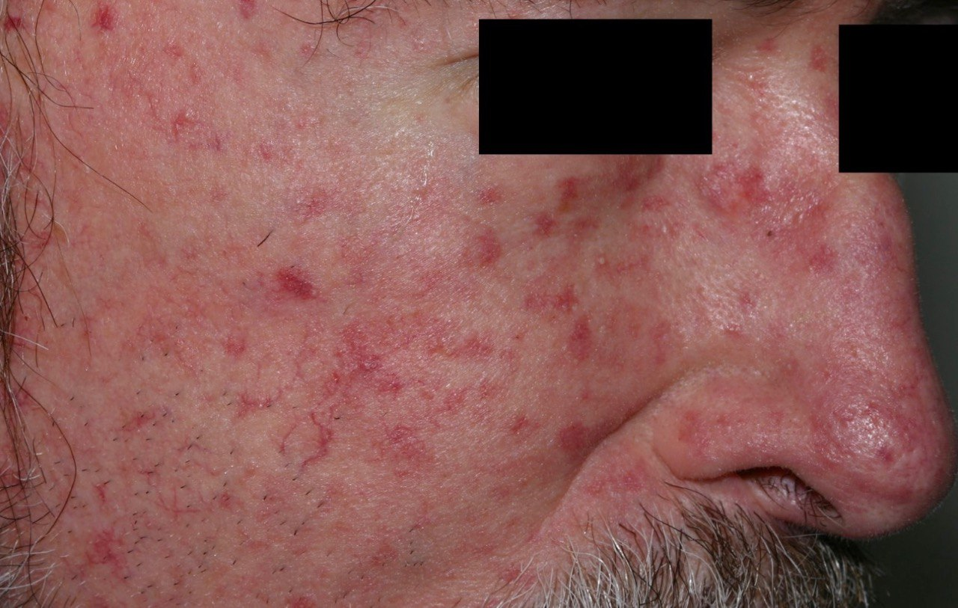

Slide 16
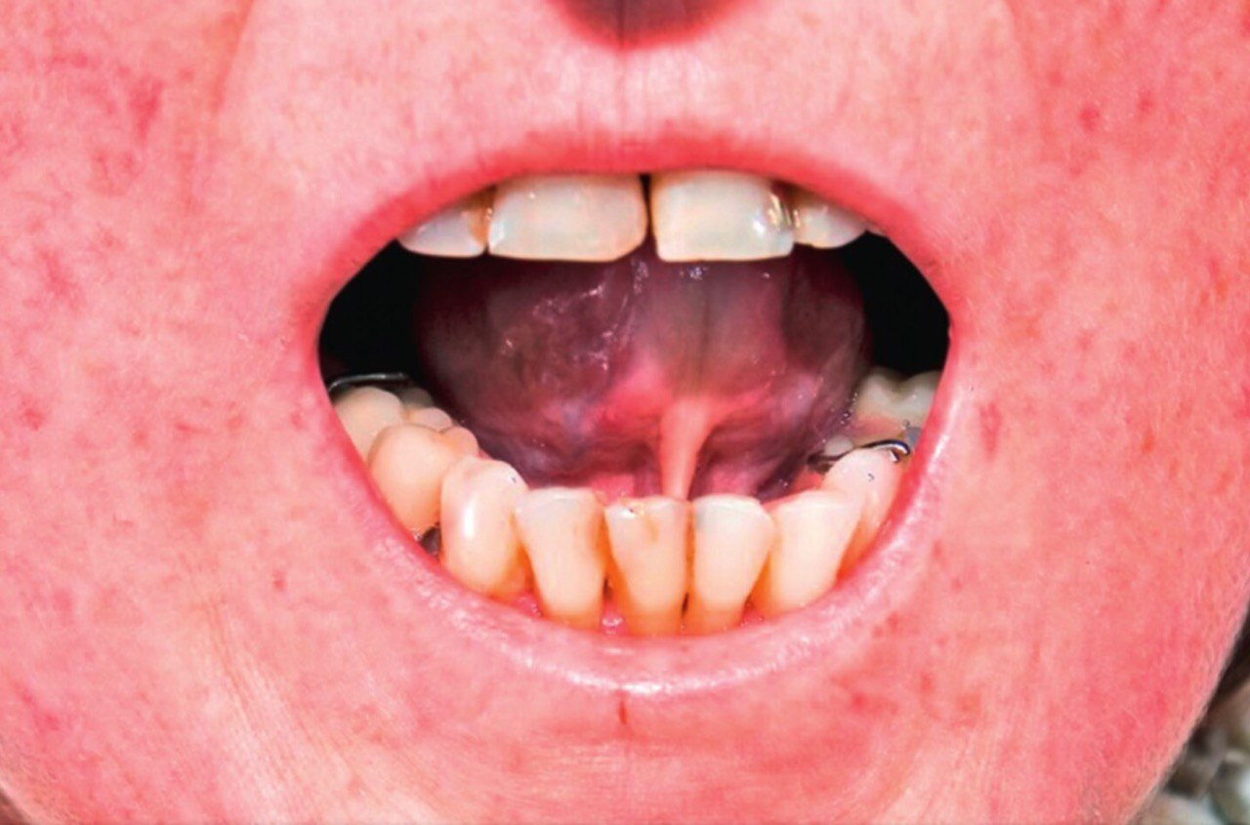

Slide 17
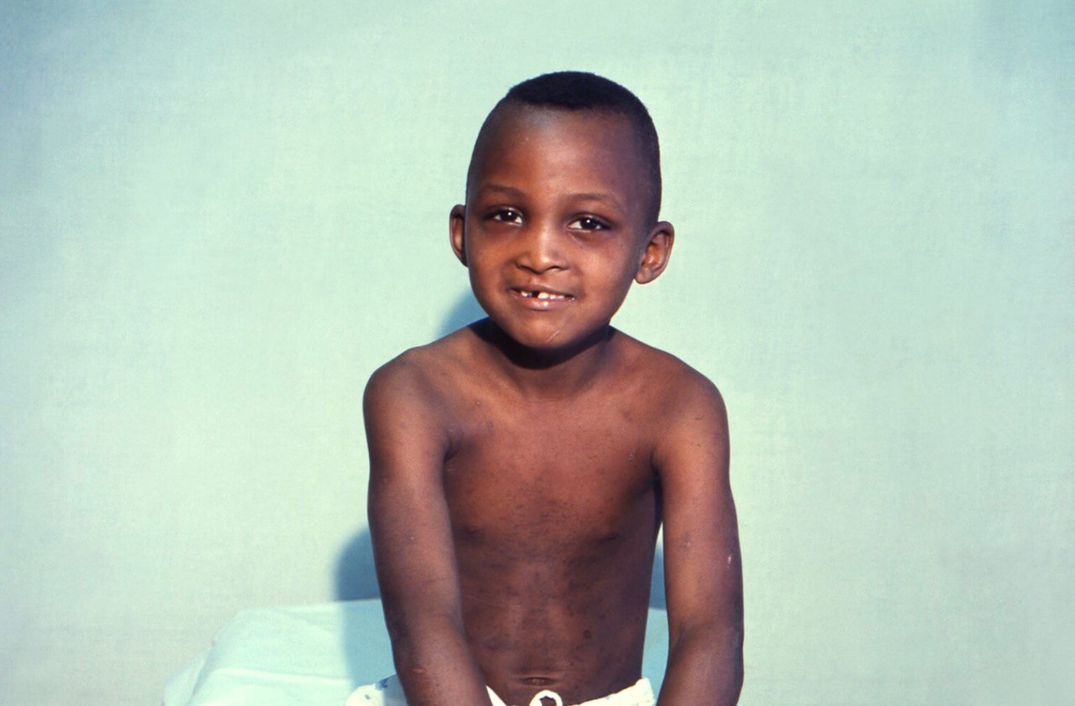

Slide 18
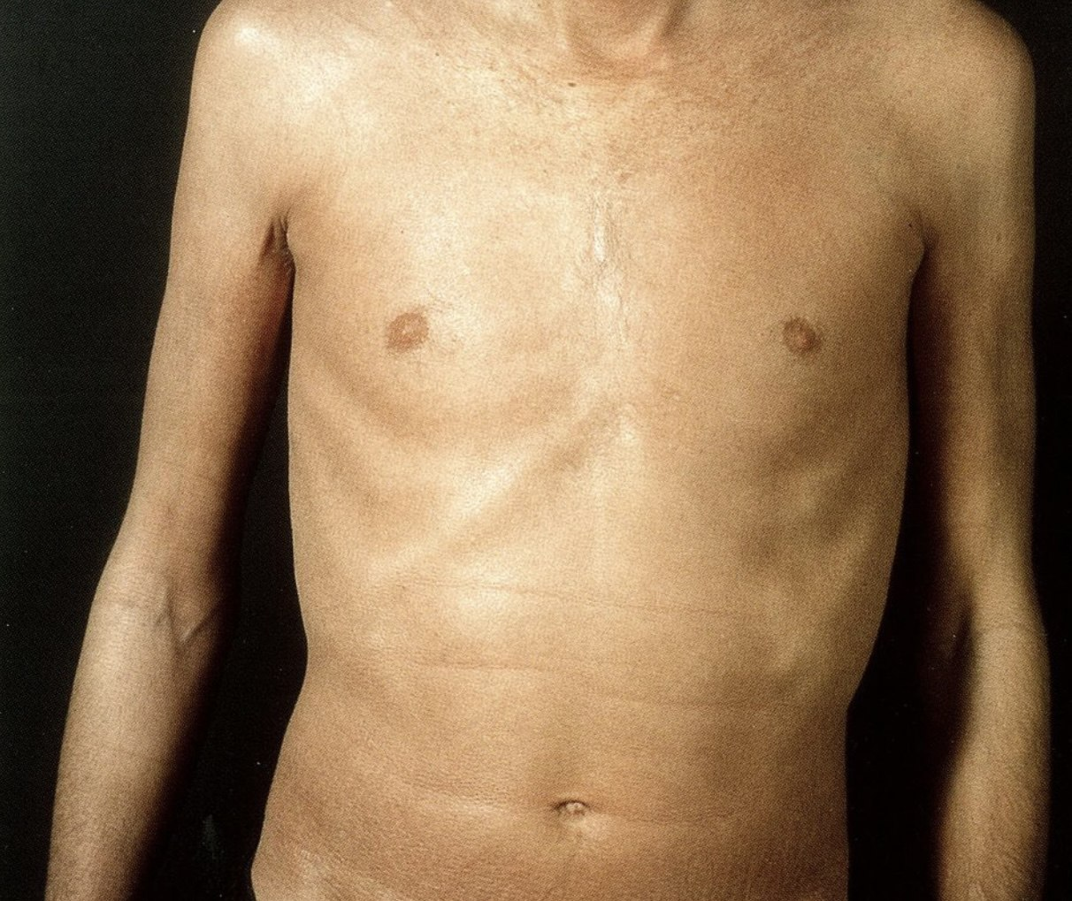

Slide 19
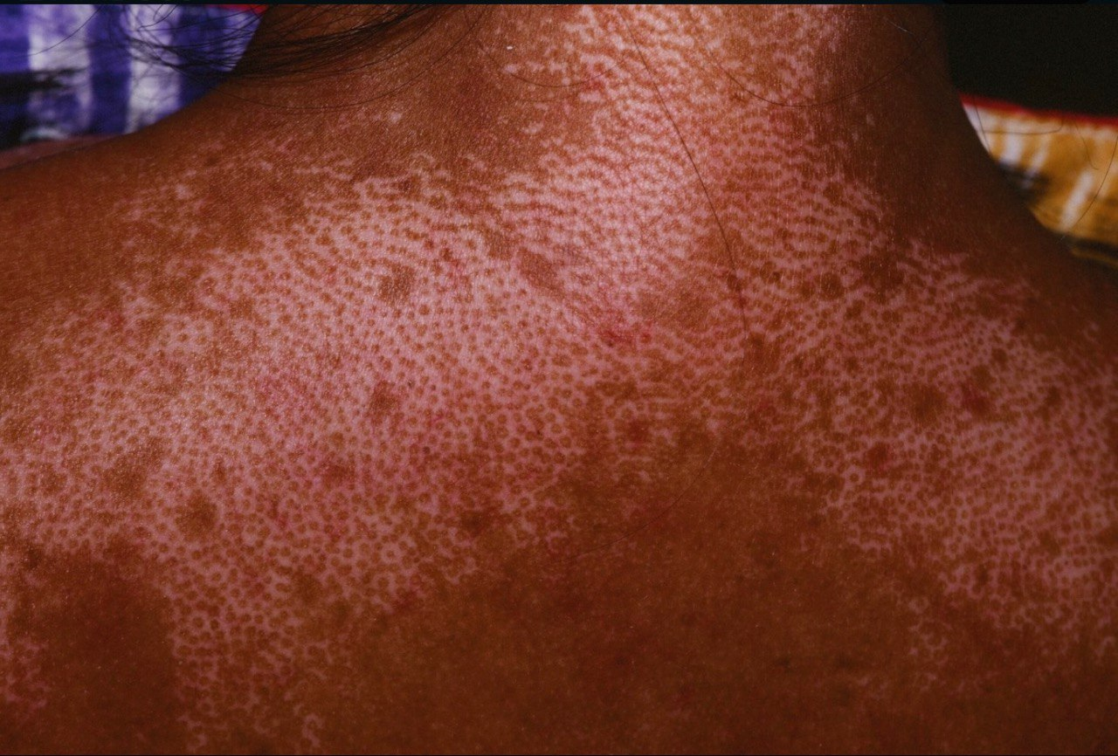

Slide 20
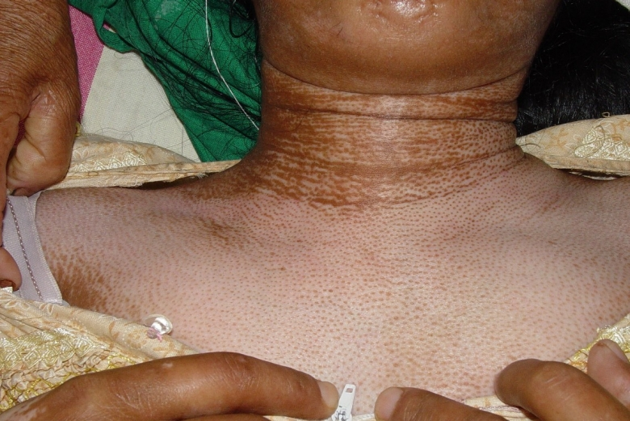

Slide 21
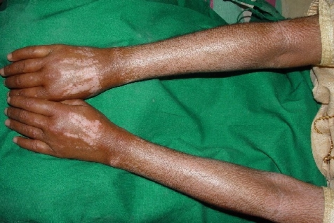

Slide 22
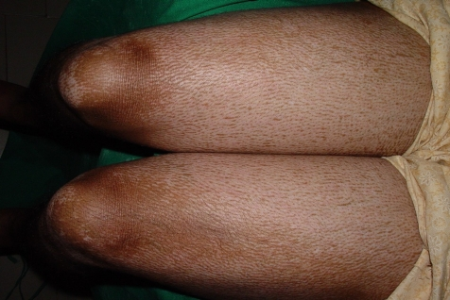

Slide 23
Scleroderma renal crisis (SRC)

Slide 24
SRC
10-15% of individuals with dSScl
1-2% of individuals with lSScl
Clinical features of SRC :
. AKI >>> oliguric , hematuria , proteinuria
. HTN with or without symptoms of hypertensive emergency
. Microangiopathic hemolytic anemia
. Thrombocytopenia
. CKD >>>due to abnormal collagen deposition …thickening of renal arteriolar walls …decreased renal blood flow

Slide 25
Cardiopulmonary

Slide 26
Cardiovascular
Primary cardiac involvement
.endomyocardial fibrosis
. Myocarditis
.pericarditis
Pulmonary
.interstitial lung disease
. Pulmonary artery hypertension

Slide 27
Other extracutaneous

Slide 28
Gastrointistenal tract
Almost ALL have gi symptoms
. Esophageal dysmotility dysphagia and reflux
. Small bowel dysmotility bloating , constipation and cramping
.Raynaud phenomenon
.thromboembolism
.erectile dysfunction
Vascular disease
Arthalgia and myalgia
May develop into contractures
Others :
Fatigue , pain ,weakness , wight loss
Sicca syndrome , hypothyroidism
Increased risk of cancer

Slide 29
Diagnosis

Slide 30
Laboratory studies
01
03
02
04
Ssc –specific auto-AB
Renal function test
. Anticentromere AB>>lSscl
. Anti-Scl (anti-topoisomerase ) >>with severe rapid progressive dSscl
.anti RNA polymarase III >> dSsc
ANA
Cardiopulmonary
Assessment
PRESENT in 90% of patients
.ECG or holter monitor
.TTE
.HRCT
.PFT : decreased FVC
decreased DLCO

Slide 31
Laboratory studies
Nailfold capillaroscopy

Slide 32
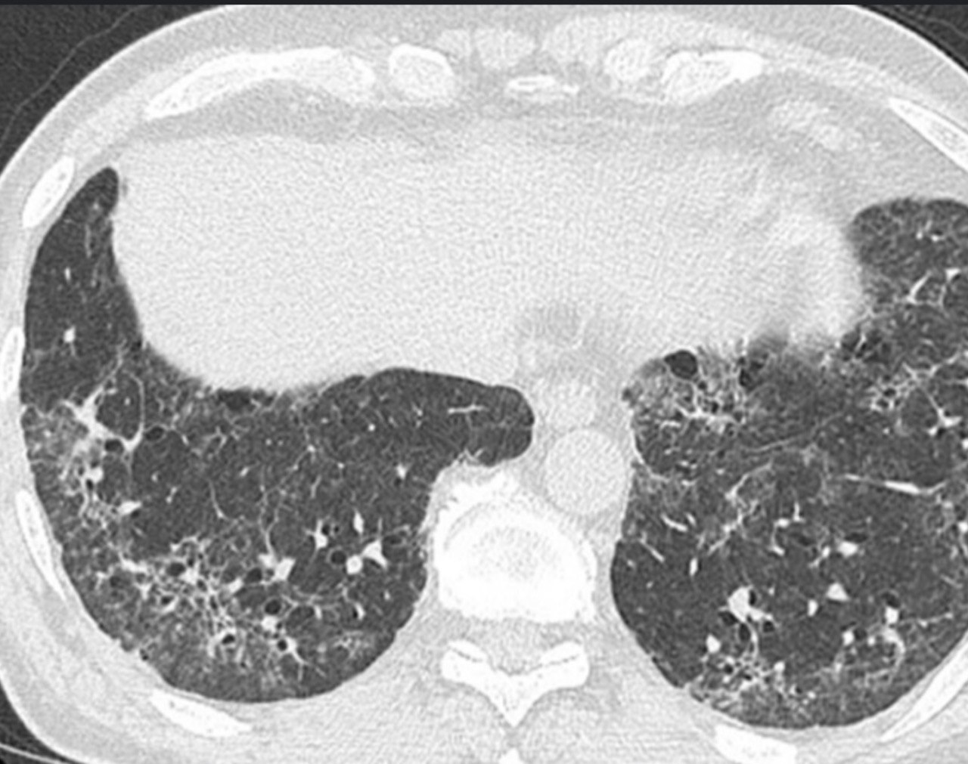

Slide 33
Major criteria for scleroderma (1980):
Proximal diffuse truncal sclerosis ,the hallmark of scleroderma
where the skin proximal to the metacarpophalangeal joints in the hand or the metatarsophalangeal joints in the foot is indurated ( non-pitting ) , thickened, hard and is often shiny with loss of skin surface markings. Loss of skin
elasticity
A "salt and pepper" pattern of hyperpigmentation.
Minor criteria:
1)sclerodactyly ( Acro sclerosis)
2)digital pitting with scars and ulcerations loss of substance of the finger pad
3)pulmonary fibrosis(bibasilar fibrosis)
To diagnose scleroderma: 2 from 3 of minors / or 1 major

Slide 34
General principles of treatment .refer to a spicialist early .ttt focuses on organ-specific , symptomatic .systemic immunemodulatory medications are indicated in dSscl

Slide 35
Cutaneous disease
***Raynaud phenomenon
CCB
***Cutaneous fibrosis
if :
early dcscl >>>phototherapy and/or pharmacotherapy(methotrexate , mycophenolate )
severe/refractory >>> cyclophophosphomide , autologous HSCT
*** calcinosis cutis
co2 laser , surgical removal if symptomatic
*** supportive care
avoid trauma
avoid cold exposure
smoking cessation
vasodilatory physical therapy and lymph drainage
antihistamine if pruritic
avoid beta blocker

Slide 36
Gastrointestinal disease
GERD: proton pump inhibitors (PPIs)
Gl motility disorder: prokinetic therapy, e.g., metoclopramide (off-label )
SIBO: antibiotic therapy, e.g., rifaximin (off-label )

Slide 37
Renal disease
Renal disease
Scleroderma renal crisis
ACE inhibitors (ACEls) are the mainstay of therapy
Captopril is most commonly used
Chronic kidney disease: See "Management of CKD
Cardiopulmonary disease
Manage specific cardiac and/or pulmonary conditions depending on manifestations
Pulmonary hypertension
***E.g., combination of ambrisentan and tadalafil
***Interstitial lung disease: systemic immunomodulatory medications, e.g., mycophenolate mofetil

Slide 38
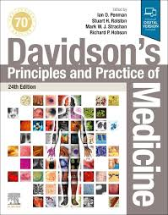
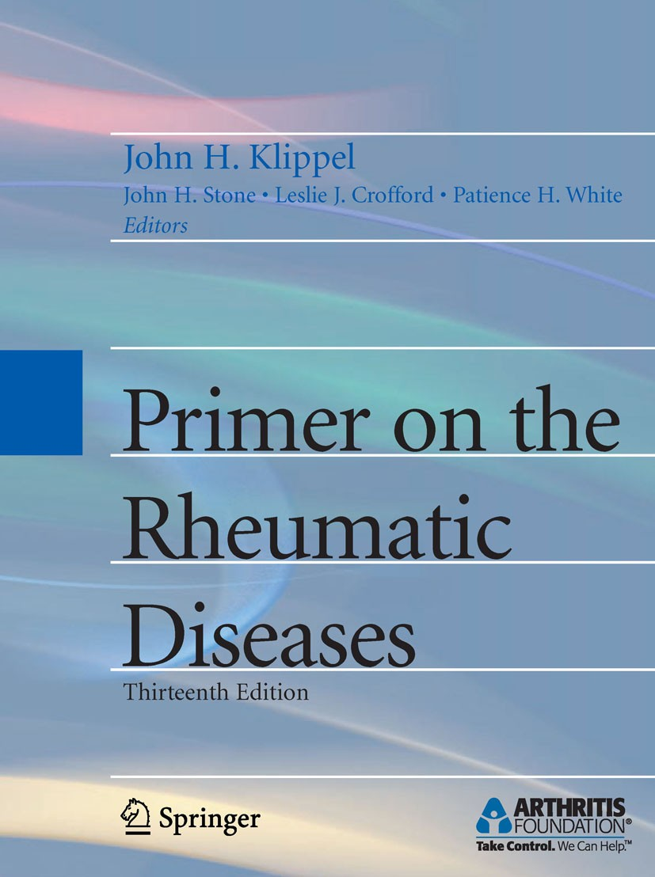
RESOURCES

Slide 39
THANKS!

