Slide 1
DNA Damage, Mutations and Repair Mechanisms
＃خليك بالبيت
Dr. Nesrin Mwafi
Biochemistry & Molecular Biology Department
Faculty of Medicine, Mutah University

Slide 2
DNA Damage
＃خليك بالبيت
DNA molecules like all other biomolecules can be damaged in numerous ways
DNA damage occurs at a rate of 10⁴ – 10⁶ molecular lesions per cell per day
What are the sources and types of this damage?
Can our cells recognise and repair this damage?
What are the consequences of unrepaired damage on the cell fate?

Slide 3
DNA Damage
＃خليك بالبيت

Slide 4
Classification of DNA Damage
＃خليك بالبيت
DNA damage can be classified according to the causative agents into two main types:
Spontaneous damage (Endogenous): arising naturally and in the absence of known causative agents. Spontaneous DNA lesions are random events
Induced damage (Exogenous): occurs in the presence of known causative agents (external factors)

Slide 5
Spontaneous DNA Damage
＃خليك بالبيت
Although DNA is highly stable, nevertheless it is susceptible to the following spontaneous changes under normal cell conditions:
Deamination
Depurination
Replication errors
Base tautomers
Oxidative DNA damage

Slide 6
Spontaneous DNA Damage
＃خليك بالبيت
Deamination: the most common type is the spontaneous deamination of cytosine to uracil which occurs at a rate of about 100 bases/cell/day

Slide 7
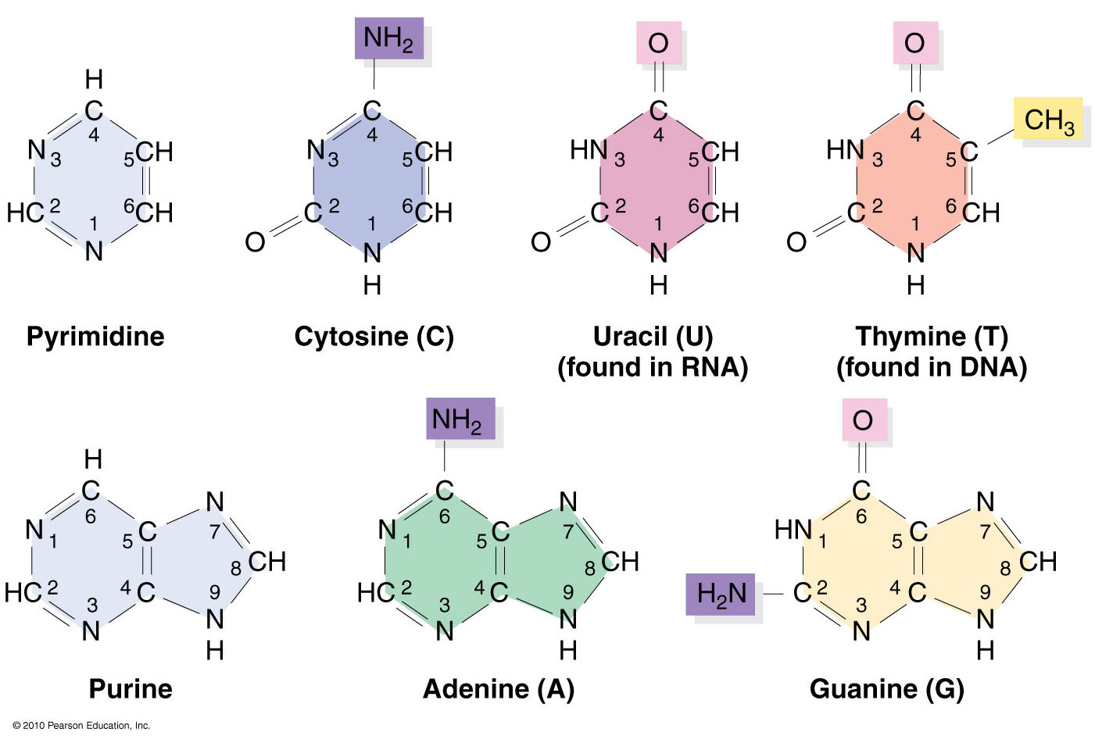
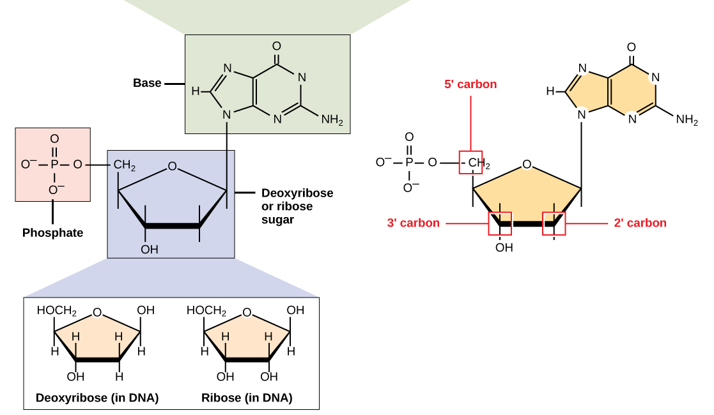
Nitrogenous Bases
＃خليك بالبيت
(in RNA )

Slide 8
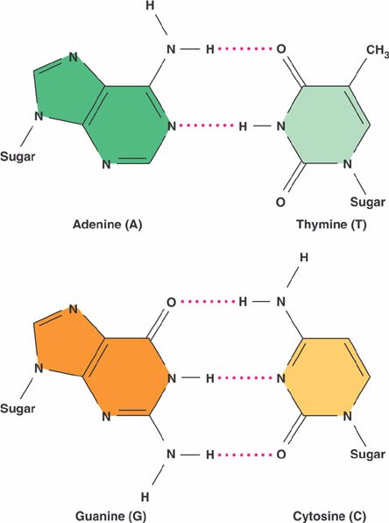
Nitrogenous Bases
＃خليك بالبيت
9
6
4
5
1
3
2
Purines
Pyrimidines
9
6
4
1
3
2
2

Slide 9
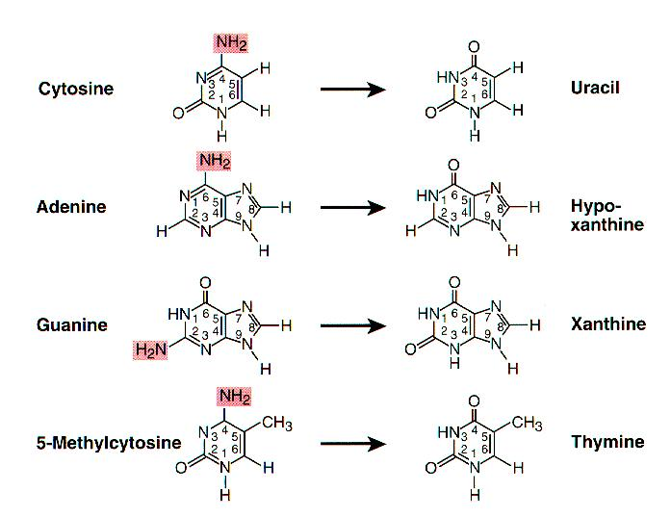
Deamination
＃خليك بالبيت
Other possible deamination events in DNA:

Slide 10
Deamination
＃خليك بالبيت
T
Nitrogenous base | Original base pair | Deamination product which base pairs with ( ) 1st round | Substituted base pair 2nd round
Cytosine | C-G | Uracil (A) | T-A
Adenine | A-T | Hypoxanthine (C) | G-C
Guanine | G-C | Xanthine (T) | A-T
5-Me cytosine | C-G | Thymine (A) | T-A
Thymine | T-A | Thymine | T-A

Slide 11
Deamination
＃خليك بالبيت
The chemistry of DNA four bases facilitates the damage detection through mismatched base pairs
Specific DNA repair enzymes (i.e. DNA N- glycosylases) are capable of detection and removal of such unusual bases
If left uncorrected, during DNA replication most of these changes would lead to mutations in the daughter DNA chain (particularly base pair substitution)
These mutations will propagate throughout subsequent cell generations (inherited)

Slide 12
Spontaneous DNA Damage
＃خليك بالبيت
Depurination: the loss of a purine base by spontaneous hydrolysis of the N-glycosidic bond that links it to deoxyribose C1’ apurinic site (AP site)
AP site

Slide 13
Depurination
＃خليك بالبيت
Under physiological conditions, depurination occurs at a rate of about 5000 bases/cell/day
Depurination results in apurinic site (AP site) which can be recognized and repaired by specific repair mechanisms
If left uncorrected, during DNA replication these changes would lead to mutations in the daughter DNA chain (particularly base pair deletion)
This error will propagate throughout subsequent generations (inherited)

Slide 14
Depurination
＃خليك بالبيت
(AP site)

Slide 15
Spontaneous DNA Damage
＃خليك بالبيت
Replication errors: spontaneous lesions may occur during DNA replication in which the wrong base is add to the newly synthesized strand (base substitution), a DNA base is skipped (base deletion) or extra base is added (base insertion)
Such errors are normally detected and repaired immediately by the proofreading/editing activity of DNA polymerase enzyme (3’-5’ exonuclease activity)
Otherwise, DNA repair enzymes will recognize the mismatched base pairs and repair them

Slide 16
Spontaneous DNA Damage
＃خليك بالبيت
Base tautomers: DNA bases exist in one of several forms called tautomers (structural isomers)
1. Keto/Enol pair
2. Amine/Imine pair
tautomerization
tautomerization

Slide 17
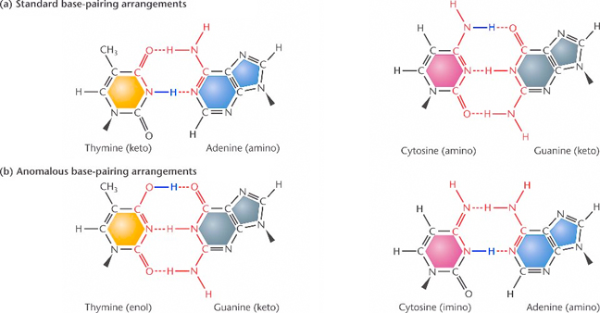
Base Tautomers
＃خليك بالبيت
Actually enol/imine forms are rare and tend to cause mispairing

Slide 18
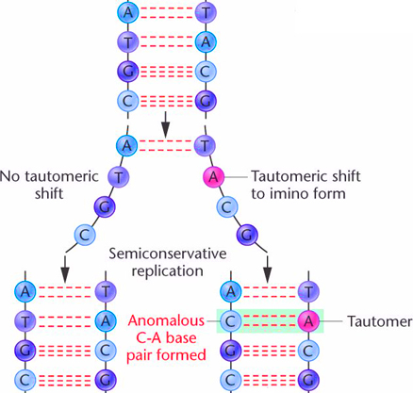
Base Tautomers
＃خليك بالبيت
If not repaired, it can lead to tautomeric shift mutation

Slide 19
Spontaneous DNA Damage
＃خليك بالبيت
Oxidative DNA Damage: Endogenous Reactive Oxygen Species (ROS) are produced as byproducts during normal metabolic processes
ROS such as superoxide radical .O₂⁻ attack DNA leading to damage. They can chemically modify nitrogenous bases leading to mispairing
8-oxoguanine (8-oxo G) is one of the major product of DNA oxidation. Another modified base is thymine glycol

Slide 20
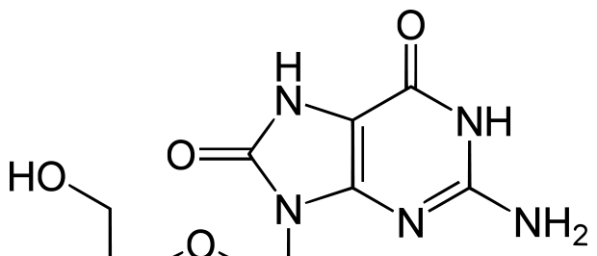
Oxidative DNA Damage
＃خليك بالبيت
Guanine (G)
8-oxoguanine
(8-oxo G)

Slide 21
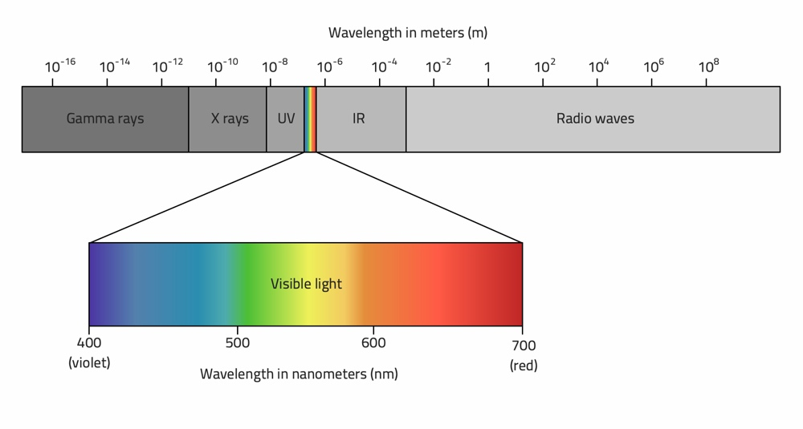
Induced DNA damage
＃خليك بالبيت
Radiation damage: which includes both UV light and ionizing radiation

Slide 22
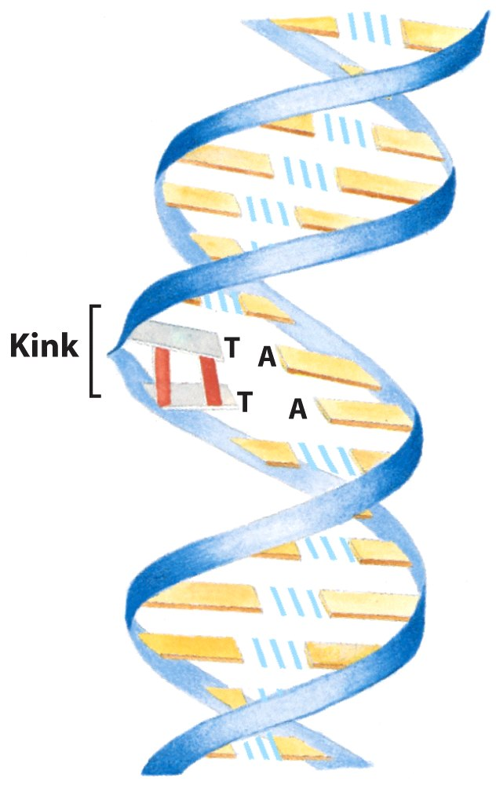
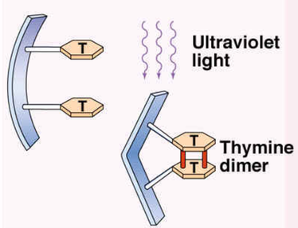
Induced DNA damage
＃خليك بالبيت
Ultraviolet Radiation
Pyrimidines are highly sensitive to UV light. They form pyrimidine dimer (intra-strand crosslinking) particularly thymine dimer (T-dimer)
Dimers alter DNA structure (kink or knot in DNA strand)
Thymine dimers prevent proper replication. The cell either dies (apoptosis) or forms a malignant tumour (cancer)

Slide 23
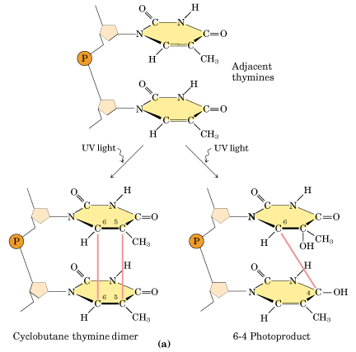
T-Dimer Types
＃خليك بالبيت

Slide 24
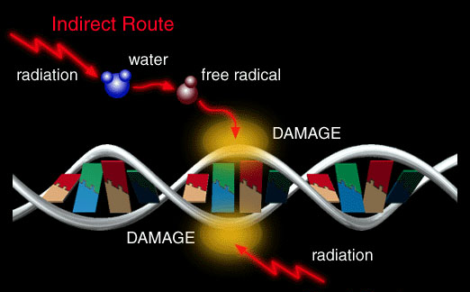
Induced DNA damage
＃خليك بالبيت
Ionizing Radiation: like cosmic rays, X-rays and gamma rays can damage DNA molecules in 2 ways:
Direct DNA damage by producing single strand break (SSB) and the more severe double strand break (DSB)
Indirect DNA damage by production of free radicals which alter the structure of bases

Slide 25
Induced DNA damage
＃خليك بالبيت
Chemical mutagens: are agents which induce mutations if their damaging effects on DNA have not been recognized and repaired
Base modifying agents
Base analogs
Intercalating agents

Slide 26
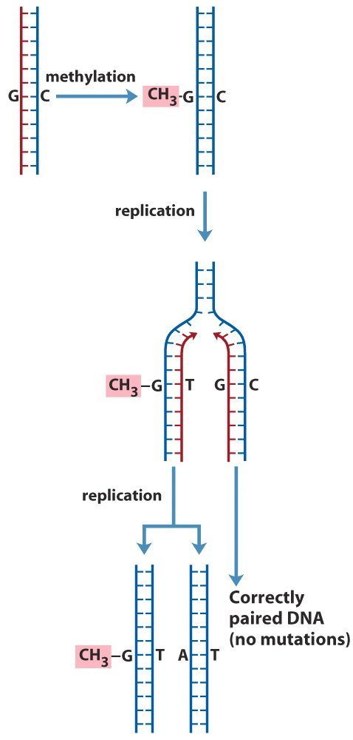
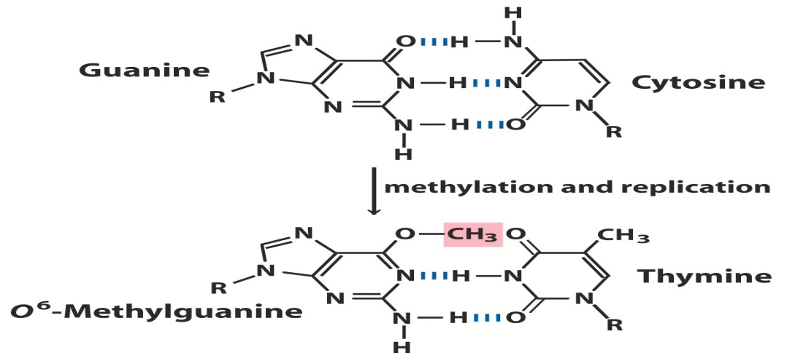
Base Modifying Agents
＃خليك بالبيت
Change or modifiy the chemical structure of DNA bases resulting in mispairing and other problems
These includes alkylating agents such as SAM (s-adenosyl Methionine) which adds methyl group to guanine leading to O⁶ methylguanine (O⁶ MeG)
If not repaired, this lesion can lead to a base pair substitution (base pair changers)

Slide 27
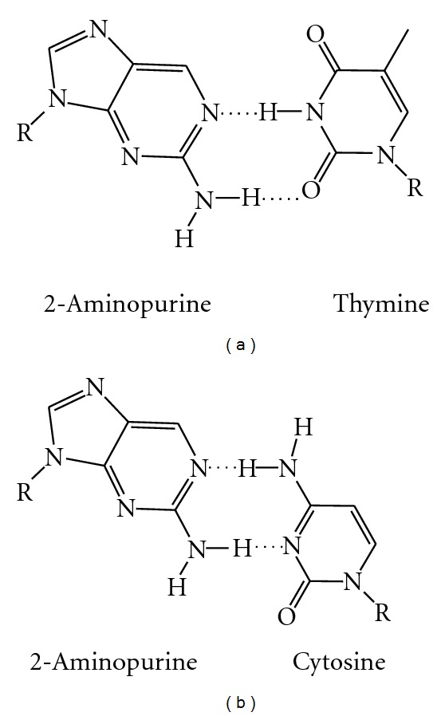
Base analogs
＃خليك بالبيت
Chemicals with structures similar to that of any of the four standard bases of DNA like 2-amino purine the base analog of adenine (6-amino purine). They replace them in DNA strand but do not always pair with normal bases leading to base pair substitution (e.g. AT bp is replaced with GC bp)

Slide 28
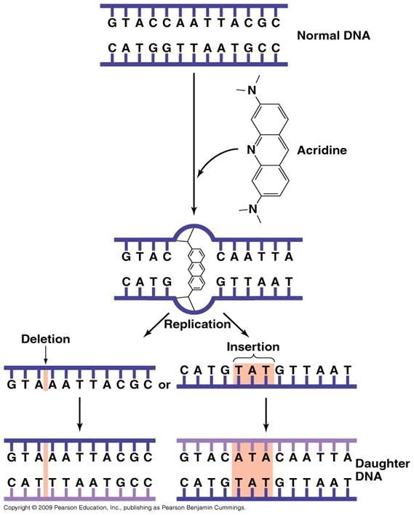
Intercalating Agents
＃خليك بالبيت
Sandwich themselves between adjacent DNA bases like acridine orange, benzopyrene (cigarette smoke), aflatoxin B1 (mycotoxins produced by some fungi)
They affect DNA structure causing insertion or deletion of an entire base pair leading to frameshift mutation

Slide 29
DNA Repair Pathways
＃خليك بالبيت

Slide 30
DNA Repair Mechanisms
＃خليك بالبيت
DNA repair system : is a collection of processes by which a cell identifies and corrects various DNA lesions
Several repair strategies are available:
Direct/reversal repair
Base excision repair (BER)
Nucleotide excision repair (NER)
Strand-directed Mismatch repair (MMR)
Double strand breaks repair (DSB)

Slide 31
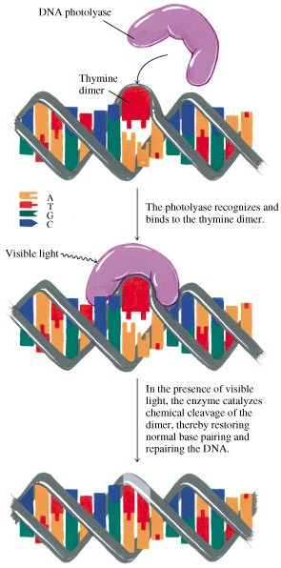
Direct Repair system
＃خليك بالبيت
Direct repair also called direct reversal because the damage can be directly recognized and reversed
Two specific enzymes are involved in direct repair:
Photolyases which repair UV induced damage in plants, bacteria and some animals (excluding humans) by splitting the dimers

Slide 32
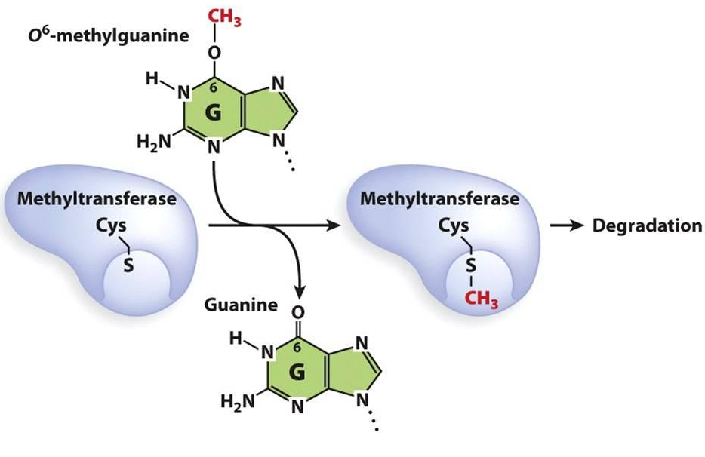
Direct Repair system
＃خليك بالبيت
O6-methylguanine methyltransferase (MGMT) which transfer methyl group from G to a cysteine residue within the enzyme itself. Ada and Ogt are the two bacterial isoforms of MGMT
This reaction is stoichiometric rather than catalytic because each enzyme can be used only once (suicide)

Slide 33
Base Excision Repair
＃خليك بالبيت
Base excision repair (BER) involves a category of enzymes known as DNA-N-glycosylases like uracil DNA glycosylase
Glycosylases recognize damaged bases and remove them resulting in apurinic or apyrimidinic (AP) site
AP endonucleases enzymes nick the damaged backbone at 5’ end of AP site
DNA polymerase removes the damaged region using its 5’ to 3’ exonuclease activity and correctly synthesizes the new strand. Finally, DNA ligase seals the strand.

Slide 34
Base Excision Repair
＃خليك بالبيت
Uracil-

Slide 35
Nucleotide Excision Repair
＃خليك بالبيت
Nucleotide excision repair system (NER) corrects lesions which commonly cause bulk distortions in DNA helix like UV-induced pyrimidine dimers. NER is highly conserved used in both eukaryotes and prokaryotes
The damaged region is removed in 3 steps process:
Recognition of the damage by NER enzymes
Excision of damaged DNA (12-24 nucleotides long) by endonucleases
Resynthesis of removed DNA region by DNA polymerase followed by ligase to seal the region

Slide 36
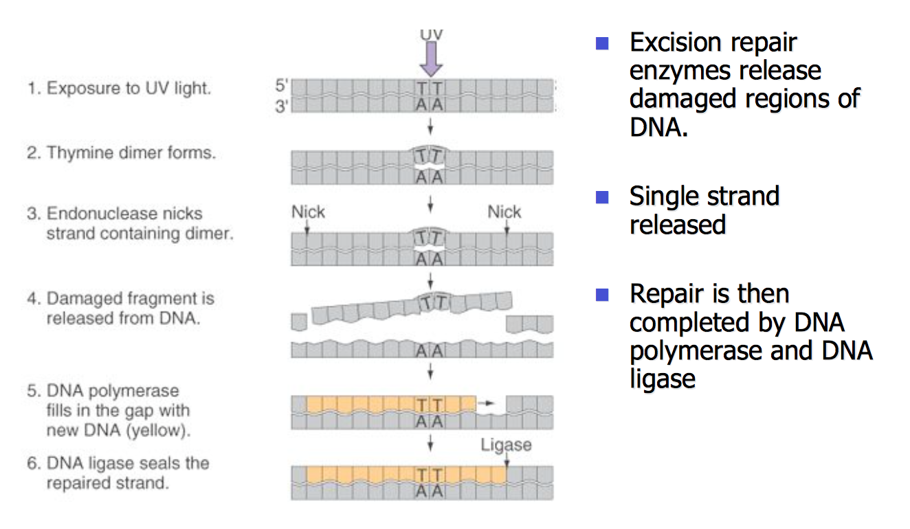
Nucleotide Excision Repair
＃خليك بالبيت

Slide 37
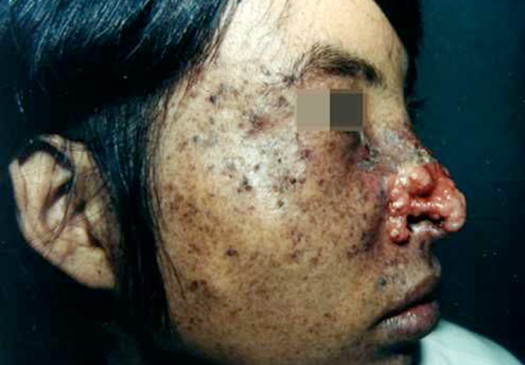
Nucleotide Excision Repair
＃خليك بالبيت
Xeroderma pigmentosum (XP) is a recessive disorder in which victims lack the normal UV repair enzymes (NER genes). This creates hypersensitivity to sunlight and a tendency to develop skin cancer

Slide 38
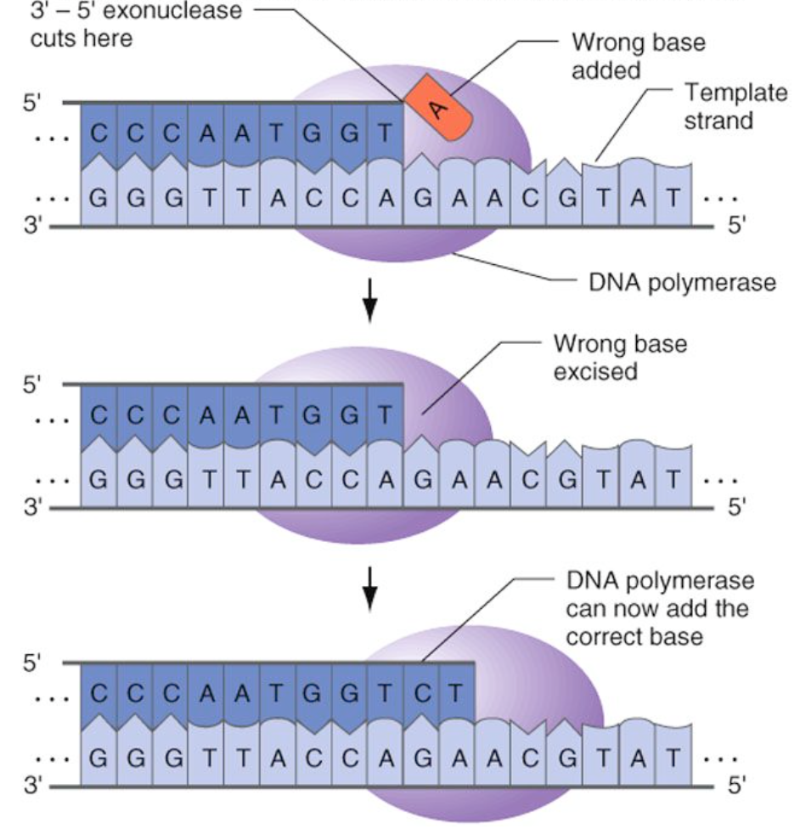
Strand-directed Mismatch Repair
＃خليك بالبيت
Mismatch repair (MMR) corrects errors introduced during DNA replication (e.g. base substitution, deletions or insertions)
Replication errors are rare due to high fidelity of DNA replication process
DNA polymerases have proofreading 3’-5’ exonuclease (reverse) activity which recognizes mismatched bases and excises them

Slide 39
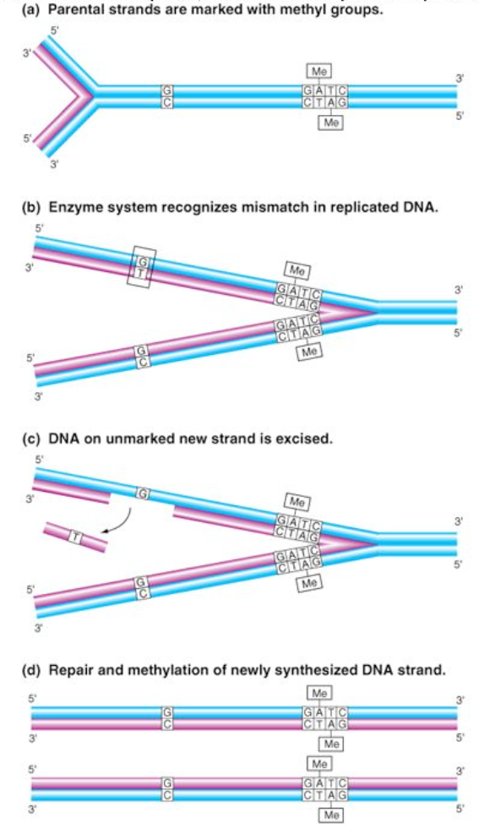
Strand-directed Mismatch Repair
＃خليك بالبيت
Mismatch system recognizes and corrects errors that escaped from DNA polymerase proofreading machinery
3 steps process:
Mismatched base pair is recognized
Excision of DNA segment containing the mismatched nucleotide from the newly synthesized strand
Resynthesis of the excised segment
It is called strand-directed MMR because MMR enzymes are selectively directed to the newly synthesized strand rather than to the old strand

Slide 40
Double strand breaks repair (DSB)
＃خليك بالبيت
A dangerous type of DNA damage which can lead to chromosomes fragmentation and consequently loss of genes (chromosomal aberration) if left unrepaired
Two types of repair mechanisms:
Non-homologous End Joining (NHEJ): it is an error-prone mechanism of repair because it results in a change of DNA sequence at the site of breakage
Homologous recombination (HR) is an error-free mechanism of repair because the damage is accurately repaired using information from sister chromatid

Slide 41
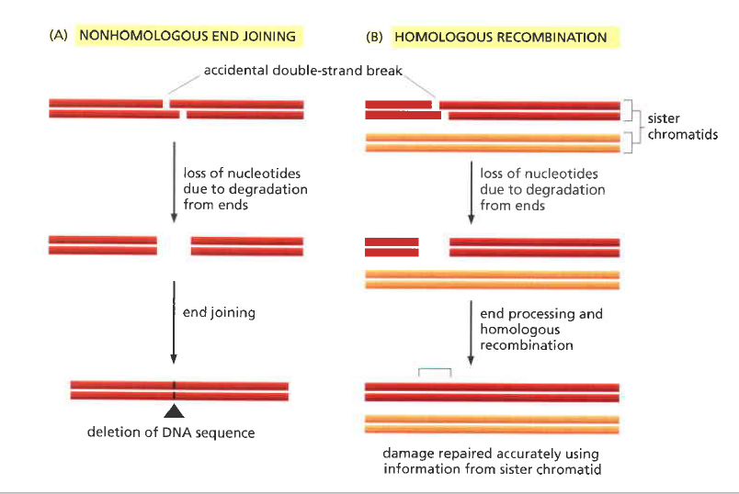
Double strand breaks repair (DSB)
＃خليك بالبيت

Slide 42
Mutation
＃خليك بالبيت

Slide 43
DNA Damage and Mutation
DNA damage
Defective Repair systems
Mutation
Diseased cells
＃خليك بالبيت
DNA damage
Repair enzymes
Normal cells
Mutation is an alteration in genetic sequence having tricked the DNA repair systems and thus getting replicated in the future (inherited, permanent and unrepaired lesion)

Slide 44
Structural Classification of Mutation
＃خليك بالبيت
Mutation
Frameshift mutation
Insertion
Deletion
Point mutation
Substitution
Transition
Transversion

Slide 45
Frameshift Mutation
＃خليك بالبيت
Frameshift mutation: any addition (insertion) or deletion which alters the reading frame (i.e. not in a multiple of three)

Slide 46
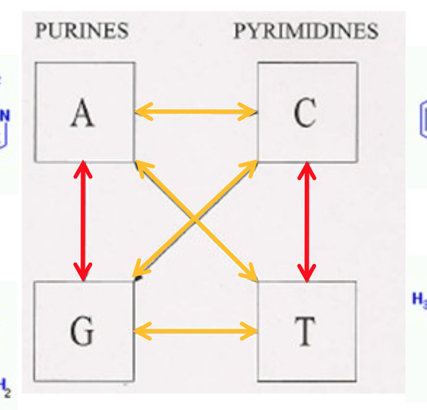
Point Mutation
＃خليك بالبيت
Point mutation: an alteration in DNA sequence by a single nucleotide base and consequently a change in single base pair (substitution)
Substitution at a point is called Transition if one purine is replaced with another purine or one pyrimidine with another pyrimidine and it is called Transversion if one purine is replaced with one pyrimidine or vise versa

Slide 47
Point Mutation
＃خليك بالبيت
Point mutation
Silent
Nonsense
Missense
Conservative
Non-conservative
At the protein level, point mutation is classified:
Silent mutation
Nonsense mutation
Missense mutation (conservative and non-conservative)

Slide 48
Point Mutation
＃خليك بالبيت
Silent mutation: a change in triplet codon without a change in the encoded amino acid. Thus, it has no effect on the protein sequence
Nonsense mutation: the codon changes from amino acid codon to stop codon resulting in truncated protein (mostly non-functional)
Missense mutation: codon change alters the amino acid encoded. It could be conservative if the new amino acid is chemically similar to the original one or non-conservative if it is chemically dissimilar

Slide 49
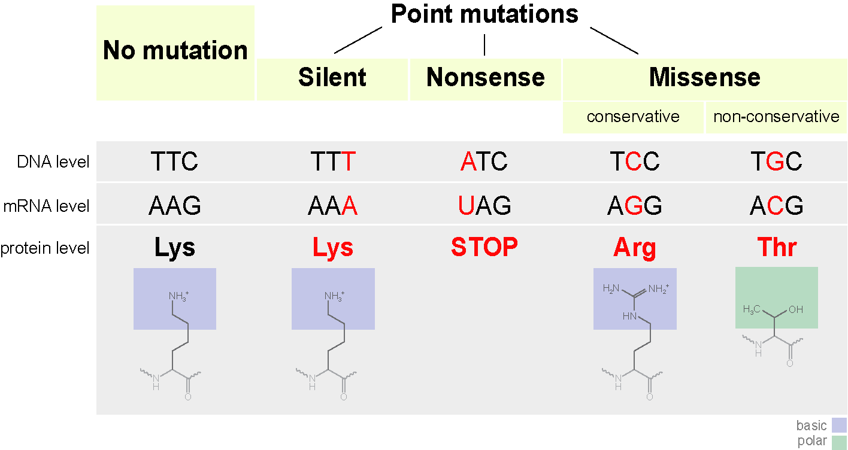
Point Mutation
＃خليك بالبيت

Slide 50
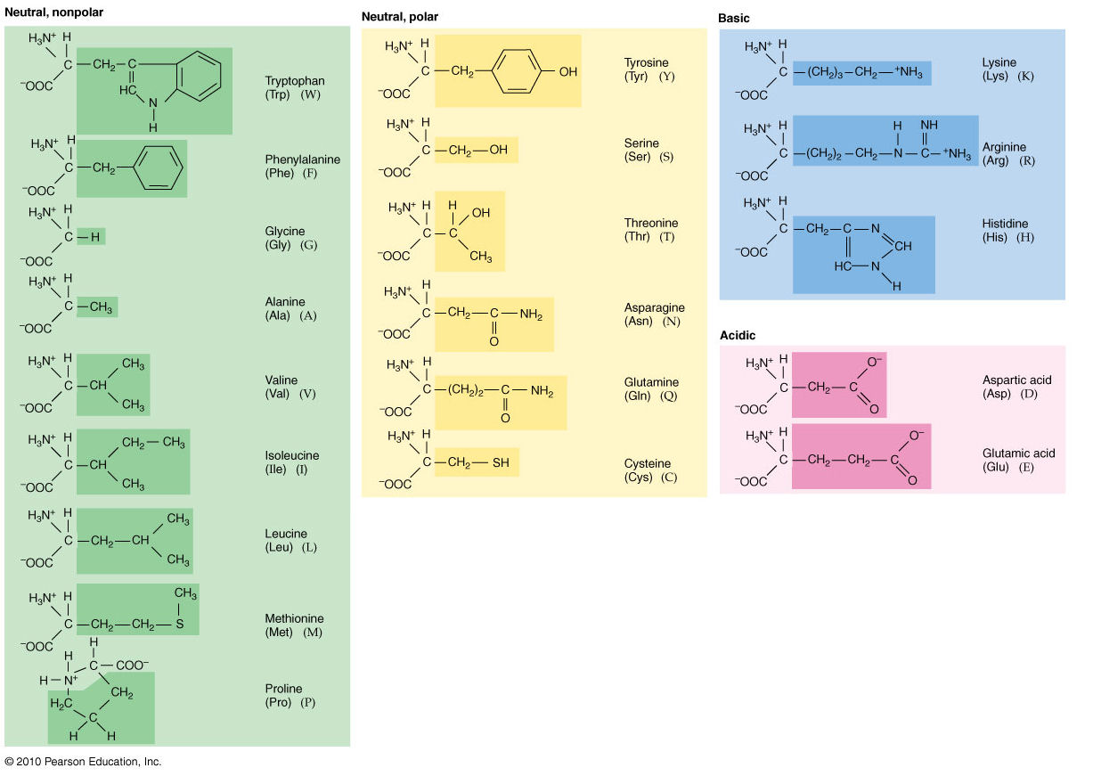
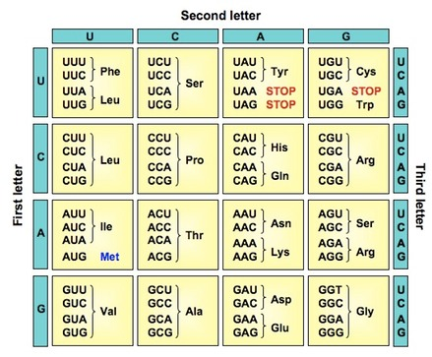
Point Mutation
＃خليك بالبيت

Slide 51
＃خليك بالبيت
Summary
& Take home message

