Slide 1
Resting membrane potential(RMP)
Dr.Arwa Rawashdeh

Slide 2
objectives
Resting membrane potential (RMP)
Nernst equation (ion equilibrium potential )
Goldman Hodgkin (GHK) equation (diffusion potential )
Combination of nernst and GHK

Slide 3
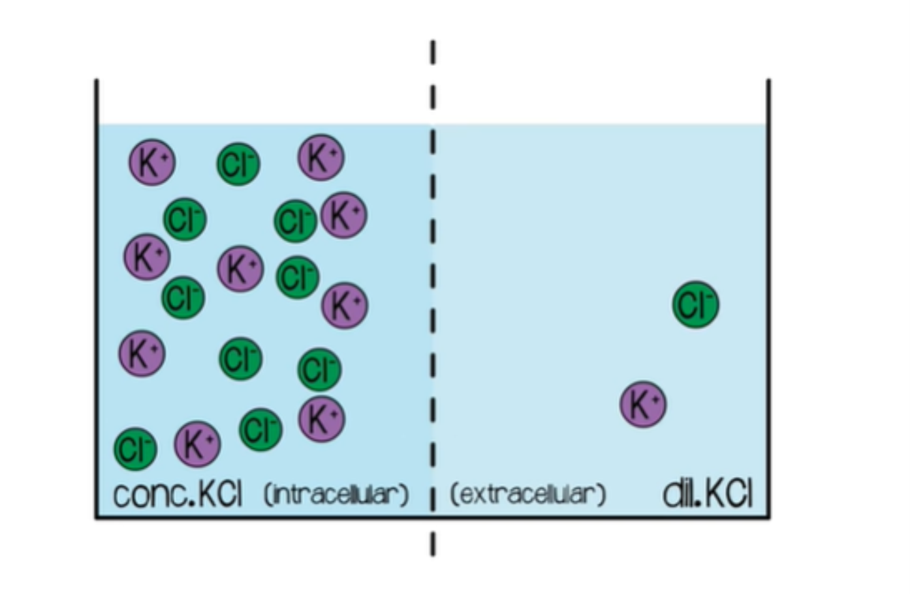
2. Nernst equation

Slide 5
Nernst equation

Slide 7
Goldman Hodgkin Equation (GHK)

Slide 8
Nernst equation
1. Calculate one ion
2. Thermodynamic equilibrium no net balance or movement (zero net flux)
3. No energy
GHK equation
All ions
2. Permeability and
Concentrations for different ions
3. Intra and extra conc
4. Not thermodynamic system ( Net flow)
5. Well , adequately explains living cells
6. Requires energy

Slide 9
Combination of nernst and GHK equations

Slide 10
Combination of nernst and GHK equations
When the permeability for a given ion increases dramatically the resting membrane potential is going to get closer to the given ion equilibrium

Slide 11
Factors to resting membrane potentials
Diffusion potential (GHK)
Pumps of sodium and pottasium
Gibbs and Donnon potential

