Slide 1
PHARYNX
By
Dr Abulmaaty Mohamed Assistant professor Anatomy & Embryology Mutah University

Slide 2
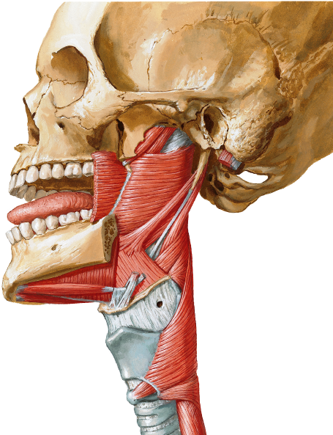
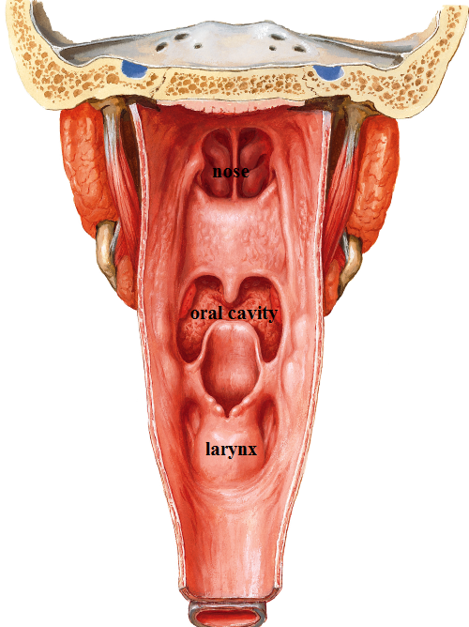
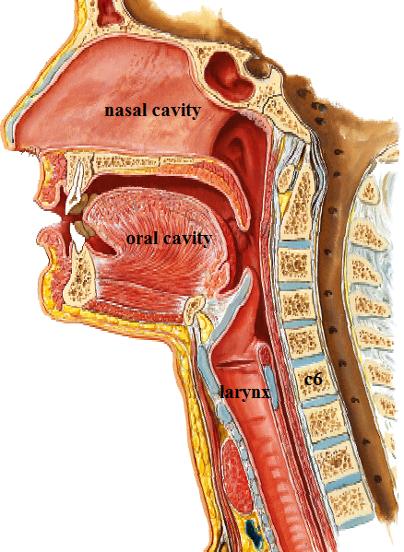
PHARYNX
Def.:
fibromuscular tube
defective anteriorly
lying behind nasal cavity,
oral cavity
and larynx.
Extent:
from base of skull
to 6th cervical vertebra,
where it continues with oesophagus.

Slide 3
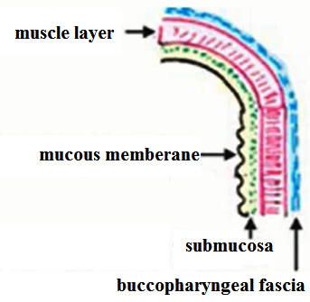
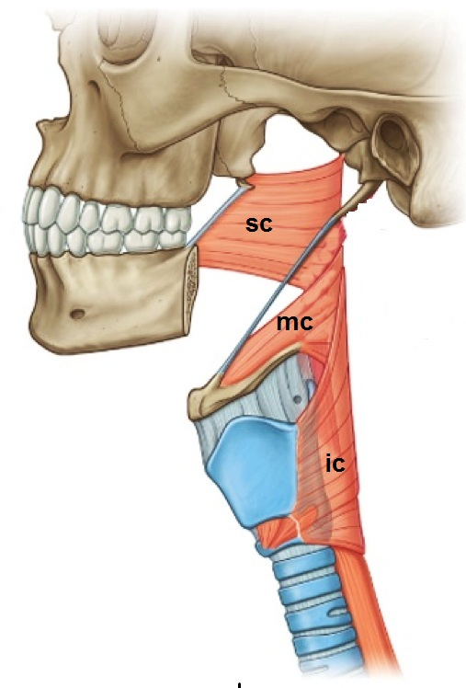
PHARYNX
Structure: From inside outwards
1-mucous membrane
2-submucosa (connective tissue layer)
3-muscle layer.
4-buccopharyngeal fascia
Muscles:
3 constrictor muscles:
forming circular outer layer.
3 longitudinal muscles:
forming longitudinal inner layer
Buccopharyngeal fascia:
covering the outer surface of constrictors.
submucosa:
It is loose connective tissue but its upper part is thickened forming pharyngobasilar fascia.

Slide 4
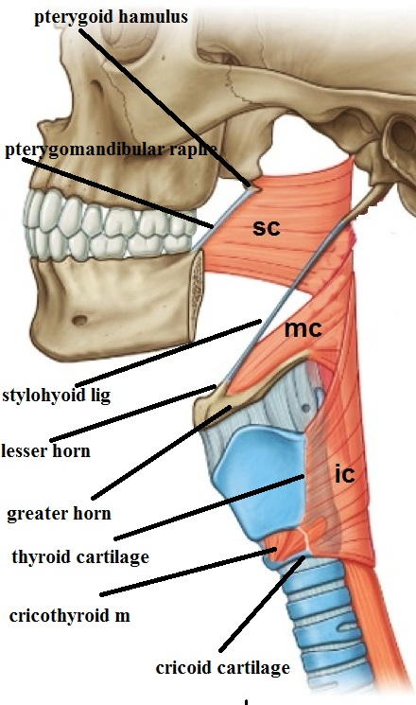
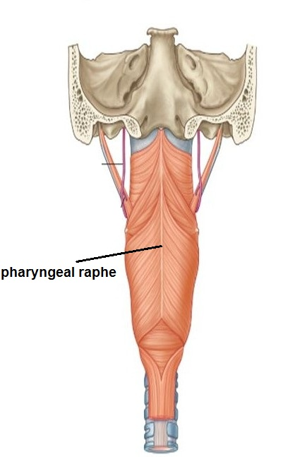
PHARYNX
Muscles:
Superior constrictor:- arise from
-Pterygoid hamulus &Pterygomandibular raphe
-Post. end of mylohyoid line
Middle constrictor:- arise from
-lower port of stylohyoid ligament.
-Lesser & greater horns of hyoid bone.
Inferior constrictor:- arise from
- oblique line of thyroid cartilage
-Fibrous arch bridging cricothyroid muscle
-Side of cricoid cartilage
I.:- All form pharyngeal raphe that is fixed superiorly to pharyngeal tubercle in base of skull
Action:-Sequential contraction from above downwards moving the bolus towards esophagus.

Slide 5
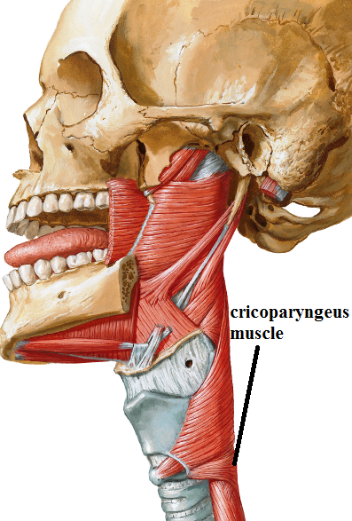
PHARYNX
Muscles:
N.B.1:-middle constrictor overlaps the superior constrictor enclosing it.
&Inferior constrictor , overlaps and encloses the middle .
N.B.2:- lower fibres of inferior constrictor arise from one side of cricoid and pass uninterrupted to other side of cricoid cartilage, this part is called cricopharyngeus muscle which forms a sphincter that open only for passage of a bolus during swallowing. This part also is the narrowest part of GIT except appendix.

Slide 6
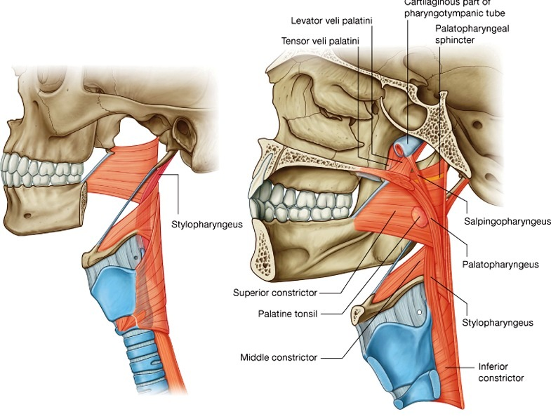
pharynx
Gaps in pharyngeal wall
(parts defective in constrictors)
a-Between superior constrictor and base of skull:
For Auditory tube
Levator palati muscle.
Tensor palate muscle.
b-Between superior and middle constrictors :
for Stylopharyngeus muscle.
Glossopharyngeal nerve
c-Between middle and inferior constrictors :
for Internal laryngeal n.
Superior laryngeal art.

Slide 7
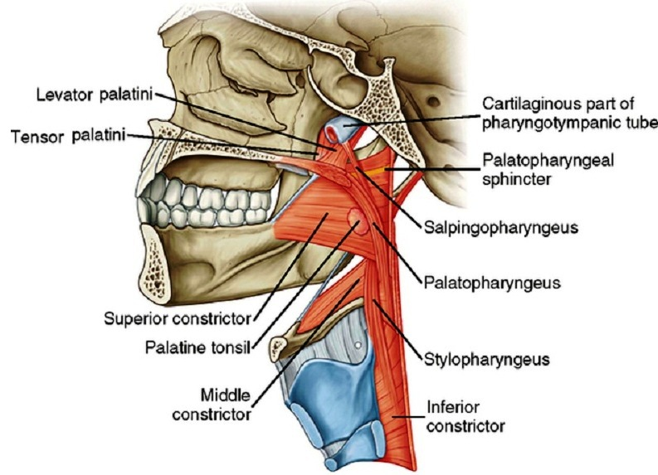
pharynx
Muscles:
Palatogpharyngeus
O.:- upper surface of palatine aponeurosis post. border of thyroid lamina.
I.:- - Side wall of pharynx inner to constrictors
Salpingopharyngus
O.:- cartilaginous part of auditory tube
I.:- spread on inner aspect of constrictors.
Stylopharyngeus
O.:- styloid process
I.:-.-post. border of thyroid lamina.
-spread on inner aspect of constrictors
A.:- ALL elevate the pharynx during swallowing so that the pharyngeal wall shorten

Slide 8
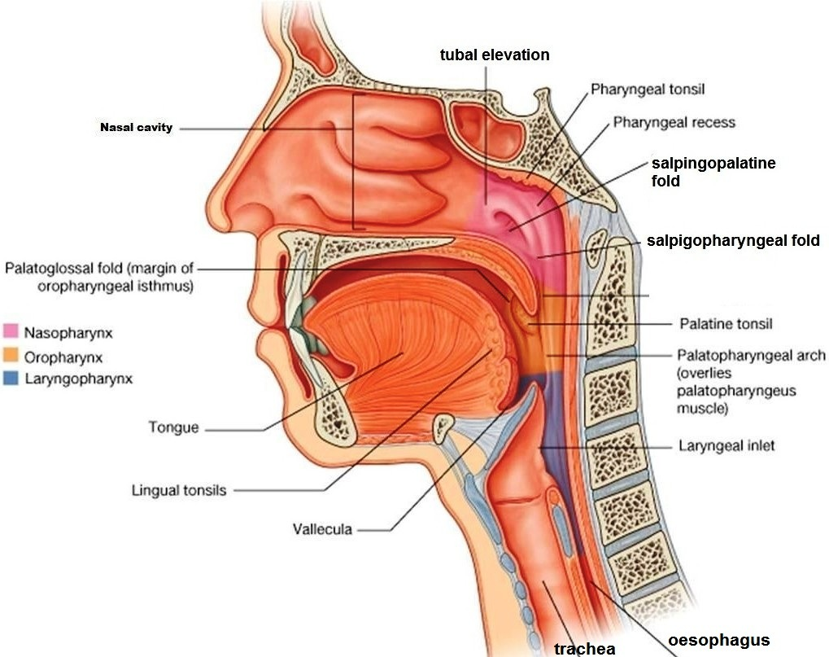
pharynx
Cavity of pharynx:
Internally pharyngeal cavity
is divided into 3 parts:
I-Nasopharynx:
Lies behind nasal cavity
Extent: from base of skull
to level of soft palate
Features:
1-Opening of auditory tube
in the side wall just above of soft palate
2-Tubal elevation
3-Salpingopalatine fold:
Produced by levator palati
extends from below the opening of auditory tube to soft palate.

Slide 9
pharynx
I-Nasopharynx:
Features:
4-Salpingopharyngeal fold
-Produced by salpingopharyngus muscle
-Extend from post. part of tubal elevation to fades away on the side wall of pharynx.
5-Pharyngeal recess
Depression just behind tubal elevation.
6-Pharyngeal isthmus
The junction between nasopharynx and oropharynx Bounded by soft palate
anteriorly and wall of pharynx opposite to soft palate posteriorly.
It is closed during swallowing by approximation of soft palate and the opposite wall of pharynx

Slide 10
pharynx
I-Nasopharynx:
Features:
7-Pharyngeal tonsils collection of lymphoid tissue at meeting of roof and post. wall.
In children, if it is enlarged, it is called adenoids that can close nasopharynx completely leading to oral breathing.

Slide 11
pharynx
II-Oropharynx :
Lies behind oral cavity
Extent: from post. border of soft palate
to upper border of epiglottis .
Features:
1-Its ant. wall is formed by
back of tongue and
oropharyngeal isthmus.
The latter is the opening
communicating between oropharynx and mouth

Slide 12
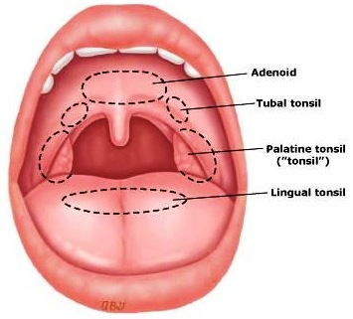
pharynx
II-Oropharynx :
Features:
2- Palatine tonsil:
def.: collection of lymphatic tissue projecting into the oropharynx just behind Palatoglossal arch.
Site: Tonsillar fossa:
the part of side wall of oropharynx
lodging the tonsil it is bounded by:
-Palatoglossal arches: anteriorly,
-Palatopharyngeal arches; posteriorly.
-Soft palate: above.
-Tongue: below.
-floor: sup. constrictor

Slide 13
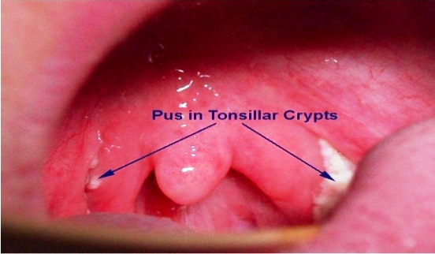
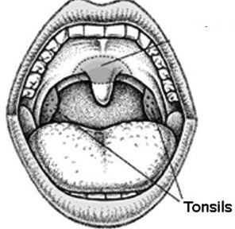
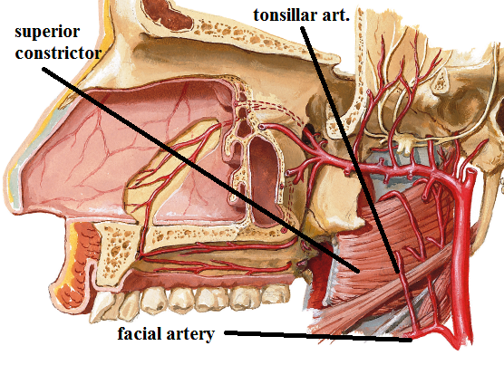
pharynx
II-Oropharynx :
Features:
2- Palatine tonsil:
Tonsillar crypts: the medial surface
of tonsil is covered by
mucous membrane.
Minute tubular extensions
from the mucous membrane
invaginate the tonsil,
end blindly within the collection of
lymphoid tissue and open
on the surface of the mucous membrane.
Blood supply : main blood supply is tonsillar artery,
a branch of facial art.

Slide 14
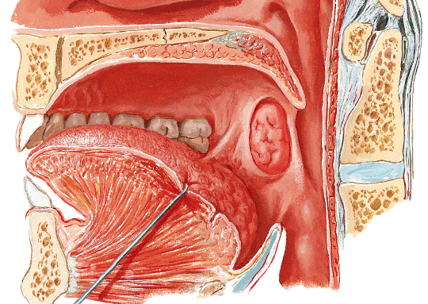
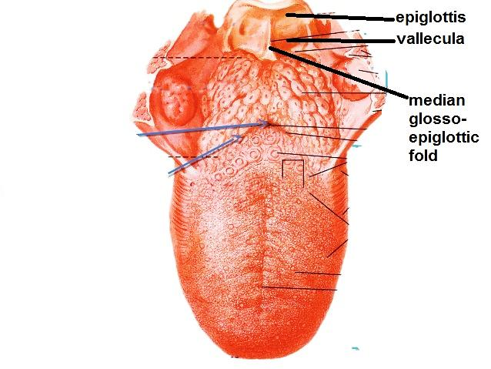
pharynx
II-Oropharynx :
Features:
3- Median glossoepiglotic fold:
fold of mucous membrane
connects back of tongue with
front of upper part of epiglottis,
4- Vallecula:
depression on each side
of median glossoepiglotic fold.

Slide 15
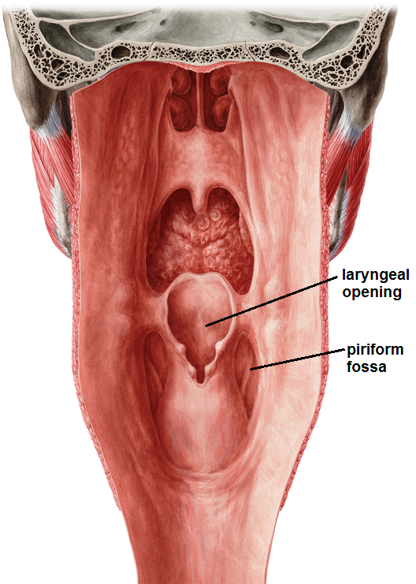
pharynx
lll- Laryngopharynx:
Lies opposite to larynx
Extent: from upper border of epiglottis
to lower border of cricoid cartilage.
Features:-
1-its ant. Wall: receives the upper opening of larynx (laryngeal inlet).
2- Piriform fossa: recess lined by mucous membrane lying on the side of laryngeal inlet and is supplied by int. laryngeal n.
It is tapering inferiorly.

Slide 16
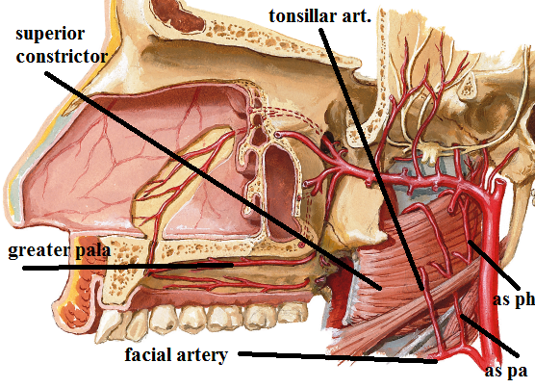
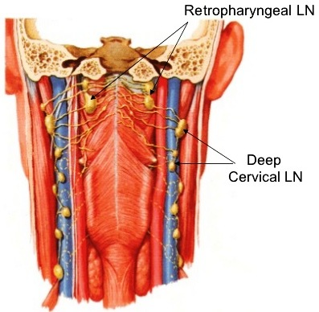
pharynx
Arterial supply :
-Pharyngeal br of maxillary art.
-Greater palatine art
-Ascending pharyngeal art.
-Ascending palatine art.
-Tonsillar art
Sup. Laryngeal art.
-Inf. laryngeal art.
Venous drainage:
-Veins from pharynx end in
the pharyngeal plexus, which drains into IJV
Lymphatic drainage:
-Retropharyngeal LNs
-Deep cervical LNs

Slide 17
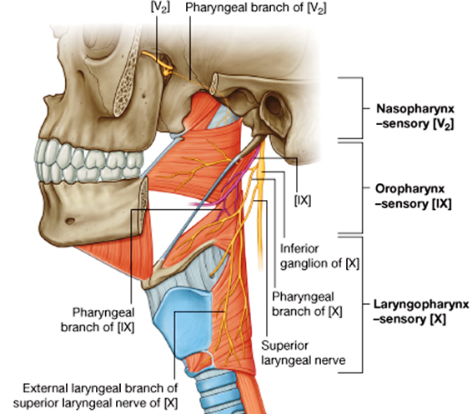
pharynx
Nerve supply:
Motor:
all muscles of pharynx are supplied by pharyngeal br. of vagus. through pharyngeal plexus except stylopharyngeus which is supplied by glossopharyngeal n.
Sensory:
-Nasopharynx: pharyngeal br. of pterygopalatine ganglion
(its sensory fibres are derived from maxillary n.)
-Oropharynx: pharyngeal brs of glossopharyngeal n. through pharyngeal plexus.
-Laryngopharynx: - Internal laryngeal n.
- Recurrent laryngeal n.

Slide 18
THANQ

