Slide 1
Colorectal Cancer
Presented by:
Monther Al-Qatawneh, Amin Al-Qatawneh
Supervised by:
Dr. Emad Aborajooh

Slide 2
Outlines
Anatomy
Epidemiology
Risk and Protective factors
Etiology
Polyps and Lynch syndrome
Pathology
Screening
Staging systems
Clinical Presentation and Diagnosis
Treatment
Follow Up

Slide 3
Anatomy
The large intestine is the terminal portion of the gastrointestinal tract and is derived from the midgut, hindgut, and cloaca.
The large intestine length is approx. 1.5 m (5 ft) long.
The large intestine is divided into the cecum and appendix, the ascending colon, transverse colon, descending colon, sigmoid colon, rectum, and anal canal.
The large intestine is less mobile than the small bowel as the ascending and descending colon are fixed to the retroperitoneum.
Notes:
Distinguished by having fat-filled peritoneal tags known as appendices epiploicae and the presence of taeniae.
The taenia coli are three flat bands of longitudinal muscle that run the length of the large intestine from the appendix base to the rectosigmoid junction and they act to pull the colon into its typical sacculated state, producing a series of haustrations.
The neurovascular supply to the colon is closely linked to its embryological origin:
Ascending colon and proximal 2/3 of the transverse colon – derived from the midgut., are supplied by the superior mesenteric artery,
Distal 1/3 of the transverse colon, descending colon and sigmoid colon – derived from the hindgut, -derived structures by the inferior mesenteric artery.

Slide 4
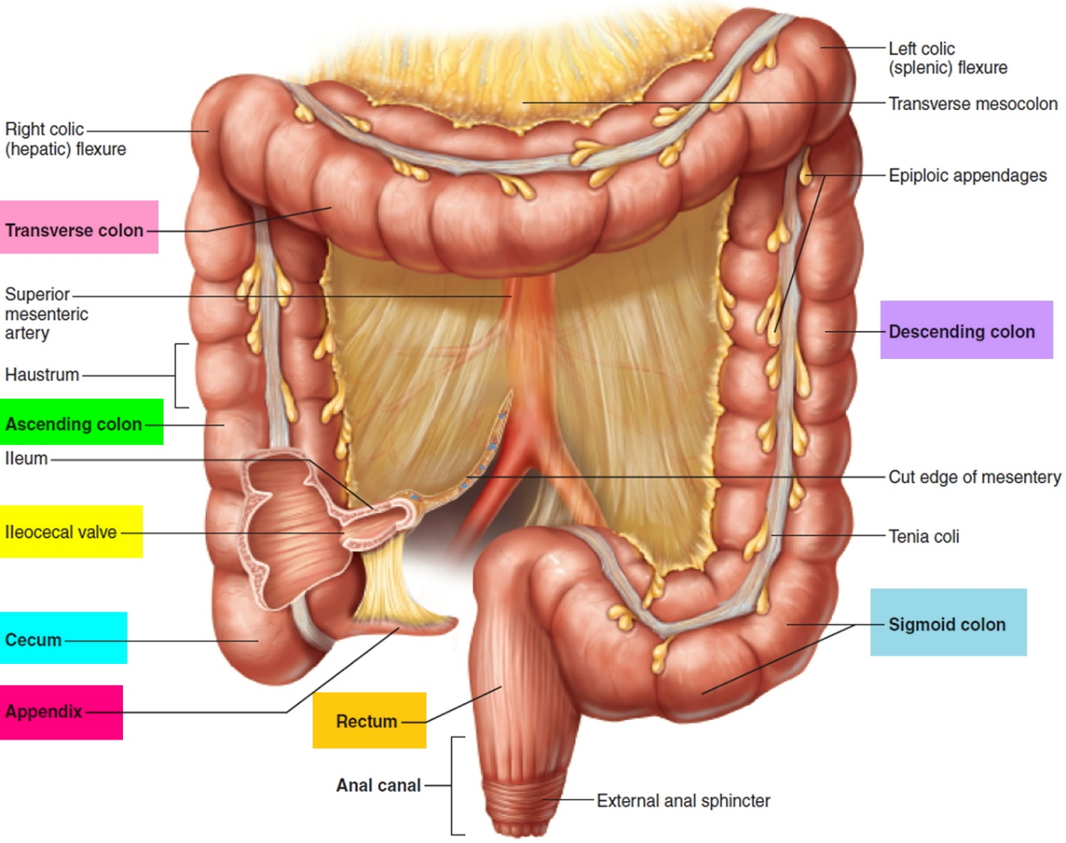
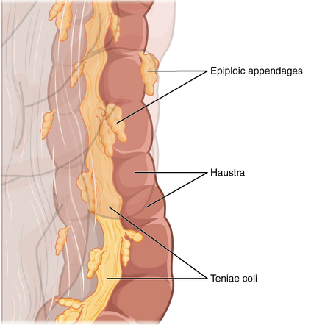
Anatomy

Slide 5
Anatomy
 | Midgut derivatives Cecum, appendix, ascending colon, proximal 2/3 of the transverse colon
Arterial blood supply | Branches of the superior mesenteric artery (SMA)
 | Ileocolic artery: Ileocolic region, cecum and appendix.
 | Rt colic artery: Ascending colon and hepatic flexure.
 | Middle colic artery: Proximal 2/3rd of transverse colon
Venous drainage | Branches of the superior mesenteric vein → portal vein
Lymphatic drainage | Superior mesenteric lymph nodes: colon to splenic flexure
innervations | Visceral: superior mesenteric plexus

Slide 6
Anatomy
 | Hindgut derivatives Distal 1/3 of the transverse colon, descending colon, and sigmoid colon
Arterial blood supply | Branches of the Inferior mesenteric artery (IMA)
 | Lt colic artery: distal 1/3rd of transverse colon, Splenic flexure and descending colon.
 | Sigmoidal arteries: Sigmoid colon.
Venous drainage | Left colic vein and sigmoid veins drain into the inferior mesenteric vein → splenic vein → portal vein
Lymphatic drainage | Inferior mesenteric lymph nodes: colon from splenic flexure to upper and middle rectum
innervations | Visceral: Inferior mesenteric plexus

Slide 7
Anatomy
 | Rectum and anal canal
 | Above pectinate line | Below pectinate line
Arterial blood supply | Superior rectal artery (IMA) | Middle rectal artery (Internal iliac)
 |  | Inferior rectal artery (Internal pudendal)
Venous drainage | Superior rectal vein → inferior mesenteric vein → splenic vein → portal vein | Middle and inferior rectal vein → internal pudendal vein → internal iliac vein → common iliac vein → inferior vena cava
Lymphatic drainage | 1) Upper and middle rectum: pararectal lymph nodes → inferior mesenteric lymph nodes 2) Direct to Internal iliac lymph nodes | Superficial inguinal lymph nodes
innervations | Visceral: Inferior mesenteric plexus | Somatic: inferior rectal branch of the pudendal nerve (S2–S4)

Slide 8
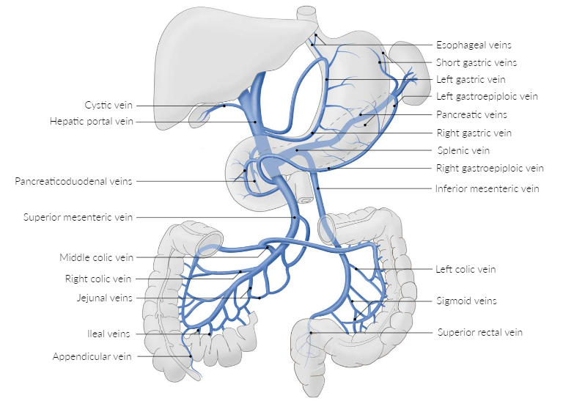
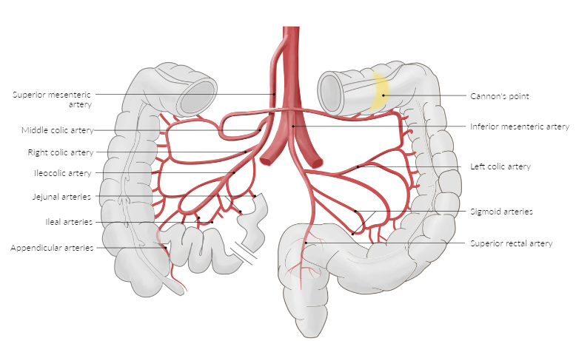
Anatomy

Slide 9
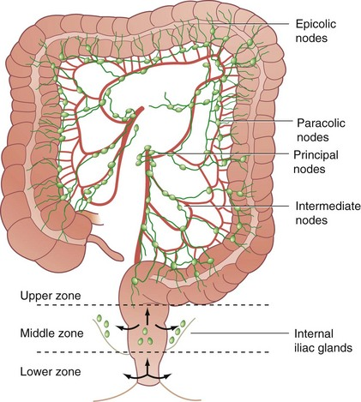
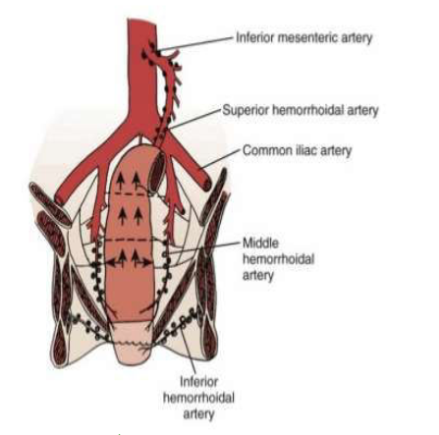
Anatomy and Functions
Innervations:
The parasympathetic nerve
Right and transverse colon is through the vagus nerve.
Distal colon and the rectum are supplied by (the pelvic splanchnic nerves) from S2,3,4.
The sympathetic system
supplies the blood vessels through the greater and lesser splanchnic nerve.
Lymphatic drainage:
Most of the lymph nodes passes into the intestinal lymph trunks, and on to the cisterna chyli – where it ultimately empties into the thoracic duct.
Functions:
Absorbs water and electrolytes
Absorbs vitamins
Eliminates feces

Slide 10
Colorectal Cancer

Slide 11
Epidemiology
Worldwide:
Colorectal cancer is the third most diagnosed cancer in male and second in female.
Colorectal cancer is the second leading cause of cancer death.
Incidence and mortality: male > female (UpToDate).
It predominantly affects older individuals, with the majority of cases occurring in people aged 40-50 and above.
Notes:
For colon cancer, the average age at the time of diagnosis for men is 68 and for women is 72. For rectal cancer, it is age 63 for both men and women.

Slide 12
Risk factors
Age: older age (> 40 years)
Race: more in black people.
Gender: male>female (UpToDate).
Hereditary syndromes
Family history: Approx. 25% of individuals with colorectal cancer (CRC) have a positive family history.
Familial adenomatous polyposis
Hereditary nonpolyposis colorectal cancer
Associated conditions
Colorectal adenomas and serrated polyps, Inflammatory bowel disease, Endocarditis and bacteremia due to S. gallolyticus and DM type 2.
Lifestyle: Alcohol and Tobacco
Cholecystectomy: slight increase in the risk of right-sided colon cancer, possibly as a consequence of increased bile acid exposure.
Diet: Obesity, Processed meat and High-fat and low-fiber
Pathogens: Streptococcus bovis, Clostridium septicum.

Slide 13
Protective factors
High fiber diet
Folic acid and folate
Aspirin
Low-dose aspirin can reduce the risk of colorectal cancer by 40% for people who meet specific criteria.
Combined oral contraceptive pills
It is not clear if the following affect the risk of colorectal cancer:
NSAIDs other than aspirin
Calcium

Slide 14
Etiology
Chromosomal instability pathway in colon cancer: The adenoma-carcinoma sequence is the progressive accumulation of mutations in oncogenes (e.g., KRAS) and tumor suppressor genes (e.g., APC, TP53) that results in the slow transformation of adenomas into carcinomas.
APC gene mutation (loss of cellular adhesion and increased cellular proliferation) → KRAS gene mutation (unregulated cellular signaling and cellular proliferation) → TP53 and DCC gene mutation
Most cases of sporadic CRC develop via this pathway.
Microsatellite instability pathway in colon cancer: due to methylation or mutations in mismatch repair genes (MMR genes, e.g., MLH1 or MSH2)
Notes:
Sporadic CRC is much more common than inherited CRC.

Slide 15
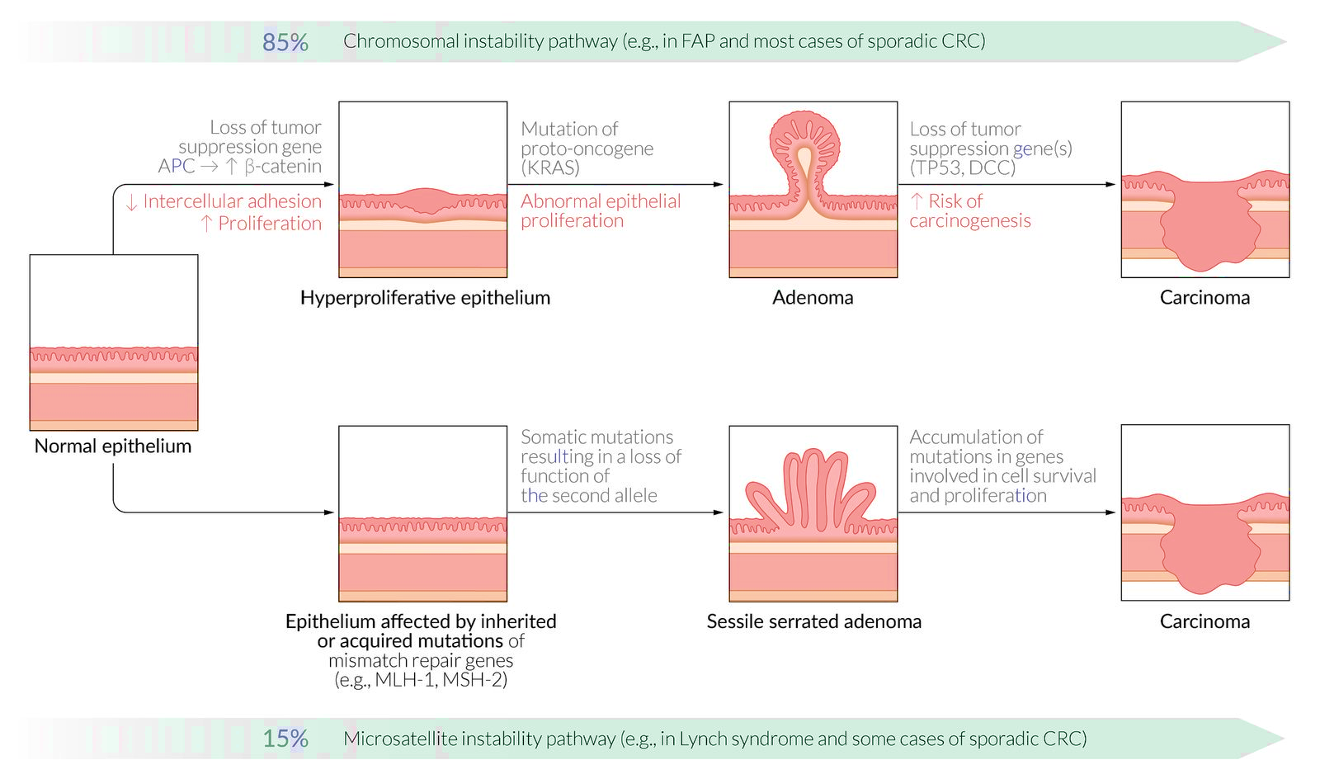
Etiology

Slide 16
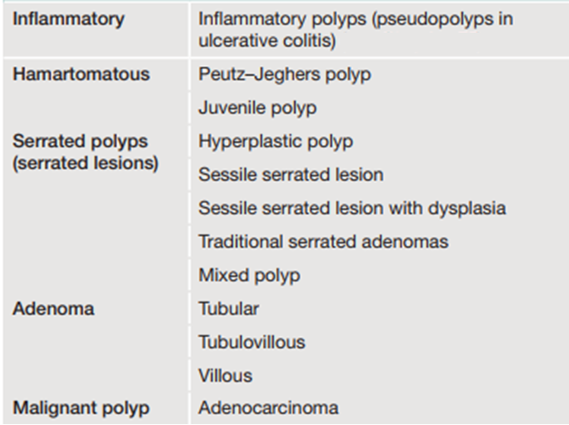
Intestinal Polyps
Adenomatous polyps:
The most common type (70%).
High malignant potential.
More risk of malignancy in:
Histology: Villous > tubular
Size: more size will increase risk
Morphology: Sessile > Pediculated

Slide 17
Hereditary non-polyposis colorectal cancer (Lynch syndrome)
caused by an autosomal dominant mutation in DNA mismatch repair (MMR) genes.
The most affected genes are MLH1 and MSH2.
increased risk of colorectal cancer and cancers of the endometrium, ovary, stomach and small intestines.
Colon cancer and lynch syndrome:
Most common cause of inherited CRC.
Accounts for approx. 3–8% of all new cases of CRC.
The lifetime risk of developing colorectal cancer in Lynch syndrome is 80%.
The mean age of diagnosis is 45 years.
Most cancers develop in the proximal colon.
Notes:
Lynch syndrome type 1: colorectal cancer
Lynch syndrome type 2: CEO; Colorectal, Endometrial, Ovarian/Others.
Turcot syndrome: presence of Lynch syndrome-related CRC and brain tumors (especially gliomas)

Slide 18
Hereditary non-polyposis colorectal cancer (Lynch syndrome)
Diagnosed by Amsterdam criteria II:
Presence of at least three relatives with a Lynch syndrome-associated cancer; all the following criteria should be present:
One should be a first-degree relative of the other two
At least two consecutive generations affected
At least one relative with a diagnosis before 50 years of age
Exclude cases of familial adenomatous polyposis.
Verify tumors with pathological examination.
Patients with HNPCC are subjected to regular (every one to two years) colonoscopic surveillance.
3-2-1 rule: (3 affected family members, 2 generations, 1 relative under 50 years of age).

Slide 19
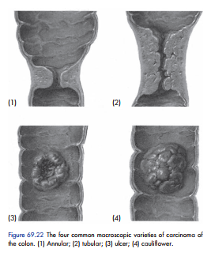
Pathology - Macroscopically
Annular.
Tubular.
Ulcerative.
Cauliflower.
The annular variety tends to give rise to obstructive symptoms, whereas the others will present more commonly with bleeding.

Slide 20
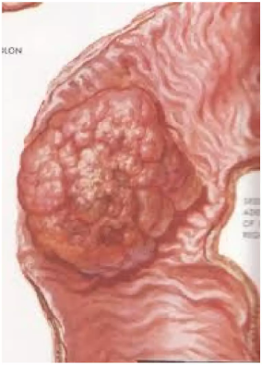
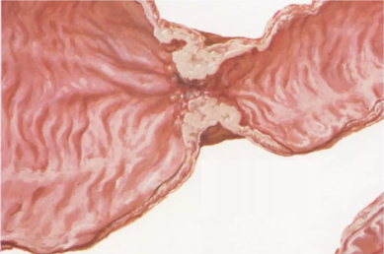
Pathology - Macroscopically
Right-sided colon carcinomas: mostly exophytic mass (polypoid or fungating); tend to bleed.
Left-sided colon carcinomas: mostly infiltrating mass (annular or encircling) produce ‘apple-core or napkin-ring’ appearance; tends to obstructive.
Exophytic mass
Napkin-ring mass
Notes:
exophytic mass: A descriptor for a structure that is growing outward (e.g., a tumor growing outward from the surface epithelium).

Slide 21
Pathology - Microscopically
Most common: adenocarcinoma (95%)
Less common (5%)
Mucinous adenocarcinoma
Signet ring cell carcinoma
Small cell carcinoma
Adenosquamous carcinoma (rare)

Slide 22
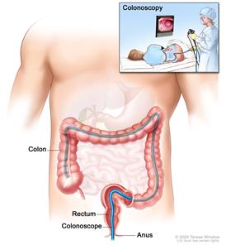
Screening
Criteria for average risk of CRC include:
No history of CRC, IBD, or adenomatous polyps
No family history of hereditary colon cancer syndromes (e.g., HNPCC, familial adenomatous polyposis).
Recommended screening age:
All individuals aged > 50 years; recent guidelines at 45 years of age.
With risk factors (family history):
At age 40 or 10 years earlier than the index patients age of diagnosis.
Screening modalities: Consider individual risk factors and patient preference when choosing a screening method.
Direct visualization
Gold standard: Complete colonoscopy every 10 years if no polyps or carcinomas are detected
Alternative: FSIG every 5 years, CT colonography every 5 years.
Stool-based testing
Annual fecal occult blood test

Slide 23
Staging
Once the diagnosis of CRC is established the local and distant extent of disease is determined via staging to provide a framework for discussing therapy and prognosis.
The most important prognostic factor is Lymph node status.
The American Joint committee for cancer (AJCC) TNM classification is the standard staging system and the Dukes classification is a simplified approach to staging for academic purposes

Slide 24
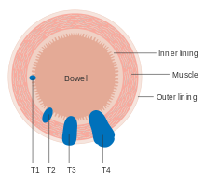
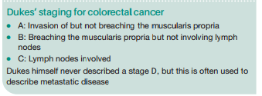
TNM classification for colorectal cancer
T | T1 | Tumor invades into submucosa
 | T2 | Tumor invades into musculars propria
 | T3 | Tumor invades into subserosa
 | T4a | Tumor breach visceral peritoneum
 | T4b | Tumor directly invades adjacent tissue or organs
N | N0 | No nodes involved
 | N1 | N1a: 1 regional LN involved N1b: 2-3 regional LNs involved
 | N2 | N2a:4-6 LNs involved N2b: 7 or more LNs involved
M | M0 | No metastases
 | M1a | Confined to one organ
 | M1b | More than one organ
 | M1c | Metastasis to the peritoneum
Source: Bailey And Love's Short Practice of Surgery 28th Ed
Notes:
The liver is the most common site for colorectal cancer metastasis.

Slide 25
Staging - AJCC staging 8th edition (simplified)
AJCC staging | TNM classification | Dukes stage
I | Up to T2, N0, M0 | A
II | Up to T4, N0, M0 | B
III | Any T, N1/N2, M0 | C
IV | Any T, any N, M1 | D

Slide 26
Clinical presentation
Patients with CRC may present in three ways:
Those with suspicious symptoms and signs
Asymptomatic patients discovered by routine screening which account for 10%
Emergency admission with intestinal obstruction, perforation or an acute GI bleed which account for 20-30% of CRC diagnosis

Slide 27
Signs and symptoms
Change in bowel habits (the most common symptom)
Rectal bleeding
Iron deficiency anemia
Rectal or abdominal mass
Abdominal pain
Constitutional symptoms like: weight loss, fever, night sweats, fatigue and abdominal discomfort

Slide 28
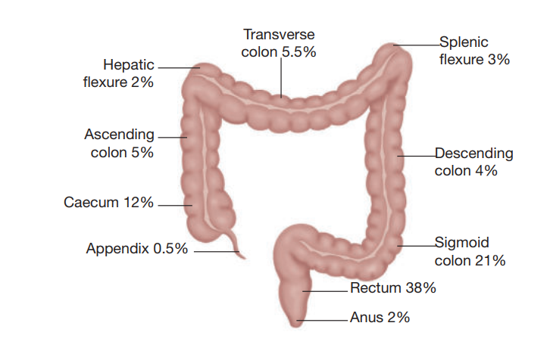
Distribution of colorectal cancer by site
Based on sites of onset, rectal cancer approximately accounts for 38% and colon cancer approximately accounts for 62%, and both sites combined account for 1.25%. Among colon cancers, the most common sites are the sigmoid colon (21%), followed by the ascending colon (5%), transverse colon (5.5%), descending colon (4%) and the cecum (12%)

Slide 29
Right-sided colon cancer
Large bowel malignancies arising in cecum, ascending colon or transverse colon.
Clinical features include:
Occult bleeding or melena
Iron deficiency anemia
Diarrhea

Slide 30
Left-sided colon cancer
Arising from the splenic flexure, descending colon, sigmoid colon or the rectosigmoid junction.
Clinical features include:
Change in bowel habits (size, consistency and frequency)
Blood-streaked stool
Colicky abdominal pain (due to obstruction)

Slide 31
Rectal carcinoma
Large bowel malignancies located within 15 cm from the anal verge.
Clinical features include:
Hematochezia
Decrease in stool caliber (pencil shaped stool)
Rectal pain
Tenesmus
Flatulence
Fecal incontinence

Slide 32
Diagnosis - History
We ask the patient about his presenting symptom’s onset, timing, severity
And then ask about the presence of other associating symptoms that could help us in diagnosis and give us a hint of the location of the tumor, we would also ask about the predisposing factors.

Slide 33
Diagnosis - Physical examination
Start with the vital signs especially in emergency symptoms
General look: look for pallor, weight loss, signs of cachexia and jaundice
Abdomen:
Inspection for distention, visible masses and scars indicative of prior surgery
Palpation for masses, tenderness and liver palpation (which may be enlarged with rough edges
Percussion which may be dull on masses , liver span for hepatosplenomegaly
Auscultation bowel sounds are hyperactive initially which then become hypoactive and eventually diminished when obstruction occurs
Digital rectal examination which should be done for all patients who present with LGIB where distal rectal cancers may be palpable nad evidence of blood may be seen

Slide 34
Diagnosis - Laboratory studies
Carcinoembryonic antigen (CEA) baseline may be obtained in all patients before initiating treatment for follow up, assessing response to treatment and to evaluate recurrence and should not be used for screening
CBC may show microcytic anemia
Liver chemistries and coagulation which may be abnormal in multiple hepatic metz.

Slide 35
Diagnosis - Imaging
Flexible sigmoidoscopy
An endoscopic evaluation of the lower gastrointestinal tract from the anus to the sigmoid colon. Can be performed using a flexible or rigid endoscope. Consider in patients with scanty intermittent hematochezia and age<40 years, no red flags and no risk factors
Complete colonoscopy: which is an indication for all patients with suspected CRC with the findings being an ulcer proliferative friable mass, and biopsy is required to confirm the diagnosis. CRC cannot be diagnosed without biopsy
Double contrast barium enema: which is an alternative to colonoscopy when it can’t be preformed; findings include endoluminal filling defect with irregular margins and an apple core lesion (napkin ring sign) which is a sharply defined circumferential narrowing of the bowel.

Slide 36
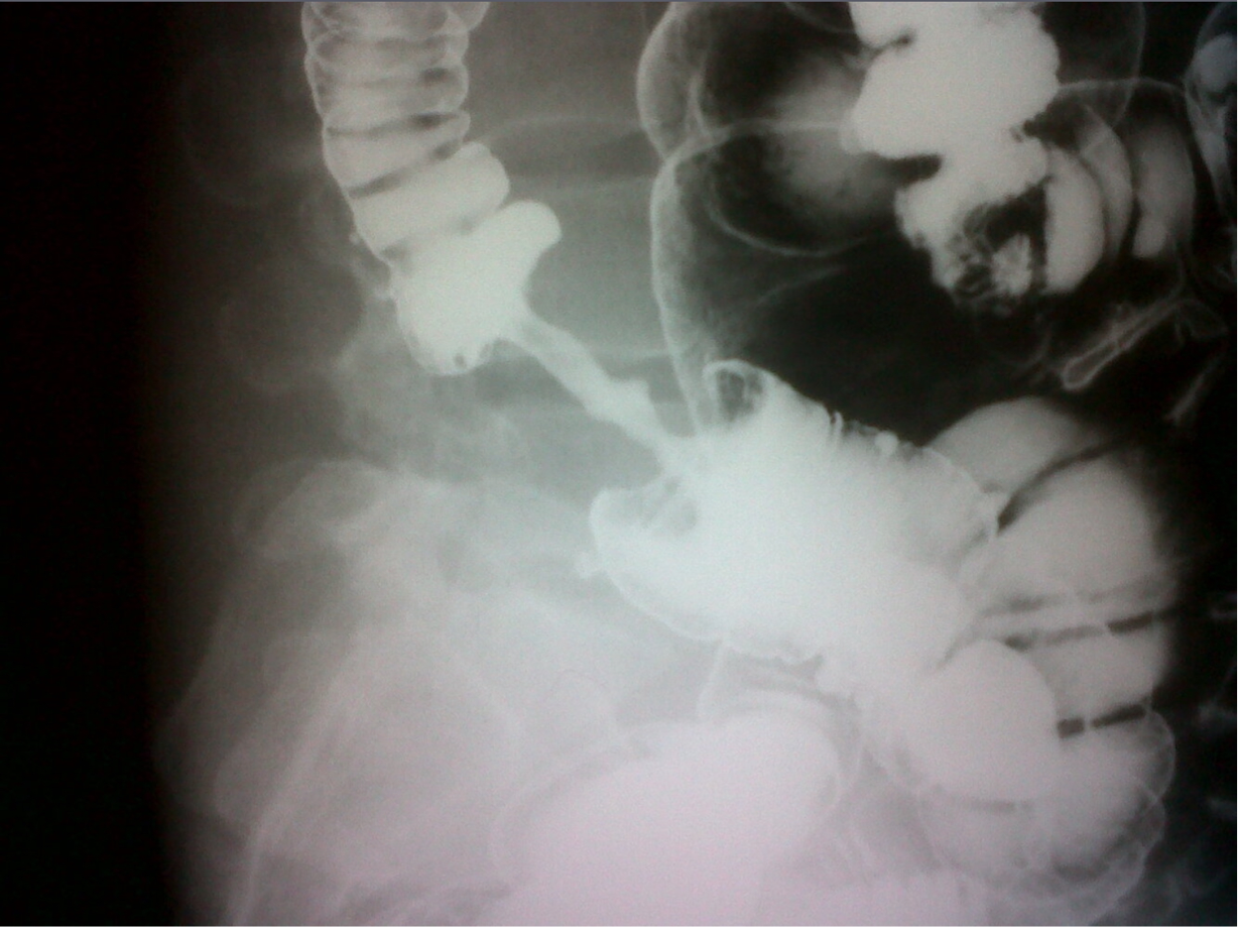
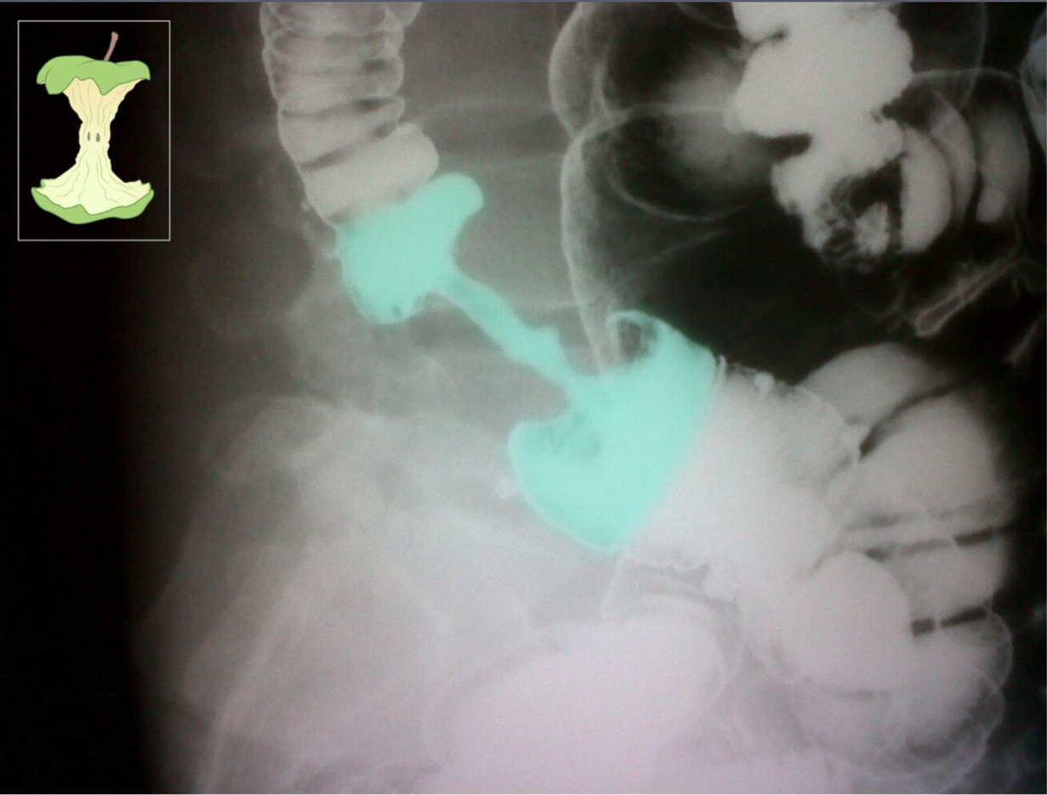
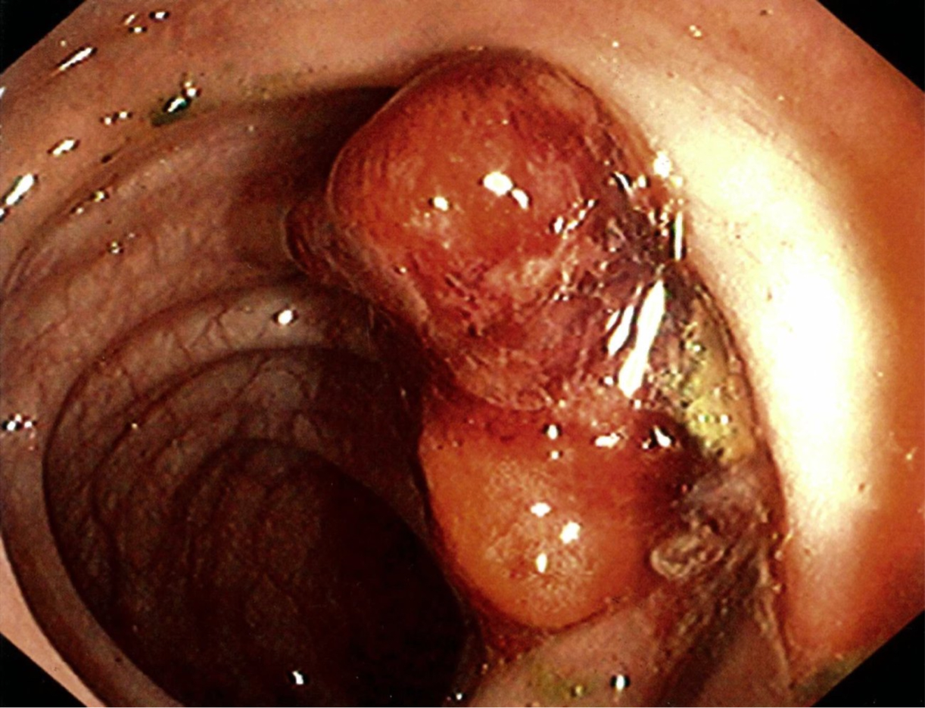
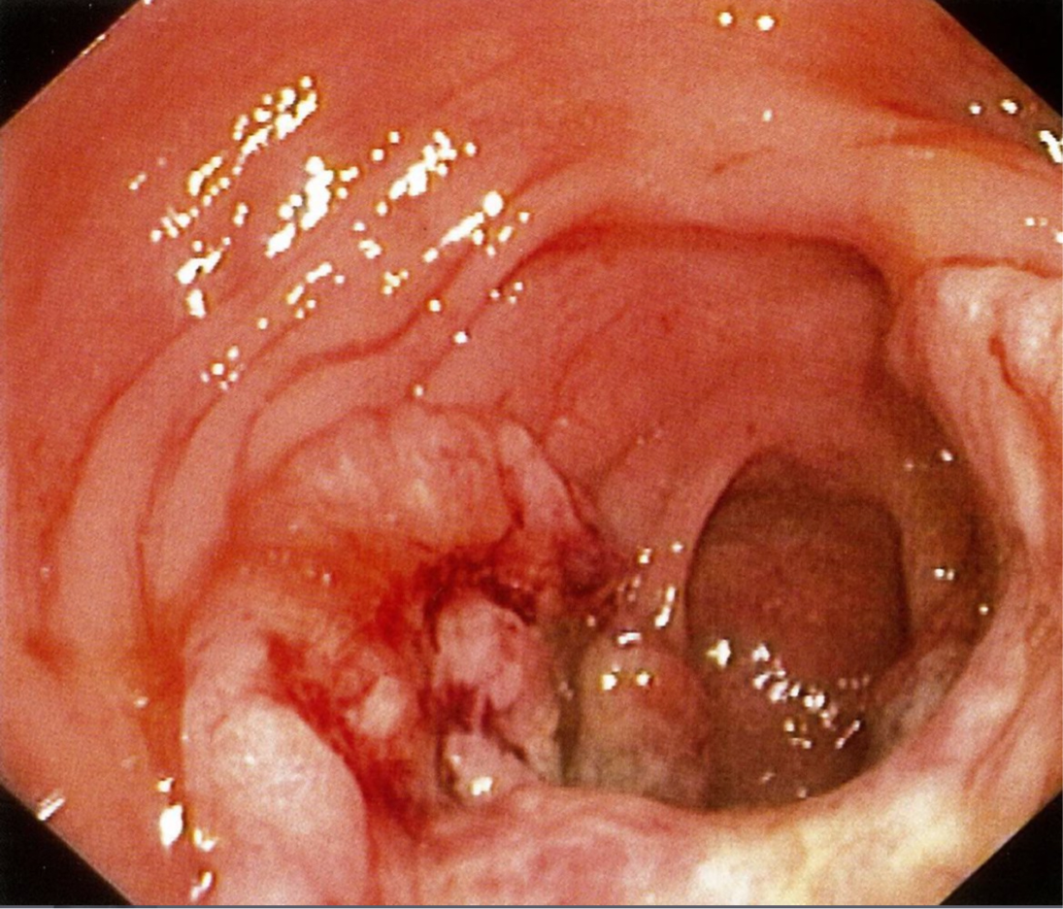

Slide 37
Treatment
A multidisciplinary approach is recommended for the treatment of CRC which primarily depends on the location of the tumor and the TNM staging.
Curative treatment is primarily surgical which is the gold standard and principal therapy for primary and non metastatic tumors and may involve neoadjuvant chemotherapy, adjuvant chemotherapy and radiotherapy.

Slide 38
Colon cancer treatment
Colectomy with lymph node dissection is indicated in all resectable tumors with the extent of resection depending on the location of the tumor, blood supply and lymphatic drainage.
According to the AJCC staging, stage 1 colon cancer requires curative surgery only, stage 2 and 3 require curative surgery and adjuvant chemotherapy to destroy al the remaining malignant cells and prevent recurrence, and in stage 4 a multidisciplinary approach is taken and neoadjuvant treatment may be used to downstage the tumor and enable resection with adjuvant chemotherapy, while palliative surgery and palliative chemotherapy is used when there is untestable metastatic disease or sever comorbidities.

Slide 39
Types of resection - Hemicolectomy
Right hemicolectomy: resection of part of the distal ileum, ileocecal valve, cecum, ascending colon, hepatic flexure and proximal third of transverse colon indicated when the tumor is in the cecum or ascending colon
Extended right hemicolectomy: Right hemicolectomy and resection of the transverse colon indicated when the tumor is near the hepatic flexure or in the proximal or middle transverse colon
Left hemicolectomy: resection of the distal third of the transverse colon, the splenic flexure, descending colon and sigmoid colon indicated when the tumor is in the descending colon

Slide 40
Types of resection
Sigmoid colectomy which is the resection of the sigmoid colon indicated when the tumor is found in the sigmoid colon.
Subtotal or total abdominal colectomy which is the resection of most of or the entire colon respectively used when there are multifocal carcinomas or when there is an underlying colonic disease.

Slide 41
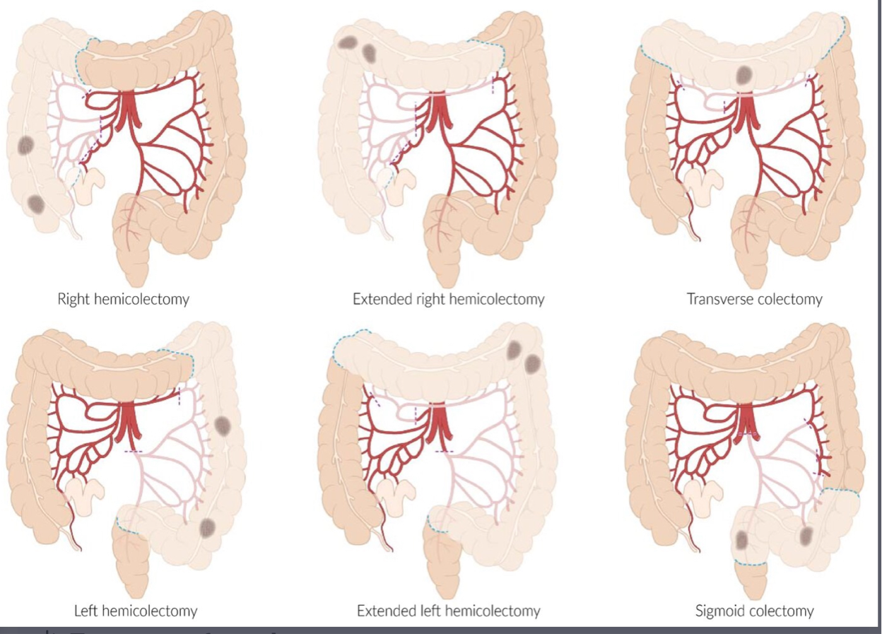

Slide 42
Emergency resection
20% of patients with colonic cancer will present as an emergency, the majority with obstruction, but occasionally with hemorrhage or perforation.
If the lesion is right-sided, it is usually possible to perform a right hemicolectomy and anastomosis in the usual manner. If there has been perforation with substantial contamination or if the patient is unstable, it may be advisable to bring out an ileocolostomy following resection of the lesion rather than forming an anastomosis.
For a left-sided lesion the decision lies between a Hartmann’s procedure and a resection and anastomosis. An on-table washout may be necessary to remove residual fecal content in the proximally obstructed bowel.

Slide 43
Rectal cancer treatment
The extent of the resection depends on the location of the tumor, the TNM staging, the sphincter’s tone and the distance of the tumor from the anal verge (which should be assessed preoperatively to plan the most appropriate surgical resection. Unlike colon cancer, both adjuvant and neoadjuvant radiotherapy can be used in stages 2,3 and 4 of rectal cancer.
Gynecologic and urologic consultation must be taken into account if there is evidence of regional spread past the rectum.

Slide 44
Rectal cancer treatment
Transanal excision: which involves minimally invasive excision of small superficial tumors endoscopically that are small (<3cm in size), T1 tumors with no risk factors.
Low anterior resection: a sphincter preserving resection of the rectum and sigmoid with optimal diverting ostomy
Abdominoperineal resection: resection of the rectum, sigmoid and anus with total mesorectal excision and a permanent colostomy indicated when the tumor is close to the sphincter or when the cancer has invaded the sphincter and the patient already has loss of sphincter tone.

Slide 45
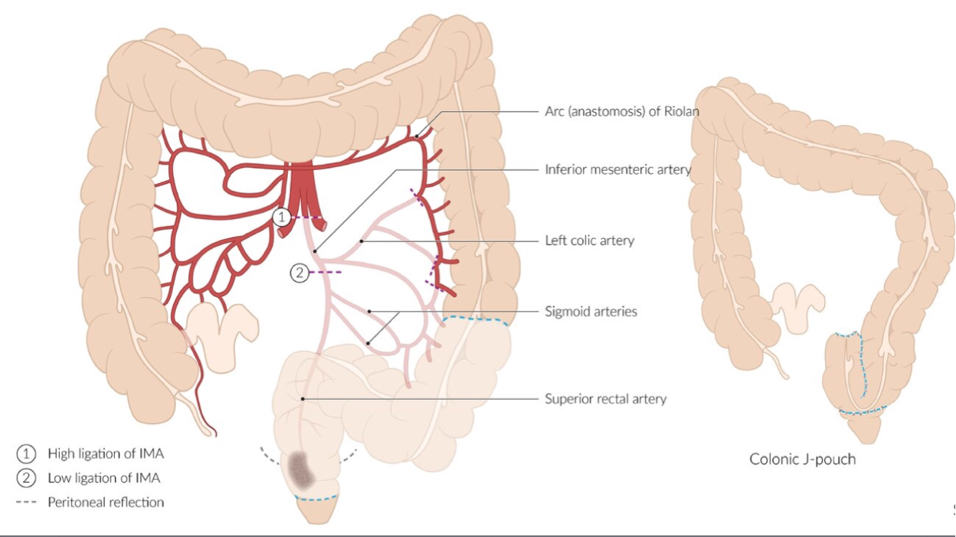
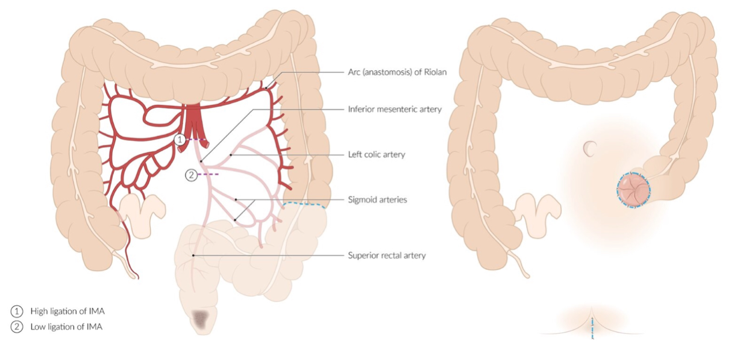

Slide 46
Metastasis
Approximately 20% of patients who present with colon cancer have distant metastasis at the time of presentation. CRC spreads by lymphatic, hematogenous, contiguous and transperitoneal dissemination.
Since the venous drainage of the intestinal tract is via the portal system, the first site of hematogenous spread is the liver, followed by lungs, bone and the brain. Tumors arising in the distal rectum may metastasize to the lungs before the liver because the inferior rectal vein drains into the inferior vena cava.

Slide 47
Abdomen, pelvis and chest CT scans is used in most institutions for all patients with satge2,3 and 4 colorectal cancer prior to or following resection which may demonstrate regional tumor extension, regional lymphatic and distant metastasis and tumor related complications.
Liver contrast-enhanced MRI is the preferred first-line imaging study for evaluating CRC liver metastasis.
PET scans can be used to localize disease recurrence in patients who have elevated CEA serum levels

Slide 48
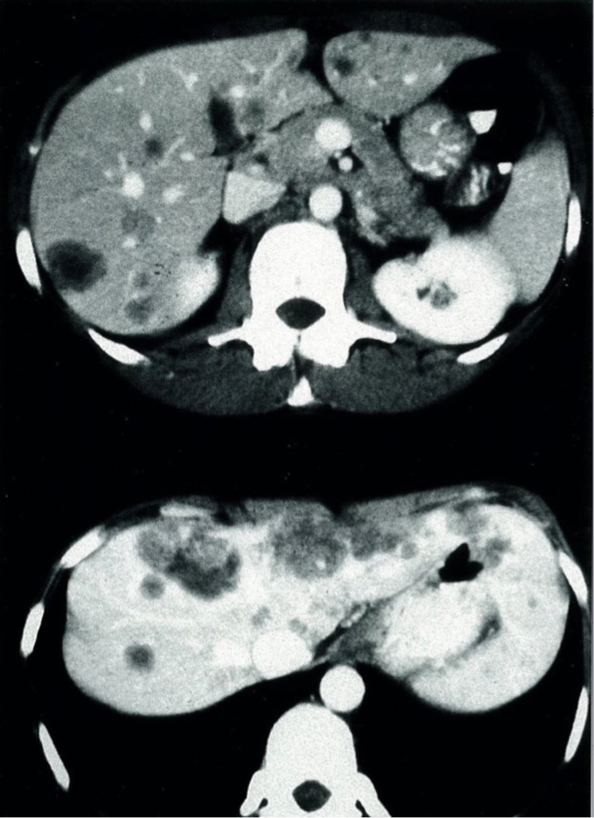
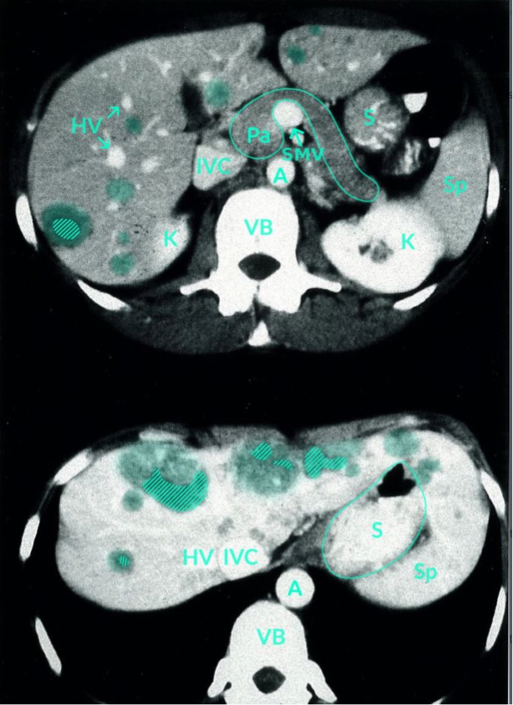

Slide 49
Follow up
All patient with CRC should be followed up closely after curative treatment to ensure early identification and management of recurrence via:
Patient history, physical examination and CEA levels every 3-6 months in the first 2 years and then every 6 months for 3 years
CT chest/abdomen/pelvis annually for 5 years
Colonoscopy 1 year after preoperative colonoscopy then every 3-5 years.
Proctoscopy/sigmoidoscopy every 6-12 months for 5 years after treatment of rectal cancer which may be combined with endorectal ultrasound.
90% of recurrences occur within the first 5 years following treatment.

Slide 50
Prognosis
Overall, 5-year survival for CRC is approximately 58%.
 | 5-Year Survival
TNM stage 1, Dukes’ stage A | 95%
TNM stage 2, Dukes’ stage B | 85%
TNM stage 3, Dukes’ stage C | 45–50%
Unresectable metastatic disease at diagnosis | 10%
Source: Bailey And Love's Short Practice of Surgery 28th Ed

Slide 51
Free Palestine Thank You
Sources:
Bailey And Love's Short Practice of Surgery 28th Ed
UpToDate
Amboss

